Slide 1
Subscribing to Events and YANG datastores
An Introduction
IETF #96 Berlin
21-July-2016
Eric Voit - evoit@cisco.com
Alexander Clemm - alex@cisco.com

Slide 2




Two Views of the Network’s Job
(NOT mutually exclusive)
Where Data Is Created
Where Data Is Useful
1. As much data, as fast as possible, single destination
Telemetry Server
2. Custom streams, multiple destinations
rate consumable by the receiver
NMS
Interface up/down
Instantaneous config
Instantaneous topology
Flow fingerprints
Routes
Controller
Network Element

Slide 3

Must have Alternative to Polling
Continuous Polling Device
fetch
Device
Subscribing Device
Anything different?
push
no
Anything different?
Just the new stuff
No.
Anything different?
NO!
Anything different?
Yeah.
  Well known cost/scale limits with continuous polling
    Propagation latency
    CPU, Bandwidth
    Multiple Polling devices
  Up-to-date objects delivered
    Reaction speed
    CPU, Bandwidth reduced
    New use cases based on distributed synched state

Slide 4
Subscriptions
Subscriber
Receiver
Subscription
Request
Response
Pushed Updates
(On-Change, Periodic, Event)
Device
Publisher
Datastore
Events

Slide 5
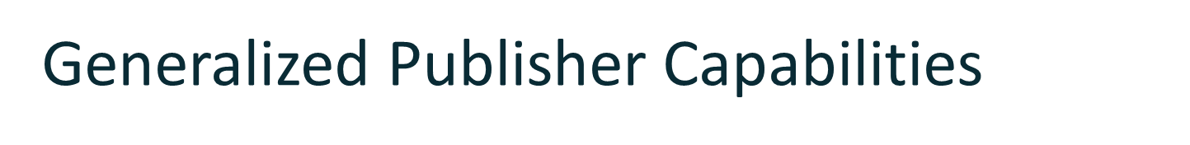







Streaming of updates
  Customized to recipient
  On-change, Periodic, Event
Subscribing to updates
  Event Stream or YANG Datastore Subtree(s)
  Statically configured or dynamically signaled
Publisher
Subscription
interface
Streaming
mechanism
Vendor Model
Datastore
Events
Any Model

Slide 6



Many Consumption Models
Application
Collector
NMS
Network
Element
Orchestration
Controller
Routes
Counters
Status
Counters
Flows
Config
Status
Config
Config
Routes
Config
Capacity
Config
Counters
Status
Routes
Subscriber
Subscriber
Subscriber
Subscriber
Subscriber
Subscriber
Publisher
Network Element
Publisher
Subscriber
Datastore
Events

Slide 7
Applicability beyond the Network Element
NMS
Subscriber
Controller/Collector
Publisher
  YANG Models describing network state abstraction.
Datastore
Application
Subscriber
Network
Element
Publisher
  Can be driven by a subscription to a device abstraction.
Datastore
Events

Slide 8

Event Notifications Raw Datastore Objects
Events
Datastore
Monitoring need | Today’s SNMP Trap (effectively an Applet) | Functionality needed to generate equivalent datastore object from raw data
CPU temp exceeds range | enable traps cpu | Range Based Object Filtering
Interface exits ‘down’ state | enable traps link | Burst Dampening Stateful Filtering Multi-object filtering
BGP tables getting too big | enable bgp traps | Count of the Number of Objects under a subtree
Don’t get overwhelmed by link state changes | enable traps ospf | Burst Dampening

Slide 9
When to use Event Notifications or YANG Datastore Push
Events
Datastore
What you need | Consume a stream of Publisher generated messages at the cadence determined by the Publisher | Consume a stream of Publisher generated YANG data updates at a cadence negotiated with the Subscriber
What to use | 5277bis Event Notifications | YANG Push
Requirements | RFC 5277 + NETCONF WG Discussions | RFC 7923
complementary

Slide 10


Some Subscription Use Cases
Distributed Eventing
Eliminate Polling in Brownfields NMS Integrity Verification
Streaming Telemetry
Data Center Telemetry Secure Audit Trail
Network as the Subscriber
Policy mirroring Maintain Tunnel endpoints

Slide 11
Event & YANG Subscription Drafts
Current draft
Git name
Subscription Mechanism: | YANG Datastore Push draft-ietf-netconf-yang-push | yang-push
 | Subscriptions for Event Notifications draft-gonzalez-netconf-5277bis | rfc5277bis
Choice of Transports: | NETCONF Transport for Event Notifications draft-gonzalez-netconf-event-notifications | notif-netconf
 | RESTCONF & HTTP Transport for Event Notifications draft-voit-netconf-restconf-notif | notif-restconf
 | Future Transport Notification drafts
NETCONF
WG
adopted
Github repository https://github.com/netconf-wg
Minutes, Meeting Recordings, Terminology, Issues

Slide 12
Functional Partitioning
 |  | Event Notifications |  | YANG Datastore Push
 |  | 5277 Mode | Enhanced
 | Types of Subscription | Dynamic | Dynamic and Configured
 | Subscriptions per Session | one | many
 | Negotiation | No | Yes
 | RPCs | create | establish, modify, delete
 | Control Plane Notifications | None | started, suspended, resumed, terminated, modified
Data Plane Notifications |  | notification | +subscription-id | push-update, push-change-update
 | NETCONF | Yes
 | RESTConf, HTTP, HTTP2 | No | Yes
Subscription
Transport
Legend
YANG Datastore Push
Subscriptions for Event Notifications
NETCONF Transport for Event Notifications
RESTCONF Transport for Event Notifications
Compatibility with RFC-5277

Slide 13
Subscription Drafts in Layered Framework
Application
Subscriber
Recipient
Publisher
Subscription
Mgmt
Update
Packaging
and
Flow Control
Transport
Session
TLS
SSH
HTTP
HTTP2
RFC5424
gRPC
Restconf
Netconf
Encoding
Dynamic
Configured
Thrift
CBOR
GPB
JSON
XML
Syslog
IPFIX
ASN.1 BER
TDL
YANG
Subscription Mtc
YANG
Admission Control
OAM
Negotiation
Event Notification
Generation
Stream Discovery
Filtering
Access Control
On-Change
Periodic
Event
Stream
Generation
Intended Config
Operational State
Running Config
System State
Startup
Config
Candidate
Config
Ephemeral
Config
Persistent
Config
Applied
Config
System
Config
Counters
Operational
Status
Syslog
Flows

Slide 14
Subscription Drafts Functional Partitioning
YANG Datastore Push (includes functions above Base Subscription Draft):
Datastore on-change and periodic triggers
YANG filters per RFC6241
Authorization model per object
Negotiation
Push-update, Push-change-update
New stream types & stuff
Prioritization
Subscriptions for Event Notifications (Base Subscription Draft)
Support for many subscriptions / transport
Dynamic & Configured state machines
Multiple configured receivers
New stream types?
Authorization model per stream
RPCs: Establish, modify, delete
Error responses (under error-info?)
Notifications: started, suspended, resumed, terminated, modified
RFC5277 & XPATH filters
Stream discovery
Data Plane Notification
5277 mode & YANG model
Replay
Monitoring
NETCONF Transport for Event Notifications
Transport mapping
5277 mode
RESTCONF & HTTP Transport for Event Notifications
Transport mappings
Subscriber/receiver different
Heartbeats and clean-up
Subscription to HTTP2 stream

Slide 15
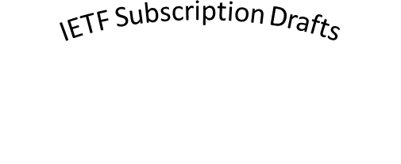
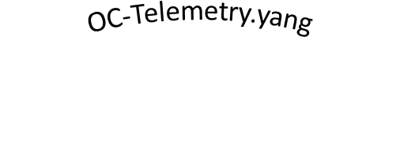
Context with OC-Telemetry.yang
Streams
NETCONF
Periodic
RESTCONF
Security by subtree
On-change
Dampened Eventing
Configured subscriptions
Parameter negotiation
Dynamic subscriptions
GBP
gRPC
RFC-5277 Compatibility
Multiple receivers
Value and Range filtering
Prioritized subscriptions
Subtree filtering
DDoS vector protection
HTTP/2
Push synchronization
DSCP
Start/stop time
JSON
VRF support
XML
Recurring requirement: specification of market requested, non-IETF technologies
For both Events & YANG Datastores
For only YANG Datastore Push

Slide 16
Requirements of RFC 7923
VRF support
Parameter negotiation
Dynamic
Multiple receivers
Configured
Start/stop time
Event Notification
Push synchronization
Configuration
Periodic
Visibility
Operations
Burst dampening
Trigger
Subscriptions
On-change
Modify
Stateful
Filters
Security
Subtree
Substring
Per leaf/subtree
Range
Encoding
Transport
Netconf
DDoS protection
QoS
Restconf
Admission Control
Prioritized Push
JSON
HTTP/2
XML
For both Events & YANG Datastores
For only YANG Datastore Push

Slide 17

Dampening Eventing vs. Periodic Behavior (1)
Subscription to interface state
Subscription
E0
E1
Interfaces-state
interface [name]
oper-status
Interface UP
Interface DOWN
E0
E0
E0
E0
E0
E0
E0
E0
E0
E1
E1
Time
On-change Eventing
Dampening period =10
0
10
11
21
23
33
43
E0
E0
E0
E0
E0
Update Stream
Faster reaction
Shows flaps underway
E1
E1
Periodic State
Period =10
0
10
20
30
40
50
E0
E0
Update Stream
State at a certain time
E1

Slide 18
Dampening Eventing vs. Periodic Behavior (2)
50 access-list permit ip any any
100 access-list permit host 192.168.1.1
200 access-list deny any any
Subscription to
Access Control List
Subscription
ACL*
ACL entries
commit
200
commit
100
200
commit
50
100
200
commit
100
200
ACE
matches
action
Time
On-change Eventing
Dampening period =60
25
85
125
Vulnerability
Update Stream
Exposes existence of transient config
Current 6020 conflict
create
200
create
100
delete
50
Periodic State
Period =60
0
60
120
create
100
200

Slide 19
Supporting multiple Receivers for a Configured Subscription
Configured Receiver (#1)
Single Configured Subscription with 2 destinations
Configured Receiver (#2)
Implementation Domain
D1
D2
Dynamic Subscription (#3)
Filtered Stream
D3
D4
Dynamic Subscription (#4)
All four have a unique destination IP+Subscription ID
D
= Destination

Slide 20
Prioritization of Subscriptions
Network
Element
Publisher
subscription-priority (8bit integer, optional)
priority of a subscription
subscription-dependency (string, optional)
points to single parent subscription
Subscription
Subscription
Subscription
Stream multiplexing
Stream prioritization
Flow control, per–stream
Flow control, per–TCP
HTTP2
Client
Weight (8bit integer)
enables proportional bandwidth when there are multiple streams to same TCP Peer
Stream Dependency (31bit integer)
preempts the marshalling of updates for any dependent streams
Stream
Stream
Stream
TLS
NMS
Controller
(re)Transmit frames at rate consumable into destination
TCP
Prioritize and rate shape
IP
Subscriber
Subscriber
Dequeue
Phys
DSCP used here

Slide 21
HTTP/2 Transport Prioritization Example
Network Element
YANG Model
YANG Model
Publisher
HTTP2 Client
HTTP2 de-queues and forwards priority objects first
On-change
Stream
Interfaces-state
interface [name]
On-change
Stream
oper-status
D
D
statistics
Periodic
Stream
shut
TLS
NMS
Controller
TCP
IP
Subscriber
Subscriber
Phys
Elephant flow is initiated
Priority subscription objects queued
D = Dependent upon

Slide 22
Transport for Event Notifications
Transport bindings defined
NETCONF
RESTCONF
Locally Configured
Configured
Subscriber
Publisher
Subscriber
Publisher
HTTP Receiver
Publisher
Subscription
Subscription
Subscription
Subscription
Subscription
Subscription
Subscription
Requests
Subscription
Requests
Subscription
Subscription
YANG
YANG
YANG
YANG
YANG
YANG
XML
XML
JSON
JSON
JSON
JSON
Netconf Client
Netconf Server
Restconf Client
Restconf Server
HTTP2 Server
HTTP2
Client
Stream
Stream

Slide 23
RESTCONF & HTTP Transport for Event Notifications
Appendix
Separate Subscriber & Receiver
Subscriber
Publisher
Receiver
Subscription
Subscription
Subscription
Requests
Subscription
YANG
YANG
YANG
JSON
JSON
JSON
Restconf Client
Restconf
Server
HTTP
Client
HTTP Server

Slide 24
Subtree and XPATH Filtering
Can enable a reduction in sent objects by order(s) of magnitude
Subtree and XPATH cannot be combined
XPATH Filtering
Subscribe to this target node
Interfaces-state
interface [name]
Use when you want a subset of instances from a list
(e.g.: [E0, E1])
name
oper-status
phys-address
Subtree Filtering
speed
statistics
Use when you want to explicitly exclude (or include) all of an object type:
discontinuity-time
in-octets
out-octets
in-discards
…

Slide 25
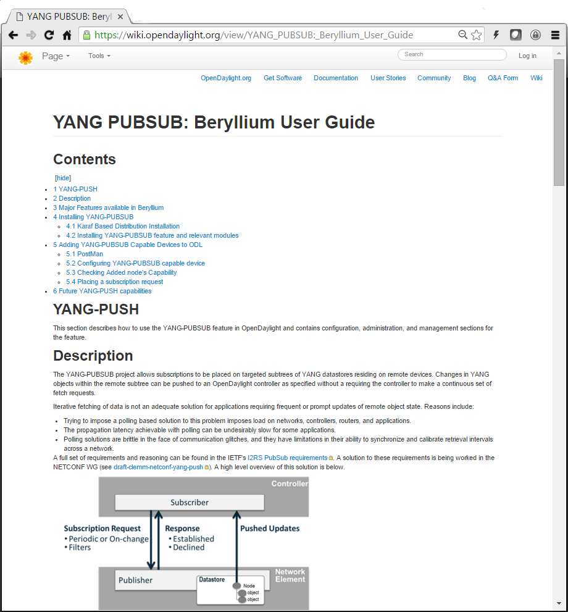
YANG Push results at IETF95 Hackathon
Objective
Extend OpenDaylight’s YANG Push Client
Coded / Demonstrated
Create Subscription (via OpenDaylight)
Delete Subscription (via NETCONF session)
On-change subscription (via NETCONF session)
  March 2016

Slide 26
YANG Model & Draft Details

Slide 27
rfc5277bis
Highlights
Support for dynamic subscriptions (via RPC) and configured subscriptions
  Dynamic:
    Subscription lifetime tied to subscriber session
    Supports negotiation of subscription parameters
  Configured:
    Established via configuration
    Allows multiple receivers
  No mix-and-match – cannot terminate configured subscription via RPC and vice-versa
Subscriptions are directed at an Event Stream
  NETCONF (all notifications, per RFC 5277)
  Potentially others: OAM, Push, more
Subscriptions can specify filters
Support for multiple transport and encoding mappings

Slide 28
rfc5277bis
Model overview: Streams, filters
module: ietf-event-notifications
+--ro streams
| +--ro stream* notif:stream
+--rw filters
| +--rw filter* [filter-id]
| +--rw filter-id filter-id
| +--rw (filter-type)?
| +--:(rfc5277)
| +--rw filter
+--…

Slide 29
rfc5277bis
Model overview: subscription configuration
module: ietf-event-notifications
+--…
+--rw subscription-config {configured-subscriptions}?
| +--rw subscription* [subscription-id]
| +--rw subscription-id subscription-id
| +--rw stream? stream
| +--rw (filter-type)?
| | +--:(rfc5277)
| | | +--rw filter
| | +--:(by-reference)
| | +--rw filter-ref? filter-ref
| +--rw startTime? yang:date-and-time
| +--rw stopTime? yang:date-and-time
| +--rw encoding? encoding
| +--rw receivers
| | +--rw receiver* [address]
| | +--rw address inet:host
| | +--rw port inet:port-number
| | +--rw protocol? transport-protocol
| +--rw (push-source)?
| +--:(interface-originated)
| | +--rw source-interface? if:interface-ref
| +--:(address-originated)
| +--rw source-vrf? uint32
| +--rw source-address inet:ip-address-no-zone
+--…

Slide 30
rfc5277bis
Model overview: subscription state
module: ietf-event-notifications
+--…
+--ro subscriptions
+--ro subscription* [subscription-id]
+--ro subscription-id subscription-id
+--ro configured-subscription? empty {configured-subscriptions}?
+--ro subscription-status? subscription-status
+--ro stream? stream
+--ro (filter-type)?
| +--:(rfc5277)
| | +--ro filter
| +--:(by-reference)
| +--ro filter-ref? filter-ref
+--ro startTime? yang:date-and-time
+--ro stopTime? yang:date-and-time
+--ro encoding? encoding
+--ro receivers
| +--ro receiver* [address]
| +--ro address inet:host
| +--ro port inet:port-number
| +--ro protocol? transport-protocol
+--ro (push-source)?
+--:(interface-originated)
| +--ro source-interface? if:interface-ref
+--:(address-originated)
+--ro source-vrf? uint32
+--ro source-address inet:ip-address-no-zone

Slide 31
rfc5277bis
Other model aspects
RPCs (for dynamic subscriptions)
  Establish-subscription
  Modify-subscription
  Delete-subscription
Notifications (OAM)
  OAM notifications are used by server to signal receivers certain events concerning the subscription itself
  Basic lifecycle
    Subscription-started, -modified, -terminated
    Added-to-subscription, removed-from-subscription (configured subscriptions only)
  Temporary suspension by server
    Subscription-suspended, subscription-resumed
    Server has the option to suspend the subscription when needed
    YANG-Push: server might not be able to keep up with update events in some circumstances – e.g. large number of instances, high velocity of changes, etc.
    Receivers need to be able to “count on” subscription (unless told otherwise) to not have to revert to polling
    Defined in RFC5277bis, as might be applicable beyond YANG-Push
  Replay complete

Slide 32
rfc5277bis
Control Plane Notifications aka OAM Messages
Servers need to indicate to receivers relevant events about the subscription itself
Events to be signaled by the server modeled as YANG Notifications
  Notifications can be initiated by the server
Issues
  Standard YANG Notifications are “general purpose” – anybody can subscribe
  How to allow receiver to only get notifications regarding “its” subscriptions, not everyone else’s
Proposed solution
  Add YANG extension “control-plane-notif”
    Use to tag OAM notifications
    Tagged notifications are not part of regular event stream but signaling stream
    Notification receiver is automatically subscribed to signaling stream of “its” subscription
  Consideration: more general tag to indicate event stream as part of notification definition (default: NETCONF)

Slide 33
rfc5277bis
Event Streams
Which Event Streams can, which Event Stream must a server provide?
NETCONF – RFC 5277bis
  NETCONF stream per RFC 5277
  Any event that is raised per YANG Notification definition in YANG Modules implemented by the server
  Superset of all notifications that can be raised
Subscriber can apply filtering, but single stream appears too broad, unwieldy to handle
  Not every event is of interest to everyone – e.g. OAM messages
  Many use cases require only well-defined notification subsets – eg YANG Push
  Separate streams avoid need for complex filters – greater efficiency, simpler to use
Which additional streams to provide is up to server implementations
  Only NETCONF “MUST” be available
  System-provided streams are “discoverable”:
  List of system streams as oper data that is part of the YANG model
  Other streams may make sense to provide, some of which may makes sense to define in a standard

Slide 34
rfc5277bis
Candidate Event Streams
NETCONF
  General purpose stream per RFC 5277, every system supports
  Any event that is raised per YANG notification definition in a YANG module
  (caveat as per below)
CONTROL
  Designate Control Plane Notifications as such – YANG tag
  Special purpose stream - excluded from other event streams incl NETCONF
  Clients are automatically subscribed as applicable – e.g. for subscription
YANG-Push-related streams

Slide 35
yang-push
Updates since IETF #95
One revision update
Pulled basic subscription model out
  draft-gonzalez-5277-bis
  YANG-Push now builds on top of this
  YANG-Model now an augmentation
Augmentations to RPC definitions to include YANG-Push subscription parameters, as applicable
Associated editorial updates throughout
  Including discussion of issues being worked through

Slide 36
yang-push
Model overview: subscription configuration
module: ietf-event-notifications
+--…
+--rw subscription-config {configured-subscriptions}?
| +--…
+--rw (update-trigger)?
| +--:(periodic)
| | +--rw period yang:timeticks
| +--:(on-change) {on-change}?
| +--rw no-synch-on-start? empty
| +--rw dampening-period yang:timeticks
| +--rw excluded-change* change-type
+--rw dscp? inet:dscp
| {notif-bis:configured-subscriptions}?
+--rw subscription-priority? uint8
+--rw subscription-dependency? string
| +--rw (filter-type)?
| | +--:…
+--:(update-filter)
+--rw (update-filter)?
+--:(subtree)
| +--rw subtree-filter
+--:(xpath)
+--rw xpath-filter? yang:xpath1.0
YANG-Push augmentations
to RFC5277bis
Update triggers
Push QoS
Addl. filter options

Slide 37
yang-push
Model overview: subscription state
module: ietf-event-notifications
+--…
+--ro subscriptions
+--ro subscription* [subscription-id]
+--…
+--ro (update-trigger)?
| +--:(periodic)
| | +--ro period yang:timeticks
| +--:(on-change) {on-change}?
| +--ro no-synch-on-start? empty
| +--ro dampening-period yang:timeticks
| +--ro excluded-change* change-type
+--ro dscp? inet:dscp
| {notif-bis:configured-subscriptions}?
+--ro subscription-priority? uint8
+--ro subscription-dependency? string
+--…
+--ro (filter-type)?
| +--:…
+--:(update-filter)
+--ro (update-filter)?
+--:(subtree)
| +--ro subtree-filter
+--:(xpath)
+--ro xpath-filter? yang:xpath1.0

Slide 38
yang-push
Selected discussion items
YANG-Push stream types
  YANG-PUSH: Covers all YANG data, both configuration and operational
  OPER-PUSH: operdata only – superset of “statsonly” and “nostats”
  CONFIG-PUSH: config data only
  Other candidates
    Operdata-nostats
    Exclude stats – use cases include monitoring for state changes; on-change and periodic subscriptions
    Operdata-statsonly:
    Use cases include performance management, time series analysis; periodic subscriptions only
    Custom: user definable
  Other potential streams for push of applied config, derived state, other operational data
On-change subscribable data
  Consider introducing tags or metadata to distinguish stats
NACM implications
  Filter out data to which subscriber has no read-access vs. accept only subscriptions when subscriber has access to all subscribed data

Slide 39
yang-push
Next Steps
Update the spec as we close on discussion items
YP1 | Which stream types to introduce. Current list includes streams for all operational and for all config data. Consider adding stream for operational data minus counters. Also: assess implications of opstate implications on required data streams.
YP2 | In addition to identifying which items go to which streams, identifying and calling out which items (such as counters) should not be "on-change subscribable" may be useful. Consider introducing a Yang extension to define if an object: is-a-counter and/or not-notifiable.
YP3 | What QoS parameters should be supported for subscriptions?
YP4 | Implications of ephemeral requirements from I2RS
YP5 | Filters: YANG 1.1 allows filters to be defined in multiple places. How do they intersect each other in a deterministic way.
YP6 | On-change subscription: consider providing publisher with capability to initiate a refresh of contents rather than send deltas. Current proposal allows for a "synch-on-start" option; such an option might be useful also e.g. on resumption of a subscription that had been suspended.
YP7 | Do we need an extension for NACM to support filter out datastore nodes for which the receiver has no read access?

Slide 40
notif-netconf
Highlights
Support multiple subscriptions over a single NETCONF session.
Support a revised definition of the default NETCONF stream (capabilities exchange)
Backwards compatibility with RFC 5277

Slide 41
notif-netconf
Next Steps
Adopt as WG draft?
Address issues:
NT1 | Support multiple create-subscriptions over a single NETCONF session? or only multiple establish-subscription?
NT2 | Configured subscription need to be refined in [event-notifications] and then adjust this document based on it.
NT3 | Express filter in JSON should be documented.
NT4 | Call Home support

Slide 42
notif-restconf
Highlights
Dynamic = RESTCONF
Configured = HTTP
Configured
Subscriber
Publisher
HTTP Receiver
Publisher
Subscription
Subscription
Subscription
Subscription
Requests
Subscription
Subscription
YANG
YANG
YANG
YANG
JSON
JSON
JSON
JSON
Restconf Client
Restconf Server
HTTP2 Server
HTTP2
Client
Stream
Stream
Leverage HTTP/2 QoS capabilities where viable
  Subscription multiplexing over independent HTTP/2 streams
  Stream prioritization and stream dependencies
  Flow control on independent streams
Considering proxy subscription transport issues

Slide 43
Some Terms
Configured Subscription
Data Node
Data Node Filter
Data Node Security Filter
Data Node Update
Dynamic Subscription
Datastore
Event
Event Notification
Event Stream
Filter
Notification
Publisher
Receiver
Subscriber
Subscription
Subscription Policy
Update Notification
Update Record
Update Record Filter
Update Stream
Update Trigger
Working definitions at:
https://github.com/netconf-wg/yang-push/wiki/Terminology
(Expect tweaks/changes)

