Slide 1
Networks as Humanities Data
The following slides are great for introducing networks in your classroom
Notes:
Kalani

Slide 2
What is network analysis?
Lots of one-on-one interactions grouped together
STUDENT-FACING SLIDE
I sent a text message to you.
Source Node
SUBJECT
Node
Node
Target Node
OBJECT
Edge
VERB
We visited a new state.
Notes:
Kalani

Slide 3
Can I track other stuff about an interaction?
Anything we want. A node or edge can have many “attributes”.
STUDENT-FACING SLIDE
I sent a text message to you.
Why?
Why you specifically?
What did it say?
When?
iOS or Android?
We visited a new state.
Why?
When?
Who is “we”?
Was it part of a bigger trip?
Notes:
Kalani

Slide 4
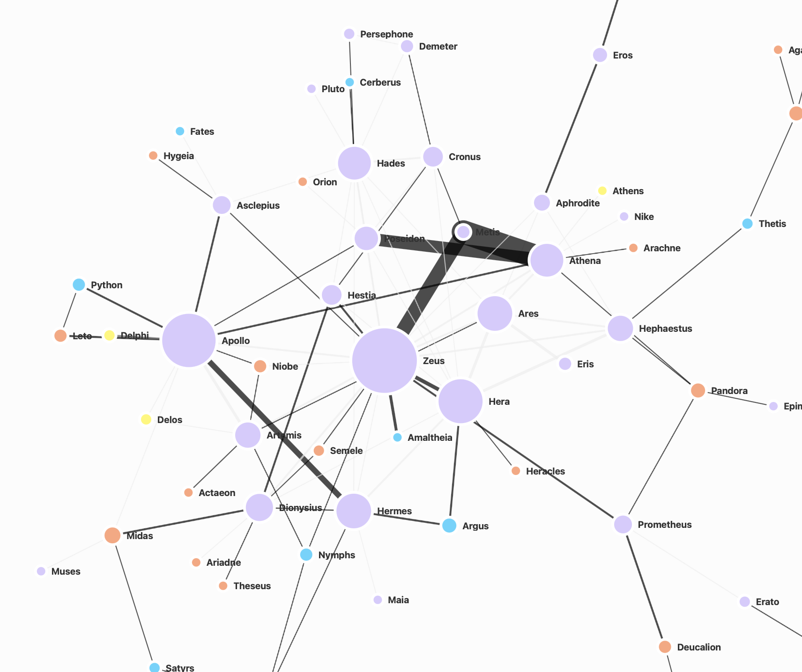
What can we learn from networks?
STUDENT-FACING SLIDE
Who are the
Influencers or big nodes
Outliers or unconnected nodes
Connectors who might be small but connect important nodes
How fast does information spread?
How many nodes does information have to pass through to get from one side of the network to the other?
More details about one-on-one interactions, and the bigger patterns those interactions reveal.
Interactions between Greek Gods
lavender = Greek god
blue = mythological creature
Orange: Human
Notes:
Show filtering, tables, sorting to help wayfind
Maybe highlighting similar to the prior set to show how you see influencers, etc in this network and how you know? - JD

Slide 5
Students’ Interest Network
Students and Greek myths in an identity/content network:
https://authoring.netcreate.app/graph/ConsentedHistoryIdentityGreekMyth/
Connecting classroom content and data literacy:
How does this emerging network help us understand a classroom’s shared identity in network-analysis-specific concepts?
  Gravity
  Node/edge data tables
  Attribute data in open-ended notes
How can we connect that shared identity to classroom content using data- and disciplinary-specific concepts?
  Centrality and outliers
  Simple filters
Notes:
Kalani

Slide 6
Bringing Data Literacy Into YOUR Humanities Classrooms
The following slides are great for guiding you as you work with your students to combine humanities inquiry and data literacy
Notes:
Kalani

Slide 7
Ask
Data Inquiry
Questions
Bold = DH questions
Manage
Where does this data come from?
  Who created this, and what might they have been focused on? How does this change how we think about this data?
How are we using this data and for what?
  Does that change how we should interpret it?
Are there any “mistakes” in this data? What could you look for to determine this?
Click on table view: What kinds of information shows in the table that didn’t show in the network? Scroll through the table. What new questions do you have after looking at the table?
Click on each column. How does this help us learn more about the data in the network?
Click on filter or focus: What can you learn by filtering or focusing the data? How does this help us manage the data in the network?
How do the different ways of looking at the data change what we see?
Play
Nodes: What happens as we drag a node away? What other nodes follow? Which don’t move?
Edges: Do the edges change as we drag a node away? Why or why not?
Nodes: Click on a node. What can you learn about this node?
Edges: Is there information about each edge? What can we learn?
Observe
Nodes: Which nodes are the largest? Which are the smallest? What does this mean?
Edges: Which edges are the thickest? What kind of connections are different edges? Are there any nodes without edges? What do these mean?
Colors: What colors are the largest nodes? What does that color represent in this network? What other color nodes do we notice? What do those colors represent in this network?
Synthesize
What patterns do we see in our data as a whole?
How does the network help us see patterns that we couldn’t see in a piece of text or other information source?
What connections do we see between us, content, and each other?
What does this experience tell us about the humanities?
Data is information that was collected and organized for a reason. When we interpret data we should be mindful that the way the data was collected, organized, and presented can change how we might interpret it. While data is often associated with math & science, it can also be used to make sense of patterns in literature, history, really any subject!
These questions help to guide our data inquiry and can be asked in any order. All questions are important.
Notes:
Kyle first, Autumn and Kalani popping in as necessary
Good Data Questions

Slide 8
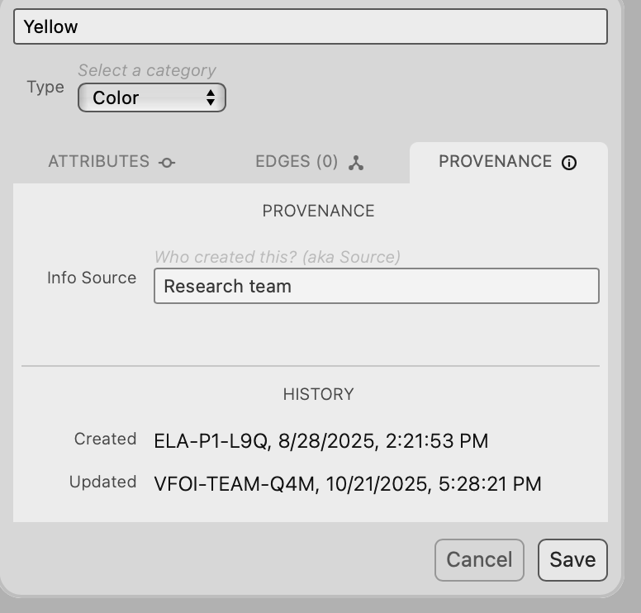
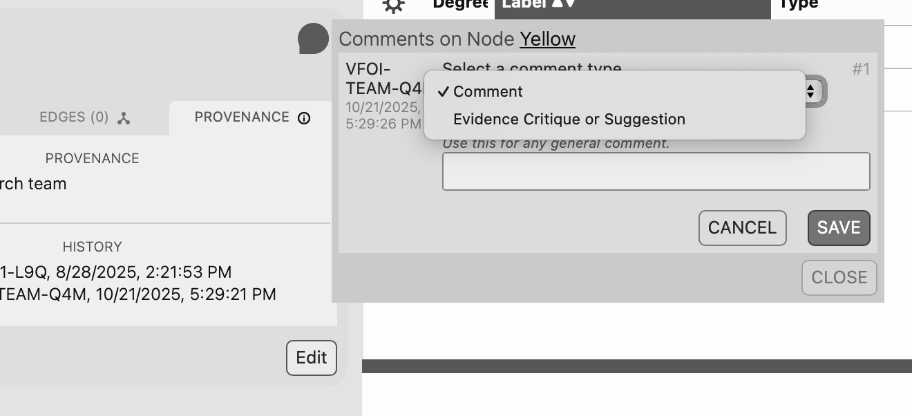
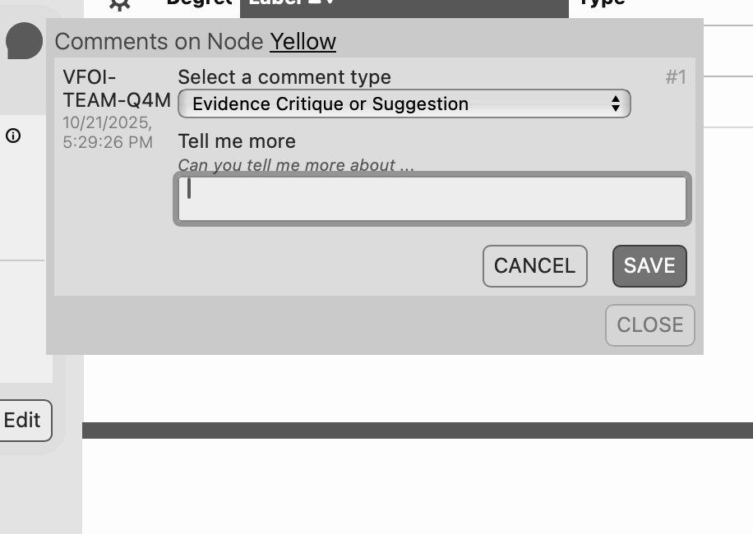
Putting Good Data Questions into Net.Create
Where did this come from?
How are we interpreting and revising the data?
Notes:
Kalani

