Slide 1
What is network analysis? Lots of one-on-one interactions grouped together
I sent a text message to you.
Source Node
Node
Node
Target Node
Edge
We visited Alabama.

Slide 2
Can I track other stuff about an interaction?
Anything we want. A node or edge can have many “attributes”.
I sent a text message to you.
Why?
Why you specifically?
What did it say?
When?
iOS or Android?
We visited Alabama.
Why?
When?
Who is “we”?
Was it part of a bigger trip?

Slide 3
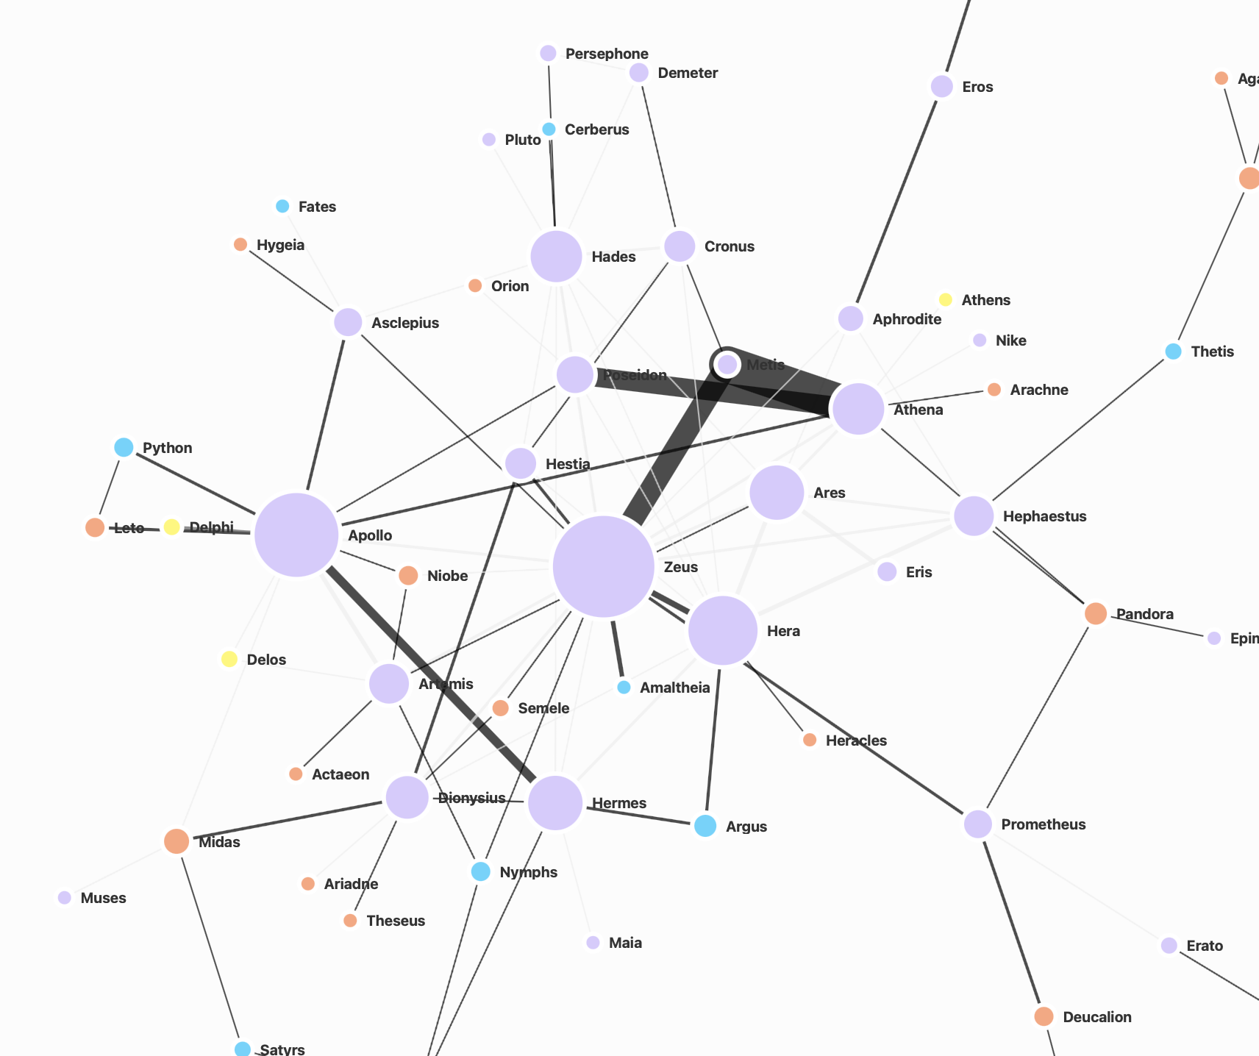
What can we learn from networks?
Who are the
Influencers or big nodes
Outliers or unconnected nodes
Connectors who might be small but connect important nodes
How fast does information spread?
How many nodes does information have to pass through to get from one side of the network to the other?
More details about one-on-one interactions, and the bigger patterns those interactions reveal.
Interactions between Greek Gods
lavender = Greek god
blue = mythological creature
Orange: Human
view sample network
Notes:
Show filtering, tables, sorting to help wayfind
Maybe highlighting similar to the prior set to show how you see influencers, etc in this network and how you know? - JD

