Slide 1
Net Create

Slide 2
Goals:
Objective - After reading excerpts from Walk Two Moons and Roll of Thunder Hear My Cry, students will map the character traits and conflicts of characters using Net.create.
Learning Target - I can analyze the character traits and conflicts of characters in two literary excerpts using the Net.create tool.

Slide 3
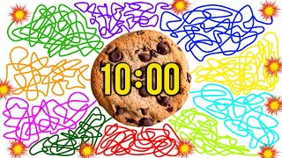
Review Character Traits and Textual Evidence
Get out both graphic organizers on “Walk Two Moons” and “Roll of Thunder, Hear My Cry.”
What are character traits? Textual evidence?
Turn and talk to your partner/group about the characters and traits you chose.
Did you choose the same characters? Traits? Evidence?
Do you remember who these characters may have had a conflict with in the text?
What emotions do you believe your character(s) to have been feeling? Why?

Slide 4
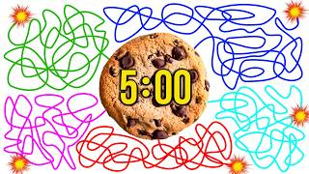
Graphic Organizer 1
“Walk Two Moons”: Look at the characters and traits you have chosen. Discuss which ones you both can agree on are most dominant. Make sure you have textual evidence to support your chosen trait for that character.
Do you have any predictions?
What do you think we will learn?
What characters may be linked?
Which trait do you think will be the most dominant?
Let’s put in our information to find out!

Slide 5
Graphic Organizer 2
“Roll of Thunder, Hear My Cry”: Look at the characters and traits you have chosen. Discuss which ones you both can agree on are most dominant. Make sure you have textual evidence to support your chosen trait for that character.
Do you have any predictions?
What do you think we will learn?
What characters may be linked?
Which trait do you think will be the most dominant?
Let’s put in our information to find out!

Slide 6
Logging In
Go to Google Classroom. Find the assignment entitled “Net Create”
Open up the posted Google Sheet. Your login information will be next to your name. Write this down on the back of your graphic organizer. We will use this today and tomorrow.
Click on the 3rd period/5th period link I have posted.
At the top right hand corner, type in your code exactly. If it does not work the first time, go back and make sure you have written it correctly.

Slide 7
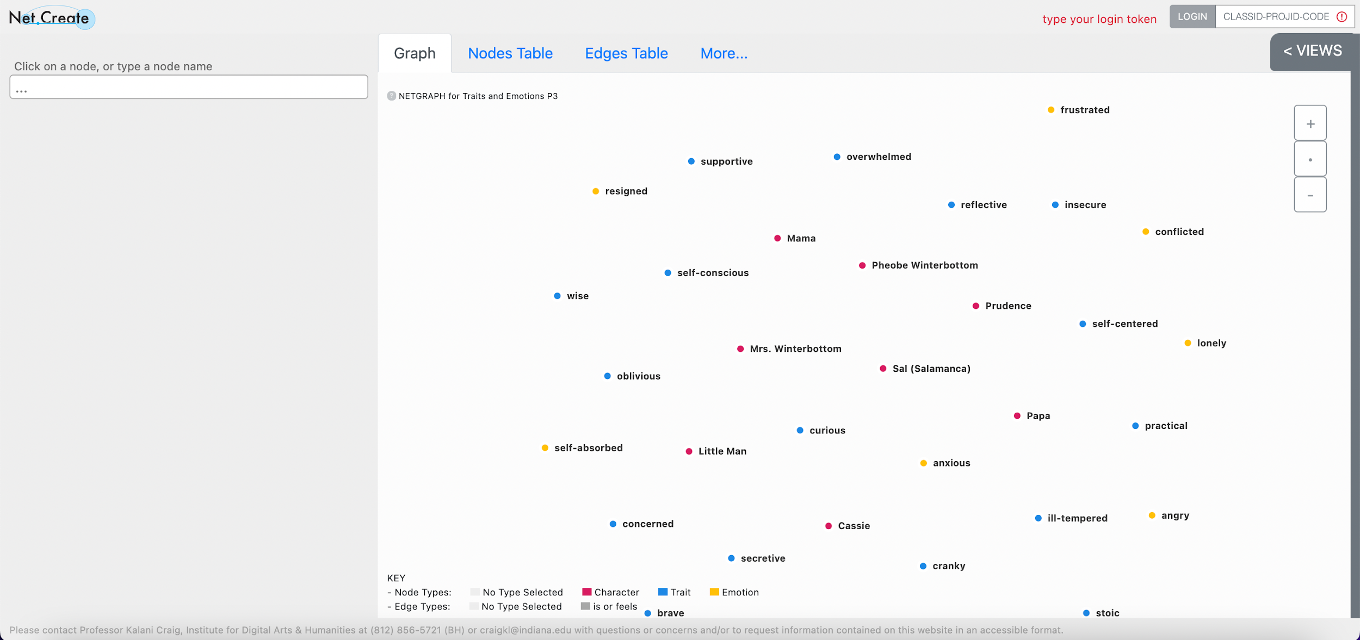
Log in HERE!
Does your screen look like this? If not, raise your hand.

Slide 8
Vocabulary:
Nodes: The name of each character, traits,
Edges: Connections between characters based on shared character traits, and conflict in the story(?)
Character — has conflict with — Character
Character — can be described as — Trait
Character — Feels — Emotion
Attributes
Nodes
Types: Character, Trait, Emotion
Provenance: Source
Edges:
Types: has conflict with, can be described as, or feels
Quote
Provenance:
Source (what page / line)
Person inputting

Slide 9

Data Entry Norms for “Walk Two Moons”
Raise your hand if you have a question.
Do not move around the room to discuss your data/thoughts with those not in your group. I want your information/opinions/thoughts to be real, not copied.
Remember you are to follow directions precisely. Do not add traits,evidence, opinions, etc. that are unrelated or in excess to what you are asked. This helps to ensure that the data entered is relevant.

Slide 10
Data Entry Norms for “Roll of Thunder, Hear My Cry”
Raise your hand if you have a question.
Do not move around the room to discuss your data/thoughts with those not in your group. I want your information/opinions/thoughts to be real, not copied.
Remember you are to follow directions precisely. Do not add traits,evidence, opinions, etc. that are unrelated or in excess to what you are asked. This helps to ensure that the data entered is relevant.

Slide 11
Question/Answer/Discuss
Which character reminds you most of yourself? Why?
Which characters are more resilient based on their character traits? – link it back to the essential question for the second unit - which character matters most?
What characters are related based on the data you see?
Are you surprised by the connections you see?
What character(s) have the most centrality (importance)? (Largest dot on the data because it has the most connections.)
Do the protagonist (main character) share any character traits? Were you surprised by the shared traits?

Slide 12
Vocabulary
https://www.canva.com/design/DAGZdsO1CSs/tZ-0qVczqhKbOkmLTySKsg/edit?utm_content=DAGZdsO1CSs&utm_campaign=designshare&utm_medium=link2&utm_source=sharebutton

