Slide 1


UNIVERSITY OF MINNESOTA
DEPARTMENT OF PSYCHIATRY AND BEHAVIORAL SCIENCES
Laboratory (PhD) : ‘Sciences de l’Ingénieur & Biosciences (LSIB)’
Discipline (PhD) : ‘Génie Électrique’
Specialty : ‘Électronique, Signal et Intelligence Artificielle’
Postdoctoral Interview Presentation on the subject:
Post-Doctoral Associate in Neuroimaging Informed Neuromodulation
Presented by Mr. Said ABENNA
In the presence of the jury members from University of Minnesota:
MD. Hamed Ekhtiari
MD. Arash Rahmani
Said ABENNA
Postdoctoral Interview Presentation
July 11, 2025
|
Notes:
Salam, hi, my name is said abenna born in morocco in 1994, I want to thank you doctor hamed ekhtiari and doctor arash rahmani for the invitation to pass this postoctoral intervie in the subject of …

Slide 2
Plan
1
Education
2
PhD Record
3
Professional Project
4
Conclusion
Said ABENNA
Postdoctoral Interview Presentation
July 11, 2025
|

Slide 3
Plan
1
Education
2
PhD Record
3
Professional Project
4
Conclusion
Said ABENNA
Postdoctoral Interview Presentation
July 11, 2025
|

Slide 4
1
Education
Diplomas:
High School Diploma in Life and Earth Sciences | From Tagzirt-High-School, Beni-Mellal;
Bachelor in Physics: Option of Electronics | From FP, USMS, Beni-Mellal;
Master of Sciences in Intelligent and Communicant Systems | From ENSA, USMBA, Fez;
Doctorate Specialist: Electronics, Signal, and Artificial Intelligence | From FST, UH2, Casablanca;
Projects:
Final-Project: Processing and Analysis of ECG Signals (Matlab);
Study of Cybernetic Systems and Cryptography Algorithms (Text, Image; RSA, DES, AES);
Internship : Design and Embedding of an Online Subscription, Management, and Payment System (RFID, Arduino, Flask/js/html , SQL , Tkinter, OpenCV);
Electroencephalography-based Brain-Computer Interface: Embedding a Command-Control for Intelligent Systems by Detection and Modeling of Brain Activities (Arduino, Python, ML/DL, MH, MNE).
Said ABENNA
Postdoctoral Interview Presentation
July 11, 2025
|

Slide 5
Plan
1
Education
2
PhD Record
3
Professional Project
4
Conclusion
Said ABENNA
Postdoctoral Interview Presentation
July 11, 2025
|

Slide 6
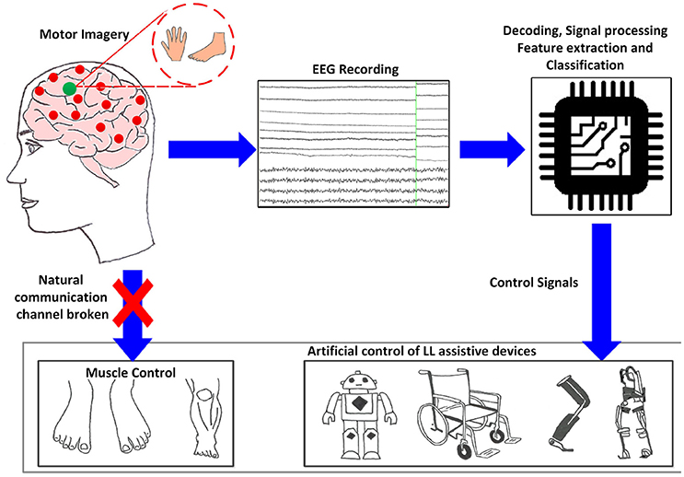
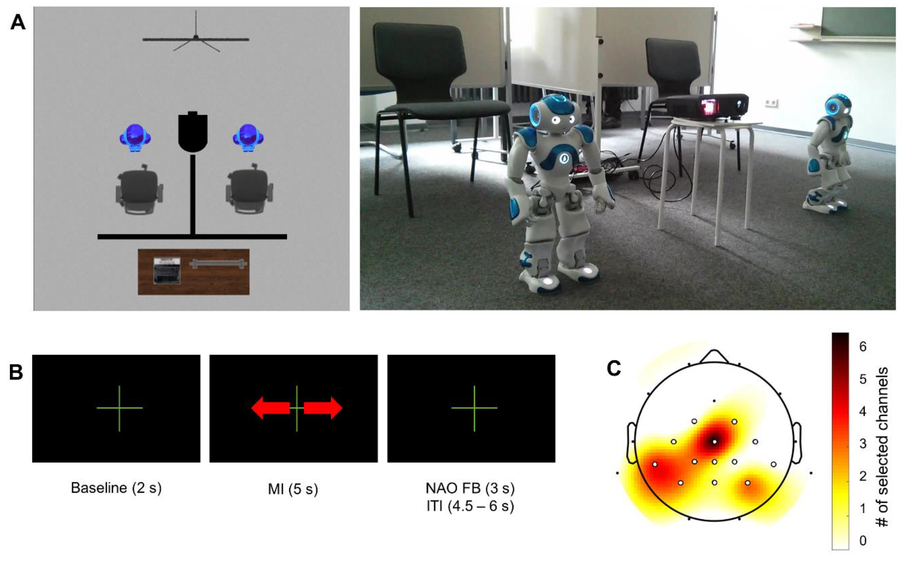
2
PhD Record > Context
Title:
Electroencephalography-based Brain-Computer Interface: Embedding a Command-Control for Intelligent Systems by Detection and Modeling of Brain Activities
Problematic :
Addressing the instability of real-time biomedical signal acquisition due to low-amplitude (10–100 µV) and biopotential noise;
Processing a high volume of real-time input signals, ranging from 3 to 512 electrodes;
Classifying mental tasks with acceptable accuracy (>70%).
A structured approach to research and development is being implemented to achieve our key objectives, which include:
Real-time acquisition of biomedical signals;
Ensure the removal of all noise sources to stabilize signal variability;
Optimize spatial data distribution to enhance classification accuracy;
Optimization of internal algorithm parameters to achieve optimal prediction performance across the entire system.
Goals:
Said ABENNA
Postdoctoral Interview Presentation
July 11, 2025
|

Slide 7
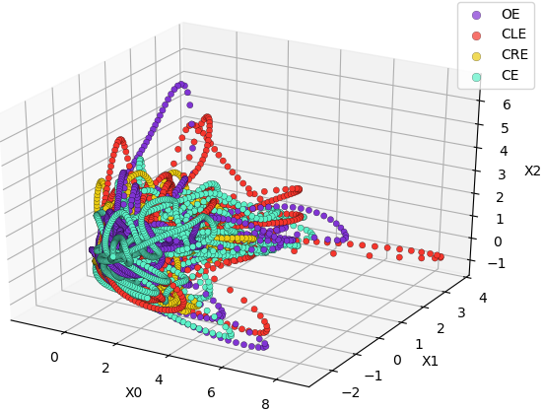
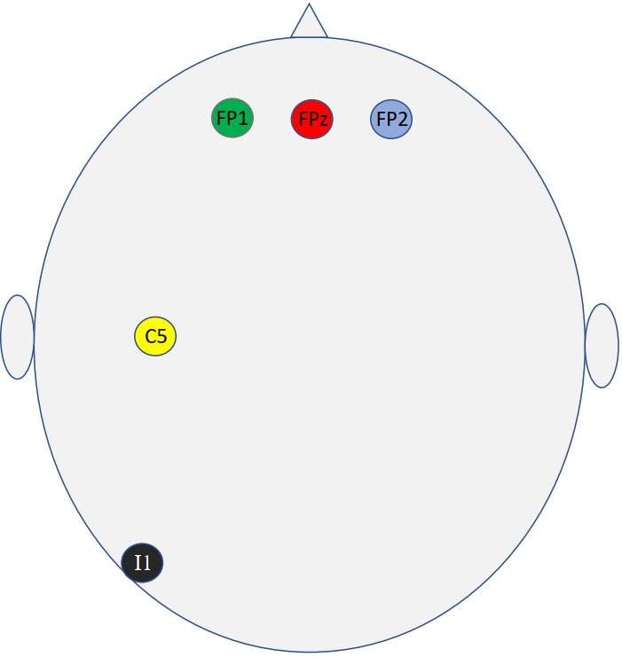
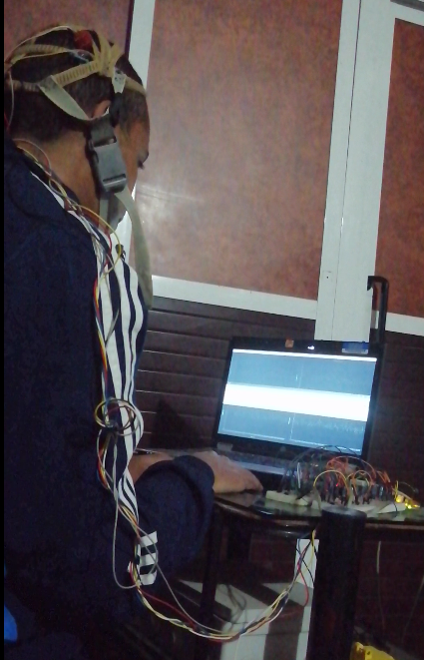
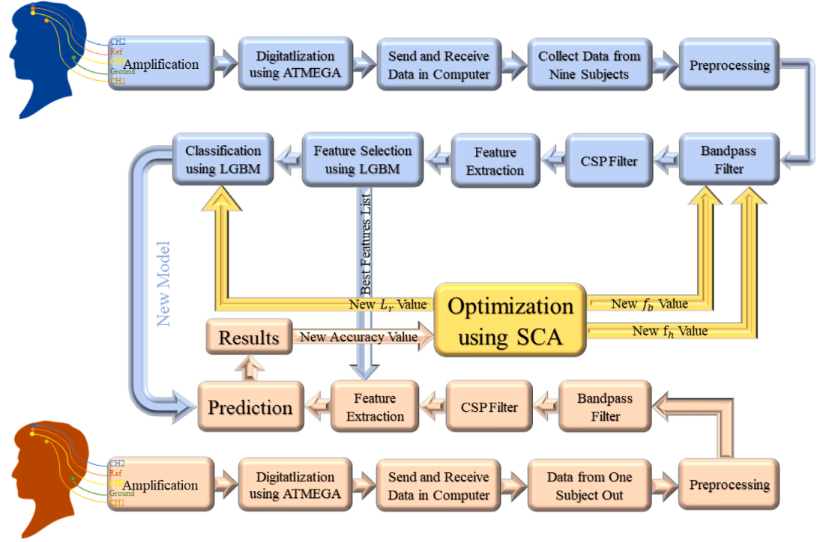
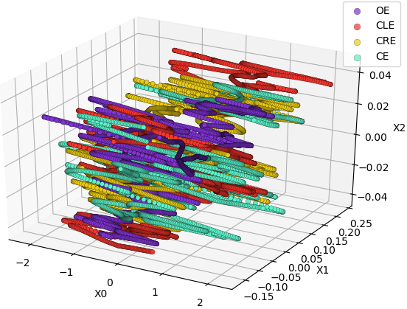
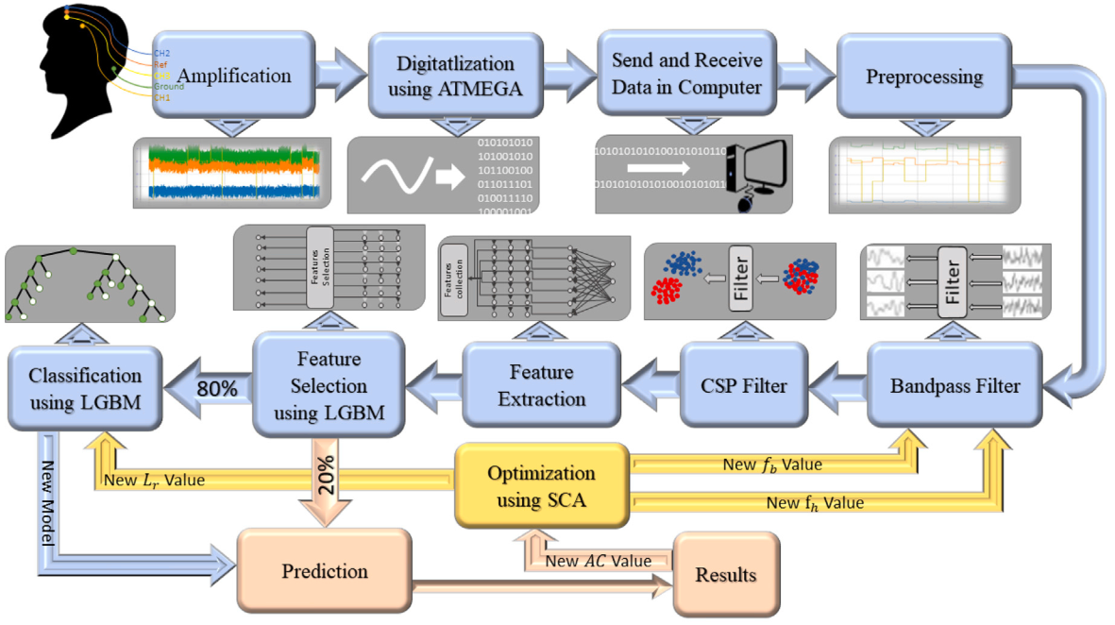
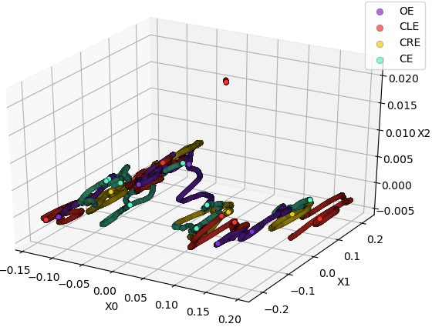
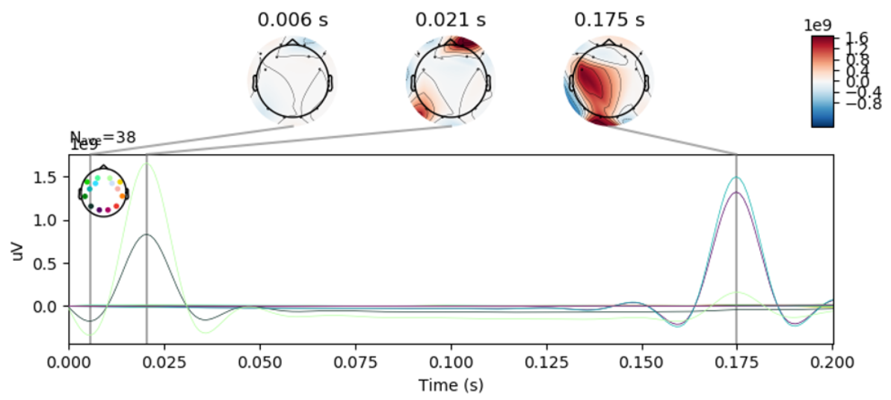
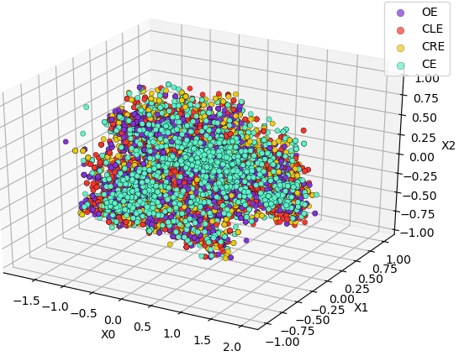
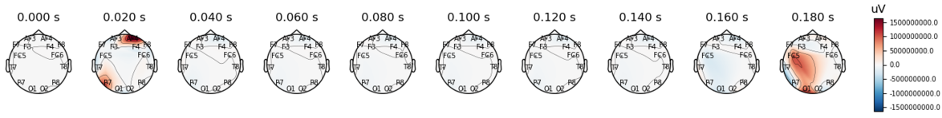
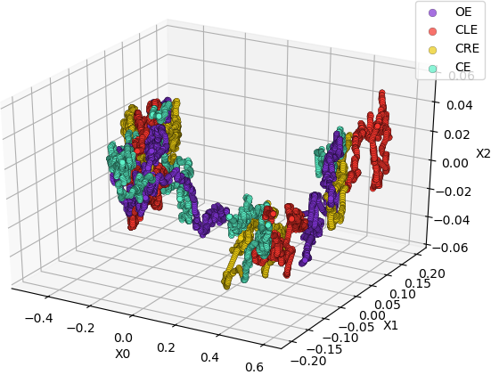
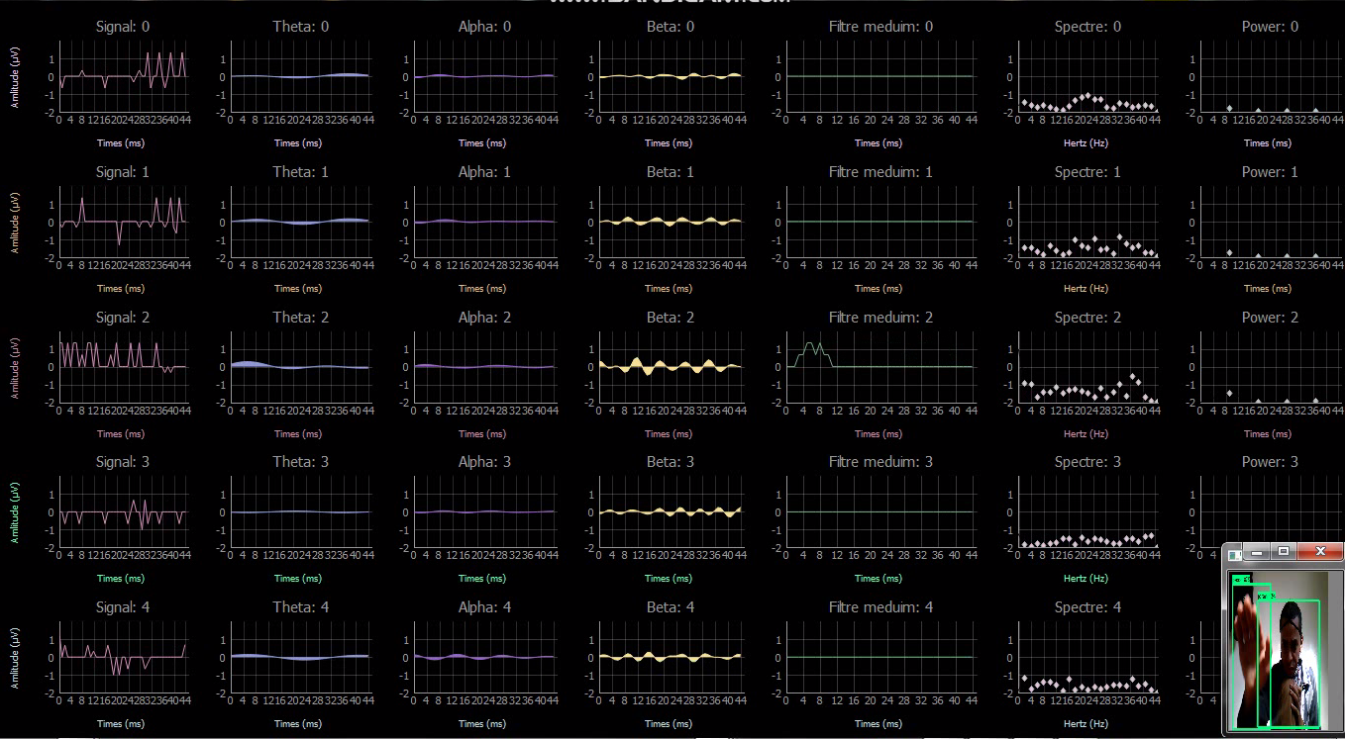
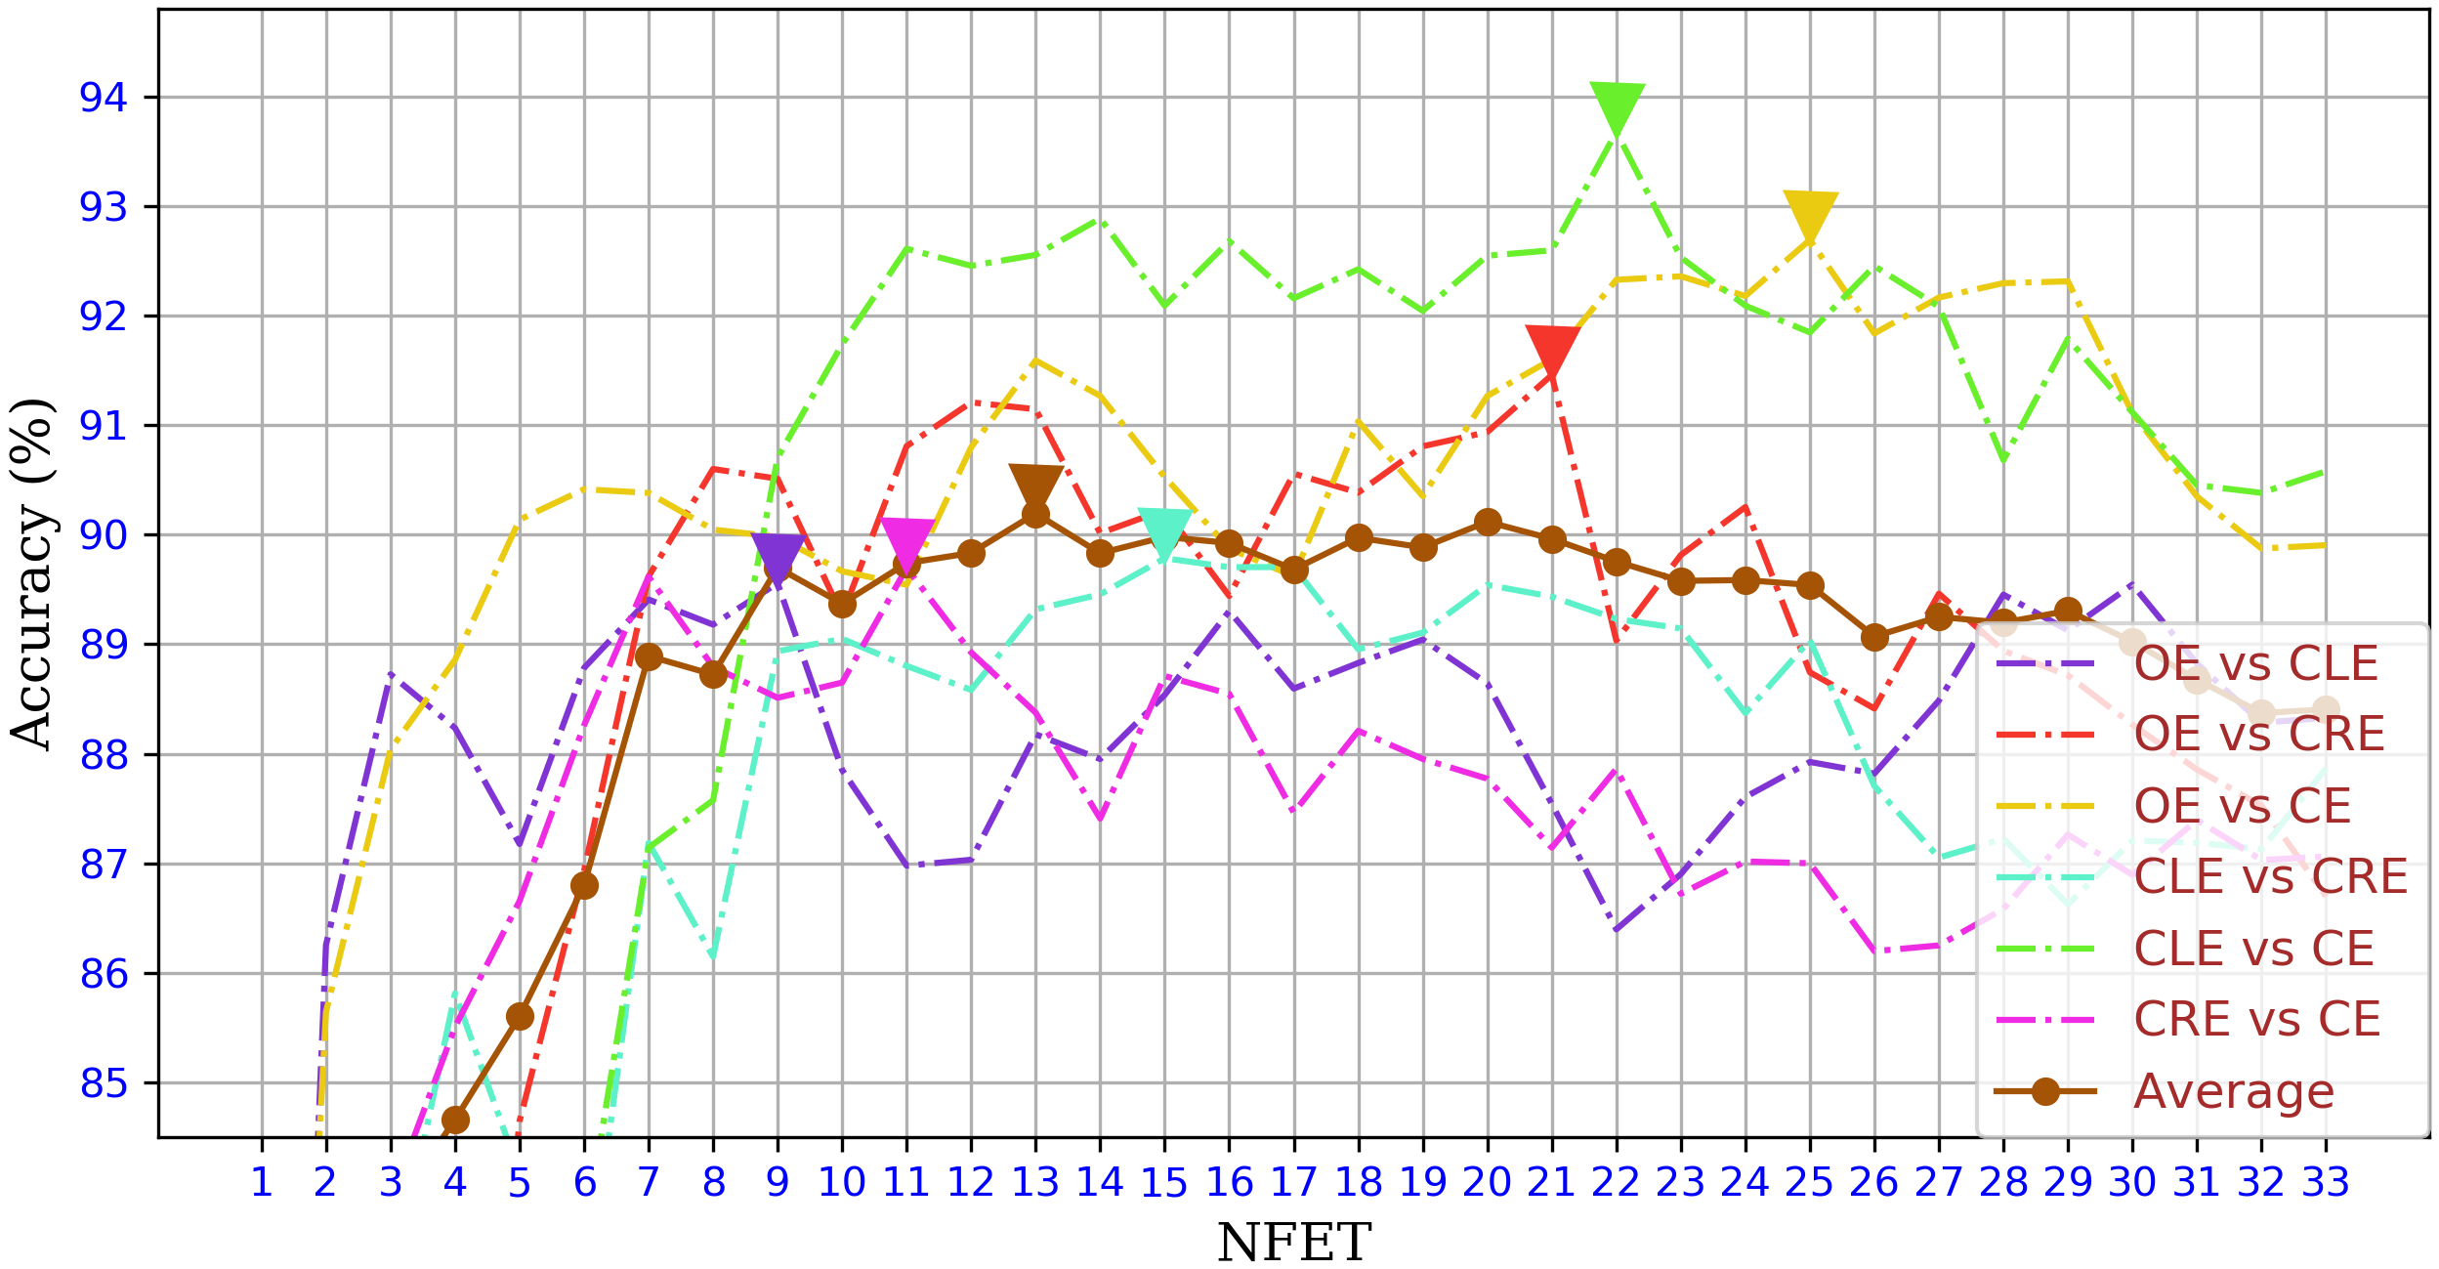
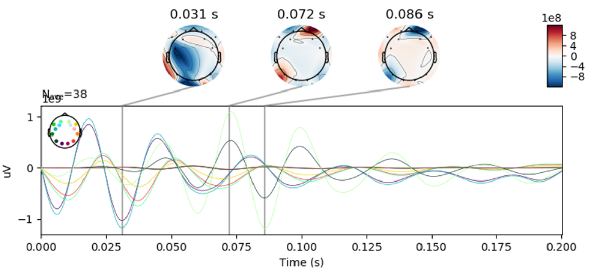
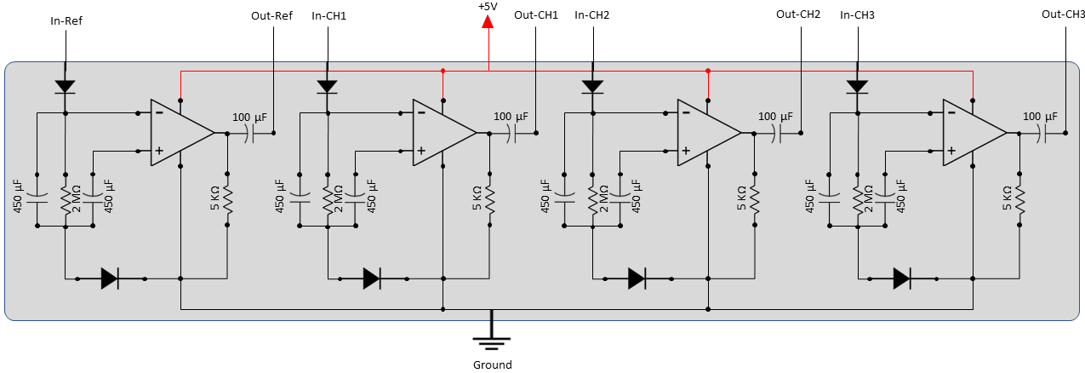
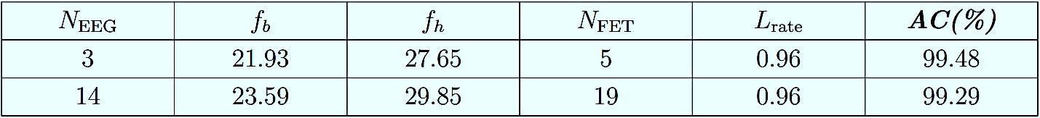
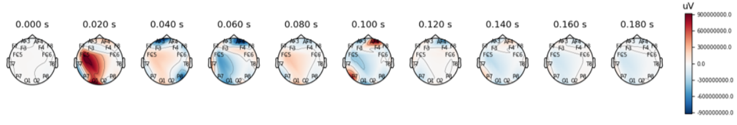
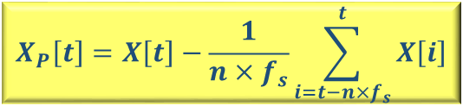
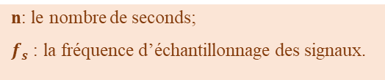
2
PhD Record > Technical Structure
Architecture of the overall system integrating signal processing, optimization, and classification algorithms.
$$X_{P}\left[t\right]=X\left[t\right]−\frac{1}{n×f_{s}}\sum_{i=t−n×f_{s}}^{t}{X\left[i\right]}$$
n: le nombre de seconds;
$f_{s}$ : la fréquence d’échantillonnage des signaux.
Said ABENNA
Postdoctoral Interview Presentation
July 11, 2025
|

Slide 8
2
PhD Record > Research-Phases
Schedule :
Study of the state-of-the-art (Phase 1 : six months) ;
Global design (Phase 2 : one month);
Specific design (Phase 3 : two months);
Selection and purchase of basic electronic components (Phase 4 : two months);
Built the first prototype (Phase 5 : one month);
Test and validation (Phase 6 : two weeks);
Built the second improved prototype (Phase 7 : two months);
Start with sharing results in communications (Phase 8 : three months);
Introduce novel advanced solutions for real-time applications (Phase 9 : six months);
Reports and publication of high-quality papers (continuously until the end of my PhD degree);
The defence.
Start: December 2018
End : February 2023
Duration
Said ABENNA
Postdoctoral Interview Presentation
July 11, 2025
|

Slide 9
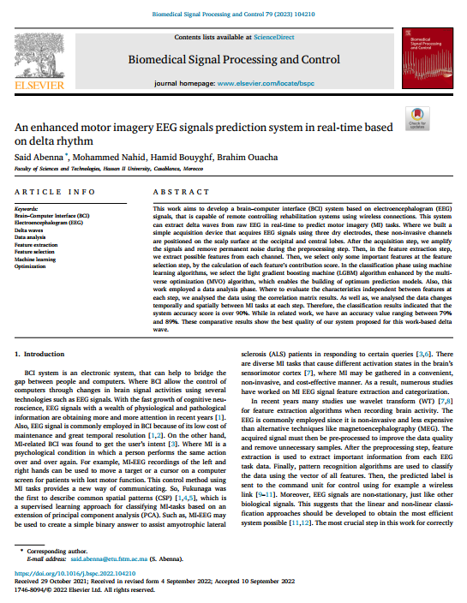
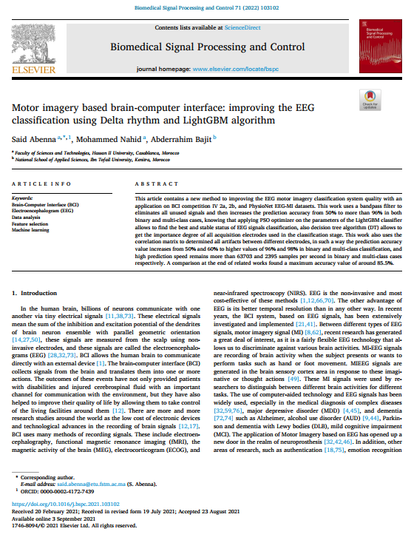
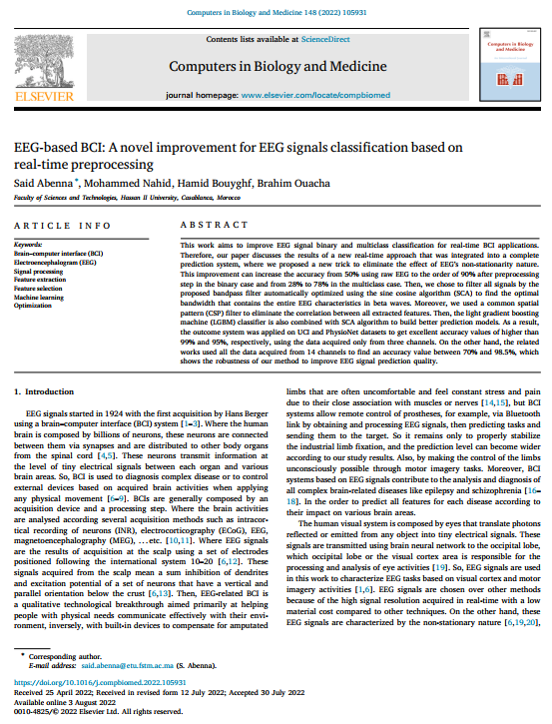
2
PhD Record > Expertises Acquired
Expertise:
Provide expertise in the following areas :
Design of multi-input acquisition devices;
Biomedical signal processing;
Data science;
Big data;
Artificial intelligence;
Optimization algorithlms;
Rehabilitation systems;
……
Said ABENNA
Postdoctoral Interview Presentation
July 11, 2025
|

Slide 10
Plan
1
Education
2
PhD Record
3
Professional Project
4
Conclusion
Said ABENNA
Postdoctoral Interview Presentation
July 11, 2025
|

Slide 11
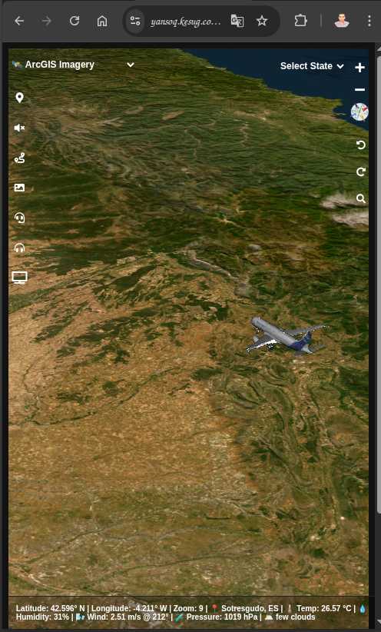
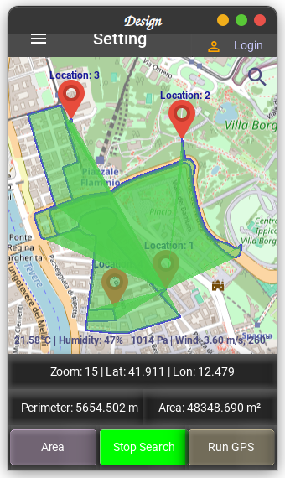
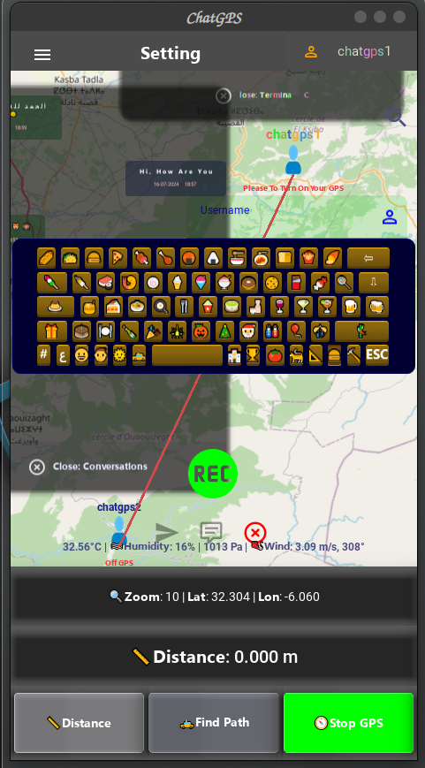
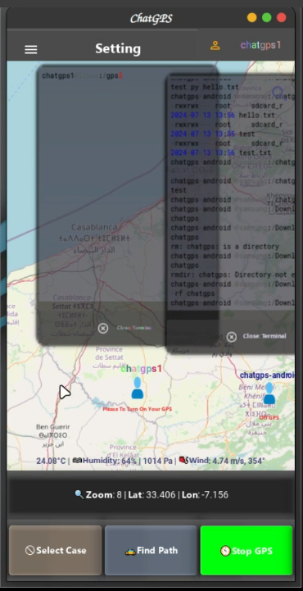
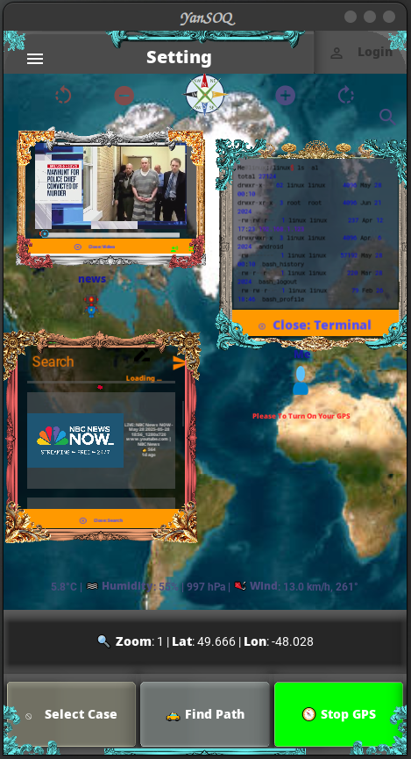
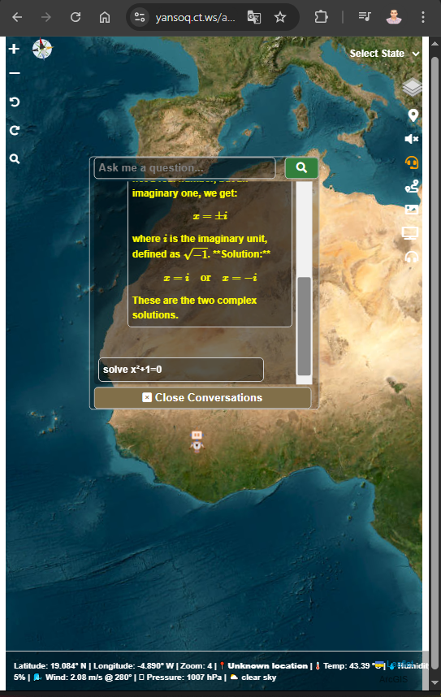
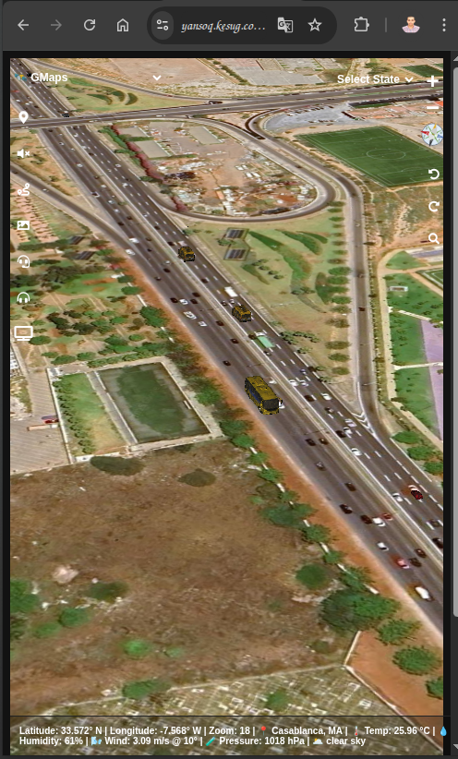
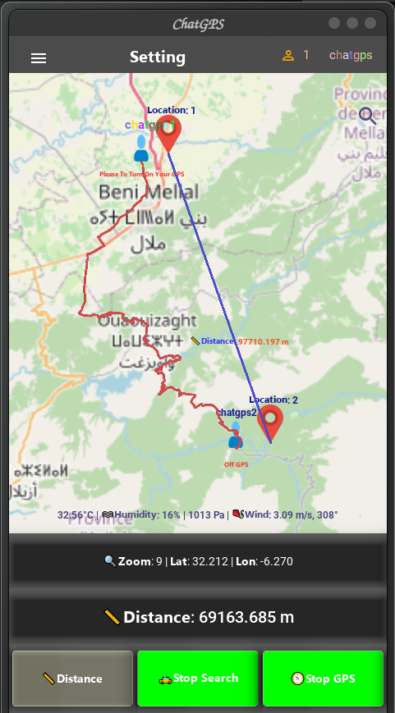
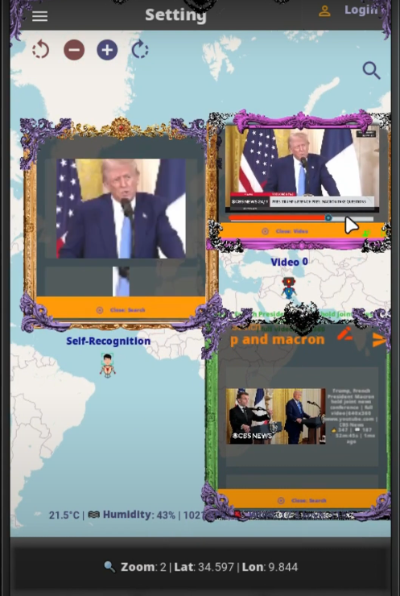
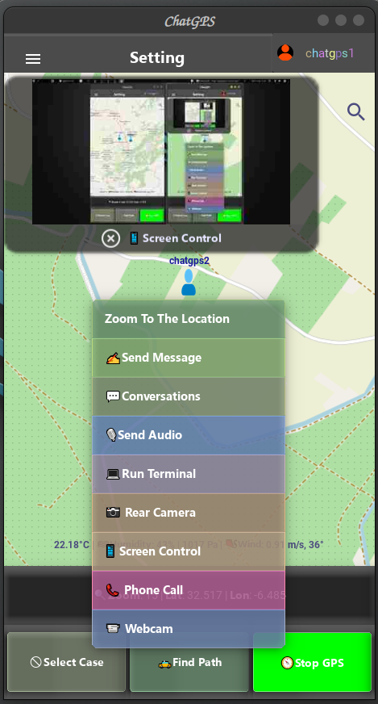
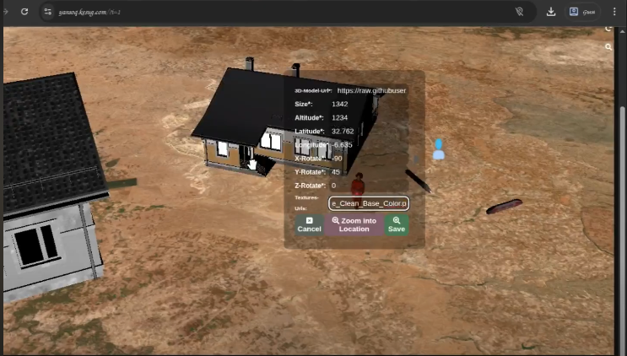
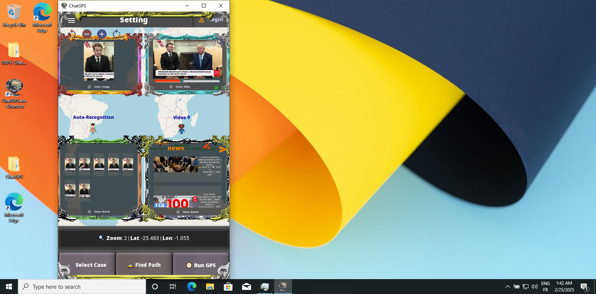
3
Professional Projet
Built smart application (YanSOQ) using cutting-edge technologies and artificial intelligence
Expertise:
Expertise Provided in the Following Areas:
Development of cross-platform applications using Python for Android, Linux, and Windows;
Establishment of TCP socket connections for data transmission, including text, files, and VoIP;
Online data storage, processing, and management;
GPS tracking and Online SSH communication between networked devices;
Implementation of geolocation features such as distance, area, and trace-routing;
Design and integration of online APIs and backend servers;
Create facial/object recognition models;
Use of speech-to-text, text-to-speech technologies, and AI-based chatbots (text and voice);
Simulation of traffic systems involving vehicles and aircraft;
Integration of 3D objects into geographic maps.
Said ABENNA
Postdoctoral Interview Presentation
July 11, 2025
|

Slide 12
Plan
1
Education
2
PhD Record
3
Professional Project
4
Conclusion
Said ABENNA
Postdoctoral Interview Presentation
July 11, 2025
|

Slide 13
4
Conclusion
Results :
The scientific contributions across all projects include:
Developed a real-time multi-sensor data acquisition system;
Designed and implemented a real-time signal processing and prediction system using AI and optimization algorithms;
Created cross-platform applications for Android, Linux, Windows, and browsers;
Demonstrated expertise in cybersecurity and geolocation-based applications;
Gained experience with generative AI for content creation, including text, images, and audio.
Brain Applications :
Worked with : Motor cortex, motor imagery, eye states, sleep stages, and Alcohol use disorder.
Prospects : Parkinson’s, depression, schizophrenia, Alzheimer’s; fMRI, fNIRS, MEG, etc.
Said ABENNA
Postdoctoral Interview Presentation
July 11, 2025
|
Notes:
….
I hope to work on the diagnostic and prediction research of complex desease that threat many humans lifs such as, Parkison’s, ….,

Slide 14
4
Perspectives
System Engineering
Biomedical Embedded Systems
Artificial Intelligence
Application
Computer Control
Digital Diagnosis
Collaborative tool
Signal Processing
Said ABENNA
Postdoctoral Interview Presentation
July 11, 2025
|
Notes:
So why not based on the high level of investissement on USA compared to other contries, we can make some smart device or application, that can help the public to make online and fast dignostic or predictions in few seconds for their health from home or work. Finally thank youMr hamed ad Mr arash for your attention, If there is some questions, please.

Slide 15
Questions
Thanks for Your Attention
Said ABENNA
Postdoctoral Interview Presentation
July 11, 2025
|

