Slide 1

Gateway API
Advanced networking configuration
in Kubernetes
Francesco Cappa
Politecnico di Torino

Slide 2
Challenges with Ingress
Limited protocol support
Only HTTP and HTTPS
Complex routing requirements
Basic routing based on hostnames and paths.
Customization and Extensibility
Ingress and ingress controller behaviour could only be "adjusted" through IngressClass
Standardization
Features and capabilities depend on controller implementation
Ecosystem adoption

Slide 3
Gateway API & design principles
Gateway APIs make network services available by using an extensible, role-oriented, protocol-aware configuration mechanism.
Gateway API is an add-on containing API kinds that provide dynamic infrastructure provisioning and advanced traffic routing.
Design principles:
Role-oriented: Gateway API kinds are modeled after organizational roles that are responsible for managing Kubernetes service networking:
Infrastructure Provider
Cluster Operator
Application Developer
Portable: Gateway API specifications are defined as custom resources and are supported by many implementations.
Expressive: Gateway API kinds support functionality for common traffic routing use cases such as header-based matching, traffic weighting, and others that were only possible in Ingress by using custom annotations.
Extensible: Gateway allows for custom resources to be linked at various layers of the API. This makes granular customization possible at the appropriate places within the API structure.

Slide 4
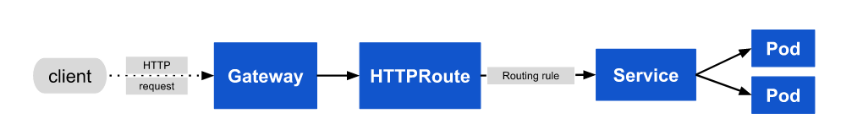
Resource model
Gateway API has three stable API kinds:
GatewayClass: Defines a set of gateways with common configuration and managed by a controller that implements the class.
Gateway: Defines an instance of traffic handling infrastructure, such as cloud load balancer.
HTTPRoute: Defines HTTP-specific rules for mapping traffic from a Gateway listener to a representation of backend network endpoints. These endpoints are often represented as a Service.

Slide 5
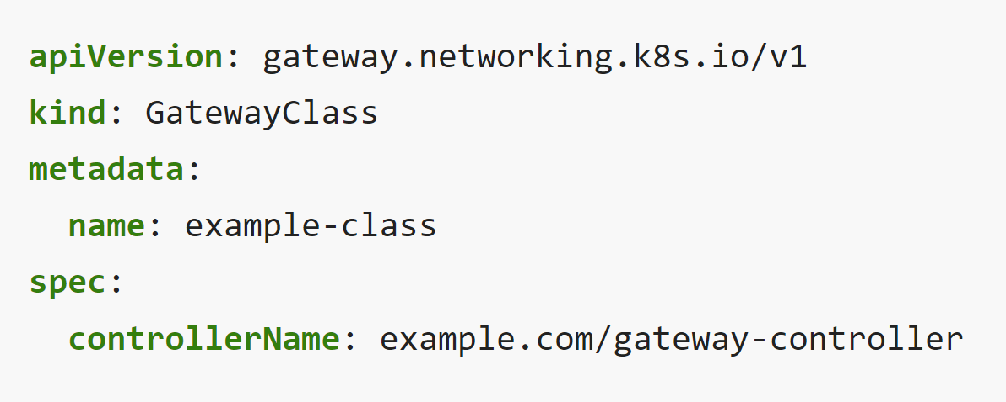
GatewayClass
Gateways can be implemented by different controllers, often with different configurations.
A Gateway must reference a GatewayClass that contains the name of the controller that implements the class.
See the GatewayClass reference for a full definition of this API kind.

Slide 6
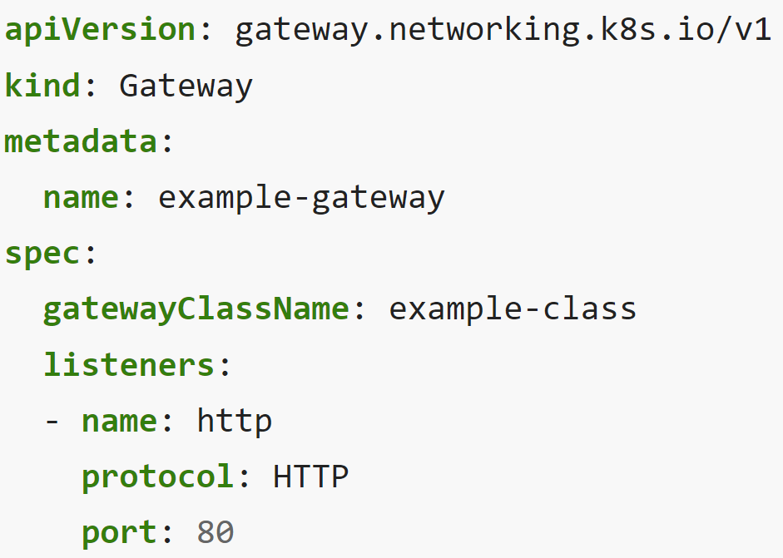
Gateway
A Gateway describes an instance of traffic handling infrastructure.
It defines a network endpoint that can be used for processing traffic, i.e. filtering, balancing, splitting, etc. for backends such as a Service.
Example:
an instance of traffic handling infrastructure is programmed to listen for HTTP traffic on port 80.
Since the addresses field is unspecified, an address or hostname is assigned to the Gateway by the implementation's controller.
This address is used as a network endpoint for processing traffic of backend network endpoints defined in routes.
See the Gateway reference for a full definition of this API kind.

Slide 7
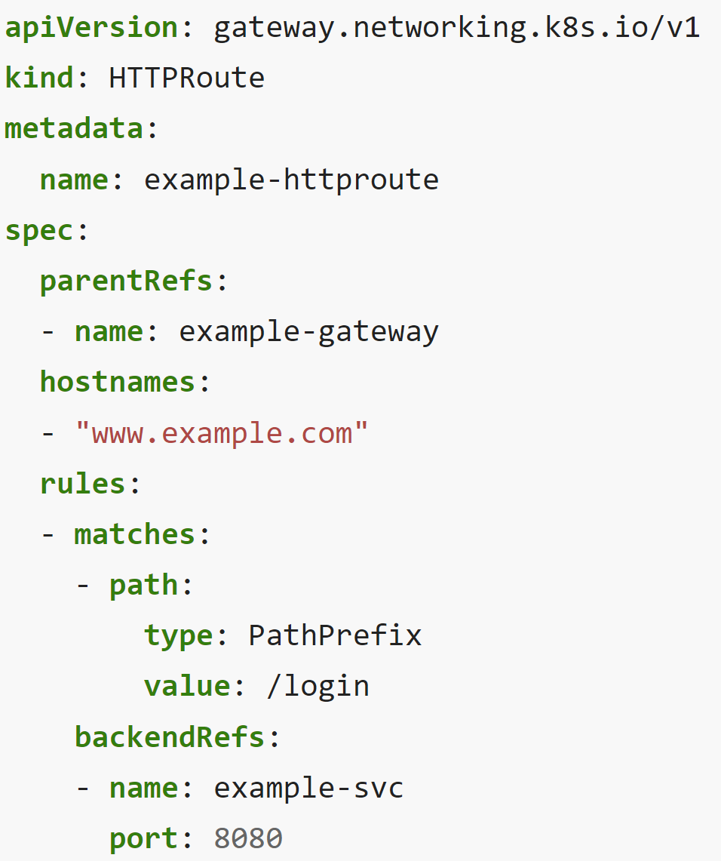
HTTPRoute
The HTTPRoute kind specifies routing behavior of HTTP requests from a Gateway listener to backend network endpoints.
An HTTPRoute represents configuration that is applied to the underlying Gateway implementation. For example, defining a new HTTPRoute may result in configuring additional traffic routes in a cloud load balancer or in-cluster proxy server.
See the HTTPRoute reference for a full definition of this API kind.

Slide 8
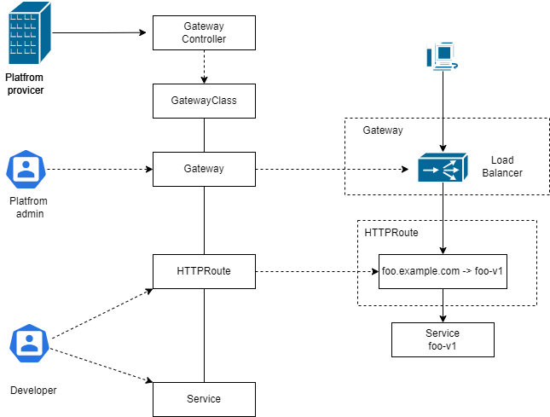
High-level schema

Slide 9
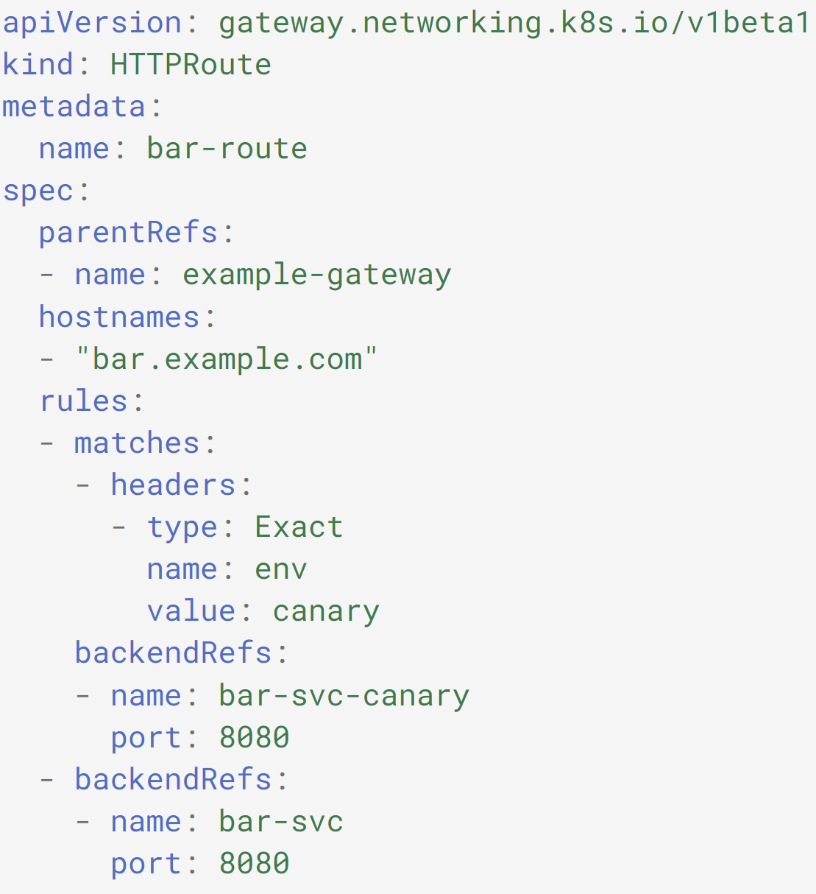
Example: HTTP header-based matching

Slide 10
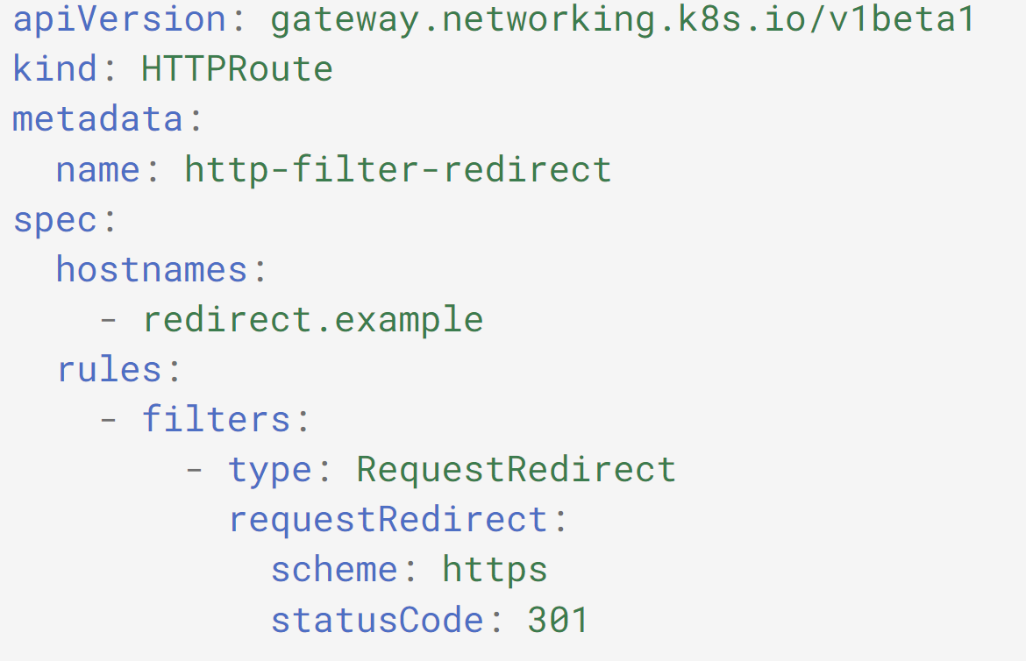
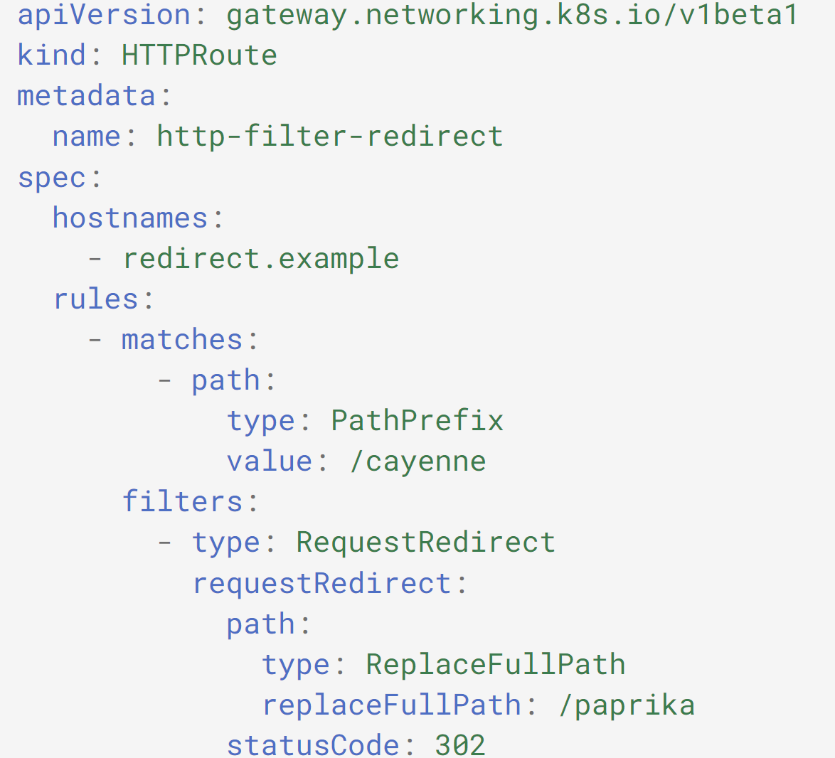
Example: HTTP redirect

Slide 11
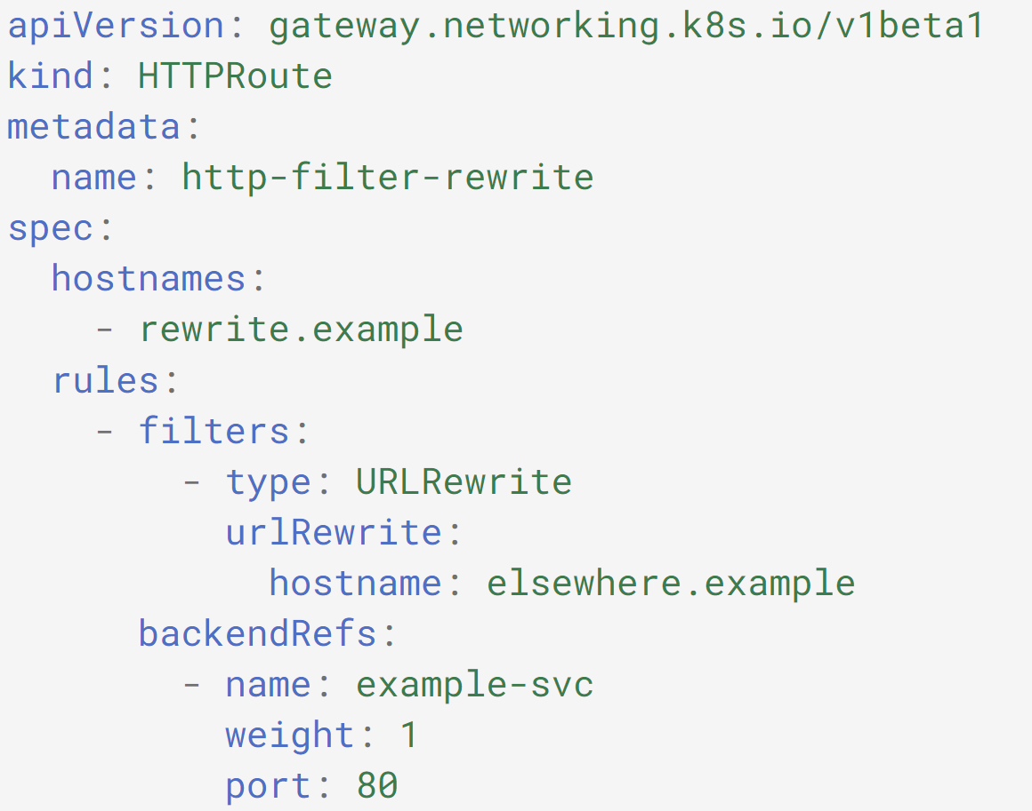
Example: HTTP rewrite

Slide 12
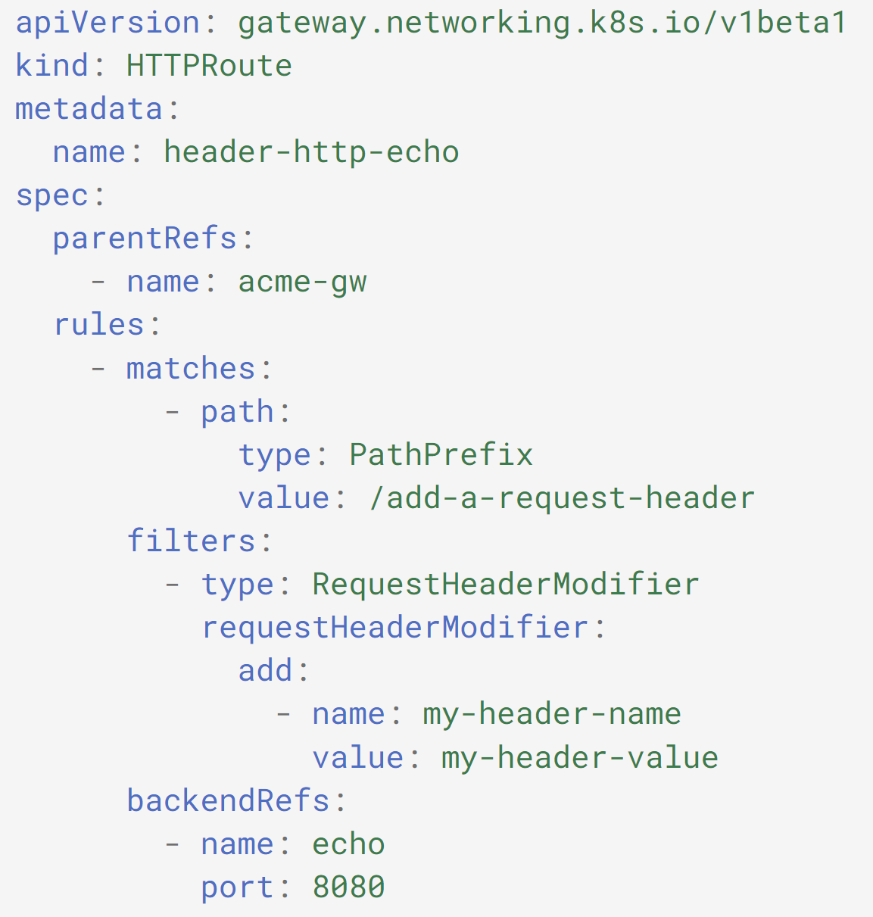
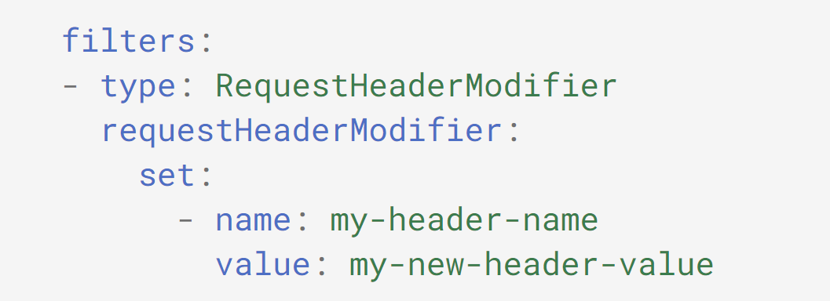
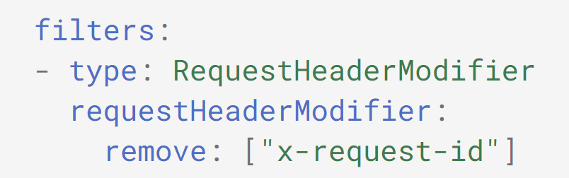
Example: HTTP request header modification

Slide 13
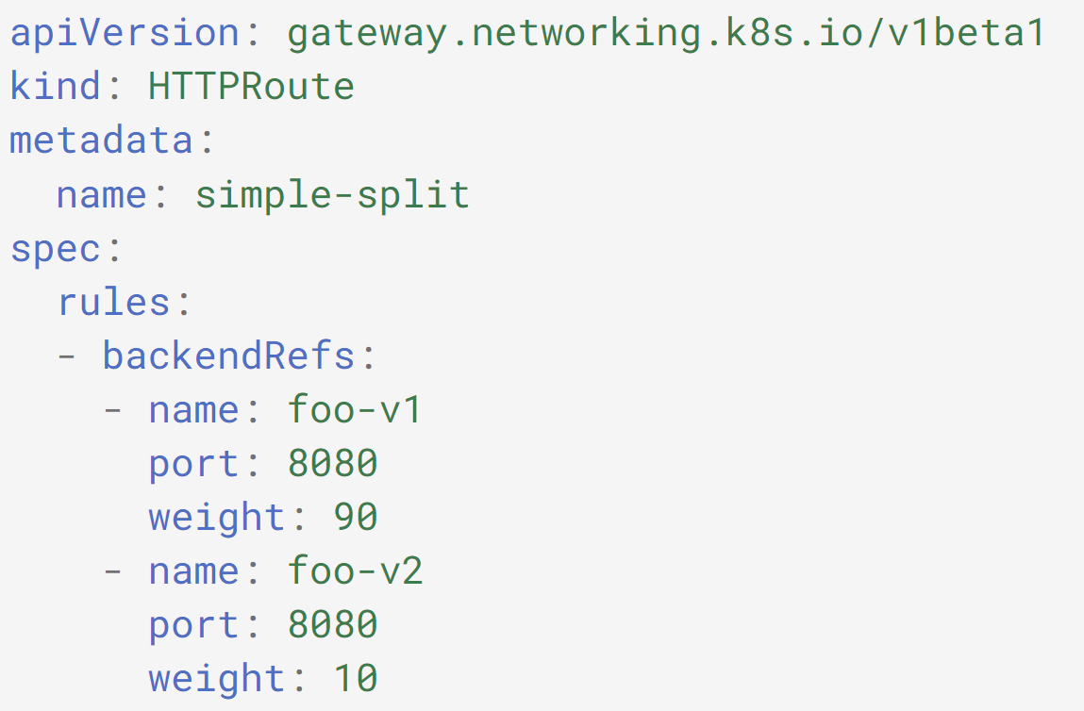
Example: HTTP traffic splitting

Slide 14

Questions

