Slide 1
VPNaaS
Horizontal Pod Autoscaling in Kubernetes:
the VPN service use case

Slide 2
Use Cases
Remote connection from abroad for professors/researchers
Expose internal services, e.g. student labs
Tracking/accounting

Slide 3
Why OpenVPN?
Open protocol
Exports metrics
Cross-platform
Secure (mainly TLS)

Slide 4
War Plan
Deploy OpenVPN on k8s
Export Prometheus Metric
Adapt the Metrics for k8s
Autoscale

Slide 5
Deploy OpenVPN
OpenVPN Helm chart:
ConfigMap for certificate scripts.
Persistent Volume for certificates and crypto keys.
Load Balancer service in front.

Slide 6
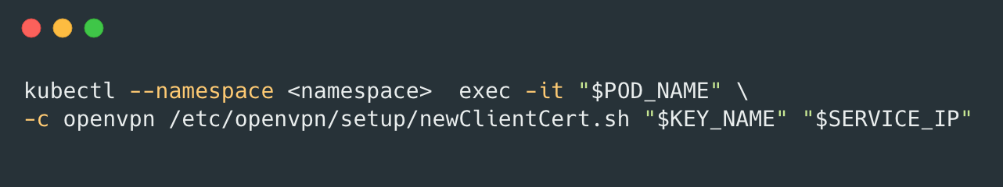

Generate client VPN certificates
Revoke client VPN certificates

Slide 7
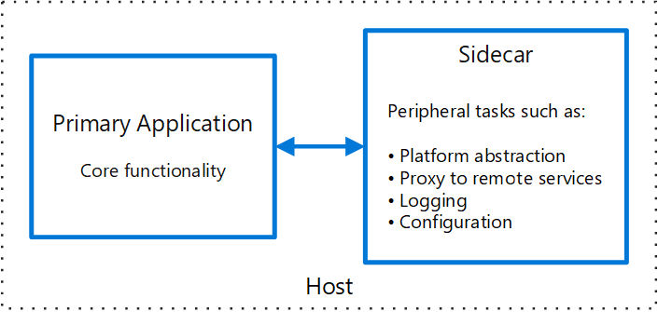
Exporting OpenVPN metrics -> Sidecar

Slide 8
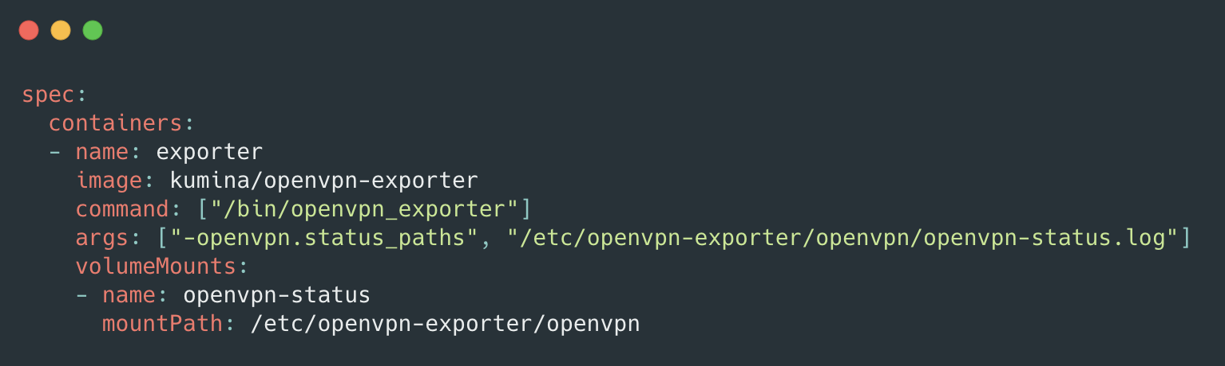
Exporting OpenVPN metrics -> Sidecar

Slide 9
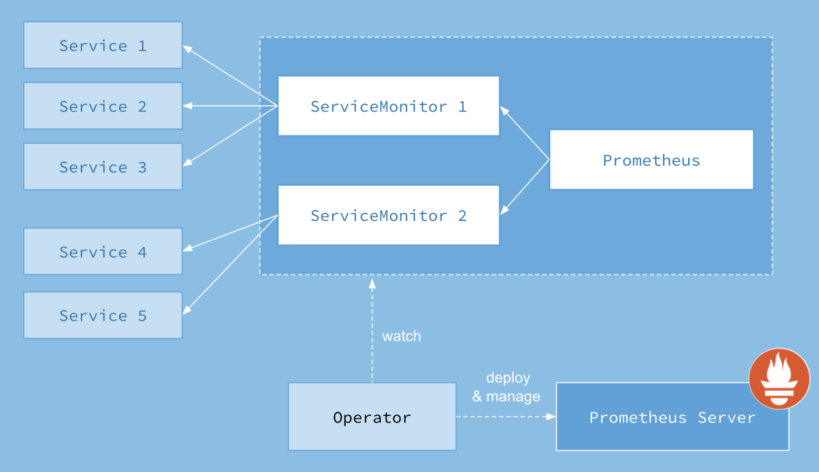
Prometheus monitoring -> Prometheus Operator
Notes:
An Operator is an application-specific controller that extends the Kubernetes API to create, configure, and manage instances of complex stateful applications

Slide 10
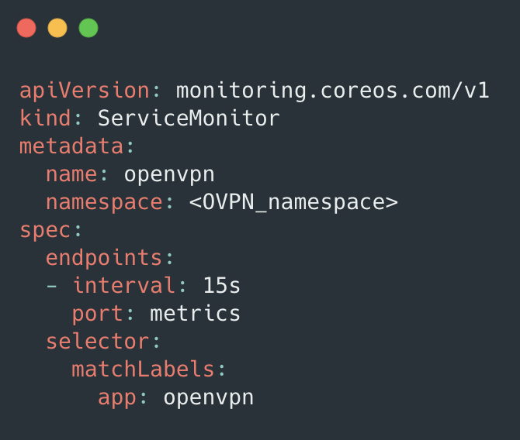
Prometheus ServiceMonitor
Allows selecting Services, and thus Pods, that expose metrics to monitor.
Notes:
The Prometheus resource includes a field called serviceMonitorSelector, which defines a selection of ServiceMonitors to be used.

Slide 11
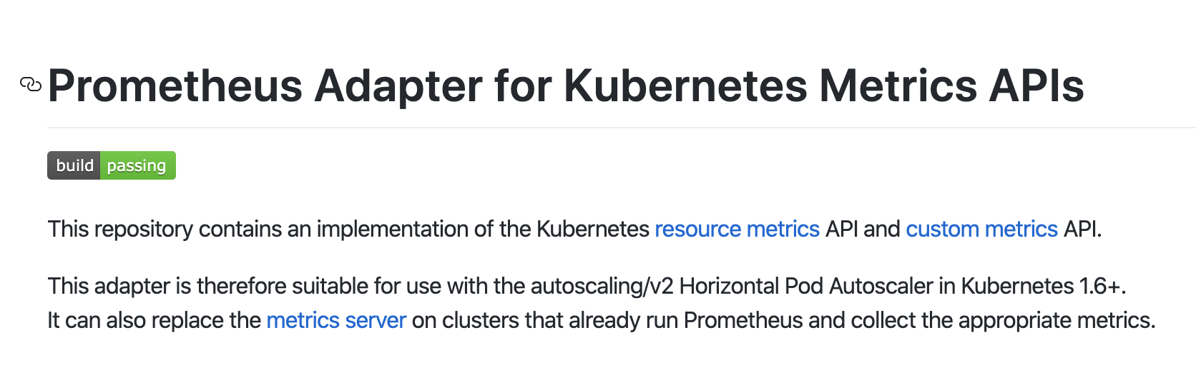
Prometheus to k8s Custom Metrics

Slide 12
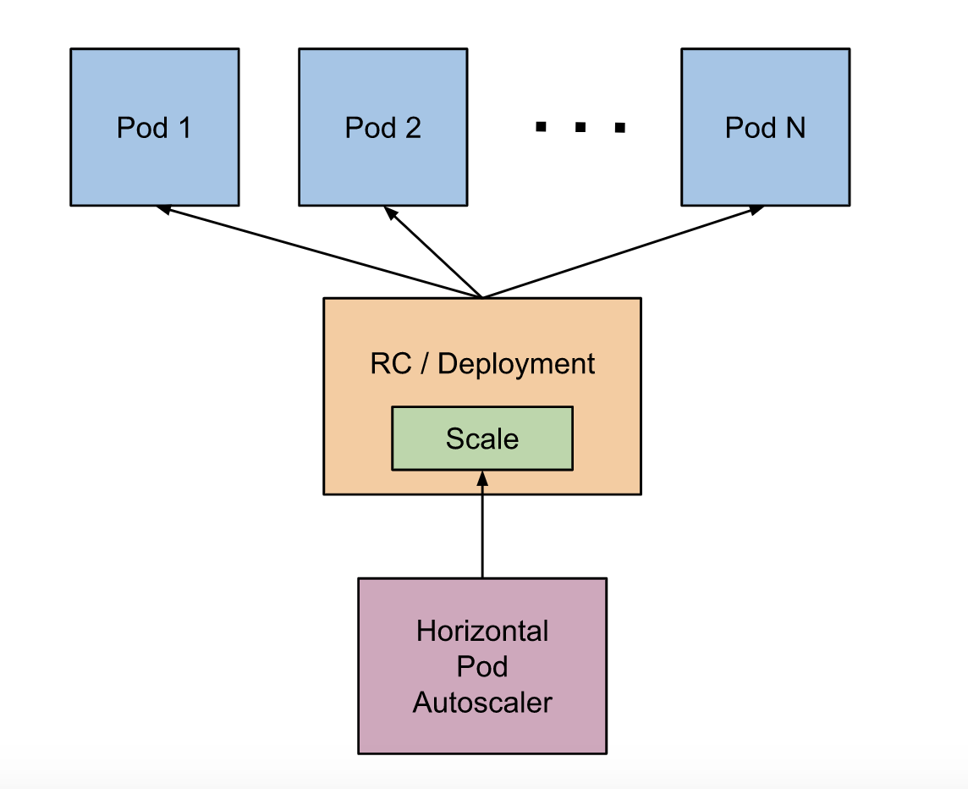
Now that we are exposing Custom Metrics for our application, we can autoscale against them!
Notes:
During each period, the controller manager queries the resource utilization against the metrics specified in each HorizontalPodAutoscaler definition. The controller manager obtains the metrics from either the resource metrics API (for per-pod resource metrics), or the custom metrics API (for all other metrics).

Slide 13
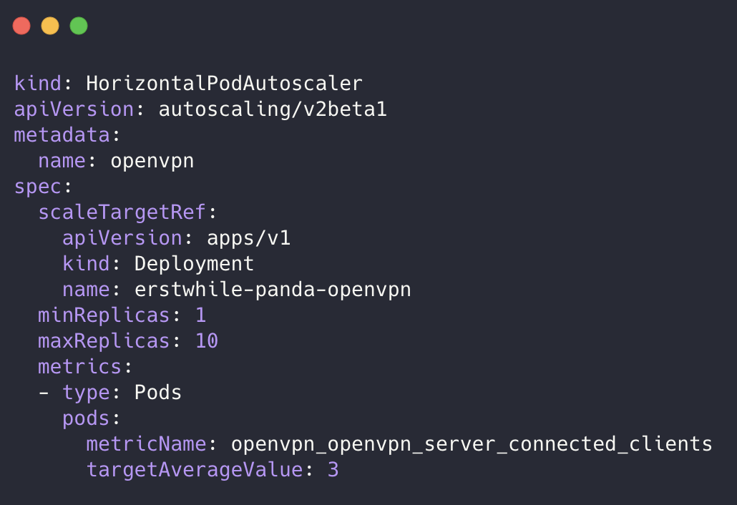
HPA with n. of clients connected.
desiredReplicas = ceil[currentReplicas * ( currentMetricValue / desiredMetricValue )]

Slide 14
Next Steps
Seamlessly integrate with Students CRD
E.g. generate certificate on creation of Student resource, revoke certificate on deletion.
Route Internet traffic through VPN
Understand right metrics and values for autoscaling

Slide 15
Recap: conceptual view
Prometheus Operator
OpenVPN
Prometheus
Prometheus Adapter
Prometheus exporter
Horizontal Pod Autoscaler
Custom metrics API

