Slide 1
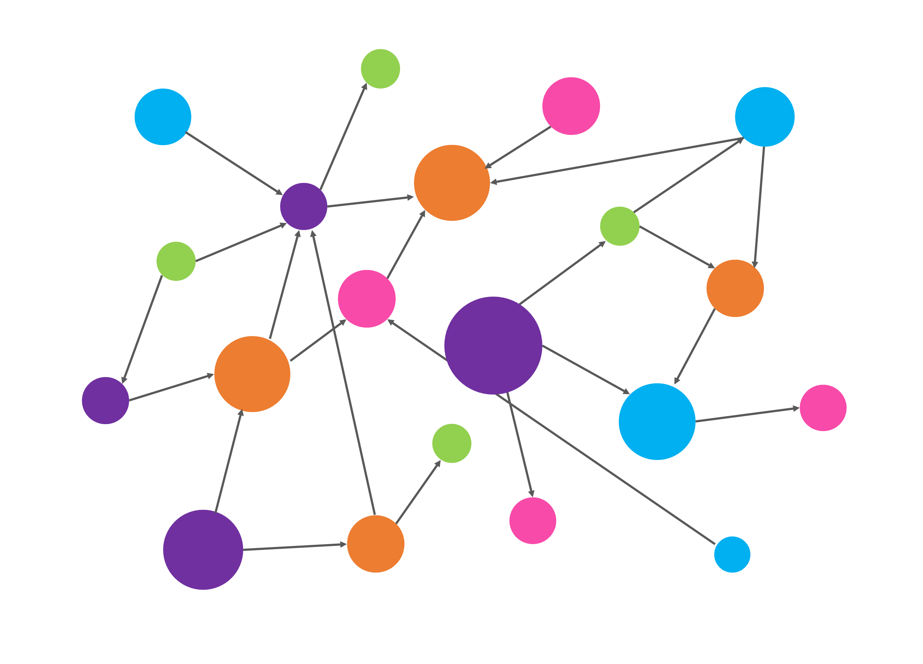

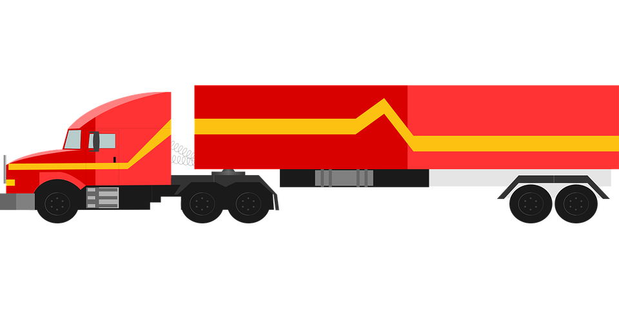
SERVER APPLICATION
THE SERVER APPLICATION STORES PERSISTENT DATA TO MONITOR THE AREA
DATA
WEB APPLICATION
EACH VEHICLE HAS ITS OWN APPLICATION TO COMMUNICATE WITH THE SERVER
DATA
WEB APPLICATION

