Slide 1


Automating Network Security Configuration in NFV/SDN: Foundations, Challenges, and Hands-on Experience
D. Bringhenti, F. Pizzato
November 2nd, 2026

Slide 2
Agenda
Session 1
The Security Configuration Challenge in the Era of Network Virtualization
Network Security Configuration Automation: Past, Present, and Future
Session 2
The VEREFOO Framework for Automated Virtual Firewall Configuration
Hands-on Playground: Configure the Firewall of Your Virtual Network

Slide 3

The Security Configuration Challenge in the Era of Network Virtualization

Slide 4




Network Security Configuration
Network security configuration consists of two main operations:
e₁
e₅
e₂
e₆
Security Service Composition
e₃
e₄
e₇
Which NSFs are needed?
Where should they be placed?
ID | IPSrc | IPDst | pSrc | pDst | tProto | Action
r₁ | e₁, e₂, e₃ | e₅ | * | 80 | TCP | DENY
r₂ | e₁, e₂ | e₅ | 735 | 22 | TCP | ALLOW
r₃ | e₆ | e₄, e₅ | * | * | * | DENY
NSF Rule Configuration
How should the rules of each NSF
be configured?
NSF = Network Security Function (e.g., firewall, VPN gateway)

Slide 5
Security Service Composition
Which NSFs are needed?
r₁, r₂, r₃ are connectivity requirements
  firewalling NSFs are required
Possible firewall options:
  Packet filters (PFs)
  Web-application firewalls (WAFs)
  Next-generation firewalls (NGFWs)
Packet filters are enough, because the conditions of r₁, r₂, r₃ are 5-tuple-based.
e₁
e₅
e₂
e₆
e₃
e₄
e₇
ID | IPSrc | IPDst | pSrc | pDst | tProto | Action
r₁ | e₁, e₂, e₃ | e₅ | * | 80 | TCP | DENY
r₂ | e₁, e₂ | e₅ | 735 | 22 | TCP | ALLOW
r₃ | e₆ | e₄, e₅ | * | * | * | DENY

Slide 6
Security Service Composition
Where should the NSFs be placed?
Firewalls must be put in the paths crossed by any flows to be blocked:
  i.e., the paths between (e₁,e₅), (e₂,e₅), (e₃,e₅), (e₆,e₅), (e₆,e₄).
Solution #1: put a firewall on any link crossed by a malicious flow.
Solution #2: put the minimum number of firewalls, at flow intersection.
e₁
e₅
e₂
e₆
e₃
e₄
e₇
ID | IPSrc | IPDst | pSrc | pDst | tProto | Action
r₁ | e₁, e₂, e₃ | e₅ | * | 80 | TCP | DENY
r₂ | e₁, e₂ | e₅ | 735 | 22 | TCP | ALLOW
r₃ | e₆ | e₄, e₅ | * | * | * | DENY

Slide 7
NSF Rule Configuration
How should the rules of
each NSF be configured?
Each firewall must be configured with a filtering rule set enforcing all requirements:
  also service continuity should be preserved.
Example for left firewall:
  A deny rule covering r₁
  An allow rule covering r₂
  A default action (e.g., deny)
e₁
e₅
e₂
e₆
e₃
e₄
e₇
ID | IPSrc | IPDst | pSrc | pDst | tProto | Action
r₁ | e₁, e₂, e₃ | e₅ | * | 80 | TCP | DENY
r₂ | e₁, e₂ | e₅ | 735 | 22 | TCP | ALLOW
r₃ | e₆ | e₄, e₅ | * | * | * | DENY

Slide 8

Looking at This Example…
Does this manual security configuration process
really look so hard, complex, and troublesome?
My (personal) answer is… both answers have their own reasons!

Slide 9
Why Manual Configuration is Complex
Multi-step process
  All steps (NSF selection, placement, configuration) must be coordinated as decisions made at one stage directly constrain the others.
Interdependencies between requirements
  A rule introduced to satisfy one requirement may affect the enforcement of another one, so administrators must reason on them jointly.
Optimization challenge
  When multiple configurations satisfy all requirements, identifying the one that best minimizes resource usage, cost, or performance overhead is difficult.

Slide 10
Why Manual Configuration Is Not Impossible
Recurring requirement patterns
  Many policies are variations of common needs, such as isolation, service continuity, communication protection (e.g., confidentiality, integrity).
Experience helps
  Skilled administrators can recognize typical situations and reuse known configuration strategies instead of starting from scratch.
Incremental trial-and-error refinement
  A first solution can be improved over time through testing, observation, and small corrections when issues appear.

Slide 11
When Manual Configuration Is Feasible
Manual security configuration is applicable when the network is…
Small
  The number of endpoints, middleboxes, links, requirements, etc. is limited.
Homogeneous
  Security functions use similar capabilities and configuration languages.
Static
  Topology, services, and requirements do not change frequently.
Fully controlled
  The administrator has complete visibility and authority over the whole network.
These conditions hold for traditional physical networks, but nowadays…

Slide 12
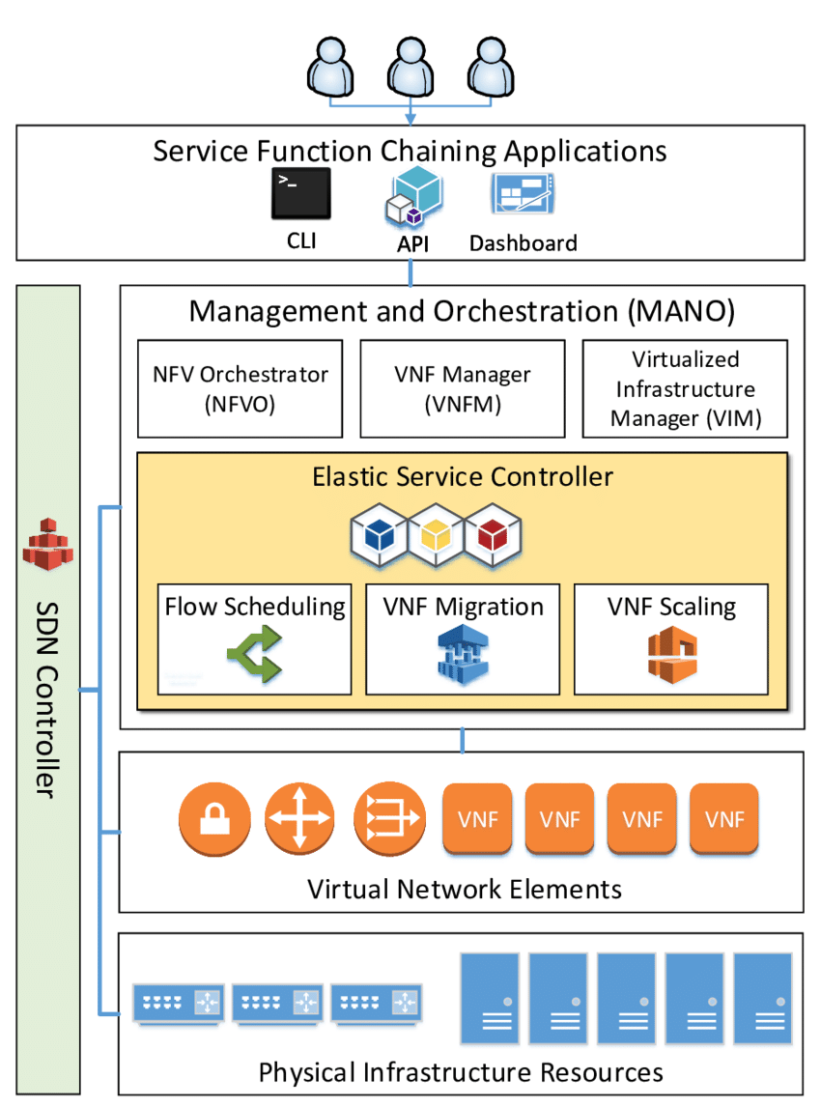
…but Virtualized Networks Are Different
NFV/SDN have created networks with different characteristics:
Large
  Enlarging virtual networks is cheap and easy.
Heterogenous
  Different virtual function types may coexist.
Dynamic
  Everything may change at runtime.
Partially Controlled
  Resources and services may span multiple domains.
≠ Small
≠ Homogenous
≠ Static
≠ Fully Controlled

Slide 13

Is Manual Security Configuration Feasible Now?
Traditional manual configuration is now
error-prone, unoptimized, time consuming.

Slide 14
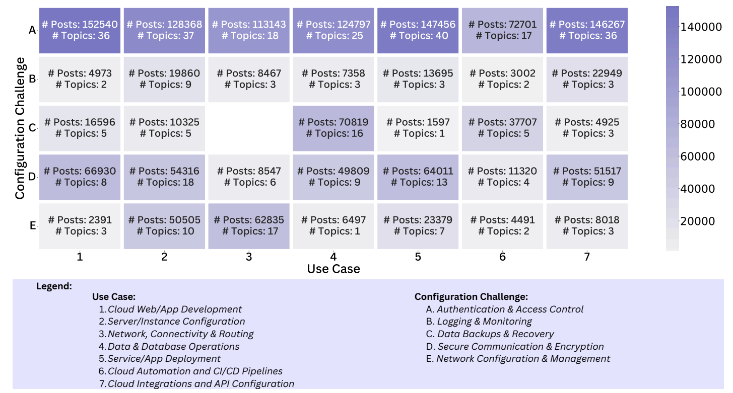
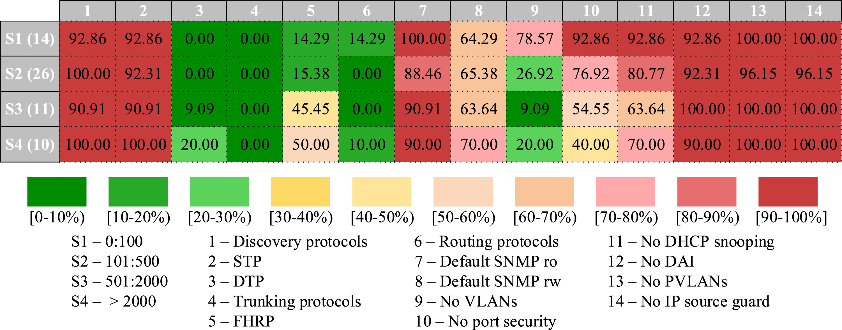
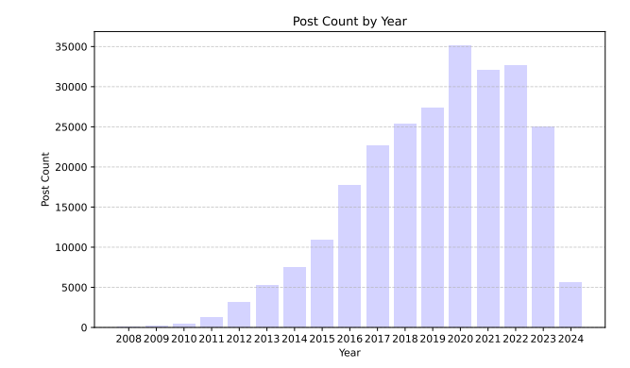
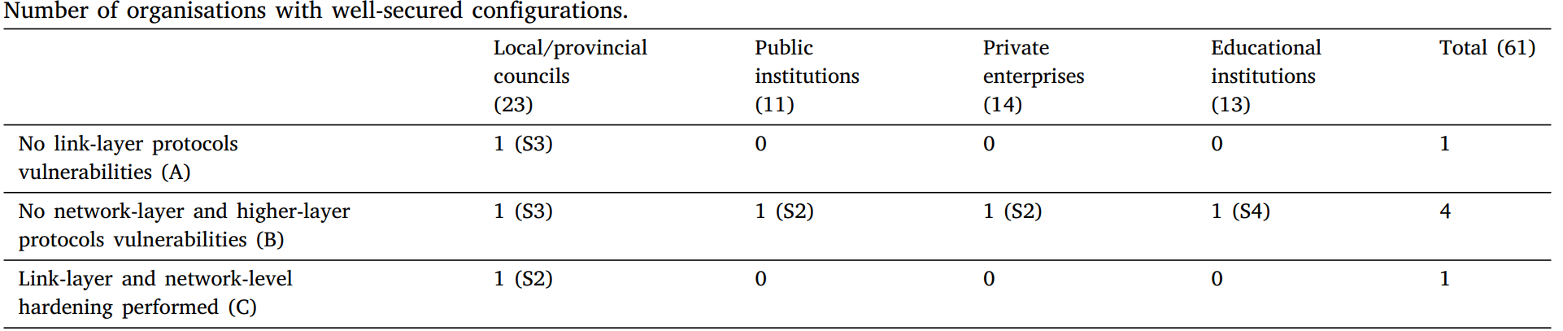
Evidence from Real-World Studies
D. Álvarez, P. Nuño, F. G. Bulnes, and J. C. Granda, “Network security misconfigurations in Spanish organisations: An empirical study,” Computer Networks, vol. 288, art. no. 112631, 2026, doi: 10.1016/j.comnet.2026.112631.
S. I. Hashmi, S. Kashif, L. Gröber, K. Krombholz, and M. Javed, “Mapping the Cloud: A Mixed-Methods Study of Cloud Security and Privacy Configuration Challenges,” in Proc. of the Network and Distributed System Security Symposium (NDSS), 2026, doi: 10.14722/ndss.2026.241302

Slide 15

Network Security Configuration Automation
Automated approaches may derive security configurations
from security requirements, avoiding manual trial-and-error.
Why is security automation more suitable now?
NFV/SDN networks are already designed to be software-controlled:
  SDN Controller → already programs traffic forwarding.
  NFV MANO → already manages the lifecycle of virtual functions.
  APIs → provide integration points for embedding security-configuration logic.
In virtualized networks, security automation is not an external
add-on, but it is part of the existing orchestration stack.

Slide 16




What Automation Can Add for Network Security
Abstraction for the user
  Administrators can specify what security properties are required, without manually writing every device-level rule.
Repeatable configuration
  The same reasoning process can be applied consistently whenever topology, services, or requirements change.
Formal verification
  The computed configuration can be checked against the intended security requirements before deployment.
Optimization
  Automation can search for solutions with lower cost, resource usage, rule-set size, or performance overhead.

Slide 17


Intent/Policy-Based Networking
Two well-established paradigms for network management can be adopted and customized for network security:
Intent-Based Networking (IBN)
A. Leivadeas and M. Falkner, “A survey on intent-based networking,” IEEE Communications Surveys & Tutorials, vol. 25, no. 1, pp. 625–655, 2023, doi: 10.1109/COMST.2022.3215919.
Policy-Based Network Management (PBNM)
R. Boutaba and I. Aib, “Policy-based management: A historical perspective,” Journal of Network and Systems Management, vol. 15, no. 4, pp. 447–480, 2007, doi: 10.1007/s10922-007-9083-8.

Slide 18




Intent/Policy-based Network Security
Intents
Intent Enrichment
and Translation
Policies
Feedback
Policy Refinement
Policy Assurance
Configuration
Monitoring Data
Virtual Network

Slide 19
Intent/Policy-based Network Security
RFC 9315:
Intent defines goals and outcomes in a manner that is purely declarative, specifying what to accomplish, not how to achieve it.
Example:
“Isolate the guest network from critical corporate services.”
Intents
Intent Enrichment
and Translation
Policies
Feedback
Policy Refinement
Policy Assurance
Configuration
Monitoring Data
Virtual Network

Slide 20
Intent/Policy-based Network Security
RFC 9315:
Policies precisely specify what needs to be done when and in which circumstance (imperative). Policies typically involve a certain degree of abstraction in order to cope with the heterogeneity of networking devices.
Example:
“Deny TCP traffic from the guest subnet to the server subnet on ports 22 and 3389.”
Intents
Intent Enrichment
and Translation
Policies
Feedback
Policy Refinement
Policy Assurance
Configuration
Monitoring Data
Virtual Network

Slide 21
Intent/Policy-based Network Security
Intent Enrichment and Translation
It transforms high-level user intents into more precise security policies.
How it may work:
Consult knowledge bases and ontologies.
Use asset inventories and service catalogs.
Exploit topology and contextual information (e.g., with OpenC2).
Use structured policy templated to map natural-language sentences.
Intents
Intent Enrichment
and Translation
Policies
Feedback
Policy Refinement
Policy Assurance
Configuration
Monitoring Data
Virtual Network

Slide 22
Intent/Policy-based Network Security
Policy Refinement
It transforms security policies into concrete network security configurations.
How it may work:
Identify suitable NSFs (e.g., from databases).
Decide NSF placement and chaining.
Generate device- or function-level configuration rules.
Intents
Intent Enrichment
and Translation
Policies
Feedback
Policy Refinement
Policy Assurance
Configuration
Monitoring Data
Virtual Network

Slide 23
Intent/Policy-based Network Security
Policy Assurance
It checks whether the deployed configuration satisfies the intended network security behavior.
How it may work:
Collect runtime monitoring and telemetry data.
Analyze deployed configurations.
Apply compliance checking.
Trigger feedback or reconfiguration when violations are detected.
Intents
Intent Enrichment
and Translation
Policies
Feedback
Policy Refinement
Policy Assurance
Configuration
Monitoring Data
Virtual Network

Slide 24
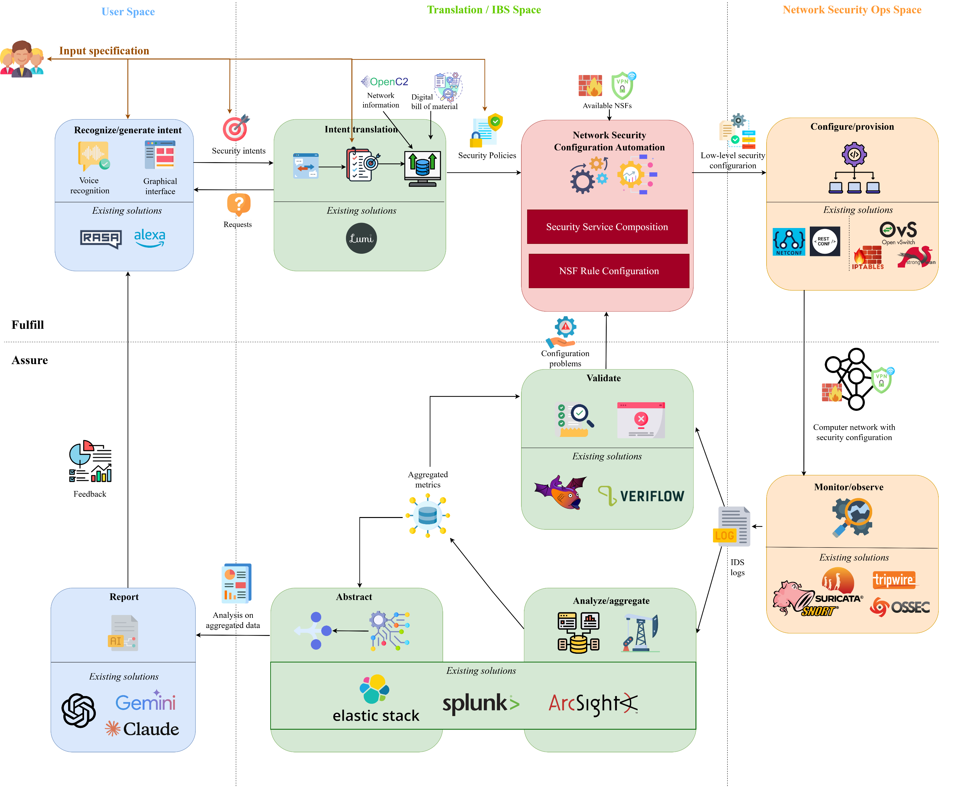
Security Configuration in the IBN/PBNM Loop (RFC 9315)

Slide 25

Network Security Configuration Automation: Past, Present, and Future

Slide 26
How We Will Analyze the Literature
Understand the historical evolution
Trace how network security configuration automation has progressed over time, from early function-specific solutions to increasingly comprehensive and integrated approaches.
Characterize the research landscape
Analyze existing approaches along five main dimensions.
  Automation Scope: Which phase is automated?
  Target Environment: Does the approach operate in physical or virtual networks?
  Security Functions: Which NSFs are supported?
  Correctness Guarantees: Is configuration correctness ensured?
  Optimization Objectives: Is the approach optimized?

Slide 27
How the Corpus was Built
A recent Systematic Literature Review (SLR) on network security configuration automation provides the starting point of this analysis.
The original corpus was extended through forward snowballing and targeted searches, focusing on papers published in the last two years.
Final corpus: 117 papers
D. Bringhenti, G. Marchetto, R. Sisto, and F. Valenza, “Automation for Network Security Configuration: State of the Art and Research Trends,” ACM Computing Surveys, vol. 56, no. 3, Article 57, pp. 57:1–57:37, 2024. DOI: 10.1145/3616401.

Slide 28

The (R)evolution of Network Security Configuration Automation
Early Security Policy-Based Automation
1997-2004
2030

Slide 29
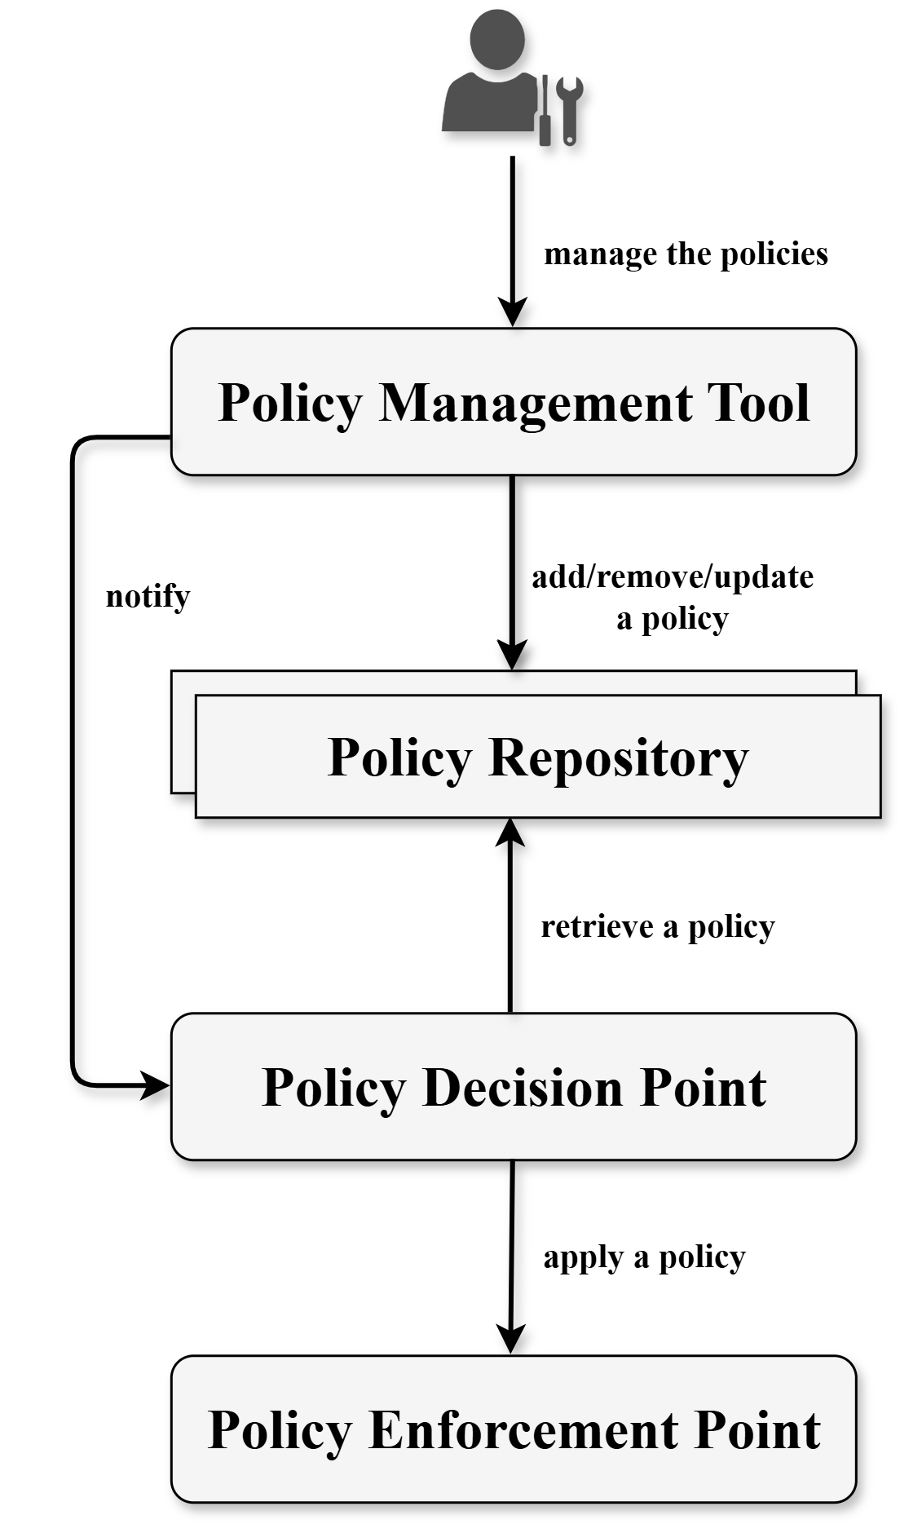
1) Early Security Policy-Based Automation
Main idea:
Introduce Policy-Based Network Management (PBNM) to separate high-level security requirements from low-level device configurations.
Representative papers: [1], [3], [7], [10], [12]
Key characteristics:
Centralized, network-wide security policies
Automatic translation of policies into device-level rules
Topology-aware configuration
Security functions (mainly, firewalls) assumed to be already deployed

Slide 30
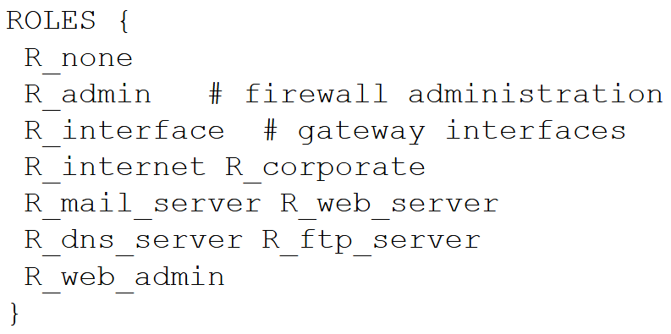
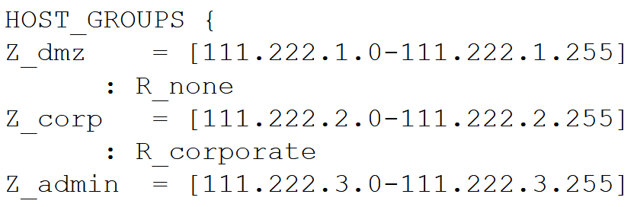
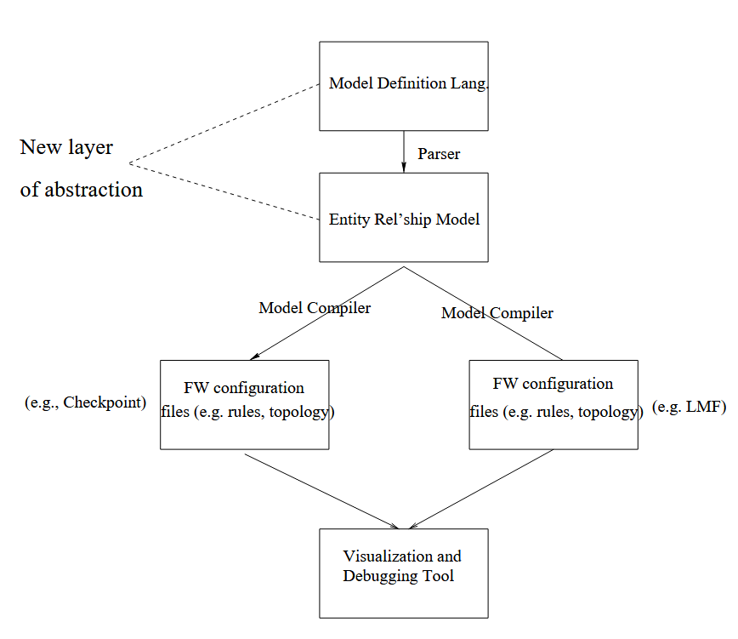
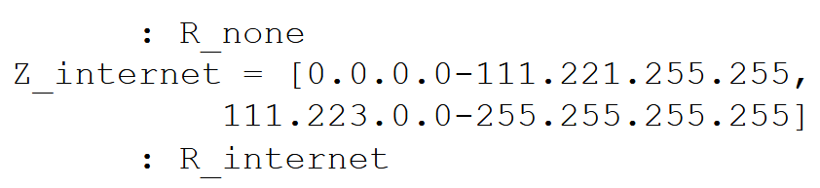
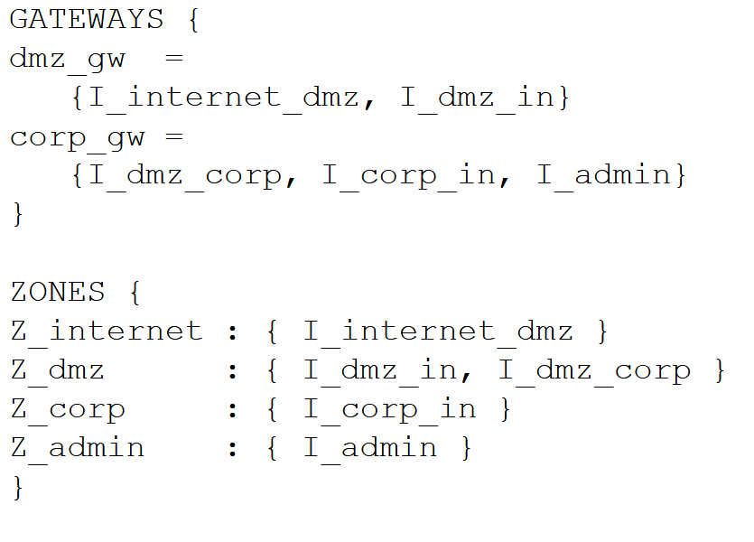
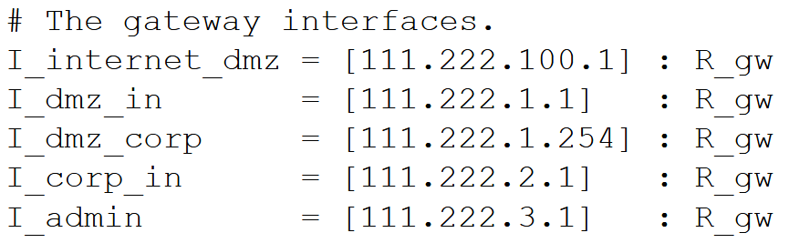
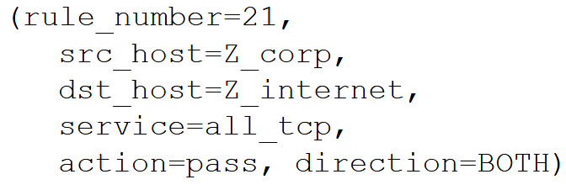
1) Early Security Policy-Based Automation
[7] Y. Bartal, A. J. Mayer, K. Nissim, and A. Wool, “Firmato: A novel firewall management toolkit, ” ACM Trans. Comput. Syst., vol. 22, no. 4, pp. 381–420, 2004. DOI: 10.1145/1035582.1035583

Slide 31
1) Early Security Policy-Based Automation
Main limitations:
Narrow support for security-function types
  Only firewalls and access-control devices
Extremely limited support for NSF placement
Mostly static network environments
Limited or no formal correctness guarantees
Next step:
How can automatically generated
configurations be guaranteed to be correct?

Slide 32
The (R)evolution of Network Security Configuration Automation
Early Security Policy-Based Automation
1997-2004
2004-2012
2030
Formal Policy Refinement & Correction

Slide 33
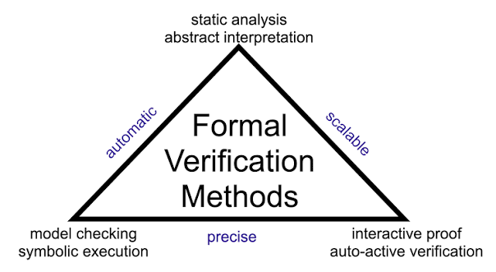
2) Formal Policy Refinement & Correction
Main idea:
Enrich policy-based automation with formal models and verification techniques to ensure that automatically generated configurations correctly enforce the policies.
Representative papers: [14], [16], [22], [27]
Key characteristics:
Formal semantics for security policies
Use of formal logic, constraint solving, theorem proving, or refinement methods
Verification of policy consistency for configuration fixing
https://verse.systems/blog/post/2025-10-21-formal-verification-triangle/

Slide 34
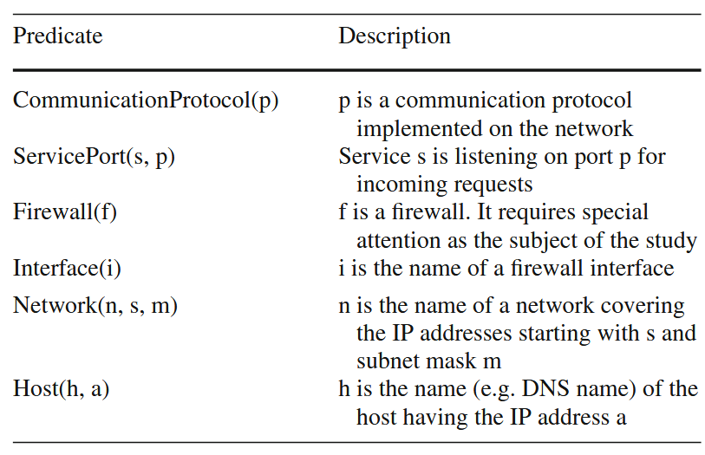
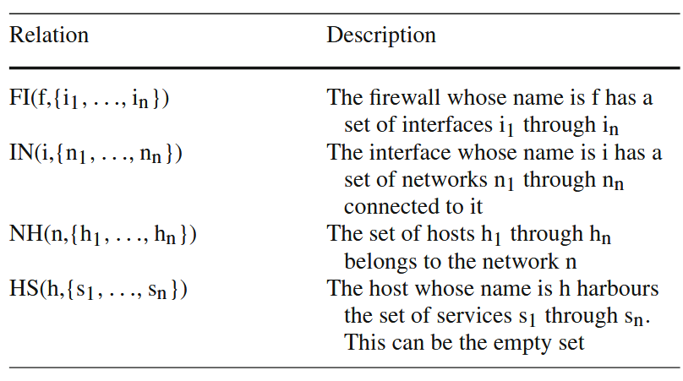
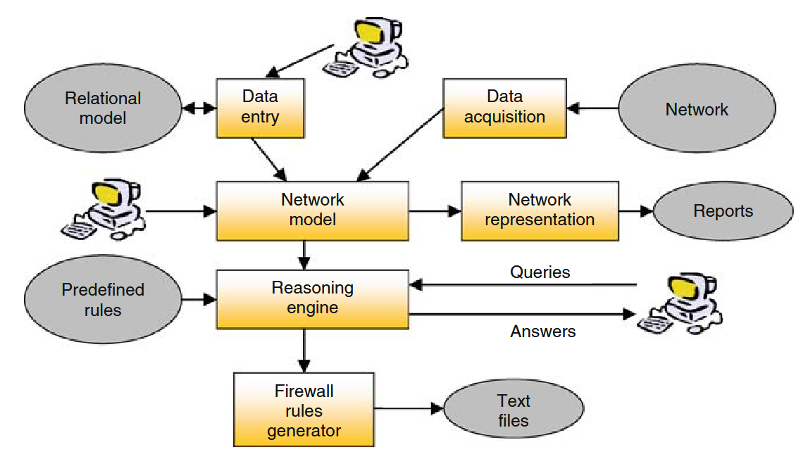
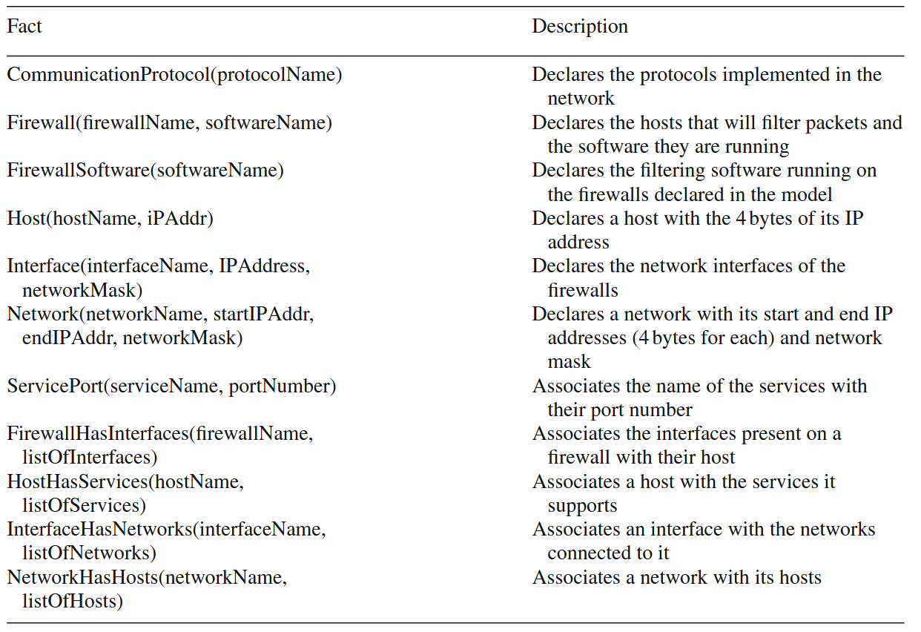
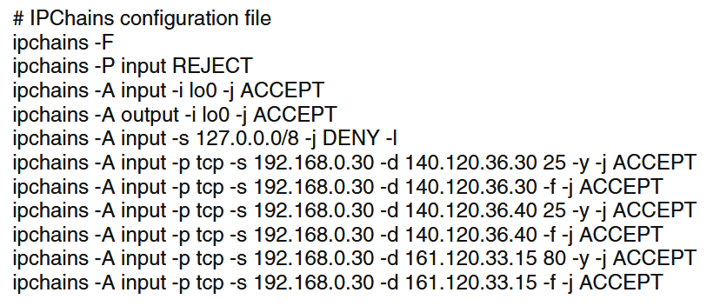
2) Formal Policy Refinement & Correction
[17] J. Govaerts, A. K. Bandara, and K. Curran, “A formal logic approach to firewall packet filtering analysis and generation, ” Artif. Intell. Rev., vol. 29, no. 3-4, pp. 223–248, 2008. DOI: 10.1007/s10462-009-9147-0

Slide 35
2) Formal Policy Refinement & Correction
Main limitations:
Formal methods increase modeling and computational complexity
Correctness guarantees depend on the accuracy and completeness of the formal model
Still mainly focused on function configuration, rather than security-function placement
Mostly designed for traditional and relatively static networks
Next step:
Can automation go beyond configuring existing devices and also decide where and how security functions are allocated?

Slide 36
The (R)evolution of Network Security Configuration Automation
Early Security Policy-Based Automation
Programmable & Virtualized Security Automation
1997-2004
2012-2018
2004-2012
2030
Formal Policy Refinement & Correction

Slide 37
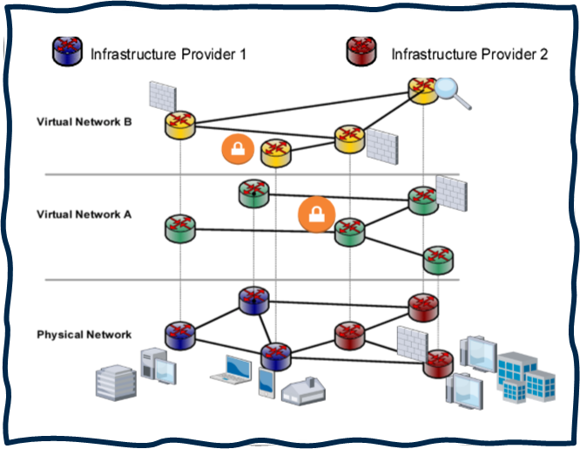
3) Programmable & Virtualized Security Automation
Main idea:
NFV/SDN change the scope of security automation. NSFs become programmable, virtualized, dynamically allocated.
Representative papers: [44], [49], [55], [61], [62]
Key characteristics:
NFV and SDN enable virtualization and programmable traffic steering
Security Service Composition now explicitly addressed
Automatic creation of Service Function Chains (SFCs)
Automation moves from device-level configuration to network-wide security service design

Slide 38
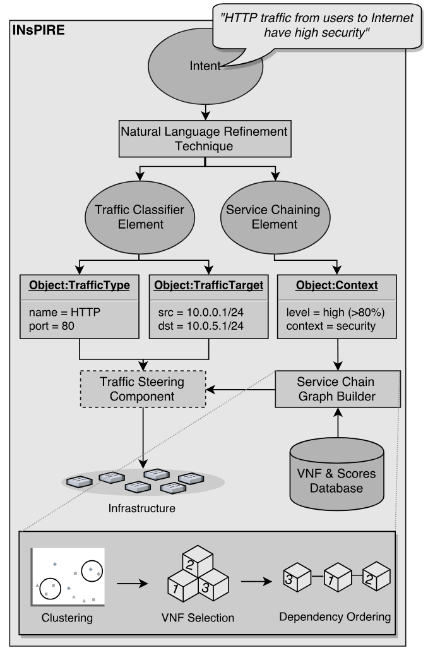
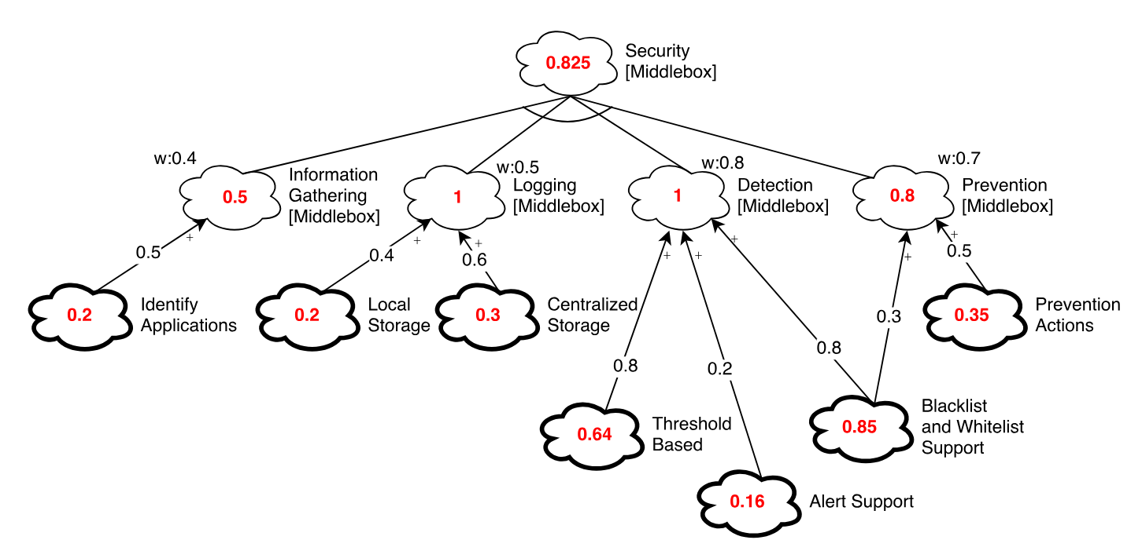
3) Programmable & Virtualized Security Automation
[44] E. J. Scheid, C. C. Machado, M. F. Franco, R. L. dos Santos, R. J. Pfitscher, A. E. S. Filho, and L. Z. Granville, “Inspire: Integrated nfv-based intent refinement environment, ” in Proc. of the IFIP/IEEE Symp. on Integrated Network and Service Management (IM17), pp. 186–194, 2017. DOI: 10.23919/INM.2017.7987279

Slide 39
3) Programmable & Virtualized Security Automation
Main limitations:
Security Service Composition and NSF Rule Configuration are still addressed separately
Optimization is typically partial or focused on a single sub-problem
Limited support for runtime adaptation and reactive reconfiguration
Next step:
Can all the configuration decisions be jointly taken, while guaranteeing correctness and optimization?

Slide 40
The (R)evolution of Network Security Configuration Automation
Early Security Policy-Based Automation
Programmable & Virtualized Security Automation
1997-2004
2012-2018
2004-2012
2018-2023
2030
Formal Policy Refinement & Correction
Integrated & Optimized Security Automation

Slide 41
4) Integrated & Optimized Security Automation
Main idea:
Security automation starts addressing the two configuration decisions jointly, while often embedding formal verification and optimization.
Representative papers: [66], [68], [72], [79], [91]
Key characteristics:
The two configuration tasks are jointly addressed
Larger heterogeneous security scenarios are considered
Formal methods and constraint-solving techniques are used to guarantee correctness
Optimization objectives are explicitly introduced

Slide 42
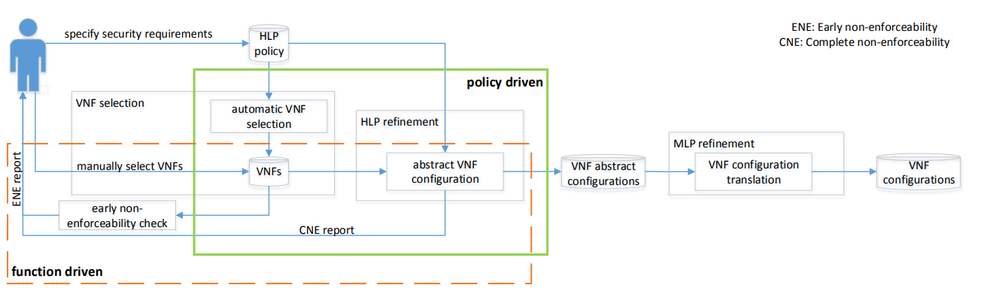
4) Integrated & Optimized Security Automation
[66] C. Basile, F. Valenza, A. Lioy, D. R. Lopez, and A. P. Perales, “Adding support for automatic enforcement of security policies in NFV networks, ” IEEE/ACM Trans. Netw., vol. 27, no. 2, pp. 707–720, 2019. DOI: 10.1109/TNET.2019.2895278

Slide 43
4) Integrated & Optimized Security Automation
Main limitations:
Higher computational complexity due to larger joint search spaces
Solutions often rely on accurate and complete network models
Automation is still mostly one-shot or event-triggered rather than continuously adaptive
Next step:
Can security configurations continuously adapt to changing network conditions, requirements, and threats?

Slide 44
The (R)evolution of Network Security Configuration Automation
Early Security Policy-Based Automation
Programmable & Virtualized Security Automation
Adaptive & Autonomous Security Automation
1997-2004
2012-2018
2023-now
2004-2012
2018-2023
2030
Formal Policy Refinement & Correction
Integrated & Optimized Security Automation

Slide 45
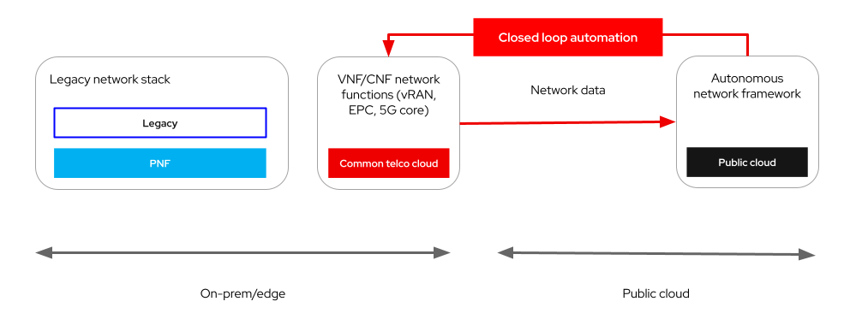
5) Adaptive & Autonomous Security Automation
Main idea:
Security automation increasingly moves to continuously adapting security decisions to changes in requirements, threats, traffic, and infrastructure.
Representative papers: [99], [102], [107], [110], [114], [116]
Key characteristics:
Security configurations are automatically reconfigured in response to network or security changes (e.g., attacks).
Automation increasingly targets distributed environments, including edge-to-cloud.
AI/ML techniques are introduced
https://www.redhat.com/en/blog/telco-autonomous-networks-choosing-the-right-cloud-and-framework

Slide 46
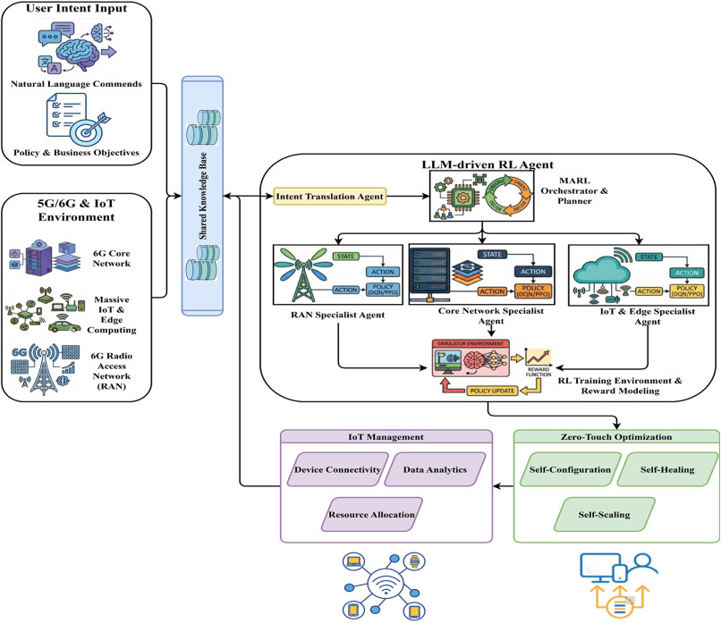
5) Adaptive & Autonomous Security Automation
[114] P. Kamarajapandian, S. Nithya, A. Syed Haroon, V. Bharathi, A. Kaliappan, and L. Meenachi, “Intent-based networking using LLM-driven agentic reinforcement learning for zero-touch 5G/6G and IoT systems,” Computer Communications, vol. 257, art. 108602, 2026. **DOI:** `10.1016/j.comcom.2026.108602`

Slide 47

Five-Dimensional Analysis of the Literature
Automation Scope
Target Environment
Security Functions
Correctness Guarantees
Objectives
Which phase of the configuration process is automated?
Does the approach operate in physical, virtual, or mixed networks?
Which NSFs are supported?
Is configuration correctness formally ensured?
Is the approach optimized?

Slide 48
Automation Scope
Distribution
Function Configuration
81
69.2%
Service Composition
23
19.7%
Joint Composition + Configuration
13
11.1%
Security Service Composition still requires investigation
  In the literature, Virtual Network Embedding (VNE) is more addressed.
Joint Composition + Configuration has been dominating the last years.

Slide 49
Target Environment
Distribution
Virtual
52
44.4%
Traditional
40
34.2%
Both
25
21.4%
Virtualized networks are the dominant class…
…but such historical transition is not a replacement of traditional networks: it is a broadening of the design space toward mixed software-controlled infrastructures.

Slide 50
Security Functions
Distribution
Firewall
31
26.5%
Generic / Multiple NSFs
30
25.6%
Embedded systems
19
16.2%
Access-control devices
12
10.3%
SDN switch
11
9.4%
VPN gateway
10
8.5%
Others
4
3.4%
Firewalls represent the most investigated NSF.
Embedded systems have seen strong growth in recent years.
Most service composition approaches are not tailored to a specific NSF.

Slide 51
Correctness Guarantees
Distribution
No formal guarantee
80
68.4%
Formal correctness assurance
37
31.6%
Automation still does not imply always assurance.
Several approaches can generate configurations, but only a subset can prove or verify that the generated configuration enforces the intended behavior.

Slide 52
Optimization Objectives
Distribution
No optimality
83
70.9%
Optimization
34
29.1%
Optimization is present in a significant minority of the corpus, but most papers do not formulate optimality as a primary goal.
Most goals are about resource consumption instead of security efficiency.

Slide 53
The (R)evolution of Network Security Configuration Automation
Early Security Policy-Based Automation
Programmable & Virtualized Security Automation
Adaptive & Autonomous Security Automation
1997-2004
2012-2018
2023-now
2004-2012
2018-2023
...and the future?
Formal Policy Refinement & Correction
Integrated & Optimized Security Automation

Slide 54
Future Challenges: Scaling Security Automation
Security automation must scale from isolated configuration tasks to large, heterogeneous, distributed security infrastructures.
Scalability of joint reasoning
  Larger service graphs and richer policies rapidly increase the search space.
Heterogeneous security functions
  Automation must reason jointly across firewalls, VPN gateways, IDS/IPS, monitors, cloud-native controls, and other middleboxes.
Multi-tenant and multi-domain enforcement
  Policies may span administrative boundaries where topology, resources, or security capabilities are only partially visible.
Integration with orchestration ecosystems
  Security configuration must be coordinated with NFV/SDN and cloud orchestrators.

Slide 55
Future Challenges: Truly Autonomous Security
Automation must evolve from one-shot configuration synthesis to trustworthy, adaptive, and human-friendly autonomous security management.
Continuous adaptation and closed-loop operations
  Configurations should be continuously revised.
Correctness under continuous reconfiguration
  Formal guarantees should survive configuration updates.
From resource optimization to security-aware optimization
  Current optimization often focuses on resource consumption; future approaches should jointly consider security effectiveness, risk, resilience, latency, and energy.
AI-assisted policy and intent management
  AI/LLMs can improve usability and support policy generation or refinement, but their decisions must remain explainable, constrained, and verifiable.

Slide 56

The VEREFOO Framework for Automated Virtual Firewall Configuration

Slide 57





The VEREFOO Core Idea
VEREFOO aims to combine Security Automation, Formal Verification, Optimization in a unified approach to simultaneously:
  define the optimal firewall allocation scheme;
  generate the optimal firewall configuration rules.
Firewall Configuration
VErified REFinement and Optimized Orchestration
Automation
Formal Verification
Optimization

Slide 58
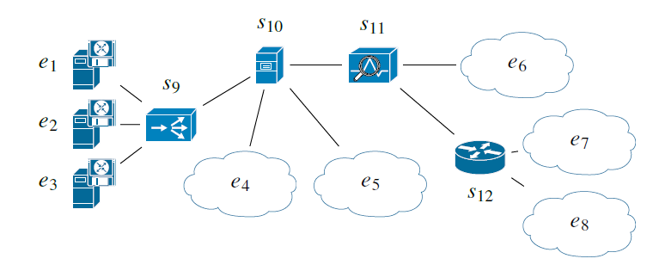
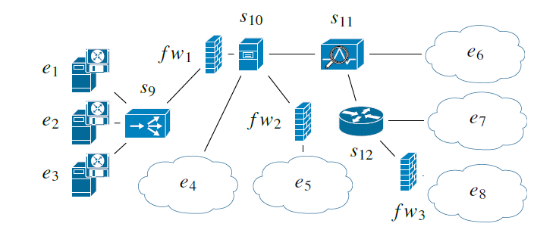

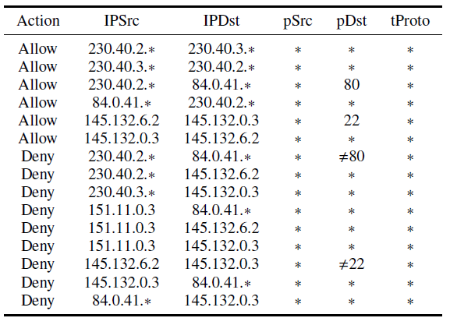
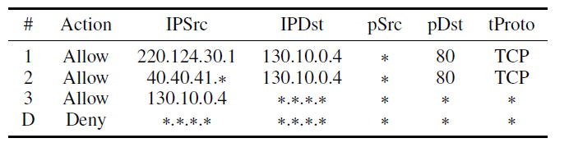

The VEREFOO Approach
Input
Output
Service Graph (SG)
Firewall Allocation Scheme
Network Security Requirements (NSRs)
Firewall Configuration Rules

Slide 59



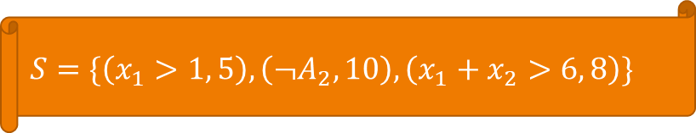




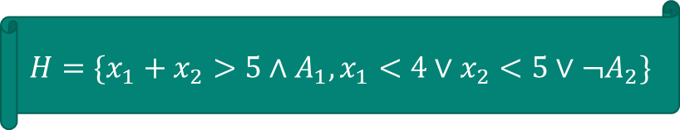












MaxSMT Problem Formulation
Partial weighted MaxSMT: an optimization-enhanced version of the Satisfiability Modulo Theories (SMT) problem.
  Partial: there are hard constraints that must be always satisfied and soft constraints that should be satisfied as far as possible.
  Weighted: find an assignment of the variables that maximizes the total weight of the satisfied soft clauses.
$$H=\{x_{1}+x_{2}>5∧A_{1}, x_{1}<4∨x_{2}<5∨{¬A}_{2}\}$$
$$S=\{\left(x_{1}>1, 5\right),\left({¬A}_{2}, 10\right),\left(x_{1}+x_{2}>6, 8\right)\}$$
$$x_{1}$$
$$x_{2}$$
$$A_{1}$$
$$A_{2}$$
sum of weights
$$2$$
$$3$$
$$true$$
$$false$$
$$15$$
$$2$$
$$4$$
$$true$$
$$true$$
$$13$$
$$2$$
$$5$$
$$true$$
$$false$$
$$23$$
…

Slide 60
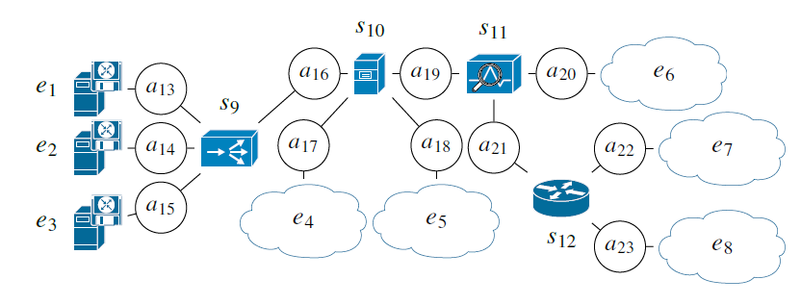
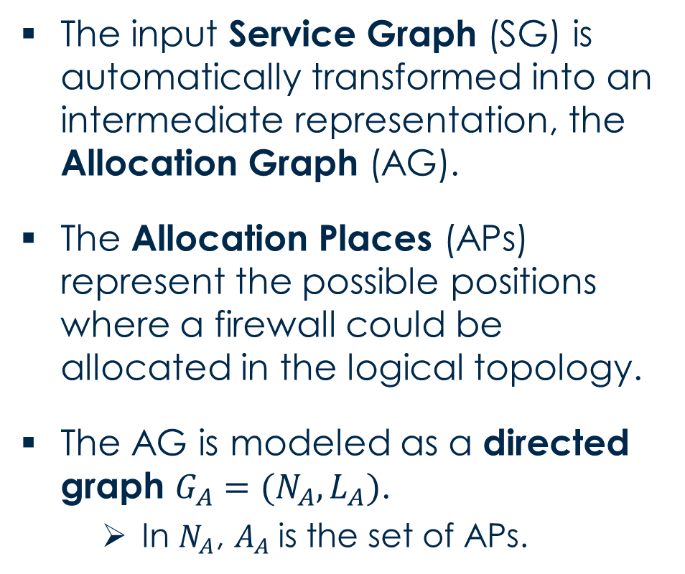
Service Graph and Allocation Graph Models
The input Service Graph (SG) is automatically transformed into an intermediate representation, the Allocation Graph (AG).
The Allocation Places (APs) represent the possible positions where a firewall could be allocated in the logical topology.
The AG is modeled as a directed graph $G_{A}=(N_{A},L_{A})$.
  In $N_{A}$, $A_{A}$is the set of APs.

Slide 61
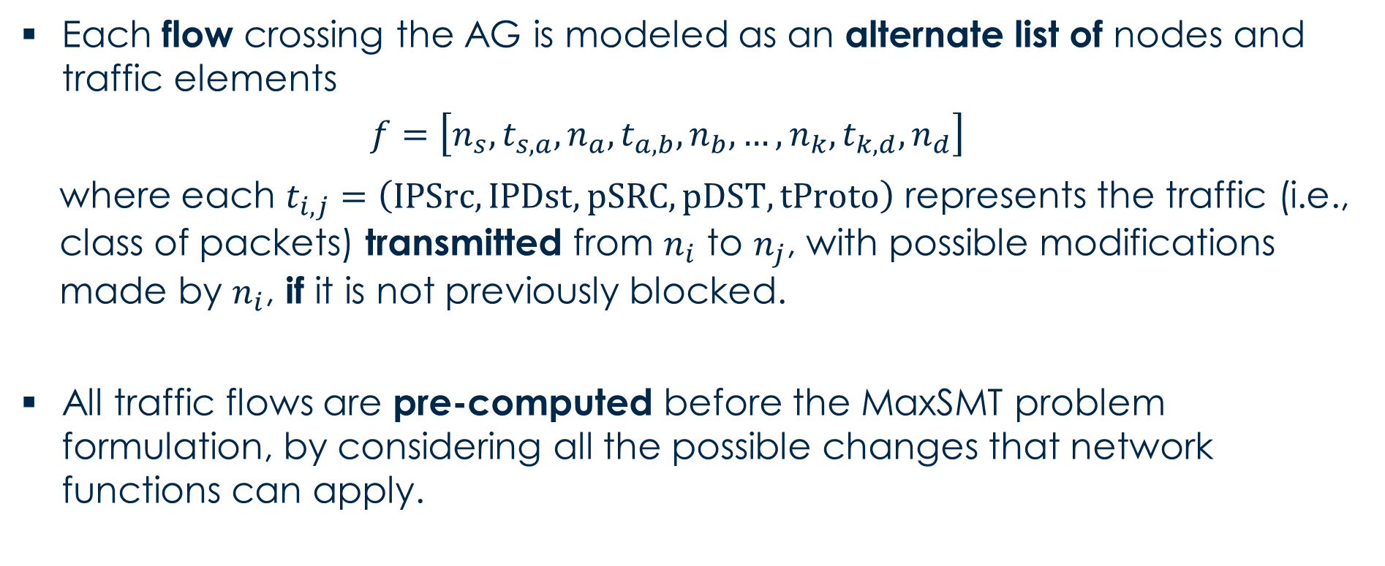
Traffic Flows Model
Each flow crossing the AG is modeled as an alternate list of nodes and traffic elements
  $$f=\left[n_{s}, t_{s,a}, n_{a},t_{a,b},n_{b},…, n_{k},t_{k,d}, n_{d}\right]$$
  where each $t_{i,j}=\left(IPSrc, IPDst, pSRC, pDST, tProto\right)$ represents the traffic (i.e., class of packets) transmitted from $n_{i}$ to $n_{j}$, with possible modifications made by $n_{i}$, if it is not previously blocked.
All traffic flows are pre-computed before the MaxSMT problem formulation, by considering all the possible changes that network functions can apply.

Slide 62
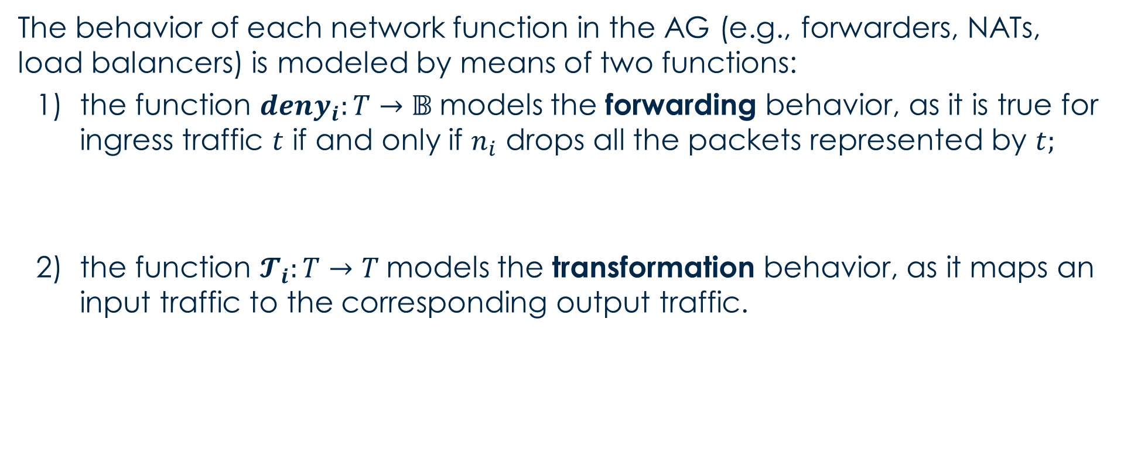
Network Function Behavior Model
The behavior of each network function in the AG (e.g., forwarders, NATs, load balancers) is modeled by means of two functions:
  the function $deny_{i}:T→𝔹$models the forwarding behavior, as it is true for ingress traffic $t$ if and only if $n_{i}$ drops all the packets represented by $t;$
  the function $𝓣_{i}:T→T$models the transformation behavior, as it maps an input traffic to the corresponding output traffic.
used for the formulation of hard constraints
used for the computation of the traffic flows

Slide 63
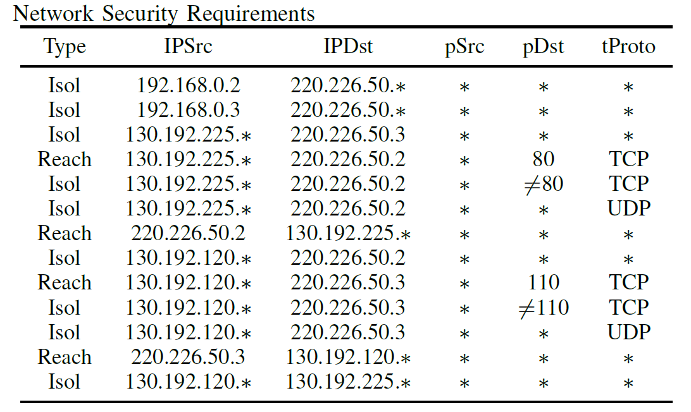
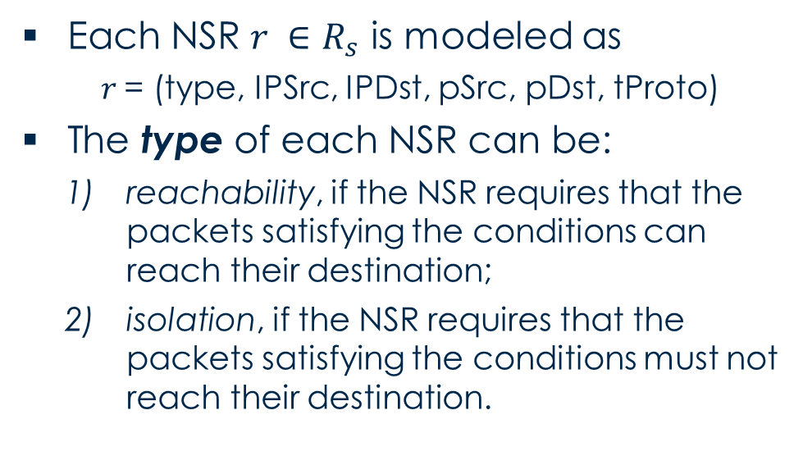
Network Security Requirements Model
The policy model is composed of a set of Network Security Requirements (NSRs), describing connectivity requirements related to specific packet classes.
Each NSR $r ∈R_{s}$ is modeled as
$r$= (type, IPSrc, IPDst, pSrc, pDst, tProto)
The type of each NSR can be:
  reachability, if the NSR requires that the packets satisfying the conditions can reach their destination;
  isolation, if the NSR requires that the packets satisfying the conditions must not reach their destination.

Slide 64
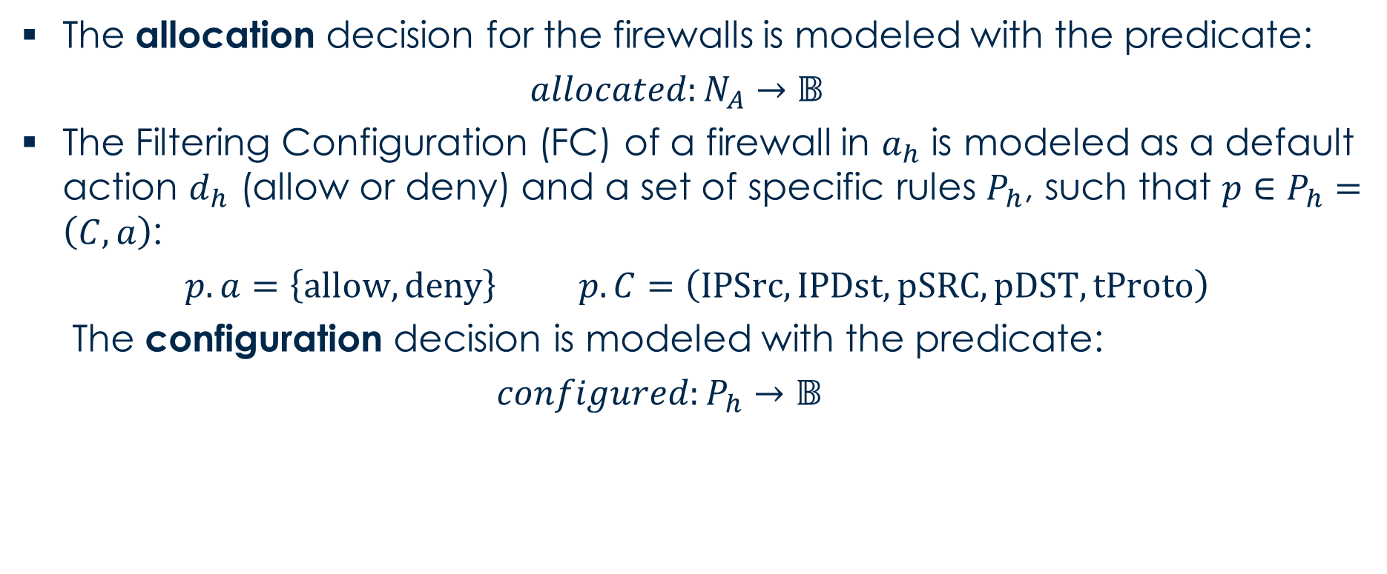
Firewall Allocation and Configuration Model
The allocation decision for the firewalls is modeled with the predicate:
  $$allocated:N_{A}→𝔹$$
The Filtering Configuration (FC) of a firewall in $a_{h}$ is modeled as a default action $d_{h}$ (allow or deny) and a set of specific rules $P_{h}$, such that $p∈P_{h}=\left(C,a\right)$:
$$p.a=\left\{allow, deny\right\} p.C=\left(IPSrc, IPDst, pSRC, pDST, tProto\right)$$
The configuration decision is modeled with the predicate:
$configured:P_{h}→𝔹$
The FC is modeled with open variables and the values of the two predicates are left free, so both will be decided by the solver when computing the solution.

Slide 65
Firewall Allocation and Configuration Model
MaxSMT Problem
Hard Constraints
Soft Constraints
Hard Constraints related to the forwarding behavior of the functions
Hard Constraints related to the enforcement of the NSRs
Soft Constraints related to the optimal firewall allocation scheme
Soft Constraints related to the optimal firewall configuration rule set

Slide 66
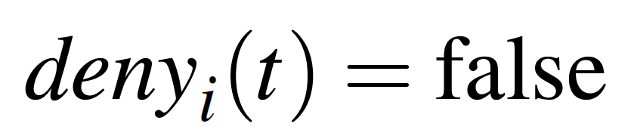
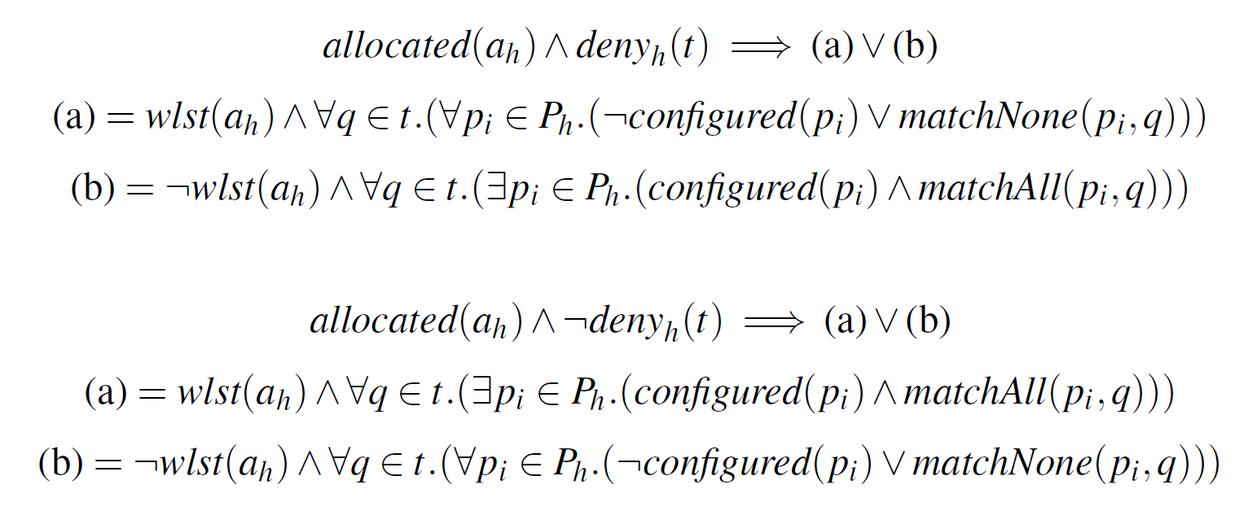
Hard Constraints: Forwarding Behavior
The hard constraints related to the forwarding behavior differ depending on the type of the specific network functions.
Examples:
Forwarder / Load Balancer
Firewall

Slide 67
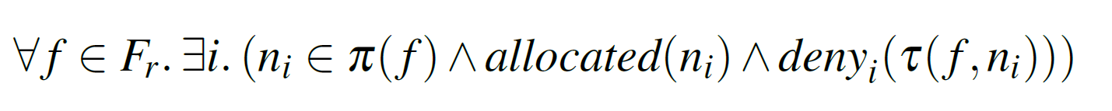
Hard Constraints: NSR Enforcement
The hard constraints related to the NSR differ depending on the NSR type.
Isolation Requirement
Reachability Requirement

Slide 68
Soft Constraints: Optimal Allocation Scheme
The first objective is to minimize the number of allocated virtual firewalls, to save:
  resources of the servers where the firewalls are deployed;
  time to deploy the virtual firewall implementations.
For each Allocation Place, a class of soft constraints is introduced:
The optimal allocation scheme does not have any allocated firewall – but, if a firewall is needed to enforce the NSRs, then it is allocated to satisfy the hard constraints.
$$∀k | a_{k}∈A_{A}. Soft(allocated\left(a_{k}\right)=false, c_{k})$$

Slide 69
Soft Constraints: Optimal Configuration Rule Set
The second objective is to minimize the number of configured rules in the allocated firewalls:
  to reduce the memory for storing the rules;
  to speed up the filtering operations.
A different class of soft constraints is needed:
The optimal configuration does not have any rules – but, if a rule is needed to enforce the NSRs, then it is configured to satisfy the hard constraints.
$$∀i | p_{i}∈P_{k}. Soft(configured\left(p_{i}\right)=false, c_{ki})$$

Slide 70
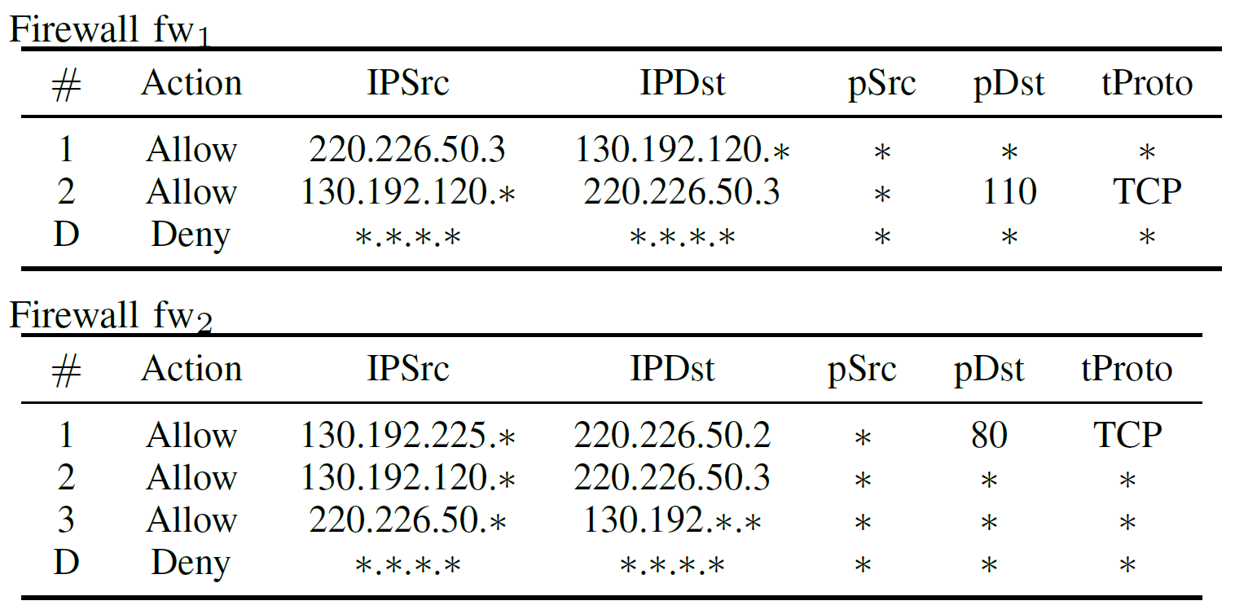
The VEREFOO Output
After receiving the hard and soft constraints, the MaxSMT solver establishes:
the firewall allocation scheme, with the minimum number of APs where a firewall is needed;
the firewall configuration rule set, with the minimum number of rules which each allocated firewall needs.

Slide 71





The VEREFOO Implementation
Main characteristics:
Java-based framework
z3 as MaxSMT solver
REST APIs and GUI for interaction
Code publicly available on GitHub:
https://github.com/netgroup-polito/verefoo
Used in multiple cybersecurity research projects:

Slide 72
VEREFOO in the MIRANDA Digital Twin

Slide 73
VEREFOO applied to NSF Reconfiguration
The original VEREFOO version is not optimized for NSF reconfiguration.
When there is the need of establishing a new NSF configuration (e.g., new policies are defined after a cyberattack):
  VEREFOO ignores any previously allocated or configured NSF;
  VEREFOO recomputes the configuration of the whole network from scratch, even if the change is just limited to a small portion.
In the context of a cyberattack, such unoptimized NSF reconfiguration:
  may be based on an excessive number of operations required to change the configuration.
  may require an excessive timing, and the delay may cause a higher window of exposure.

Slide 74
The REACT-VEREFOO Idea
REACT-VEREFOO
Fast efficient reconfiguration approach for distributed firewalls, with the goals of:
achieving a new formally assured configuration in a short computation time
satisfying a new set of Network Security Requirements (NSRs)
Main changes to VEREFOO:
  Modification of the inputs
  Algorithm to select the minimum network area that must be reconfigured, maintaining other components as static elements
  Update of the MaxSMT constraints to minimize the changes in the configuration and achieve better performance

Slide 75
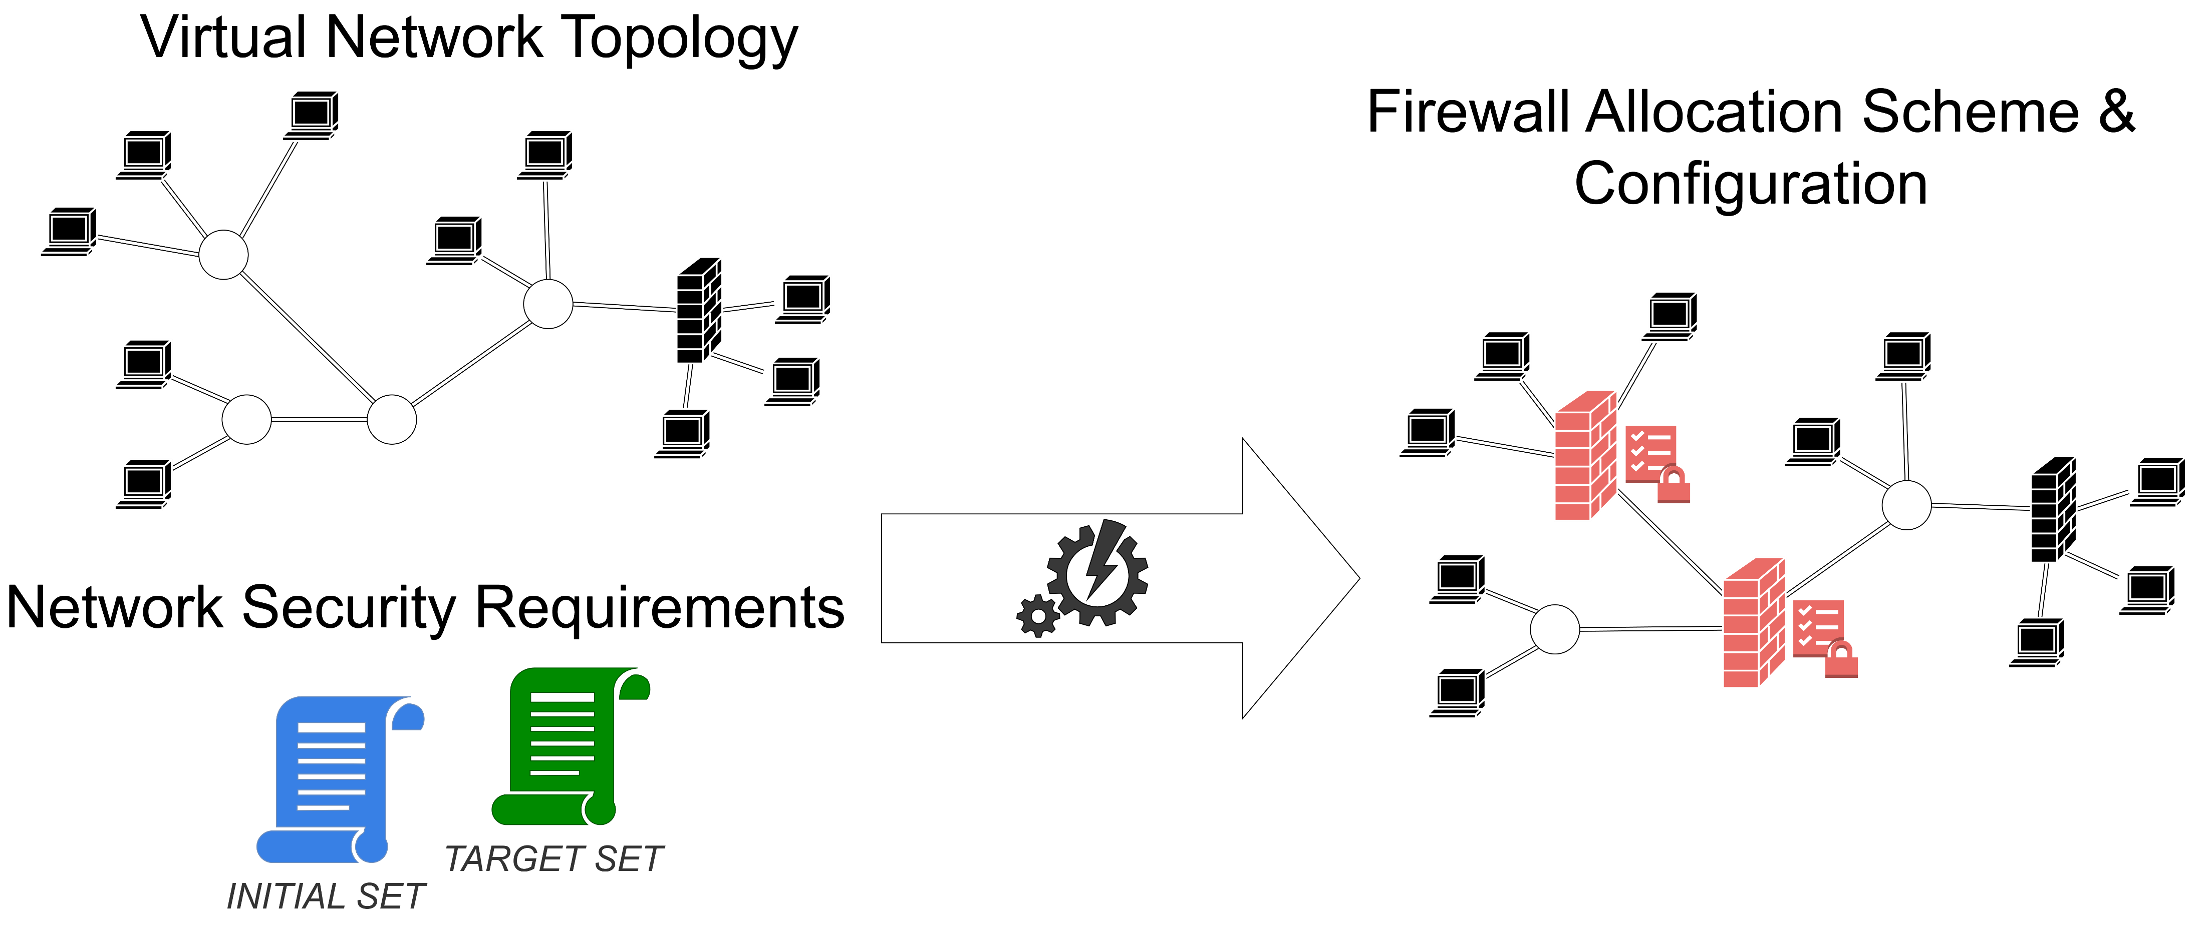
Modified Inputs for REACT-VEREFOO

Slide 76
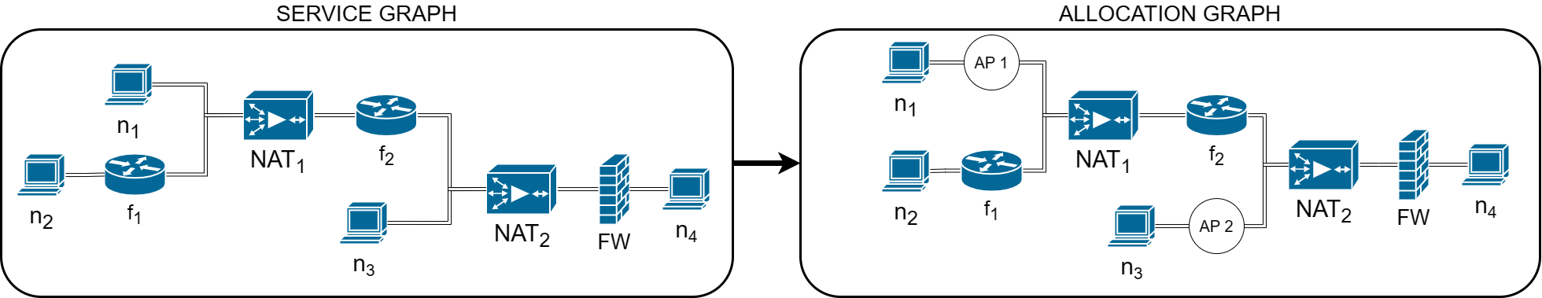
Modified Inputs: Allocation Graph
In the REACT-VEREFOO approach, the input Service Graph may already have allocated and configured firewalls.
In the generation of the Allocation Graph, an AP is not be placed besides a firewall which could be reconfigured by itself.

Slide 77
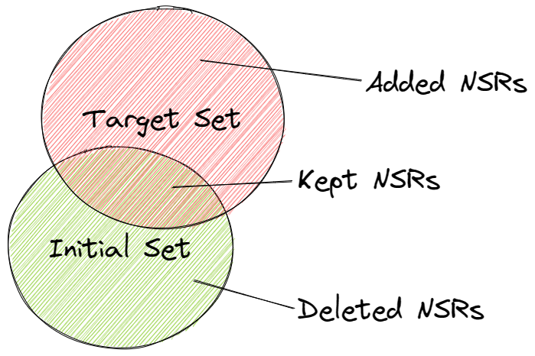
Modified Inputs: NSRs
The modified NSRs are divided into two different sets:
    Initial Set containing all the NSRs enforced in the initial partially configured virtual network topology
    Target Set containing the new NSRs which must be configured on the given virtual network topology

Slide 78
Algorithm for Area Identification
For each NSRs in the added group, we check if it is already satisfied, and if this is not the case which is the smallest set of nodes which should be selected for reconfiguration
an Isolation NSR is satisfied if all
correlated flows are blocked
nodes to be reconfigured are the ones belonging to an uninterrupted traffic flow
a Reachability NSR is satisfied if there is at least one flow which is not blocked from source to destination
nodes to be reconfigured are the ones blocking any of the flows

Slide 79
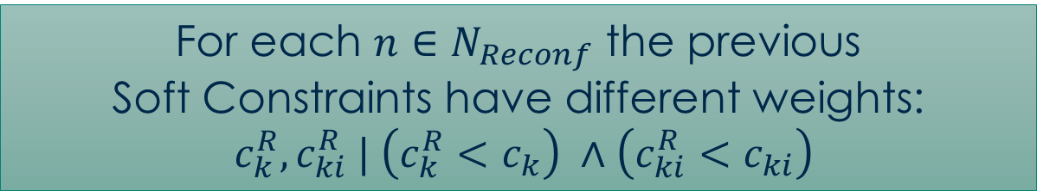
Update of the Soft Constraints
Only for the selected nodes the constraints for allocation and configuration are included in the MaxSMT problem.
The soft constraints have been updated to prefer an already allocated firewall or configured rule instead of deploying a new one:
  the optimal reconfiguration is the one that does not require any update to the network, thus causing the lowest possible delay.
$$∀k | a_{k}∈A_{A}. Soft\left(allocated\left(a_{k}\right)=false, c_{k}\right)$$
$$∀i | p_{i}∈P_{k}. Soft\left(configured\left(p_{i}\right)=false, c_{ki}\right)$$
For each $n∈N_{Reconf}$ the previous
Soft Constraints have different weights:
$c_{k}^{R}, c_{ki}^{R} | \left(c_{k}^{R}<c_{k}\right) ∧\left(c_{ki}^{R}<c_{ki}\right)$

Slide 80
Thanks for your attention!
Daniele Bringhenti, Francesco Pizzato
<{daniele.bringhenti,francesco.pizzato}@polito.it>

