Slide 1



BITCOIN PRICE PREDICTION &
ALGORITHMIC TRADING SOLUTION
BitEstimators:
Muthukumaran Samiayyan (e0994676)
Varun Sharma (e0997897)
Samin Batra (e0997888)
Prasanna Govindarajan (e0997955)
Bhavyasree Bhuvanagiri (e0998060)
Nandhini Selvaganapathy (e0997933)

Slide 2

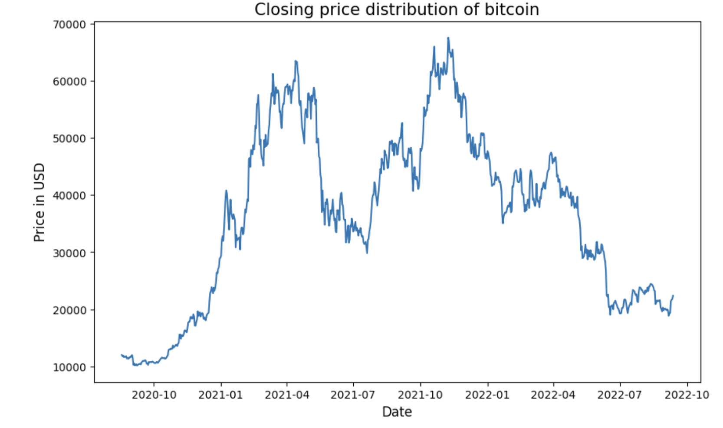
CONTENTS
OVERVIEW
METHODOLOGY
IMPLEMENTATION
ARIMAX
LONG SHORT-TERM MEMORY (LSTM)
XGBoost
COMPARISON OF MODELS
ALGORITHMIC TRADING SOLUTION
CONCLUSION
REFERENCES
BTC Price Volatility

Slide 3
OVERVIEW
OBJECTIVE:
To predict the price of bitcoin (‘BTC’) with the aid of features that are likely to influence it’s price
Application of the prediction results in algorithmic trading solution
METHODOLOGY:
Collection of Data
Feature Engineering
Build the Model
Train and Validate
Final Model for Prediction

Slide 4


Data Collection
Historical BTC Price
S&P 500 Index
VIX (Volatility) Index
MSCI World ETF Index
Features Explored
Gold
Crude Oil
EUR-USD, CNY-USD, JPY-USD
SUBJECTIVITY
SENTIMENT ANALYSIS
POLARITY
Dataset considered for the period between
18-Aug’20 – 12-Sep’22
Historical BTC Price
MSCI World ETF Index
S&P 500 Index
Features Considered
VIX (Volatility) Index
CNY-USD
SENTIMENT ANALYSIS
POLARITY

Slide 5
Feature Engineering
TICKER DATA PRE-PROCESSING
TWEETS PRE-PROCESSING
Missing Values
Filtering twitter accounts to get tweets on bitcoin from influential individuals
Feature Scaling *
Cleaning tweets to replace hashtags, links and emojis
Analyze subjectivity and polarity and classify them into positive, negative and neutral
Feature Selection ^
* Log transform, Min Max Scaling
^ Feature selection based on Arima model

Slide 6
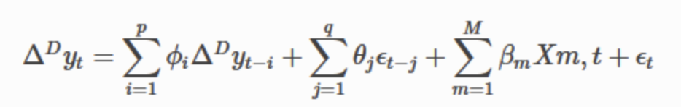
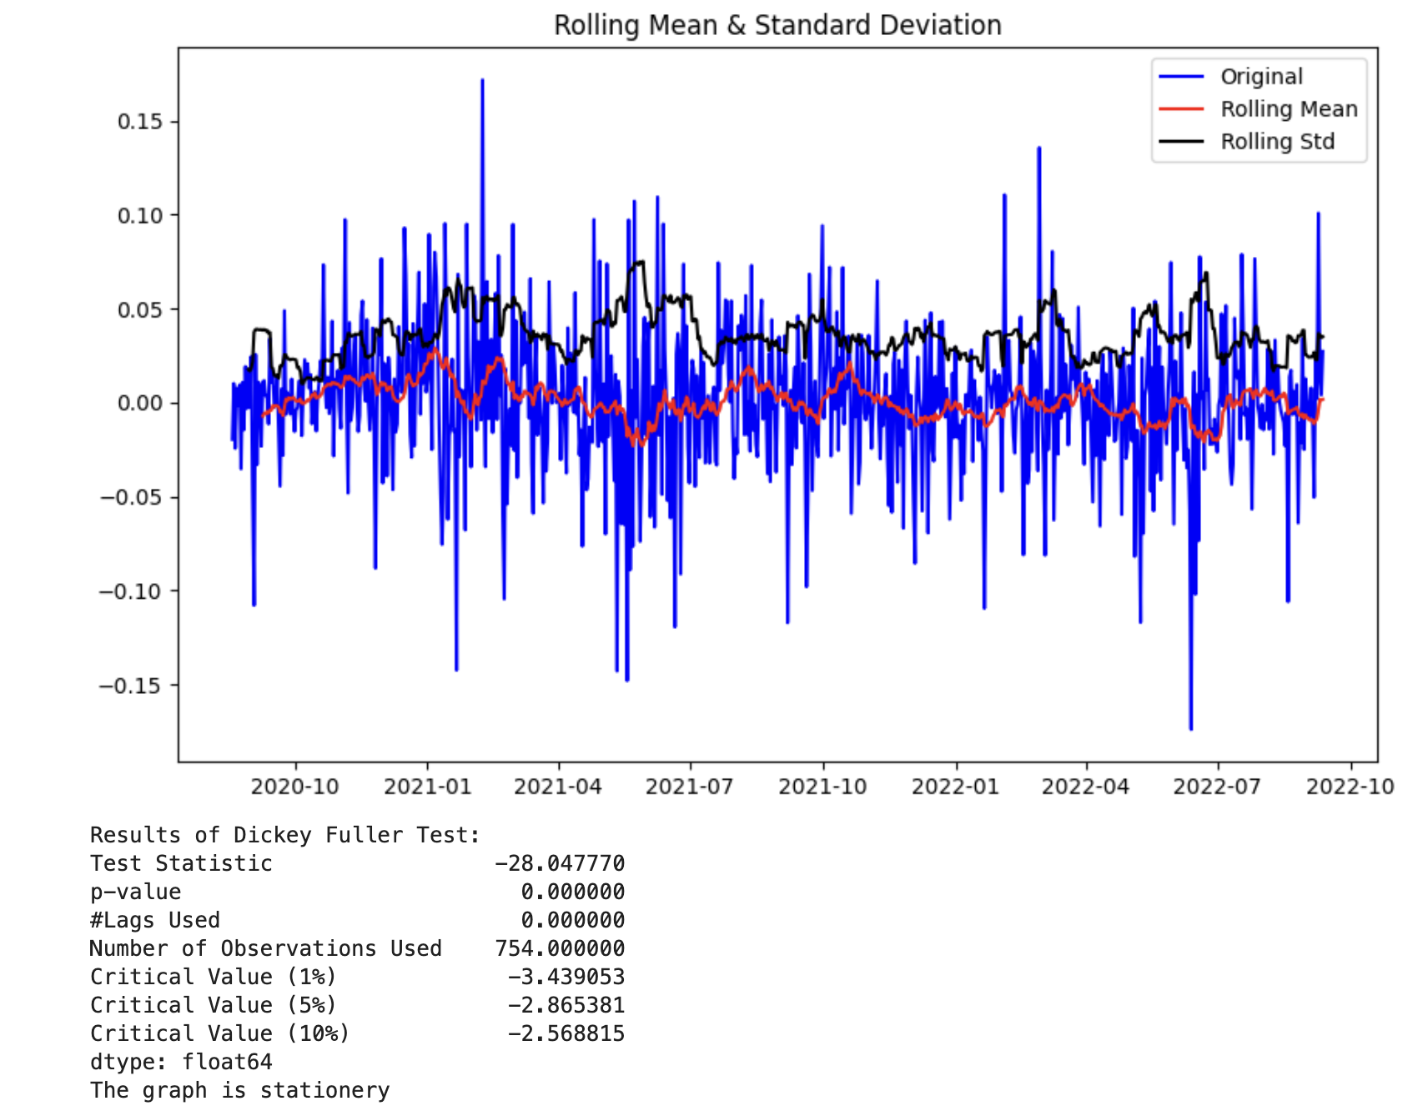
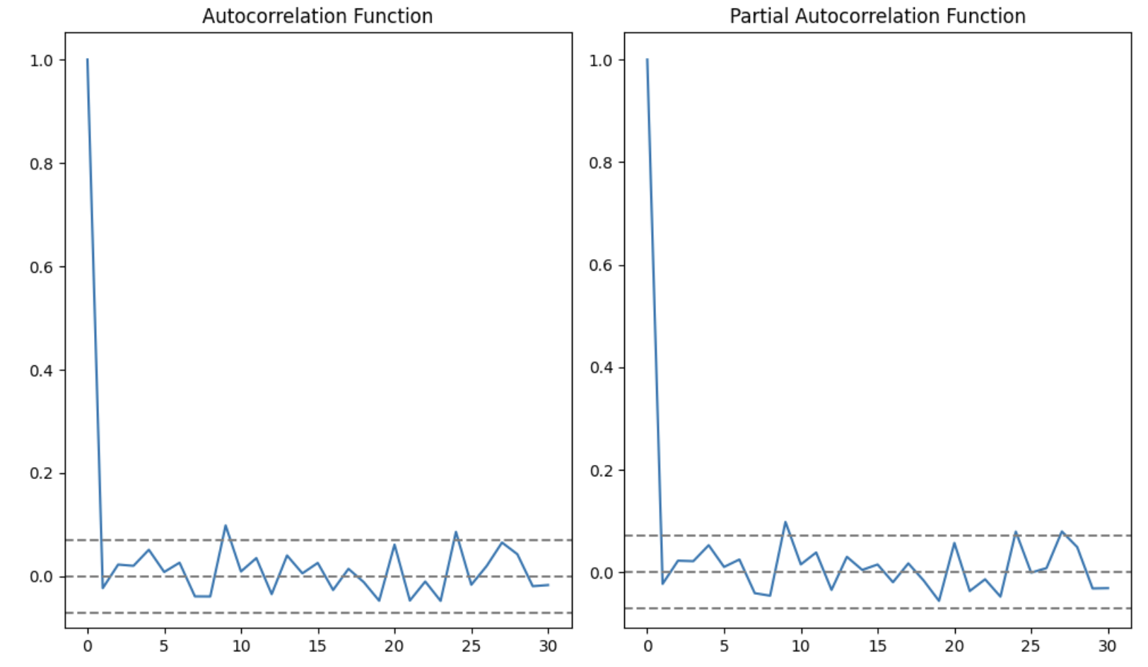
MODEL IMPLEMENTATION - ARIMAX
ARIMAX
Class of models that explains a given time series based on:
Its own lags (p)
Its own forecasted errors (q)
Input to establish the differences of the input needed to obtain stationarity (d)
It also includes time series of exogenous variables used to predict (X)
Stationarity Test
Arima model requires the time series data to be stationary
Utilizing the Augmented Dickey Fuller (ADF) test, Log Differences of the time series input (Bitcoin closing price) was established to have stationarity
Estimations of p, d & q
Log differences makes the time series stationary
d = 1
Based on the partial Autocorrelation Function (PACF)
p=2
Based on Autocorrelation Function
q=2

Slide 7
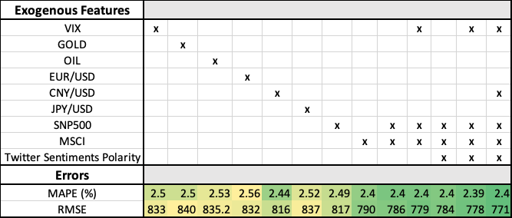
MODEL IMPLEMENTATION - ARIMAX
Feature Selection
Exogenous Features with the lowest error:
Log Open of SNP500
Log Open of MSCI
Log Open of VIX
Log Open of CNY/USD
Twitter Sentiments – Polarity
These features were used for alternative models for comparison
Training And Validation
Last 100 days used as validation set
Train Model
Move actual data for the day to training set
Predict for 1 day
Calculate error

Slide 8
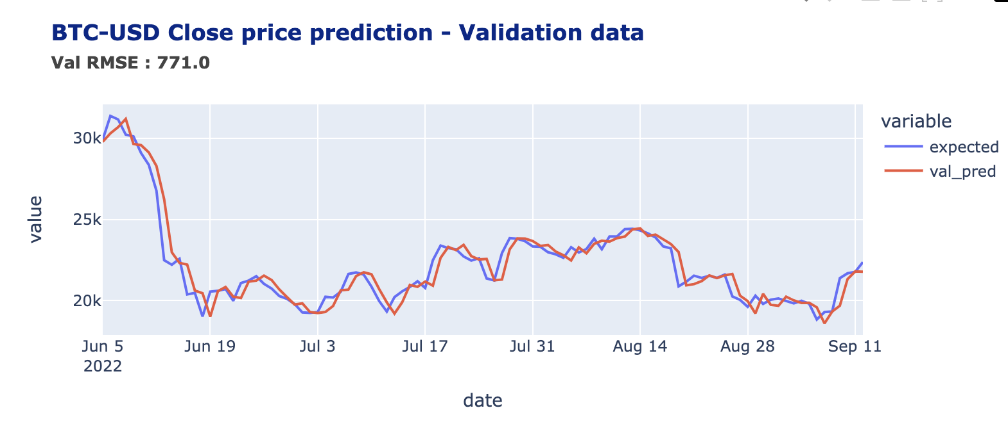
MODEL IMPLEMENTATION - ARIMAX
Expected vs. Predicted Views Forecast:

Slide 9
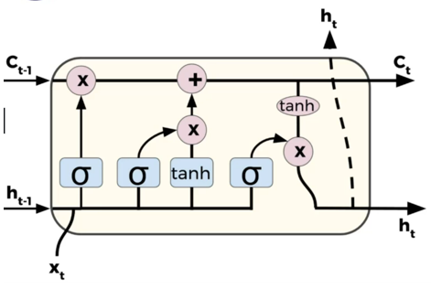
MODEL IMPLEMENTATION – Long Short-Term Memory (LSTM)
Inputs:
X_{t,} input features
h_{t-1,} output of previous timestep
C_{t-1,} cell state of previous timestep
Output:
h_{t}, output of current timestep
C_{t,} cell state of current timestep
Feature engineering done to create more features from the input features using lag of 3 days.
Single LSTM Cell

Slide 10
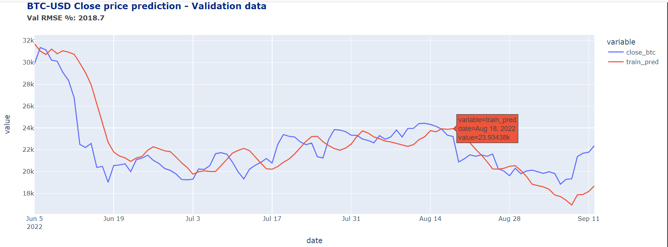
Model Implementation - LSTM (Contd.)
Features Used | Time Frame | Hidden Layers | Epochs | Dropout | TimeStep Lag | Validation window
MSCI Index, VIX (Volatility) Index, S&P 500 Index, Chinese Yuan, Tweets Sentiments Polarity | Daily | 4 | 45 | ~20% | 3 days | Last 100 days (JUN-SEPT 2022)
Expected vs. Predicted Views Forecasting

Slide 11
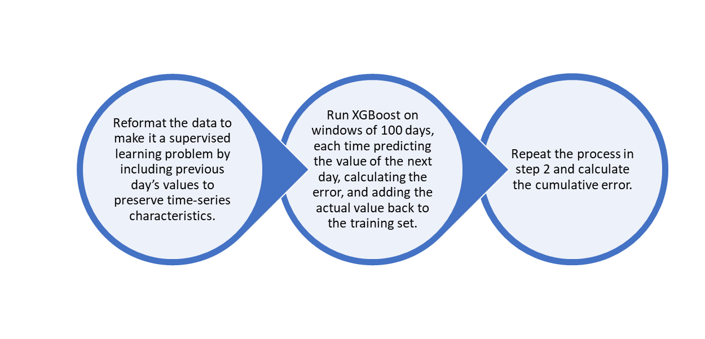
MODEL IMPLEMENTATION - XGBoost
eXtreme Gradient Boosting (XGBoost) is one of the most popular ML algorithms for structured and tabular data.
implementation of gradient boosted decision trees designed for speed and performance
Suitable for ML problems, but can be adapted for time series

Slide 12
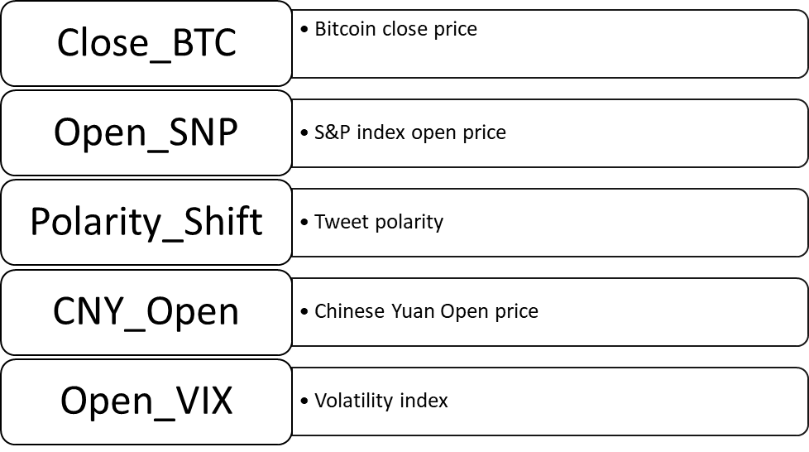
XGBoost - Features Used

Slide 13
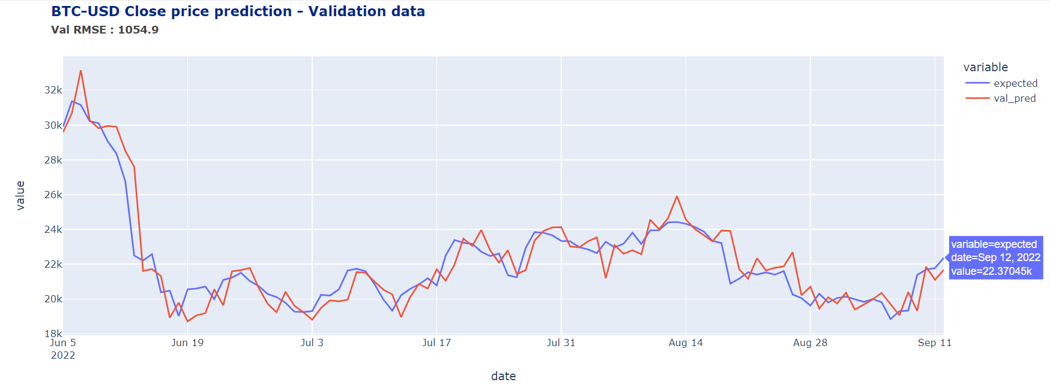
XGBoost (Contd.)
Expected vs. Predicted Views Forecasting

Slide 14
Comparison of Models
ARIMAX
(RMSE: 771)
XGBoost
(RMSE: 1055)
LSTM
(RMSE: 2019 )

Slide 15
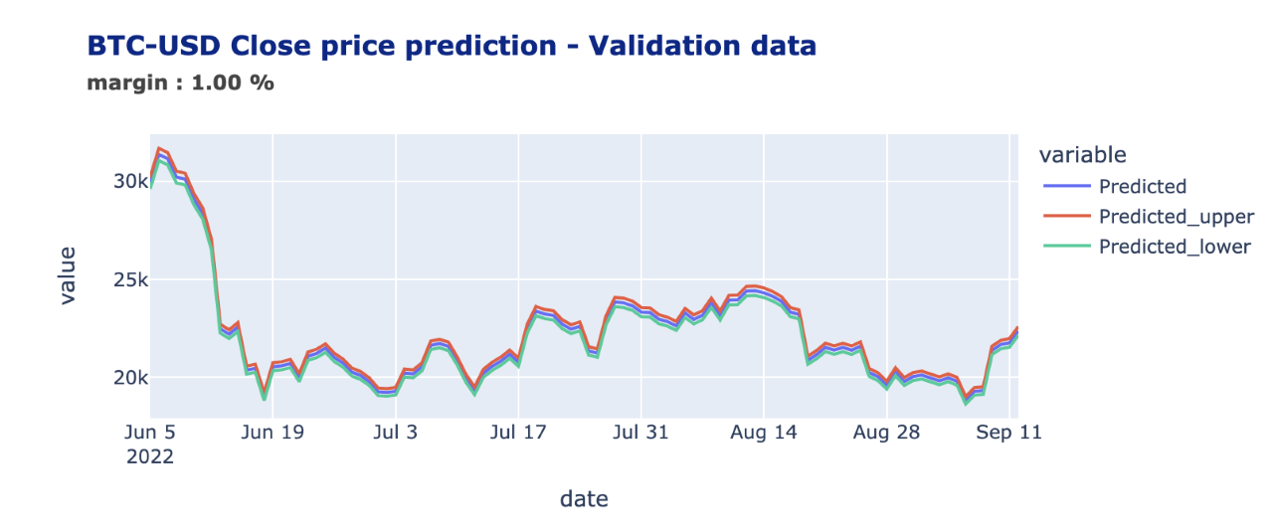
ALGORITHMIC TRADING SOLUTION
3 Different Trading strategies analyzed for comparison:
Trading strategy based on model prediction :
Day trade at the start of the day based on opening price
Long position(buy) if opening price < predicted closing price
Short position(sell) if opening price > predicted closing price
Buy & Hold :
Long position regardless of opening price and hold everyday
Random Trading :
Randomly assign short or long positions everyday
Based on the model trading strategy, less risky positions also analyzed:
m – margin(%) to depict upper bound and lower bound of predicted price
Long position(buy) if opening price < lower bound of predicted price
Short position(sell) if opening price > upper bound of predicted price

Slide 16
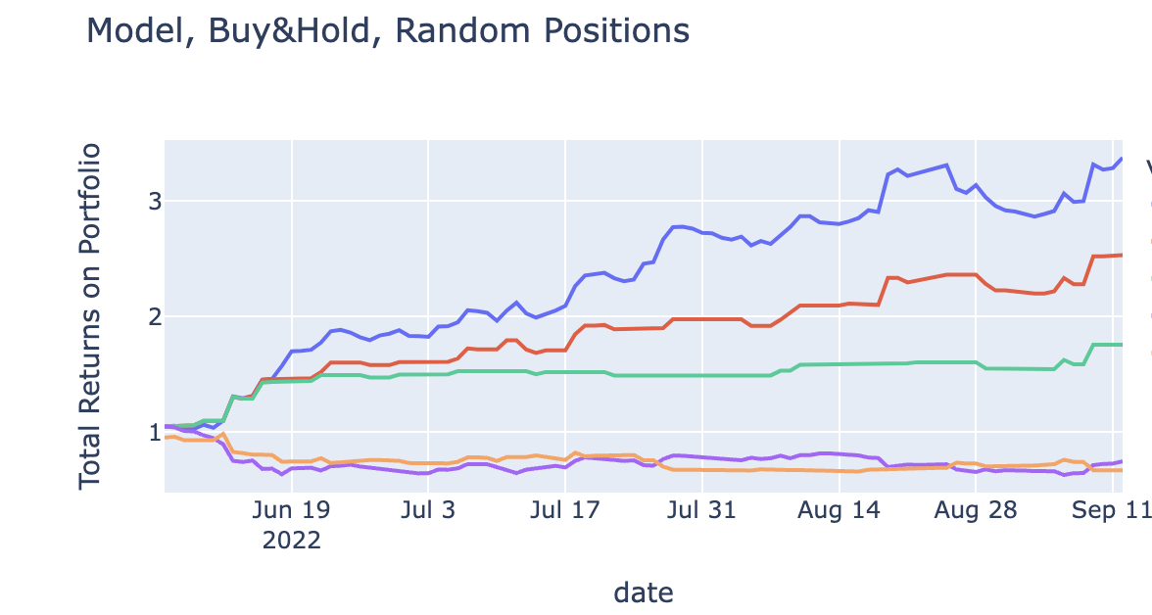
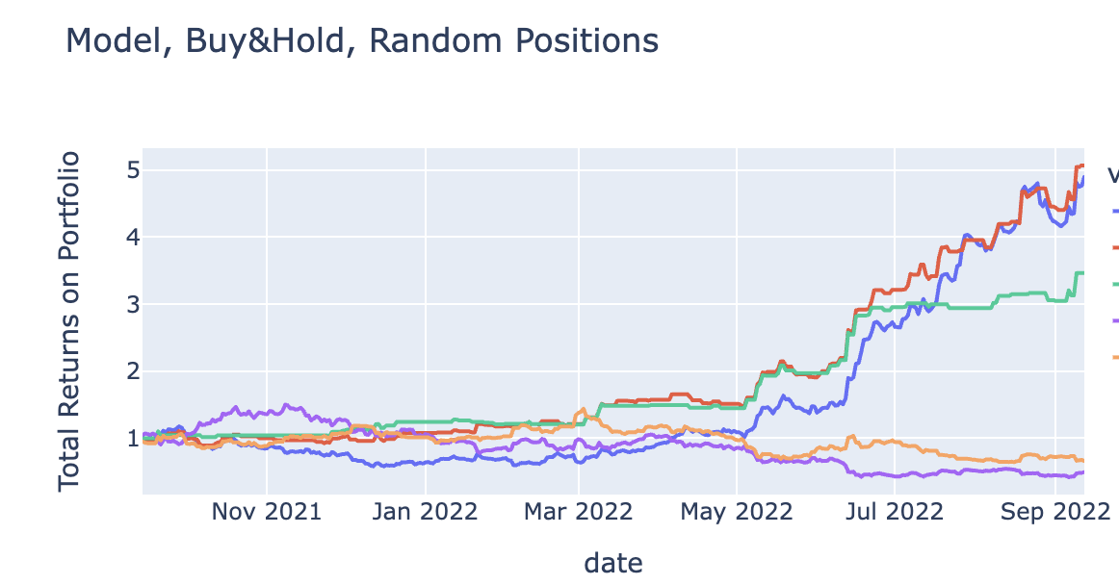
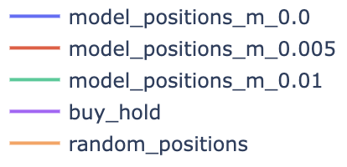
ALGORITHMIC TRADING STRATEGY
Back testing of trading strategy
Last 100 days:
Model trading strategy obtain best returns : ~200%
Last 365 Days
Model trading strategy obtain best returns : ~400%
Model trading strategy does not give good returns during high volatile period of bitcoin price as the prediction of the model is not robust enough during these periods – trading positions with margin gives better returns

Slide 17
CONCLUSION
Out of the 3 models that were analyzed, ARIMAX resulted in the lowest RMSE followed by XGBoost and LSTM
Based on algorithmic trading solution, ARIMAX model is still unable to predict robustly during the high volatility periods of BTC price movement
Potential improvements include
Exploring more features that has a potential to influence BTC price
Re-evaluating feature engineering strategy
Considering larger tweet feed / re-tweets and likes for improving sentiment analysis
Hyper-parameter tuning of models
Collecting more historical data
Exploring other models

Slide 18
REFERENCES
http://jips-k.org/digital-library/manuscript/file/23030/JIPS-2019-15-3-694.pdf
https://www.mdpi.com/1999-4893/15/7/230/pdf
https://www.kaggle.com/code/akashmathur2212/bitcoin-price-prediction-arima-xgboost-lstm-fbprop
http://colah.github.io/posts/2015-08-Understanding-LSTMs/
https://money.usnews.com/investing/articles/the-history-of-bitcoin
https://medium.com/analytics-vidhya/how-well-can-machine-learning-models-predict-the-price-of-bitcoin-f036fdecdc03
https://machinelearningmastery.com/gentle-introduction-xgboost-applied-machine-learning/
https://towardsdatascience.com/bitcoin-price-prediction-using-time-series-forecasting-9f468f7174d3
https://www.kaggle.com/code/someadityamandal/bitcoin-time-series-forecasting/notebook
https://medium.com/geekculture/what-happens-if-you-day-trade-crypto-with-facebook-prophet-84df66c31657
https://lucaslouca.com/Why-Use-Logarithmic-Returns-In-Time-Series-Modelling/
https://link.medium.com/t5nLO1zXVtb

