Slide 1
Music Moderation
04-03-22

Slide 2
Agenda
Alternative approaches
Experiments
Beat matching
Multimodal embedding space
Sheet MIDI retrieval
Future Roadmap

Slide 3
Alternative approaches
Beat matching among MIDI files
Directly matching sheet music images and audio, with deep neural networks
Projecting the MIDI data into pixel space (bootleg score) and performing alignment in the image domain

Slide 4
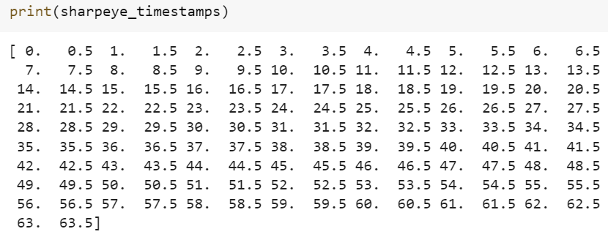
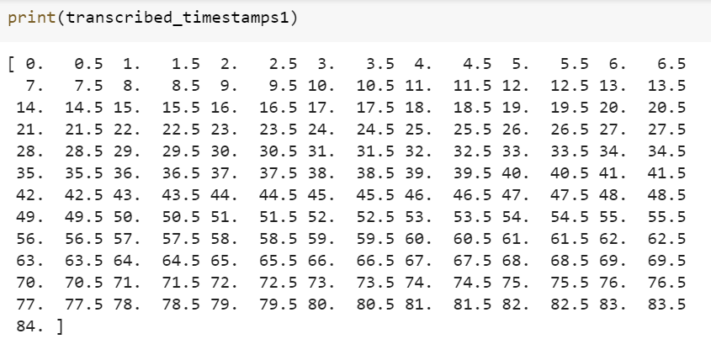
Beat matching of MIDI files
Comparing two MIDI files transcribed via Sharpeye and MT3 transformer
Returned a list of beat locations by using the MIDI tempo change events
Got varying accuracy of 7% to 93% and mean accuracy of 44% for 47 Flowkey songs
Notes:
by using pretty_midi library function get_beats().

Slide 5
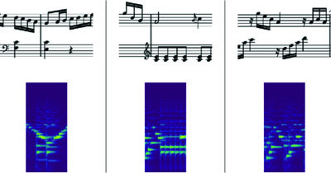
Multimodal embedding space
Matches audio directly to sheet music
Applies the embedding networks to:
Sheet music by detecting staff systems in the sheet image
Audio files by computing a spectrogram from the audio file
Dataset audio and sheet music is aligned
Notes:
88% accuracy, uses multimodal CNN

Slide 6

Multimodal embedding space
Notes:
88% accuracy, uses multimodal CNN

Slide 7
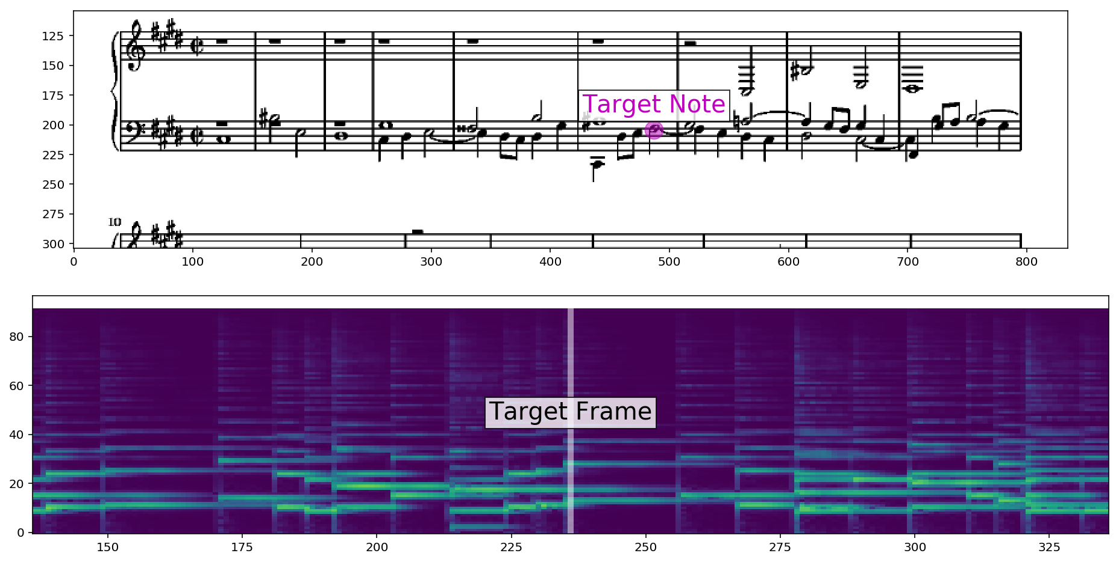
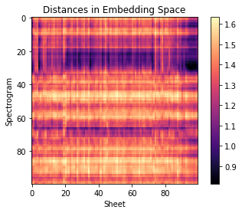
Multimodal embedding space
Ran for a song ‘JingleBellsAdvance’ song from flowkey dataset
Got the sheet and spectrogram in common embedding space
Goal is to project back to spectrogram and sheet music
End Goal

Slide 8
Sheet MIDI Retrieval
Converts multiple sheet music images and MIDI into a “bootleg score”
Uses OpenCV blob detection to detect note heads
87% accuracy on annotated dataset

Slide 9
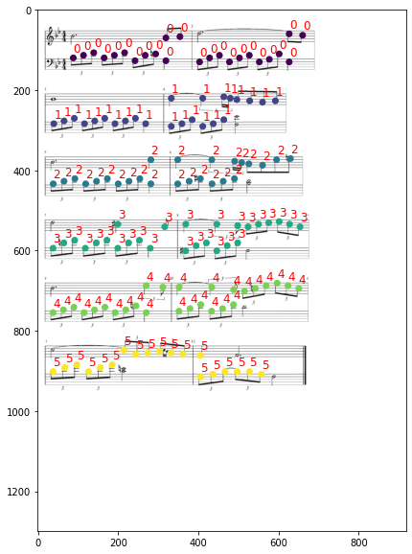
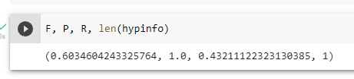
Sheet MIDI Retrieval
Testing with a Flowkey intermediate song and corresponding MIDI output from transformer resulted in a 60% accuracy

Slide 10
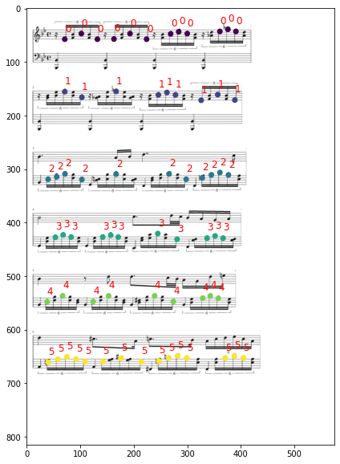

Sheet MIDI Retrieval
Testing with a Flowkey advanced song and corresponding MIDI output from transformer resulted in a 10% accuracy

Slide 11
Roadmap Further
Create a simplified bootleg approach to compare note sequence that can be tested with the whole flowkey dataset
Explore multimodal embedding space to see if stated accuracy can be achieved with Flowkey dataset

