Slide 1

נדב רותם

Slide 2

Family

Slide 3
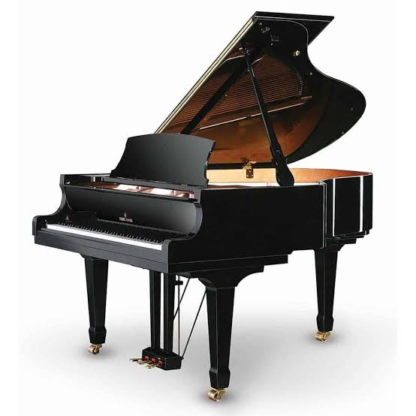


I have one brother and one sister
NEXT
SHOW

Slide 4

my brother name is itay
my sister name is shachar
my mom name is inbal
and my father name is ido
NEXT
SHOW

Slide 5
Hobbies

Slide 6

i like to play minecraft read books
and eat
NEXT
SHOW

Slide 7

i like to make youtubes videos on my youtube channel
NEXT
SHOW

Slide 8
Places

Slide 9
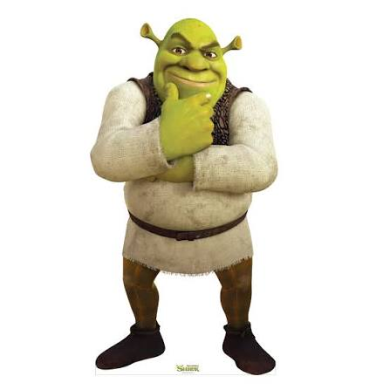
i live in yokneam
NEXT
SHOW

Slide 10
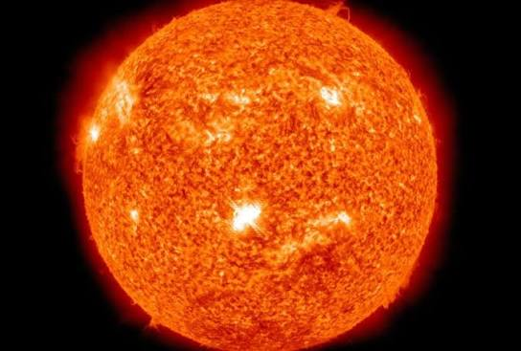
i live in earth
NEXT
SHOW

Slide 11
Favorite Things

Slide 12

food
NEXT
SHOW

Slide 13

win
NEXT
SHOW

Slide 14
My Room

Slide 15

My room is next to the room that is close to my room.
NEXT
SHOW

Slide 16

Sometimes I sleep in my room.
NEXT
SHOW

Slide 17
Myself

Slide 18
my name is nadav rotem
NEXT
SHOW

