Slide 1
IT3011 — THEORY AND PRACTICES IN STATISTICAL MODELLING — STATX
"Employees Who Receive Regular
Feedback Perform Better Than
Those Who Do Not"
IT23698536 - WEERASINGHE N.H
IT23686410 - SENEVIRATHNE D.V.S
IT23703094 - DE SILVA W.H.P.P
IT23702622 - G.HARAN AKASH
Datasets: Employee.csv + PerformanceRating.csv | Significance level: alpha = 0.05

Slide 2
Problem Statement
What we are investigating and why it matters
"Employees who receive regular feedback perform better than those who do not"
Why This Matters
Hypotheses
Performance is a key business outcome in any organisation
If proven, organisations can invest in structured feedback programmes
This study tests a widely held workplace assumption using real data
H0: No significant difference in exists between the two groups. H1: Regular feedback group has significantly higher performance. Significance level: alpha = 0.05

Slide 3
Objectives
What this assignment sets out to achieve
Data Collection
Inferential Analytics
01
05
Collect and merge two secondary datasets using R
Run 4 statistical tests to test the hypothesis
Preprocessing
Predictive Analytics
02
06
Clean data, check missing values, engineer variables
Build regression models to predict performance
Descriptive Analytics
Final Decision
03
07
Summarise and compare performance across feedback groups
Justify conclusion based on statistical evidence
Time Series
04
Track performance trends over 10 years of review data

Slide 4
Data Collection
Secondary datasets provided for the module
Dataset 1 — Employee.csv
Dataset 2 — PerformanceRating.csv
1,470 employee records | 23 variables
Key variables: EmployeeID, Department,
JobRole, Age, Salary, YearsAtCompany, Attrition
6,709 review records | 11 variables
Key variables: EmployeeID, ManagerRating,SelfRating,
TrainingOpportunitiesWithinYear,TrainingOpportunitiesTaken,
ReviewDate
Why two datasets?
Because employee personal information and performance review information were stored separately. Each employee can have multiple reviews that is why PerformanceRating has more rows than Employee.
How did you merge them?
Using inner_join() on EmployeeID — the common column in both files. Inner join keeps only rows where EmployeeID exists in BOTH datasets. Result was 6,709 rows.
Key Variables Selected
Independent Variable (IV): TrainingOpportunitiesWithinYear - proxy for regular feedback Dependent Variable (DV): ManagerRating (scale 2-5) - measure of performance

Slide 5
Data Cleaning
Secondary datasets provided for the module
Removed duplicate records using distinct()
Handled missing values:
Numeric variables → Median imputation
Categorical variables → Mode imputation
Validated data ranges (Ratings kept between 1-5)
Standardized text fields using trimming functions (trimws)
Ensured dataset consistency before analysis
Outcome:
No missing values remain after cleaning
Data is consistent and suitable for statistical modelling
Improved reliability of inferential and predictive analysis
Key Steps:

Slide 6
Data Preprocessing
Merging, cleaning, and preparing data for analysis in R
1
Merge Datasets
inner_join() on EmployeeID - combines both files into 6,709 rows with all variables
2
Missing Value Check
is.na() on all key columns - result: 0 missing values found in every column
3
Feature Engineering
FeedbackGroup: sessions >= 2 = Regular Feedback, 1 = No Regular Feedback
HighPerformer: ManagerRating >= 4 = High, below 4 = Low
4
Date Conversion
ReviewDate converted to proper date format. Year extracted for time series analysis (2013-2022)
5
Normality Check
Histogram + Q-Q plot confirmed ManagerRating is approximately normal - validates use of t-test

Slide 7
Data Preprocessing
Merging, cleaning, and preparing data for analysis in R
Feature Engineering
What is feature engineering?
Creating new variables from existing data to improve analysis
New variables created:
FeedbackGroup (Proxy for feedback frequency)
TrainingOpportunitiesWithinYear ≥ 2 → Regular Feedback
TrainingOpportunitiesWithinYear < 2 → No Regular Feedback
Reason: No direct feedback variable exists in dataset
2. HighPerformer
ManagerRating ≥ 4 → High Performer
ManagerRating < 4 → Low Performer
Reason: Needed binary variable for chi-square and logistic regression
Proxy Variable Concept
What is a proxy variable?
An indirect measure used when the real variable is not available
In this study:
Feedback quality is NOT directly recorded
So we used: → TrainingOpportunitiesWithinYear as a proxy for feedback frequency
Limitation:
This is not a perfect measure of feedback quality
It may not fully reflect actual managerial feedback

Slide 8
Descriptive Analysis
Summarising and comparing performance across feedback groups
Mean — No Feedback
Mean — Regular Feedback
Mean Difference
High Perf (both groups)
3.485
3.468
0.017
~49%
Group Statistics
Time Series (2013-2022)
Group
n
Mean
SD
High %
Review data spans 10 years - 6,709 records
Both group lines cross 6 times over 10 years
No consistent advantage for either group
In 2015: No Feedback (3.623) scored HIGHER than Regular Feedback (3.502)
Both groups track around the overall mean of 3.473
No Regular Feedback
2,214
3.485
0.942
50.45%
Regular Feedback
4,495
3.468
0.971
48.50%

Slide 9
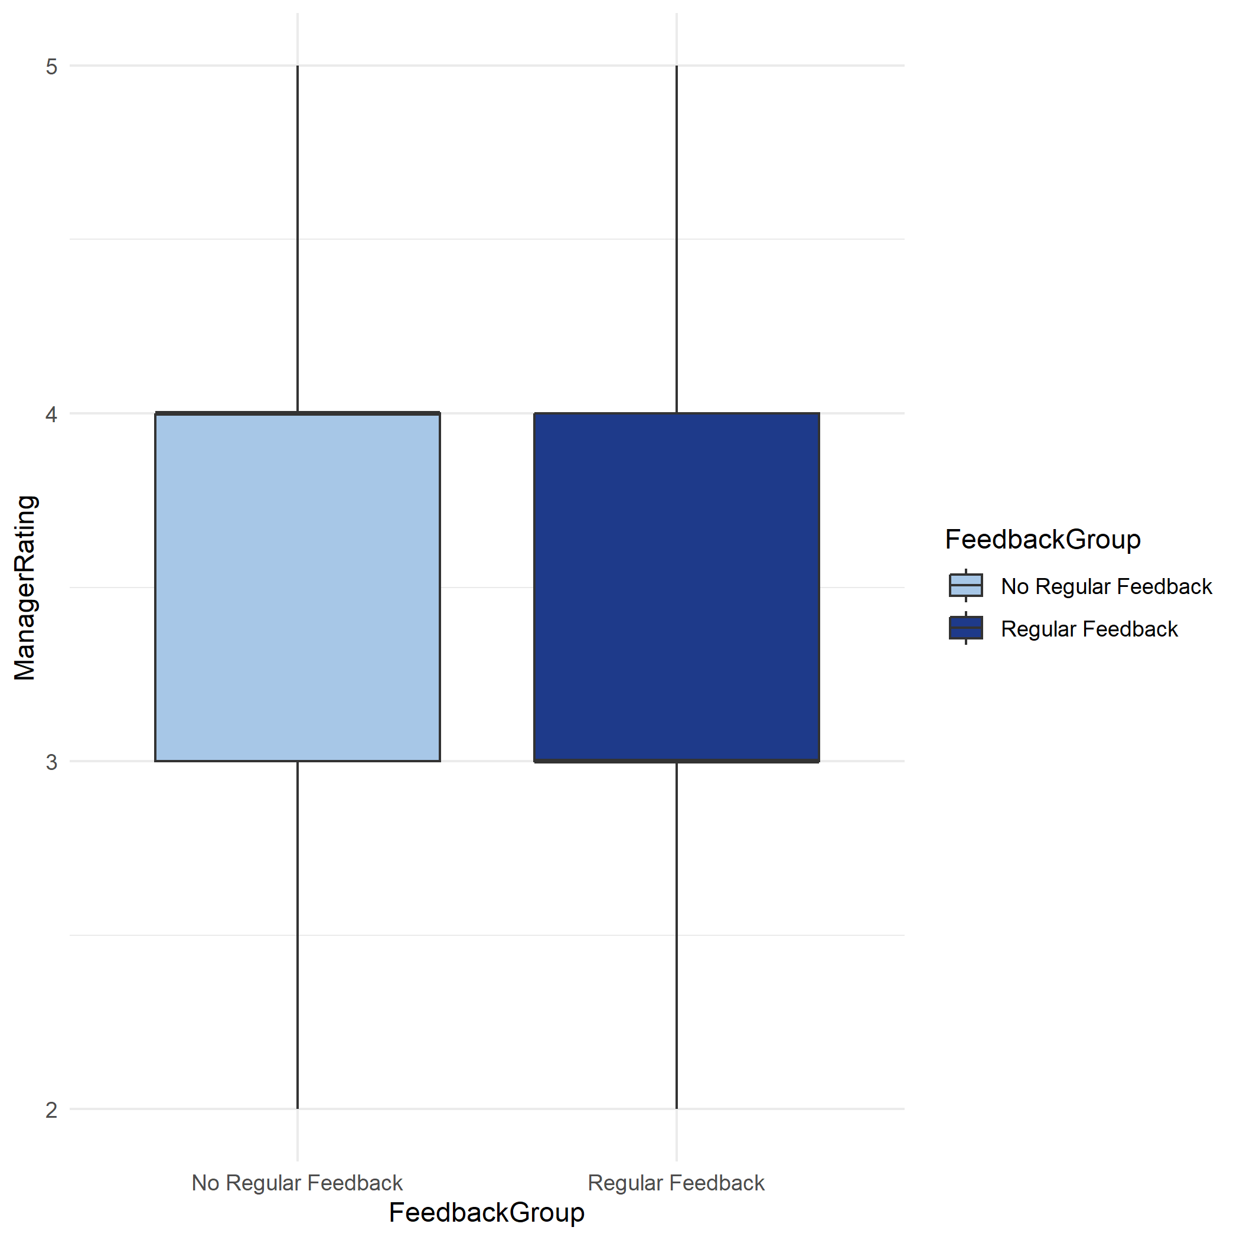
Descriptive Analysis
Summarising and comparing performance across feedback groups
Boxplot
The boxplot compares the distribution of Manager Ratings between the two groups.
It shows the median, spread, and variability of ratings
Both groups have very similar medians and overlapping ranges
There is no clear difference in performance between employees with and without regular feedback
Conclusion: Feedback does not create a noticeable shift in performance distribution

Slide 10
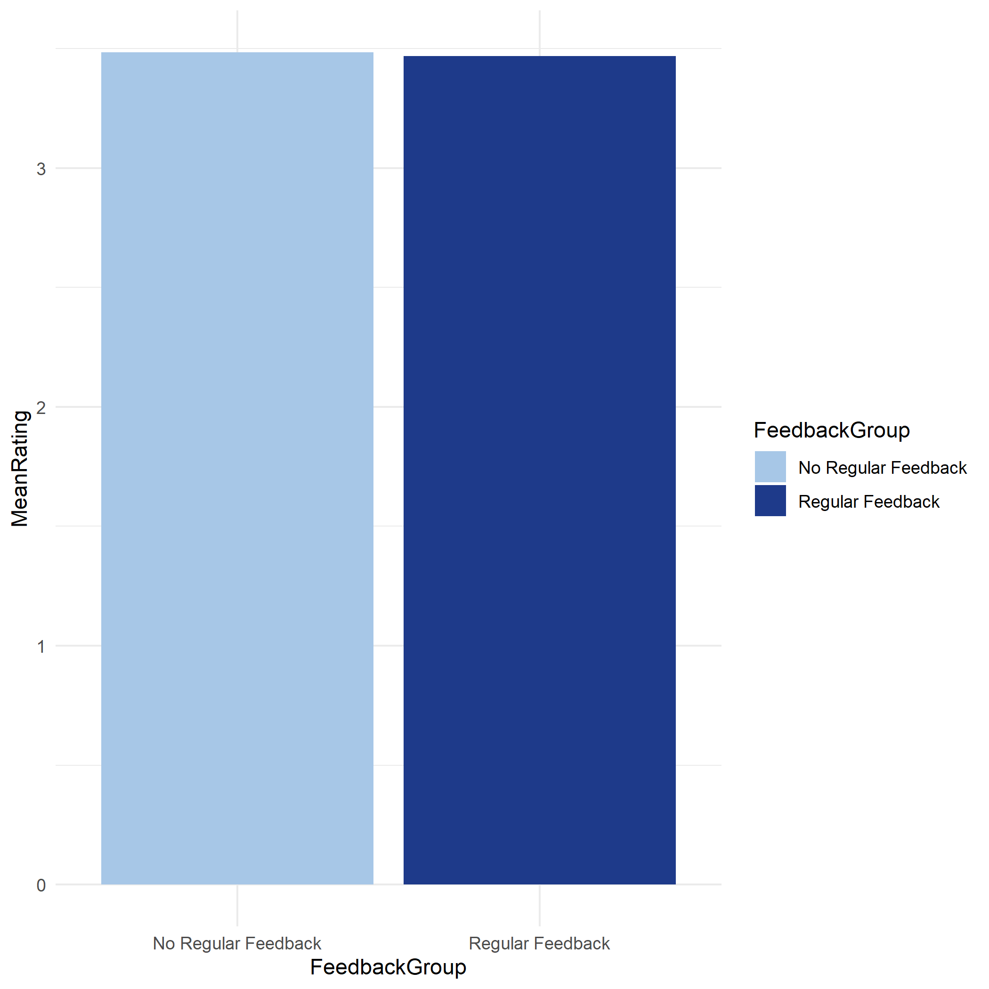
Descriptive Analysis
Summarising and comparing performance across feedback groups
Bar Chart
The bar chart shows the average Manager Rating for each group
The mean ratings are 3.485 (No Feedback) and 3.468 (Regular Feedback)
The difference is extremely small (0.017)
Conclusion: Average performance is nearly identical in both groups

Slide 11
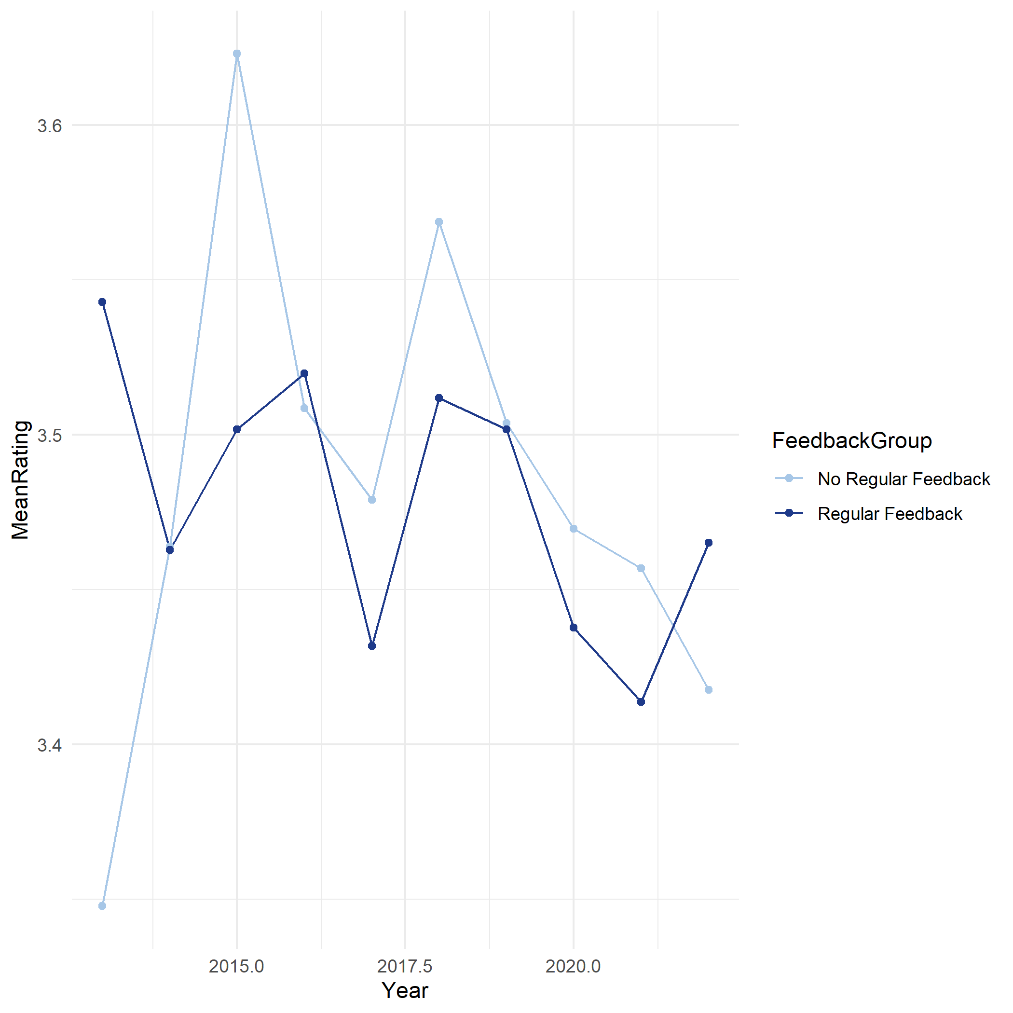
Time Series Analysis
Summarising and comparing performance across feedback groups
Time Series
The time series shows performance trends over 10 years (2013–2022)
Both groups follow a similar pattern over time
The lines cross multiple times, showing no consistent advantage
In some years, No Feedback group performs better
Conclusion: There is no stable or long-term impact of feedback on performance

Slide 12
Inferential Analysis
Four statistical tests — all at significance level alpha = 0.05
H0: No significant difference in between two groups H1: Regular feedback group has significantly higher performance alpha = 0.05
t-test (one-tailed)
Chi-Square Test
Compares mean ManagerRating between 2 groups. One-tailed is used because hypothesis predicts exact direction ( higher performance with feedback)
Tests association between FeedbackGroup and HighPerformer — both are categorical variables.
t = -0.672
p = 0.501
chi-sq = 2.341
p = 0.126
FAIL TO REJECT H0
FAIL TO REJECT H0
One-Way ANOVA
Pearson Correlation
Compares all 3 training levels (1, 2, 3 sessions) simultaneously. t-test only compares 2 groups.
Tests linear relationship between training sessions (number) and manager rating (number).
F = 0.253
p = 0.776
r = -0.009
p = 0.484
FAIL TO REJECT H0
NO SIGNIFICANT CORRELATION
All 4 tests returned p > 0.05 - We FAIL TO REJECT H0

Slide 13
Inferential Analysis
Four statistical tests — all at significance level alpha = 0.05
H0: No significant difference in between two groups H1: Regular feedback group has significantly higher performance alpha = 0.05
t-test (one-tailed)
Chi-Square Test
Assumptions:
1. Independence of observations → Each employee’s rating is not influenced by another
2. Normality → ManagerRating should be approximately normally distributed
3. Homogeneity of variance → Both groups should have similar variance
Assumptions:
1. Independence of observations
2. Expected frequency ≥ 5 in each cell (Each cell in the table must have enough data (at least 5) for the Chi-square test to be reliable)
One-Way ANOVA
Pearson Correlation
Assumptions:
1. Independence of observations → Each employee’s rating is not influenced by another
2. Normality → ManagerRating should be approximately normally distributed
3. Homogeneity of variance → Both groups should have similar variance
Assumptions:
1. Linearity → Relationship should be roughly a straight line
2. Normality (approximate)
3. No extreme outliers (there should not be unusually large or small values in the data, because they can distort the correlation and give misleading results)
All 4 tests returned p > 0.05 - We FAIL TO REJECT H0

Slide 14
Predictive Model
Multiple Linear Regression + Logistic Regression
Model 1 — Multiple Linear Regression
Model 2 — Logistic Regression
Why this model:
Why this model:
Outcome (ManagerRating) is a NUMBER - scale 2 to 5
We have 7 predictor variables - so MULTIPLE, not simple
Outcome (HighPerformer) is a CATEGORY - High or Low
Linear regression cannot predict categories - predicts numbers only
Logistic regression converts output to probability, then classifies
Results:
Results:
R-squared:
0.729
72.9% variance explained
Accuracy: 84.4% (84 out of 100 correctly classified)
Precision: 83% (of predicted High, 83% actually were High)
Recall: 86% (of actual High, 86% correctly found)
Training coef:
0.000
No effect on rating
TrainingOpportunitiesWithinYear (p = 0.1459) → Not statistically significant → Does not meaningfully affect probability of being a High Performer
SelfRating → Strongest significant predictor of High Performance
The model predicts performance well overall, but training does not significantly influence whether an employee is classified as a High Performer.
SelfRating coef:
1.008
Dominant predictor
High R² is mainly due to SelfRating, not feedback variables
Both models confirm: Training variables have near-zero coefficients - feedback does not predict performance.

Slide 15
Predictive Model
Multiple Linear Regression + Logistic Regression
Assumptions
Linearity: Relationship between predictors and ManagerRating is linear.
Independence: Each employee observation is independent
No Multicollinearity: Predictors are not highly correlated with each other
Homoscedasticity: Constant variance of residuals across all levels
Normality of Residuals: Errors are approximately normally distributed
Assumptions
Model 1 - Multiple Linear Regression
Model 2 - Logistic Regression
Binary Outcome: Dependent variable is binary (High / Low performer)
Independence: Observations are independent
No Multicollinearity: Predictors are not highly correlated
Linearity of Logit: Predictors have a linear relationship with log odds
Sufficient Sample Size: Enough data for stable classification
84.4%
83%
86%
Both models confirm: Training variables have near-zero coefficients — feedback does not predict performance.

Slide 16
Results
Summary of all analytical findings
Descriptive Analytics
Inferential Analytics
Mean ratings: 3.485 vs 3.468 - difference of only 0.017
High performer rate: ~49% in BOTH groups - virtually identical
t-test: p = 0.501 | ANOVA: p = 0.776
Chi-Square: p = 0.126 | Correlation: p = 0.484
ALL 4 tests: Fail to Reject H0 (p > 0.05)
Time Series Analysis
Predictive Analytics
10 years of data (2013–2022) shows no consistent pattern
Lines cross 6 times - no stable advantage for regular feedback
Linear Regression R2 = 0.729 - driven by SelfRating (coef = 1.008)
Training coefficient = 0.000 - adds nothing to prediction
Logistic Regression accuracy = 84.4% - training not significant
Consistent finding across ALL 4 analytical approaches: No support for the statement

Slide 17
Final Decision
DECISION: FAIL TO REJECT H0
The statement is NOT supported by the statistical evidence from this dataset.
Why We Fail
What This Means
What It Does NOT Mean
All 4 inferential tests returned p > 0.05
Mean difference = 0.017 — negligible
Time series: no consistent direction over 10 years
Both regression training coefficients ≈ zero
H0 stands — no sufficient evidence for H1
Feedback quantity does not predict performance
High performer rate identical in both groups (~49%)
This is a valid and important academic finding
It does NOT mean feedback is useless
It means THIS dataset cannot confirm the statement
Proxy variable (training count) may miss quality
Future research with better data may find different result
Limitation:
TrainingOpportunitiesWithinYear is a proxy — measures frequency of sessions offered, not quality of feedback received.

Slide 18
Conclusion
Summary, limitations, and recommendations
Summary of Findings
We tested the statement from 4 analytical angles — descriptive, time series, inferential, and predictive analytics
All approaches consistently showed no significant relationship between feedback frequency and performance
The conclusion is robust — it is not an accident of one test, but consistent across every method applied
Limitations
Recommendations for Future Research
Proxy variable — training session count measures frequency, not quality of feedback
Cross-sectional data — cannot establish cause and effect
Confounding variables not fully controlled (role, manager style)
Collect direct qualitative feedback data — quality not just frequency
Use longitudinal tracking of same employees over time
Control for job role and department in future analysis
Thank You — IT3011 Group Assignment

