Slide 1






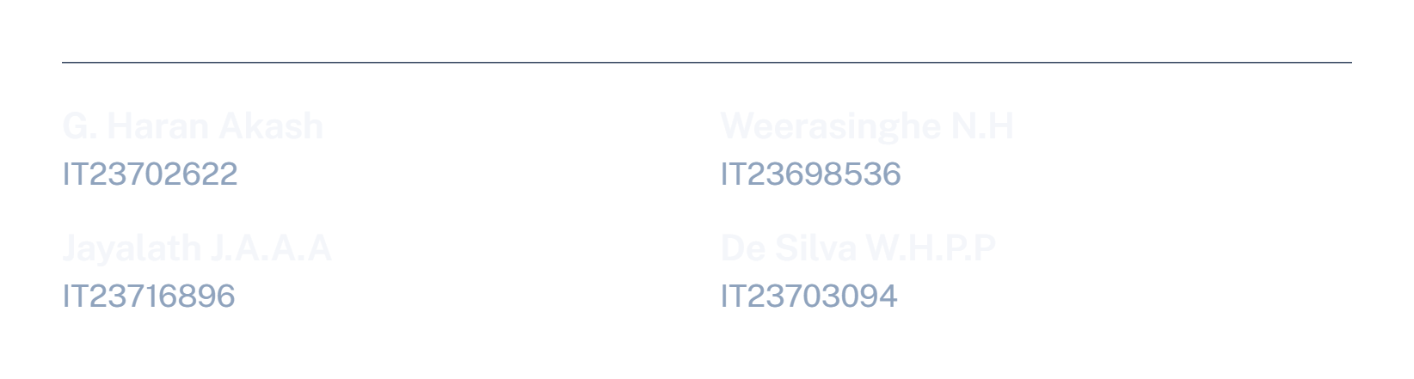
Notes:
Presenter: G. Haran Akash. Welcome everyone. Introduce the four members. One-line purpose: we built a tool that tells HR which employees are likely to leave, why, and what to do about it, so the company can act before a resignation instead of after it.

Slide 2
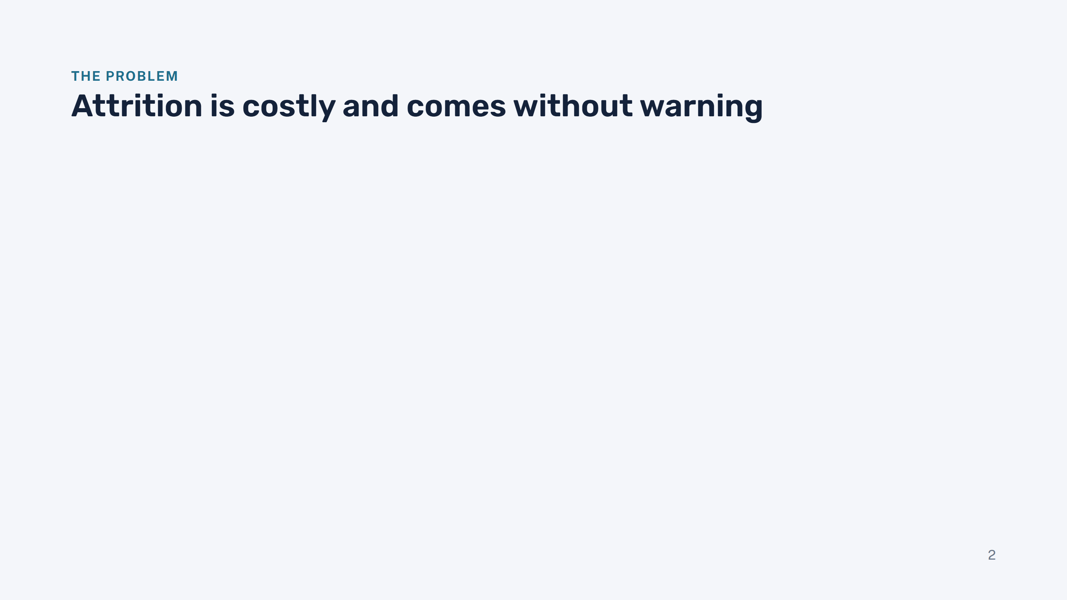
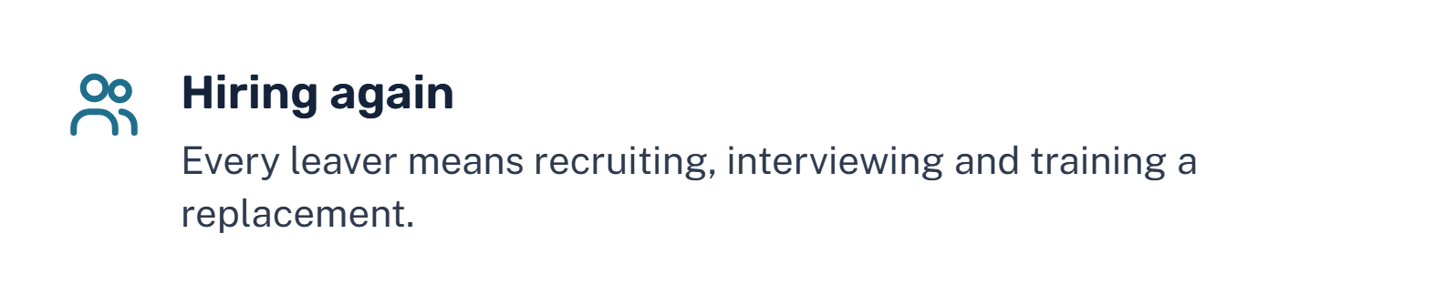
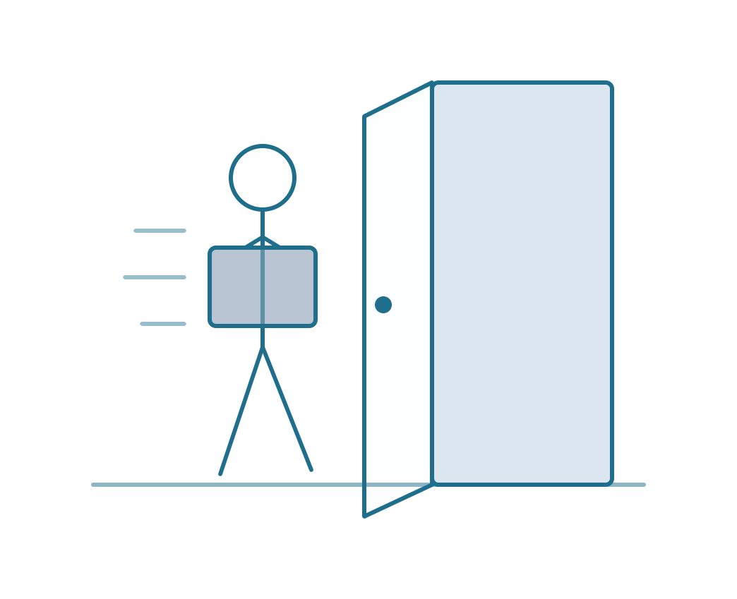
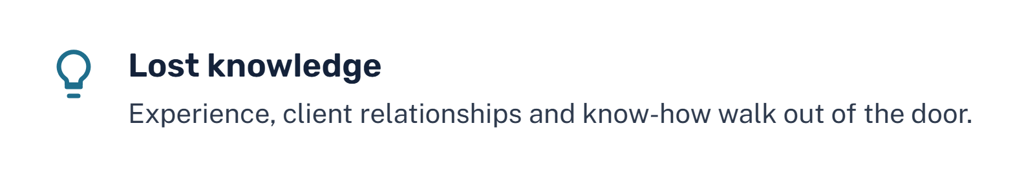
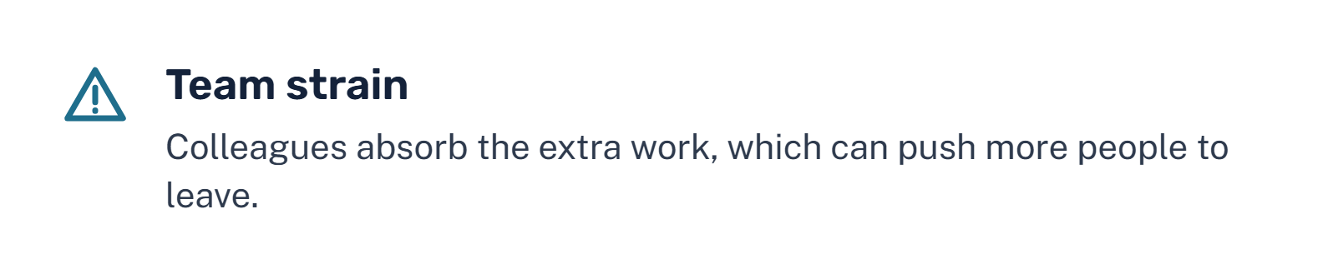
Notes:
Presenter: G. Haran Akash. Explain why attrition matters to the company: replacing someone costs time and money, knowledge leaves with them, and the team left behind carries the load. The real problem is timing: HR normally learns about it only when someone resigns. Our goal was to give HR an early warning so they can act while there is still time.

Slide 3

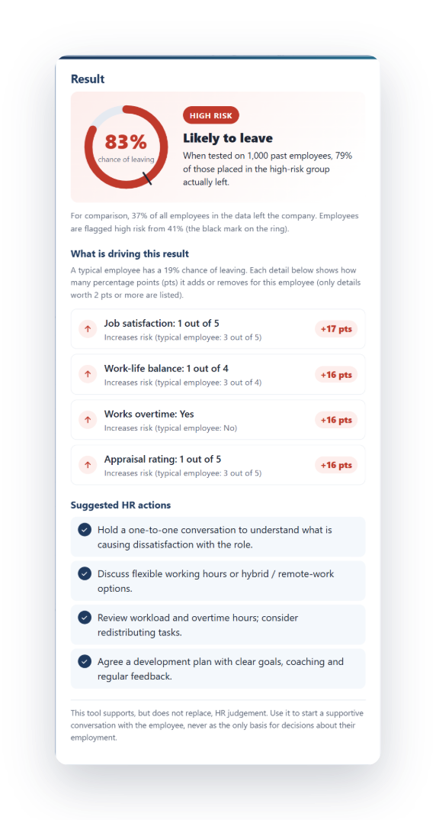
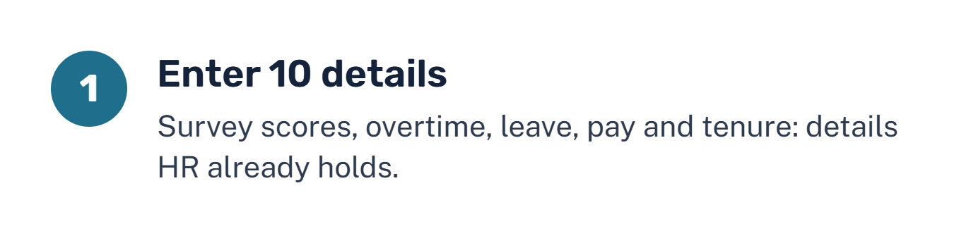
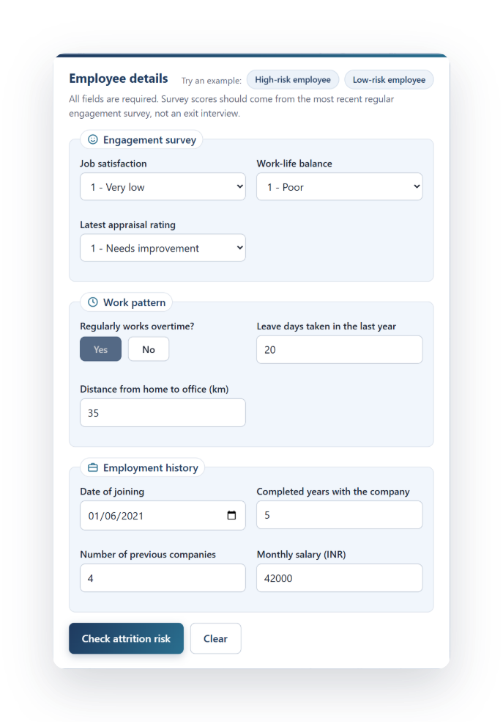
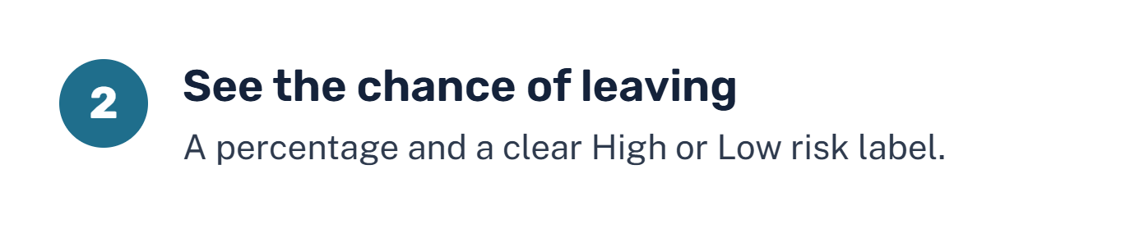
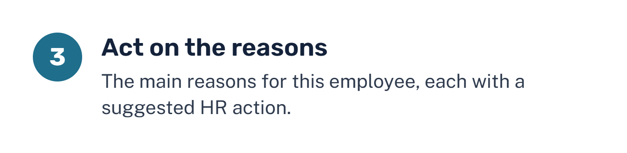

Notes:
Presenter: G. Haran Akash. Walk through the three steps from HR's point of view: type in ten details the company already has, get a percentage chance of leaving with a High or Low label, and see the reasons with a suggested action for each. The two screenshots are the real tool: the form on the left, the result on the right. Stress that it is fast and simple and needs no technical knowledge. Hand over to Weerasinghe, who will explain what the data taught us.

Slide 4
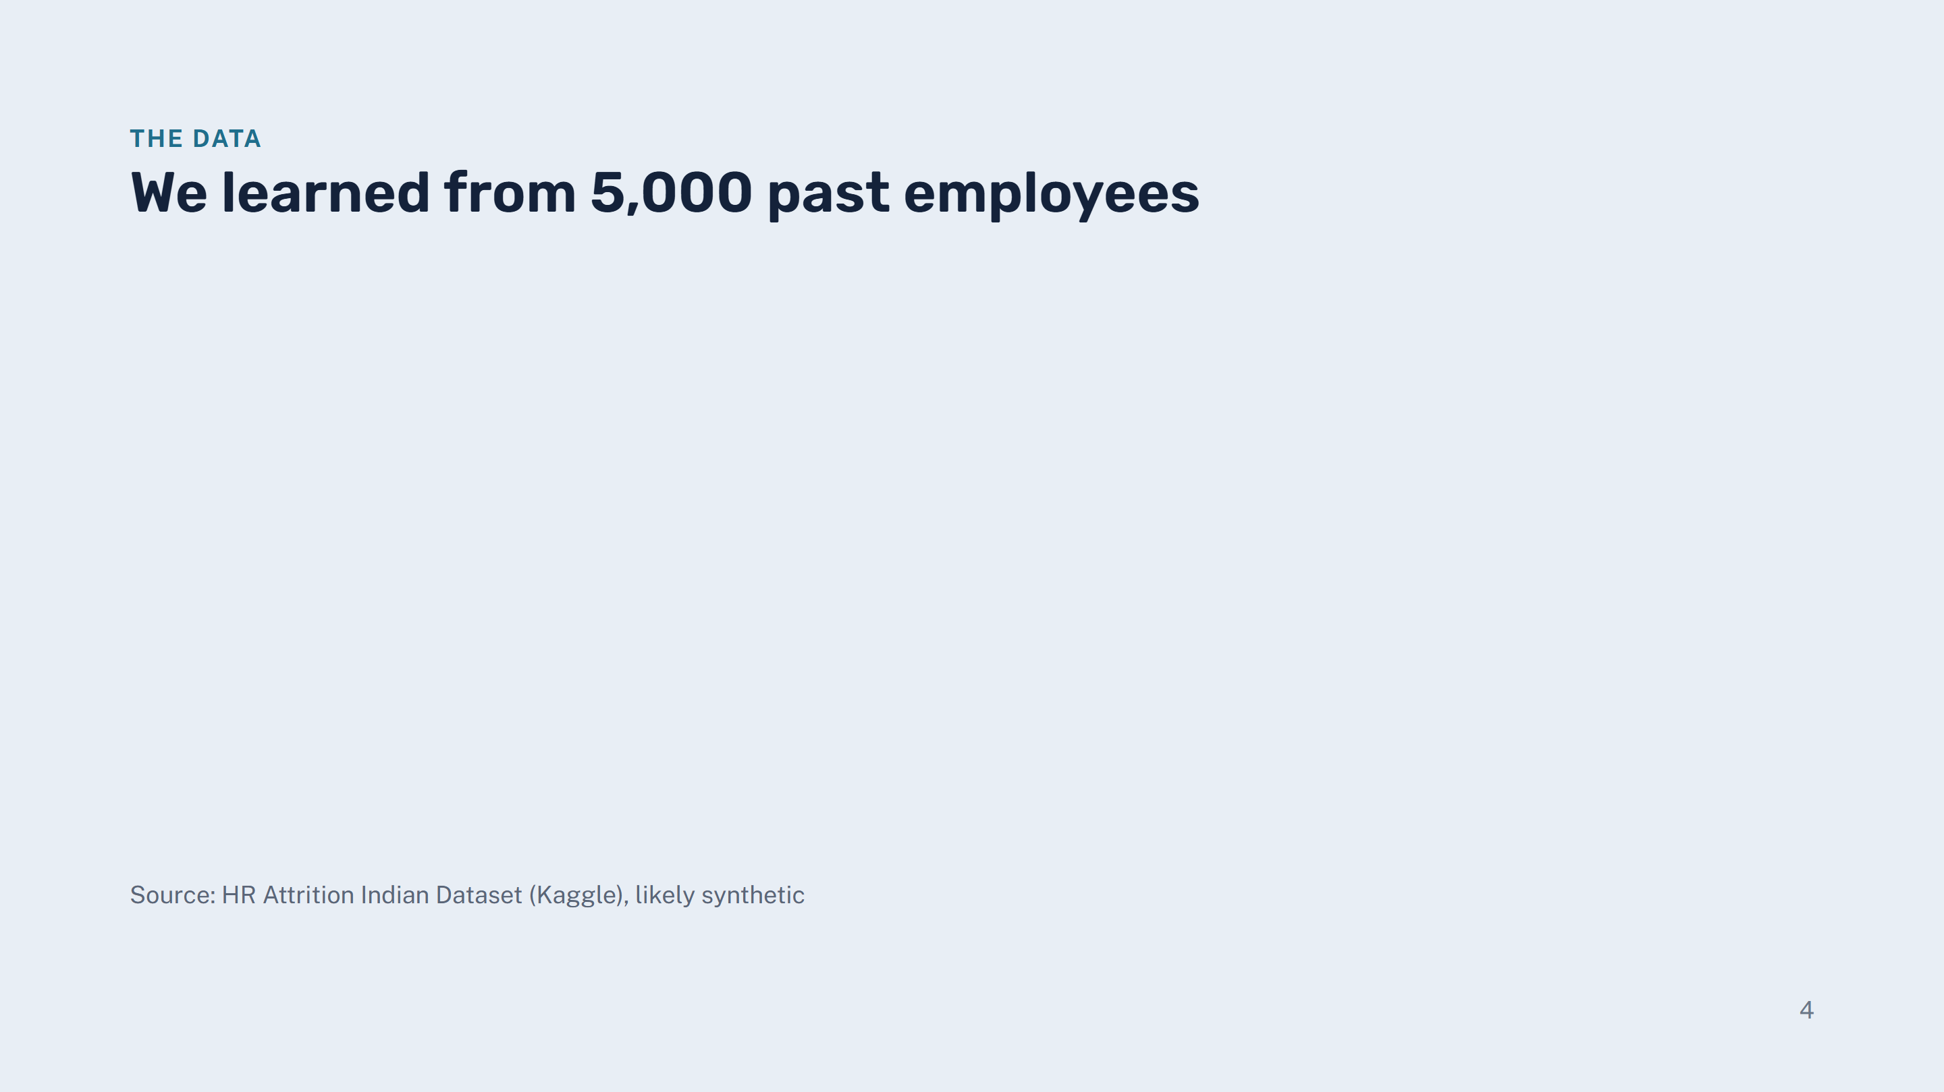

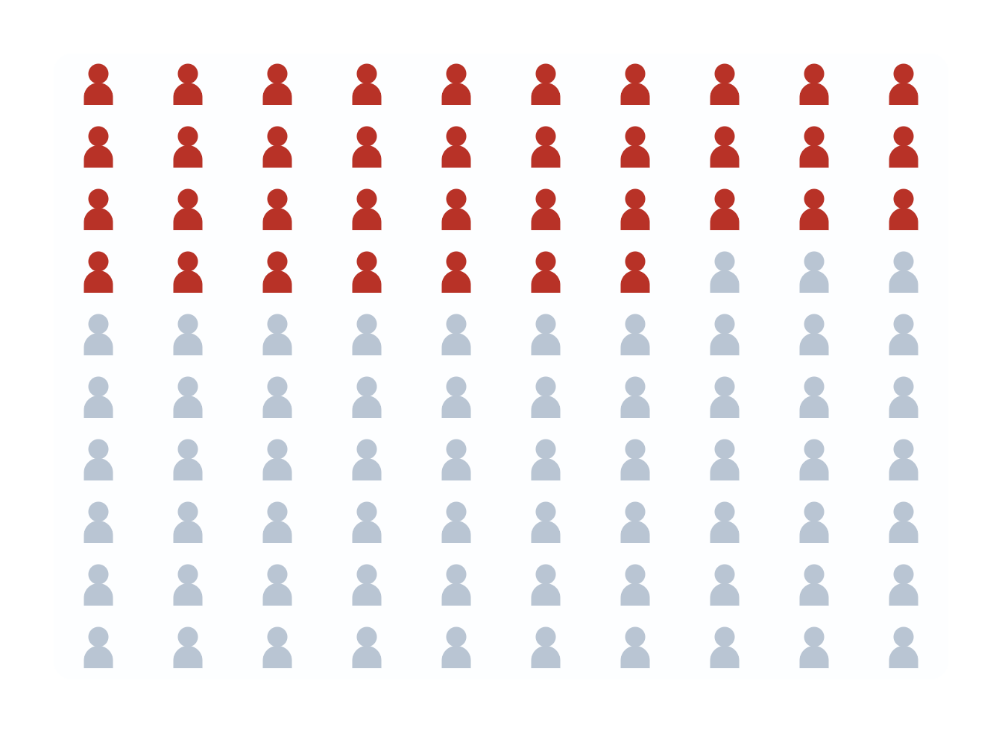
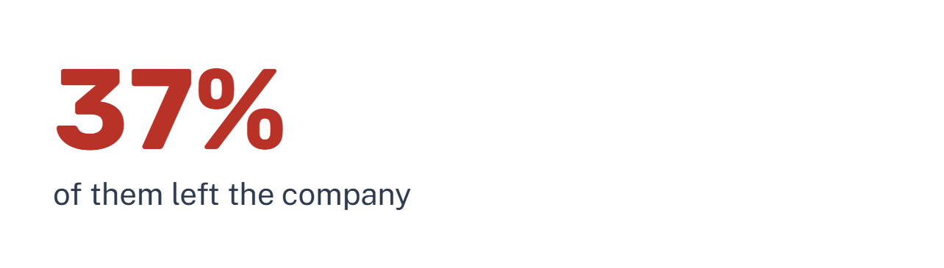


Notes:
Presenter: Weerasinghe N.H. Explain the data in plain words: 5,000 employee records, each showing whether the person stayed or left. The picture shows it at a glance: of every 100 employees, 37 left, which is high, so the problem is real. Each record has 19 details. Be honest that the dataset looks synthetic (very clean and evenly spread), so before the company relies on it the model should be checked on real company data.

Slide 5
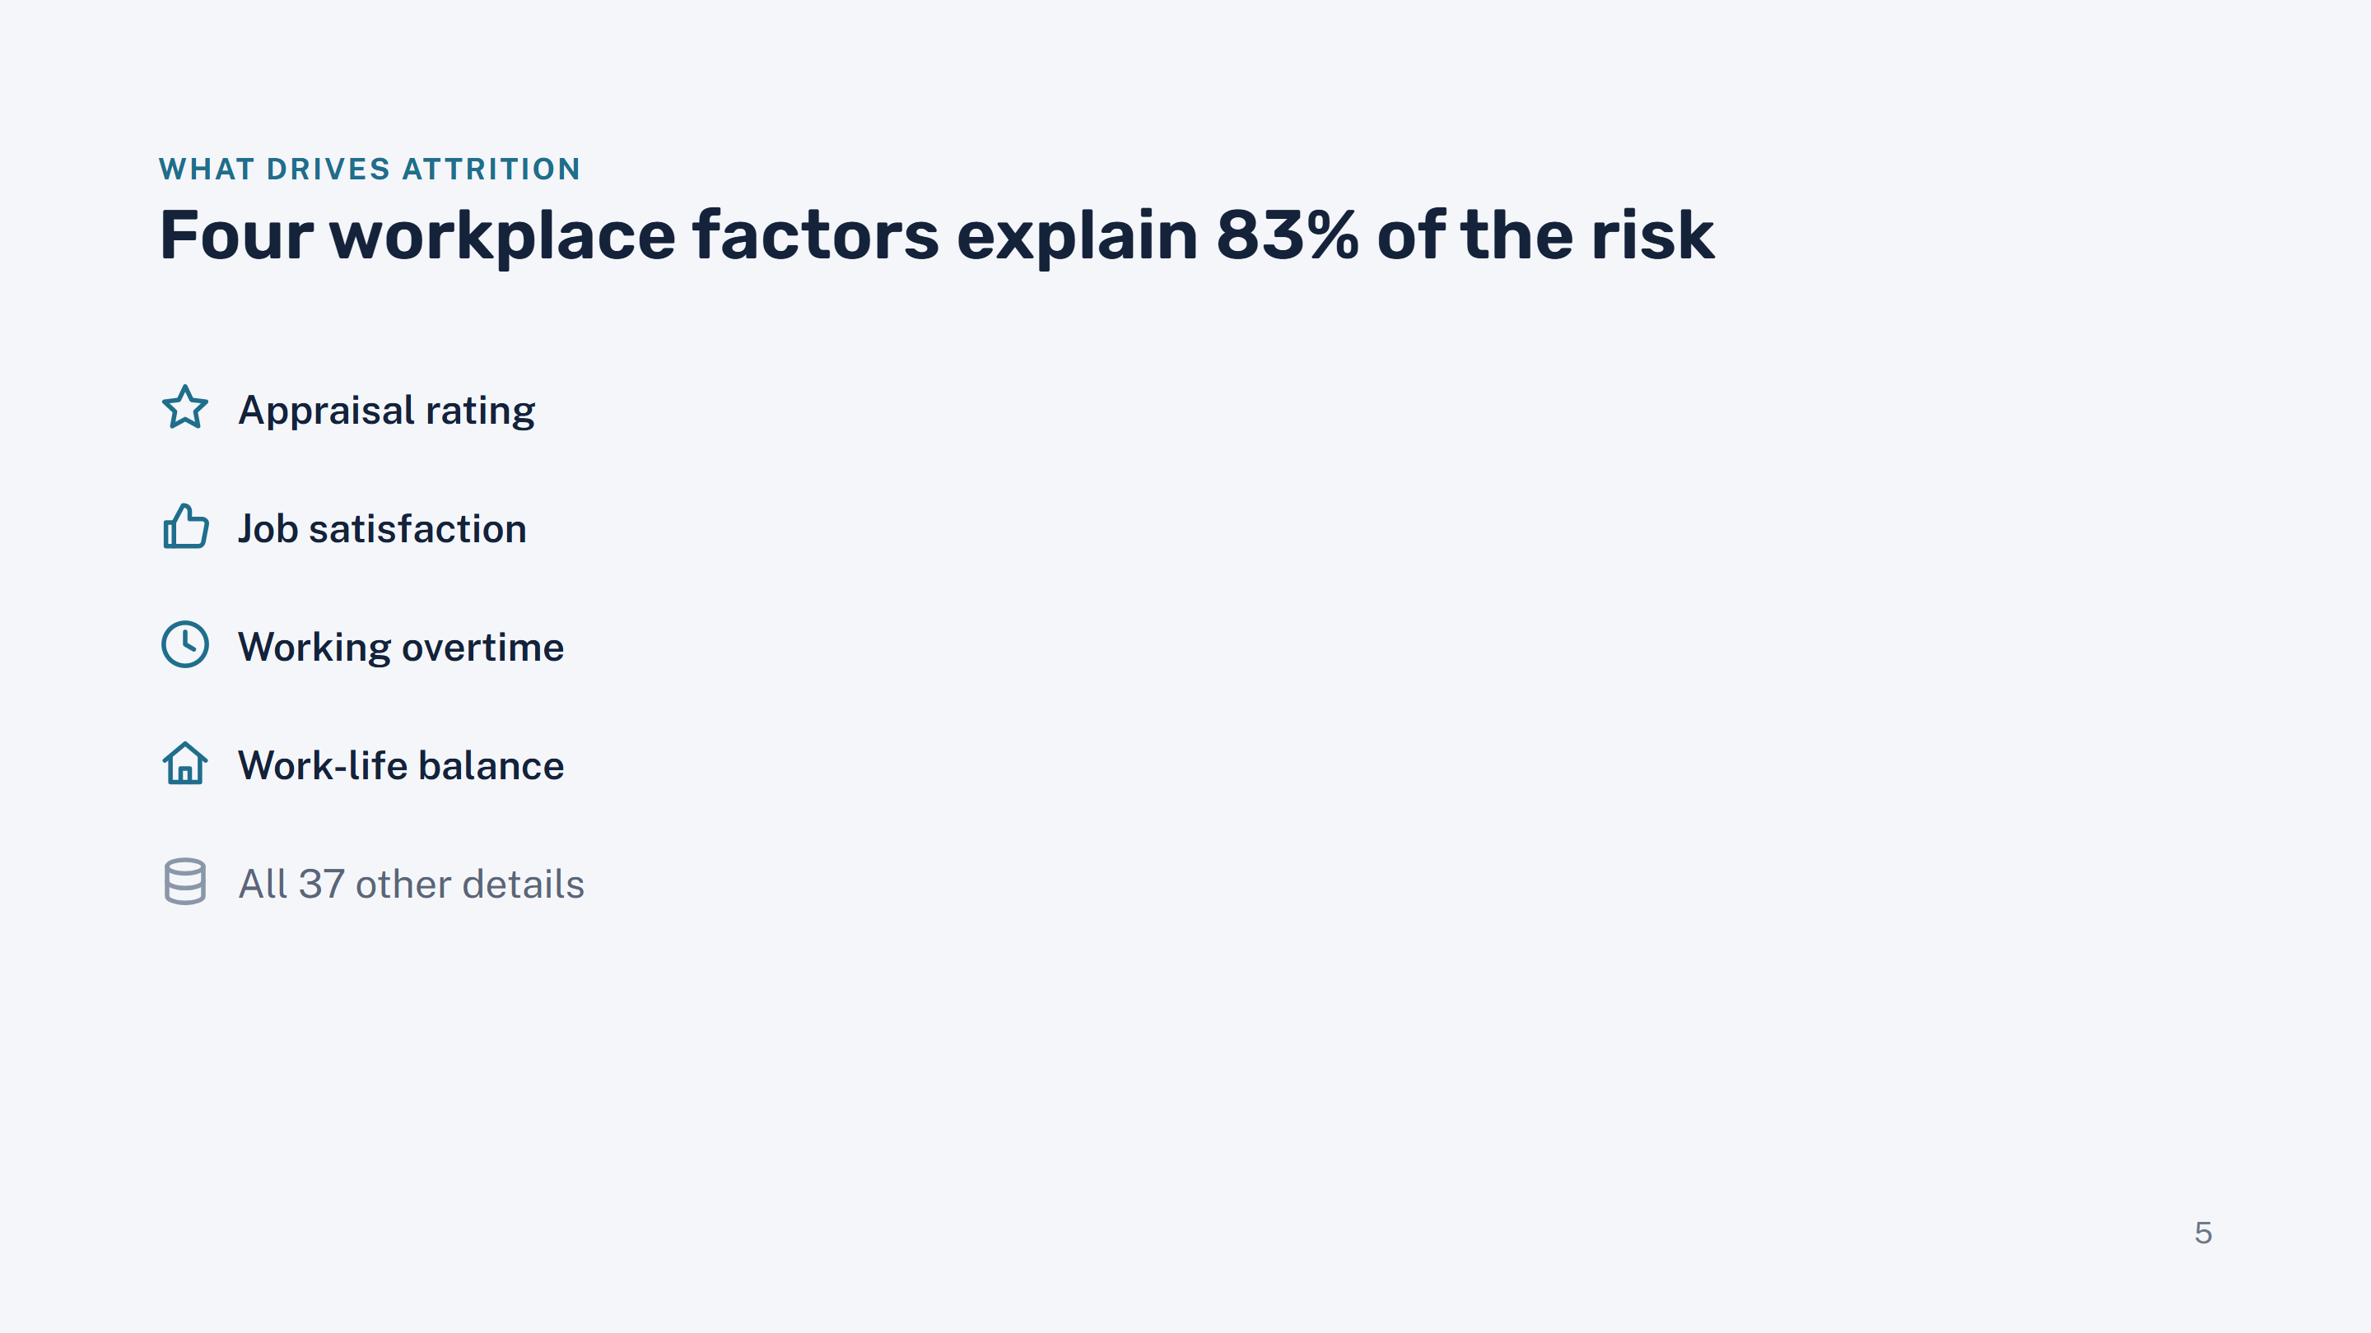

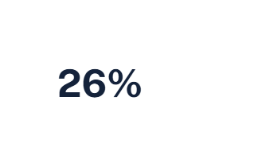

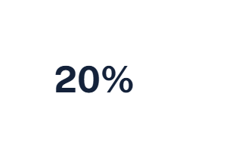

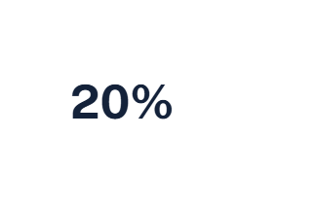

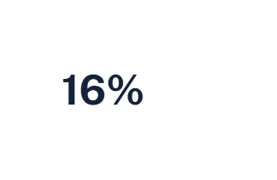

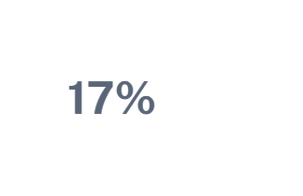

Notes:
Presenter: Weerasinghe N.H. The model told us which details matter most. Four workplace factors carry 83% of the weight: how the employee was rated in their appraisal, how satisfied they are, whether they work overtime, and their work-life balance. Everything else combined, including salary, age and commute, is only 17%. Good news for HR: all four are things the company can influence.

Slide 6
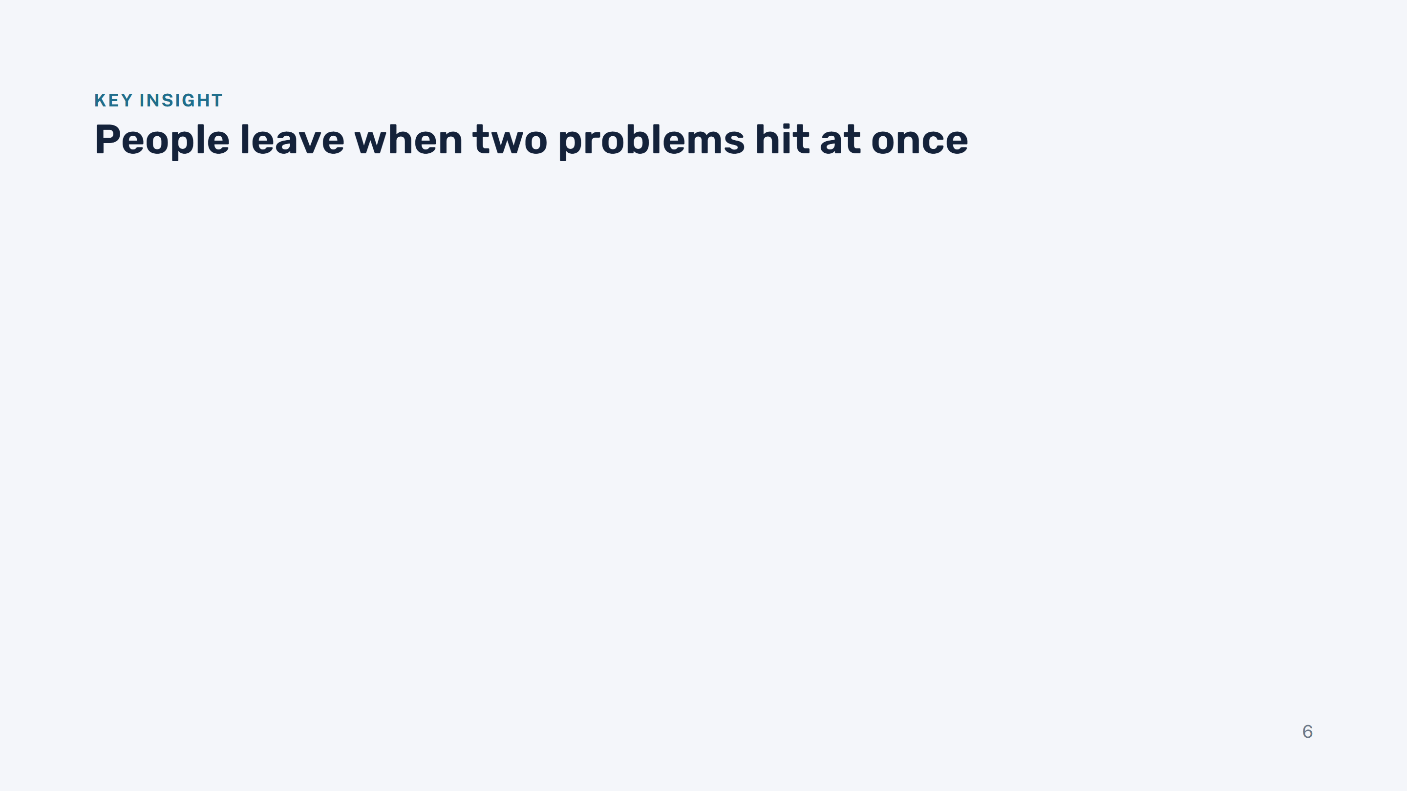
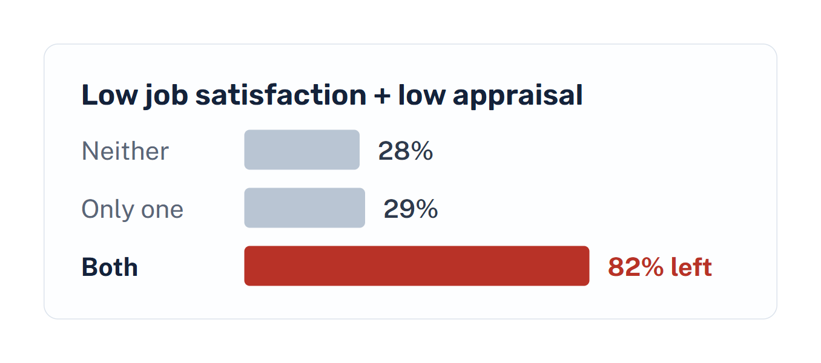
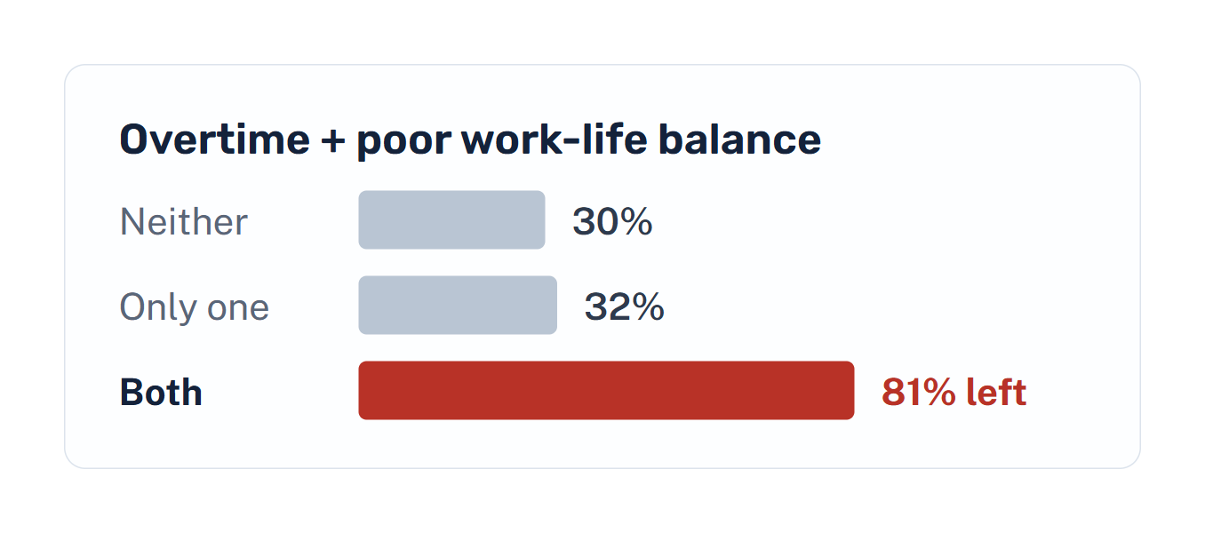
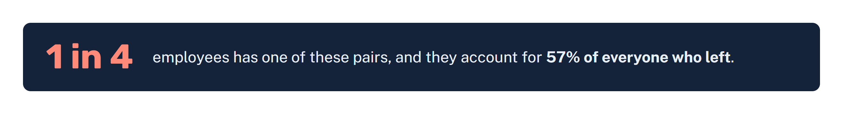
Notes:
Presenter: Weerasinghe N.H. This is our most important finding. One problem on its own barely changes anything: an unhappy employee with a good appraisal leaves at about the normal rate. But when two problems come together, attrition jumps to over 80%. There are two danger pairs: low satisfaction together with a low appraisal, and overtime together with poor work-life balance. A quarter of employees fall into one of these pairs, and they make up 57% of everyone who left. So HR can focus its effort on a small, clearly identifiable group.

Slide 7
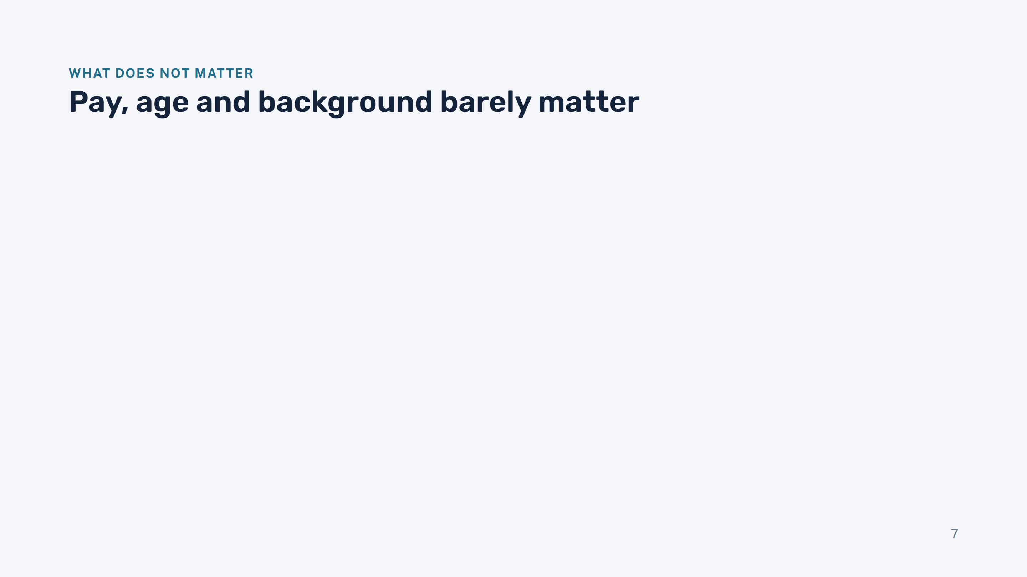
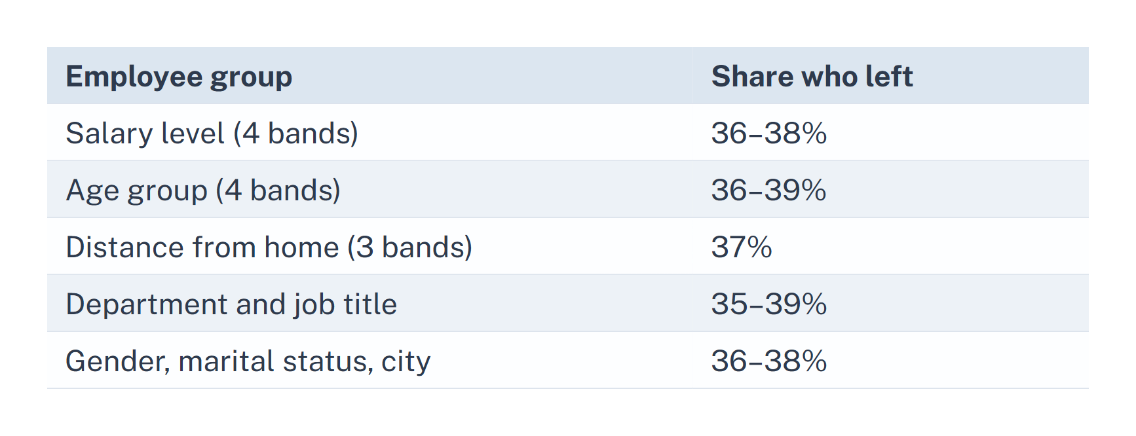
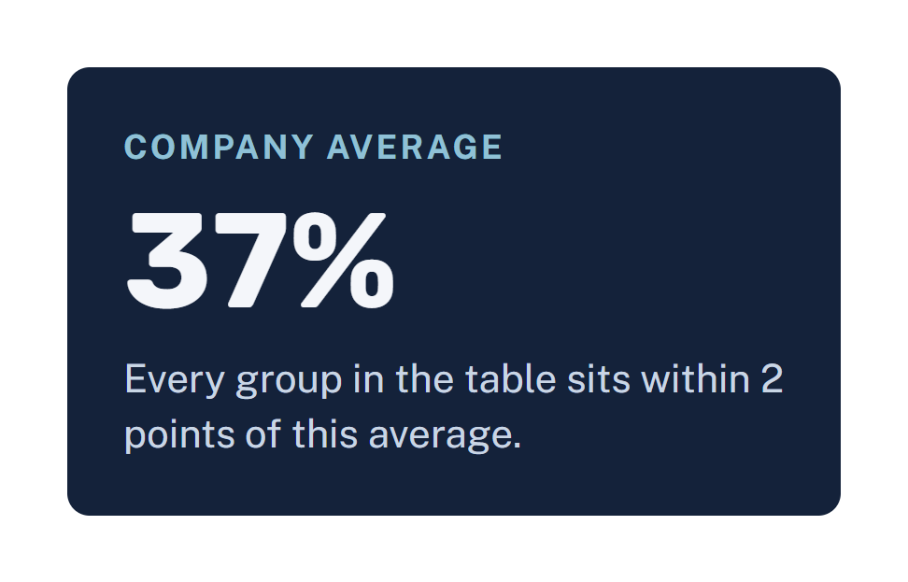
Notes:
Presenter: Weerasinghe N.H. Equally useful is what does not matter. Whatever the salary level, age group, commute distance, department, gender or city, about 37% left, the same as the company average. So a pay rise alone, for example, is unlikely to fix attrition here. The one clear exception is overtime. The final model does not even use gender, marital status or city, which also makes it fairer. Hand over to Jayalath, who explains how we built and checked the tool.

Slide 8
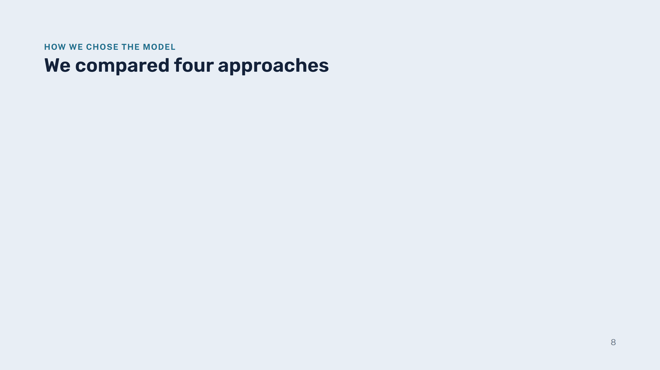
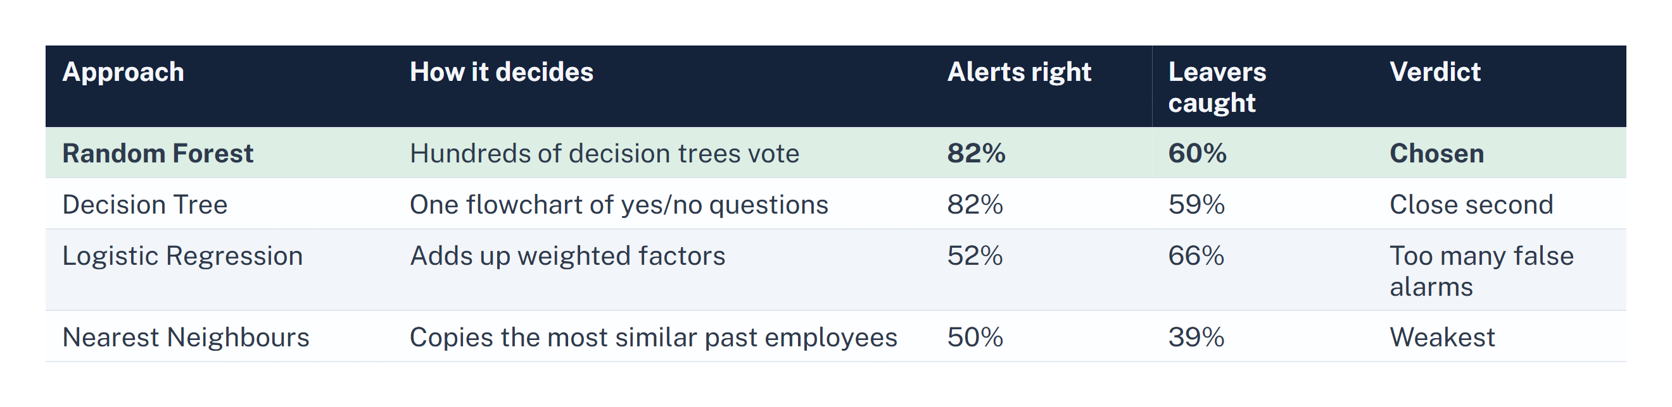
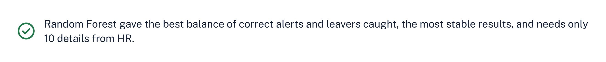
Notes:
Presenter: Jayalath J.A.A.A. We did not rely on one method: we tried four different ways of learning from the data, each tuned to its best settings and tested the same way. "Alerts right" means: when it says someone will leave, how often it is correct. "Leavers caught" means: of the people who really left, how many it warned us about. Logistic Regression catches more leavers but raises far too many false alarms. Random Forest gives the best balance and the most consistent results, and it only needs 10 details, so we chose it.

Slide 9
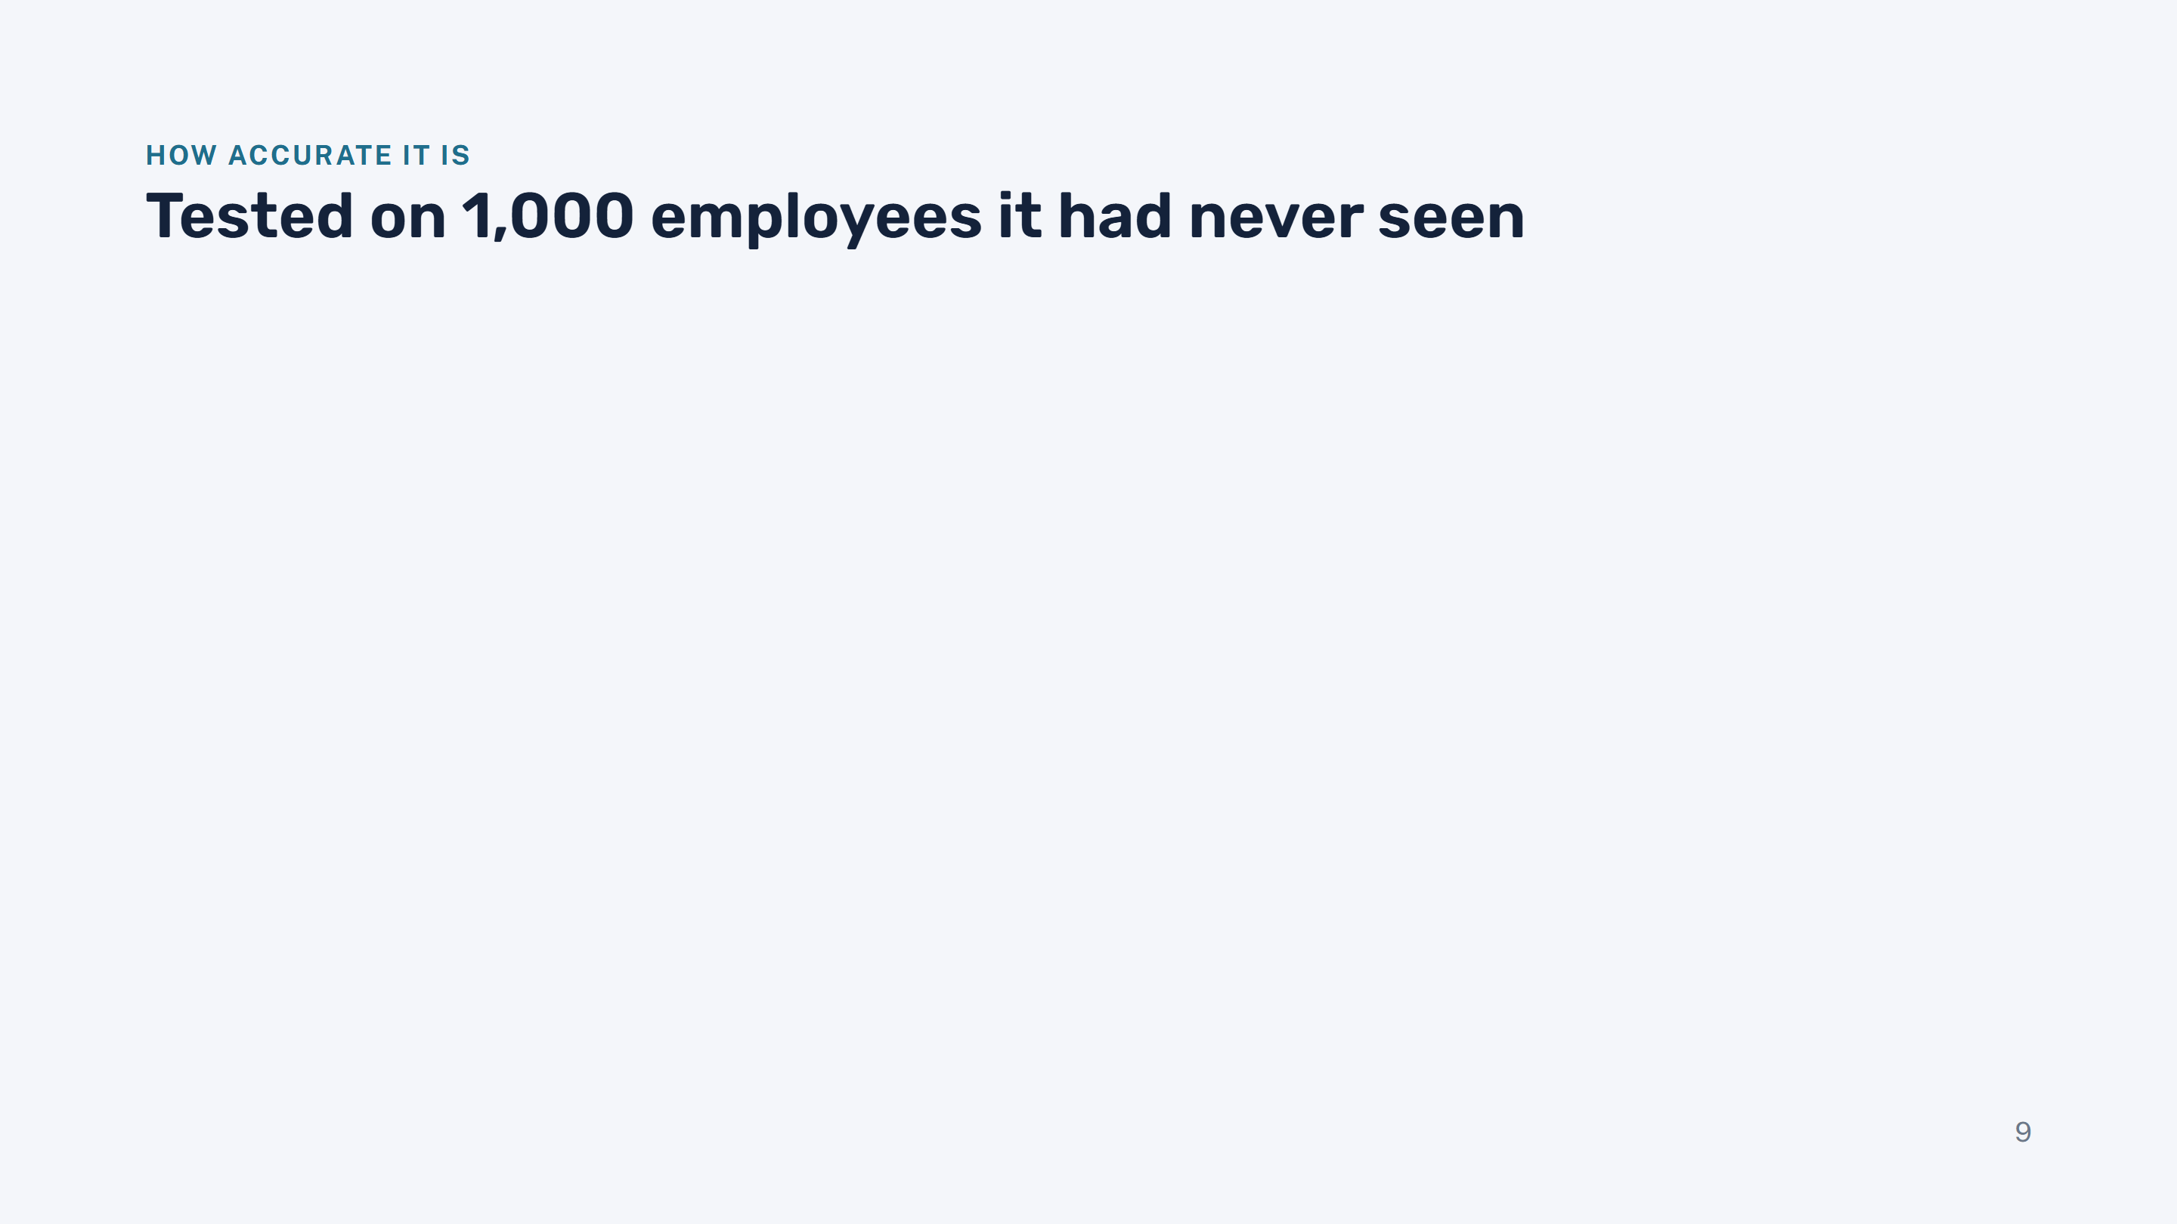
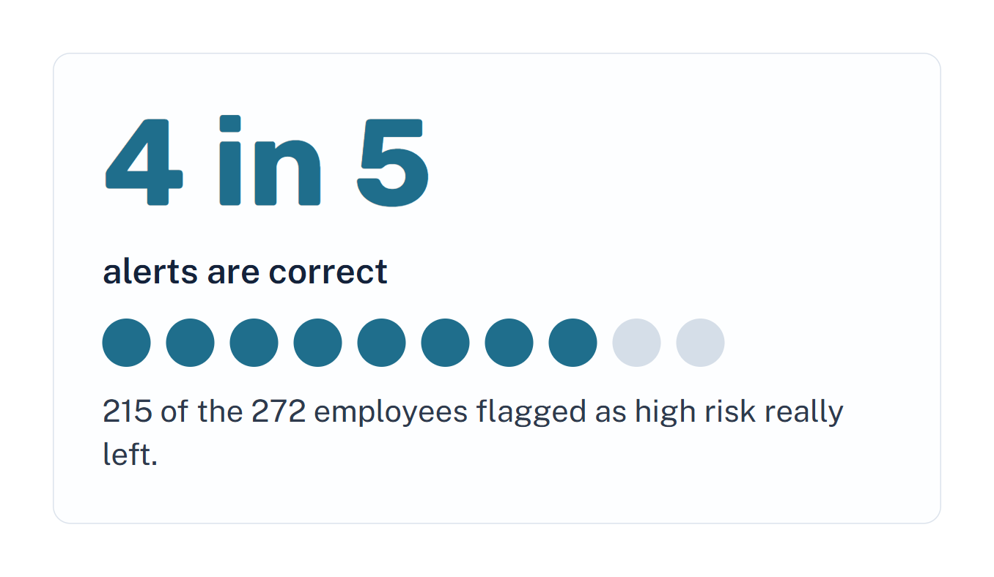
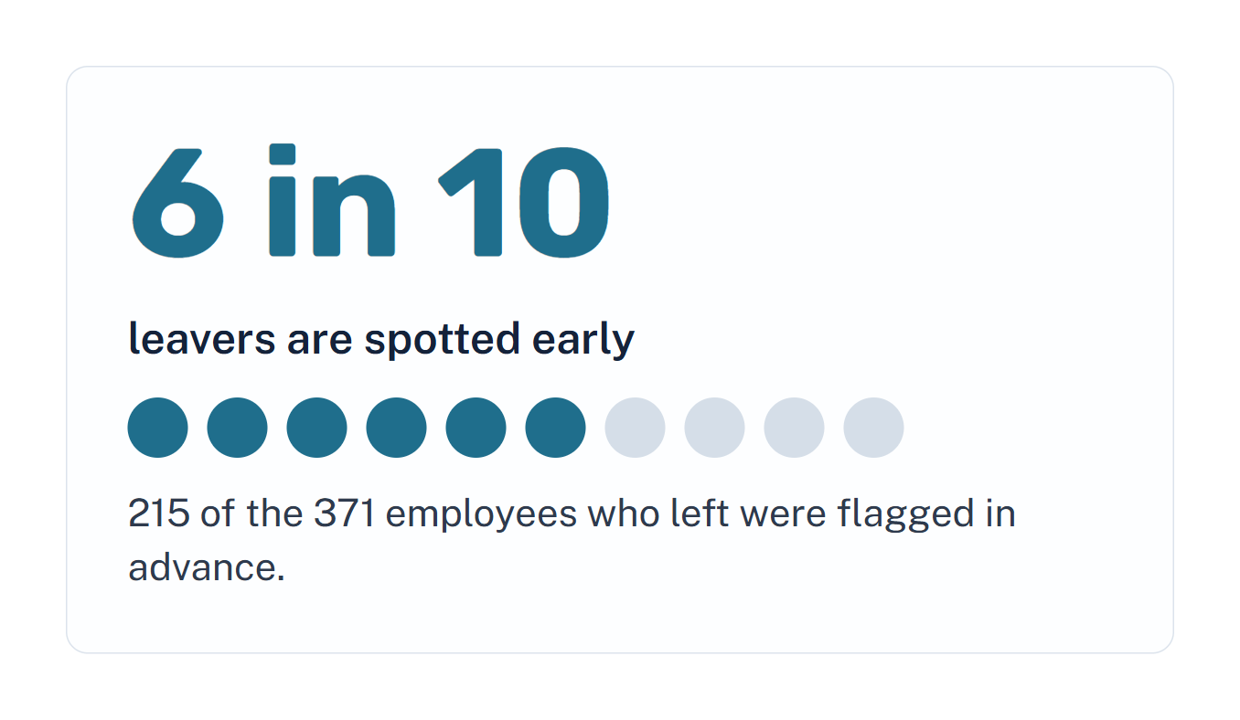
Notes:
Presenter: Jayalath J.A.A.A. We kept 1,000 employees aside and never showed them to the model during development, like a final exam. On those: when the tool raises an alert, it is right about 4 times out of 5, so HR's time is not wasted. It spots about 6 in 10 leavers in advance. Overall 79% of predictions were correct, compared with 63% if you simply guessed that nobody leaves.

Slide 10
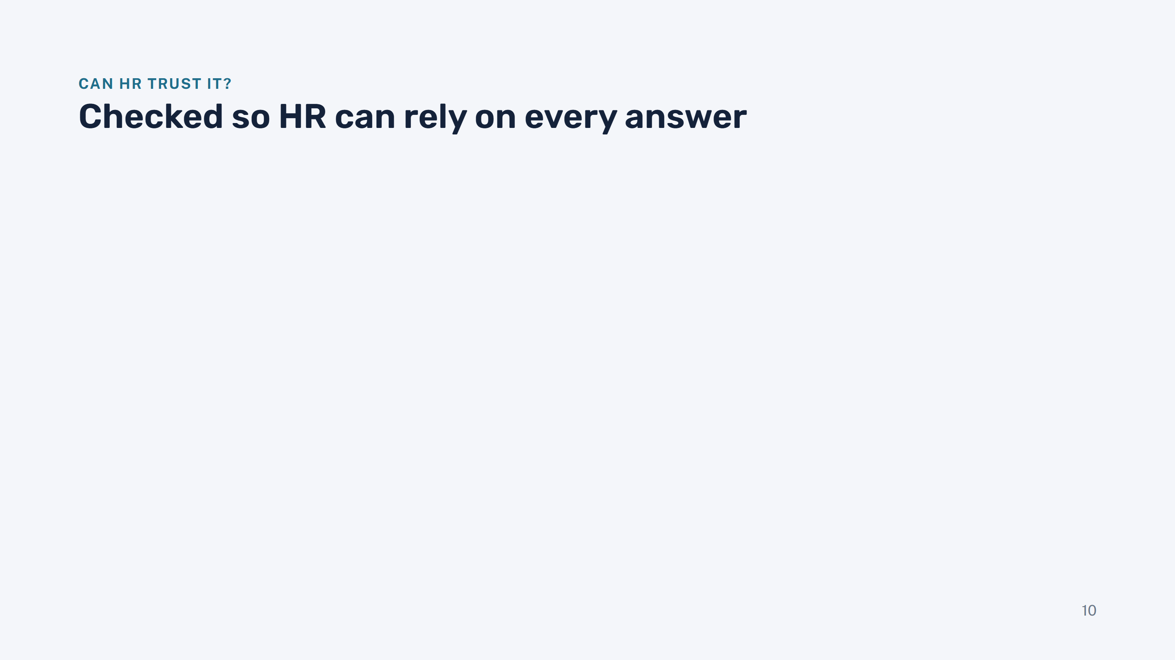
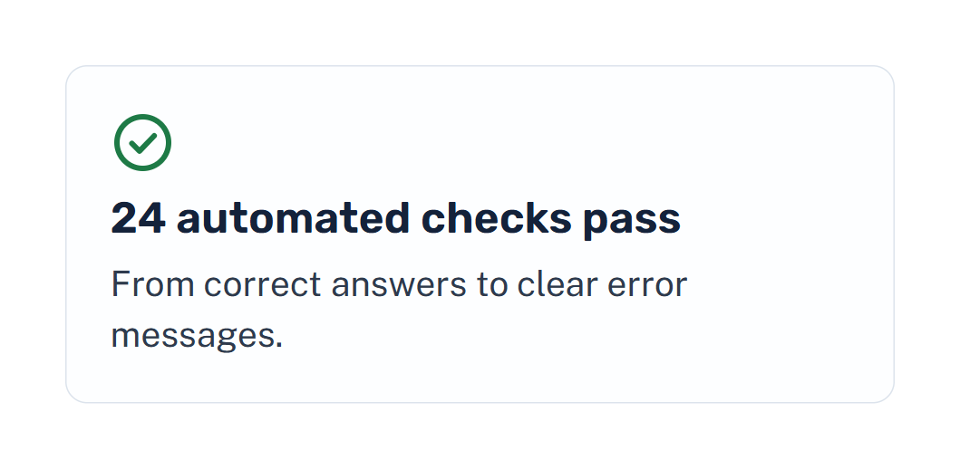
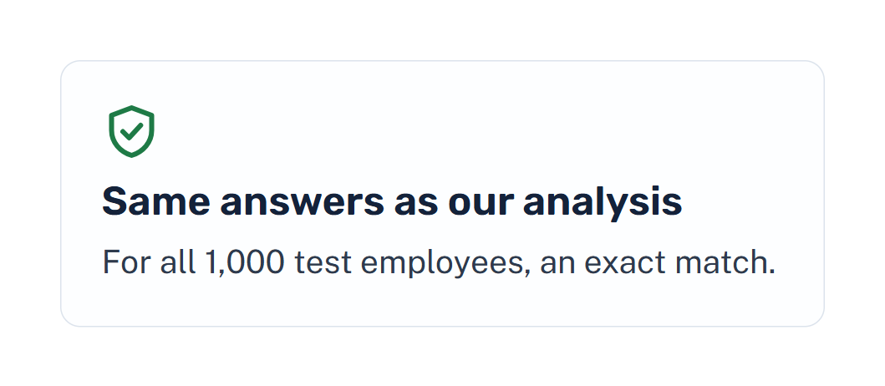
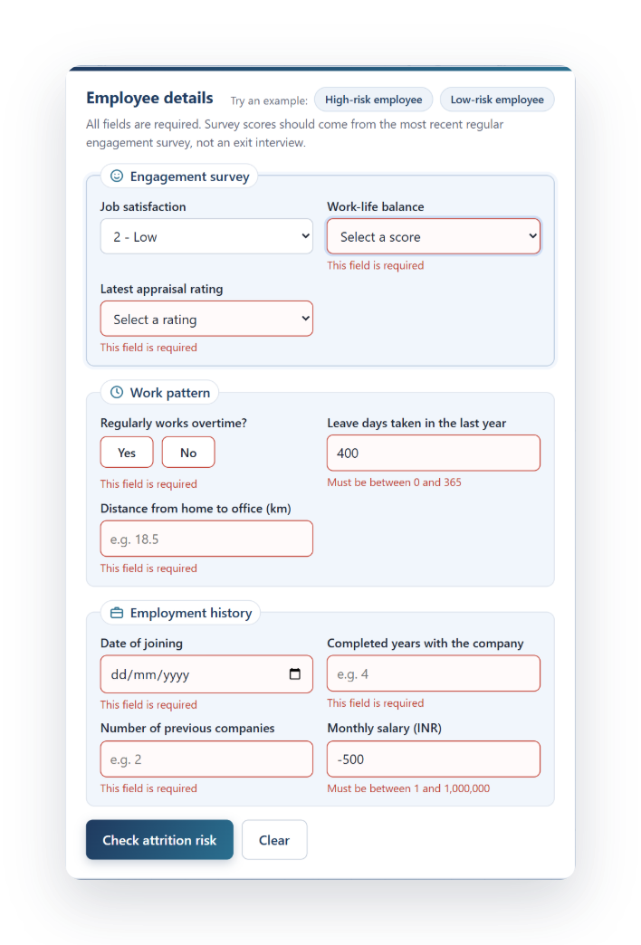
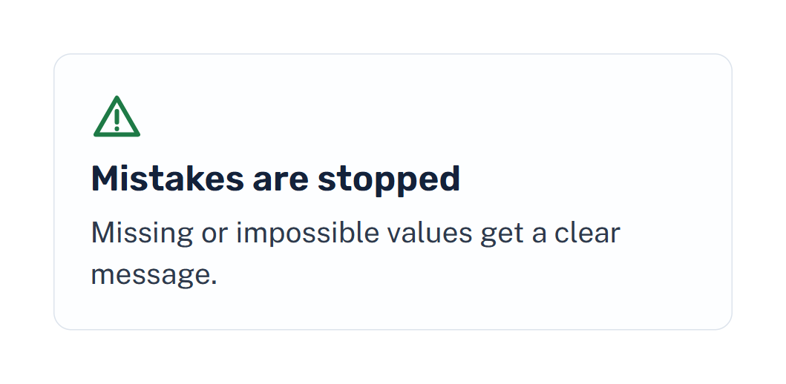
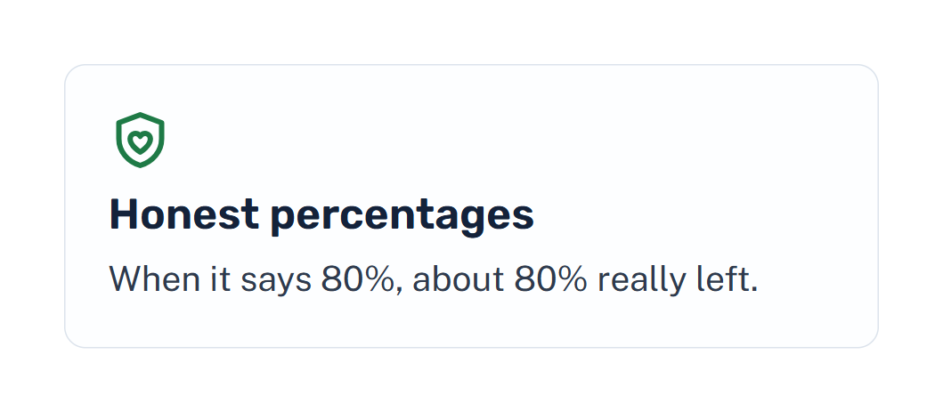
Notes:
Presenter: Jayalath J.A.A.A. A tool is only useful if people can trust it. We wrote 24 automated checks, and all of them pass. We proved that the web tool gives exactly the same answers as the model we evaluated, for all 1,000 test employees. Wrong inputs are caught with a clear message, as the screenshot shows. And the percentages are honest: we adjusted them so that, for example, of employees shown around 80%, about 80% really left. Hand over to De Silva for the live demo.

Slide 11
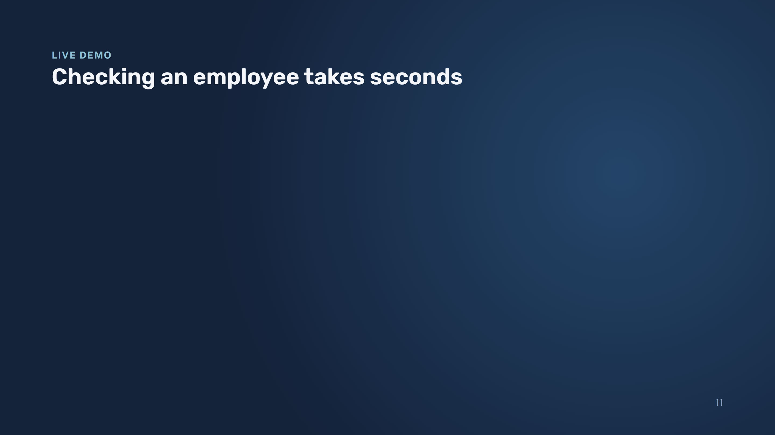
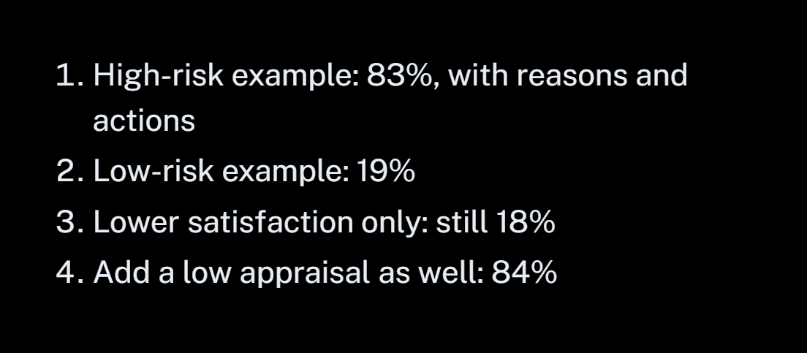
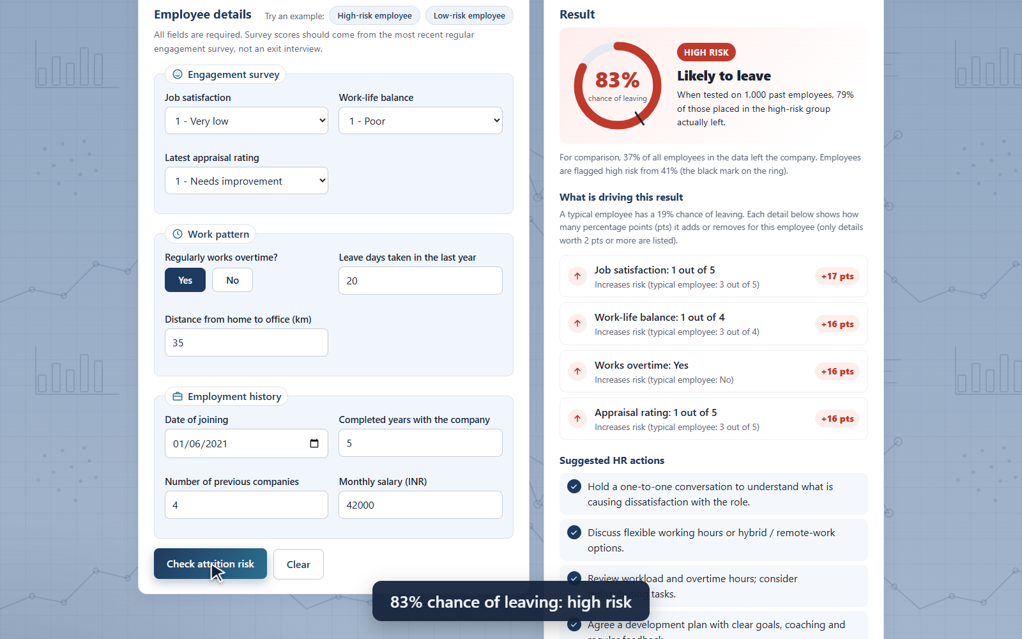
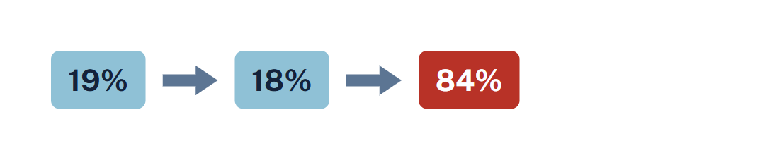
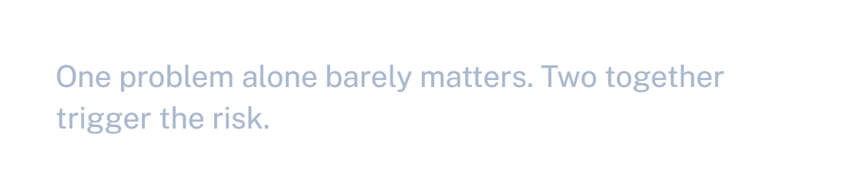
Notes:
Presenter: De Silva W.H.P.P. The video on the right is a recording of the real tool and plays by itself. Talk over it: first the high-risk example, 83% chance of leaving, with the four reasons and the suggested HR actions. Then the key insight: the low-risk example is 19%; lowering job satisfaction alone keeps it low at 18%; lowering the appraisal as well makes it jump to 84%. One problem alone barely matters, two together trigger the risk. If time allows, repeat it live in the browser at 127.0.0.1:8000; if not, the video is enough.

Slide 12

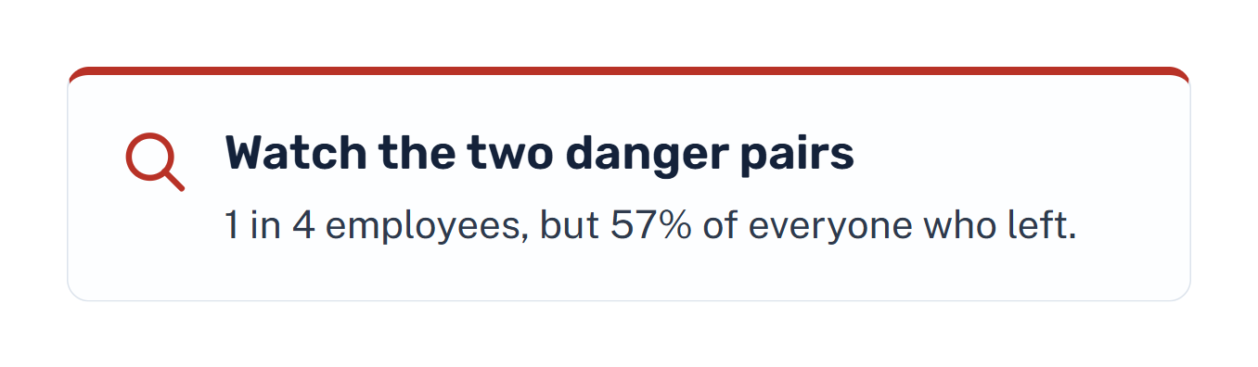
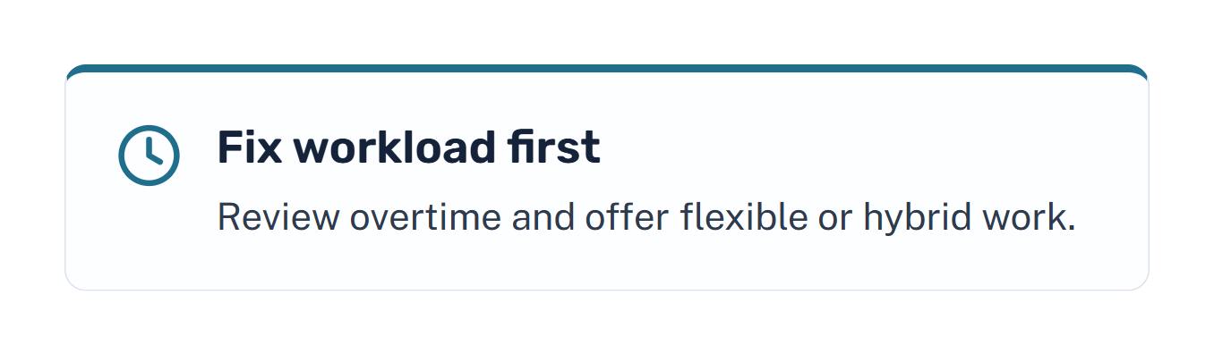
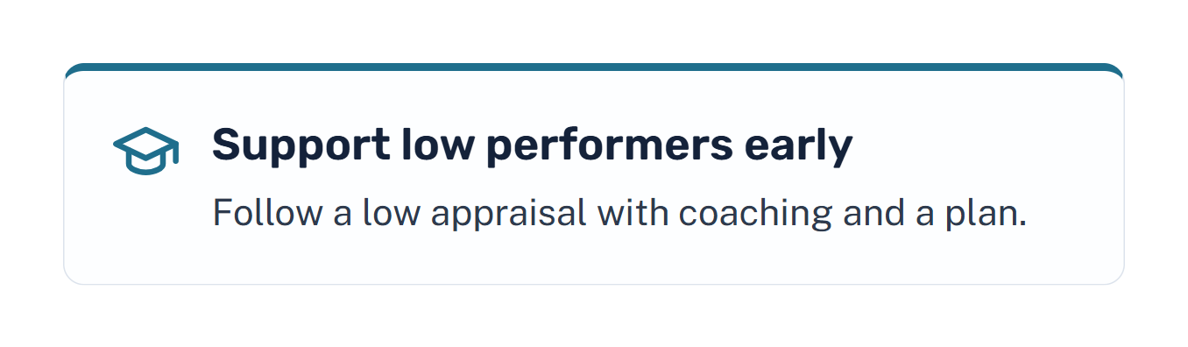
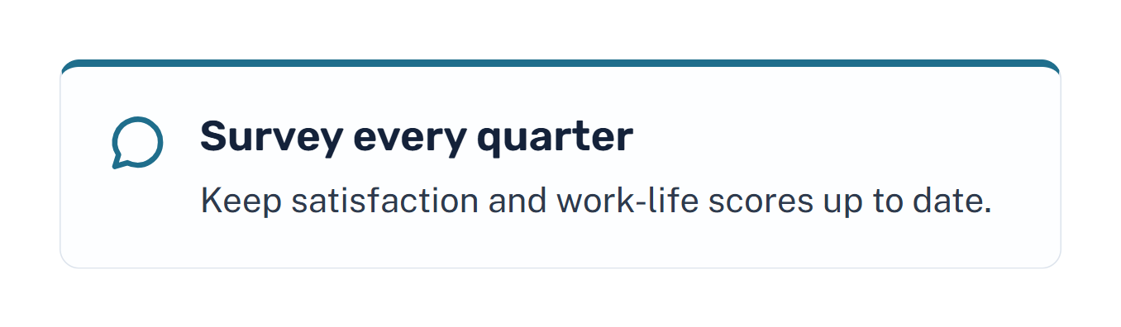
Notes:
Presenter: De Silva W.H.P.P. Turn the findings into action. First, focus on the danger pairs: they are only a quarter of staff but more than half of all leavers. Second, workload: overtime with poor balance is one of the pairs, so review overtime and offer flexibility. Third, a low appraisal combined with low satisfaction is the other pair, so pair appraisals with coaching. Fourth, the tool depends on survey scores, so collect them regularly, not at exit interviews. Finally, the tool supports HR judgement; it does not replace it.

Slide 13

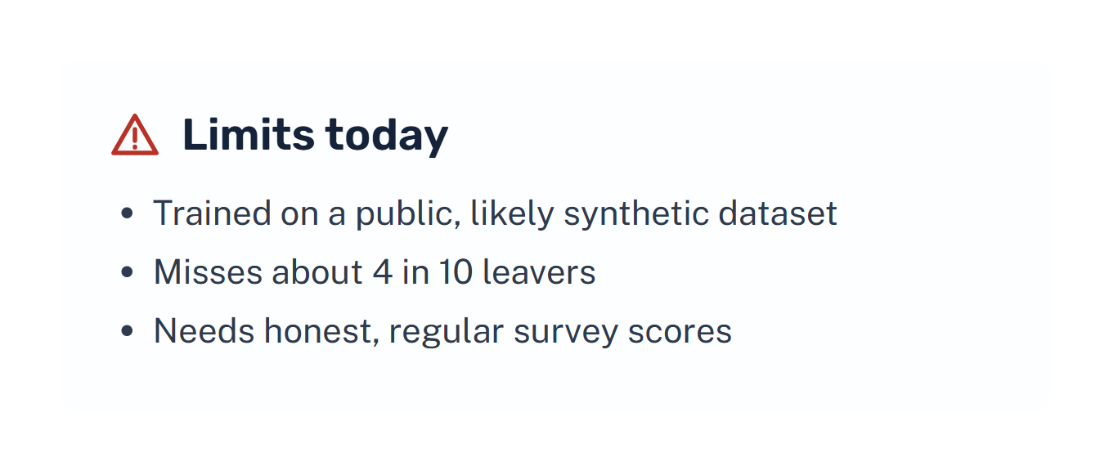
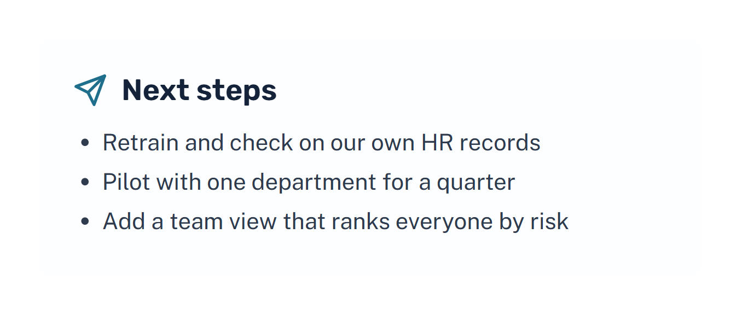
Notes:
Presenter: De Silva W.H.P.P. Be honest about the limits: the data is public and probably synthetic, the tool misses about 4 in 10 leavers, and it depends on good survey data. Next steps: retrain on our own records, run a one-quarter pilot in one department, and add a view that ranks a whole team by risk. If HR wants to catch more leavers, the alert level can be lowered, accepting more false alarms.

Slide 14





Notes:
Presenter: De Silva W.H.P.P. Thank the audience and invite questions. Each member answers questions about their own part: Haran on the problem and the tool, Weerasinghe on the data and insights, Jayalath on model choice and testing, De Silva on the demo and recommendations.

