Slide 1

LOGO
Advanced Database Management Systems
Distributed Databases

Slide 2


Session Objectives
LOGO
On completion of this session, student will be able to
Describe the importance of distributed databases
List advantages of distributed databases
Describe architecture of distributed databases
List features of distributed databases

Slide 3
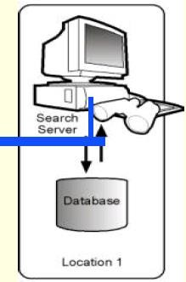

Centralised DBMS
LOGO
Centralised DBMS all system components (data, DBMS software and secondary storage devices) reside at a single computer or site.
A centralised database can be accessed remotely via terminals connected to the site.

Slide 4
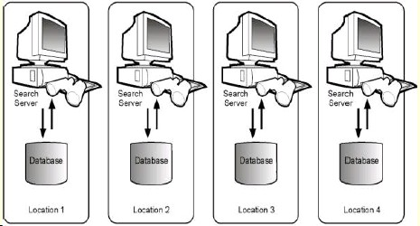
Distributed Database
LOGO
A distributed database is a database that is under the control of a central database management system (DBMS) in which storage devices are not all attached to a common CPU.
It may be stored in multiple computers located in the same physical location, or may be dispersed
over a network of interconnected computers.

Slide 5
Use of Distributed DBMS
Consider a company that has branches all over the world. Each branch stores information about the customers, products, and purchases in that branch.
To get the number of purchases in the whole company, we would have to log in to each branch, run a query to get the count of purchases, and then combine the results, which is very time-consuming.
But if the system is a distributed database, we can get the count of all purchases by using a single query.

Slide 6
Distributed DBMS Software
Apache Cassandra
Apache Hbase
Amazon SimpleDB
Clusterpoint
FoundationDB

Slide 7
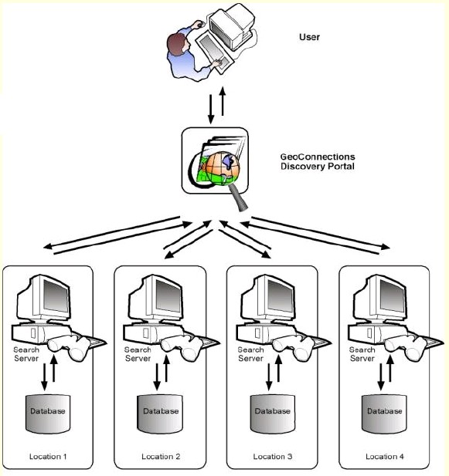
Distributed DBMS
LOGO
A Centralised view, but distributed

Slide 8
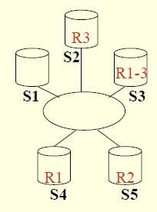
Cont…
LOGO
In Distributed DBMS, each site is a database system site in its own right, but the sites have agreed to work together (if necessary).
User at any site can access data anywhere in the network exactly as if the data were all stored at user’s own site.
E.g.
5 Sites,
4 Databases,
1 Replicate

Slide 9
Cont…
LOGO
A database server is the software managing a database, and a client is an application that requests information from a server.
Each computer in a system is a node. A node in a distributed
database system acts as a client, a server, or both, depending on the situation.

Slide 10
Distribution
LOGO
Deals with Physical distribution of data over
multiple sites
Three alternative architectures available
Client-Server, communication duties are shared between the client machines and
servers.
Peer-to-peer systems, no distinction of client machines versus servers. Integrate all local schemas.
Multi - DBMS. Integrate some local schema.

Slide 11
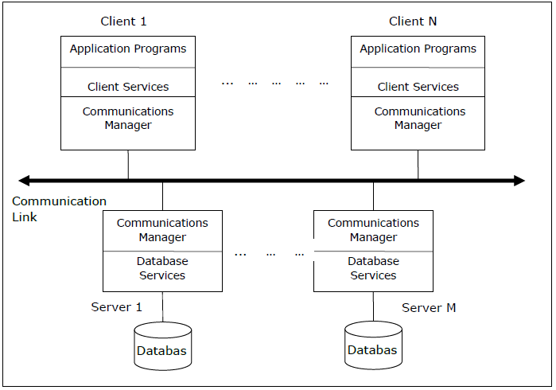
Client-Server (Multiple)
LOGO
Client-Server, communication duties are shared between the client machines and servers.

Slide 12
Cont …
LOGO
The two different client - server architecture are:
Single Server Multiple Client
Multiple Server Multiple Client (shown in the above diagram)

Slide 13
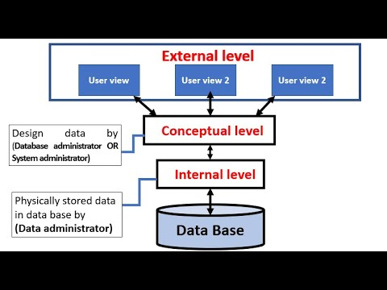
3 Level Architecture (ANSI/X3/SPARC)
External Scheme -Provide access for applications; Only data that is relevant.
Conceptual Scheme – Independent from internal schema; what data is stored in the whole database.
Internal scheme – Data on storage media, indexes

Slide 14
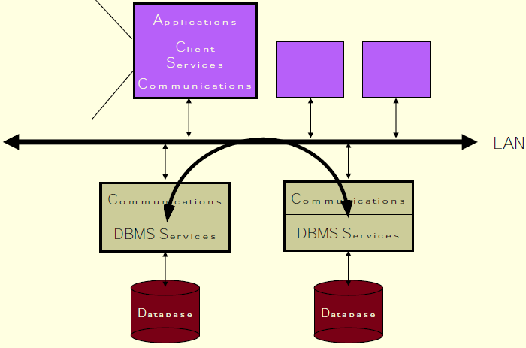
Peer-to-Peer (P2P) or Server-to-Server
LOGO
Peer-to-peer systems, no distinction between client machines versus servers. Integrate all local schemas.
SQL interface
Programmatic interface
Other application support environments

Slide 15
Cont …
LOGO
This architecture generally has four levels of schemas:
Global Conceptual Schema: Depicts the global logical view of data.
Local Conceptual Schema: Depicts logical data organization at each site.
Local Internal Schema: Depicts physical data organization at each site.
External Schema: Depicts user view of data.

Slide 16
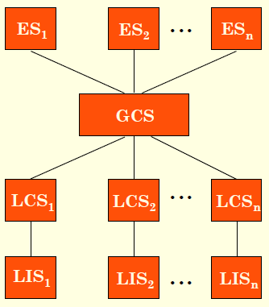
Distributed DBMS Architecture
LOGO
ES - External Schema
GCS – Global Conceptual Schema
LCS - Local Conceptual Schema
LIS - Local Internal Schema

Slide 17
Multi - DBMS
LOGO
Non-distributed systems. Integrate some local autonomous database systems. (Each database is independent and functions on its own.)
GCS is generated by integrating LCS’s.
Design of GCS is bottom-up.

Slide 18
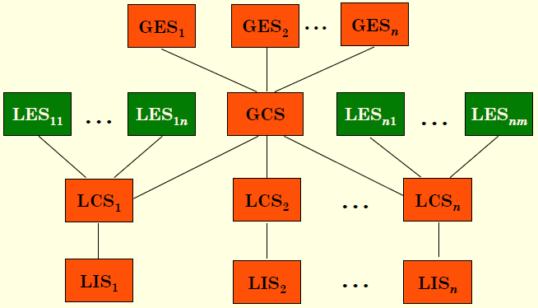
Multi-DBMS Architecture
LOGO
GES – Global External Schema
LES – Local External Schema
LCS - Local Conceptual Schema
LIS - Local Internal Schema

Slide 19
Design Alternatives
The distribution design alternatives for the tables in a DDBMS are as follows:
Non-replicated and non-fragmented
In this design alternative, different tables are placed at different sites. Data is placed at the site where it is used most. Can reduce the communication cost
Fully replicated
In this design alternative, at each site, one copy of all the database tables is stored. Queries are very fast. Negligible communication.
LOGO

Slide 20
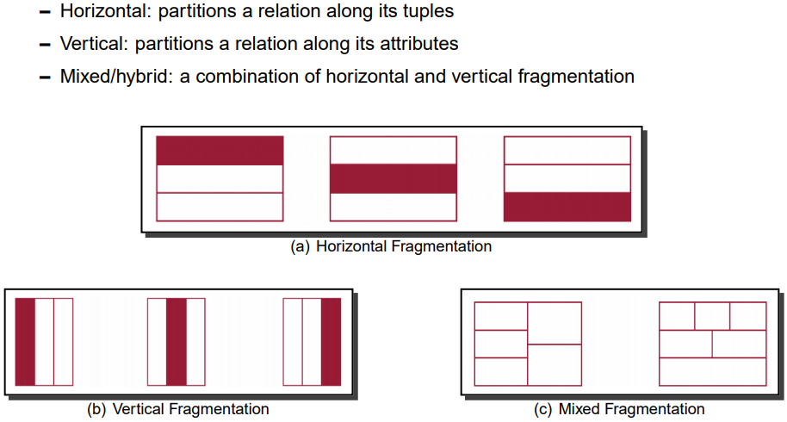
Partially replicated
Copies of tables or portions of tables are stored at different sites. The distribution of the tables is done in accordance with the frequency of access.
Fragmented
A table is divided into two or more pieces referred to as fragments and can be stored at different sites.

Slide 21
LOGO
Mixed Distribution
This is a combination of fragmentation and partial replications.
Here, the tables are initially fragmented in any form (horizontal or vertical), and then these fragments are partially replicated across the different sites according to the frequency of accessing the fragments.

Slide 22
Fragmentation
LOGO
A database is broken into logical units called fragments and assigned for storage at various sites.
Data fragmentation is partitioning data into number of disjoint subsets.

Slide 23
Type of Data Fragmentation
LOGO
Horizontal Fragmentation
Vertical Fragmentation
Hybrid/Mixed Fragmentation

Slide 24
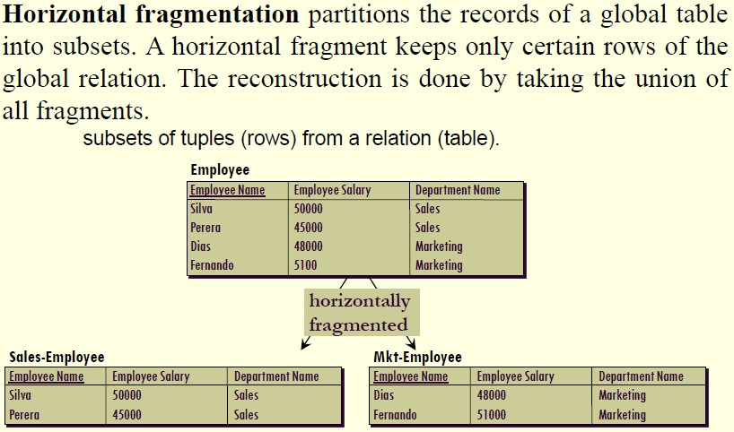
Horizontal Fragmentation
LOGO

Slide 25
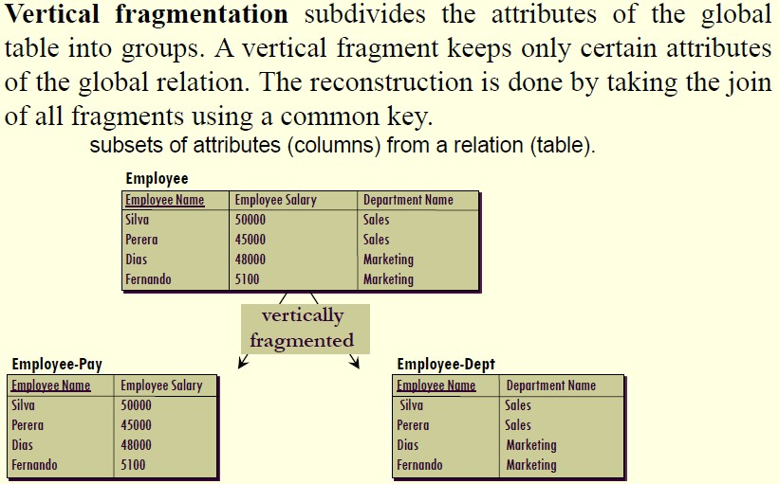
Vertical Fragmentation
LOGO

Slide 26
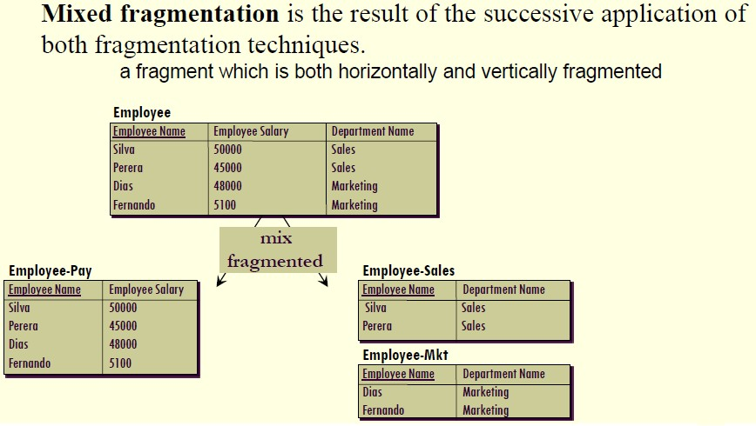
Mixed Fragmentation
LOGO

Slide 27
Criteria for Fragmentation/Integration
LOGO
Completeness Condition
All the data of the global relations must be mapped into the fragments. i.e. The global schema should integrate all concepts of the local schemas
Reconstruction Conditions
It must always be possible to reconstruct each global relation from its fragments. Concepts of the integrated schema must correspond to at least one concept in a local schema. Relationships in the integrated schema must not contradict local schemas

Slide 28
Criteria for Fragmentation/Integration
LOGO
Minimality
Semantically similar concepts should appear only once in the integrated schema
Understandability
The integrated schema should be understandable to users (keep names for attributes/relations if possible)

Slide 29
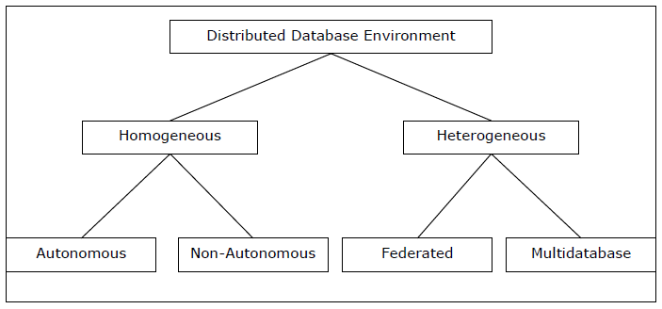
Types of Distributed Databases
LOGO

Slide 30
Homogeneous DDBMS
Homogeneous DDBMSs are software to integrate DBMSs geographically distributed over network; all DBMSs have same data model/query language; hardware is same manufacturer/operating system (server & user).
Uses one DBMS (e.g.: MS-SQL or Oracle)
LOGO

Slide 31
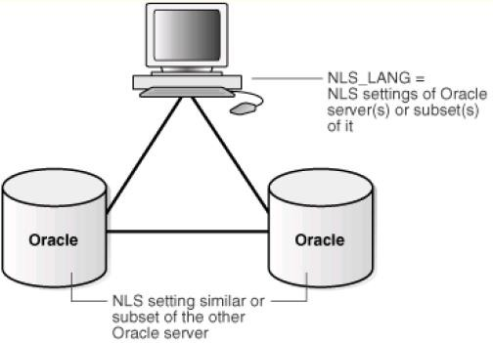
Cont …
LOGO

Slide 32
Types of Homogeneous DD
There are two types of homogeneous distributed database:
Autonomous: Each database is independent that functions on its own. They are integrated by a controlling application and use message passing to share data updates.
Non-autonomous: Data is distributed across the homogeneous nodes and a central or master DBMS co-ordinates data updates across the sites.
LOGO

Slide 33
Heterogeneous DDBMS
Difference in local DBMS and user software uses multiple DBMS's
e.g.: Oracle and MS-SQL and PostgreSQL.
LOGO

Slide 34
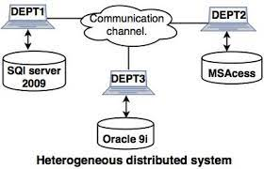
Cont …
LOGO

Slide 35
Types of Heterogeneous DD
There are two types of heterogeneous distributed database:
Federated: The heterogeneous database systems are independent in nature and integrated together so that they function as a single database system.
Un-federated: The database systems employ a central coordinating module through which the databases are accessed.
LOGO

Slide 36
Advantages of Distributed DB
Reflects organizational structure — database fragments are located in the departments they relate to.
Local autonomy — a department can control the data about them (as they are the ones familiar with it.)
Improved availability — a fault in one database system will only affect one fragment, instead of the entire database.
LOGO

Slide 37
Cont …
Improved performance — data is located near the site of greatest demand, and the database systems themselves are parallelized, allowing load on the databases to be balanced among servers. (A high load on one module of the database won't affect other modules of the database in a distributed database.)
LOGO

Slide 38
Cont …
Economics — it costs less to create a network of smaller computers with the power of a single large computer.
Modularity — systems can be modified, added and removed from the distributed database without affecting other modules (systems).
LOGO

Slide 39
Disadvantages of Distributed DB
LOGO
Complexity — extra work must be done by the DBAs to ensure that the distributed nature of the system is transparent. Extra work must also be done to maintain multiple disparate systems, instead of one big one. Extra database design work must also be done to account for the disconnected nature of the database — for example, joins become prohibitively expensive when performed across multiple systems.

Slide 40
Cont …
LOGO
Economics — increased complexity and a more extensive infrastructure means extra labour costs.
Security — remote database fragments must be secured, and they are not centralized so the remote sites must be secured as well. The infrastructure must also be secured (e.g., by encrypting the network links between remote sites).

Slide 41
Cont …
Difficult to maintain integrity — in a distributed database, enforcing integrity over a network may require too much of the network's resources to be feasible
Inexperience — distributed databases are difficult to work with, and as a young field there is not much readily available experience on proper practice.
LOGO

Slide 42
Cont …
Lack of standards — there are no tools or methodologies yet to help users convert a centralized DBMS into a distributed DBMS.
Database design more complex - In addition to traditional database design challenges, the design of a distributed database has to consider fragmentation of data, allocation of fragments to specific sites and data replication.
LOGO

Slide 43
Features DDMS
It is used to create, retrieve, update and delete distributed databases.
It synchronizes the database periodically and provides access mechanisms by the virtue of which the distribution becomes transparent to the users.
It ensures that the data modified at any site is universally updated.
LOGO

Slide 44
Cont …
It is used in application areas where large volumes of data are processed and accessed by numerous users simultaneously.
It maintains confidentiality and data integrity of the databases.
LOGO

Slide 45



LOGO
SESSION Guide 05

