Slide 1

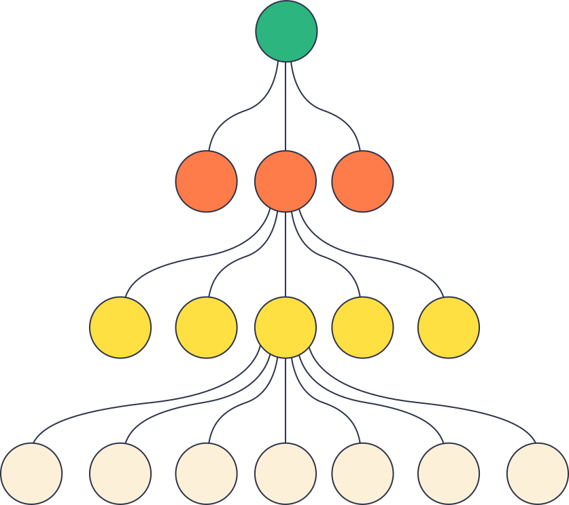
WEEK 07:DATABASES AND DATA STRUCTURES
TREE
Data Structure

Slide 2

INTRODUCTION
OUTLINE
TREE STRUCTURE
BINARY TREES
BINARY SEARCH TREES

Slide 3

rr
INTRODUCTION
What is a Tree DS?
  Non- linear data structure
  A hierarchical structure
  Uses to represent and organize data in a way that is easy to navigate and search
  A collection of nodes that are connected by edges and has a hierarchical relationship between the nodes.

Slide 4
rr
INTRODUCTION
Why uses Trees?
  Hierarchical Data Representation (e.g., file systems, organizational charts, DOM).
  Efficient Searching and Sorting (e.g., Binary Search Trees).
  Applications in:
    Databases
    Networking (e.g., routing)
    Artificial Intelligence (e.g., decision trees, random forest).

Slide 5
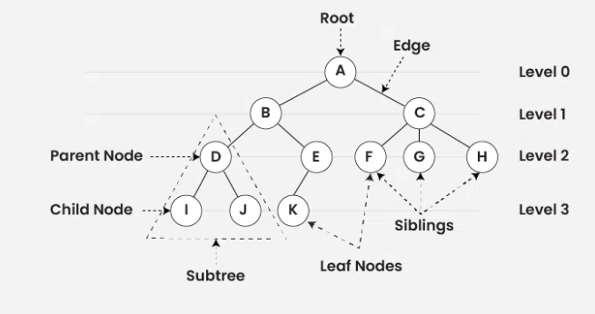
rr
INTRODUCTION
Structure of a Tree DS

Slide 6
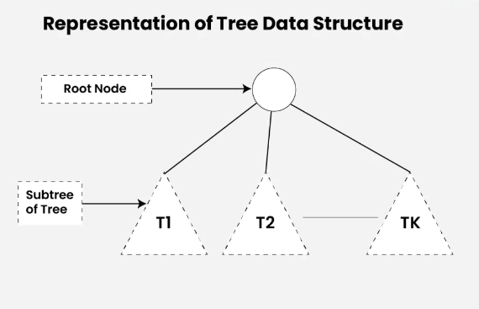
rr
INTRODUCTION
Structure of a Tree DS

Slide 7
rr
TERMINOLOGIES
Terminologies Associate with Tree DS
  Parent Node: The node which is an immediate predecessor of a node is called the parent node of that node.
  Child Node: The node which is the immediate successor of a node is called the child node of that node.
  Root Node: The topmost node of a tree or the node which does not have any parent node is called the root node.
  Leaf Node: The nodes which do not have any child nodes are called leaf nodes.
  Ancestor of a Node: Any predecessor nodes on the path of the root to that node are called Ancestors of that node.
  Descendant: A node x is a descendant of another node y if and only if y is an ancestor of x
  Sibling: Children of the same parent node are called siblings.

Slide 8
rr
TERMINOLOGIES
Terminologies Associate with Tree DS
  Level of a node: The count of edges on the path from the root node to that node. The root node has level 0.
  Internal node: A node with at least one child is called Internal Node.
  Neighbor of a Node: Parent or child nodes of that node are called neighbors of that node.
  Subtree: Any node of the tree along with its descendant.
  Height: The number of edges from the root node to the deepest leaf node
  Size of the tree: number of nodes in the tree.

Slide 9
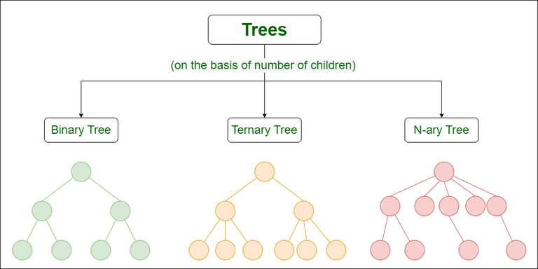
rr
TYPES OF TREES

Slide 10
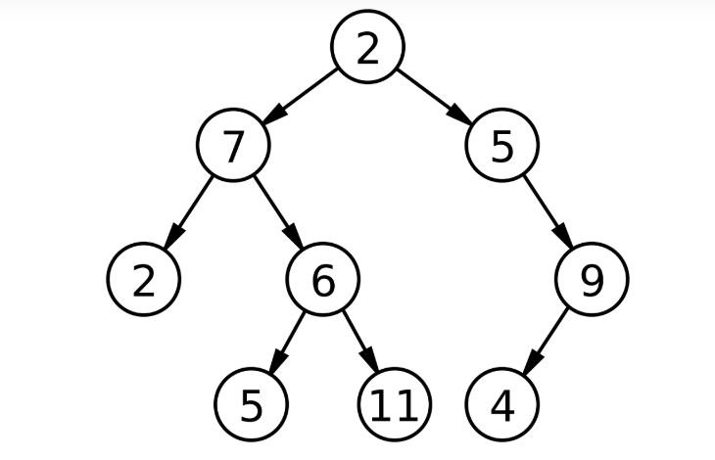
rr
BINARY TREES
  A hierarchical data structure in which each node has at most two children ( the left child and the right child)
  commonly used in computer science for efficient storage and retrieval of data

Slide 11
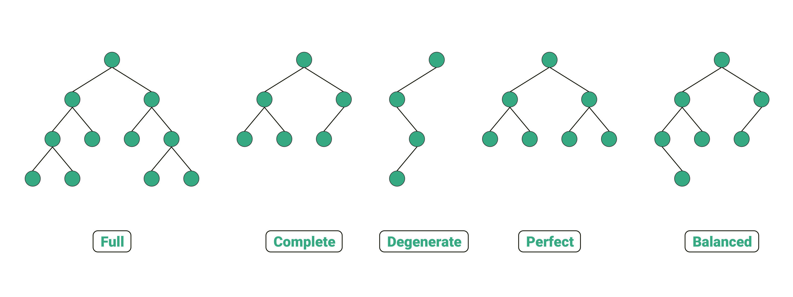
TYPES OF BINARY TREE

Slide 12
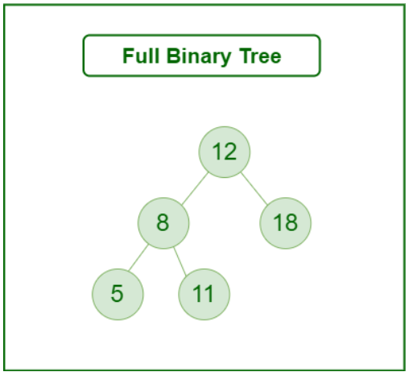
TYPES OF BINARY TREE
Full Binary Tree
  A Binary Tree is a full binary tree if every node has 0 or 2 children
  In other words, a full binary tree is a binary tree in which all nodes except leaf nodes have two children
  A special type of binary tree in which every parent node/internal node has either two or no children.
  It is also known as a proper binary tree.

Slide 13
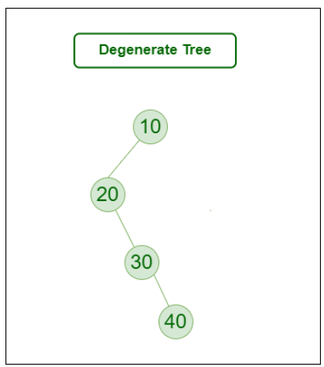
TYPES OF BINARY SEARCH TREE
Degenerate Tree
  A Tree where every internal node has one child.
  Perform as a linked list
  Each non leaf node has a one child, either as left or right node

Slide 14
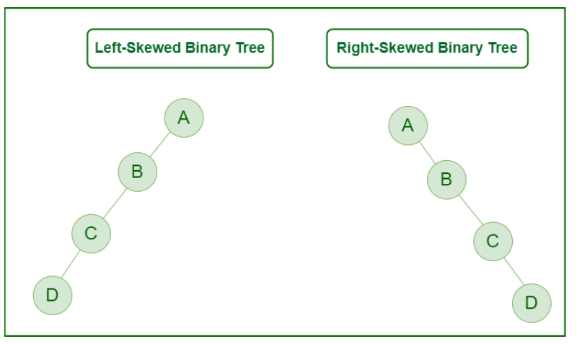
TYPES OF BINARY TREE
Skewed Binary Tree
  A skewed binary tree is a degenerate tree in which the tree is either dominated by the left nodes or the right nodes.
  Thus, there are two types of skewed binary tree: left-skewed binary tree and right-skewed binary tree.

Slide 15
TYPES OF BINARY TREE
Skewed Binary Tree
  A skewed binary tree is a degenerate tree in which the tree is either dominated by the left nodes or the right nodes.
  Thus, there are two types of skewed binary tree: left-skewed binary tree and right-skewed binary tree.

Slide 16
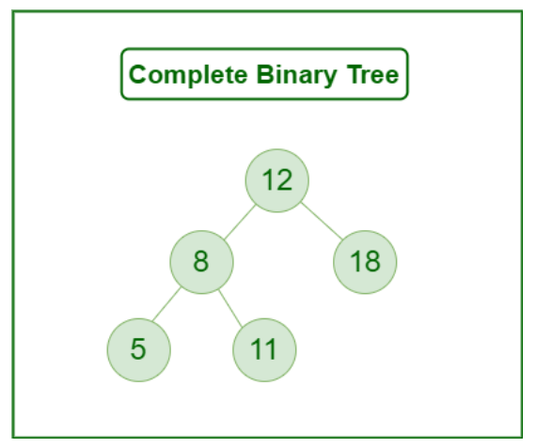
TYPES OF BINARY TREE
Complete Binary Tree
  A Binary Tree is a Complete Binary Tree if all the levels are completely filled except possibly the last level and the last level has all keys as left as possible.
  A complete binary tree is just like a full binary tree, but with two major differences:
    Every level except the last level must be completely filled.
    All the leaf elements must lean towards the left.
    The last leaf element might not have a right sibling i.e. a complete binary tree doesn’t have to be a full binary tree.

Slide 17
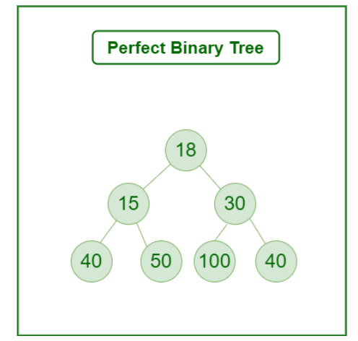
TYPES OF BINARY TREE
Perfect Binary Tree
  A Binary tree in which all the internal nodes have two children and all leaf nodes are at the same level.

Slide 18
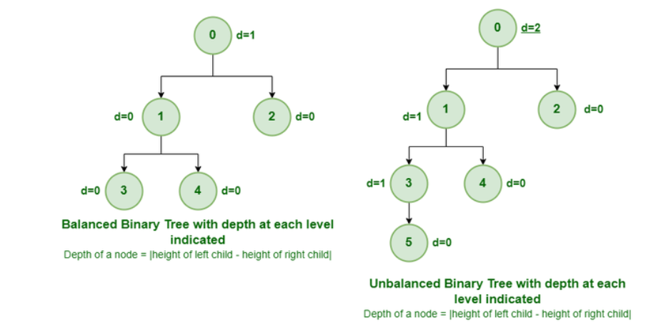
TYPES OF BINARY TREE
Balanced Binary Tree
  A binary tree in which the difference in height (the number of edges on the longest path from the root to a leaf) between the left and right subtrees of any node is at most one. This ensures that the tree remains roughly balanced, which helps optimize operations such as searching, insertion, and deletion.

Slide 19
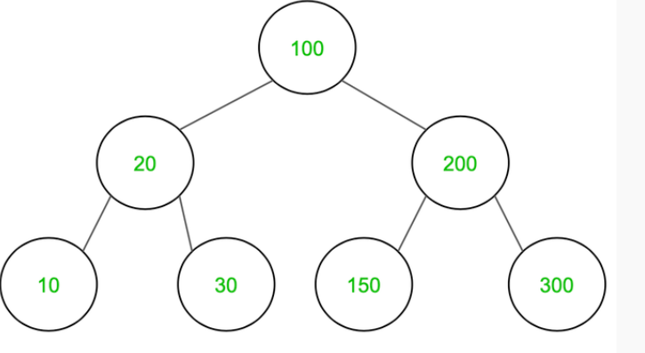
BINARY TREES
(TRAVERSAL)
  Breadth First Search (BFS) is when the nodes on the same level are visited before going to the next level in the tree. This means that the tree is explored in a more sideways direction.
  Depth First Search (DFS) is when the traversal moves down the tree all the way to the leaf nodes, exploring the tree branch by branch in a downwards direction.
    in-order
    pre-order
    post-order

Slide 20
BINARY TREES
(TRAVERSAL)
  In-Order Traversal: At first traverse left subtree then visit the root and then traverse the right subtree.
  Steps:
    Traverse left subtree
    Visit the root and print the data.
    Traverse the right subtree
  In-order:
10,20,30,100,150,200,300

Slide 21
BINARY SEARCH TREES
(TRAVERSAL)
  Pre-Order Traversal: At first visit the root then traverse left subtree and then traverse the right subtree.
  Steps:
    Visit the root and print the data.
    Traverse left subtree
    Traverse the right subtree
  Pre-order:
100,20,10,30,200,150,300

Slide 22
BINARY TREES
(TRAVERSAL)
  Post-Order Traversal: At first traverse left subtree then traverse the right subtree and then visit the root.
  Steps:
    Traverse left subtree
    Traverse the right subtree
    Visit the root and print the data.
  Post-order:
10,30,20,150,300,200,100

Slide 23
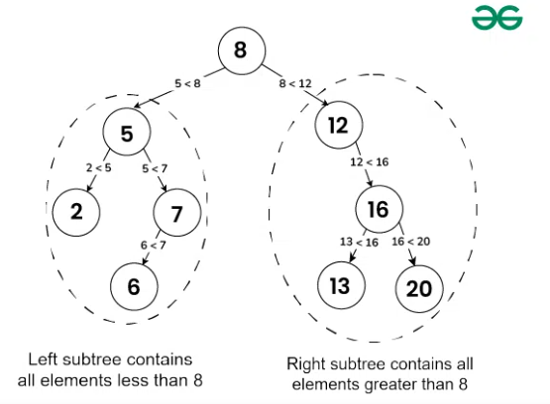
BINARY SEARCH TREES
  BST is a data structure used in computer science for organizing and storing data in a sorted manner.
  Each node in a Binary Search Tree has at most two children, a left child and a right child,
  The left child containing values less than the parent node and the right child containing values greater than the parent node.
  Allows for efficient searching, insertion, and deletion operations on the data stored in the tree.

Slide 24
BINARY SEARCH TREES
  Properties of BST:
  The left subtree of a node contains only nodes with keys lesser than the node’s key.
  The right subtree of a node contains only nodes with keys greater than the node’s key.
  The left and right subtree each must also be a binary search tree.
  There must be no duplicate nodes(BST may have duplicate values with different handling approaches).

Slide 25
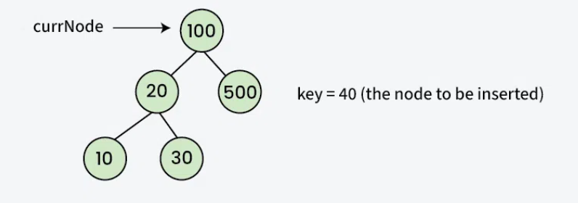
BINARY SEARCH TREES
  Insertion in BST
    Initilize the current node (say, currNode or node) with root node
    Compare the key with the current node.
    Move left if the key is less than or equal to the current node value.
    Move right if the key is greater than current node value.
    Repeat steps 2 and 3 until you reach a leaf node.
    Attach the new key as a left or right child based on the comparison with the leaf node’s value.

Slide 26
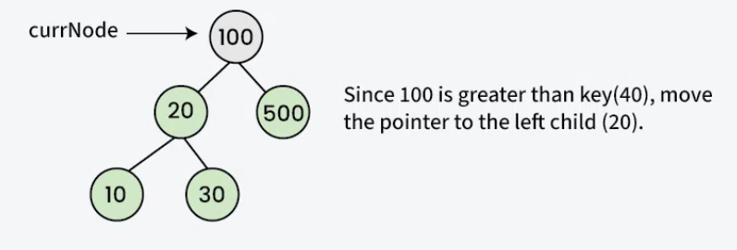
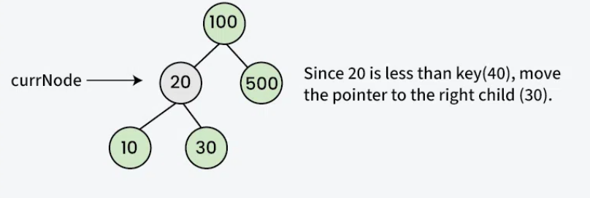
BINARY SEARCH TREES
(INSERTION)

Slide 27
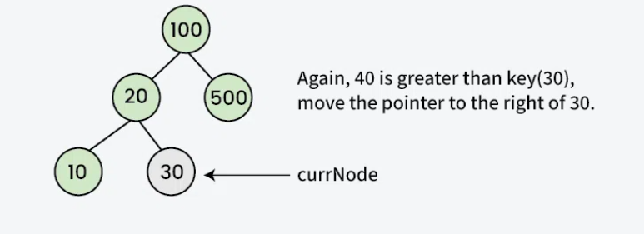
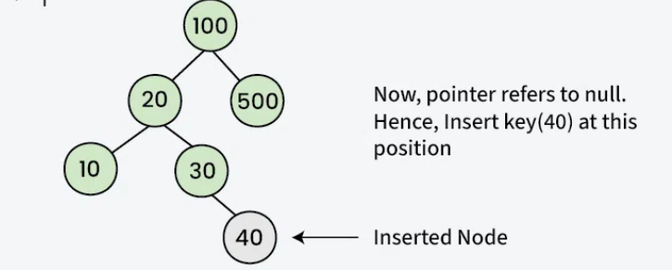
BINARY SEARCH TREES
(INSERTION)

Slide 28
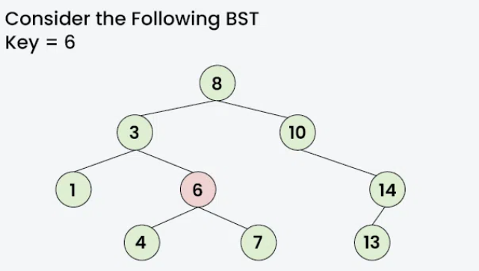
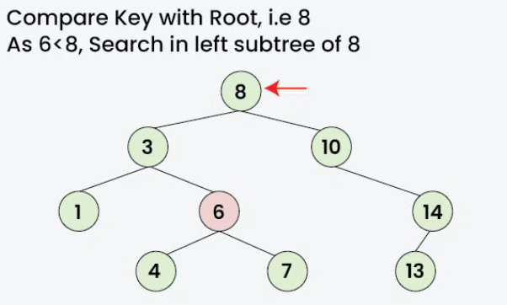
BINARY SEARCH TREES
(SERACH OPERATION)

Slide 29
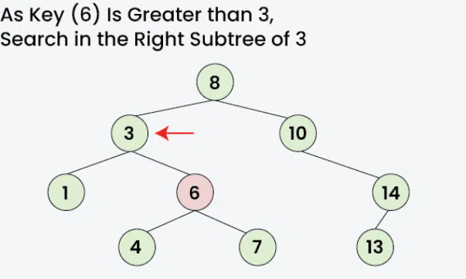
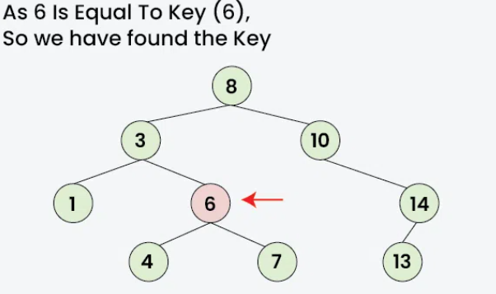
BINARY SEARCH TREES
(SERACH OPERATION)

Slide 30
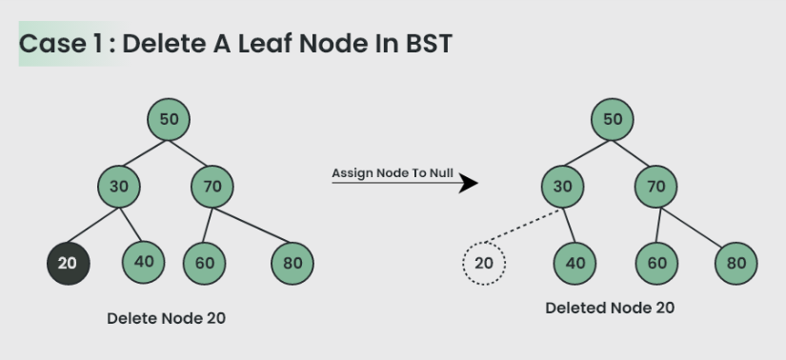
BINARY SEARCH TREES
(DELETION)
  Delete a Leaf Node
    Simply, the node can be deleted by assigning null to the deleting node

Slide 31
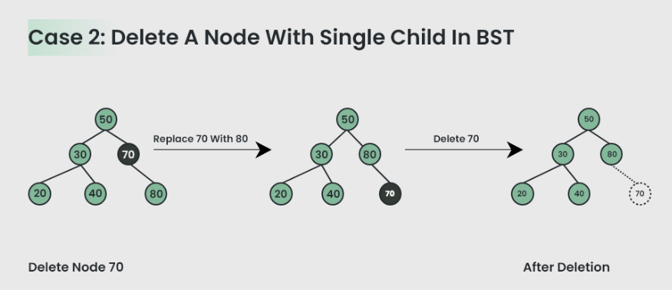
BINARY SEARCH TREES
(DELETION)
  Delete a Node with Single Child in BST
    Deleting a single child node is also simple in BST. Copy the child to the node and delete the node.

Slide 32
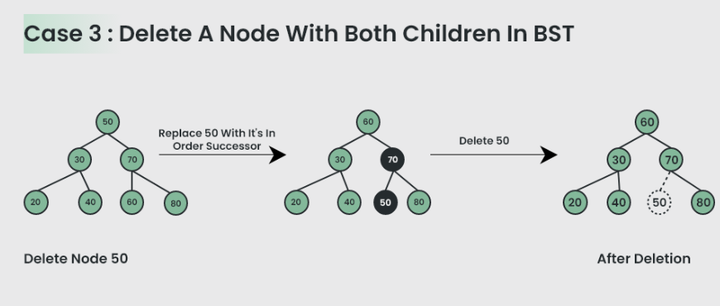
BINARY SEARCH TREES
(DELETION)
  Delete a Node with Both Children in BST
    Deleting a node with both children is not so simple.
    Have to delete the node is such a way, that the resulting tree follows the properties of a BST.
    The trick is to find the inorder successor of the node.
    Copy contents of the inorder successor to the node, and delete the inorder successor.

