Slide 1
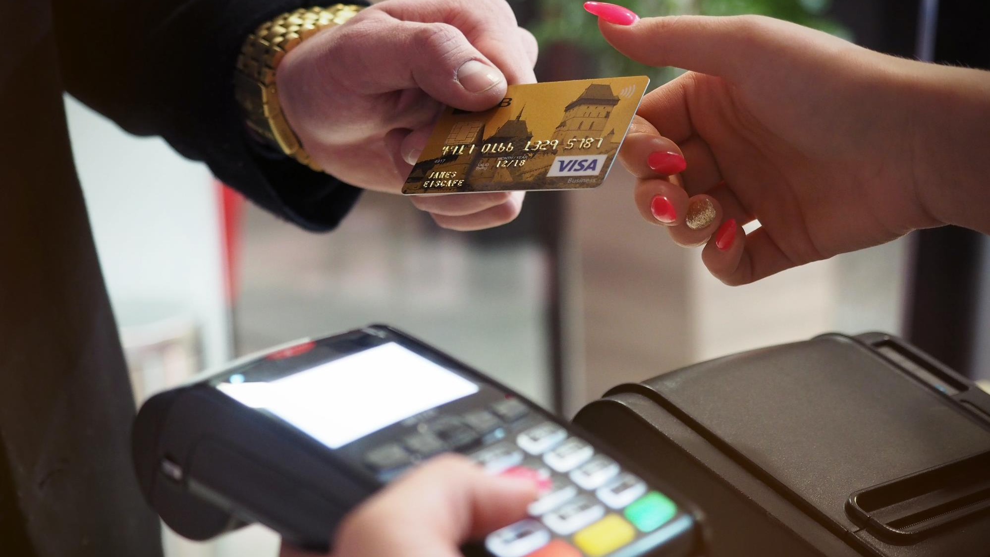
Braintree Provider Participants: Nethravathi A

Slide 2
Braintree
A PayPal service for payment solutions
INTRODUCTION
Braintree is a PayPal service for an Online Payment Solutions.
Facilitates mobile and web payment systems for e-commerce companies.
Braintree provides clients with a merchant account and a payment gateway.
The Payments platform supports wide range of payment methods PayPal, Credit/Debit cards, Google Pay, Venmo(in US) etc.
Provides robust mechanism for secured data transfer and fraud protection.
Braintree is available for merchants in the United States, Canada, Australia, Europe, Singapore, Hong Kong, Malaysia, and New Zealand.
Supports various important Payment services including Authorize Payment Method, Capture Transaction, Charge Payment Method, Vault Payment Method etc.

Slide 3
Braintree
A PayPal service for payment solutions
webMethods.io – Braintree connector supports performing various actions on Braintree account using GraphQL APIs.
The following actions are currently supported by the Braintree connector:
Create Client Token – Create a client token for creating payment methods.
Authorize Payment Method – Verify the payment method details and authorize the payment transaction.
Capture Transaction – Initiate fund transfer from customer account into the merchant’s account.
Refund Transaction – Refund amount for a settled transaction.
Charge Payment Method – Charges for the respective payment method. Ex for Payment methods: PayPal, Credit cards etc.
Vault Payment Method – Save the Payment method details in a Vault. The customer need not key in the payment method details and will be retrieved from the Vault for any new transactions.
Search Transactions – Search for transactions on transaction status. Based on the transaction status, further actions can be invoked.

Slide 4
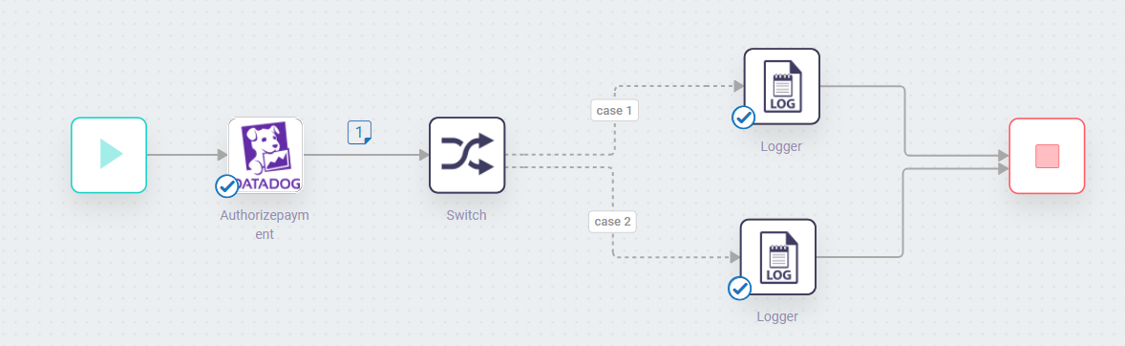
Screenshots for workflow
Braintree Connector
Authorize Payment Method

Slide 5
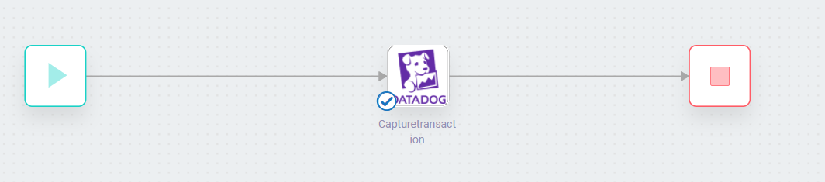
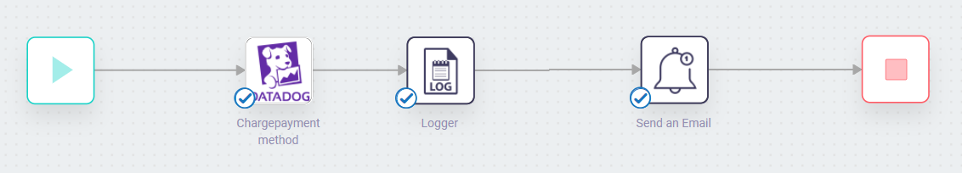
Screenshots for workflow
Braintree Connector
Capture Transaction
Charge Payment Method

Slide 6
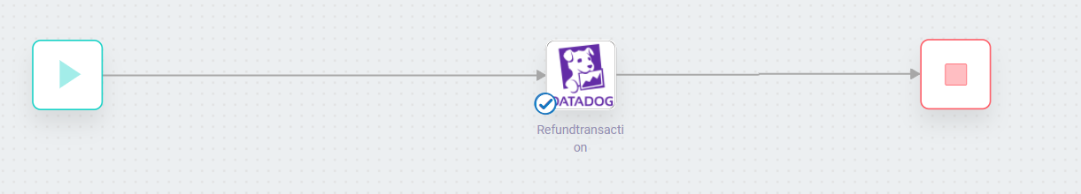
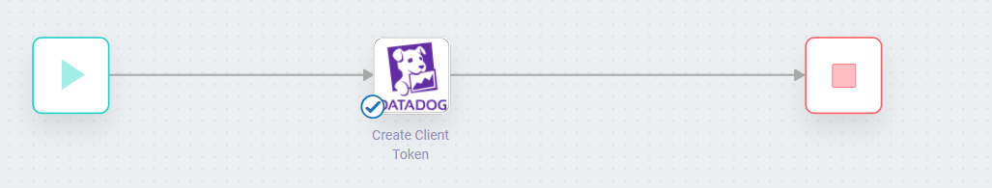
Screenshots for workflow
Braintree Connector
Refund Transaction
Create Client Token

Slide 7
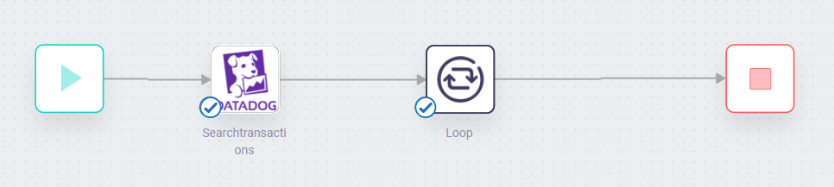
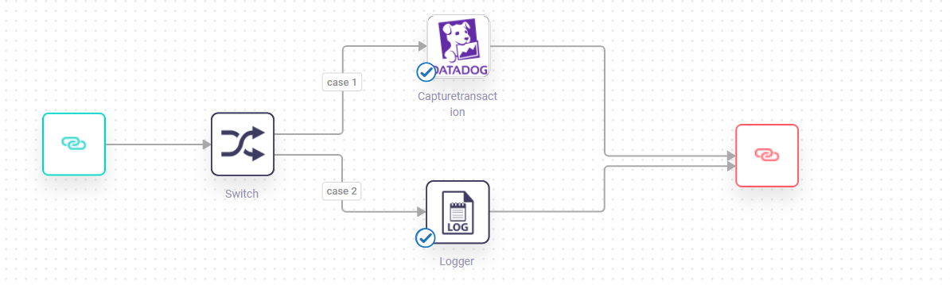
Screenshots for workflow
Braintree Connector
Search Transactions

