Slide 1
Capstone Project
Title: Bank Loan Default Prediction
Name: Nethra K
Shreya H K
Vanitha Shree
Manasa R
Nageshwari S
Bhuvana TS
College: BCU
Foundational Data Analysis

Slide 2
AGENDA
Project Overview
Research Questions / Objectives
Dataset Description
Data Preparation (SQL + Cleaning)
Descriptive Statistics
Inferential Statistics
Correlation & Relationships (EDA)
Linear Regression Model
Key Insights & Interpretation
Conclusion

Slide 3
Introduction and Statement

Slide 4
Background
Loan approval decisions are critical in the financial industry, impacting both lenders and borrowers. With millions of loan applications processed annually in India, effective assessment of creditworthiness is essential for minimizing risk and maximizing approval rates for creditworthy applicants. Traditional methods rely on credit scores and manual underwriting, but integrating machine learning into loan approval processes can enhance accuracy and provide personalized insights for lenders.

Slide 5
Goal of the Project
The goal of this project is to build a robust and interpretable machine learning model capable of predicting load demands accurately. Using techniques such as time series analysis, feature engineering, and regression models, the project seeks to provide data-driven insights that can aid in load forecasting and management. Additionally, deploying the model via Streamlit ensures accessibility, allowing users to interact with the predictions through a user-friendly web application.

Slide 6
Objective
The primary objective of this study is to develop a machine learning-based predictive model that can assess loan approval likelihood based on various demographic, financial, and loan-specific factors. By analyzing historical loan application data, the model aims to identify key factors influencing loan approval and estimate the probability of approval for new applicants. This can help lenders in risk assessment, decision-making, and optimizing loan approval processes.

Slide 7
Project Overview

Slide 8
Purpose : The purpose of this project is to predict whether a customer defaults on a loan and to analyze patterns in approval data within the Banking/Finance domain.
Objective: To analyze the relationships between variables like age, income, credit score, loan amount, gender, date, education level, interest rate, region, loan term, loan purpose, loan approved, loan status, martial status.
Tools Used: Python (Numpy, Pandas, Seaborn, Matplotlib, Scikit-learn), SQL, Statistics
Dataset: 1000+ loan records with variables — age, income, credit score, loan amount, gender, date, education level, interest rate, region, loan term, loan purpose, loan approved, loan status, martial status.

Slide 9
Dataset Description
Purpose: To predict whether a customer defaults on a loan and analyze
patterns in approval data in the Banking/Finance domain.
Include:
Variables: Income, age, Credit_score, loan amount, Gender , Date, Education level, Interest rate, Region, loan term , loan purpose, loan approved, loan status, martial status.

Slide 10
Research Questions / Objectives
Purpose: To predict whether a customer defaults on a loan and analyze
patterns in approval data in the Banking/Finance domain.
Possible Questions:
How does loan approval vary with credit score, income, or loan amount?
Does gender, marital status, or education level impact loan approval?
Are business loans approved more often than personal loans?
How does credit score distribution look for approved vs rejected loans?

Slide 11
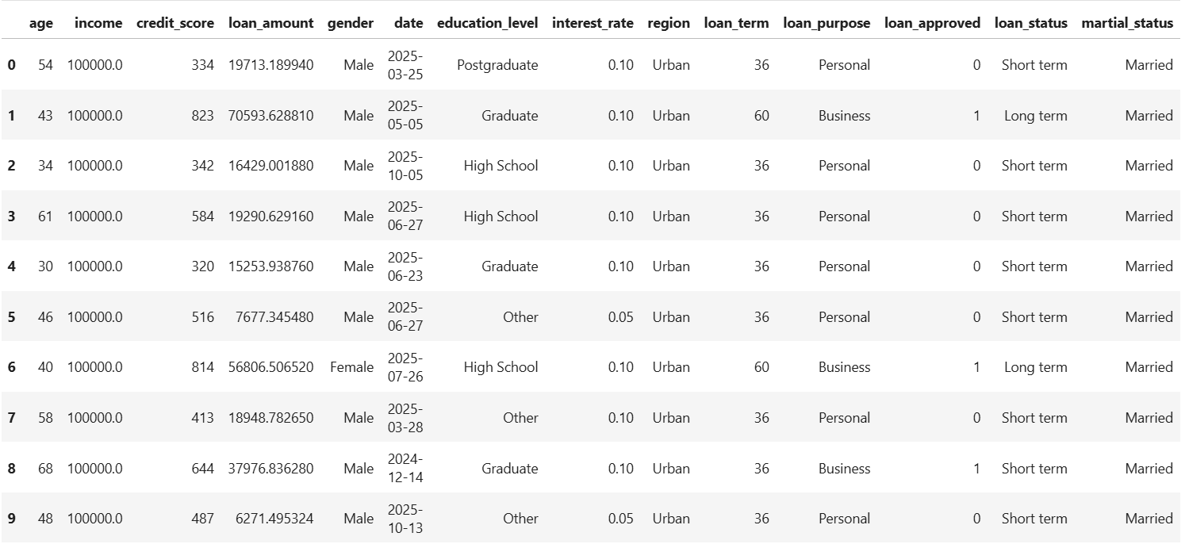

Slide 12
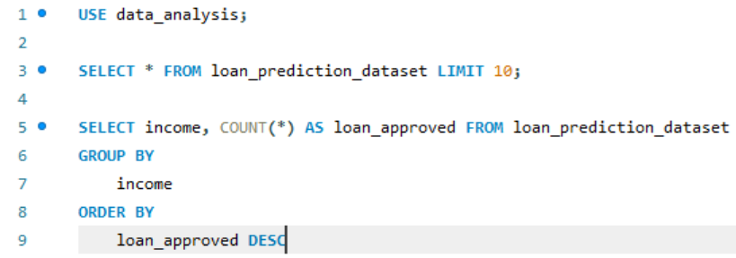
Data Preparation (SQL + Cleaning)
Purpose: This query analyzes loan distribution by income levels, grouping data and counting loans in each category to identify trends.
Include:
SQL Query to group data by income.
Count of loans (loan count) per income level.
Results ordered by loan count in descending order

Slide 13
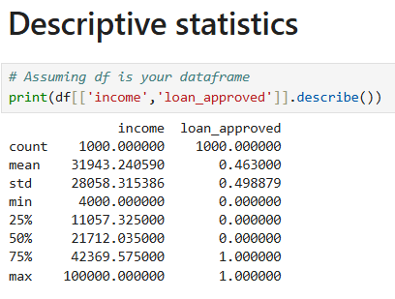
Descriptive Statistics
Purpose: Present summary findings.
Include:
Count, mean, median, std of income and loan approved
Highlight interesting points:
  Average income : 31,943
  Loan Approval Rate : 46.3%
  Income range : 4,000 – 100,000

Slide 14
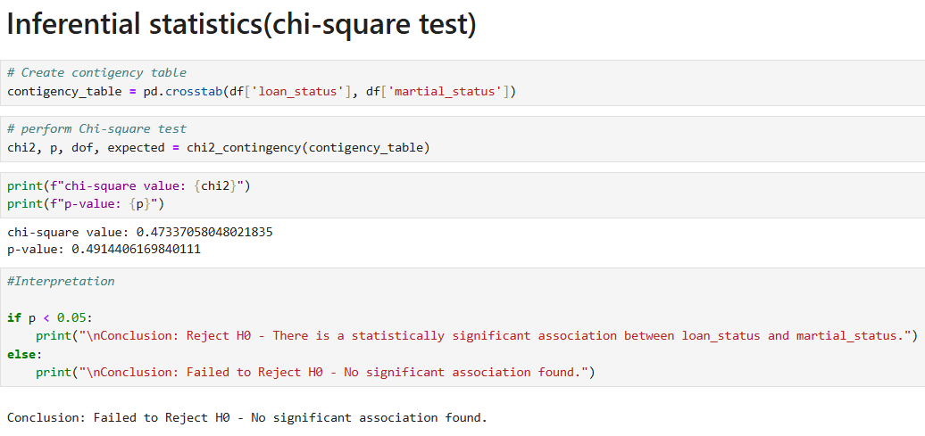
Inferential Statistics
Purpose: Present hypothesis testing results.
Example:
Hypothesis: Testing the association between loan status and martial status.
Method: Chi-square test
Result: p-value = 0.49 (< 0.05) → No statistically significant

Slide 15
Exploratory Data Analysis (EDA)

Slide 16
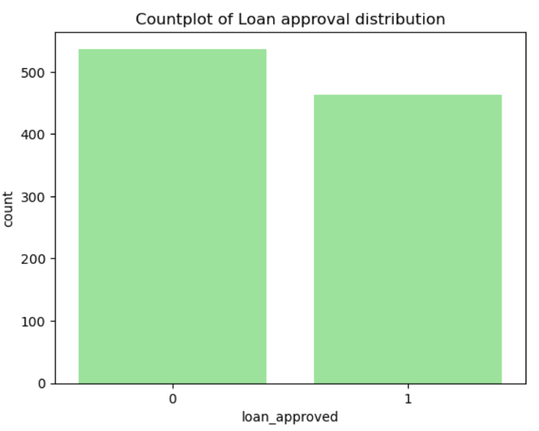
Insights gained
1. Distribution of Loan Approval
Countplot of Loan Approval Distribution: The countplot shows the distribution of loan approvals (0 and 1), indicating a relatively balanced count between approved and possibly not approved loans.
Key Insights
The distribution suggests a balanced dataset in terms of loan approval outcomes.

Slide 17
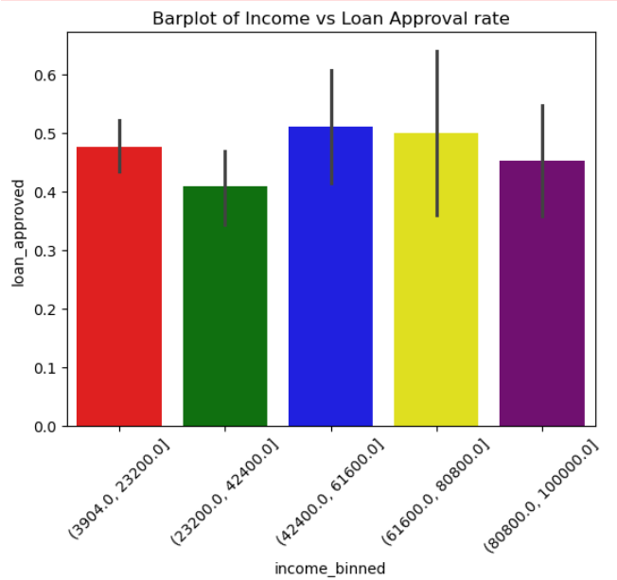
Barplot of Income vs Loan Approval Rate: Loan approval rates are shown across different income bins. Approval rates seem somewhat consistent across income groups, with slight variations.
Key Insights
Approval rates are somewhat consistent across different income levels, suggesting income might not be a major differentiator in this dataset for loan approval.

Slide 18
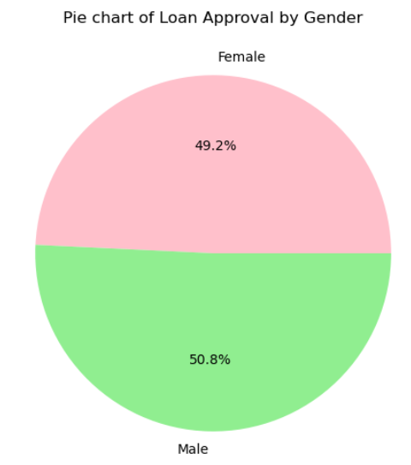
Pie Chart of Loan Approval by Gender: Loan approvals are split between males (50.8%) and females (49.2%), indicating a slight edge in approval percentage for males.
Key Insights
Approval rates are somewhat consistent across different income levels, suggesting income might not be a major differentiator in this dataset for loan approval.

Slide 19
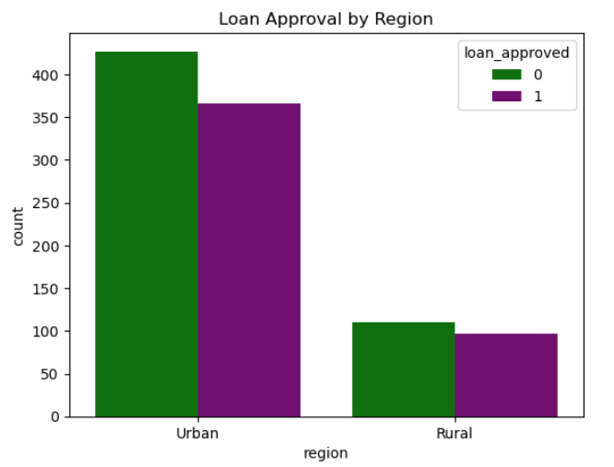
Loan Approval by Region: The bar chart shows loan approval counts for Urban and Rural regions. In both regions, there are counts for loans not approved (0, green) and approved (1, purple).-
In Urban regions, non-approved loans (green) are more than approved loans (purple).
In Rural regions, counts are lower overall compared to Urban, with non-approved loans (green) more than approved loans (purple).
Key Insights
Loan applications are more frequent in Urban regions compared to Rural.
Approval rates seem lower than non-approval rates in both regions.

Slide 20
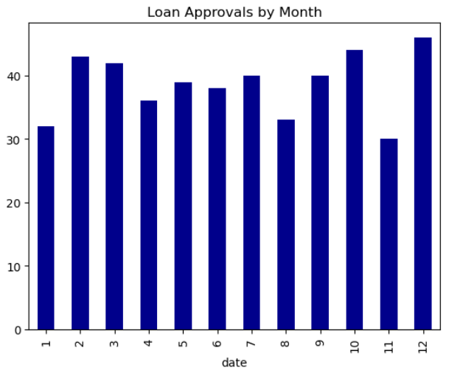
Loan Approvals by Month: The bar chart shows loan approvals by month (1 to 12).
Approvals vary across months, with some months having higher counts (e.g., months 3, 4, 10, 11).
Month 12 has one of the lower approval counts.
Key Insights
Loan approval counts fluctuate across months, suggesting potential seasonal patterns or varying demand.
Certain months see higher approval counts, possibly due to financial cycles or business needs.

Slide 21
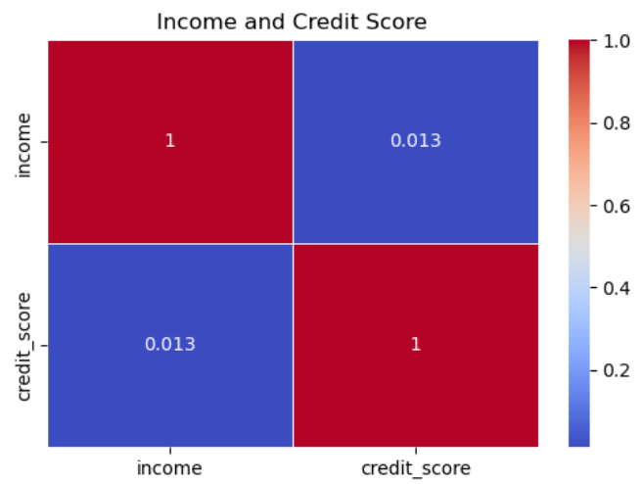
Correlation & Relationships
Purpose: Show relationships between key variables.
Include:
Scatter plot: Income vs Credit Score
Correlation heatmap of (Income, Credit Score)
Interpretation: strong positive correlation between Income and Credit Score (r = 1.0).

Slide 22
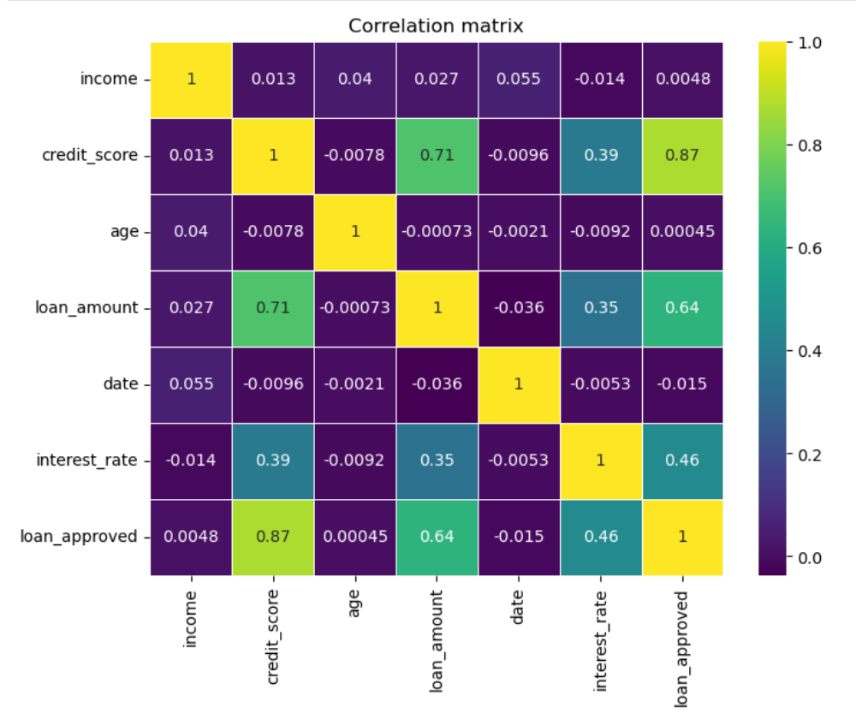

Slide 23
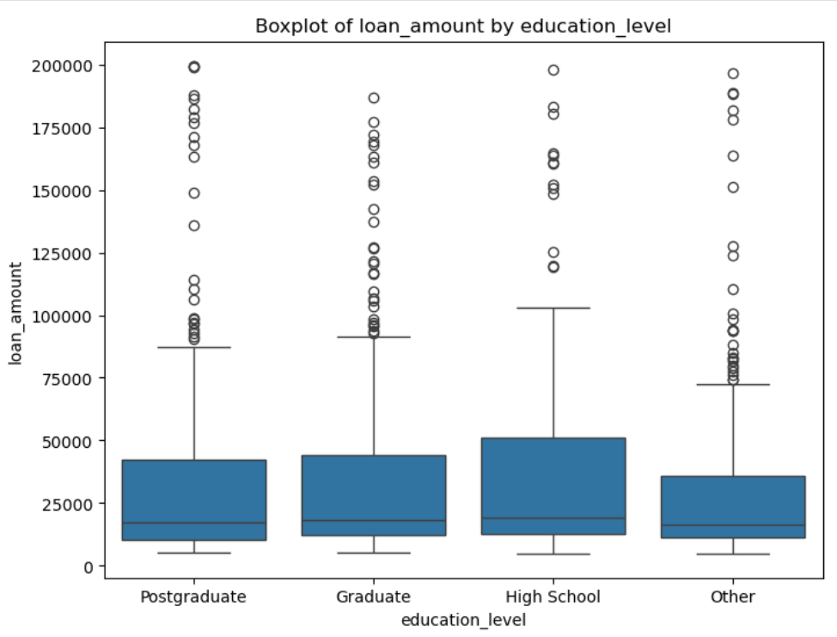
Visualization of Box Plot
Boxplot of loan amount by education level: Loan amounts are distributed similarly across education levels (Postgraduate, Graduate, High School, Other). Some outliers have higher loan amounts.
Key Insights
Education level doesn't seem to strongly impact loan amounts.
Outliers indicate some applicants get larger loans.

Slide 24
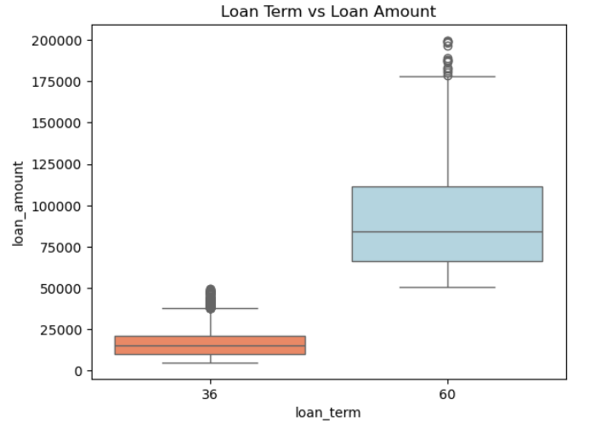
Loan Term vs Loan Amount: Loans with a 60-month term have higher amounts compared to 36-month terms.
Key Insights
Longer loan terms are associated with higher loan amounts.
Median loan amount is higher for 60-month terms.

Slide 25
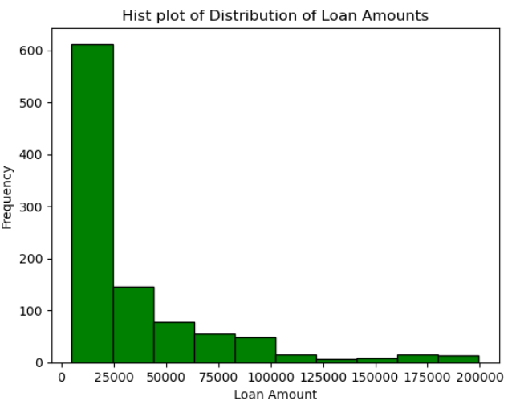
Visualization of Hist Plot
Histogram of Distribution of Loan Amounts: Most loans are for lower amounts (peaking at the lowest bin).
Frequency decreases as loan amount increases.
Key Insights
Loan amounts are right-skewed.
Most loans are smaller.

Slide 26
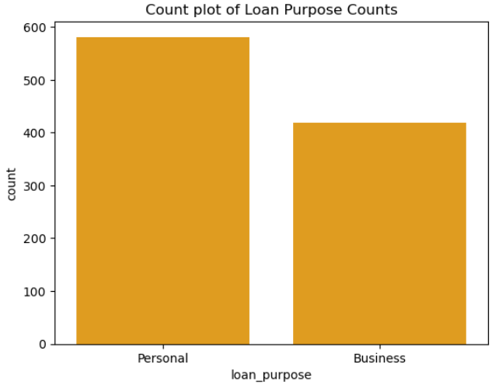
Visualization of Count Plot
Count plot of Loan Purpose Counts: Personal loans outnumber business loans.
Key Insights
Personal loans are more common than business loans.

Slide 27
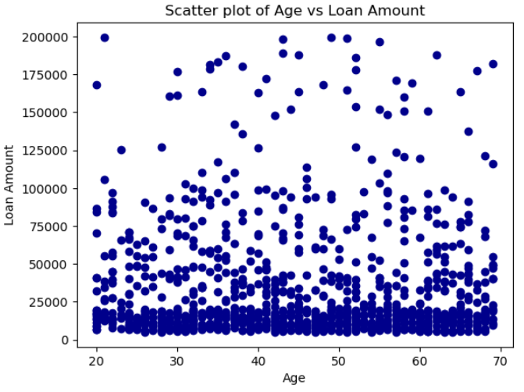
Visualization of Scatter Plot
Scatter plot of Age vs Loan Amount: clear pattern between age and loan amount. Points are spread out.
Key Insights
Age doesn't seem to strongly correlate with loan amount.

Slide 28
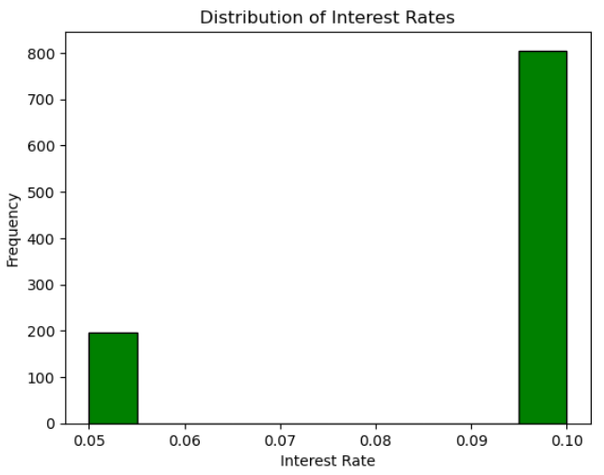
Distribution of Interest Rates: Most interest rates are concentrated at the higher end (around 0.10), with a smaller portion at a lower interest rate (around 0.05).
Key Insights
Most data points are at a higher interest rate (0.10).

Slide 29
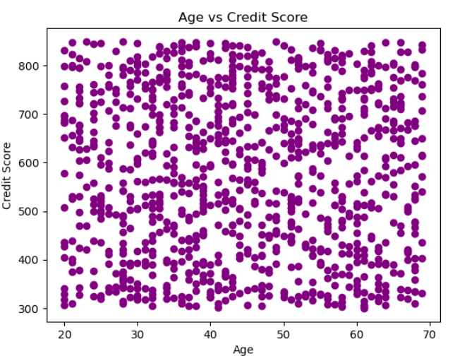
Age vs Credit Score: There's no clear visible correlation between age and credit score from the scatter plot. The data points are spread out without a distinct pattern.
Key Insights
No clear correlation between age and credit score.

Slide 30
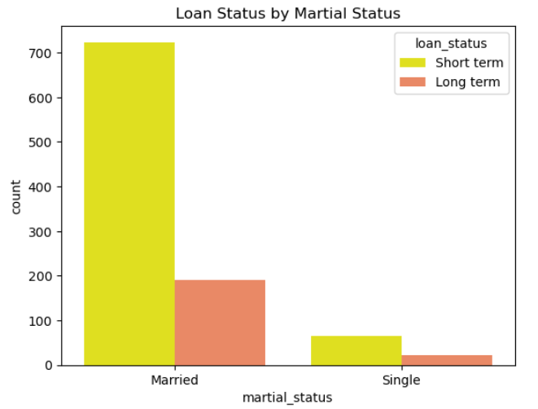
Loan Status by Martial Status: Married individuals have a higher count of loans compared to single individuals.
For both married and single individuals, short-term loans are more common than long-term loans.
Key Insights
Married folks have more loans than singles.
Short-term loans are more common for both married and single individuals.

Slide 31
Machine Learning Models

Slide 32
Algorithms Implemented
1. Logistic Regression
Logistic Regression provides clear insights into feature importance and relationships.
Suitable for binary loan approval outcomes (approved/rejected).
Assumes linear relationships between features and log-odds.
2. Random Forest
Random Forest captures complex relationships between features.
Provides feature importance scores for selection.
Handles missing values and outliers well.
3. XGBoost
XGBoost often outperforms other algorithms in terms of accuracy.
Captures complex feature interactions.
Built-in regularization techniques prevent overfitting.

Slide 33
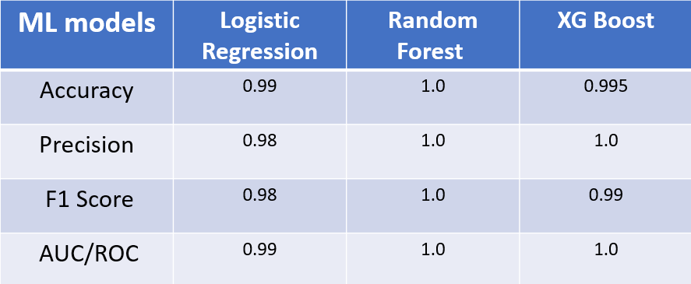
Comparison of the models after hyperparameter tuning
Model Evaluation

Slide 34
Confusion Matrix Representation:
A confusion matrix helps us visualize the model’s classification performance.
It consists of:
  True Positives (TP): Correctly predicted positive cases.
  True Negatives (TN): Correctly predicted negative cases.
  False Positives (FP): Incorrectly predicted positive cases.
  False Negatives (FN): Incorrectly predicted negative cases

Slide 35
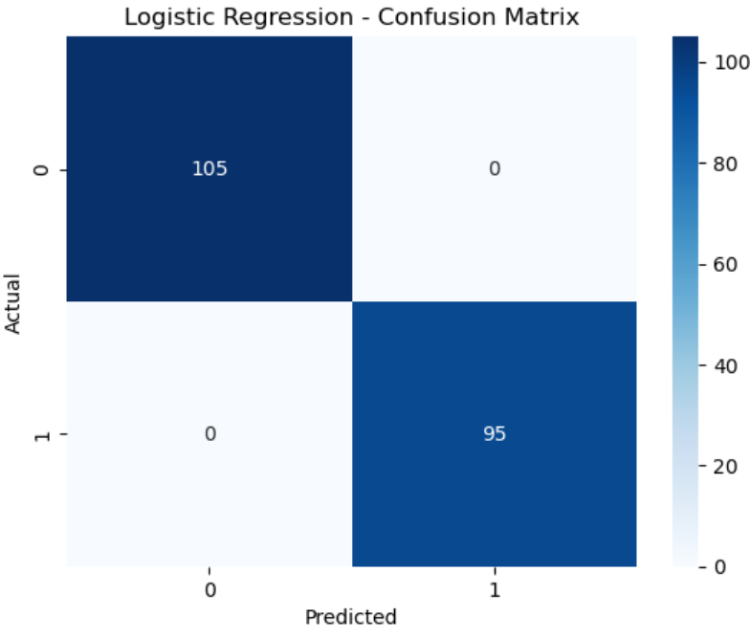
Logistic Regression

Slide 36

Random Forest

Slide 37
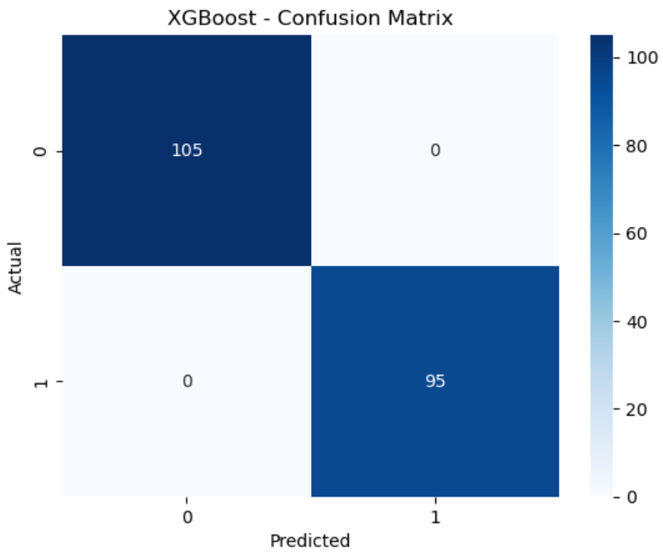
XGBoost

Slide 38
Key Insights & Interpretation
Purpose: Predict loan approval based on factors like age, income, credit_score, loan_amount, interest_rate, and loan_term.
Accuracy: 1.0 on test data.
Coefficients indicate:
Higher credit_score significantly increases likelihood of approval.
age has a slight negative impact.
income, loan_amount, interest_rate, loan_term have minimal impact.

Slide 39
Conclusion
The model shows promise for practical application in loan approval processes, and future work can focus on refining the model and exploring additional features.
Purpose: This project aimed to develop a model to predict loan approval based on key features such as age, income, credit_score, loan_amount, interest_rate, and loan_term.
Insights:
Higher credit_score significantly increases likelihood of loan approval.
Other factors like age have a slight negative impact.

Slide 40
Further Enhancement
I aim to deploy this model in streamlit app or AWS cloud to make the model more interactive.
Logistics regression model, Decision tree, Random forest to capture non linear relationship and other state of the art result driven models such as XG Boost.

Slide 41
Questions ?

Slide 42
Thank You

