Slide 1
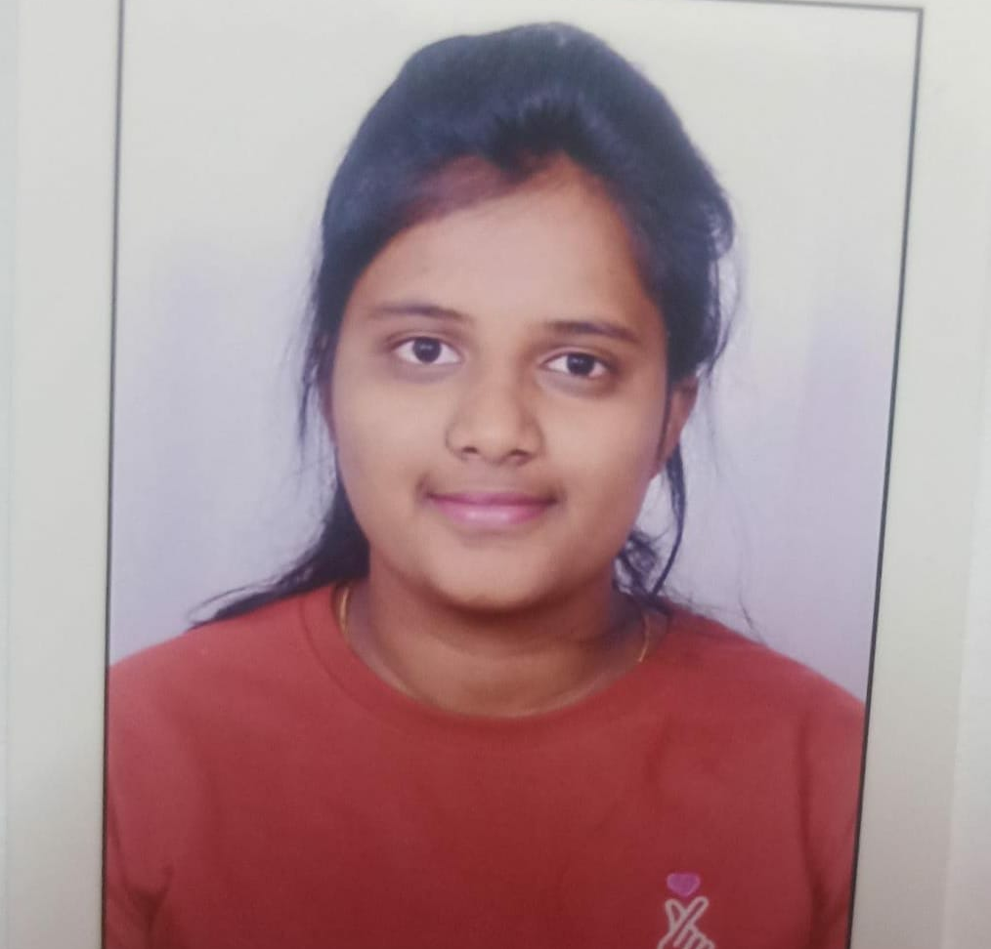

Nethra M J
Analyst/Software Engineer
Bachelor of Engineering
Electrical and Electronics: 2017-2021
Skills
Java | Java Basics, OOPS, Generics, Collections, Arrays, Loops.
Database | Postgre SQL Server
UI Tech | HTML 5 & CSS 3, JavaScript
Tools | Git, Postman, Eclipse , Visual Studio Code
Add On skills | Communications, Team management.
Bangalore
nethra.m-j@capgemini.com
A4
+91 8217373842
Full Stack Developer
Hands on experience on core java , Spring Boot Framework
Hands on experience in creating Single page Web Application in Angular.
Hands on experience in developing webpages using HTML , CSS.
Ready to learn new technologies and implement them for the future knowledge improvement.
Online Food Ordering System.
Completed end to end case study of online food ordering System with API,responsive UI with HTML and CSS, Angular js used for user interface.
Completed JEE Full Stack with Angular(duration:3 months) from Capgemini India
qa

