Slide 1
DIGITAL PORTFOLIO

Slide 2
PROJECT TITLE
STUDENT NAME. : NETHRA.R
REGISTER NUMBER AND NM ID : 22422k1588 and asbru4q2422k1588
DEPARTMENT. : COMPUTER SCIENCE
COLLEGE. :KSG COLLEGE OF ARTS AND SCIENCE
UNIVERSITY. : BHARATHIAR UNIVERSITY

Slide 3
AGENDA
Problem statement
Project overview
End users
Tools and technologies
Portfolio design and layout
Result and screenshot
Features and functionality
Conclusion

Slide 4
PROBLEM STATEMENT
1. Define your topic: What’s the main theme or subject of your presentation? 2. Identify your audience: Who are you presenting to? 3. Outline your content: Break down your topic into key points and organize them logically. 4. Design your slides: Use visuals, headings, and concise text to make your slides engag

Slide 5
PROJECT OVERVIEW
1. Project title: A concise name for your project. 2. Objective What do you aim to achieve? 3. Scope: What specific aspects will you cover? 4. Target audience: Who will benefit from your project? 5. Key features: Main components or functionalities.

Slide 6
WHO ARE THE ENDUSER
1. Demographics: Age, location, occupation, etc. 2. Needs: What problems or goals do they have? 3. Behavior:How will they interact with your project? Examples of end-users include: - Customers - Students - Employees - Website visitors

Slide 7
TOOLS AND TECHNOLOGIES
1. Programming languages*: Python, JavaScript, Java, etc. 2. *Development frameworks*: React, Angular, Django, etc. 3. *Databases:
MySQL, MongoDB, PostgreSQL, etc. 4. *Design tools*: Figma, Adobe XD, Sketch, etc. 5. *Version control: Git, GitHub, GitLab, etc. Depending on your project, you might also use: 1. *Cloud platforms*: AWS, Azure, Google Cloud, etc. 2. *Collaboration tools*: Trello, Asana, Slack,

Slide 8
PORTFOLIO DESIGN AND LAYOUT
1. Clear navigation: Make it easy for visitors to find your projects. 2. Visual hierarchy : Use size, color, and typography to draw attention to key elements. 3. Consistent branding: Reflect your personal style and brand identity. 4. Project showcases: Include images, descriptions, and links to your work. 5. Responsive design: Ensure your portfolio looks great on various devices. Some popular portfolio layouts include: 1. Grid-based 2. Minimalist 3. Storytelling-driven

Slide 9
FEATURES AND FUNCTIONALITY
1. User authentication and login 2. Search functionality 3. Responsive design 4. Interactive elements (e.g., animations, quizzes) 5. Data visualization 6. Filtering and sorting 7. Feedback mechanisms (e.g., ratings, comments) Functionality can include:
1. User registration and profile management 2. Content creation and editing 3. Payment gateway integration 4. Notifications and alerts 5. Integration with third-party services

Slide 10
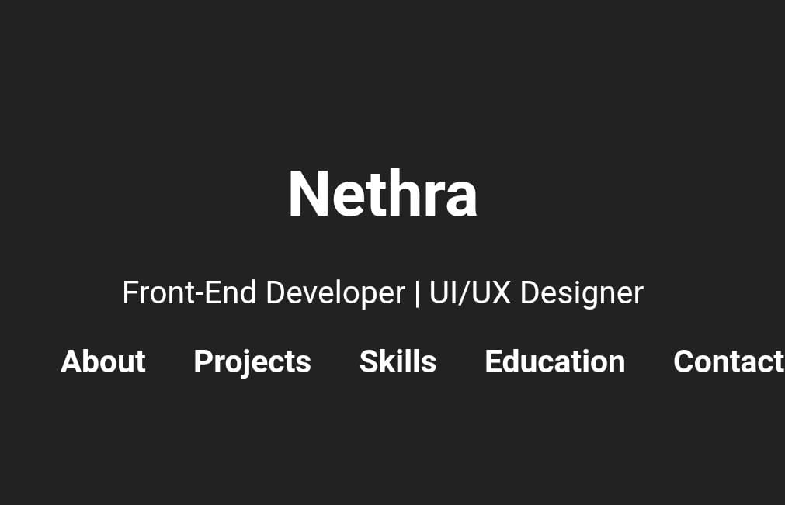
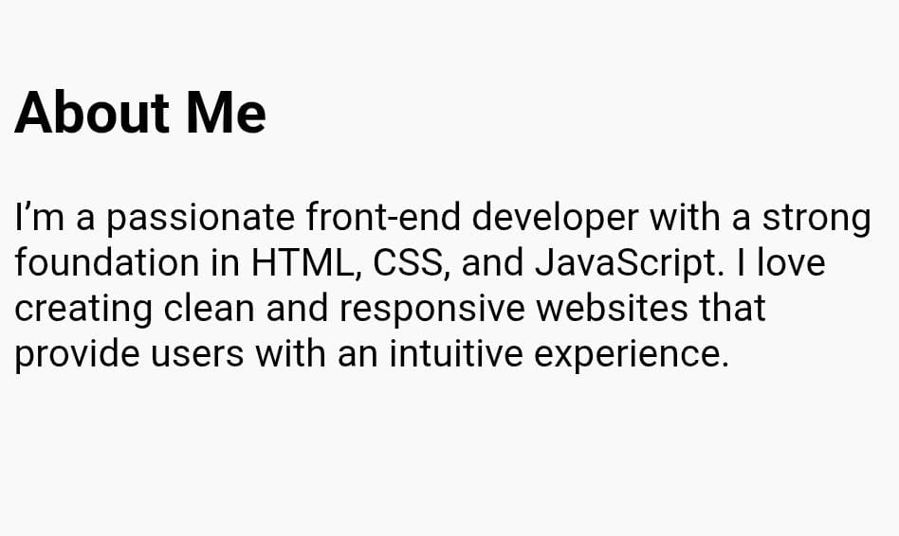
RESULTS AND SCREENSHOT

Slide 11
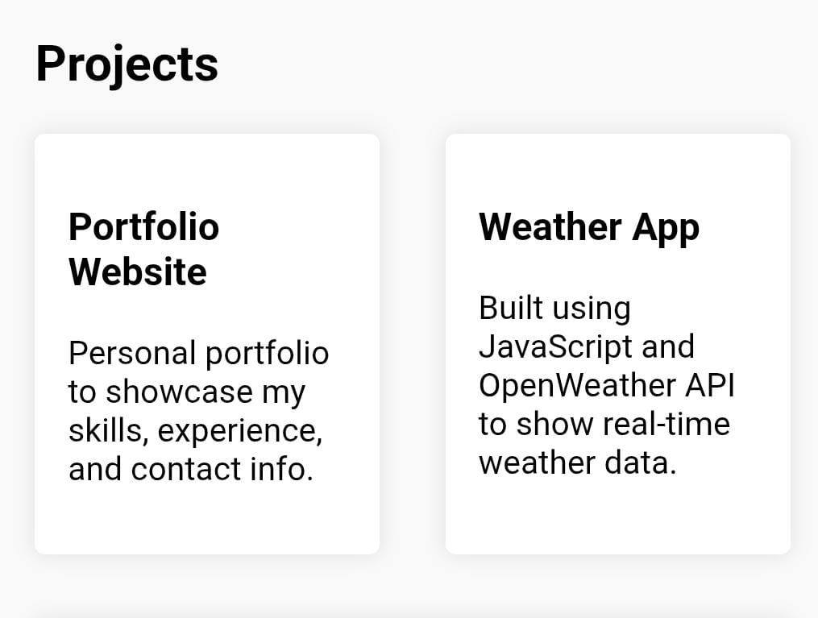
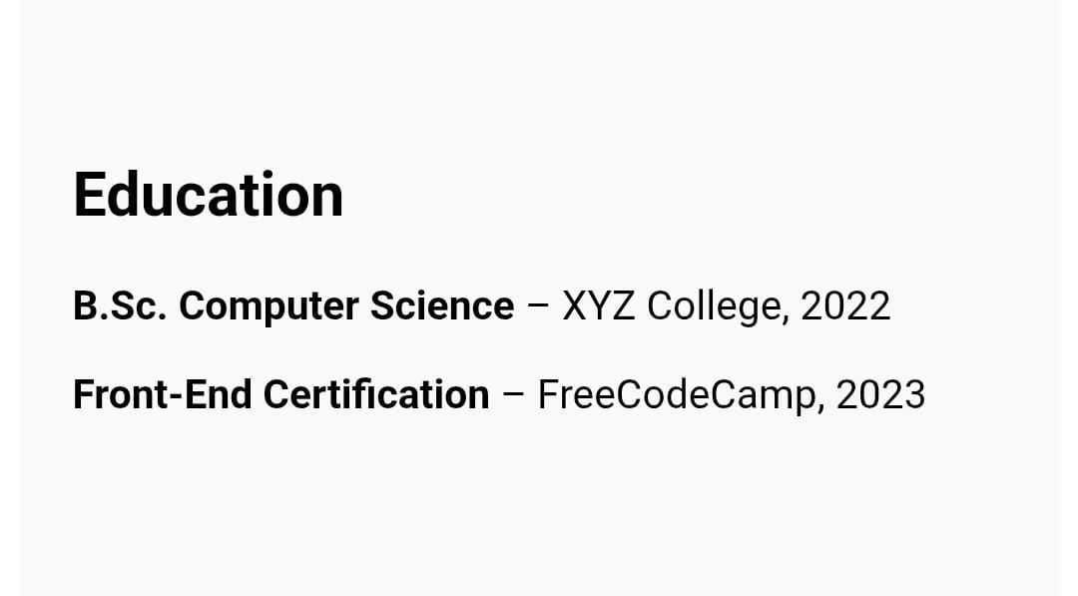

Slide 12
CONCLUSION
1. Restating the main argument or point 2. Summarizing key findings or takeaways 3. Emphasizing significance or implications 4. Final thoughts or recommendations

