Slide 1
TressFX Hair Technology

Slide 2
TressFX Hair Rendering

Slide 3
TressFX
Realistic hair rendering and simulation
  Used in shipping AAA game
  Goes beyond simple shells and fins representation used in games
  Hair is rendered as actual strands with self shadowing, antialiasing and transparency
  Physical simulation using GPU compute shaders
    Very flexible to allow for different hair styles and different conditions

Slide 4
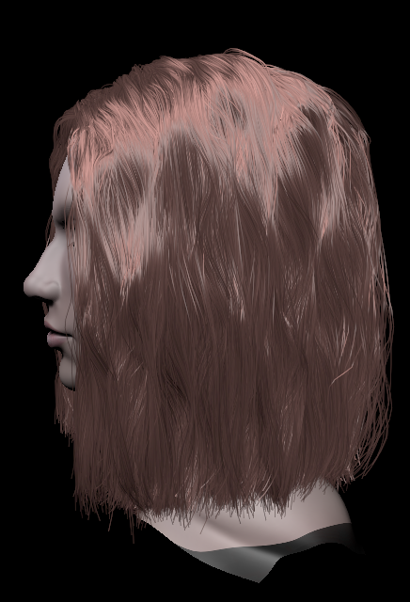
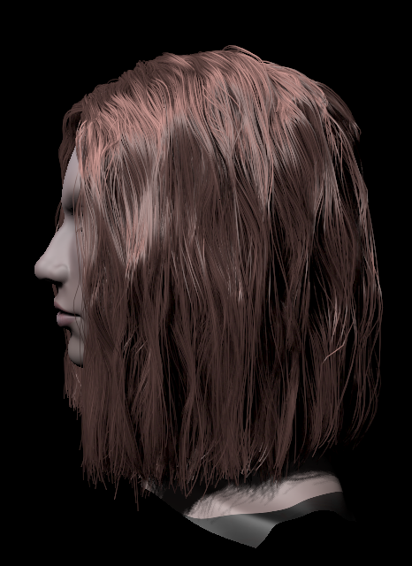
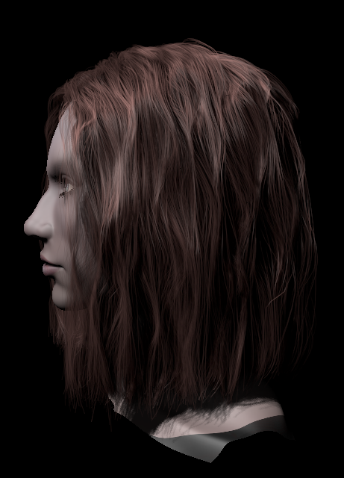
TressFX Rendering
What goes into good hair?
  Volumetric self shadowing
  Transparency
  Anti-aliasing
Based on an ID3 2012 paper
  “A Framework for Rendering Complex Scattering Effects on Hair”, Yu, et al.
  Algorithms modified for improved real-time performance
Anti-Aliasing
+ Volume Shadows
+ Transparency

Slide 5
TressFX Self Shadowing
Self Shadowing
  Uses a simplified Deep Shadow Map technique
No Self Shadows
With Self Shadows

Slide 6
TressFX Antialiasing
Every hair strand is anti-aliased manually
  Not using Hardware MSAA!
Compute pixel coverage on edges of hair strands and convert it to an alpha value
Notes:
Not using Hardware MSAA!: this means you get anti-aliasing even when HW MSAA or SSAA is not used. Additional reason why real transparency support is essential.

Slide 7
TressFX Transparency
Order Independent Transparency (OIT) using a Per-Pixel Linked List (PPLL)
  Nearest K fragments are stored in a sorted link list on the GPU
No Transparency
With Transparency

Slide 8
TressFX Hair Simulation

Slide 9
TressFX Physics Simulation
Hair strand is represented as polylines with vertices and edges
LC(Length constraints) is for inextensible hair.
Efficient global and local shape constraints to simulate various hair styles
GSC(Global shape constraints) help preserve hair style and initial shape
  It can guarantee that initial hair style can be restored even after strong agitations
LSC(Local shape constraints)
  For bending/twisting forces to support various hair styles i.e. straight, curly or wavy
Stable time integration with Verlet method
Collision detection and response between hair and model using capsules

Slide 10
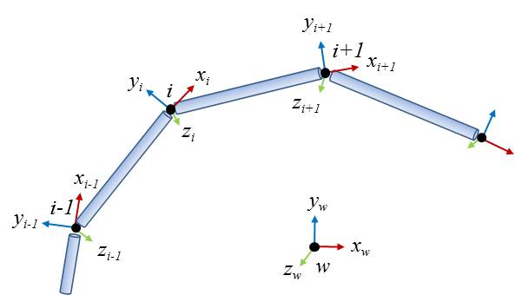

TressFX Physics Simulation
The most difficult part of simulation was to figure out how to simulate stylized hair.
In other words, how to hold curly hair shape?
To do it, bending and twisting forces are crucial.
  As in robotics, an open-chain structure has joints and each joint has parent-child relationships to its connected joints.
With local transforms in chain structure, we can get a global transform
We find goal positions using local/global transforms for each
vertex and update vertex position by interpolating it using
stiffness value.
${{}_{ }^{w}T}_{i}^{}={{}_{ }^{w}T}_{0}^{}∙{{}_{ }^{0}T}_{1}^{}…∙$ ${{}_{ }^{i−2}T}_{i−1}^{}∙{{}_{ }^{i−1}T}_{i}^{}$

Slide 11
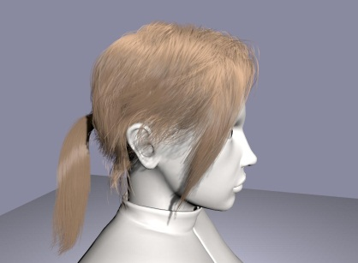
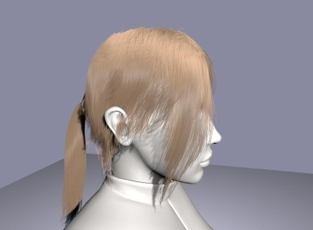
TressFX Physics Simulation
Hair can be assigned to the different groups
  Allows different simulation parameters such as stiffness and damping
Fine tuning mechanism for users
  Various hair conditions can be simulated such as wet or heavy on the fly
A simple aerodynamics for wind
All simulation is processed inside GPU using Compute Shader in DX11
Mixed hair vertex and strand level parallel processes utilize GPU architecture efficiently.
By combining with vertex instancing, the actual simulated number of hair can be lower – guide hairs
dry
wet

Slide 12
Disclaimer & Attribution
The information presented in this document is for informational purposes only and may contain technical
inaccuracies, omissions and typographical errors.
The information contained herein is subject to change and may be rendered inaccurate for many reasons, including but not limited to product and roadmap changes, component and motherboard version changes, new model and/or product releases, product differences between differing manufacturers, software changes, BIOS flashes, firmware upgrades, or the like. There is no obligation to update or otherwise correct or revise this information. However, we reserve the right to revise this information and to make changes from time to time to the content hereof without obligation to notify any person of such revisions or changes.
NO REPRESENTATIONS OR WARRANTIES ARE MADE WITH RESPECT TO THE CONTENTS HEREOF AND NO RESPONSIBILITY IS ASSUMED FOR ANY INACCURACIES, ERRORS OR OMISSIONS THAT MAY APPEAR IN THIS INFORMATION.
ALL IMPLIED WARRANTIES OF MERCHANTABILITY OR FITNESS FOR ANY PARTICULAR PURPOSE ARE EXPRESSLY DISCLAIMED. IN NO EVENT WILL ANY LIABILITY TO ANY PERSON BE INCURRED FOR ANY DIRECT, INDIRECT, SPECIAL OR OTHER CONSEQUENTIAL DAMAGES ARISING FROM THE USE OF ANY INFORMATION CONTAINED HEREIN, EVEN IF EXPRESSLY ADVISED OF THE POSSIBILITY OF SUCH DAMAGES.
AMD, the AMD arrow logo, and combinations thereof are trademarks of Advanced Micro Devices, Inc. All other names used in this presentation are for informational purposes only and may be trademarks of their respective owners.
[For AMD-speakers only] © 2013 Advanced Micro Devices, Inc.
[For non-AMD speakers only] The contents of this presentation were provided by individual(s) and/or company listed on the title page. The information and opinions presented in this presentation may not represent AMD’s positions, strategies or opinions. Unless explicitly stated, AMD is not responsible for the content herein and no endorsements are implied.

Slide 13
Trademark Attribution
AMD, the AMD Arrow logo and combinations thereof are trademarks of Advanced Micro Devices, Inc. in the United States and/or other jurisdictions. Other names used in this presentation are for identification purposes only and may be trademarks of their respective owners.
©2013 Advanced Micro Devices, Inc. All rights reserved.

