Slide 1
ASP.NET

Slide 2
IIS
(Internet Information Services)
The first Microsoft web server
IIS1.0 was add-on of Windows NT 3.51(1995)
IIS3.0 introduced the Active Server Pages
(NT4.0 SP3/1997)
IIS5.0/5.1 integrated with .NET Framework
(Windows 2000/XP)
IIS6.0 increased security as well as reliability.
(Windows 2003 Server)
IIS7.0 was rewritten and redesigned completely
(Windows 2008 Server)

Slide 3
ASP(Active Server Page)
Server-side script generates HTML files dynamically.
  Microsoft introduced lightweight script(Javascript and VBscript)
<form method="post" action="phonelist.asp" target="mainpage">
<select name="Brand" id="Brand">
<% while (!PhoneRecord.EOF) { %>
<option value="<%=(PhoneRecord.Fields.Item("Brand").Value)%>">
<%=(PhoneRecord.Fields.Item("Brand").Value)%></option>
<% PhoneRecord.MoveNext(); }
if (PhoneRecord.CursorType > 0) {
if (!PhoneRecord.BOF) PhoneRecord.MoveFirst();
} else {
PhoneRecord.Requery();
}%>
</select>
<input type="submit" name="submit" value="Go"/>
</form>

Slide 4
ASP(Generated Page by ASP)
<form method="post" action="phonelist.asp“
target="mainpage">
<select name="Brand" id="Brand">
<option value="Apple">Apple</option>
<option value="BlackBerry">BlackBerry</option>
<option value="LG">LG</option>
</select>
</form>

Slide 5
Java Web Technology(1997)
Sun Microsystems introduced dynamic web technology with Java.
Microsoft started to develop .NET Framework(CLR) around 1998.
From 1999, Sun made a cause(law) action for Microsoft for using Java technology on Windows
Microsoft focused on the new environment(.NET Framework)
ASP.NET was introduced into IIS instead of Java technology.

Slide 6
Advantage of ASP.NET
Because Microsoft developed this technology, it has very wide and good compatibility with Windows Platform.
  Java does not have compatibilities with Windows
Because Microsoft only develops, milestone and price is very clear.
  Sun mainly develops Java. But IBM/Oracle is controlling Java. Each company has different level Application Server.
Ease of development, use and maintenance.
  Before Java 5, Mixing of xml configurations and Java codes.
Disadvantage of ASP.NET
We should follow Microsoft world.
We can not control the Microsoft milestone.

Slide 7
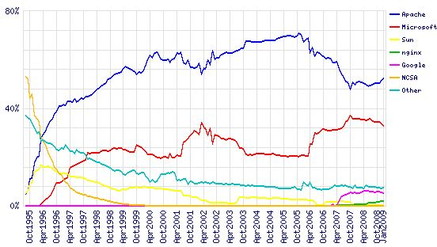
Market share percentage of WWW Server

Slide 8
Advanced Web Control
Calendar Control
AdRotator Contorl
Menu Control
TreeView Control
SiteMapPath Contorl
ImageMap Control
FileUpload Control
Java Servlet and JSP only defines basic mechanisms based on HTML standard. Above control is not included in HTML forms
Customer desires is more important.

Slide 9
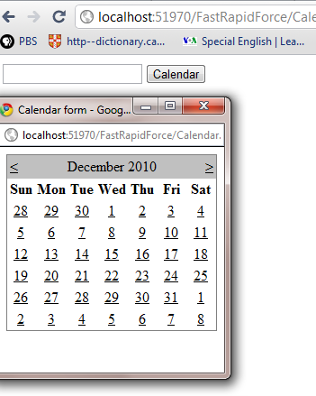
Calendar button and Control

Slide 10
Mainform.aspx
<body>
<form id="form1" runat="server">
<div>
<asp:TextBox ID="TextBox1" runat="server">
</asp:TextBox>
<asp:Button ID="Button1“ runat="server"
Text="Button" />
</div>
</form>
</body>

Slide 11
Mainform.aspx.cs
protected void Page_Load(object sender, EventArgs e)
{// get ID of HTML elements
string id = TextBox1.ClientID;
string opt = "height=250,width=250,dependent=yes,
location=no,menubar=no," +"scrolbars=no,toolbar=no,status=no";
//create script for opening calendar form
string script =
"var url = 'Calendar.aspx?id={0}&date=' + getElementById('{0}').value;" +
"window.open(url,'_blank', '{1}'); return false;";
script = String.Format(script, id, opt);

Slide 12
Source of HTML of Mainform
// set script in onclick attribute.
Button1.Attributes.Add("onclick", script);
}
<input name="TextBox1" type="text" id="TextBox1" />
<input type="submit" name="Button1" value="Button" onclick=“
var url = 'Calendar.aspx?id=TextBox1&amp;date=' + getElementById('TextBox1').value;window.open(url,'_blank', 'height=250,width=250,dependent=yes,location=no,menubar=no,scrolbars=no,toolbar=no,status=no'); return false;" id="Button1" />

Slide 13
Calendar.aspx
<body>
<form id="form1" runat="server">
<div>
<asp:Calendar ID="Calendar1" runat="server“
OnSelectionChanged="Calendar1_SelectionChanged">
</asp:Calendar>
</div>
</form>
</body>

Slide 14
Calendar.aspx.cs(Page_Load)
protected void Page_Load(object sender, EventArgs e){
if (IsPostBack == true) return;
// Initialize GET parameter of date.
DateTime dateParam;
DateTime.TryParse(
Request.QueryString["date"], out dateParam);
Calendar1.VisibleDate = dateParam;
Calendar1.SelectedDate = dateParam;
}

Slide 15
Calendar.aspx.cs
(Calendar1_SelectionChanged)
protected void Calendar1_SelectionChanged
(object sender, EventArgs e){
// store the selected date.
string sDate = Calendar1.SelectedDate.ToString("d");
// get ID of calendar from
string id = Request.QueryString["id"];

Slide 16
Calendar.aspx.cs
(Calendar1_SelectionChanged)
// create script for changing Mainform.
string script =
"if(!window.opener || window.opener.closed) {" +
" window.close();" +
"} else { " +
" window.opener.document.getElementById('" + id +
" ').value = ' " + sDate + " ';" + " window.close();" +
"}";
ClientScript.RegisterClientScriptBlock(
this.GetType(), "calendar", script, true);
}

Slide 17
THANK YOU FOR YOUR ATTENTION

