Slide 1
SQL Language
Employee Time Record
(Aggregate Function and View)
MASANORI KAWAI
17th May 2010
Notes:
Thank you for inviting my presentation.
I'm talking about an aggregate function and a view of creation through of more real situation

Slide 2
Background
In Japan, most of companies decide the salary of employees working time.
It is important to record the working time and calculate the salary from it.
Notes:
I have worked in a Japanese company until last year.
Most of company except foreign capital company suppose that a employee's salary is deci

Slide 3
Example Sutuation
Five employees
Each employee has ID, Name, Level and Address.
ID is the unique number assigned to each employee
Level is the skill level.
Employer decide the salary depend on skill levels

Slide 4
Created Tables of Employer1
Employee Table
ID | Name | Address | Level
1 | James | Koramagala | 9
2 | David | M.G.Road | 7
3 | Charles | Shanjinagara | 5
4 | Thomas | Hosur Road | 4
5 | Richard | White Feild | 3

Slide 5
SalaryLeveltable
Skill Level | Salary (per a hour)
1 | 14000.0000
2 | 16000.0000
3 | 18000.0000
4 | 20000.0000
5 | 25000.0000
6 | 30000.0000
7 | 50000.0000
8 | 70000.0000
9 | 100000.0000

Slide 6
Creation of three Procedures
StartWork(EmpID)
  When employee starts work, he or she calls this function.
FinishWork(EmpID)
  When employee finishes work, he or she calls this function.
WorkTimeView
  Employer check the working hours of each employee from this view.

Slide 7
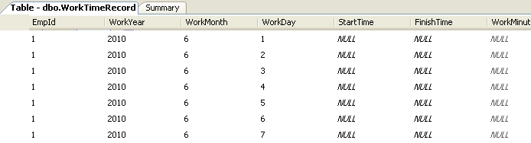
Automatic Generated Table
I should design the automatically generated table to record the start time and finish time.

Slide 8
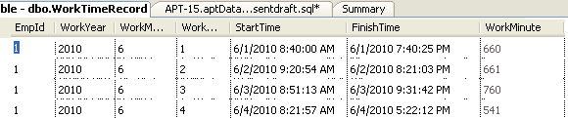
Record the Start and Finish Time
Employee should call the StartWork when he or she start the own work,and call the FinishWork when finish own work.

Slide 9
Create view for totally adding the work minutes by each employees
create view TotalWorkHourView
as
select r.empid, (sum(r.WorkMinute)/60.0) as Totalhour from
WorkTimeRecord r
where WorkYear = year(getdate())
and WorkMonth = month(getdate())
group by r.empid

Slide 10
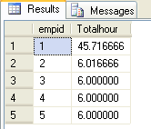
Select * from the previous view

Slide 11
Create one more view for checking the name
create view SalaryView
as
select e.empid, e.empname, t.totalhour, (t.totalhour*m.Salary) as TotalSalary
from
EmployeeTable e,TotalWorkHourView t,EmployeeSalaryView m
where e.empid = t.empid and
e.empid = m.empid

Slide 12
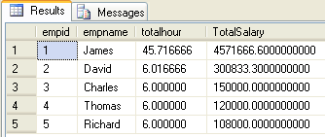
Results

