Slide 1
TCP/IP OVERVIEW
Masanori Kawai Aptech
09/08/2010

Slide 2
Contents
What is network??
Typical network is telephone network
In case of computer network
Address Resolution
IP protocol and IP address
TCP protocol and Port number
Examples of Application protocol
Network Layer

Slide 3
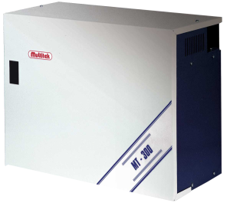
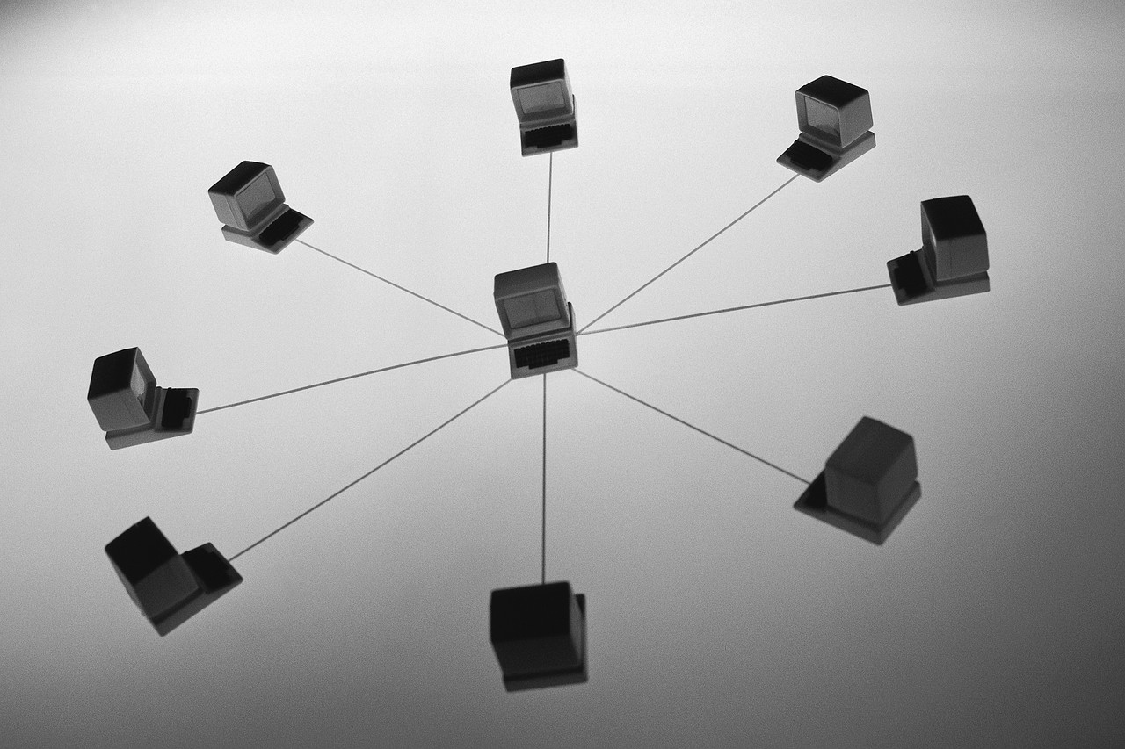
What is network
Network is something connected by three or more equipment's

Slide 4




Typical network is telephone(1)
ABC Engineer’s NAOTO
Phone Number:
6256
XYZ Company’s GEORGE
ABC Secretary’s ERI
Phone Number:
7896
Phone Number:
3478

Slide 5

Let’s replace the situation to computer network(1)
Most of the modern PCs have a wired/wireless network port(i.e. cable entry point).
This network is called “Ethernet”
In this network, each network port has a physical address(48bit). This is NOT IP address.

Slide 6
Let’s replace the situation to computer network(2)
We can give a network port the specific number.
Naoto’s phone number(6256) belongs to “Naoto”.
Eri’s phone number(3478) belongs to “Eri”.
Similarly, each network port is set at the specific number. This is called a IP(Internet Protocol) address(32bit) in Version4.

Slide 7

Computer network(1)
Naoto’s IP address:
192.168.1.45
I only write 8bit physical address.
The Physical address:
0x01
Gorge’s IP address:
192.168.1.71
Eri’s IP address:
192.168.1.12
Physical address:
0x89
Physical address:
0x45

Slide 8
Layer Name
In network, Physical wires and components are called “Physical Layer”
Physical address is known as MAC address. This layer is called “MAC Layer”
  MAC = Media Access Control
IP address is a sort of Logical(Network) address. This layer is called “IP Layer”
    Honestly, speak about this lastly.

Slide 9
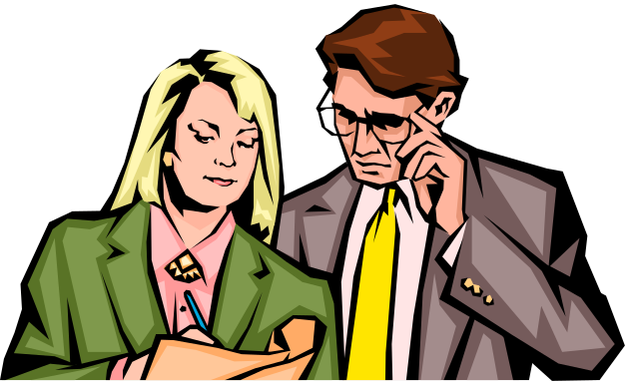
How did Naoto know Eri’s phone number?
Usually, before he dials, he should know the Eri’s phone number.
For example, When he met her the first time, he asked her phone number.
Naoto: I would like to know your phone number.
Eri: My phone is 3478
He got it!!

Slide 10
Address Resolution
Naoto’s computer should know the physical address from Eri’s IP address.
Early network engineer defined the rules.
  These rules are called “Protocol”.
This rule(protocol) is called Address Resolution Protocol(ARP).
In this protocol, computer sends the inquiry’s message to all computers.

Slide 11
ARP(1)
Naoto’s IP address:
192.168.1.45
Broadcast Message
The Physical address:
0x01
Who is 192.168.1.12?
Gorge’s IP address:
192.168.1.71
Eri’s IP address:
192.168.1.12
Physical address:
0x89
Physical address:
0x45

Slide 12
ARP(2)
Naoto’s IP address:
192.168.1.45
The Physical address:
0x01
Who is 192.168.1.12?
Who is 192.168.1.12?
Gorge’s IP address:
192.168.1.71
Eri’s IP address:
192.168.1.12
Physical address:
0x89
Physical address:
0x45

Slide 13
ARP(3)
Naoto’s IP address:
192.168.1.45
The Physical address:
0x01
NOT me!!!
About me!!!!
Gorge’s IP address:
192.168.1.71
Eri’s IP address:
192.168.1.12
Physical address:
0x89
Physical address:
0x45

Slide 14
ARP(4)
Naoto’s IP address:
192.168.1.45
The Physical address:
0x01
I should respond to 0x01 about me(192.168.1.12 is 0x45)
Gorge’s IP address:
192.168.1.71
Eri’s IP address:
192.168.1.12
Physical address:
0x89
Physical address:
0x45

Slide 15
ARP(5)
Naoto’s IP address:
192.168.1.45
The Physical address:
0x01
192.168.1.12 is 0x45
Gorge’s IP address:
192.168.1.71
Eri’s IP address:
192.168.1.12
Physical address:
0x89
Physical address:
0x45

Slide 16
ARP(6)
Naoto’s IP address:
192.168.1.45
I got (192.168.1.12 is 0x45)
The Physical address:
0x01
Gorge’s IP address:
192.168.1.71
Eri’s IP address:
192.168.1.12
Physical address:
0x89
Physical address:
0x45

Slide 17

ARP(7)
Example
Notes:
For example,

Slide 18
Telephone network(2)
One day, Naoto will call Eri for confirming tomorrow schedule… What happens??
  1. Naoto dials the Eri’s telephone number(3478).
  2. Eri’s telephone rings bell.
  3. Eri takes the phone.
    The phone connection is established……

Slide 19
Telephone network(2)
  “Hello, This is Eri.”
Phone Number:6256
Phone Number:3478
ABC Engineer’s NAOTO
ABC Secretary’s ERI

Slide 20
Telephone network(2)
  “Hello, This is Naoto.”
  “I would like to confirm tomorrow schedule.”
Phone Number:6256
Phone Number:3478
ABC Engineer’s NAOTO
ABC Secretary’s ERI

Slide 21
Telephone network(2)
  “OK.”
  “Tomorrow schedule is…… ”
Phone Number:6256
Phone Number:3478
ABC Engineer’s NAOTO
ABC Secretary’s ERI

Slide 22
Telephone network(2)
He could achieve the purpose!!
  “OK.”
  “Tomorrow schedule is…… ”
Phone Number:6256
Phone Number:3478
ABC Engineer’s NAOTO
ABC Secretary’s ERI

Slide 23
Telephone network(2)
However…. Naoto’s room is very nosy.
  “Hello, This is Eri.”
Phone Number:6256
Phone Number:3478
ABC Engineer’s NAOTO
ABC Secretary’s ERI

Slide 24
Telephone network(2)
  “H..l…, Th….s…a…..”
  “I….d…..co….nfir…. t…..rr…. sch…..d..”
Phone Number:6256
Phone Number:3478
ABC Engineer’s NAOTO
ABC Secretary’s ERI

Slide 25
Telephone network(2)
  “Please say again.”
Phone Number:6256
Phone Number:3478
ABC Engineer’s NAOTO
ABC Secretary’s ERI

Slide 26
Early network is telephone(2)
After Naoto made room silent,
  “Hello, This is Naoto.”
  “I would like to confirm tomorrow schedule.”
Phone Number:6256
Phone Number:3478
ABC Engineer’s NAOTO
ABC Secretary’s ERI

Slide 27
Early network is telephone(2)
  “OK.”
  “Tomorrow schedule is…… ”
Phone Number:6256
Phone Number:3478
ABC Engineer’s NAOTO
ABC Secretary’s ERI

Slide 28
Early network is telephone(2)
He could achieve the purpose!!
  “OK.”
  “Tomorrow schedule is…… ”
Phone Number:6256
Phone Number:3478
ABC Engineer’s NAOTO
ABC Secretary’s ERI

Slide 29
TCP
(Transport Connection Protocol)
TCP is rules for guarantee of communications.
Also, TCP has the Port Number which is used to distinguish the purpose of communications.
(It is like ”Tomorrow meeting” of Naoto’s mention.)
Server sides wait for the connection from clients on the defined Port Number.
[ Web(HTTP) Servers wait on 80, Mail(POP3) Servers wait on 110, etc.]
Client sides use to arbitrarily assign the Port Number as Source Port to connect to Server.

Slide 30
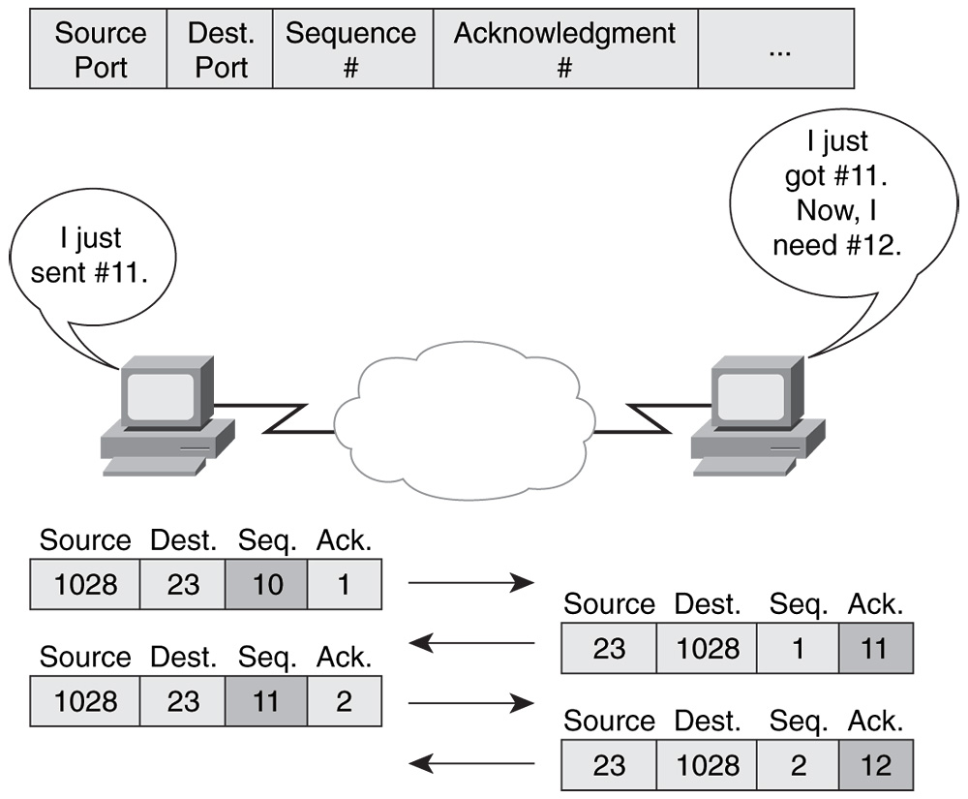
Communications on TCP
Client
Server
Predefined assign
Arbitrarily assign

Slide 31
Examples of Application Protocol
Web application uses HTTP to get html files.
  HTTP is Hyper Text Transfer Protocol.
This protocol uses 80 of the Port Number.
The one of defined message is GET
  “GET / HTTP/1.1(CR)(LF)
  Host: www.google.com(CR)(LF)(CR)(LF)”
  (CR)(LF) is equal to line break in Windows.
I show getting HTML files without Web Browser.(telnet www.google.com 80)

Slide 32
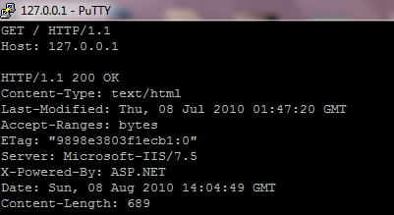
Example of HTTP(1)
Request from Client
Response of Server

Slide 33
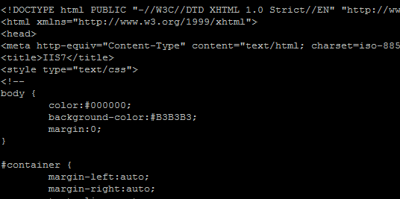
Example of HTTP(2) continue… response of server

Slide 34


Computer network(2)
Naoto’s IP address:
192.168.1.45
Unicast Message
The Physical address:
0x01
Web Browser
I only write 8bit physical address.
GET HTML files from 192.168.1.12(0x45)
Web Server
Gorge’s IP address:
192.168.1.71
Eri’s IP address:
192.168.1.12
Physical address:
0x89
Physical address:
0x45

Slide 35
Computer network(2)
Naoto’s IP address:
192.168.1.45
Unicast Message
The Physical address:
0x01
Web Browser
I only write 8bit physical address.
OK. Send HTML Contents to 192.168.1.45(0x01)
Web Server
Gorge’s IP address:
192.168.1.71
Eri’s IP address:
192.168.1.12
Physical address:
0x89
Physical address:
0x45

Slide 36
What data does this message have?
Application Layer
(Message)
ApplicationData
GET / HTTP/1.1…
Application
Operating System
TCP Layer
(Segment)
Dst Port | Src Port | … | AppData
80 | 5400 |  | GET / HTT
IP Layer
(Packet)
Dst IP | Src IP | … | Dst Port | Src Port | … | AppData
192.168.1.12 | 192.168.1.45 |  | 80 | 5400 |  | GET / HTT
MAC Layer
(Frame)
Dst MAC | Src MAC | … | Dst IP | Src IP | … | Dst Port | Src Port | … | AppData
0x45 | 0x01 |  | 192.168.1.12 | 192.168.1.45 |  | 80 | 5400 |  | Get / HTT

Slide 37
Network Layer
Each Layer only handles the own header or data in layer.
Application Layer
TCP Layer (Layer4)
IP Layer (Layer3)
MAC Layer (Layer2)
Physical Layer
Message
Application Layer
TCP Layer
IP Layer
MAC Layer
Physical Layer
Segment
Packet
Frame
Physical Wire

Slide 38
The End
Thank you for
your attention.

Slide 39
The End
Q&A

