Slide 1


Android – ESP32 Data Exchange
Application for data exchange between Android - ESP32 with BLE
Alessio Amatucci
Federica Di Giacomo
Alessandro Paniccià

Slide 2
Overview of our project.
The purpose of our project is to implement a Point-to-Point communication between an Android mobile phone and an ESP32
This communication is made using BLE
In this first phase, our mobile will act as a client and the ESP32 as a server
Android – ESP32 Data Exchange
10/03/2021
Pagina <number>

Slide 3
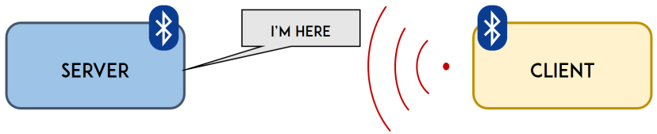
Startup
At startup, the server advertises, waiting to connect, while the mobile phone scans its surroundings to detect whether or not a server is present.
Android – ESP32 Data Exchange
10/03/2021
Pagina <number>

Slide 4
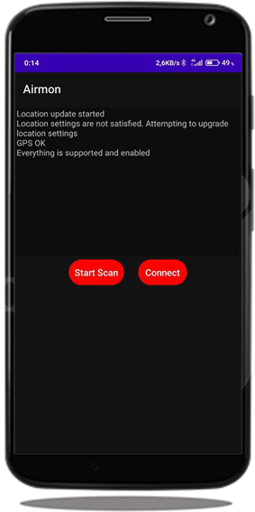
Android Client
Listeners and Callbacks have been developed to allow the asynchronous exchange of messages;
Send message;
Subscribe to the Characteristic of the Service in Server;
Is not pairing.
Android – ESP32 Data Exchange
10/03/2021
Pagina <number>

Slide 5
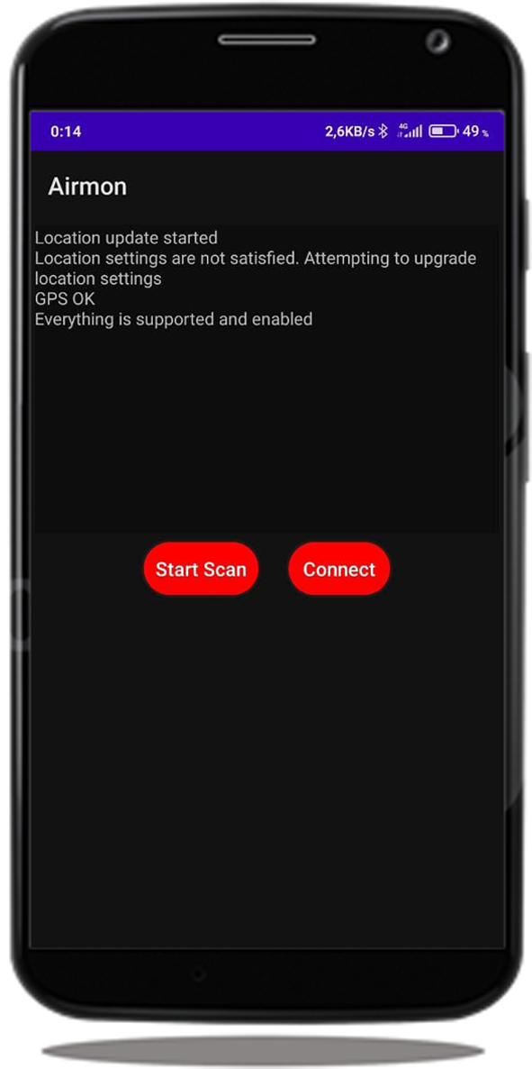
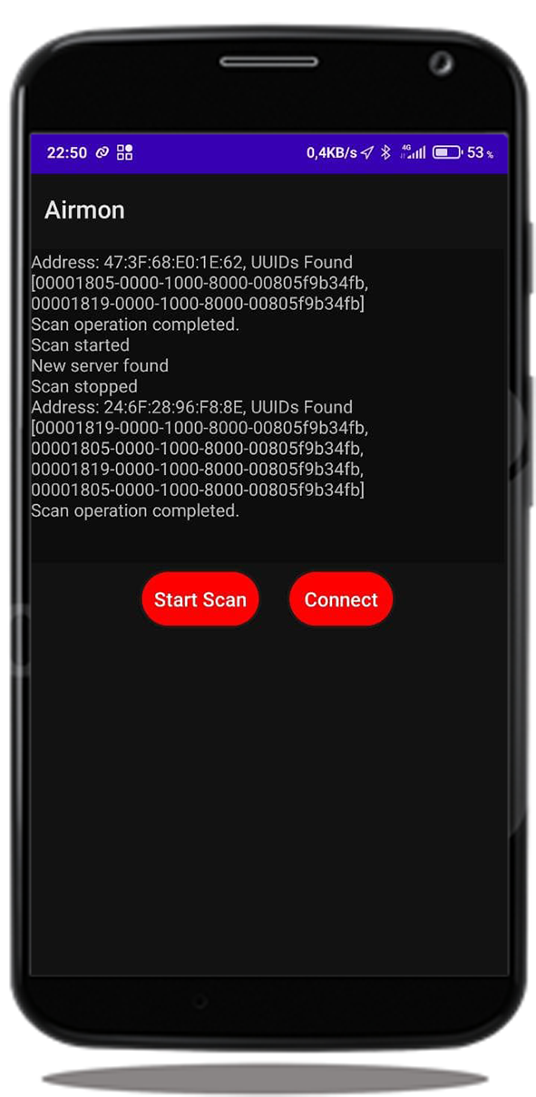

Airmon: Start scan
Start scanning to find server
Android – ESP32 Data Exchange
10/03/2021
Pagina <number>

Slide 6
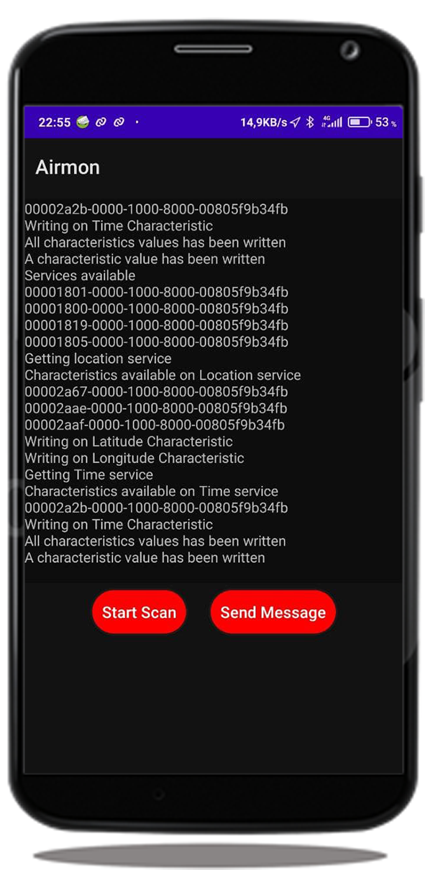

Airmon: Connection
Connection to the server
Android – ESP32 Data Exchange
10/03/2021
Pagina <number>

Slide 7
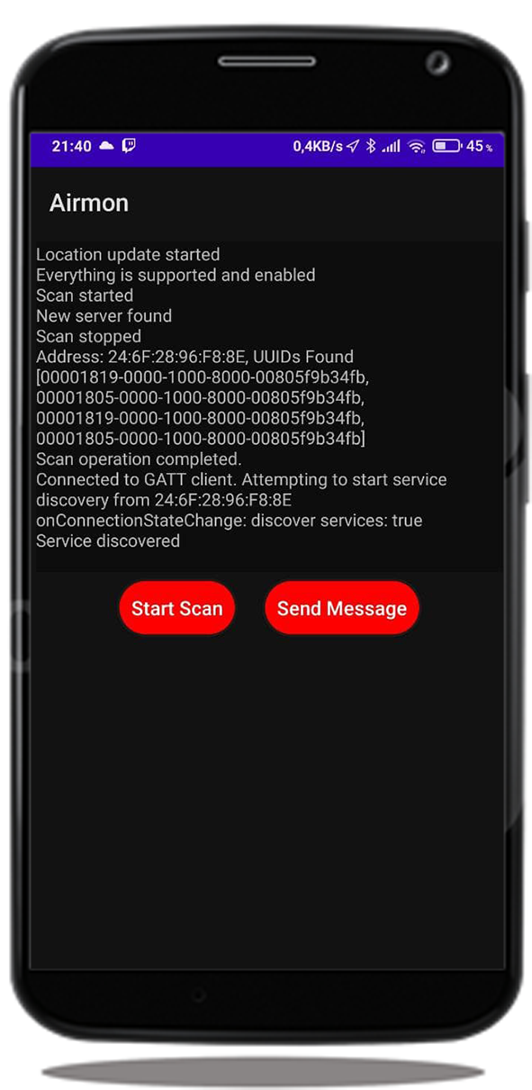

Airmon: Send message
Write characteristics values
Android – ESP32 Data Exchange
10/03/2021
Pagina <number>

Slide 8
Communication between device and ESP32
What does the development of our project consist of?
Our project provides for an air monitoring that through an air pollution chip takes the data of the latter and through BLE takes the data of the position. Through the intersection of these two data we can verify the quality of the air with the relative position.
In our project there are 3 operations available through the characteristics:
Read
Write
Notify
Let’s see some examples of use cases in the following slides
Android – ESP32 Data Exchange
10/03/2021
Pagina <number>

Slide 9
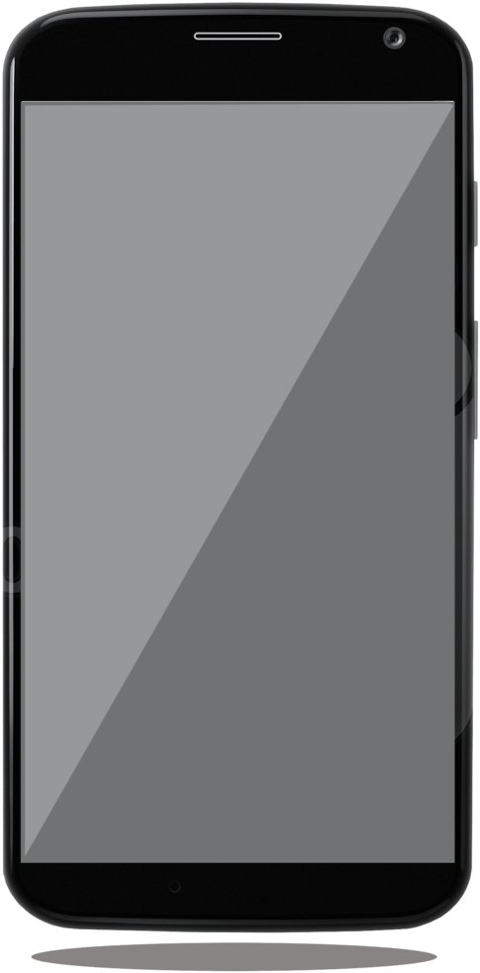
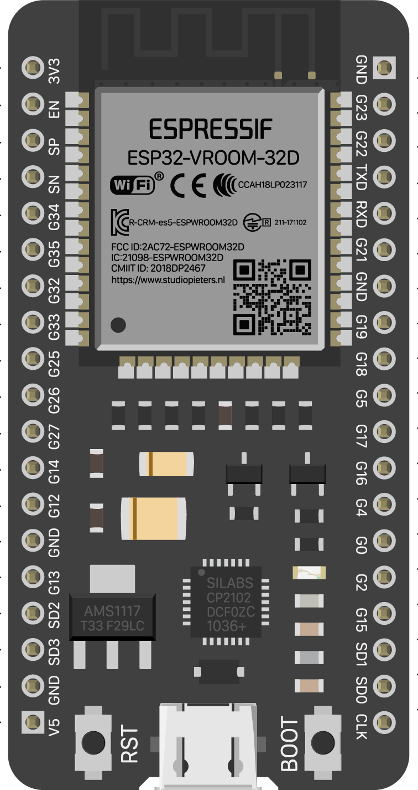


Communication between device and ESP32
Write values to the ESP and be notified after being subscribed
WRITE: LATITUDE, LONGITUDE, TIME
Android – ESP32 Data Exchange
10/03/2021
Pagina <number>

Slide 10
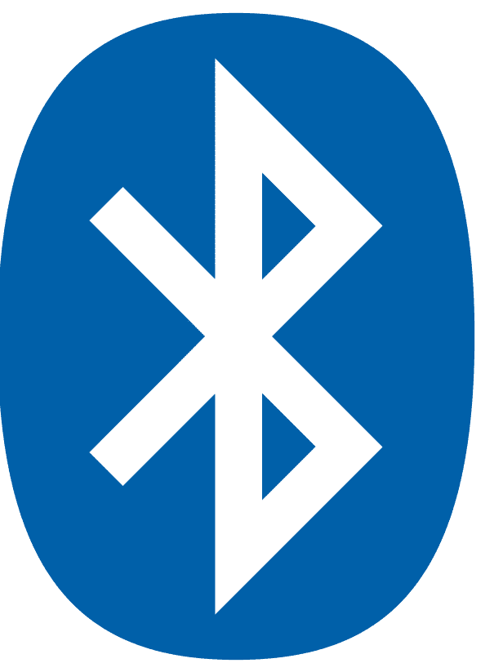
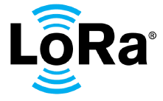



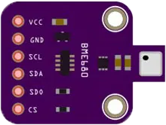

Project architecture overview
The modules and devices
BME680
Android – ESP32 Data Exchange
10/03/2021
Pagina <number>

Slide 11
Communication between device and ESP32
Case 1/3: everything good
Data is received from the sensor and the phone, then latitude, longitude, time and air pollution are sent to LoRaWAN
BME680
Android – ESP32 Data Exchange
10/03/2021
Pagina <number>

Slide 12
Communication between device and ESP32
Case 2/3: LoRaWAN is not reachable
Data is received from the sensor and the phone, but can’t send to LoRaWAN then add tuple
BME680
Android – ESP32 Data Exchange
10/03/2021
Pagina <number>

Slide 13
Communication between device and ESP32
Case 3/3: LoRaWAN is not reachable for a while
Data is received from the sensor and the phone, but can’t send to LoRaWAN then add tuple until 256, then send warning
BME680
Android – ESP32 Data Exchange
10/03/2021
Pagina <number>

Slide 14


Establish BLE communication
To send and receive data with BLE we had to create a BLE server and establish a bi-directional connection. But how does our BLE server works? How have we implemented this kind of connection?
CLIENT
SERVER
Android – ESP32 Data Exchange
10/03/2021
Pagina <number>

Slide 15
Connection between layers
BLE Server: How is our BLE server composed?
SERVER
Location Service
<0x1819>
Time Service
<0x1805>
Location Characteristic
<0x2A67>
<VALUE>
Latitude Characteristic
<0x2AAE>
<VALUE>
Longitude Characteristic
<0x2AAF>
<VALUE>
Current Time Characteristic
<0x2A2B>
<VALUE>
Descriptor
<0x2902>
Descriptor
<0x2902>
Descriptor
<0x2902>
Descriptor
<0x2902>
Android – ESP32 Data Exchange
10/03/2021
Pagina <number>

Slide 16
How we implemented BLE communication
The server is able to communicate just by writing in one of it's own characteristic
Why not implement a server on android too?
Complexity of:
  increase in system complexity
  waste of resources
  waste of energy
Android – ESP32 Data Exchange
10/03/2021
Pagina <number>

Slide 17
Future developments
Addition of the air pollution module with its implementation
Addition of the LoRa module to send the data tuples received from the mobile device and from the BME680
Implementation of the server on the Android side for any additional features
Android – ESP32 Data Exchange
10/03/2021
Pagina <number>

Slide 18
Questions?
Android – ESP32 Data Exchange
10/03/2021
Pagina <number>

Slide 19
Thank you for your attention!
Android – ESP32 Data Exchange
10/03/2021
Pagina <number>

