Slide 1
Managing your network with Netmagis
Jean Benoit, Pierre David, Sébastien Boggia
Université de Strasbourg
Campus Network Monitoring Workshop
April 24-25 2012

Slide 2
Managing your network with Netmagis
What is Netmagis ?
The topology module
Netmagis and other network management tools

Slide 3
What is Netmagis?
Netmagis = NETwork MAnaGement Information System
Open Source, BSD license
Context: Osiris, a large campus network
  1500 network equipments, 400 subnets, 200 contacts
Not Osiris-specific
  A tool for any network, large or small
Web application
Manages the Network Information System
  Central repository of all objects managed by the network operator
  Processes
  Consistancy, exhaustivity, documentation, automation...

Slide 4
Some functions of Netmagis
Managing hosts: names, IPv4 and IPv6 addresses
  → Automatic generation of DNS zones, DHCP configurations...
Topology: VLAN, links between equipments
  → Automatic generation of network maps
  → Setting a VLAN
  → Multi-vendor environment (Cisco, HP, Juniper)
Metrology: traffic graphs
  → Automatic generation (RRD database, SNMP polling)
Mac: locate a host by its IP address
  → Find the MAC address and the interface/equipment
Delegate all these functions to other people

Slide 5
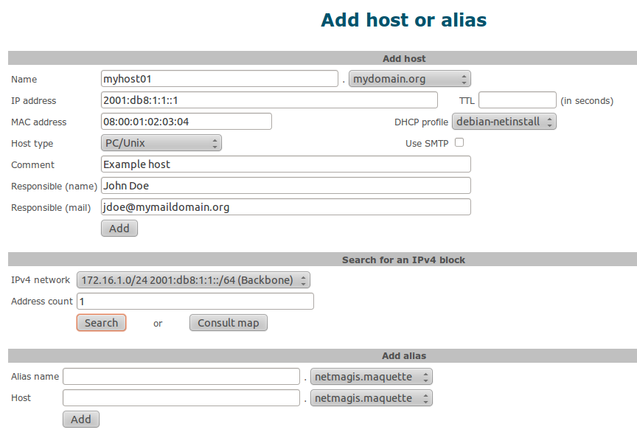

Slide 6
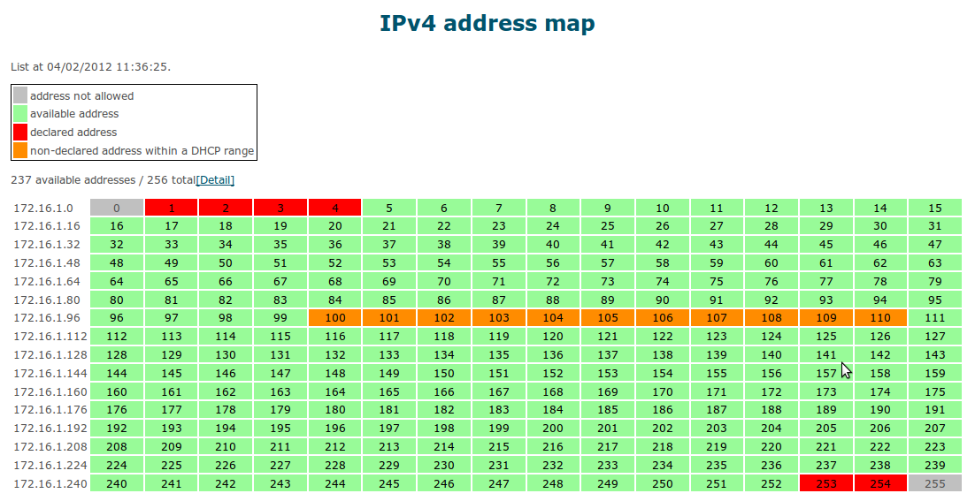

Slide 7
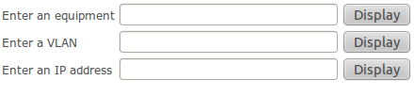
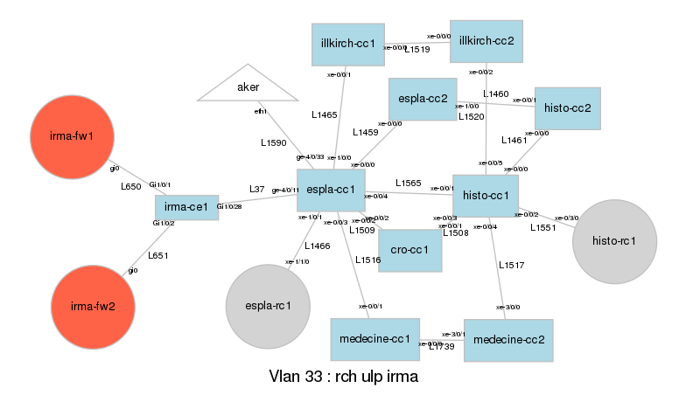
Topology: L2
irma

Slide 8
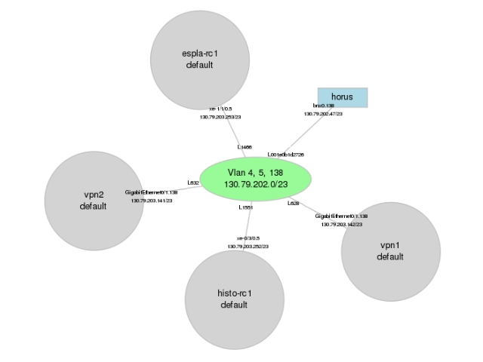
Topology: L3
130.79.202.1

Slide 9
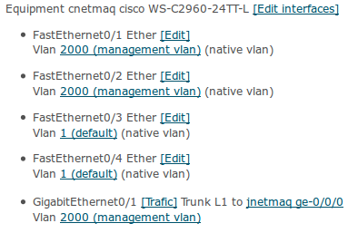
Topology: network equipments
cnetmaq

Slide 10
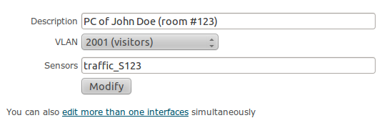
Topology: interface modification
Works on Cisco, HP and Juniper equipments
Can be delegated to other admins

Slide 11
Topology: traffic on an interface
cnetmaq

Slide 12
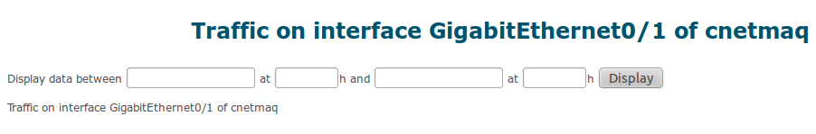
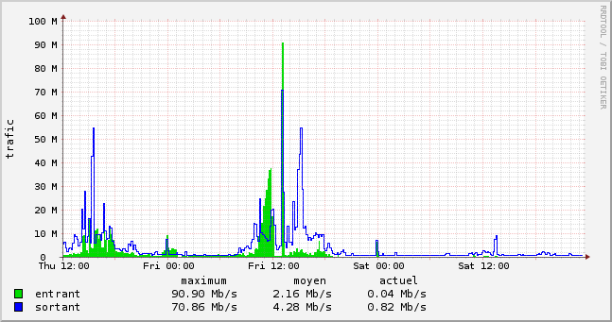
Topology: traffic on an interface

Slide 13
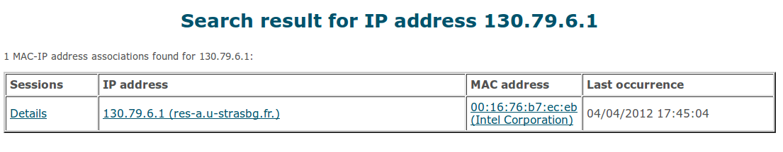
MAC: locate an IP address

Slide 14

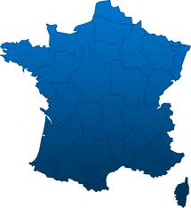

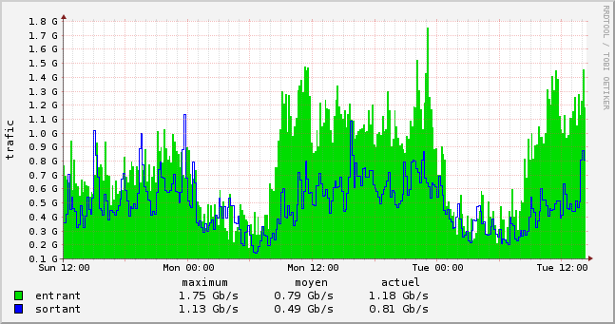
Functional domains
DNS
DHCP
Central
repository
management
Host management
MAC address management
Mail routing
Authentication
and
authorization
Network and equipment management
topology
métrology

Slide 15
Managing your network with Netmagis
What is Netmagis ?
The topology module
Netmagis and other network management tools

Slide 16
Functional domains
DNS
DHCP
Central
repository
management
Host management
MAC address management
Mail routing
Authentication
and
authorization
Network and equipment management
topology
métrology

Slide 17
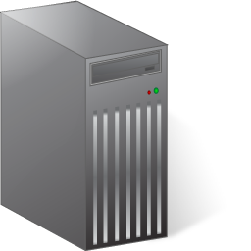

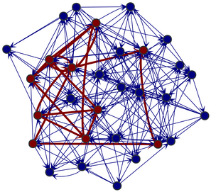
Configuration-driven automation
Topology server
Network administrator
Configuration modification
Download
Model of the network

Slide 18
Configuration-driven automation
A simple modification in the configuration of a network equipment:
  add <link number sensor number> in the interface description:
The modification is detected ; it triggers a chain of actions:
→ Analysis of the configuration
→ Matching identical link numbers
→ Building of a (highly detailed) network model
→ Automatic generation of traffic sensors
→ SNMP polling and creation of an RRD database
interface Gi0/23
description <L23 M23>
R1
R2
L23
L23

Slide 19
Network model
SW1
SW2
L23
L9
SW3

Slide 20
Network model
L23
L9
Giga 1/1
Giga 1/2
L1
20
20
10
20
L2
Bridging instance
L3
10
10.1.2.3/24

Slide 21
Using the topology graph
Detailed network model → many possibilities
1. generate the network graphs (L2 & L3)
  No network model → no map
2. Topology anomalies/inconsistencies detection
  Non-contiguous VLAN
  Graph building process sends a report email after each run
3. Informed MAC address collection
  MAC module: locate a host on an switch port
  Fetch forwarding table of all switches and record it into a database
    Must not collect MAC address on backbone ports
    Must only collect MAC addresses on the network edge
  Edge ports extracted from the network model
    Collect process is informed of which port should be recorded

Slide 22
Using the topology graph
3. VLAN provisioning along a path
  Perl script (not included in Netmagis distribution)
  Given a VLAN ID, origin and destination equipment
  The graph is explored, paths are selected and the configurations lines are generated for each equipment
  The configurations are pushed with Rancid
4. Parent/child relationships generation
  Perl script (not included in Netmagis distribution)
  For each network equipment in the graph:
  → Find parent equipment
  → Set parent in Nagios for this equipment

Slide 23
Managing your network with Netmagis
What is Netmagis ?
The topology module
Netmagis and other network management tools

Slide 24
Definition vs. discovery
Different approaches
  User defines every objects (Stanford NetDB)
  User inputs seed information (subnets) and the Network Management System discovers everything else (Tivoli NetView)
Netmagis is definition-oriented
  Netmagis began as an IPAM (IP Address Management) software
  Main purpose: store authoritative informations (subnets, hosts, link numbers, rights etc.) and delegate management
  → Network Information System
  No host discovery, no host availability checking
Topology, metrology and MAC modules: later additions
Other tools only provide a dynamic view of the network

Slide 25
Different design philosophies
Is a Network Management System a set of tools or a framework ?
Unix: one tool implements one function efficiently
  eg: grep, sort, uniq etc.
  Each tool is relatively small
  It is used stand-alone
  It is also used as a building block → assembled in a larger system (for example, a document generation system)
Emacs
  The tool becomes a framework (language, libraries)
  Extend the framework to implement everything
  Example: a web browser in emacs

Slide 26
Network management frameworks
Abstract model covering many aspects of network management
  Topology, availability etc.
High-learning curve
  Read documentation, understand the abstractions
Configuration non-trivial and time-consuming
  Display a relevant map of auto-discovered hosts
Integrating a new function is hard
No single framework will fit all needs
  There will always be something missing

Slide 27
Network Management tool set
Each tool has a specific function: traffic monitoring, inventory...
Some tools play a key role
  Tools providing reference data: subnets, hosts, equipments, network topology graph
Tools are loosely coupled
Flexible and easy to extend
But ...
  No clear functional boundaries, some overlaps
  Lack of internal consistency
User Interface and API should be carefully designed

Slide 28
Our toolset 1/2
Netmagis follows the tool set approach
We integrated several tools to meet our needs
  Netmagis is central
  Netmagis plays nicely with others
Configuration management:
  Netmagis: Network reference data (subnets, hosts name and address, VLAN names and ID etc.)
  Netmagis/Topology:
    Network maps (L3, L2, equipment view)
    Some network provisioning (VLANs)
  Rancid: tracks network equipment configuration changes
  Fusion (OCS) Inventory: network equipment inventory
    Network equipment synced with Netmagis Database

Slide 29
Our toolset 2/2
Problem and performance management:
  Netmagis/Metrology: traffic graphs
  Nagios: availability checking, event management
  Netmagis/Topology:
    Pro-actively detects inconsistency in network topology
    Network map navigation with access to traffic graphs
  Netmagis/MAC: host tracking
  RRDTool: traffic graph backend
  Request Tracker: ticketing system

Slide 30
Conclusion
Netmagis evolved over many years
Maturity: used in production since 2002
Packed with functions
  Modules were developed to answer the management needs of a large campus network
The most important tool in our tool set
  The Network Information System
FreeBSD port (v2.1) and Debian package (v2.2)
Try it !
http://netmagis.org/

Slide 31
Other slides

Slide 32
Under the hood
Languages: Tcl, C, Perl
Database: PostgreSQL
Web Server: any web server implementing CGI
Topology: Rancid
Metrology: RRDTool
Installation
  V2.1: FreeBSD port , V2.2: Debian Package
VCS: http://github.com/pdav/netmagis
All contributions are welcome!

