Slide 1
Managing your network with Netmagis
Jean Benoit, Pierre David, Sébastien Boggia
Université de Strasbourg
FOSDEM 2012

Slide 2
What is Netmagis?
Netmagis = NETwork MAnaGement Information System
Open Source, BSD license
Context: Osiris, a large campus network
  1500 network equipments, 400 subnets, 200 contacts
Not Osiris-specific
  A tool for any network, large or small
Web application
Manages the Network Information System
  Central repository of all objects managed by the network operator
  Processes
  Consistancy, exhaustivity, documentation, automation...

Slide 3
Some functions of Netmagis
Managing hosts: names, IPv4 and IPv6 addresses
  → Automatic generation of DNS zones, DHCP configurations...
Topology: VLAN, links between equipments
  → Automatic generation of network maps
  → Setting a VLAN
  → Multi-vendor environment (Cisco, HP, Juniper)
Metrology: traffic graphs
  → Automatic generation (RRD database, SNMP polling)
Mac: locate a host by its IP address
  → Find the MAC address and the interface/equipment
Delegate all these functions to other people

Slide 4
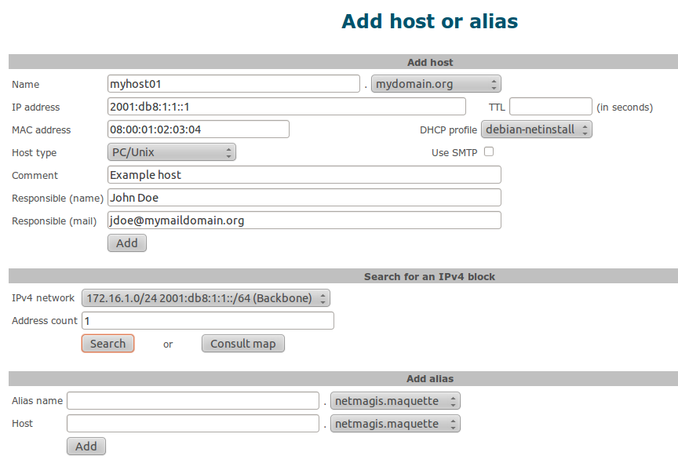

Slide 5
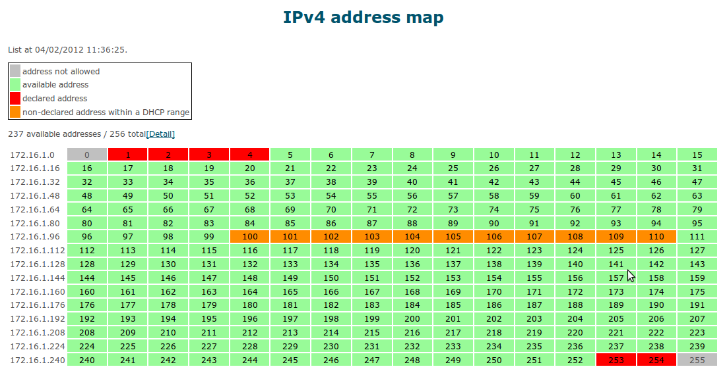

Slide 6
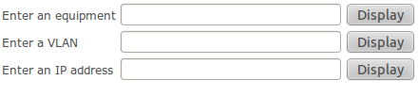
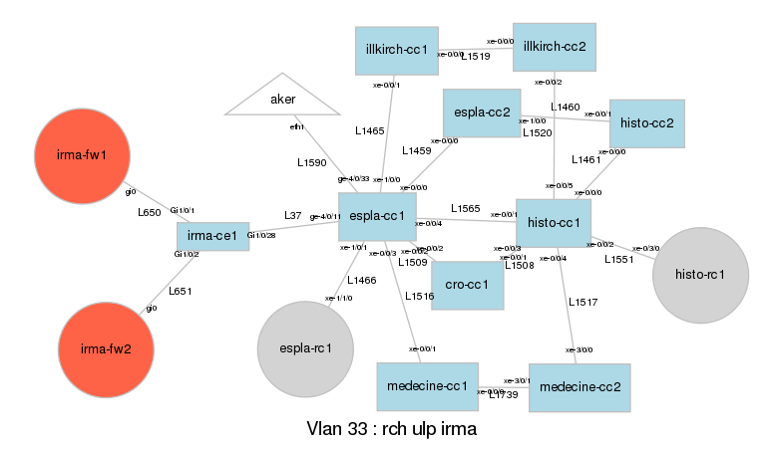
Topology: L2
irma

Slide 7
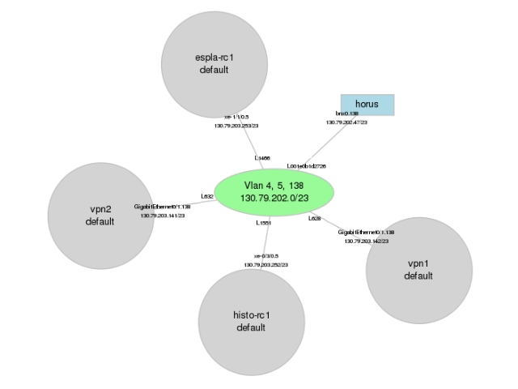
Topology: L3
130.79.202.1

Slide 8
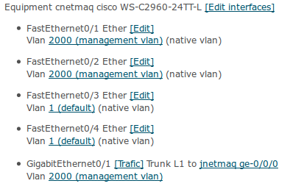
Topology: network equipments
cnetmaq

Slide 9
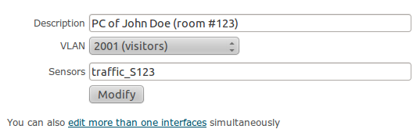
Topology: interface modification
Works on Cisco, HP and Juniper equipments
Can be delegated to other admins

Slide 10
Topology: traffic on an interface
cnetmaq

Slide 11
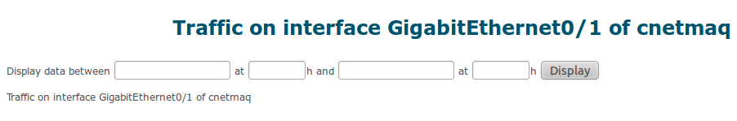
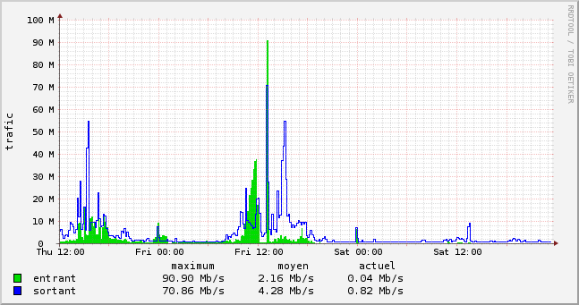
Topology: traffic on an interface

Slide 12
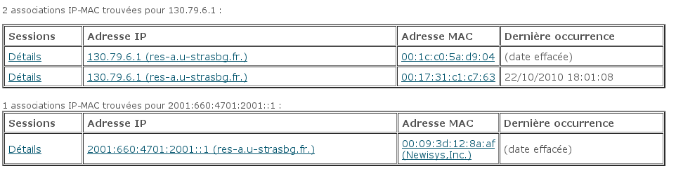
MAC: locate an IP address

Slide 13

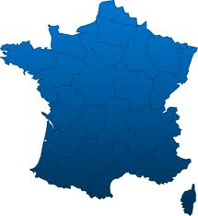

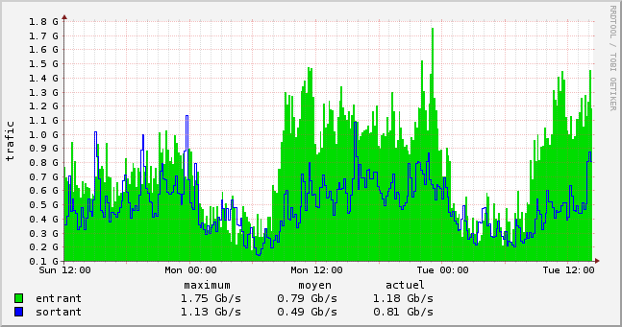
Functional domains
DNS
DHCP
Central
repository
management
Host management
MAC address management
Mail routing
Authentication
and
authorization
Network and equipment management
topology
métrology

Slide 14
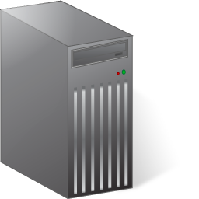

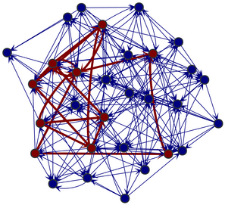
Configuration-driven automation
Topology server
Network administrator
Configuration modification
Download
Model of the network

Slide 15
Configuration-driven automation
A simple modification in the configuration of a network equipment:
  add (link number, sensor number) in the interface description:
The modification is detected ; it triggers a chain of actions:
→ Analysis of the configuration
→ Matching identical link numbers
→ Building of a (highly detailed) network model
→ Automatic generation of traffic sensors
→ SNMP polling and creation of an RRD database
interface Gi0/23
description <L23 M23>
R1
R2
L23
L23

Slide 16
Network model
SW1
SW2
L23
L9
SW3

Slide 17
Network model
L23
L9
Giga 1/1
Giga 1/2
L1
20
20
10
20
L2
Bridging instance
L3
10
10.1.2.3/24

Slide 18
Under the hood
Languages: Tcl, C, Perl
Database: PostgreSQL
Web Server: any web server implementing CGI
Topology: Rancid
Metrology: RRDTool
Installation
  FreeBSD port, Debian package (v2.1)
VCS: http://github.com/pdav/netmagis
All contributions are welcome!

Slide 19
Conclusion
Netmagis evolved over many years
Maturity: used in production since 2002
Packed with functions
  Modules were developed following our operational needs
Network management is complex
  Manual handling → inconsistencies and malfunctions
  Automation is mandatory
  You need a tool
Choose Netmagis ! (and give us feedback!)
http://netmagis.org/

