Slide 1
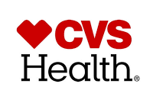
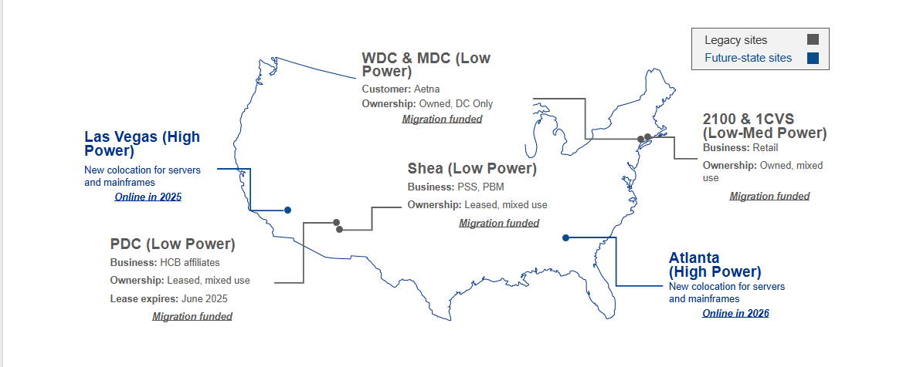

Datacenter Consolidation
What is the Datacenter Consolidation and Migration Project?
A large-scale initiative by CVS supported by KPMG to streamline and modernize CVS Health’s enterprise systems and data centers. The project involves moving critical infrastructure—servers, mainframes, and applications—from legacy and leased sites to new, high-power colocation facilities in Atlanta and Las Vegas. This will consolidate operations, improve efficiency, and ensure future readiness by funding and executing migrations for each site.
Which data centers are in-scope?
Location | Timing
PDC | In-Progress
Shea | Immediate priority; EOY 2026
WDC | 2027-2028
MDC | 2027-2028
2100 | 2027-2028
1CVS | 2027-2028
What infrastructure is being migrated?
Applications: Business-critical, development, testing, pre-production, and production environments will be migrated. The migration will follow a wave-based approach, beginning with lower environments to minimize risk.
Physical and Virtual Servers: Compute resources, including x86 platforms, IBM mainframes (iSeries, AIX, Z Series), HP NonStops, VMs, and containers.
Networking: Core network fabrics, switches, routers, firewalls, DMZs, and internal connectivity required to support all migrated compute and storage.
Third-Party Connections: External business-to-business (B2B) circuits, VPN tunnels, and direct connects with external partners.
Telecom: Voice and data telecom appliances and circuits.
Platforms: Databases and middleware (including ESL, FileNet, MFT, WebSphere)
Cloud Connectivity: Direct connections to hyperscale cloud providers will be established from the new colocations.
How will this be achieved?
This program is a multi-workstream effort broken down into these teams:
x86: Manages the inventory, validation, and migration of all x86 systems—including VMs, physical servers, containers, and VDI—across in-scope data centers.
Network: Delivers secure, resilient connectivity by designing and deploying circuits, firewalls, DMZs, and telecom systems.
Migration Planning: Drives application discovery and migration planning, defining dependencies, sequencing, and readiness.
How can CVS stakeholders enable success?
Respond to requests for validating critical information relevant to your applications, network, and systems
Review communications to understand key steps in the migration/consolidation process
Support project resource needs by recognizing demands on critical teams during concurrent buildouts and migration phases
Participate in collaborative discussions to proactively resolve emerging risks or issues
Value of Consolidation and Migration
Reduce operational complexity and cost
Enhance scalability and resiliency
Support future digital initiatives (AI, analytics, cloud-native apps)
Project Sponsors & Stakeholders
Saul Mankes
Jesse Jones
Heather LaPolt
Marizia Lopez
Marcus Brakewood

