Slide 1
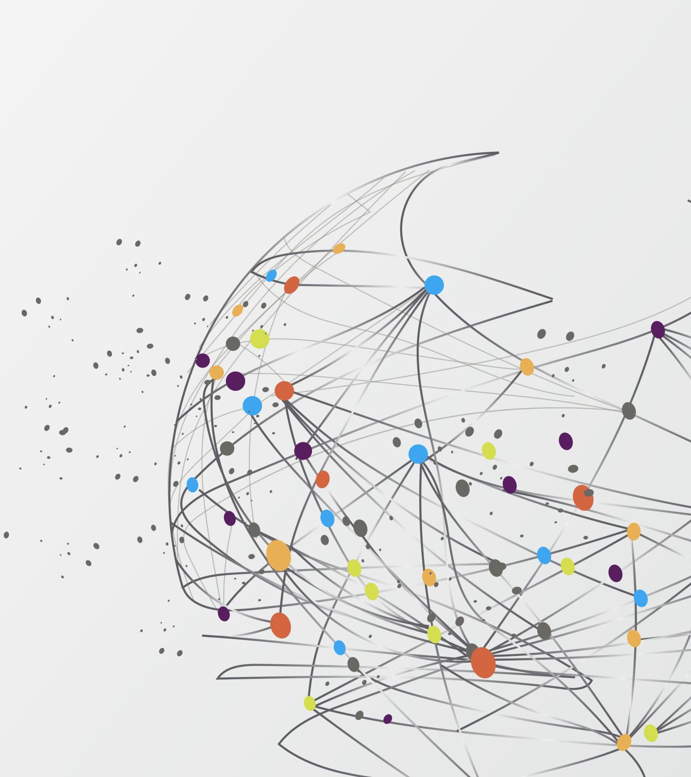
Medical Database Creation: A Workaround Implementation
Presented by: Jean Baptiste Landry Mbem and Nelson Aurelien Todem Fotso
Project in Master Informatics: Database and Information System
Professor: Prof. Dr. Sven Hartmann
Sommer Semester 2024

Slide 2

Content
Introduction
Related Work
Methodology
Implementation
Results and Discussion
Conclusion

Slide 3
Introduction
Graph databases like Neo4j are popular for efficiently managing and querying complex relationships, making them ideal for social networks, recommendation engines, and streaming apps. However, their complexity can be a barrier for users. This project aims to simplify interaction with graph databases by developing a Python-based application with a user-friendly GUI. The tool allows users to create and manage graph databases from CSV files, catering to both administrators with full control and regular users for querying and data analysis.

Slide 4
Related Work
The Movie Database: Creation of a Movie Database through Imports from CSV Files.
Building a User-Friendly Database Application through Importing and Bulk Data Loading from CSV Files (Robinson and Webber).

Slide 5
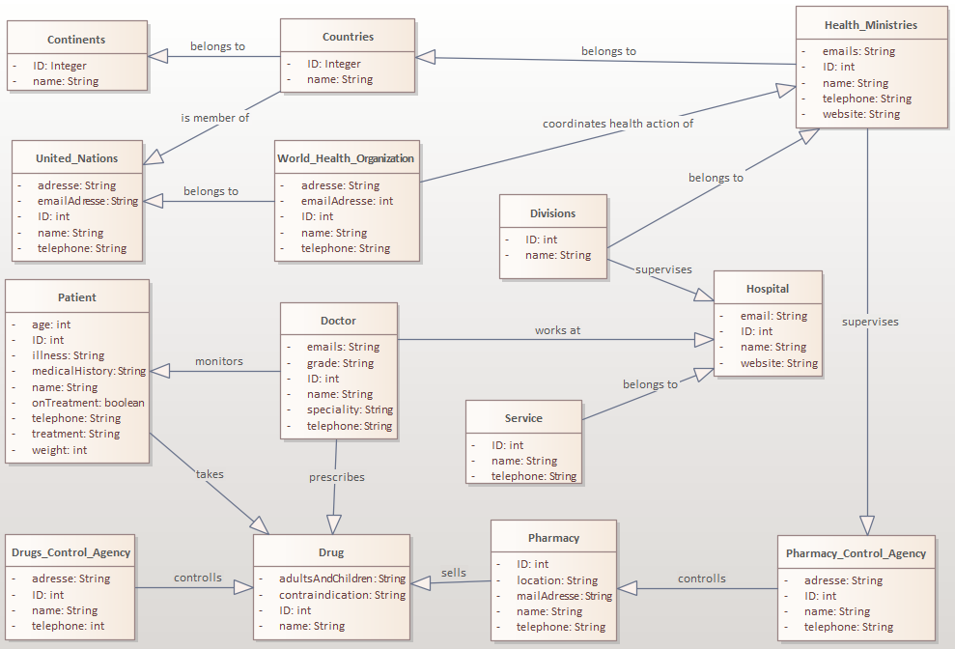
Methodology: System Architecture and Modelling
Fig1: System Class Diagram

Slide 6
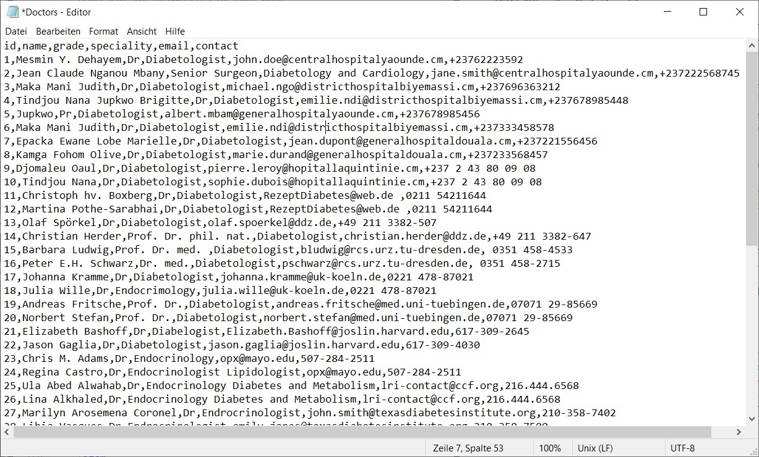
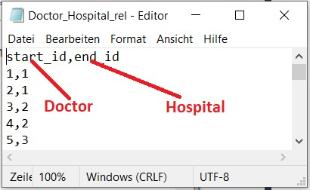
Methodology: Data Representation
Fig3: WORKS_AT Relation
CSV File
Fig2: Doctor CSV File

Slide 7
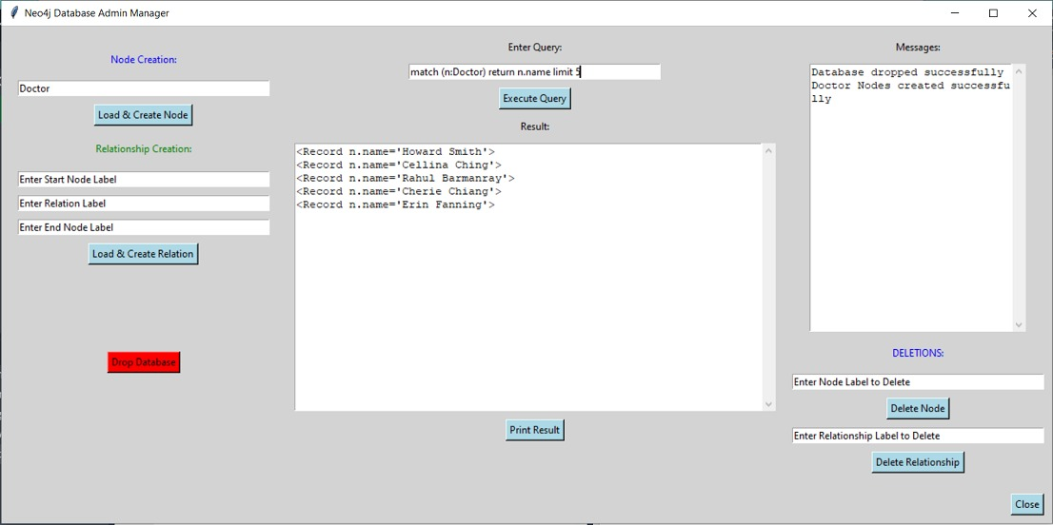
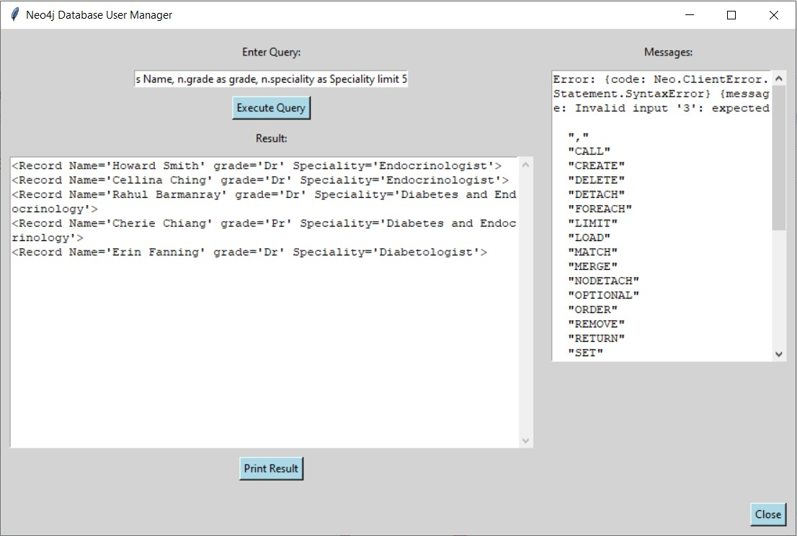
Implementation: Interfaces Design
Fig4: Admin Interface
Fig5: User Interface

Slide 8
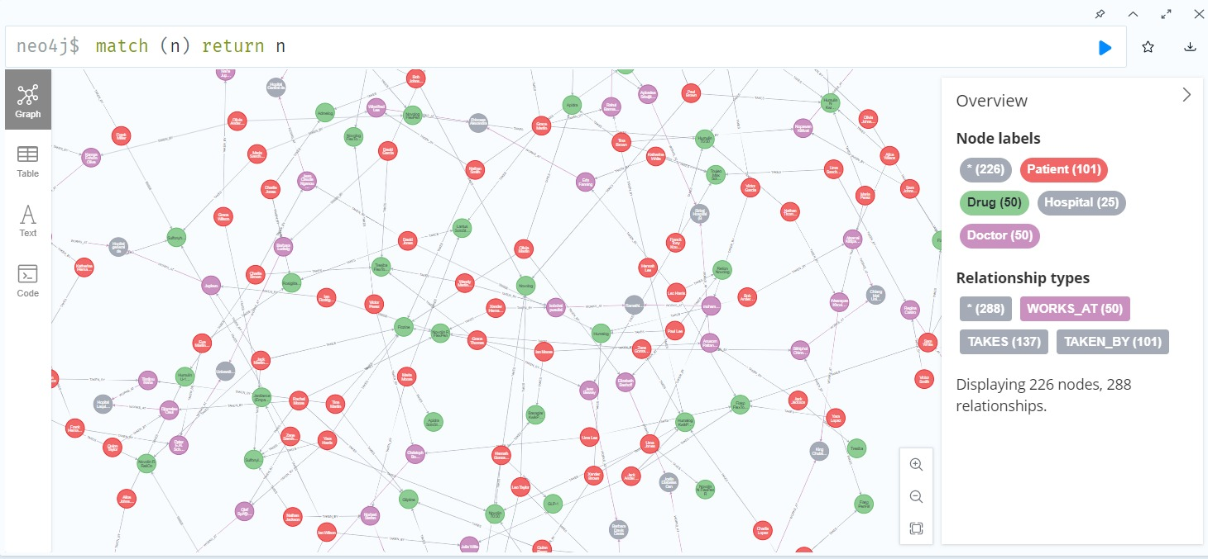
Results And Discussions
Fig6: Database Sample

Slide 9
Results And Discussions: Pros And Contra
+ User-Friendly Interface.
+ Bulk Loading with CSV-Files: Up to thousand lines.
+ Easy to Create and Read CSV-File: Human Readable Files.
CSV-Files Error prone.
No Schema Enforcement: Data integrity issues such as broken relations or orphaned nodes.
- Security Concerns: Data exposure and injection risks.

Slide 10
Conclusion
This project developed a Python application with a user-friendly GUI to simplify the creation and management of Neo4j graph databases from CSV files. The role-based access control balances security with accessibility, making graph database technology available to a wider audience. Future enhancements could include support for advanced features like data visualization and graph algorithms.

