Slide 1

DATA 5300 | 25FQ
NYC Flights | Project 1
Rashmi Kamath
Hayat Kimo
Jack Neton

Slide 2
Agenda
Introduction
Data methodology
Results of each variable
Discussion

Slide 3
Data Methodology
Used nycflights13 data
Combined weather and flights data
Ran summary statistics

Slide 4
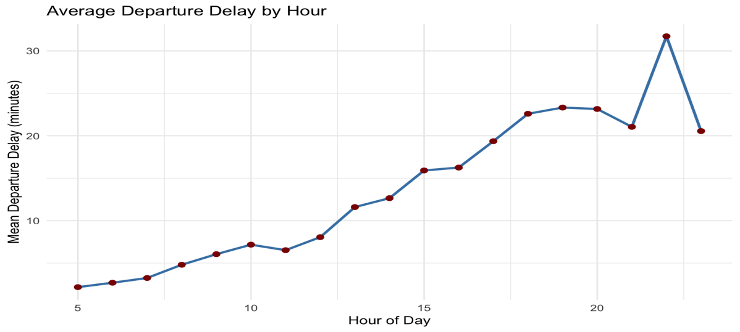
Time of day

Slide 5
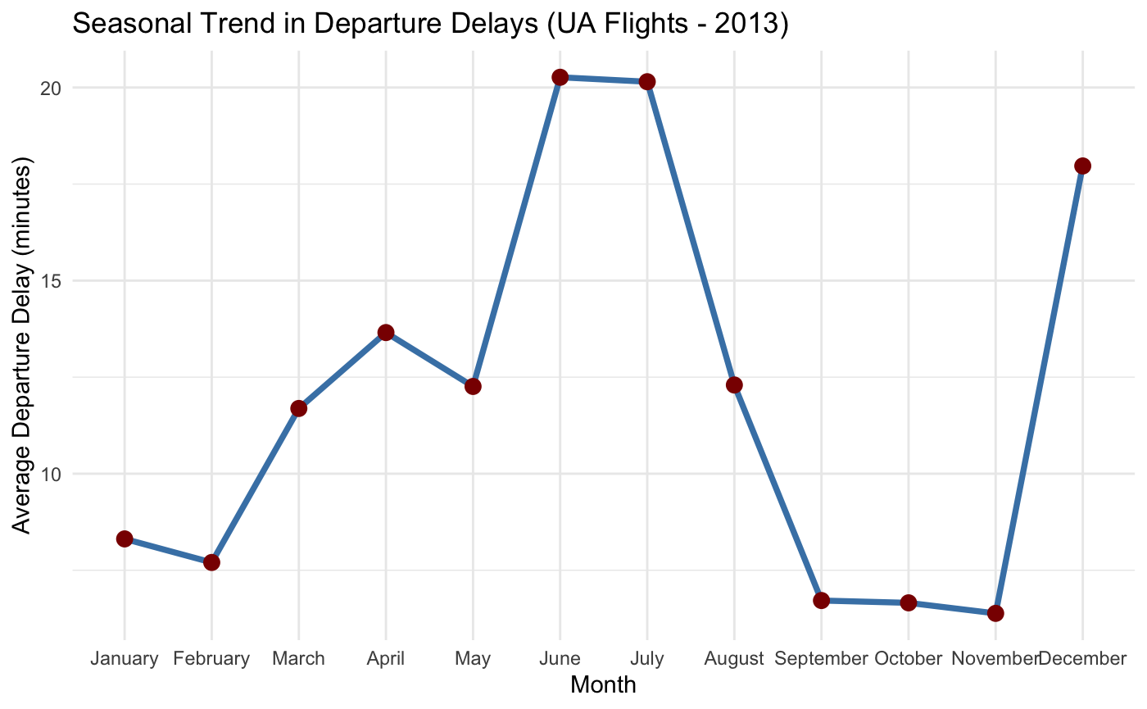
Time of year

Slide 6
Temperature

Slide 7
Wind Speed

Slide 8
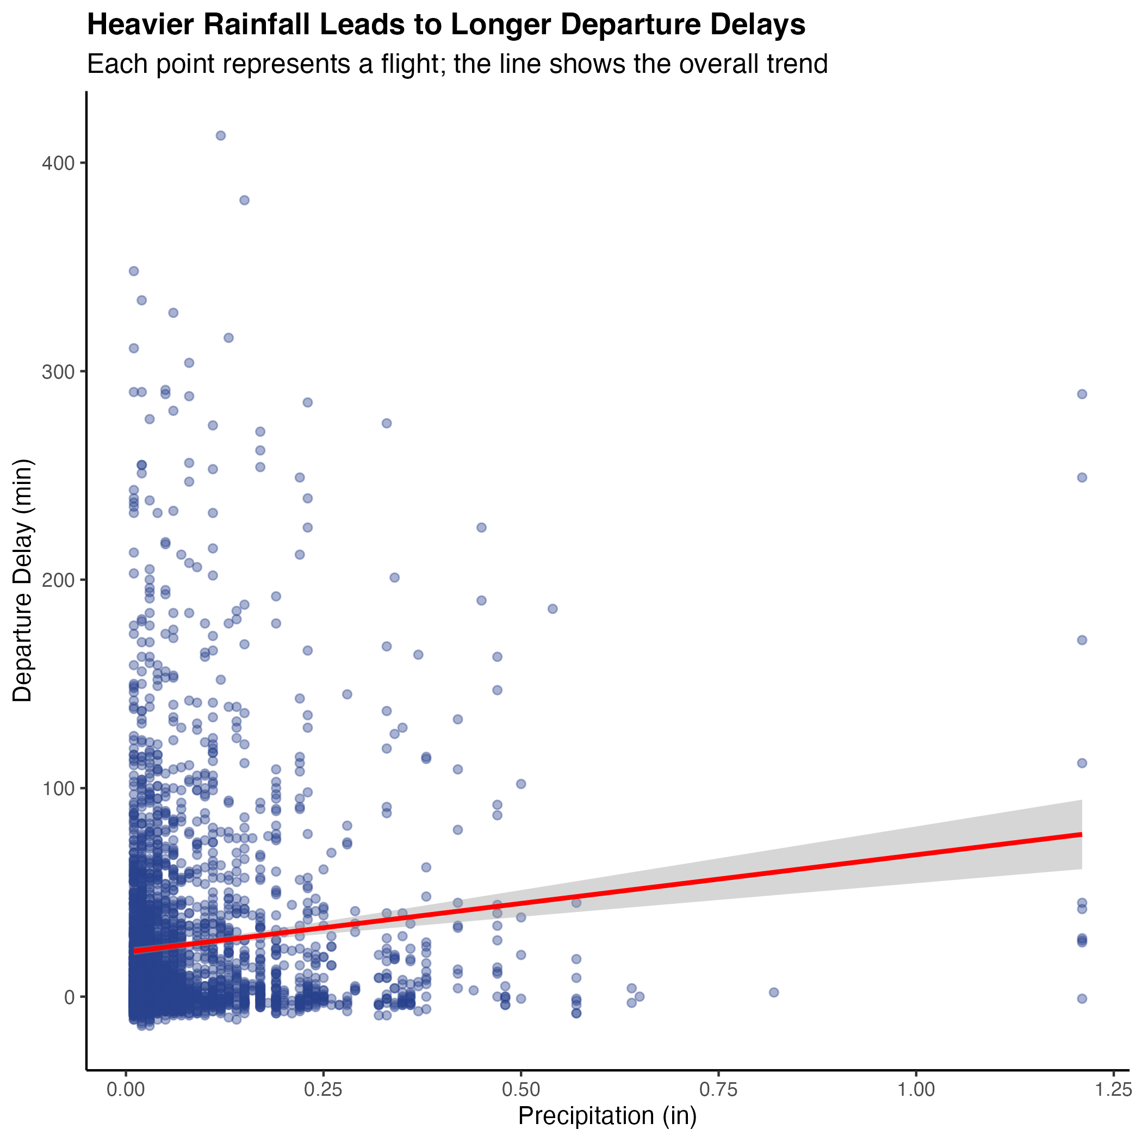
Precipitation

Slide 9
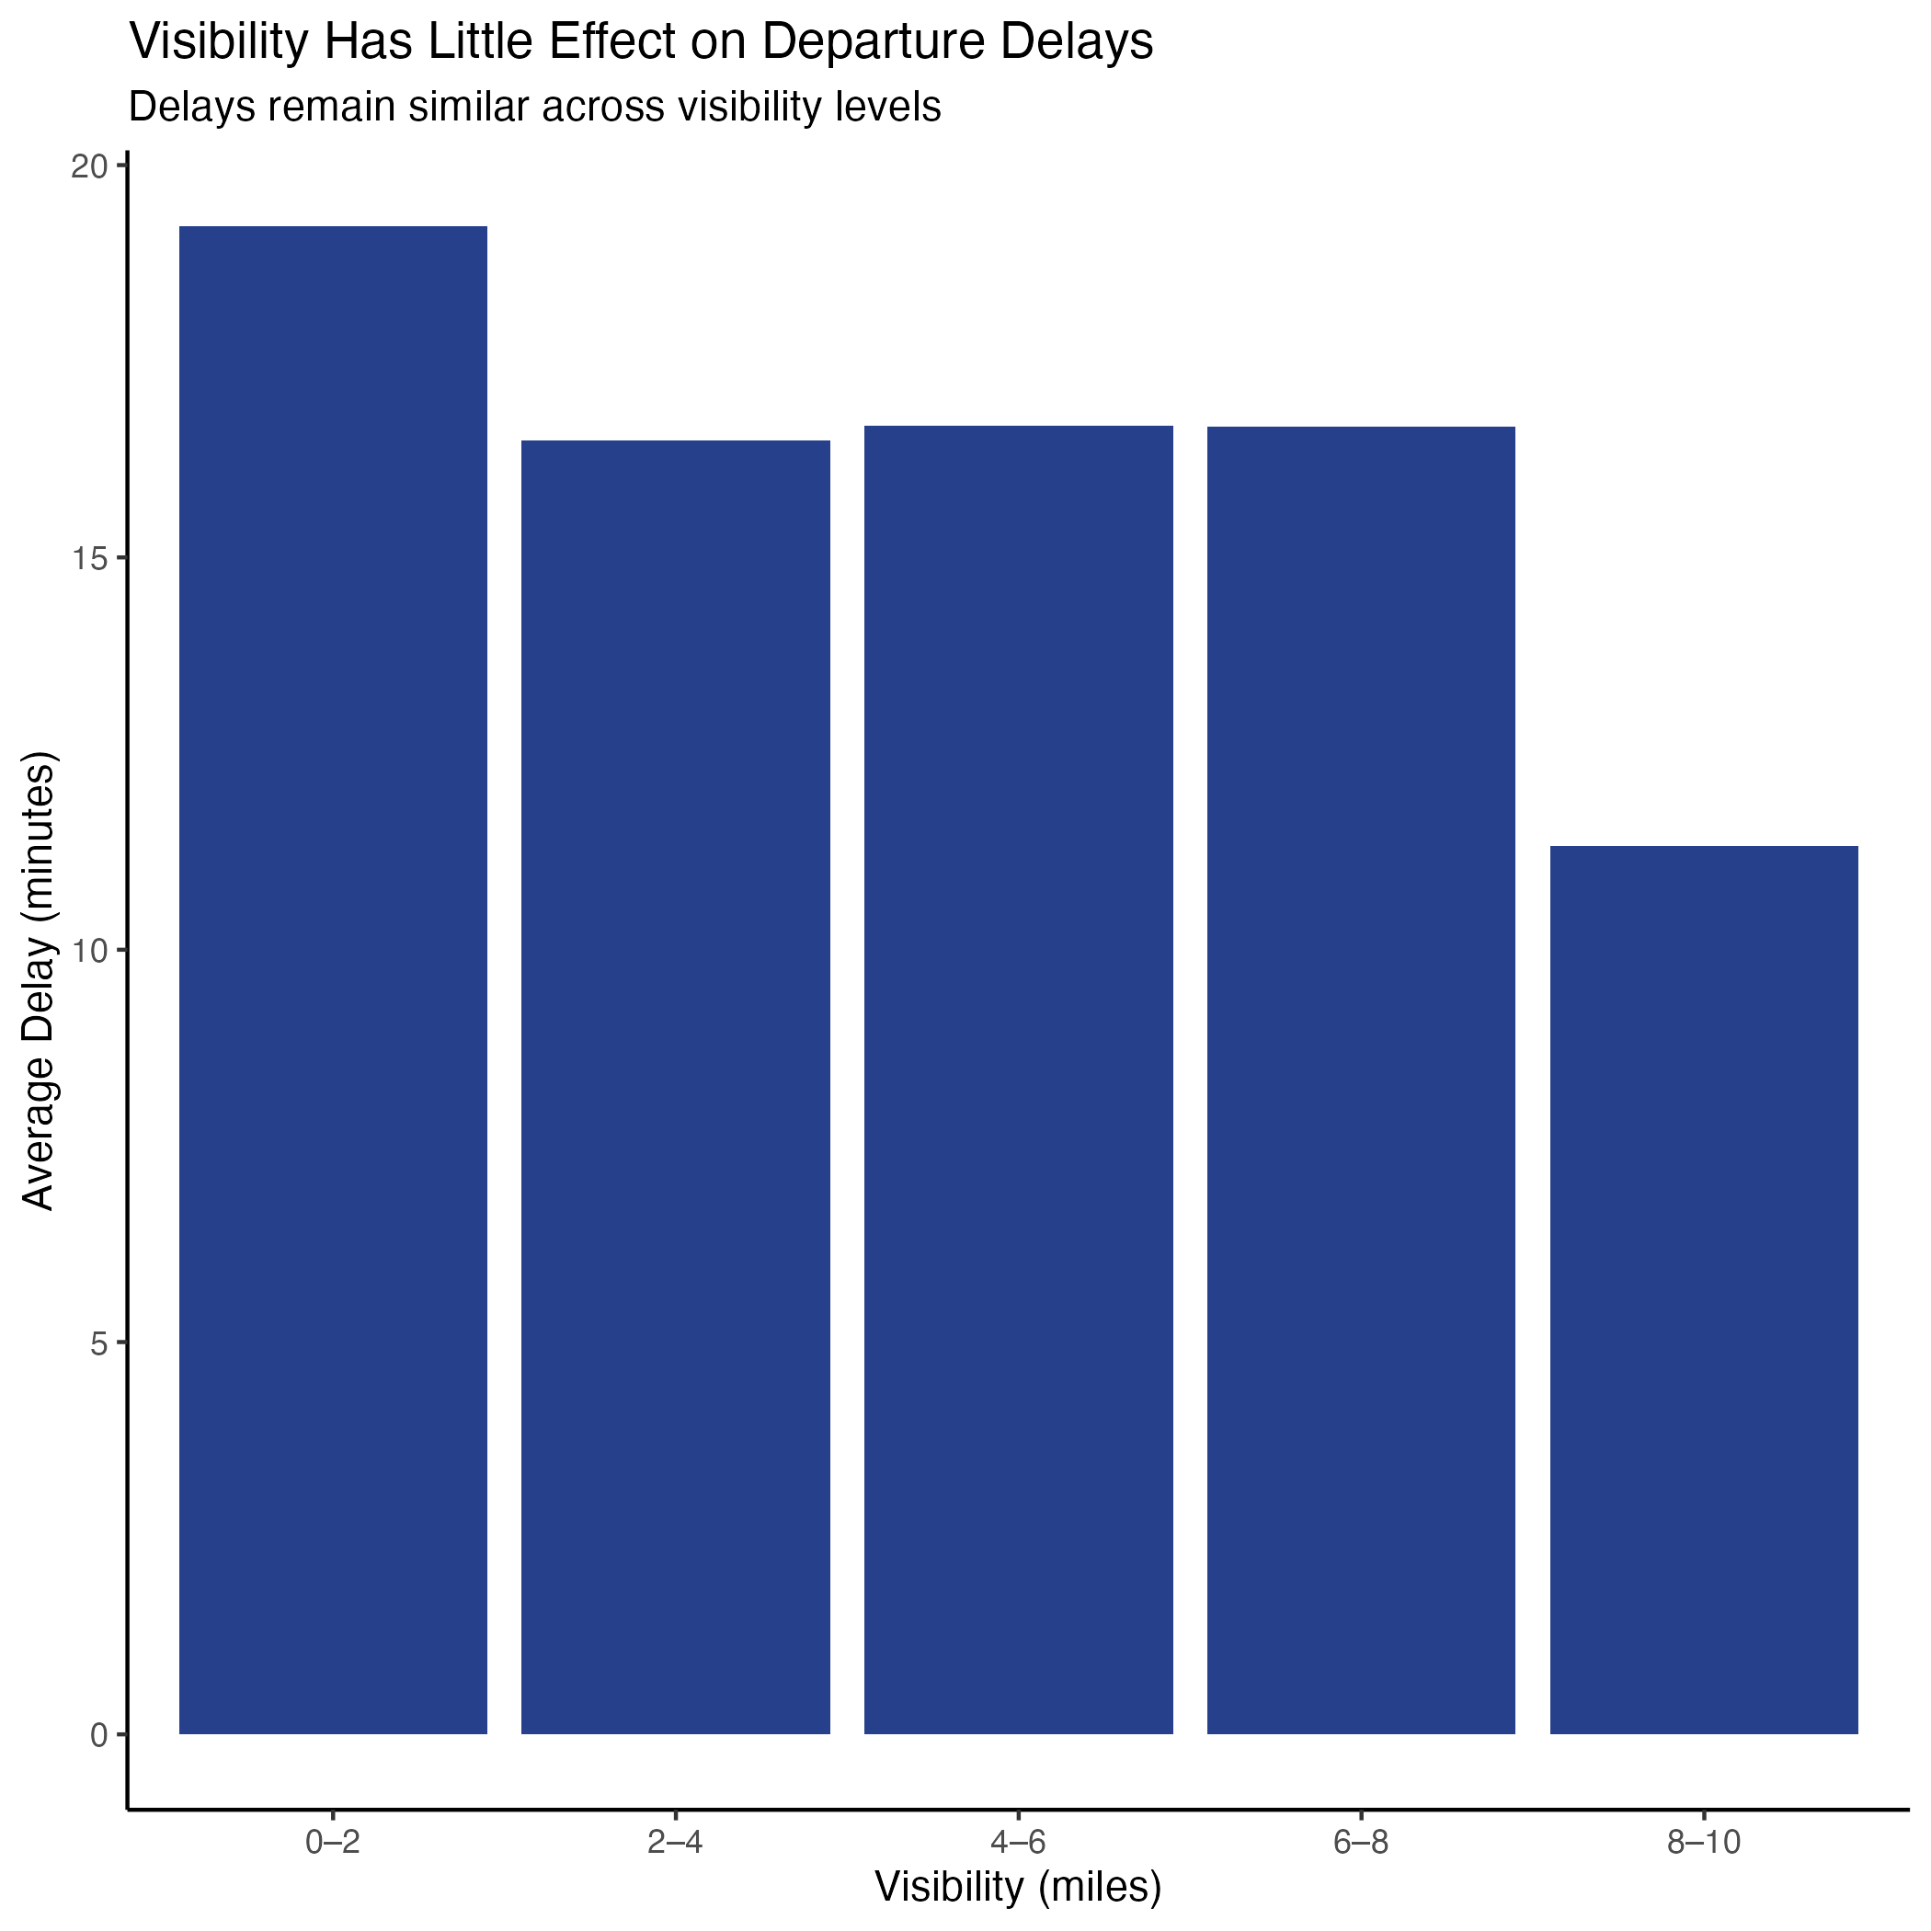
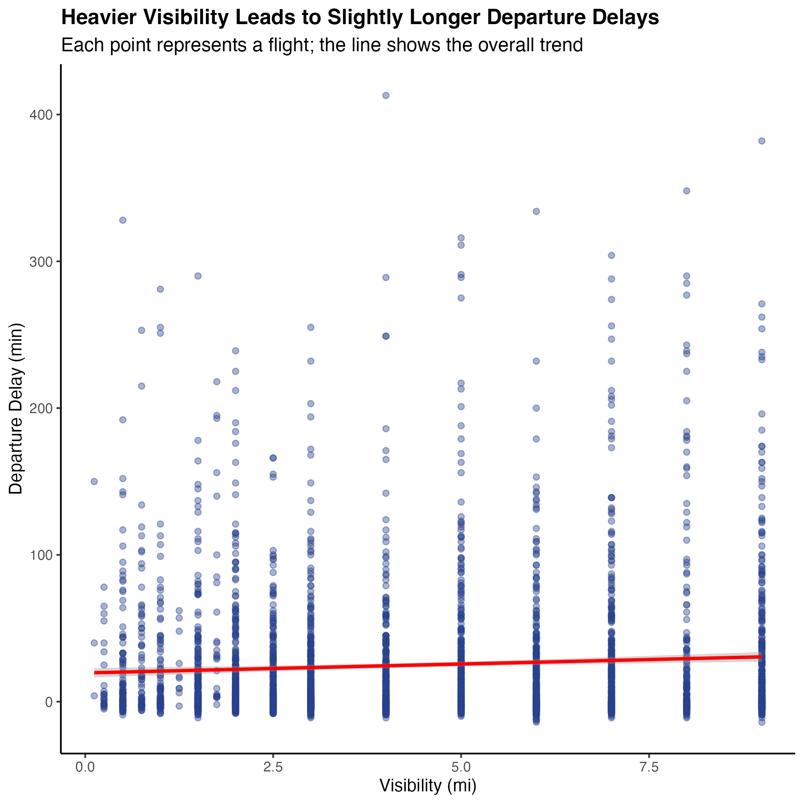
Visibility

Slide 10
Discussion

Slide 11
Thank you!

