Slide 1

DATA 5300 | 25FQ
NYC Flights | Project 1
Rashmi Kamath
Hayat Kimo
Jack Neton

Slide 2
Agenda
Introduction
Data methodology
Departure Delay & Time of Day variable
Departure Delay & Precipitation
Discussion

Slide 3
Introduction
Analyze factors contributing to departure delays for United Airlines flights from New York City (2013).
Examine how time of day, time of year, and weather conditions like temperature, wind speed, precipitation, and visibility influence delays.
Aim to improve operational efficiency and passenger experience through data-driven insights.

Slide 4
Data Methodology
Data was sourced from nycflights13 that contains flight and weather tables for NYC airports in 2013.
The two datasets were merged using common keys — year, month, day, hour, and origin.
Focused on United Airlines flights; created variables late (>0 min delay) and very late (>30 min delay), excluding missing values.

Slide 5
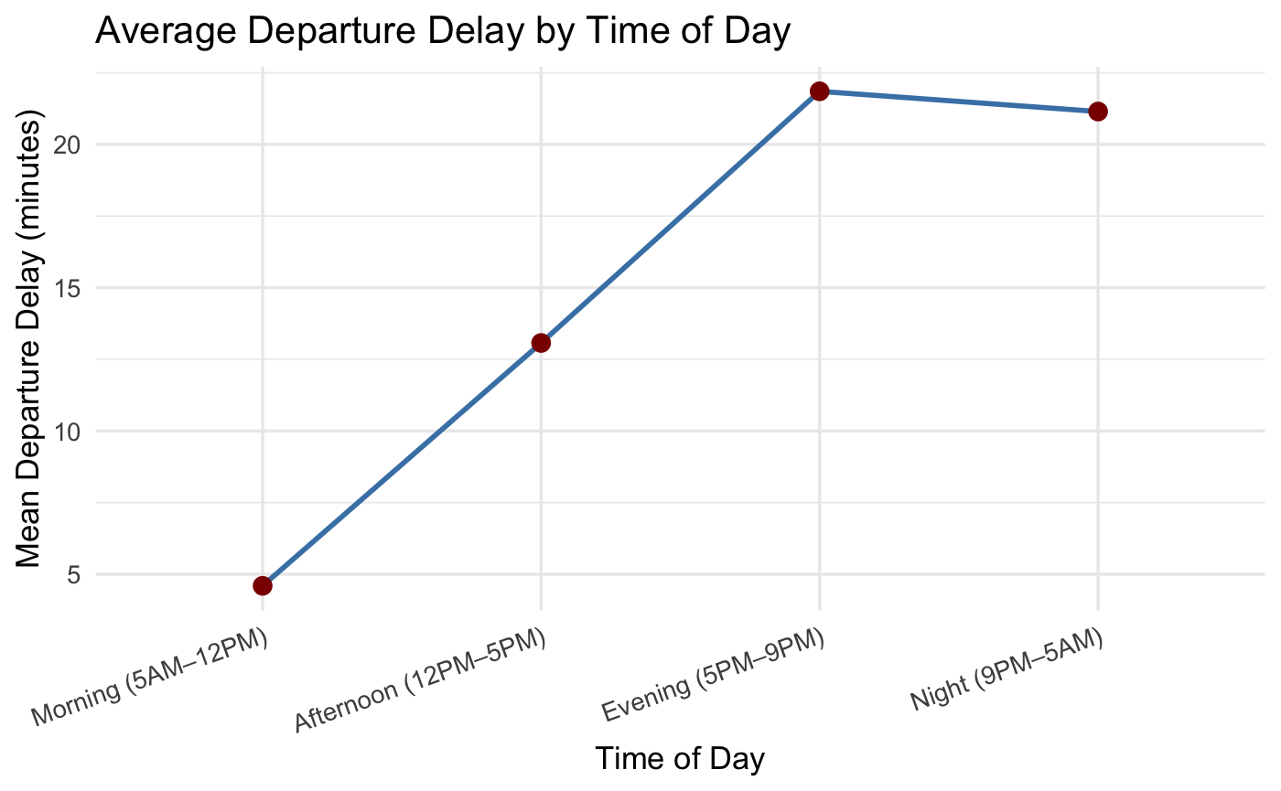
Time of day
Hours were grouped into four categories — Morning, Afternoon, Evening, and Night for clearer comparison.
Morning flights (5 AM–12 PM) show the lowest delays and best on-time performance.
Delays increase steadily through the day, peaking during evening hours (5 PM–9 PM) due to congestion and accumulated delays.
Night flights (9 PM–5 AM) show slightly fewer delays, likely because of reduced traffic.

Slide 6
Time of day
Time of day | Flights | Mean delay | Median delay | Max delay | Late % | Very late %
Morning (5AM–12PM) | 23661 | 4.60 | -2 | 420 | 33.26 | 6.15
Afternoon (12PM–5PM) | 17512 | 13.07 | 1 | 483 | 51.07 | 13.15
Evening (5PM–9PM) | 15333 | 21.85 | 5 | 406 | 62.33 | 22.85
Night (9PM–5AM) | 1180 | 21.15 | 6 | 230 | 61.19 | 26.02
Median delay rises steadily through the day, , showing delays accumulate as the day progresses
The “very late” percentage grows sharply increases.
This pattern highlights that evening and night flights face the greatest risk
Permutation tests indicates mean delay between these groups are statistically significant.

Slide 7
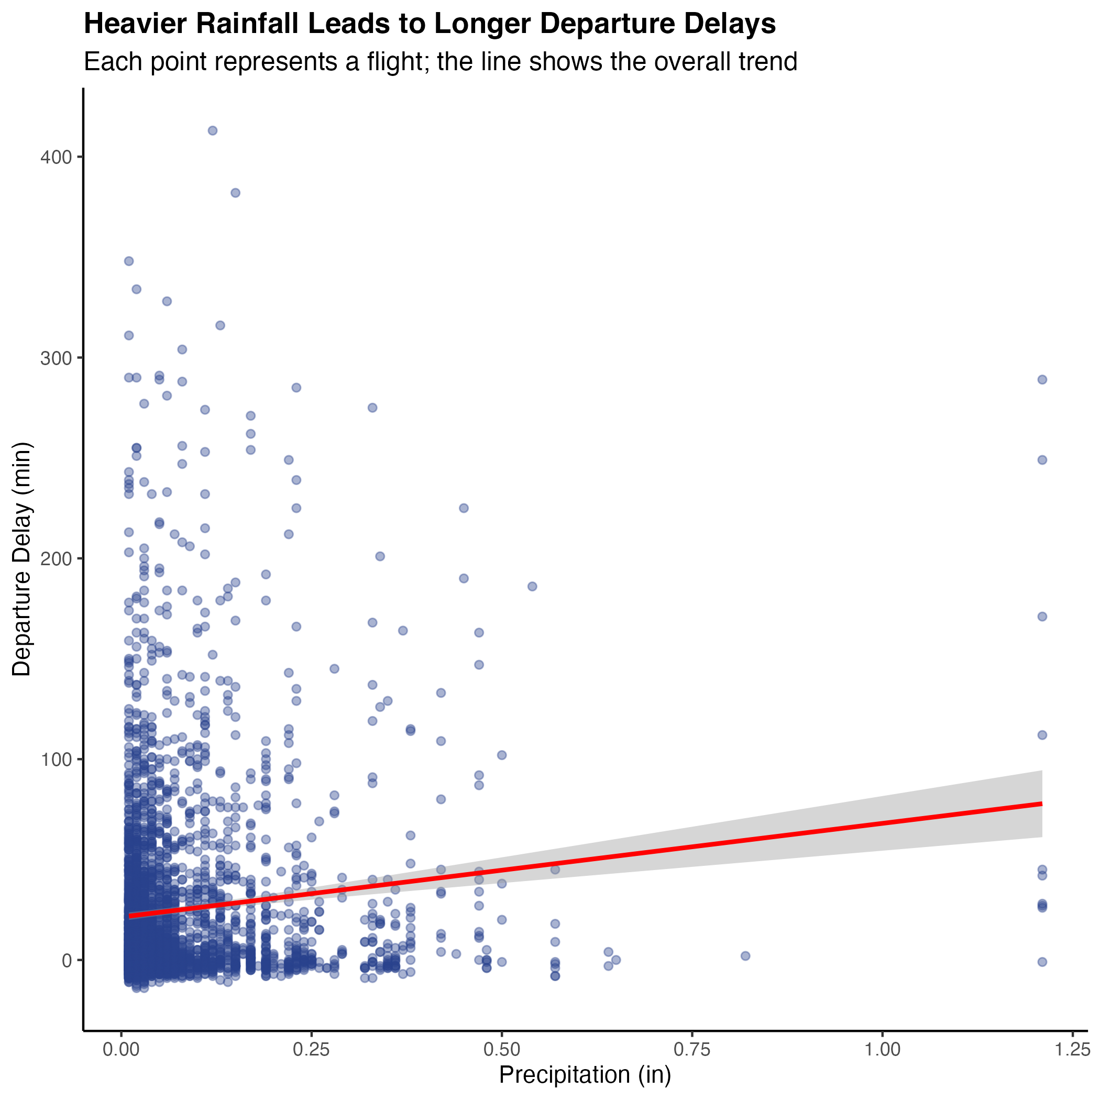
Precipitation
Rainy days show both more frequent and longer delays compared to dry days.
Permutation tests confirm this difference is statistically significant, not due to chance.
Converting precipitation into a rain/no-rain variable produced consistent results, reinforcing that rain strongly affects departure times.

Slide 8
Discussion
Time of day and time of year both show strong relationships with departure delays.
Weather factors like precipitation have a significant impact, with rainy conditions causing longer and more variable delays.
Temperature, wind speed, and visibility show little to no consistent effect on departure delays.
Overall, delays are most influenced by operational congestion (time-related) and rainy weather conditions, emphasizing the need for better scheduling and weather preparedness.

Slide 9
Thank you!

