Slide 1

DATA 5300 | 25FQ
NYC Flights | Project 2
Rashmi Kamath
Hayat Kimo
Jack Neton

Slide 2
Agenda
Introduction
Data methodology
Gain for late flights
Most common destination airports & their gain distribution
Discussion

Slide 3
Introduction
This analysis focuses on United Airlines flights leaving NYC in 2013.
Analyze factors contributing to variations in gain.
Examine how gain differs by flight punctuality, destination airport.
Aim to improve operational efficiency and passenger experience through data-driven insights.

Slide 4
Data Methodology
Data was sourced from nycflights13 that contains flight table for NYC airports in 2013.
Focused on United Airlines flights; excluding missing values.
Created variables:
  gain= departure delay – arrival delay.
  late (>0 min delay) and very late (>30 min delay).

Slide 5
Data Methodology
Conducted Exploratory Data analysis.
Performed Hypothesis tests.
Calculated Confidence intervals.

Slide 6
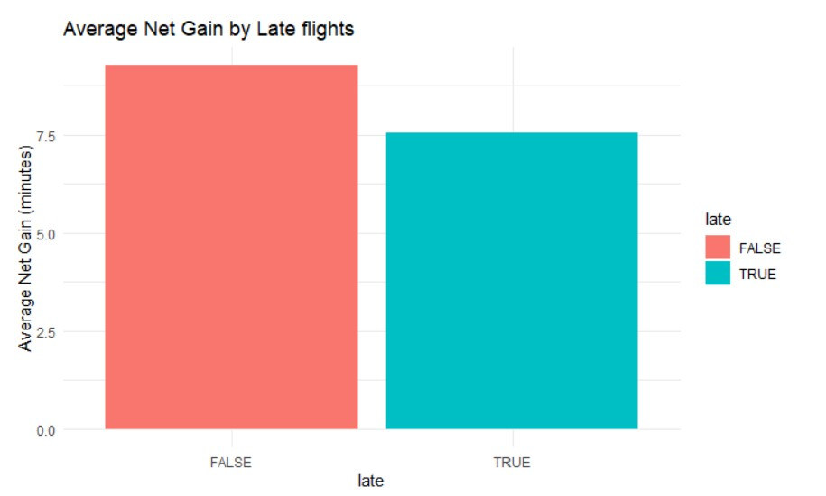
Gain for late flights
On-time flights (False) gained 9.3 minutes on average.
Late flights (True) gained 7.5 minutes on average.
Even late flights recovered some time, but less than on-time flights.
Variablility: late flights showed wider spread in gains.
Late | Average Net Gain | N
False | 9.27 | 30657
True | 7.54 | 27125

Slide 7
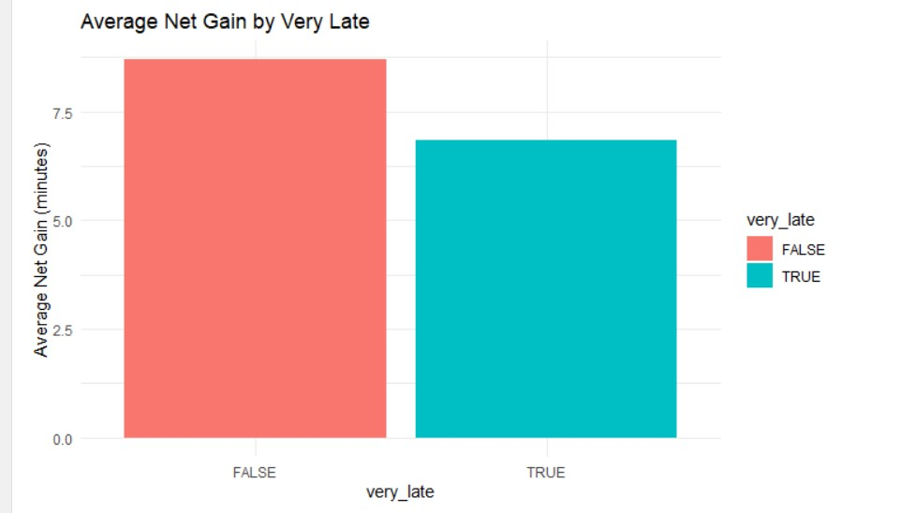
Gain for very late flights
Not very_late flights (False) gained 8.7 minutes on average.
Very late flights (True) gained 6.9 minutes on average.
Extreme delays are harder to recover = less time gained on average.
Greater inconsistency in recovery among very late flights.
Very_late | Average Net Gain | N
False | 8.7 | 50232
True | 6.86 | 7550

Slide 8
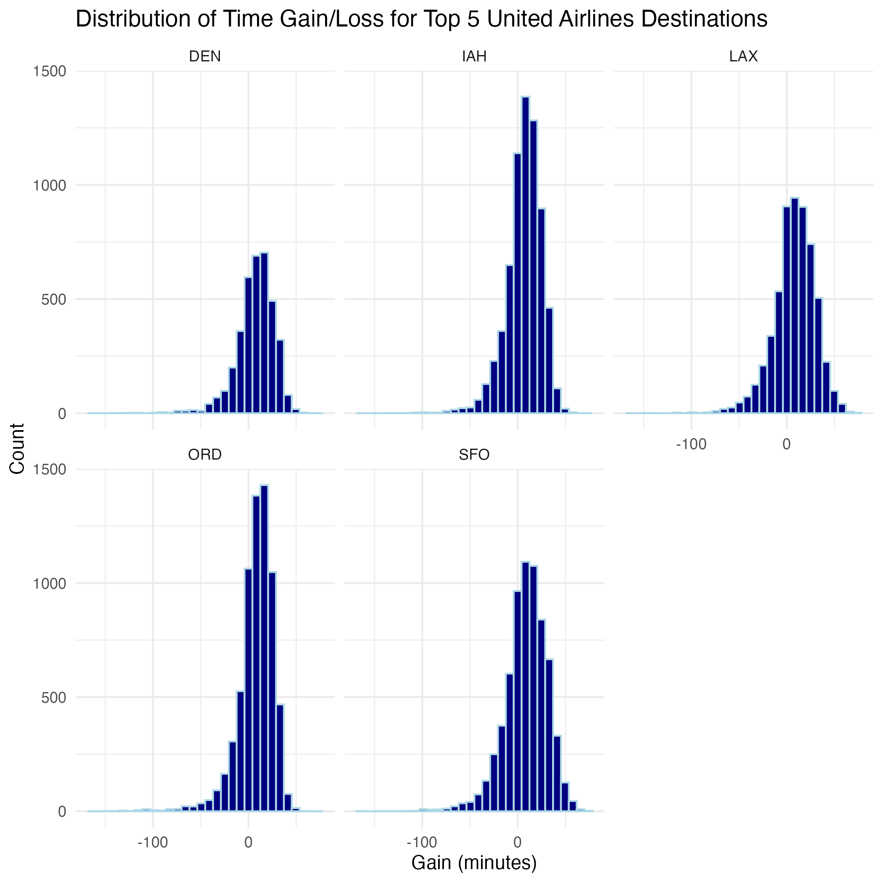
Gain by airport
Top 5 destinations: DEN, IAH, LAX, ORD, and SFO.
Centered around zero.
Average gain is negative; flight time is not made up in the air.
(Can mention about hypothesis tests or CI)

Slide 9
Discussion

Slide 10
Thank you!

