Slide 1

DATA 5300 | 25FQ
NYC Flights | Project 2
Rashmi Kamath
Hayat Kimo
Jack Neton

Slide 2
Agenda
Introduction
Data methodology
Gain for late flights
Most common destination airports & their gain distribution
Gain per hour (late flights & flight length)
Discussion

Slide 3
Introduction
Analyze factors contributing to differences in gain for United Airlines flights leaving NYC
Examine how gain differs by flight punctuality, destination airport.
Examine how gain per hour behaves compared to gain.
Aim to improve operational efficiency and passenger experience through data-driven insights.

Slide 4
Data Methodology
Data was sourced from nycflights13 that contains flight and weather tables for NYC airports in 2013.
The two datasets were merged using common keys — year, month, day, hour, and origin.
Focused on United Airlines flights; created variables late (>0 min delay) and very late (>30 min delay), excluding missing values.

Slide 5
Gain for late flights

Slide 6
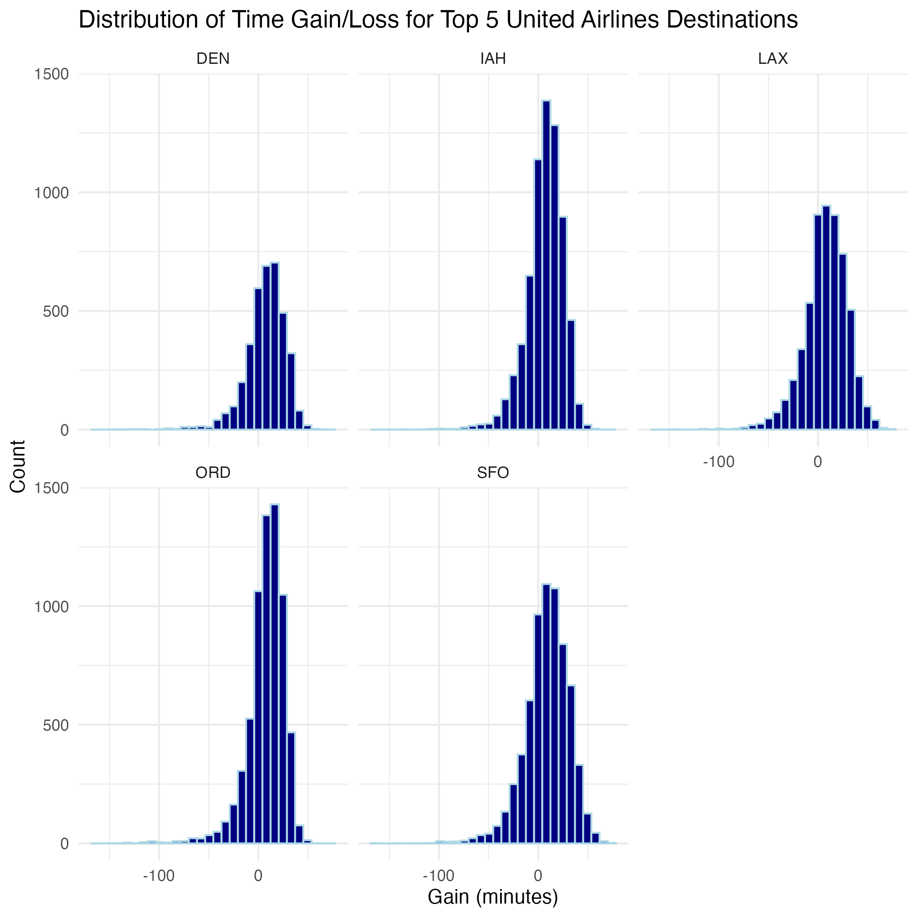
Gain by airport
Top 5 destinations: DEN, IAH, LAX, ORD, and SFO.
Centered around zero.
Average gain is negative; flight time is not made up in the air.

Slide 7
Gain relative to flight delay
Text here

Slide 8
Gain relative to flight duration
Text here

Slide 9
Discussion

Slide 10
Thank you!

