Slide 1
Project - Todoapp Telecommunications software
Netra heng – 200ADM051

Slide 2
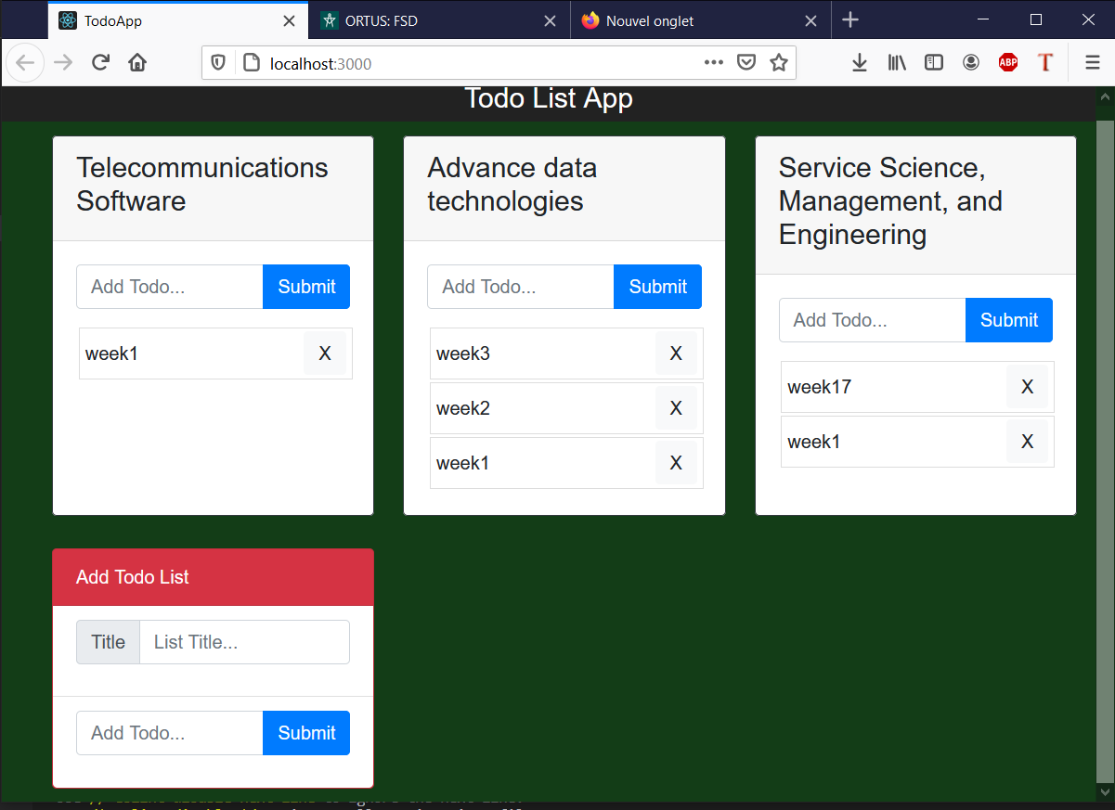
Todo list APp
App which diplay a specific list of homeworks we have to do later
You can :
Add a homework
Add a todo list
Delete a homework
Delete a todolist

Slide 3







Technologies used for this app
Bootstrap
Node.JS
Express.Js
MySQL
React.Js
HTML
CSS

Slide 4
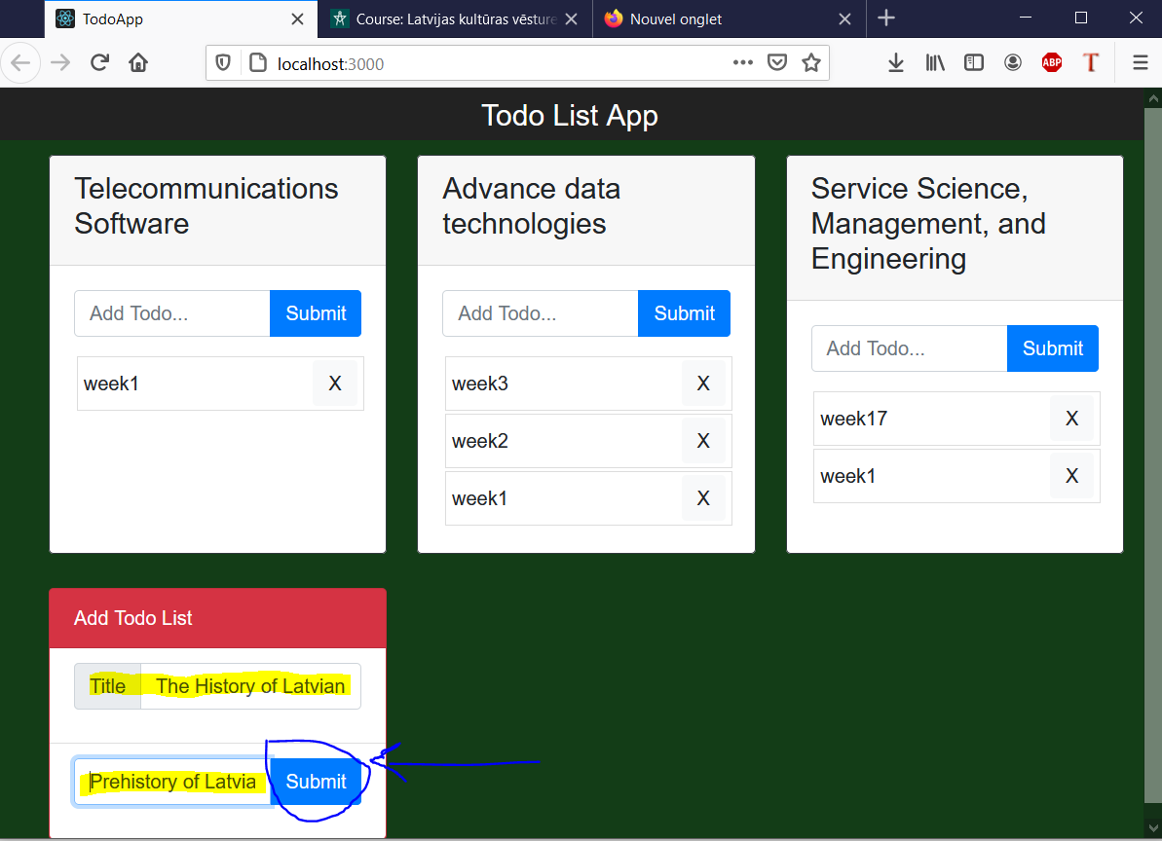
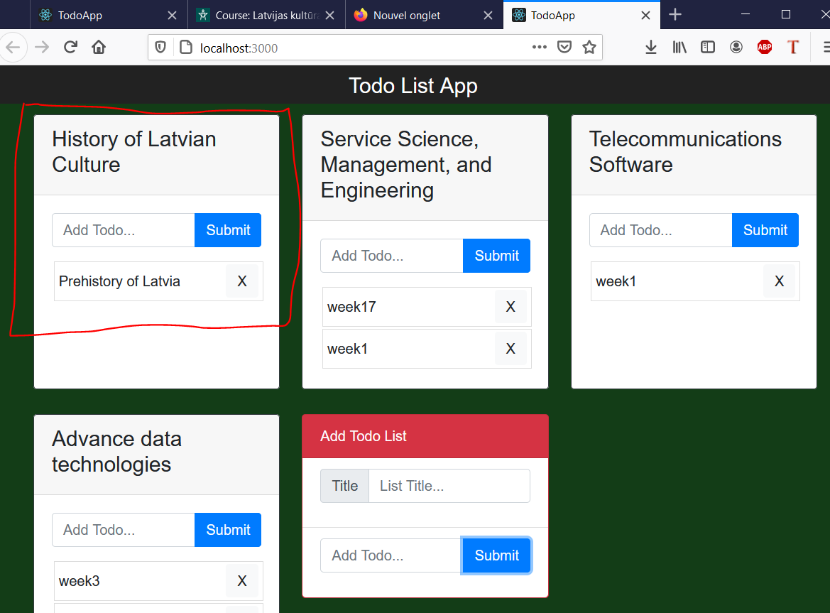
Add a tODO LIST

Slide 5
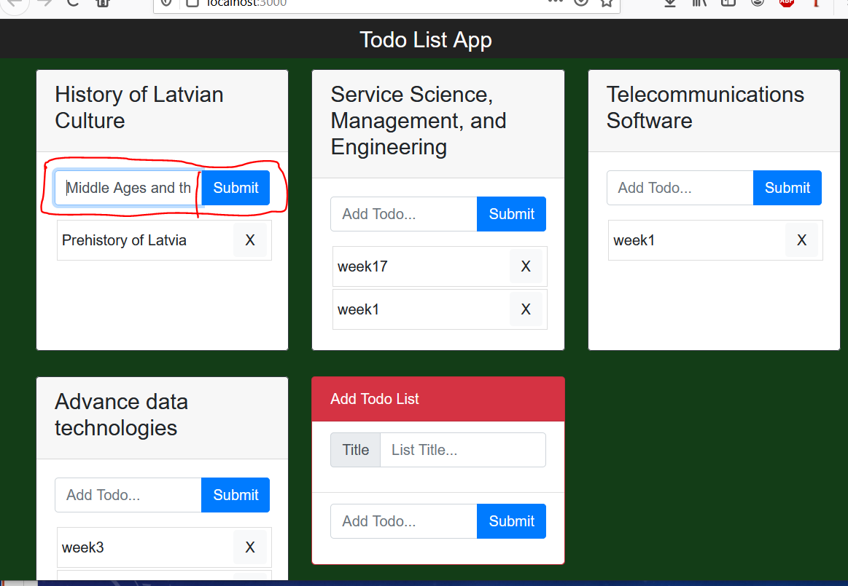
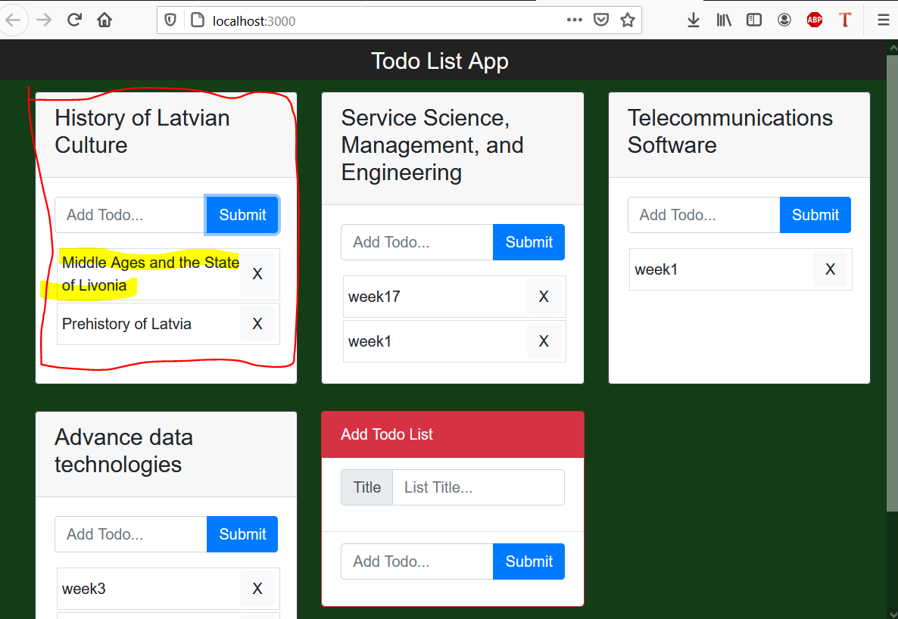
Add a Homework to a ToDO LIST

Slide 6
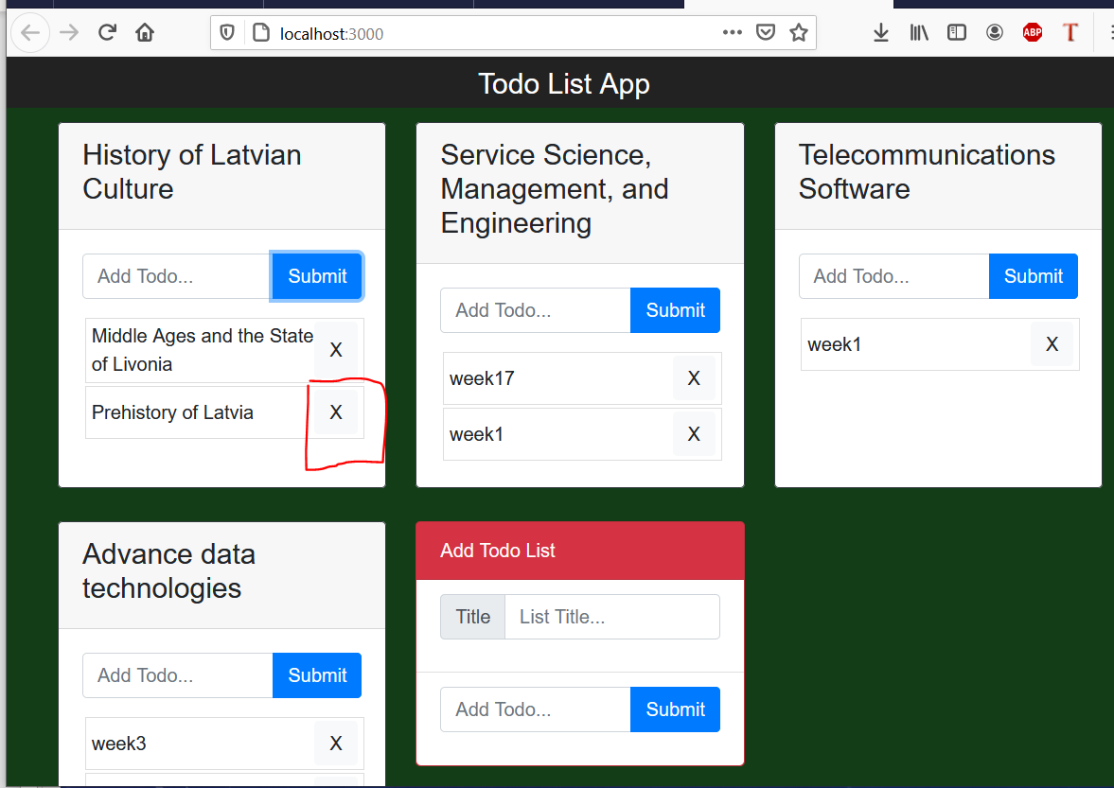
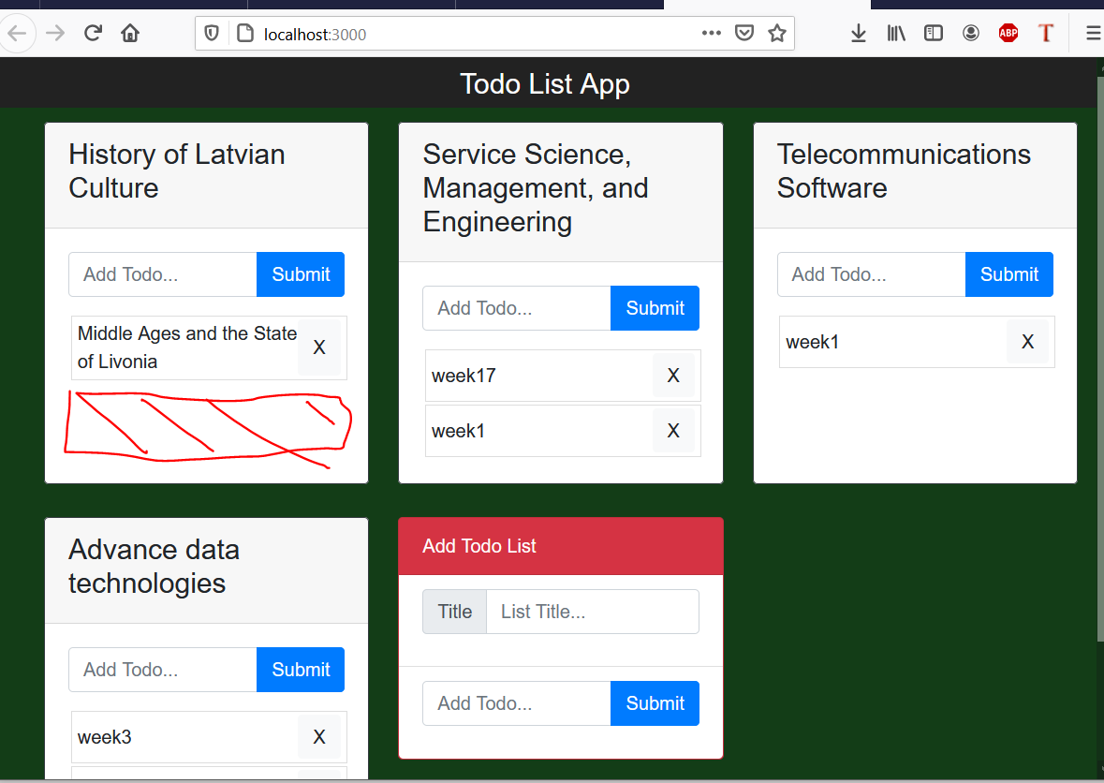
Delete a homework

Slide 7
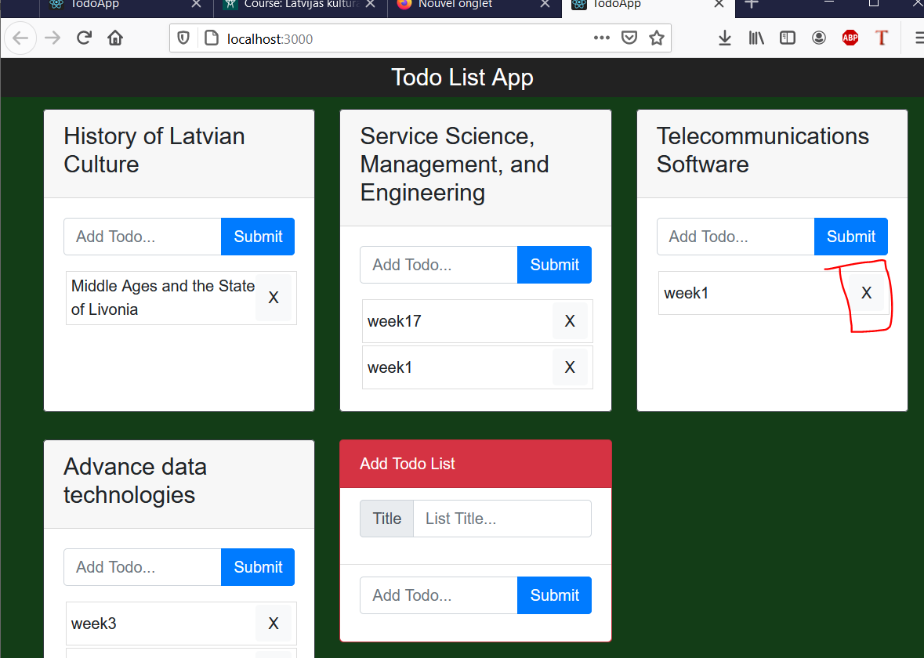
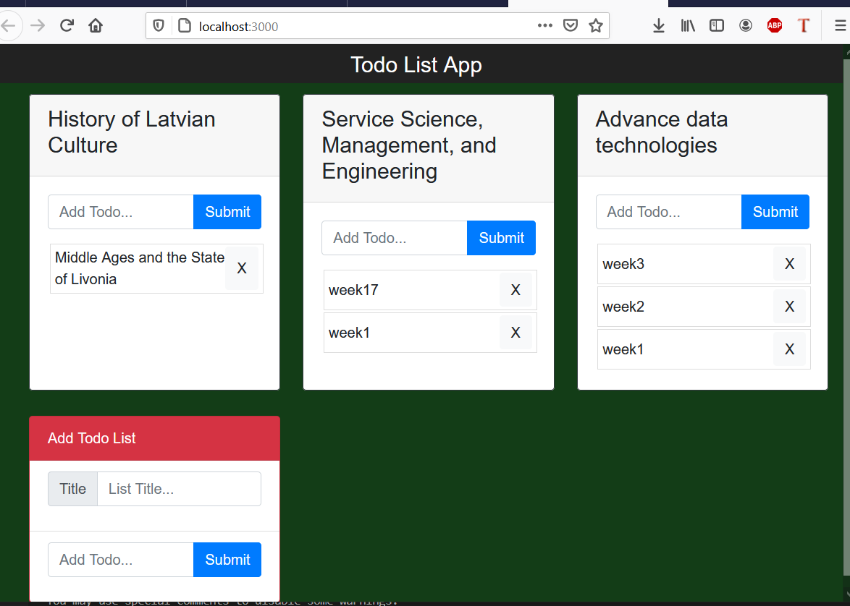
Delete a ToDOLIST

Slide 8
CONCLUSION
Knowledge : HTML CSS MySQL
Learning/Beginner : JavaScript
Never used : React
Tried my best to do an App with the more technologies we learned

