Slide 1
Data Warehouse
Dibya Tara Shakya

Slide 2
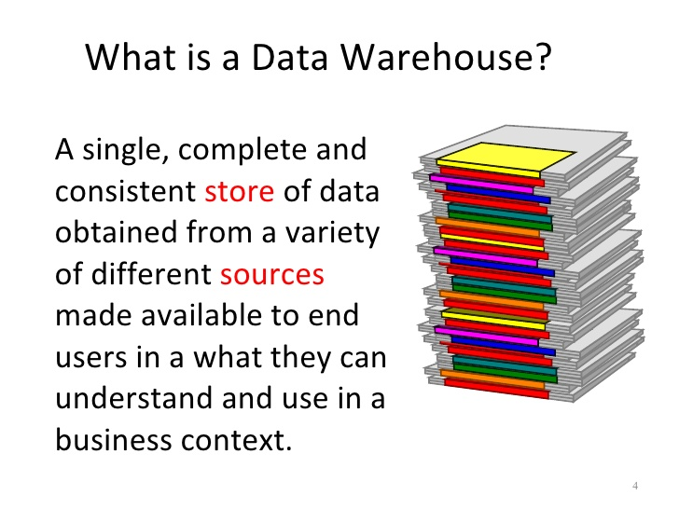

Slide 3
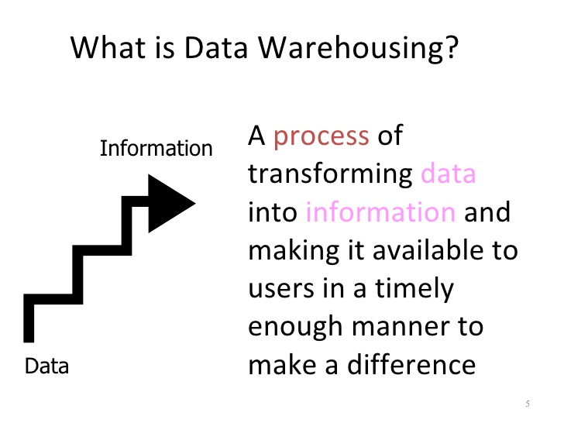

Slide 4
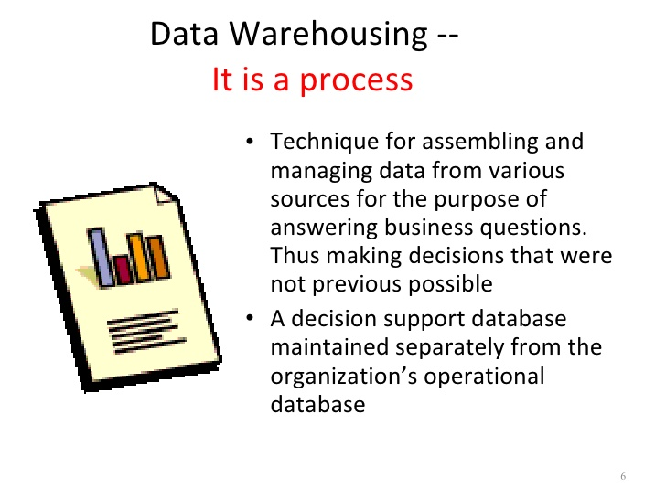

Slide 5
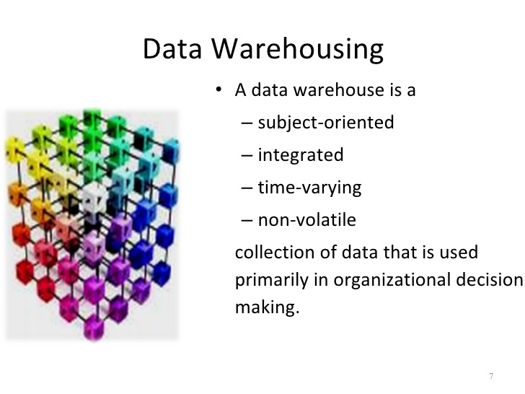

Slide 6
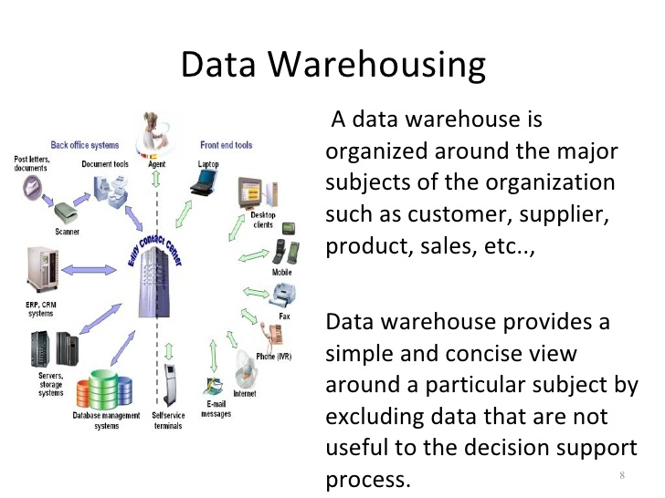

Slide 7
Introduction
What is Data Warehouse?
A data warehouse is a collection of integrated databases designed to support a DSS.
According to Inmon’s (father of data warehousing) definition(Inmon,1992a,p.5):
It is a collection of integrated, subject-oriented databases designed to support the DSS function, where each unit of data is non-volatile and relevant to some moment in time.

Slide 8
Introduction-Cont’d.
Where is it used?
It is used for evaluating future strategy.
It needs a successful technician:
Flexible.
Team player.
Good balance of business and technical understanding.

Slide 9
Introduction-Cont’d.
The ultimate use of data warehouse is Mass Customization.
For example, it increased Capital One’s customers from 1 million to approximately 9 millions in 8 years.
Just like a muscle: DW increases in strength with active use.
With each new test and product, valuable information is added to the DW, allowing the analyst to learn from the success and failure of the past.
The key to survival:
Is the ability to analyze, plan, and react to changing business conditions in a much more rapid fashion.

Slide 10
Data Warehouse
In order for data to be effective, DW must be:
Consistent.
Well integrated.
Well defined.
Time stamped.
DW environment:
The data store, data mart & the metadata.

Slide 11
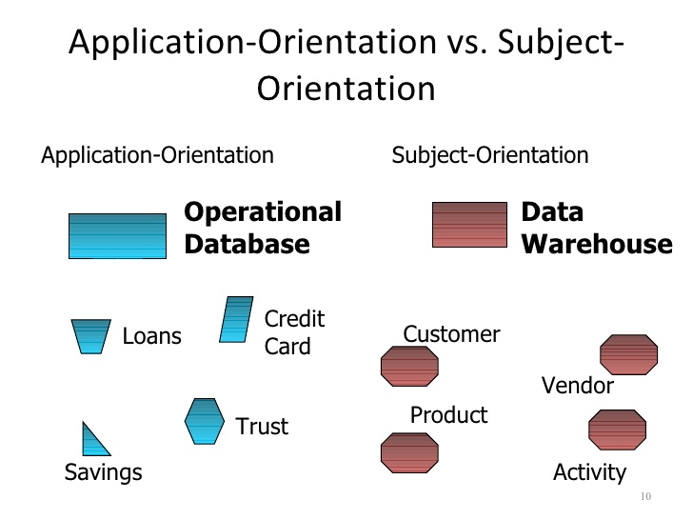

Slide 12
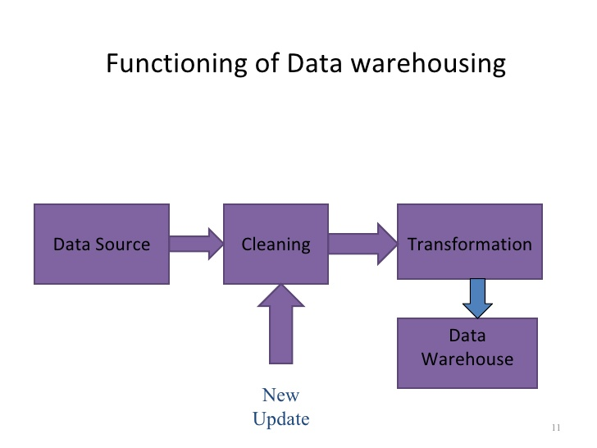

Slide 13
The Data Store
An operational data store (ODS) stores data for a specific application. It feeds the data warehouse a stream of desired raw data.
Is the most common component of DW environment.
Data store is generally subject oriented, volatile, current commonly focused on customers, products, orders, policies, claims, etc…
Its day-to-day function is to store the data for a single specific set of operational application.
Its function is to feed the data warehouse data for the purpose of analysis.

Slide 14
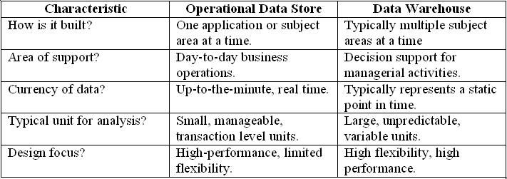
Data Store & Data Warehouse
Data store & Data warehouse

Slide 15
The Data Mart
It is lower-cost, scaled down version of the DW.
Data Mart offer a targeted and less costly method of gaining the advantages associated with data warehousing and can be scaled up to a full DW environment over time.
The Meta Data
Last component of DW environments.
It is information that is kept about the warehouse rather than information kept within the warehouse.
Legacy systems generally don’t keep a record of characteristics of the data (such as what pieces of data exist and where they are located).
The metadata is simply data about data.

Slide 16
Components of the Metadata
Transformation maps – records that show what transformations were applied.
Extraction & relationship history – records that show what data was analyzed.
Algorithms for summarization – methods available for aggregating and summarizing.
Data ownership – records that show origin
Patterns of access – records that show what data are accessed and how often

Slide 17
Typical Mapping Metadata
Transformation mapping records include:
Identification of original source
Attribute conversions
Physical characteristic conversions
Encoding/reference table conversions
Naming changes
Key changes
Values of default attributes
Logic to choose from multiple sources
Algorithmic changes

Slide 18
Conclusion
A Data Warehouse is a collection of integrated subject-oriented databases designed to support a DSS.
Each unit of data is non-volatile and relevant to some moment in time.
An operational data store (ODS) stores data for a specific application. It feeds the data warehouse a stream of desired raw data.
A data mart is a lower-cost, scaled-down version of a data warehouse, usually designed to support a small group of users (rather than the entire firm).
The metadata is information that is kept about the warehouse.

Slide 19
Characteristics of Data Warehouse
Subject oriented : Data are organized based on how the users refer to them.
Integrated : All inconsistencies regarding naming convention and value representations are removed.
Nonvolatile : Data are stored in read-only format and do not change over time.
Time variant : Data are not current but normally time series.
Operational data are mapped into a decision-usable format
Large volume : Time series data sets are normally quite large.
Not normalized : DW data can be, and often are, redundant.
Metadata : Data about data are stored.
Data sources : Data come from internal and external unintegrated operational systems.

Slide 20
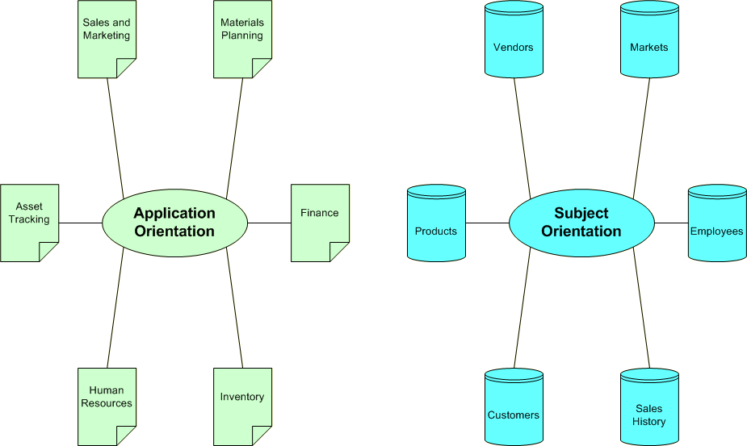
A Data Warehouse is Subject Oriented

Slide 21
Subject Orientation
Application Environment | Data warehouse Environment
Design activities must be equally focused on both process and database design | DW world is primarily void of process design and tends to focus exclusively on issues of data modeling and database design

Slide 22
Data Integrated
Integration –consistency naming conventions and measurement attributers, accuracy, and common aggregation.
Establishment of a common unit of measure for all synonymous data elements from dissimilar database.
The data must be stored in the DW in an integrated, globally acceptable manner.

Slide 23
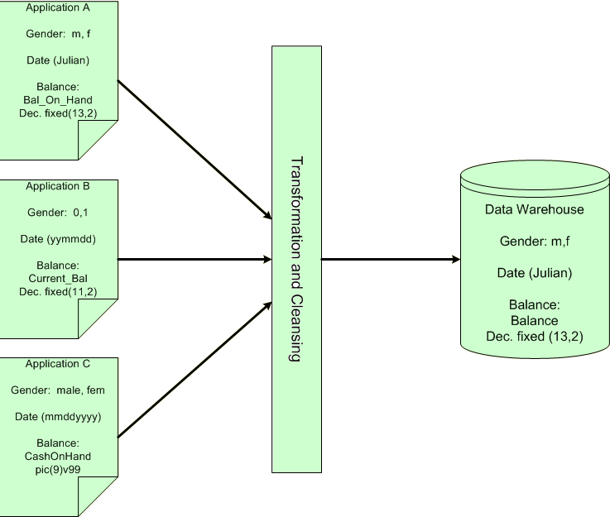
Data Integrated

Slide 24
Time Variant
In an operational application system, the expectation is that all data within the database are accurate as of the moment of access. In the DW data are simply assumed to be accurate as of some moment in time and not necessarily right now.
One of the places where DW data display time variance is in the structure of the record key. Every primary key contained within the DW must contain, either implicitly or explicitly an element of time( day, week, month, etc.)
Every piece of data contained within the warehouse must be associated with a particular point in time if any useful analysis is to be conducted with it.
Another aspect of time variance in DW data is that, once recorded, data within the warehouse cannot be updated or changed.

Slide 25
Nonvolatility
Typical activities such as deletes, inserts, and changes that are performed in an operational application environment are completely nonexistent in a DW environment.
Only two data operations are ever performed in the DW: data loading and data access

Slide 26
Nonvolatility
Application | DW
The design issues must focus on data integrity and update anomalies. Complex processes must be coded to ensure that the data update processes allow for high integrity of the final product. | Such issues are no concern to in a DW environment because data update is never performed.
Data is placed in normalized form to ensure a minimal redundancy (totals that could be calculated would never be stored) | Designers find it useful to store many of such calculations or summarizations.
The technologies necessary to support issues of transaction and data recovery, roll back, and detection and remedy of deadlock are quite complex. | Relative simplicity in technology

Slide 27
The Data Warehouse Architecture
The architecture consists of various interconnected elements:
Operational and external database layer – the source data for the DW
Information access layer – the tools the end user access to extract and analyze the data
Data access layer – the interface between the operational and information access layers
Metadata layer – the data directory or repository of metadata information

Slide 28
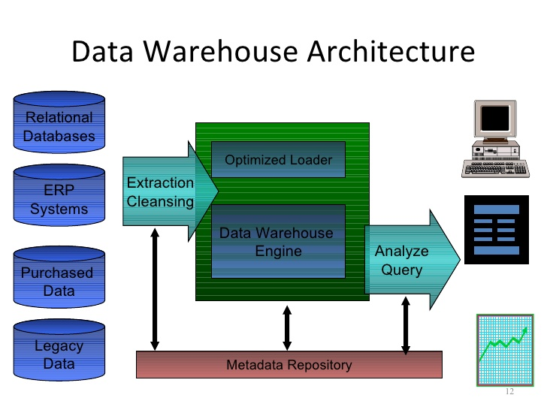

Slide 29
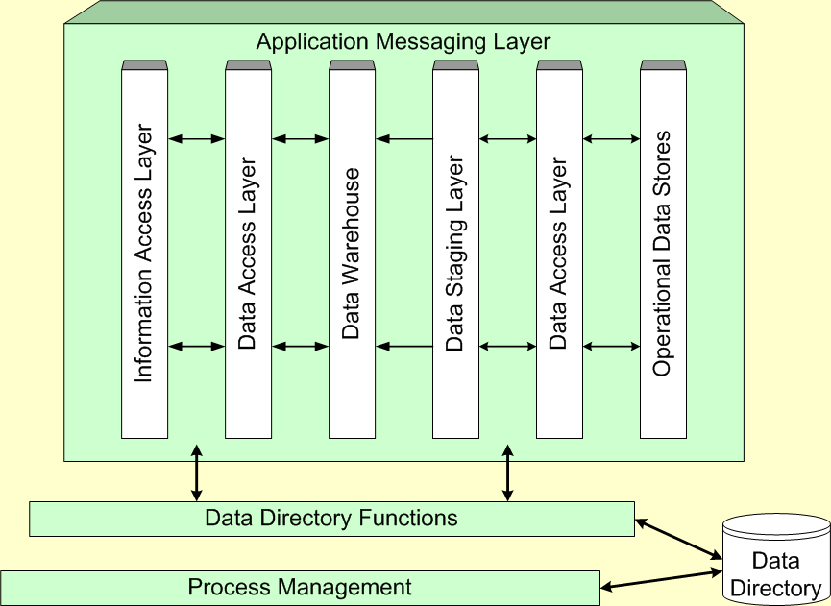
Components of the Data Warehouse Architecture

Slide 30
Data Warehousing Typology
The virtual data warehouse – the end users have direct access to the data stores, using tools enabled at the data access layer
The central data warehouse – a single physical database contains all of the data for a specific functional area
The distributed data warehouse – the components are distributed across several physical databases

