Slide 1
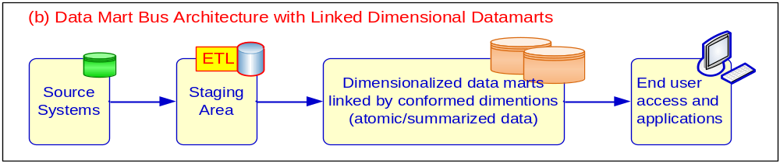
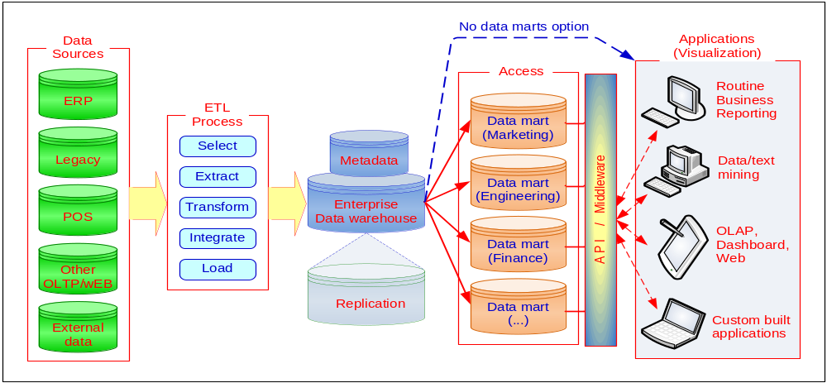
A Conceptual Framework for DW

Slide 2
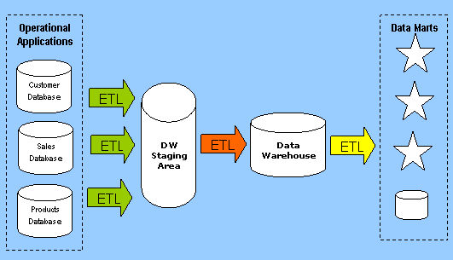
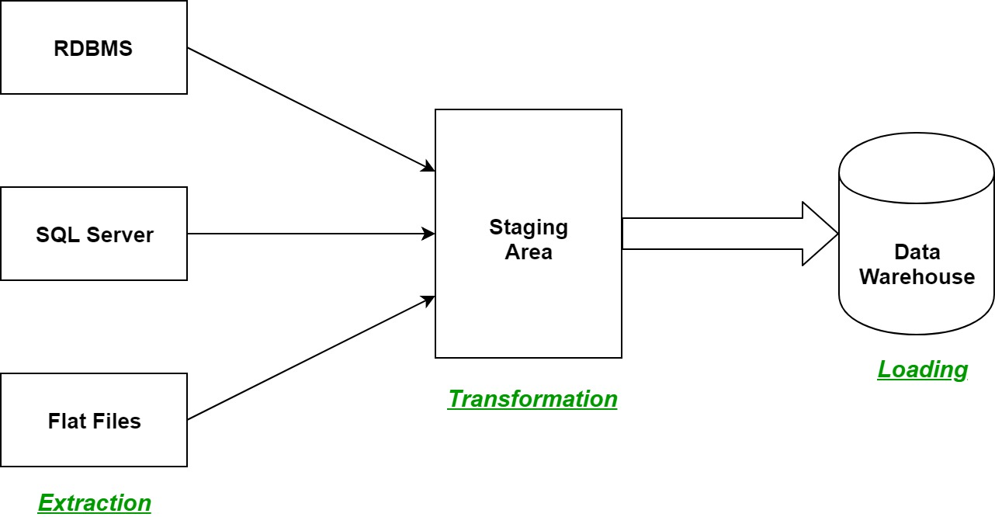
ETL Overview

Slide 3
ETL
Data Integration
  Choosing the data required
Data Extraction
  From original sources
Data Quality Checks
Data Transformations
Data Load – into the DW

Slide 4
ETL -1 session
Data Integration
  Choosing the data required
Data Extraction
  From original sources
Data Quality Checks – Design and document
Data Transformations - Design and document
Data Load – into the DW

Slide 5
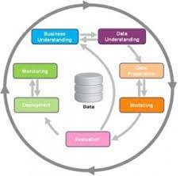
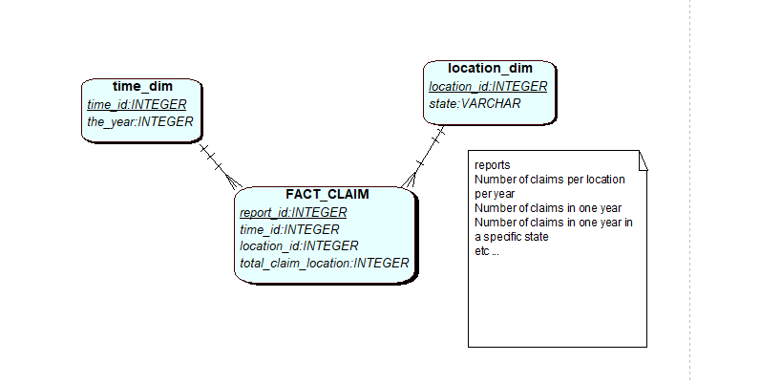
Data/Business
Report : No of claims per location per year.
Model : Star schema

Slide 6
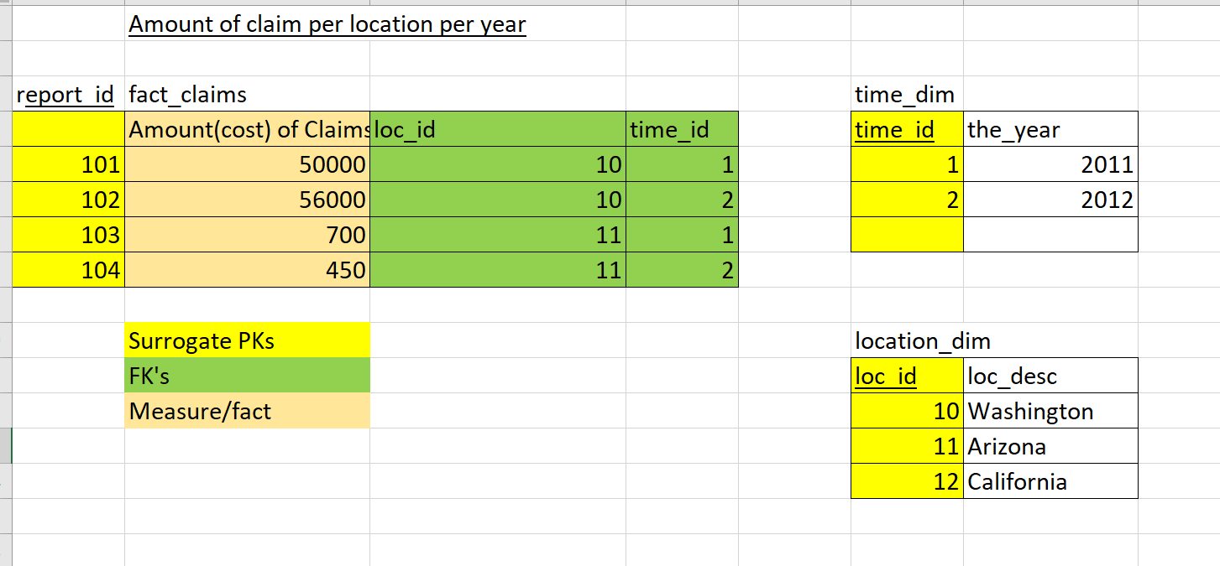
Example data

Slide 7
Data Prep – ETL – Extract, Transform
Identify ONLY the data we need for the star schema from the source data.
S0_DataSet1 and S0_DataSet2
Upload it to oracle, (Data Staging Area – S0)
Extract ONLY the data we need for the project (Data Staging Area – S1)
Identify and document mappings for the star schema model using the provided data dictionary.

Slide 8
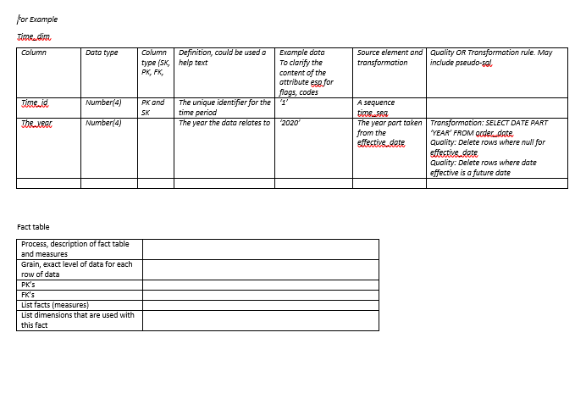
Data Prep - document

Slide 9
Data Prep - – ETL – Extract
Integrate/Merge the data we need
Into a staging area (your oracle account)

Slide 10
Data Prep - reflection
There are many ways to prep the data
  Tools, techniques, when and how
See video on data quality, as there are techniques used for this. We are only exploring the concept and acknowledging the process.
We want clean, integrated, standardised data in our data staging area/data mart/data warehouse

Slide 11
Next time – data prep (ETL2)
Data Transformation, Load

Slide 12
“A data warehouse is a
subject-oriented,
integrated,
time-variant,
and nonvolatile collection of data in support of management’s decision-making process.”—W. H. Inmon

Slide 13
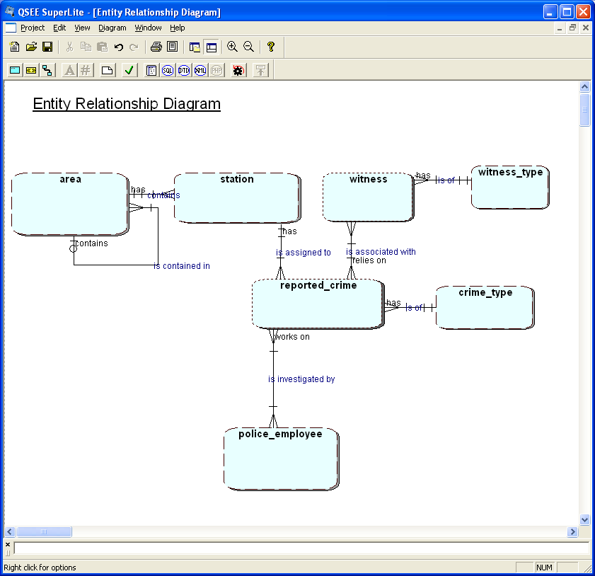
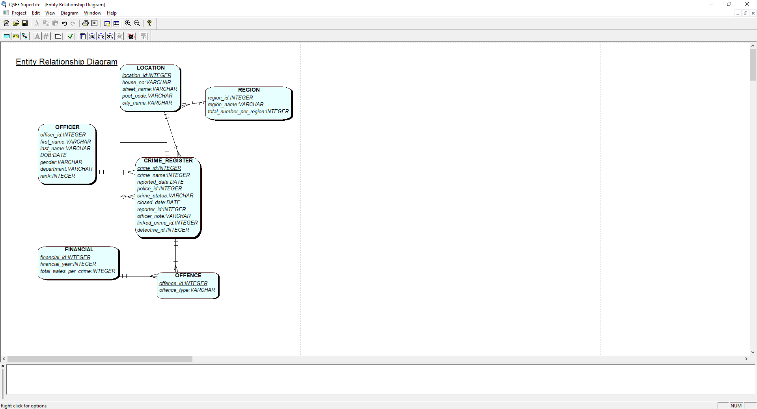
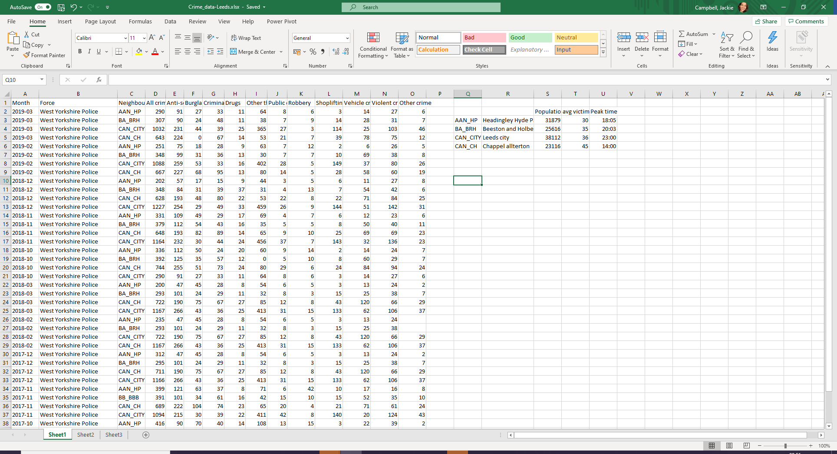

Slide 14
