Slide 1
An Introduction to Software Engineering with C#.net
Dr Duncan Mullier
Notes:
1

Slide 2
What is Software Engineering
Engineering is the scientific use of accepted tools and techniques to a given discipline
Software Engineering
The Application of CS to Building Practical Software Systems
Programming
complete program written by an individual
One Person, One Computer
Well-Defined Problem
Programming-in-the-Small
Software Engineering
Individuals Write Program Components/Objects
Team Assembles Complete Program
Programming-in-the-Large.
Notes:
2
2

Slide 3
What is Software Engineering?
Software Engineering is concerned with
Large and Complex Systems
Built By Teams
Exist In Many Versions
Last Many Years
Undergo Changes
Software systems are too complex now
can no longer be developed by lone programmers
therefore extra complexity must be managed
Role of Software Engineering is
Constructing Large Software Applications
Defining Problem Clear and Completely
Tools and Techniques to Support Process
Team-Oriented Experience.
Notes:
3
3

Slide 4
A Computer Programmer
Individual with Good Skills
Programming-in-the-Small
Knowledge on
Data Structures
Algorithms
Fluent in Several Programming Languages
May Lack Formal Training.
Notes:
4
4

Slide 5
A Software Engineer
Part of a Team
Programming-in-the-large
Design Approaches
OO, Modules, etc.
Top-Down/Bottom-Up
Translates Requirements into Specifications
Familiarity in Multiple Application Areas
Converses with Users
Sees “Big Picture”
Can Model Applications
Good Communication
and Interpersonal Skills..
Notes:
5
5

Slide 6
Object oriented programming was a paradigm shift
in the way programs were developed.
The basic concepts are grouped around the phrases
Classes
Objects
Encapsulation
Abstraction
Inheritance
Polymorphism
Notes:
6
6

Slide 7
What is an object, and what is a class?
Class
Account
Initial balance
£100
John's account
Jill's account
Jack's account
Account
Account
Account
current balance
current balance
current balance
£900
£1,304
£432
Individual objects
Notes:
7
7

Slide 8
encapsulation. This means protecting the
information (data) within the object.
Inheritance Building on the properties of an existing class.
Very useful when trying to re-use software.
Abstraction.
Treating an entity as a whole, not worrying about the details.
We use abstraction without realising it
Treat a car as a single object without worrying
about the complex mechanics.
polymorphism. This literally means many forms.
A neat way of saving duplication of code.
Notes:
8
8

Slide 9
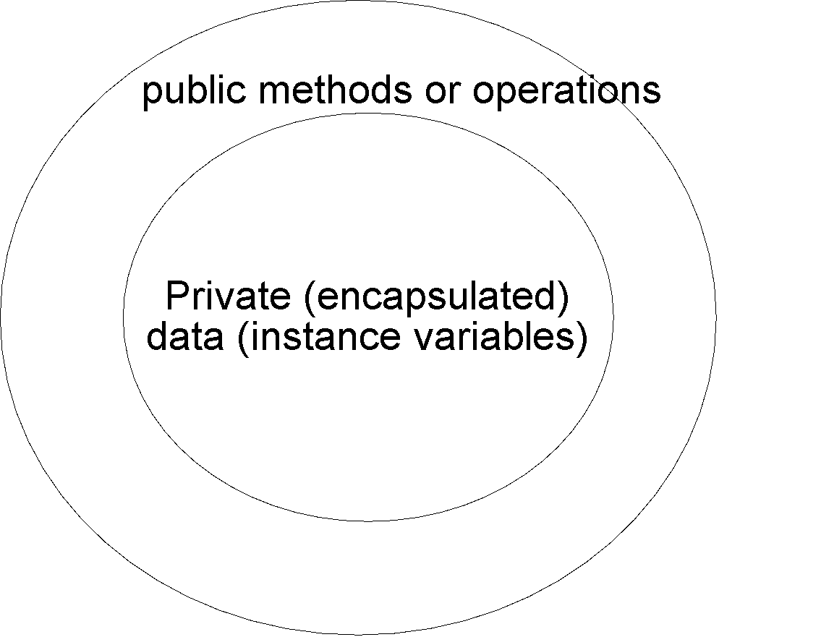
Encapsulation - protecting private data.
Retrieving data
Setting data
Notes:
9
9

Slide 10
What are candidates for classes/objects
Usually anything that cannot be represented by a primitive type.
E.g. The number of students in a lecture theatre
can be represented by a single integer (int).
But can you represent all the information necessary to describe
a student by a simple integer?
We need a new type of data storage, which can be described as: A set of values of any type (e.g. string, int, float)‏
A set of operations that are permitted on those values.
Notes:
10
10

Slide 11
Now, for some C#
C# source code (e.g. Account.cs)‏
The compiler (clc) and the msil interpreter are automatically called by a typical IDE
clc Account.cs
Account (msil)‏
Second stage compilation
Account.exe
Notes:
11
11

Slide 12
“public” means all users can see the class (when part of a namespace)‏
public class Account
{
// Instance variable
private double balance = 100;
// One of the methods
public void Transaction(double amount)
{
balance = balance + amount;
} // End of the method
public void Print()
{
Console.WriteLine("The balance is "+balance);
}
}
Private means the data can’t be seen from outside
Java/C++ point.
Structures (struct) also exist in C# and they are subtly different from classes. – more later.
Notes:
12
12

Slide 13
Usually, the launching point for code is a ‘main’ method (found in one of the classes)…
static void Main(string[] args)
{
Account jack = new Account(); // set up a new account “jack”
jack.Print();
Account jill = new Account(); // Set up a new account named “jill”
jill.Print(); //Print the balance in object Jill
Console.Read(); // wait for a key
}
Static keyword – means the following method or data can be used
without instantiating an object.
An array of command line parameters
Notes:
13
13

Slide 14
Instantiating objects
Process of creating objects from classes is called instantiation
Each new object is given a new identity
Account jack = new Account();
Account jill = new Account();
Each new object can have its own state (by containing its own data/attributes).

Slide 15
More on instantiation of objects
Account jack = new Account();
Create a reference to an object
Create an object
Assign reference to object
A reference is analogous to a pointer in C/C++ - it refers or points to an object in memory somewhere…..

Slide 16
External Libraries of code
The last example made use of Console.Read(), where did this come from?
Analogous to #include in C/C++ and import in Java
We add a ‘using’ statement to indicate the use of an external library of code (e.g. a dynamically linked library)‏
E.g. “using System” added as first program statement.

Slide 17
Data types
Like C, C++ and Java, C# also knows about two ways of declaring and accessing data. This is done by the use of Value and Reference types.
Value types - data is stored directly in a variable.
Reference types, the address of the data is kept in the variable.
Value types are primitive data types, e.g. int, char etc.
References are used to access objects.
In practice, with C#, even simple value types correspond to .NET structures (struct).
Therefore all data types can be manipulated with methods.
Notes:
17
17

Slide 18
Instance variables, local variables and variable scope
One of the powerful features of OO is the concept of instance variables and local variables.
An instance variable is declared outside any method (usually the top of the class) and can be seen & used by any method in the class
A local variable is declared inside a method, and can be used until the method finishes (this is its scope or lifetime). E.g.
Notes:
18
18

Slide 19
class Class1
{
private string s="instance string";
private int i = 10;
// a simple method, with no return type, and no parameters
public void Go()
{
//Declare a couple of local variables
// These will 'hide' the instance variables
string s = "local string";
int i=5;
Console.WriteLine("local string s is "+s);
Console.WriteLine("local int i is "+i);
// We can still reference the instance variables however, using the 'this'
// object reference
Console.WriteLine("instance string s is "+this.s);
Console.WriteLine("instance int i is "+this.i);
}
}
Notes:
19
19

Slide 20
static void Main(string[] args)
{
Class1 c = new Class1();
c.Go();
Console.Read();
}
Notes:
20
20

Slide 21
Public, private
Any class member (method or data) is visible from the outside (by users of the object) when public
Only usable within the class if declared private..

