Slide 1
Advanced Software Engineering
Dr Duncan Mullier
2020

Slide 2
Version Control
Notes:
2
2

Slide 3
Version Control
A way of managing source code
Keep code safely backed up
Allows backtracking if something goes wrong
hugely important; when bugs occur, we need to know what code change introduced the bug, and if necessary, back out the change
Allows teams to work on the same code
Handles conflicts
Store a log message with each modification to each source file stating who modified the file, and what the purpose of the modification is.
Notes:
3

Slide 4
Concepts
There is a central repository which stores all of the versions of every file in the project.
This is essentially a database of file revisions.
Typically, the central repository is located on a server reachable from the network
this allows all of the developers to access it regardless of where they are located.
Notes:
4

Slide 5
Version Control Demo Video
Version Control Demonstration Video
YouTube Version
Notes:
5

Slide 6
Version Control Tools
There are many systems for handling distributed version control systems (DVCS)
Microsoft offer Team Foundation (SourceSafe is discountinued)
The most popular is Git
We are going to use Git because it is cross platform
You can use whatever system you like
BitBucket is a service which stores Git repositories
We are going to use BitBucket
An alternative would have been GitHub
Notes:
6

Slide 7
Tools Continued
We could install Git itself
This gives command line access
This is more complex but also more flexible
We could use a visual front end
SourceTree
there can be firewall issues in our labs
Notes:
7

Slide 8
Our View
We will be approaching Version Control via
The repository view online
BitBucket
You will have to create an account
The local view on our own machine
GitBash command line
SourceTree
Notes:
8

Slide 9
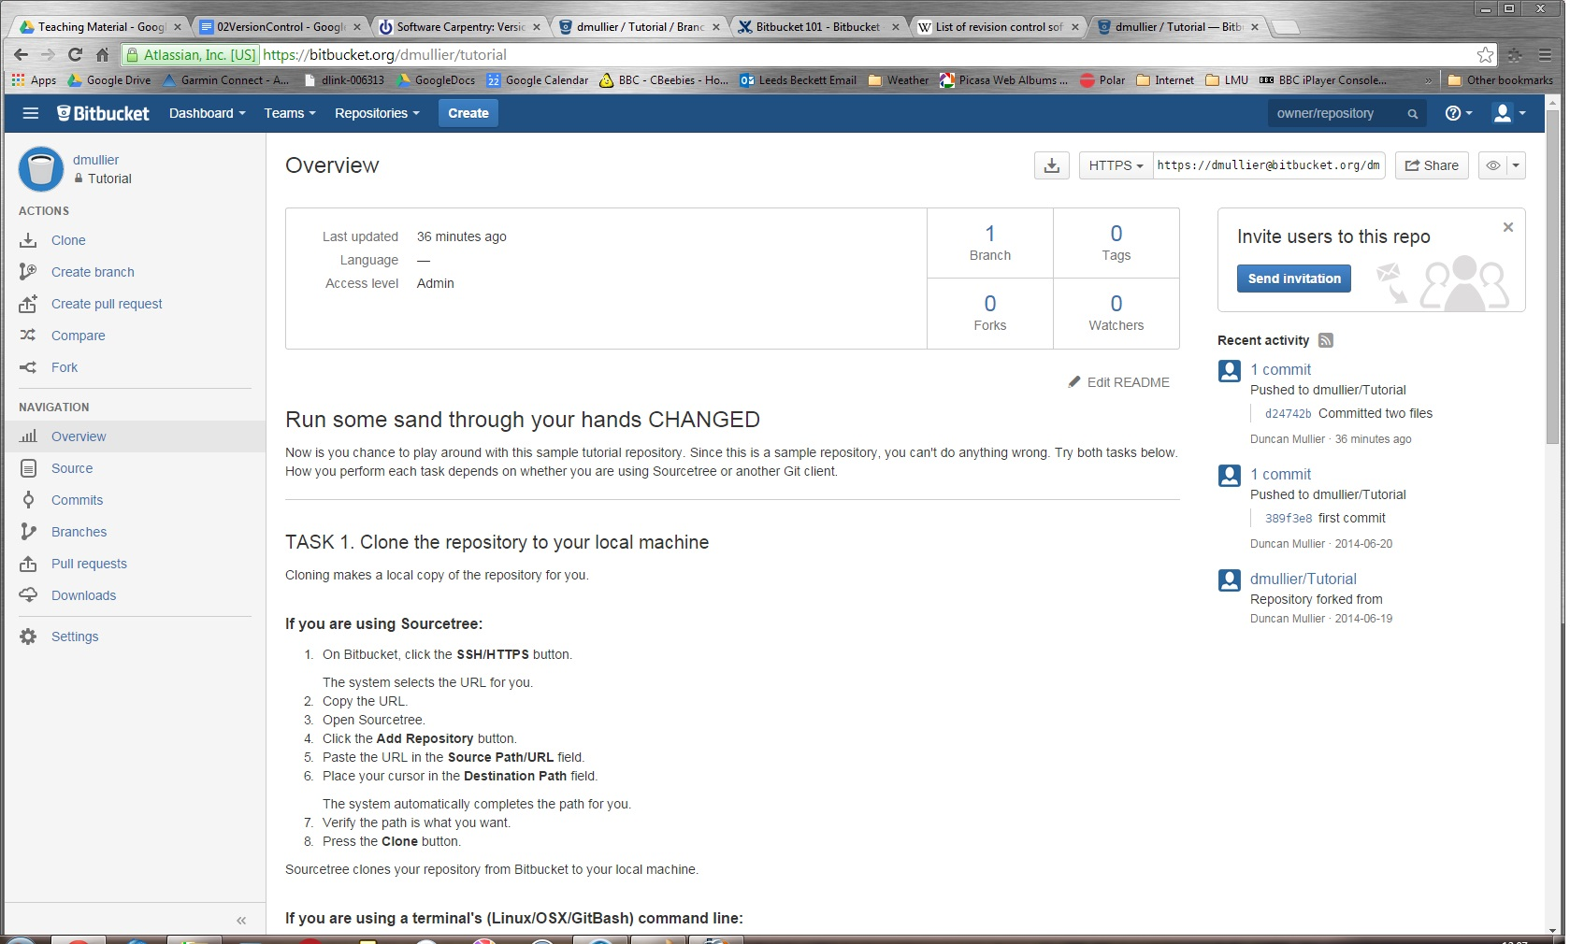
Notes:
9
Repository view - BitBucket.

Slide 10
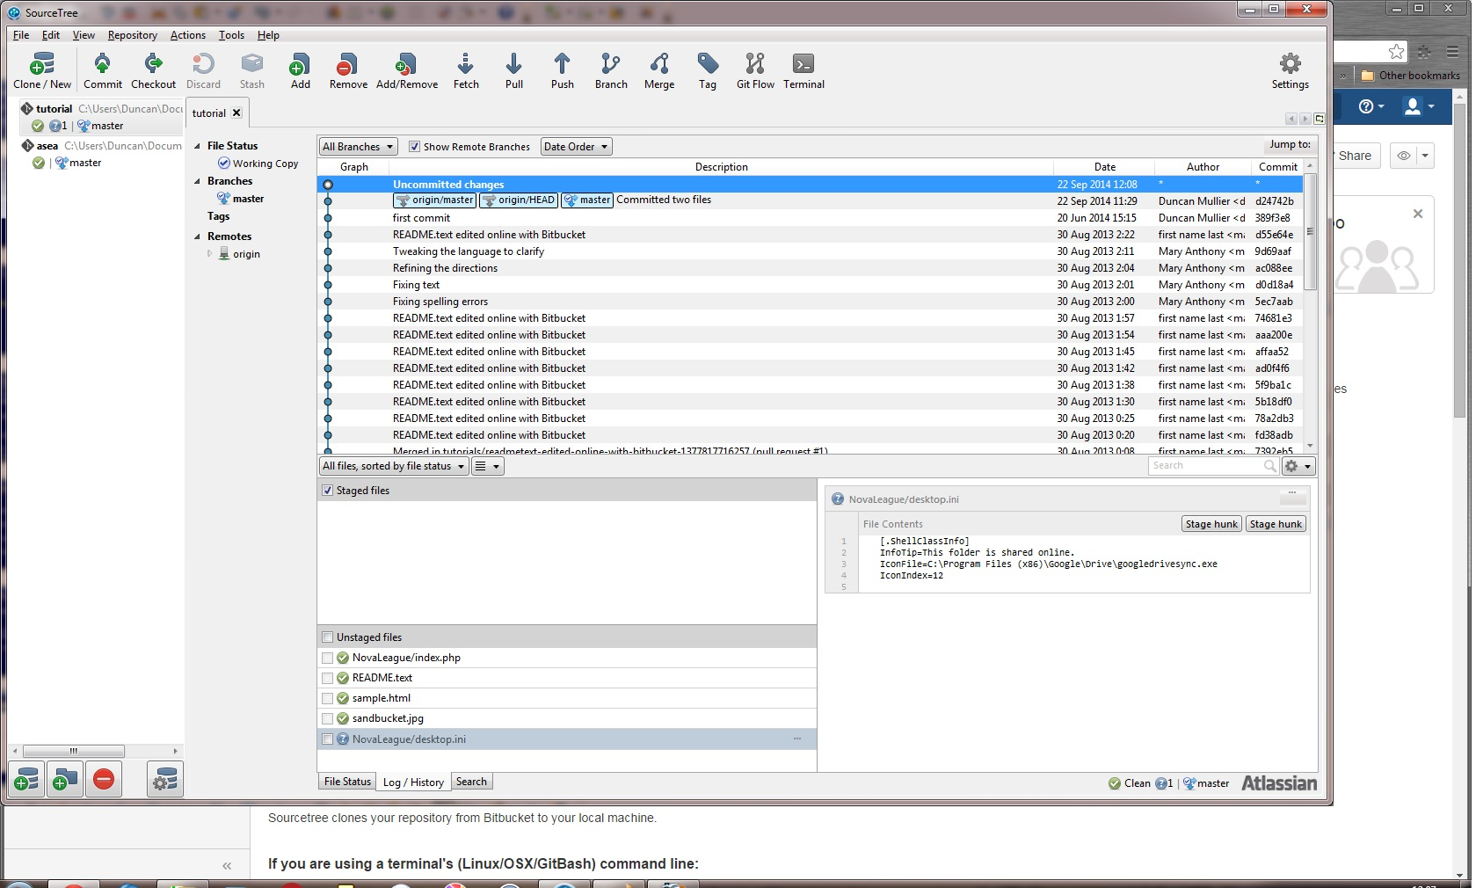
Notes:
10
Local Machine control - SourceTree

Slide 11
Tracking our project
We create a repository in BitBucket
We then get its address and give it to SourceTree or GitBash
which will then download the repository to your local machine
And anyone else who has the address
You work on your local files
When you are ready you “commit” your changes
They are uploaded to the repository

Slide 12
What to commit
Text files only
Source code (the most important)
Documents
Not Binary files
Not compiled code
Data formats such as docx
Images

Slide 13
How to commit
We tell the local system (GitBash or SourceTree)
Which files need tracking by adding them to the tracked list
For GitBash this needs to be done for each commit i.e. Each commit needs setting up
When we are ready we then push our commit to BitBucket with an appropriate comment

Slide 14

Git Branches
Branches let us maintain the integrity of our project even when trying out new features
E.g. We have a working Agile project
This means we are constantly delivering features
We don’t want to mess up what we have
Each feature would be a new branch while it is under development
Once it has been approved it is merged into the current branch

Slide 15
Git Forks and Clones
A fork is like a branch
But we tend to use it for starting something new but using an existing project as a base
We would clone a repository if we wanted several people to work on the source
One person creates the repository and others clone it.

Slide 16
It is important to remember that code must be committed by you
You are working on your local machine
You must decide when it is appropriate to do so
Fixed a bug
Added a feature
Enough coding that you wouldn’t want to lose

Slide 17
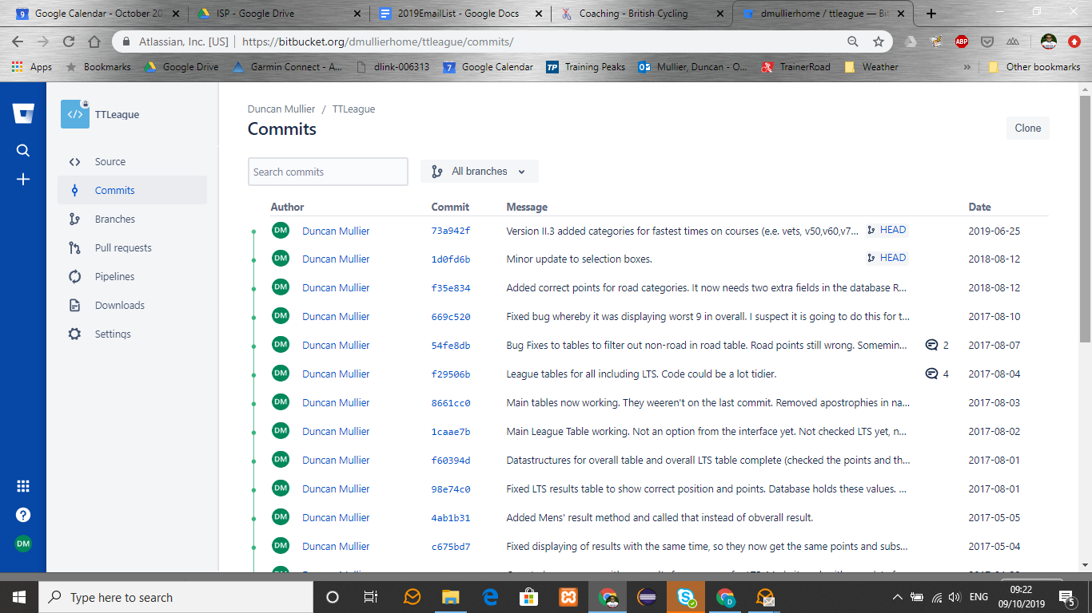
Notes:
An appropriately commented list of commits.

Slide 18
Any change could result in project failure!
Visual Studio produces managed code
When using visual front end etc.
Changing managed code manually can mess the project up!
Oh I wish I had a previous version to go back to!
Well you should have!
...

