Slide 1
Advanced Software Engineering
Dr Duncan Mullier
Interfaces and Abstract Classes

Slide 2
Contents
Interfaces – a ‘template’ for all inherited classes
Abstract classes– some methods need to be ‘filled in’
Use of Interfaces and Abstract classes in polymorphism.
Notes:
‹#›
*
*
*

Slide 3
Abstract classes and methods
Abstract base classes – can’t be instantiated
Concrete subclasses – can be instantiated
Abstract classes describe generalities:
E.g. Food or Shape could be abstract classes
Methods can be abstract
Derived classes must add these methods, before compilation is possible.
Notes:
‹#›
*
*
*

Slide 4
Abstract Classes and Methods
Can contain abstract methods and/or abstract properties
Have no implementation
Derived classes must override inherited abstract methods and properties to enable instantiation.
Notes:
‹#›
*
*
*

Slide 5
Abstract Classes and Methods
Abstract classes are used to provide appropriate base classes from which other classes may inherit (concrete classes)
Abstract base classes are too generic to define real objects
To define an abstract class, use keyword abstract in the declaration
To declare a method or property abstract, use keyword abstract in the declaration; abstract methods and properties have no implementation.
Notes:
‹#›
*
*
*

Slide 6
Abstract Classes and Methods
Concrete classes use the keyword override to provide implementations for all the abstract methods and properties of the base-class
Any class with an abstract method or property must be declared abstract
Even though abstract classes cannot be instantiated, we can use abstract class references to refer to instances of any concrete class derived from the abstract class.
Notes:
‹#›
*
*
*
Java does not need the override keyword.

Slide 7
Base class ‘food’
public abstract class Food{
private string type;
private double quantity; // quantity in grams
public abstract double GetCalories() ; // implementation will differ
public void SetQuantity(double quantity) {
// No need to override this method
this.quantity = quantity;
}
public double GetQuantity() {
return quantity;
}
public void SetType(string type) {
// and probably no need to override this one
this.type = type;
}
public override string ToString() {
// A candidate for being overridden,
// but already exists in base class 'object'
return "Type of food is " + type + " of quantity "+quantity;
}
}
If any method or property is abstract, the class must be abstract
A candidate for being overridden
Notes:
‹#›
*
*
*

Slide 8
public class Cheese : Food
{
public override double GetCalories(){
//4.4 calories per gram
return 4.4 * GetQuantity();
}
}
Concrete sub-class Cheese
Code for testing –
Could have said:
Food c = new Cheese();
Cheese c = new Cheese();
c.SetQuantity(100.0);
c.SetType("Cheshire");
Console.WriteLine("Food type " + c + " Calorie content " + c.GetCalories());
Notes:
‹#›
*
*
*

Slide 9
Interfaces
Interfaces specify the public services (methods and properties) that classes must implement
Interfaces provide no code in the methods, unlike abstract classes which may provide some code
Interfaces are used to force different classes into a mold or template, related through the interface.
Notes:
‹#›
*
*
*

Slide 10
Declaring and Using Interfaces
Interfaces are defined using keyword interface
Use inheritance notation to specify a class implements an interface (ClassName : InterfaceName)
Classes may implement more than one interface (a comma separated list of interfaces)
Classes that implement an interface, must provide implementations for every method and property in the interface definition.
Notes:
‹#›
*
*
*

Slide 11
Plusses and minuses of ‘Interfaces’ and abstract classes
Good for polymorphism (so are abstract classes) –ensure polymorphic methods and properties are present
Slow - virtual methods use ‘run time dynamic binding’.
Notes:
‹#›
*
*
*

Slide 12
Interfaces example
interface Shapes {
void SetPosition(int x, int y);
void Draw(Graphics g, Pen myPen);
string ToString();
}
No need for virtual, abstract or any other keyword
Notes:
‹#›
*
*
*

Slide 13
Interfaces example
public class Circle : Shapes {
private int x, y;
private const int size = 20;
public void SetPosition(int x, int y) {
this.x = x;
this.y = y;
}
public void Draw(Graphics g,Pen myPen){
g.DrawEllipse(myPen,x-size,y-size,size*2,size*2);
}
public override string ToString() {
return "Circle class, x, y, size = " + x + " " + y;
}
}...
No need to ‘override’ methods in an interface
Notes:
‹#›
*
*
*
note ToString() has not come from the interface, it is automatically inherited because it is in Object from which every class inherits.

Slide 14
Drawing on Components
Need a Pen object and a Graphics object
public void Draw( Graphics g , Pen myPen){
g.DrawEllipse(myPen,x-size,y-size,size*2,size*2);
}
Study the example code AbstractExample
Other parameters are x and y position, and the horizontal and vertical size of the Circle
Notes:
‹#›
*
*
*

Slide 15
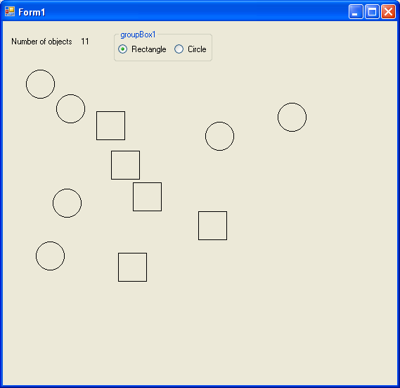
AbstractExample uses a Panel object (panel1) on which to draw
Abstract example contains an array of Shape objects
Each shape object can be either Circle or Rectangle – both derived from Shape interface – both have same methods
Shapes[] s = new Shapes[100];
// An array of references to 'interface' Shapes
Notes:
‹#›
*
*
*

Slide 16
Event handler – for the Paint event – called after resize, after the panel has been obscured etc etc
private void panel1_Paint(object sender, PaintEventArgs e) {
Graphics g = e.Graphics; // Get the graphics object
Pen myPen = new System.Drawing.Pen(System.Drawing.Color.Black);
// Use pen
int i = 0;
for (i = 0; i < icount; i++) {
s[i].Draw(g, myPen);
}
myPen.Dispose();
}
Call to polymorphic method Draw
Notes:
‹#›
*
*
*

Slide 17
private void panel1_MouseClick(object sender, MouseEventArgs e) {
int x;
int y;
x = e.X;
y = e.Y;
if (circleButton.Checked)
{
s[icount] = new Circle();
}
else
{
s[icount] = new Rectangle();
}
s[icount].SetPosition(x, y);
icount++;
label1.Text = icount.ToString();
panel1.Refresh();
}
MouseEventArgs object e contains mouse
coordinates
Add a circle, or a rectangle,
Depending on status of radio buttons
Set position of shape using polymorphic method
SetPosition
Force a repaint
Notes:
‹#›
*
*
*

