Slide 1
GearLoop
Campus gear lending, shipped the DevSecOps way
Netram Faran · 24BCS10329 · github.com/netram75/devsecops-python
Notes:
Title. GearLoop is a lending desk for campus equipment; the project is about the DevSecOps platform around it.

Slide 2
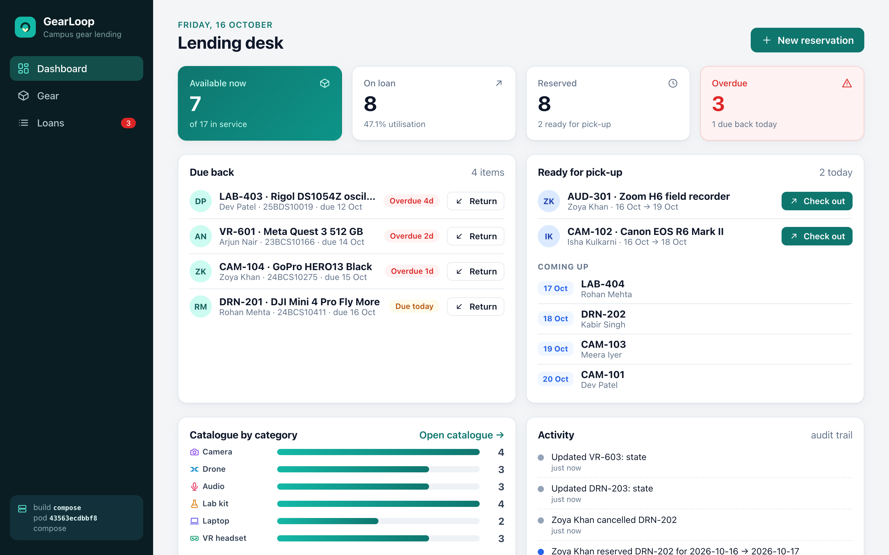
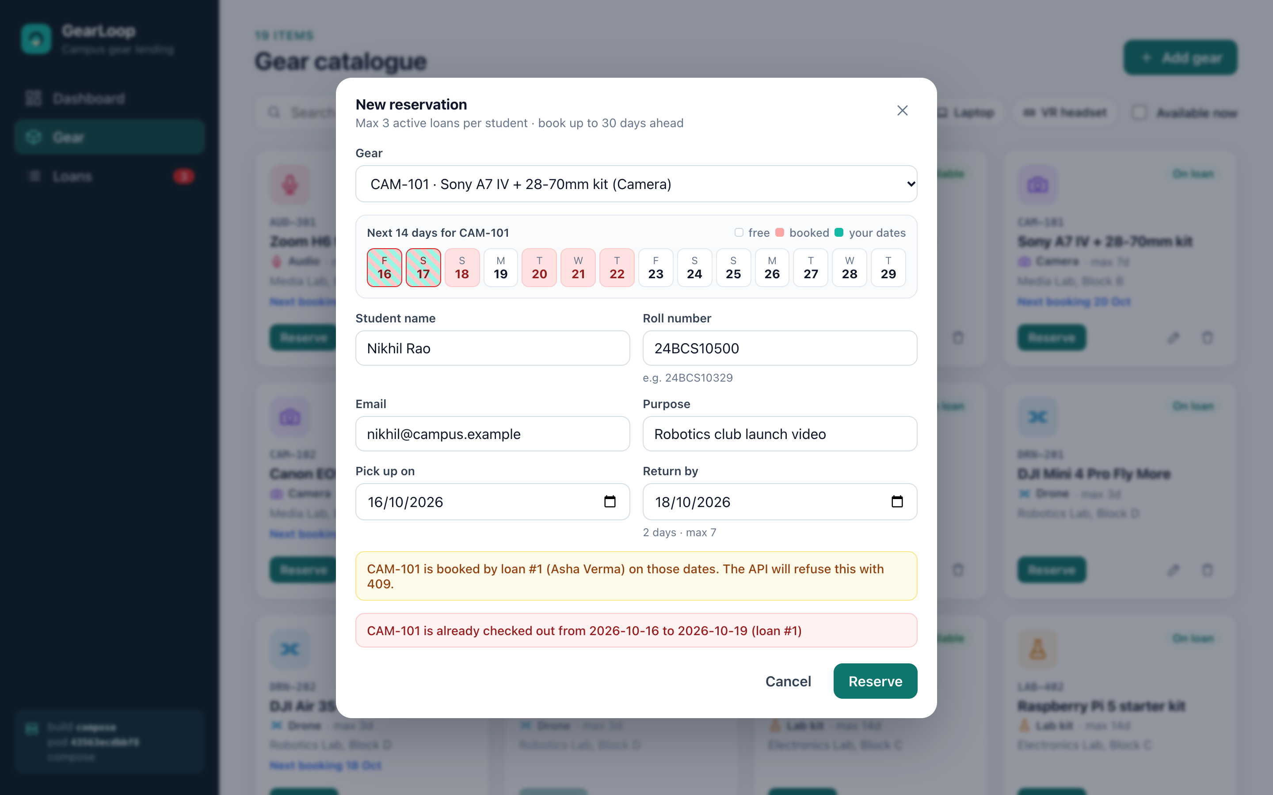
What GearLoop does
Students reserve cameras, drones, audio kits, lab kits, laptops and VR headsets; staff check items out, take them back and chase overdue loans.
No double lending
Asset row locked (FOR UPDATE) before the overlap check → 409
State machine
reserved → checked out → returned; illegal moves → 409
Fair use
≤ 3 active loans per student (advisory lock); max days per category
Audit + metrics
every change in an events table; overdue count is a Prometheus gauge
32
pytest cases, 92% coverage
15
REST operations
3
tables, 2 migrations

Slide 3
Tech stack
Application
FastAPI · SQLAlchemy 2 · Alembic · React 19 + Vite · PostgreSQL 17
Testing
pytest + coverage on a throwaway SQLite DB built by the real migrations
Containers
Multi-stage images · non-root (UID 10001 / 101) · docker compose
CI/CD
GitHub Actions (9 jobs) · GHCR · tags = commit SHA
Security
Trivy · Gitleaks · Bandit · npm audit · Pod Security restricted
Kubernetes
kind (1 + 2 nodes) · Helm chart · ingress-nginx · HPA · PDB
GitOps
Argo CD 3.5 · automated sync, prune, self-heal
Observability
Prometheus · Grafana · Alertmanager · business metrics + alerts
Infrastructure
Terraform · VPC (2 public + 2 private) · NAT · EKS 1.35 + node group

Slide 4
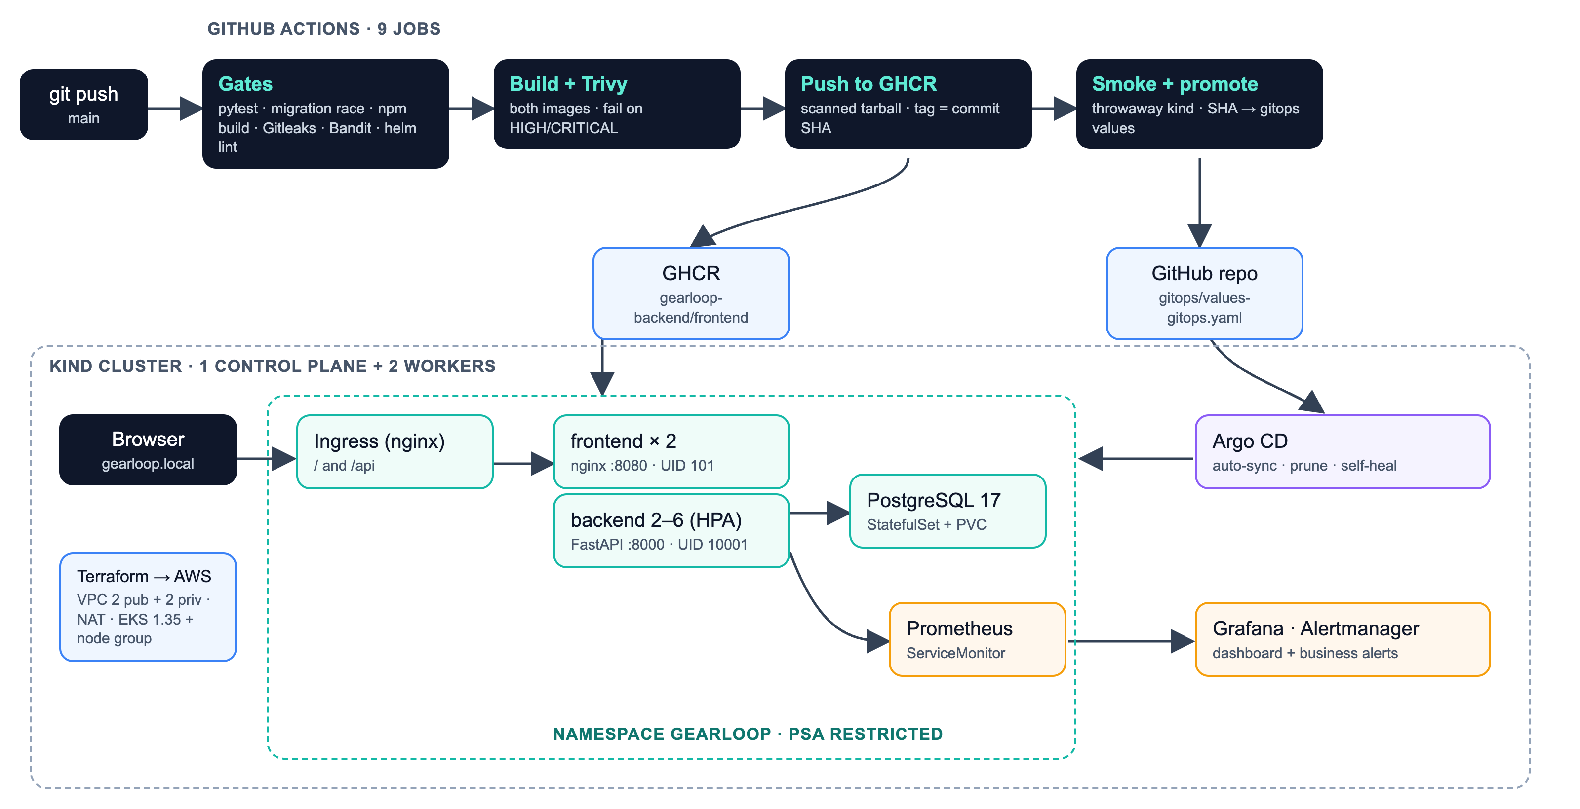
Architecture

Slide 5
CI/CD: every push to main
1
pytest gate
2
migrations race (3 at once)
3
frontend build + npm audit
4
Gitleaks + Bandit
5
helm lint
6
build + Trivy ×2
7
push scanned image to GHCR
8
smoke test in kind
9
promote SHA → GitOps
3m 26s
first run, all 11 jobs green
SHA
image tag = full commit SHA, never latest
0
rebuilds after the scan
1
loop guard: paths-ignore on the promote file

Slide 6
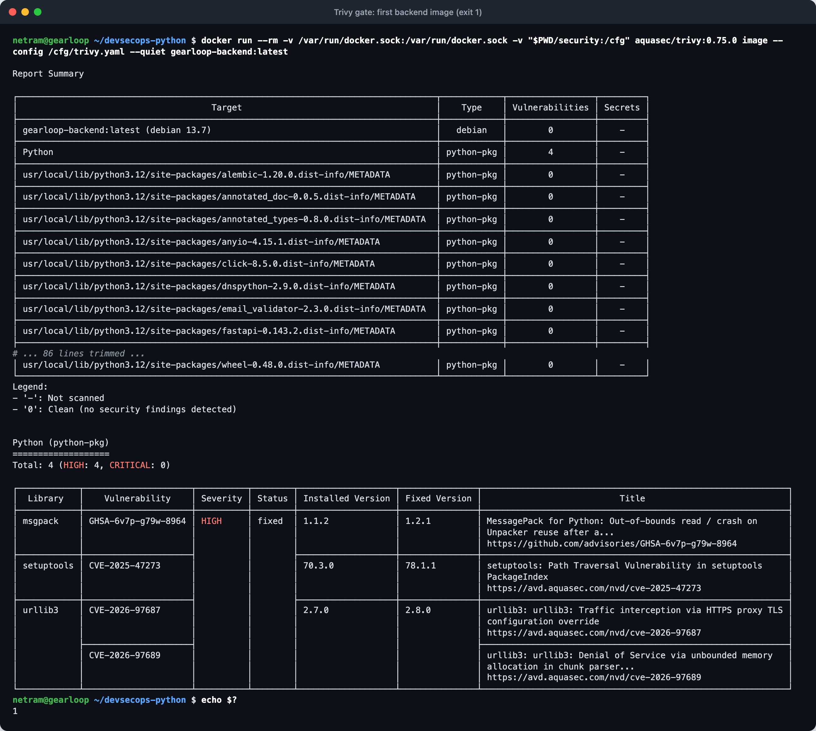
DevSecOps: the gate caught 4 HIGH CVEs
The first backend image failed Trivy: urllib3, msgpack and setuptools CVE-2025-47273 (path traversal in PackageIndex).
None were app dependencies; all four are vendored inside pip.
Fix: multi-stage build; the runtime image ships without pip/setuptools/wheel.
Now 0 HIGH/CRITICAL in both images; Gitleaks: no leaks; Bandit: clean.
4 → 0
HIGH findings, backend image
0
HIGH/CRITICAL, frontend image

Slide 7
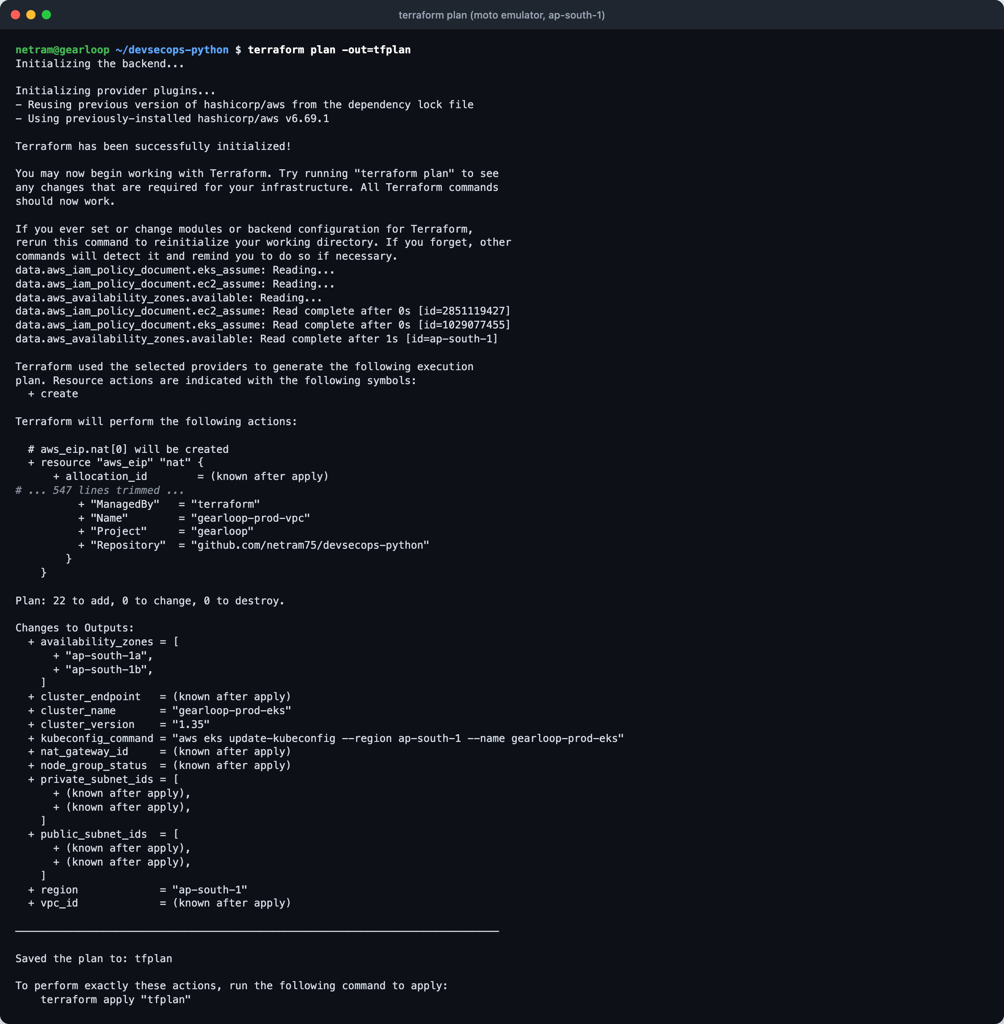
Infrastructure as code: VPC + EKS
network.tf
VPC 10.42.0.0/16 · 2 public + 2 private subnets in 2 AZs · IGW · NAT · route tables
iam.tf
cluster role + node role (worker, CNI, ECR read-only)
eks.tf
EKS 1.35 · managed node group 2 × t3.medium (1–3)
Honest note
Ran on the moto AWS emulator (no personal AWS account): init, plan (22), apply, destroy all real; no Console screenshots.

Slide 8
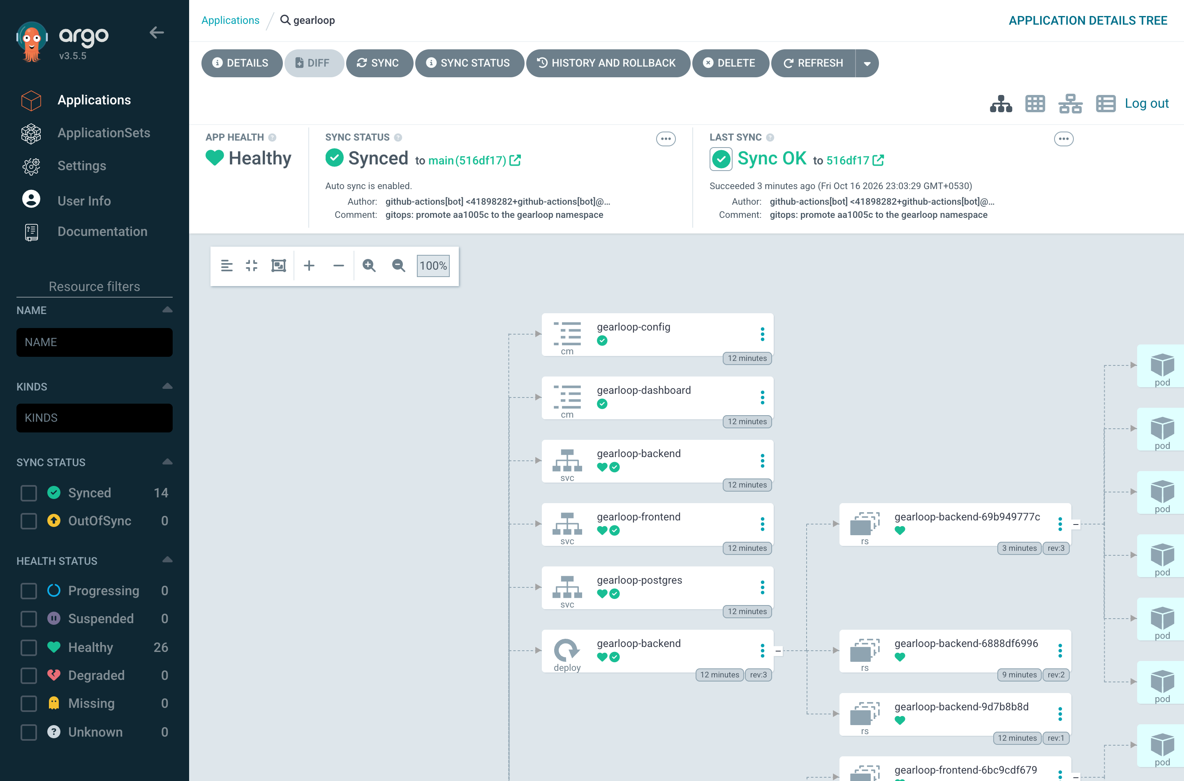
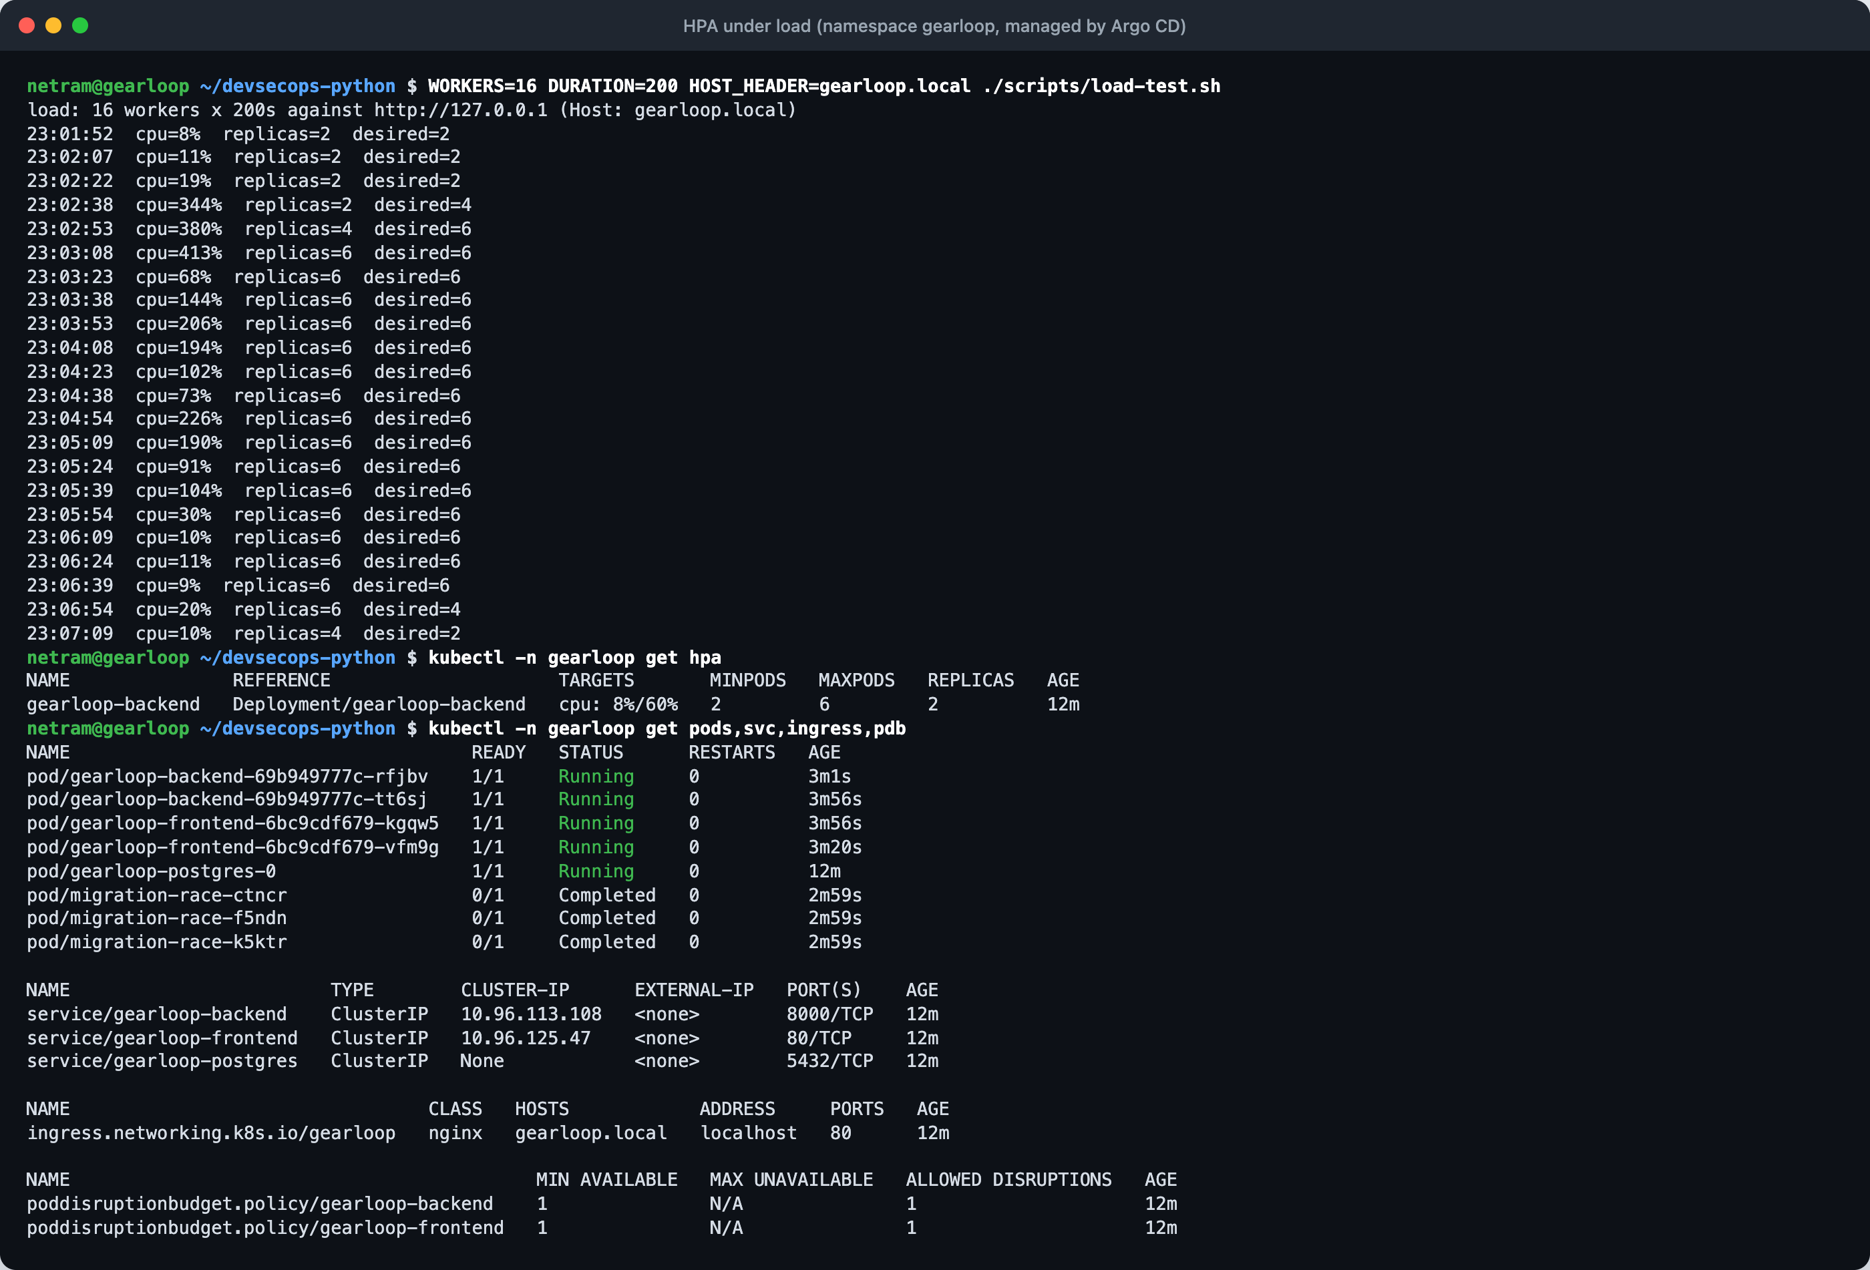
Kubernetes, Helm and GitOps
Helm chart: backend 2–6 (HPA), frontend ×2, Postgres StatefulSet, Ingress / → frontend, /api → backend
Every pod non-root, read-only root FS, no capabilities; namespace enforces Pod Security restricted
Argo CD syncs the gearloop namespace from main; CI writes the SHA it tested
Staging installed with helm upgrade --install (shows in helm list)

Slide 9
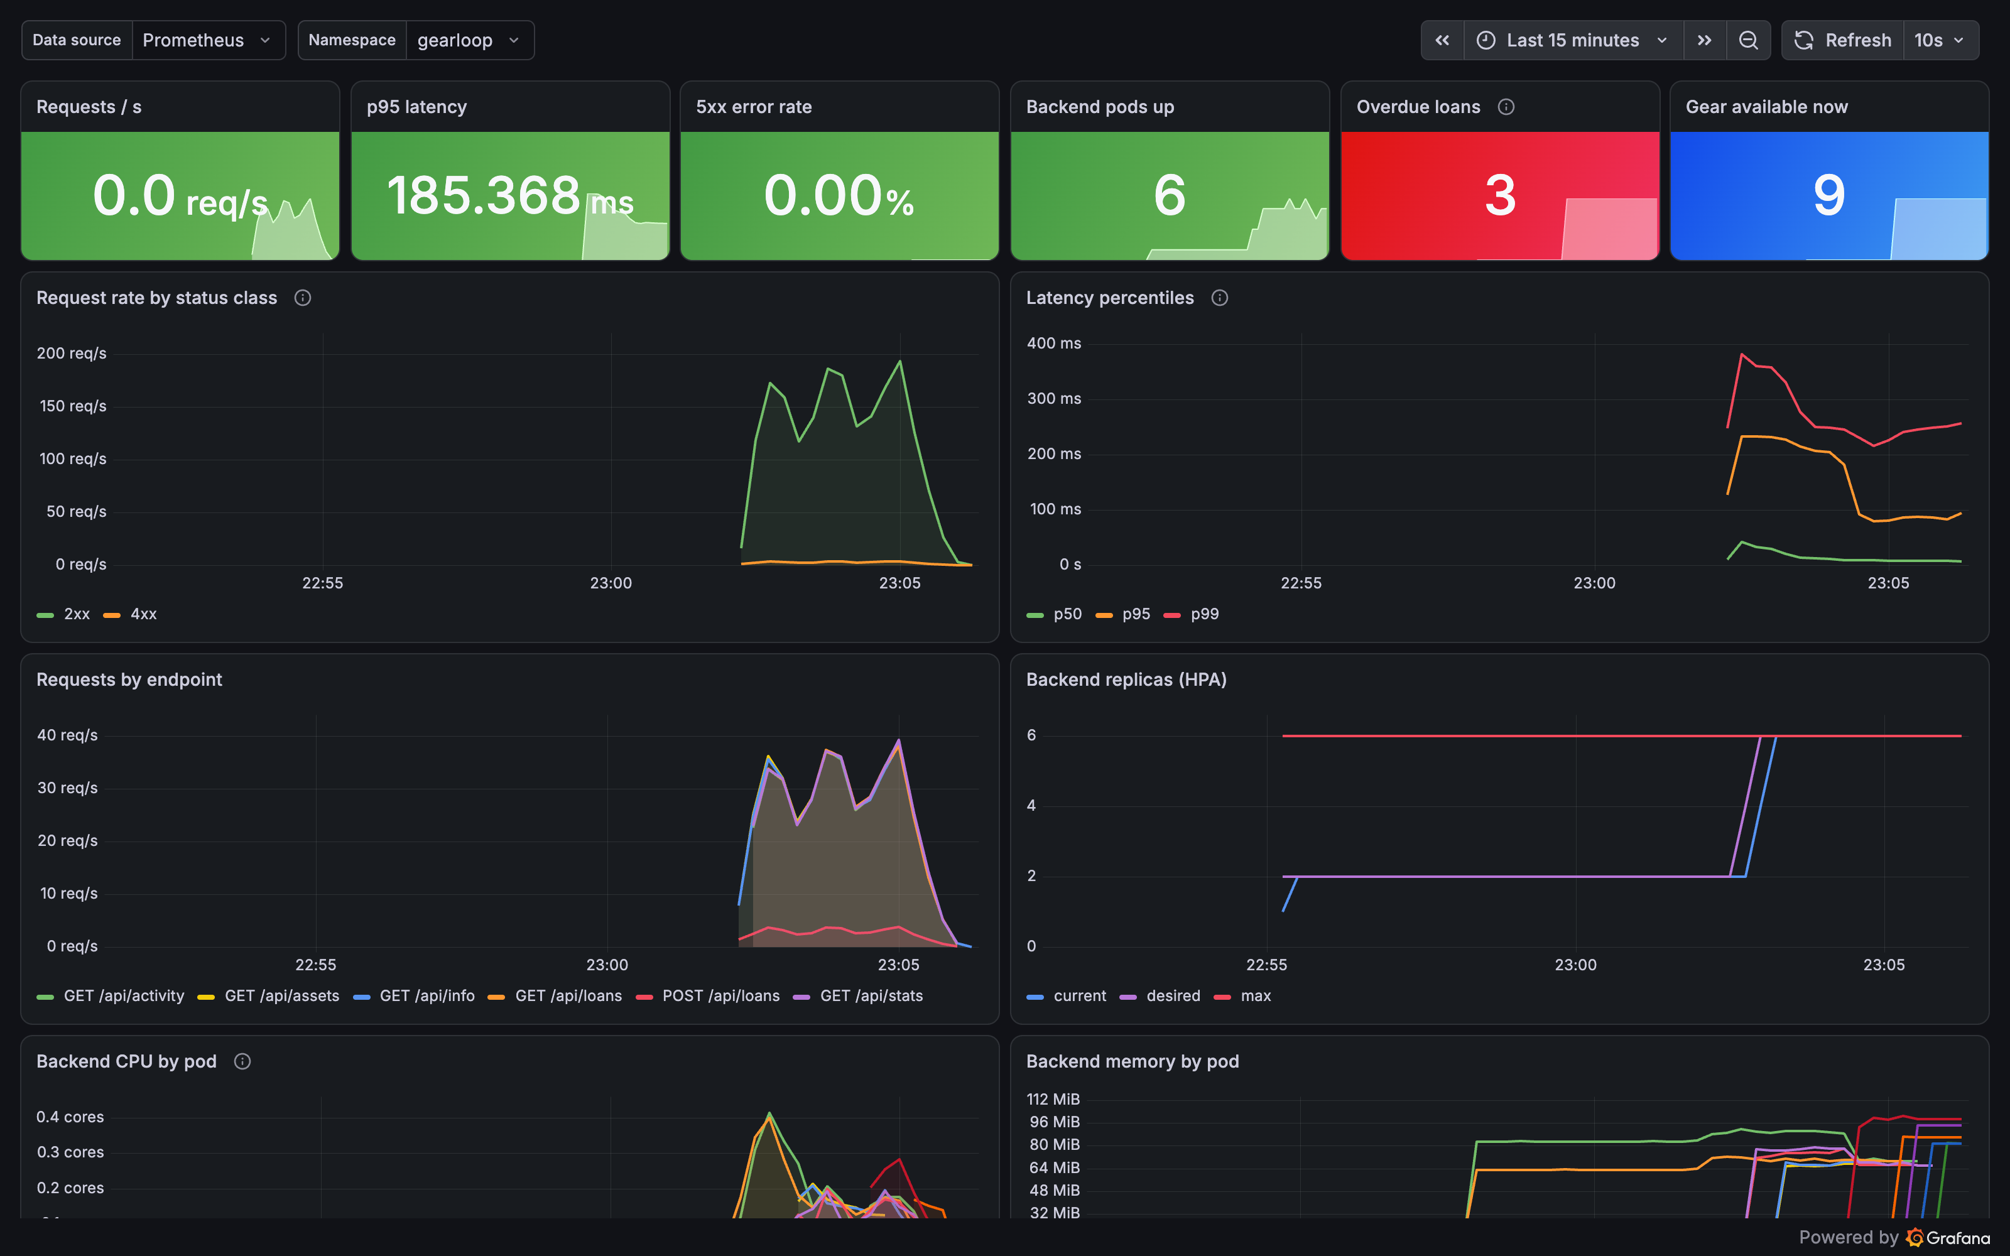
Observability
/metrics: HTTP metrics with 5 ms latency buckets + business gauges read from the DB
ServiceMonitor → Prometheus; targets UP
Alerts: backend down, 5xx > 5%, p95 > 500 ms, DB down, ≥ 3 overdue loans
Grafana dashboard ships with the chart
2 → 6
backend pods under load, back to 2 after
UP
app targets in Prometheus

Slide 10
Key learnings
Scan what you ship
Trivy's 4 HIGHs came from pip, not my code. Removing the tool removed the risk.
Locks beat checks
Overlap checks race across replicas; row and advisory locks make them safe.
Defaults hide data
100 ms latency buckets made p95 useless; 5 ms buckets fixed it.
Networking surprises
Docker Desktop sent port 80 to the kind node over IPv6; an IPv4-only network fixed it.
GitOps needs loop guards
The promote commit would retrigger CI without paths-ignore.
Operators select narrowly
Prometheus ignored my ServiceMonitor until the selector flags were set.

Slide 11
Limitations and next steps
Terraform on real AWS
Run the same code with a personal AWS profile and take Console screenshots.
Run the app on EKS
Point Argo CD at the EKS cluster instead of kind.
Replace ingress-nginx
Retired upstream in March 2026; move to Gateway API.
Managed Postgres
RDS or CloudNativePG with backups instead of one StatefulSet pod.
Sign-in
Campus SSO and an actor column in the audit trail.
Alert routing
Send Alertmanager to Slack/email; today alerts only show in Prometheus.

Slide 12
Thank you
github.com/netram75/devsecops-python
README · demo/GearLoop-demo.mp4 · GHCR: ghcr.io/netram75/gearloop-*

