Slide 1
Metis: Combining Censorship Circumvention with Measurement
Audrey Randall, Eric Wustrow

Slide 2
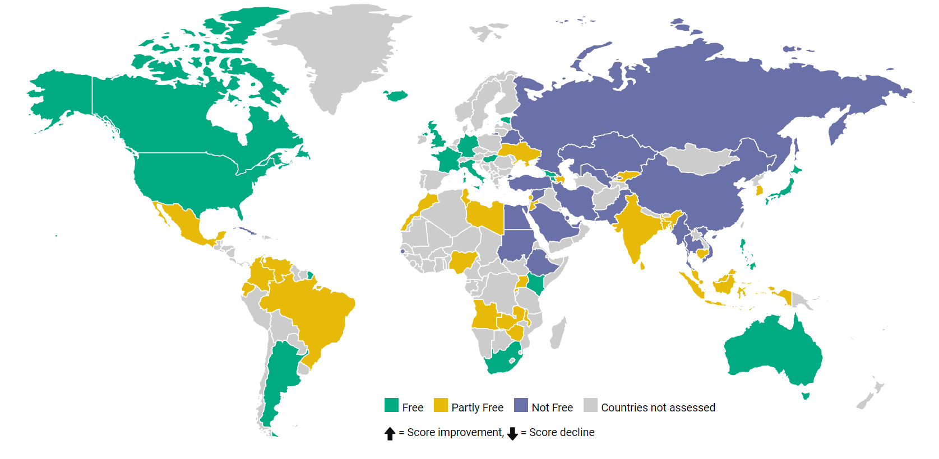
Censorship Today

Slide 3
By The Numbers
In 2016:
67 – Percentage of Internet users who lived in countries where criticism of the government, military, or ruling family was subject to censorship.
38 – Countries where authorities made arrests based on social media posts
27 – Percentage of all Internet users who live in countries where people have been arrested for publishing, sharing, or merely “liking” content on Facebook

Slide 4
The State of Censorship, 2017
Freedom on the Net, 2017:
“Rise in disruptions to mobile internet service”
“Increases in physical and technical attacks on human rights defenders and independent media”
“Seventh consecutive year of decline in Internet freedom”
“For the third consecutive year, China was the world’s worst abuser of internet freedom”
Notes:
Mobile internet restrictions often to areas populated by ethnic or religious minorities

Slide 5
A Brief History of Chinese Censorship
1979: Deng Xiaoping enacts the Open Door policy
Purpose: allow Western knowledge, investment into China
But: “If you open the window for fresh air, you have to expect some flies to blow in.” –Deng Xiaoping
1998: Start of Golden Shield Project to monitor domestic internet.
2003: The Great Firewall of China, a sub-project of the Golden Shield Project, is launched to block unwanted foreign sites
Notes:
On the one hand, Internet drives innovation, competition, trade, boosts China’s economy. On the other hand, threatens its political stability and ideological indoctrination.
Open Door policy led China towards a market economy (economy driven by market forces instead of government regulation?) and opened up the market for foreign investors.
30,000-50,000 police in Golden Shield.

Slide 6
Purpose of Chinese Censorship
To prohibit any sort of communal action, whether in opposition to, in support of, or unrelated to the Chinese government
NOT to prohibit anti-government sentiment
What gets blocked:
Sites that disagree with government narratives (regarding the Dalai Lama, Tiananmen Square, Falun Gong, etc.)
Foreign search engines that don’t comply with the policy
Obscenity (pornography)
Social media (Facebook, Twitter)
Notes:
Mention that Google didn’t index sites it found were blocked? Then they left, now they might be going back?
Reasons are economic (Baidu, Alibaba etc. doing pretty well), political, moral, security related

Slide 7




Current Circumvention Techniques
VPNs and proxies (when they aren’t blocked)
Tor, Psiphon, Lantern (high bandwidth tools)
Tapdance

Slide 8

The Trouble With Existing Tools
VPNs, proxies can be easily blocked
Tor, Lantern, etc. can be blocked with more effort
They’re SLOW, partly because all traffic is proxied, whether it needs to be or not.*
*Except possibly for Lantern.
Notes:
But 30,000 to 50,000 internet police is a lot of internet police.
Mention Meek getting blocked because it looked like an old version of Firefox, mention enumeration attacks

Slide 9

Metis
Unblocked Website
Censored
Client
Metis
Metis server
Tapdance
Blocked Website

Slide 10
Metis
Client detects when requests are censored, uses censorship circumvention tool to complete them
Server aggregates clients’ lists of censored sites without violating privacy
Hypothesis:
It is possible to significantly reduce latency for users of censorship circumvention tools by routing requests intelligently
It is possible to efficiently collect data on censorship along the way, to use for further research and improving Metis’ routing decisions

Slide 11
Choice of Transports: Why Tapdance?
Refraction networking isn’t vulnerable to enumeration attacks
Tapdance doesn’t force flow blocking: more likely to be widely deployed than Telex or Cirripede
Tapdance flows are impossible to detect except by a Tapdance station
Also, it was more or less the only option.
Attempts to use Meek failed
Pluggable transports aren’t very pluggable yet…

Slide 12
Classification: What’s censored?
Symptoms of censored request:
Timeouts (also symptoms of slow sites)
ECONNRESET, EPIPE
TCP Reset Packets (RSTs)
Symptoms Metis can’t detect:
Some DNS poisoning
HTTP hijacking
Notes:
Note that we aren’t sure if DNS poisoning happens in China, we just wouldn’t be able to spot it if it didn’t cause an error.
HTTP hijacking happens in Iran
We check for all of these in case a) China changes their strategy, b) so we can scale to other countries eventually

Slide 13
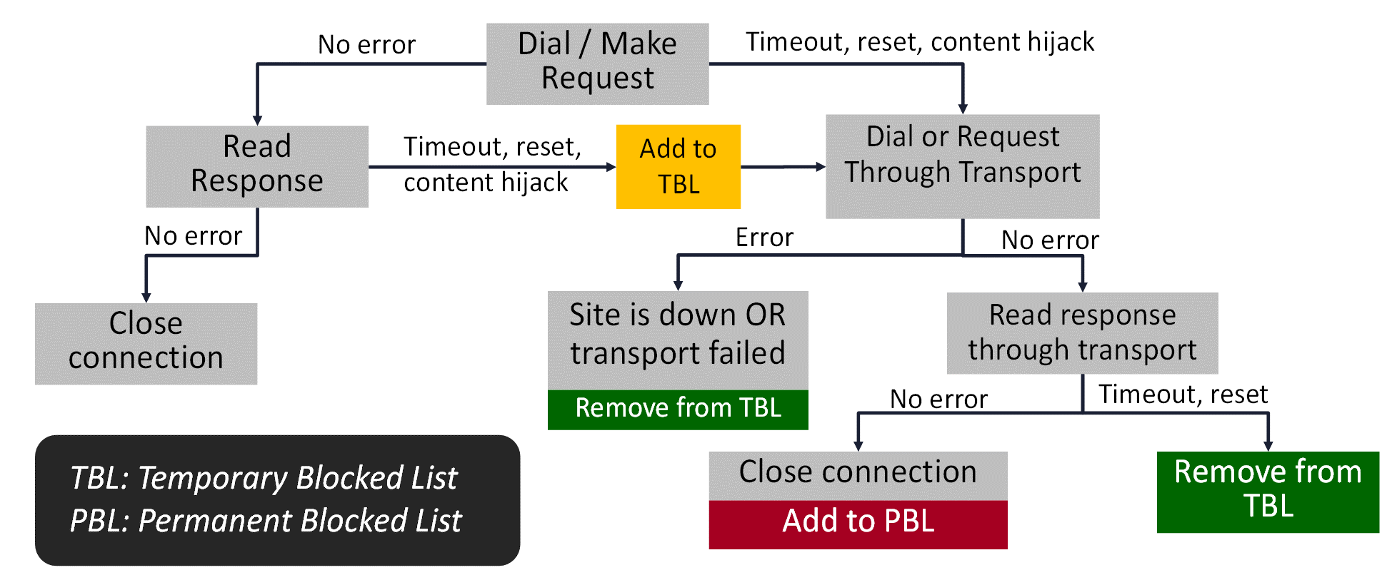
Metis’ Routing Algorithm

Slide 14
Protecting Users: Differential Privacy
Goal: Gather general usage statistics without loss of user privacy
Problem: Server can’t have access to both “sites accessed” and “who accessed them”
Existing solutions:
Google’s RAPPOR
Others, but generally not for arbitrary strings

Slide 15
Google’s RAPPOR
Prevents server from discovering what domains any particular client reported
Even given an infinite number of reports on the same domain
Allows server to discover with some probability what domains got reported by multiple clients

Slide 16
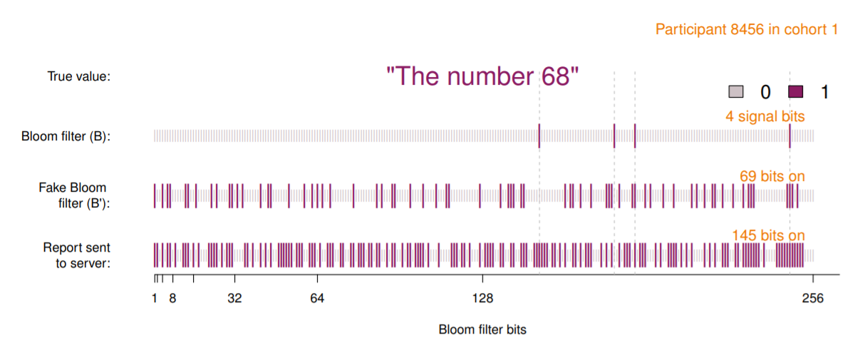
Google’s RAPPOR

Slide 17
RAPPOR Cohorts
Implement different sets of hash functions (for Bloom filters)
Reduces chance of collisions across all cohorts
Improves false positive rate
Size tradeoffs for m (number of cohorts):
Too large: too little signal from each cohort
Too small: doesn’t reduce chance of collision

Slide 18
Detecting Reported Strings
Domain #3
Estimates
Domain #2
Domain #1
Estimate how many times each bit was set in the original Bloom filter for all reports, and sum the estimates to make Y
Create design matrix of Bloom filters, X
Use LASSO regression to determine which strings were reported (coefficients nonzero)
Fit least-squares regression with relevant coefficients
1
0
0
1
1
0
0
1
0
0
1
1
0
0
1
1
1
0
1256
1325
1003
1789
1212
1243
Cohort #1
1
1
0
0
1
0
0
1
0
0
1
1
1
1
0
0
1
0
1528
1097
1486
1520
1980
1540
Cohort #2
X
Y

Slide 19

RAPPOR in Metis
With sample size N, it’s possible to detect a maximum of approximately $\sqrt{N}/10$ strings given parameter f=0.5.
Metis uses f=0.2, improves detection rate
Problems: Cross-validation and choosing the regularization parameter
Notes:
For top million domains, this means 100 billion reports

Slide 20
Results

Slide 21

Classification: What We’re Looking For
How accurate is Metis? Compare to ooniprobe censorship measurements as ground truth
Why does Metis get false positives/false negatives?

Slide 22
Ooniprobe: Open Observatory of Network Interference measurements
Tor-sponsored tool for detecting censorship, surveillance and traffic manipulation
Tests list of sites provided by user (or pre-made by OONI) for signs of tampering
Multiple types of tests
“Tens of thousands” of users

Slide 23
Ooniprobe as Ground Truth
Web connectivity test:
Resolver identification
DNS lookup
TCP connect
HTTP GET request
Steps 2-4 performed over control network as well as user’s network
Detects DNS poisoning, dropped requests, resets, HTTP injection

Slide 24
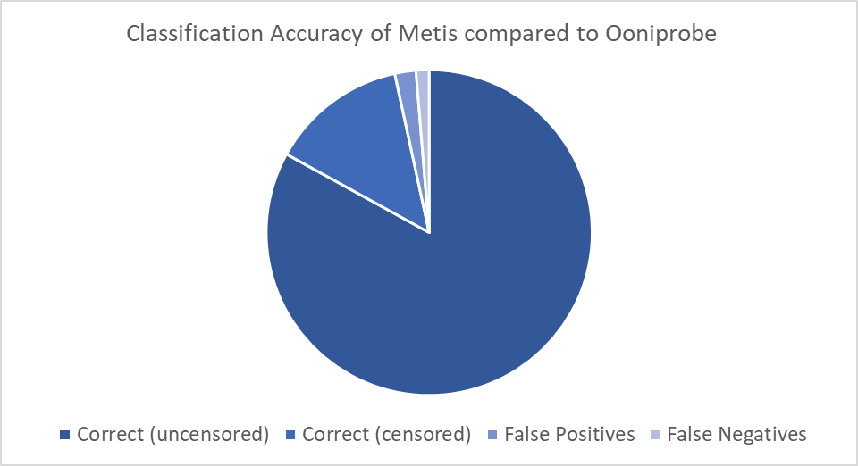
Classification Accuracy
Notes:
97% accurate, 3% falsies

Slide 25
Classification Accuracy
Tests of the Alexa top 1,000 sites were 97% accurate against ooniprobe.
False Negatives |  |  |  | False Positives
Unknown Reason | Server Error (in US & CN) | DNS Tampering | HTTP Tampering | Misinterpreted Misc. Error | Misinterpreted Timeouts
14% | 7% | 36% | 43% | 5% | 95%
Notes:
The unknown reason sites were things Metis should be able to catch: TCP-IP error, and HTTP request failed.

Slide 26
Classification Accuracy
Metis can’t detect DNS or HTTP tampering, but these make up only 1.1% of the Alexa top 1,000 sites
Further data gathered on what a reasonable timeout value is can improve accuracy to 99%
False Negatives |  |  |  | False Positives
Unknown Reason | Server Error (in US & CN) | DNS Tampering | HTTP Tampering | Misinterpreted Misc. Error | Misinterpreted Timeouts
14% | 7% | 36% | 43% | 5% | 95%
Notes:
Unknown Reason means I don’t know why Metis thought it could connect. Mention the WhatsApp weirdness.

Slide 27
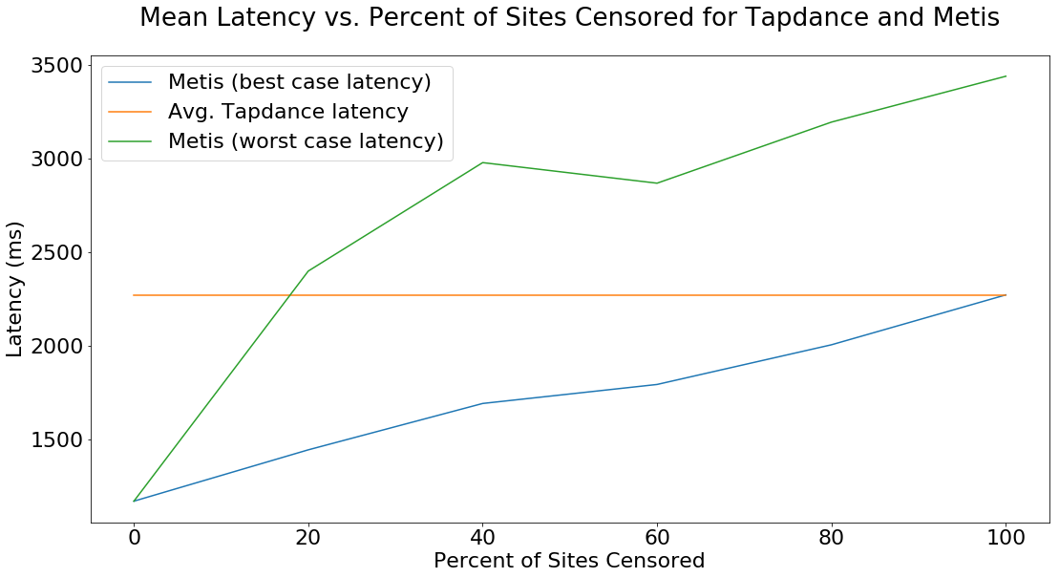
Latency Reduction
Notes:
15% of the Alexa top 1000 are censored

Slide 28
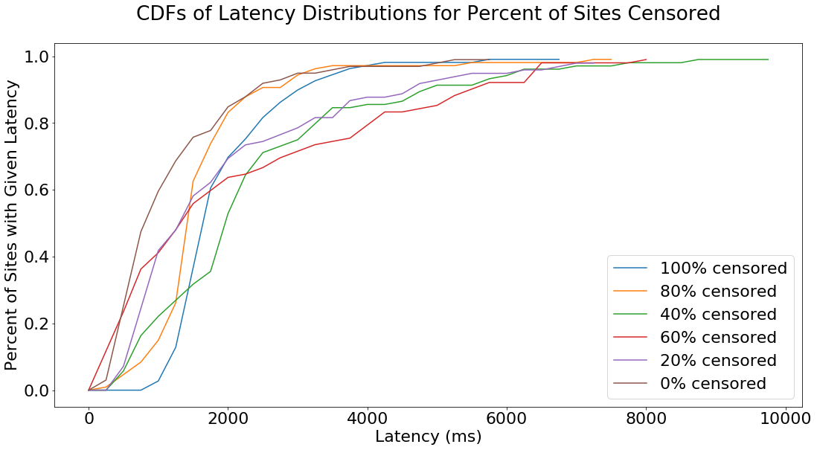
No latency patterns for % of sites censored?

Slide 29
Conclusion
Metis is faster than Tapdance in nearly all situations
Given ideal training time, Metis is faster until 100% of sites are censored, at which point it is the same speed as Tapdance
Given NO training time, Metis is faster for a censored site percentage under 18%. 15% of the Alexa top 1,000 sites were censored.
Metis will usually have much more classification data than “none.”
Metis can classify 97% of sites correctly now, and could presumably classify 99% correctly with better data about reasonable timeouts
Metis can successfully collect a database of censorship measurements without impacting its performance

Slide 30
References
[1] E. E. Schmidt and J. Cohen, “The future of internet freedom," The New York Times, 03 2014.
[2] “Freedom house," 2018.
[3] “Freedom on the net report," 2017.
[4] “Lantern: Faster than a vpn," 2018.
[5] “Ooniprobe," 2018.
[6] “Torfox: A stanford project," 2011.
[7] “What is internet censorship?."
[8] G. KING, J. PAN, and M. E. ROBERTS, “How censorship in China allows government criticism but silences collective expression," American Political Science Review, vol. 107, no. 2, p. 326-343, 2013.
[9] M. S. Clayton R. and W. R.N.M., “Ignoring the great firewall of china," Danezis G., Golle P. (eds) Privacy Enhancing Technologies, vol. 4258, 2006.
[10] “Tor metrics: Users," 2018.
[11] “Psiphon," 2018.
[12] E. Wustrow, C. M. Swanson, and J. A. Halderman, “Tapdance: End-to-middle anticensorship without flow blocking," Proceedings of the 23rd USENIX Security Symposium, 2014.
[13] U. Erlingsson, V. Pihur, and A. Korolova, “Rappor: Randomized aggregatable privacy-preserving ordinal response," Proceedings of the 21st ACM Conference on Computer and Communications Security, 2014.
[14] R. Tibshirani, “Regression shrinkage and selection via the lasso," Journal of the Royal Statistical Society. Series B (Methodological), vol. 58, no. 1, pp. 267{288, 1996.
[15] F. Pedregosa, G. Varoquaux, A. Gramfort, V. Michel, B. Thirion, O. Grisel, M. Blondel, P. Prettenhofer, R. Weiss, V. Dubourg, J. Vanderplas, A. Passos, D. Cournapeau, M. Brucher, M. Perrot, and E. Duchesnay, “Scikit-learn: Machine learning in python," Journal of Machine Learning Research, vol. 12, pp. 2825{2830, 2011.
[16] “1.1.3 lasso," 2018.

Slide 31
Questions?

