Slide 1
Basic Defense
Logs, Configuration, Firewalls, and User/File Controls

Slide 2

Logging
  Logs are usually generated by services or the operating system
  Allows you to debug services if they go down, and observe what others are doing with those services
  Important to help you keep track of what others are doing and how they are trying to get in to your systems.

Slide 3
Linux Logs
  Most log files are stored in /var/log
  Important log files:
    /var/log/auth.log - ssh login attempts, sudo usage
    /var/log/apache2/access.log - apache2 access logs
    /var/log/nginx/access.log - nginx access logs
  See logs of any service:
    journalctl -u <service-name>
    Recent logs: journalctl -u <service-name> -n 50
  Check service status:
    systemctl status <service-name>
  Check command history:
    <user home directory>/.bash_history

Slide 4
Windows Logs
  Most Windows logs stored in Event Viewer -> Windows Logs
    Application: software application logs
    Security: logins, privileges used, etc.
    System: OS events (service start/stop)
  Basic Security events:
    4624 - Successful logon
    4625 - Failed logon attempt
    4634 - Logoff
  Basic System events:
    7036 - Service state changed

Slide 5
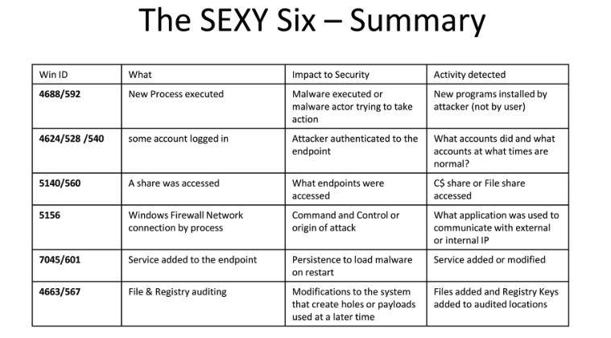
Windows Logs
https://www.slideshare.net/slideshow/finding-attacks-with-these-6-events/61445207

Slide 6
Services/Processes
Services
Processes
Programs that run automatically when system boots
Example: web servers, databases, SSH
Instance of any program that runs on the system
Monitoring processes helps detect malware
Includes services, and any user run applications

Slide 7
Linux Services/Processes
List services:
  ss -antlp
    Lists listening ports. When run as root, also lists the services
List processes:
  See all processes: “ps aux”
  ps -aef --forest ww
    See parent child relations, helps to spot malware/reverse shells
Kill processes:
  kill <process id>
  Force kill a process: kill -9 <process id>

Slide 8
Linux Services Configuration - websites
Most service config files in /etc/<service-name>/
Web services:
  Apache2:
    /etc/apache2/apache2.conf
    /etc/apache2/sites-enabled/*
  Nginx:
    /etc/nginx/nginx.conf
    /etc/nginx/sites-enabled/*
  Make sure they are run as www-data user
Websites usually located in /var/www/ or /opt/
  Can check and update their source code to remove vulnerabilities

Slide 9
Linux Services Configuration
SSH: /etc/ssh/sshd_config
  Sample settings:
    PubkeyAuthentication yes/no
    PermitEmptyPasswords no
    PasswordAuthentication yes/no
PHP config: php.ini
  Find php.ini files: find / -name 'php.ini'
  Important line to disable dangerous functions:
    “disable_functions = 1e, exec, system, shell_exec, passthru, popen, curl_exec, curl_multi_exec, parse_file_file, show_source, proc_open, pcntl_exec”

Slide 10
Windows Services/Processes
List services: Get-Service
List Running Services:
  Get-Service | ? {$_.Status -eq "Running"}
Get service info: Get-Process -Name <service-name>
Modify processes:
  Start-Service <service-name>
  Stop-Service <service-name>
  Restart-Service <service-name>

Slide 11
Windows Services Configuration - websites
Windows uses either IIS (Internet Information Services) or XAMPP for basic websites
IIS:
  Open IIS Manager -> select target site -> features view
XAMPP: stored in C:\xampp\
  Apache: C:\xampp\apache\conf\httpd.conf
  PHP: C:\xampp\php\
  Logs: C:\xampp\apache\logs\
  MySQL: C:\xampp\mysql\

Slide 12
Windows Services Configuration
SMB (Server Message Block):
  Shares:
    GUI: Computer Management → Shared Folders → Shares & Sessions
    Powershell: Get-SMBShare
  Get SMB Config: Get-SmbServerConfiguration
  Disable SMBv1 (stop eternalblue):
    Set-SmbServerConfiguration -EnableSMB1Protocol $false

Slide 13

Firewalls
Purpose: Control network traffic
  BE VERY CAREFUL!!! Very easy to block yourself!
Things you can do with firewalls:
  Block an IP address (not for netsiege)
  Block port from being accessed externally
  Limit inbound/outbound traffic
  Restrict connections to other systems (prevent lateral movement)
  Log network traffic

Slide 14
Linux Firewalls
2 main chains: INPUT, OUTPUT
View firewall rules:
  View rules with line numbers: “iptables -L --line-numbers”
  Command style syntax: “iptables -S”
Set default action: iptables -P INPUT DROP
Sample rule syntax:
  iptables -A [INPUT/OUTPUT] -p [tcp/udp] --sport <source-port> --dport <destination-port> -j [ACCEPT/DROP]
  Example to block ftp from external access:
    iptables -A INPUT -p tcp --dport 21 -j DROP
Delete rules:
  iptables -D INPUT <rule number>

Slide 15
Windows Firewalls
CLI: netsh
GUI: Windows Defender Firewall -> advanced Settings
Basic netsh commands:
  List rules: netsh advfirewall firewall show rule name=all
  Sample rule syntax:
    netsh advfirewall firewall add rule name="<Name>" dir=[in/out] action=[allow/block] protocol=[TCP/UDP] localport=<port> remoteip=<IP/Subnet>
  Example:
    netsh advfirewall firewall add rule name="Block FTP External" dir=in action=block protocol=TCP localport=21

Slide 16
User Controls
1
2
3
Permissions
Users
Groups
Individual accounts
Has username, password, and a unique id (uid)
Collections of users that share common permissions
Adminsitrator/sudo groups are extremely powerful
Define what a user or group can do with files or resources
Following least privilege principle, ensure users can only do what they need at a minimum

Slide 17
Linux User Controls
Basic user info:
  id <username>
  groups <username>
Sudo permissions: /etc/sudoers
User Management (run as root):
  Add user: adduser <username>
  Change password: passwd <username>
  Delete user: userdel <username>
Group management:
  Add group: groupadd <groupname>
  Add user to group: usermod -aG <groupname> <username>
  Remove user from group: gpasswd -d <username> <groupname>

Slide 18
Windows User Controls
Basic user info: net user <username>
Group members:
  net localgroup <groupname> (local windows systems)
  net group <groupname> (for active directory)
User Management (run as root):
  Add user: net user <username> <password> /add
  Change password: net user <username> <newpassword>
  Delete user: net user <username> /delete
Group management:
  Add group: net localgroup <groupname> /add
  Add user to group: net localgroup <groupname> <username> /add
  Remove user from group: net localgroup <groupname> <username> /delete

Slide 19
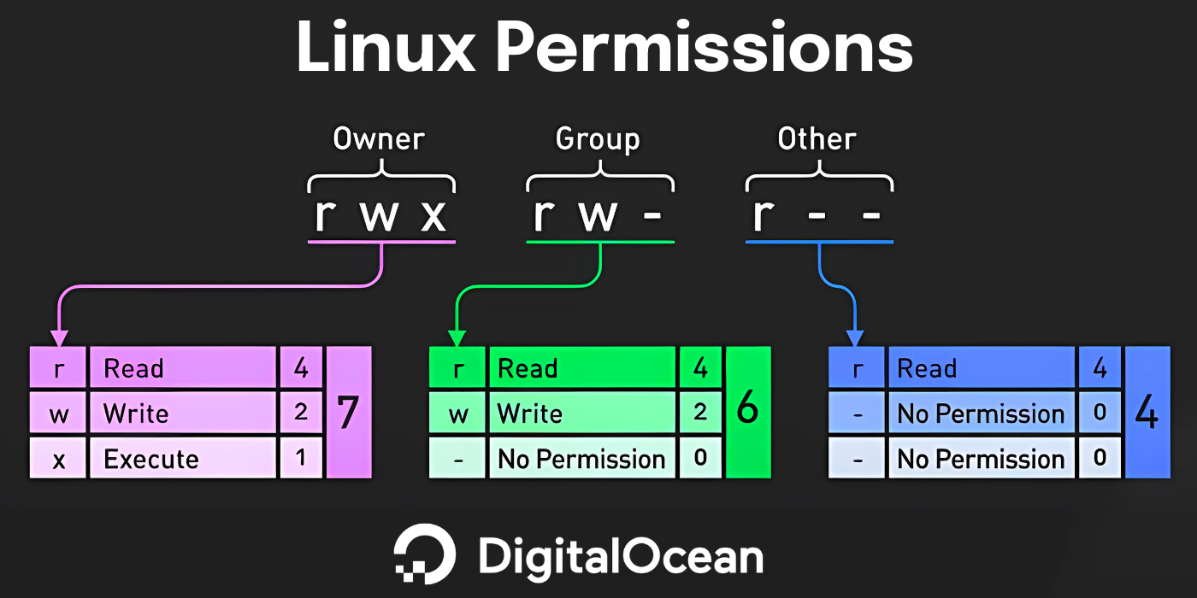
Linux File Permissions
Find files controlled by user/group:
  find / -user <username>
  find / -group <groupname>
File controls:
  View file owner/permissions: ls -l
  Change file ownership: chown <user>:<group> <file>
  Change file permissions: chmod 764 <file>

Slide 20
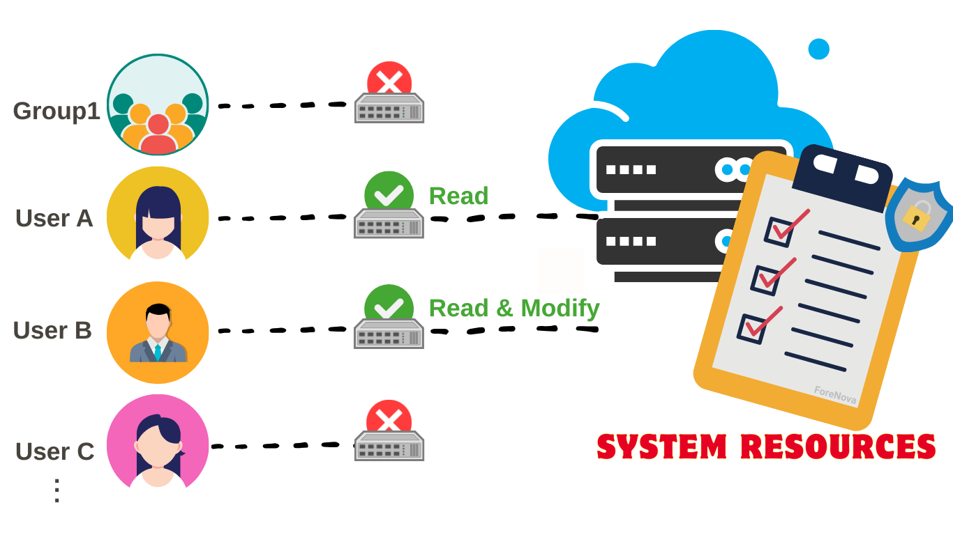
Windows File Permissions
ACL - Access Control List
  List of permissions for a resource
List fille ACLs: icacls <path>
Modify permissions:
  icacls <path> /grant <UserOrGroup>:(<Permissions>)
  Permissions:
    F = Full, M = Modify, RX = Read & Execute, R = Read, W = Write
Remove permission: icacls <path> /remove <UserOrGroup>
Reset permissions: icacls <path> /reset
Take ownership of resource: takeown /F <path> /R /D Y
  /R = Recursive, /D Y = confirm prompts automatically

Slide 21
Questions?

Slide 22

Thank You!

