Slide 1
What’s network slicing?
…. and what’s not?
Young Lee, Gert Grammel Dhruv Dhody, Daniele Ceccarelli
March 2017
IETF 98 Chicago

Slide 2

In a single Data Center
Rack Server
Rack Server
Are the switches sliced?

Slide 3
a Data Center
Rack Server
Rack Server
Which slice is this?
The Internet

Slide 4
a Data Center
Rack Server
Rack Server
Do we call this slicing?
The Internet

Slide 5
a Data Center
Rack Server
Rack Server
Is this also slicing?
Rack Server
Rack Server

Slide 6
What’s a Network Slice?
Network Slicing can be seen as an implementation of the "Network as a Service" paradigm, where a common [physical] network is able to provide and expose concurrent, partitioned and self-­contained “slices” to support different services in an efficient way and provide the required Quality of Service (QoS).
Source: https://portal.etsi.org/NFV/NFV_White_Paper_5G.pdf

Slide 7
What’s not a Network Slice?
Given that logic, any tunneling mechanism can be considered a “network slice”:
  MPLS-LSP, PW, GRE
  Ethernet-MAC, Ethernet VLAN, MacinMac, …
  IP flows with same source-destination header and protocol ID
What’s not a slice?
  Broadcast mechanisms?

Slide 8
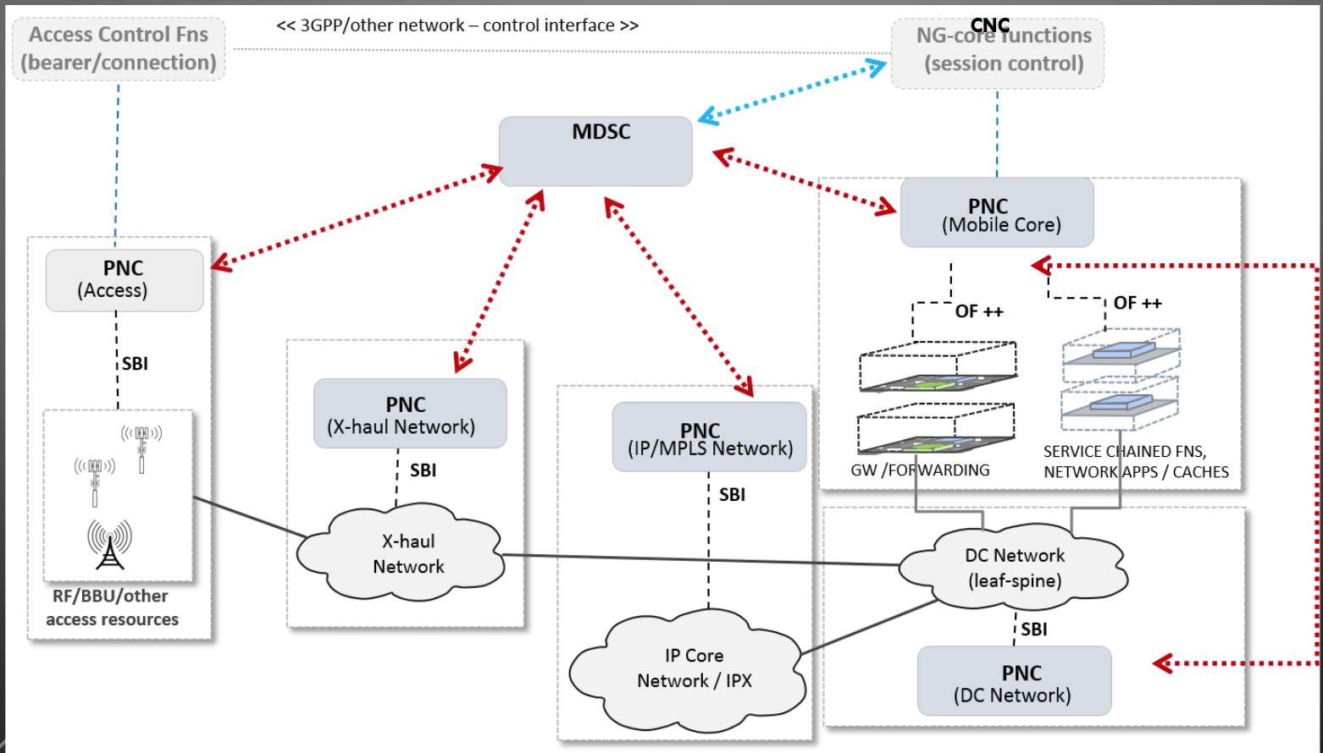
Teas/ACTN for 5G

Slide 9
What Network Slice might be:
Necessary conditions for a “Network Slice” are:
A slice is a network of nodes with its own control logic that is independent from other slices
Resources are assigned dynamically and autonomously to the slices
Operating a slice is independent on other slices - except for resource management
Nodes of a slice may require particular HW/SW capabilities

Slide 10

Crosscheck
What | Is a slice? | Why?
Layering | Typically not | Only if e.g. STP (control & operations) is enabled and client uses IGP
EPL/EVPL | no | Is a service of an underlying packet transport
Tunneling | no | Tunnels follow the logic of the technology providing tunnels
OSPF/IS-IS | yes | Different control logic, potentially implemented in different VM
L1VPN | no | Resources are not dynamically and autonomously assigned
Logical Router | yes | Logical routers are independent routing engines

