Slide 1

NEFS = J2EE Simplified
The Netspective Enterprise Frameworks Suite (NEFS) is the fastest path to advanced J2EE applications

Slide 2

Agenda
What does NEFS do?
How does NEFS work?
Application Presentation Themes
Hierarchical Application Navigation
Auto Validated Forms
Declarative Security
Declarative SQL Queries and Reports
Dynamic SQL Queries and Reports
Leveraging Existing Investments
Feature List
Conclusion – Why Use NEFS?

Slide 3
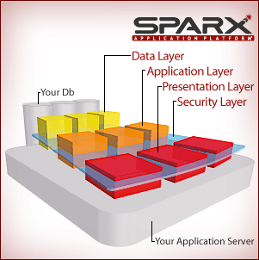
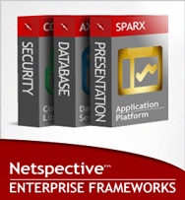
What does NEFS do?
The Netspective Enterprise Frameworks are a suite of Java libraries and add-on tools that help your software development:
  create great-looking web-based applications that are easier to use but just as sophisticated as desktop-based applications (presentation layer);
  connect to multiple data sources simultaneously and allow modern web-based applications to consume legacy data (data layer);
  secure web-based applications using rock-solid role-based access control (security layer);
  do all of this without replacing existing operating systems, app servers, IDEs, databases, or other favorite tools (true add-ons and not replacements).

Slide 4
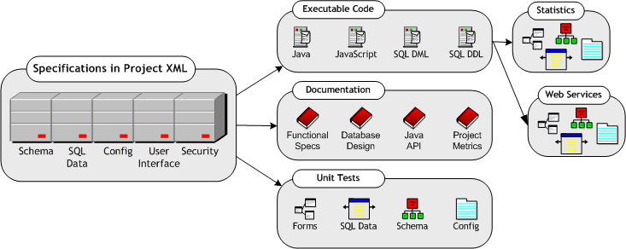
What does NEFS produce?
Generates up to 80% of all code a typical business application needs.
Custom code and business logic remains separate and reusable.
Developers supply XML declarations categorized below and NEFS generates everything else on the right.

Slide 5
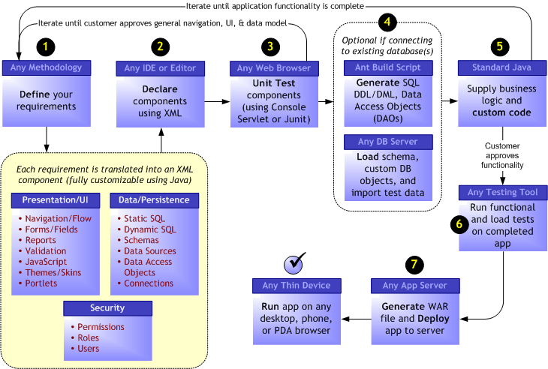
How does NEFS work?

Slide 6
NEFS Architecture Comparison
FEATURE | NEFS | OTHER FRAMEWORKS
Process and architecture | NEFS programmers write XML-based specifications and augment with Java code using a unified, reusable architecture while unit tests, documentation, metrics, logs, and performance stats are automatically generated and managed. | Programmers have to write Java code and all artifacts and logs themselves. Some frameworks have libraries that assist with logging but programmers remain responsible for calling the APIs.
Complexity | Low since almost entire UI, data, and biz logic layers are abstracted by simple XML-based Executable Specifications. | Usually high since they require use of EJBs and low-level J2EE APIs.
Programmer competency | Junior (less than 1 year Java experience required) for using all aspects of the framework. | Senior-level expertise is usually required even for basic aspects of the framework.
Learning curve | Within 2 days if trained, about 10 days if not trained | Usually several weeks due to amount of Java code understanding and usage patterns.
Containment | NEFS, as a group of frameworks, resides inside your application and is driven by your application’s use of it. | Most frameworks are application containers meaning your application is driven by the framework (not the other way around)
Dependency upon framework | Low since much of the application is available in standard XML meta models so it’s easy to move to other frameworks. | High since lots of Java code is written using the framework APIs, which in turn ties customer to the framework.
Interoperability with other frameworks | Excellent – no assumption is made that NEFS will be the only framework in use. All layers (UI, biz logic, data, security) are optional and can interoperate with other frameworks easily. | Average – many frameworks assume they are the only framework in use and make it difficult to work with newer frameworks and technologies that may come along.
Number of tools to learn | Since NEFS works with any IDE, editor, modeling tool, or ERD tool and includes a complete skins-based UI generator and persistence layer therefore programmers need to learn and use fewer tools. | Most other frameworks impose their own IDEs or other tools and don’t follow the tools consolidation approach that Sparx does.

Slide 7
NEFS Feature Comparison
FEATURE | NEFS | OTHER FRAMEWORKS
Administration Console | NEFS includes a thin-client browser-based admin console that provides a visual repository of all application components and how they relate to the framework and its APIs. Complete unit tests and implementation documentation are available from a single, extensible, console – regardless of which IDE is in use. | No other framework includes an administration console for the framework or automatic console for the application. All unit tests, performance statistics, and documentation are manually managed by programmers.
Presentation Layer | Entire user interface with default “skins” for nice-looking web interfaces is generated. All client-side validation (JavaScript), server-side validation (Java), data binding, state machine, form reloads on error, reports, navigation/workflow, and performance stats are managed by Sparx without senior engineering expertise. All functional specs and implementation documentation are automatically generated. | Most other frameworks provide low-level APIs that senior engineers use to setup user interface templates that junior engineers can implement. Most frameworks do not include automatic server and client-side validation, data binding, or state machines for automatic form reloads and error displays. Functional specs and implementation documentation are manually created.
Application Layer | A business rules repository is provided to assist developers with the creation of reusable business objects (allows junior programmers to create reusable code without really thinking about it). | Most frameworks assume that engineers will create their own repositories. Senior engineers often do a good job, junior engineers do not.
Data and Persistence Layer | Data connectivity, schema (DDL) management, lightweight data access objects (DAOs), SQL (DML) management, SQL libraries, transaction management, and performance statistics are provided allowing junior engineers to be instantly productive. Database design documents and XML import/export code is automatically generated. | Most frameworks provide data connectivity and basic SQL (DML) access but don’t provide SQL DDL, DAOs, SQL libraries, or performance statistics. Normally, no automatic database design documents or XML import/export is provided by the framework (but can usually be implemented by senior engineers).
Security Layer | Granular, hierarchical, role and permissions access control lists that can be declaratively applied to forms, fields, reports, web services, and persistent objects. | Flat resource-based permissions that can only be applied to resources like web pages and web sites (not to specific application elements).

Slide 8
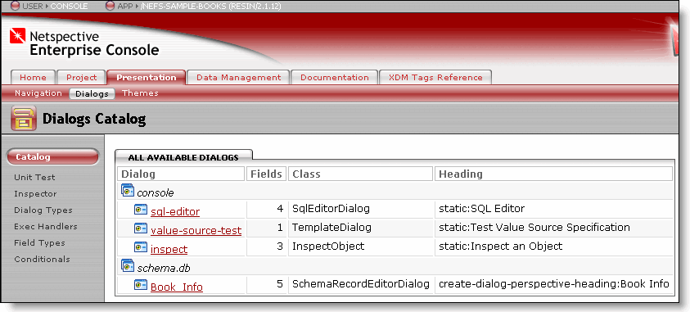
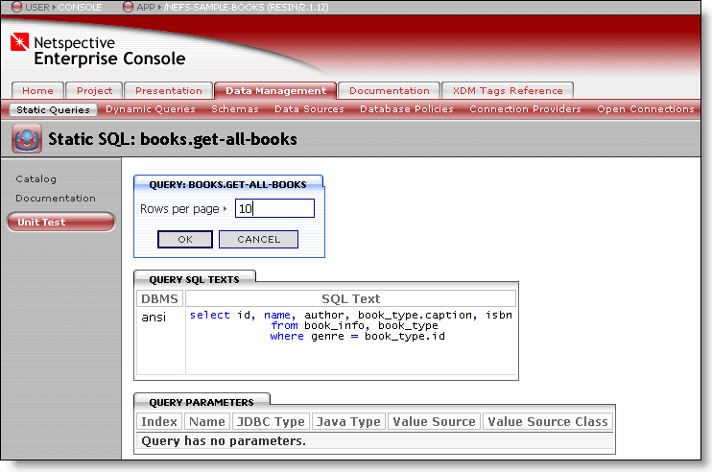
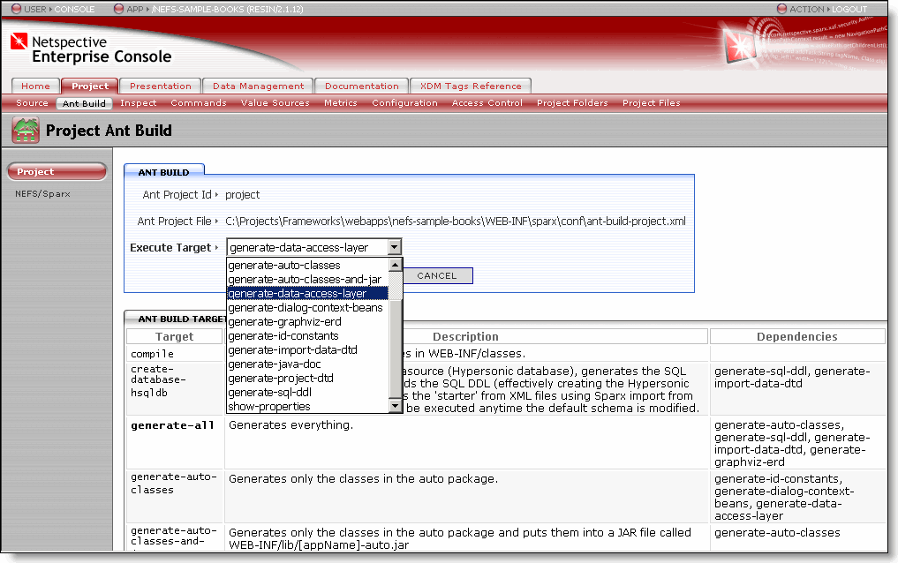
Netspective Enterprise Console
The Enterprise Console provides an IDE-independent mechanism to help you manage all your application components.
Improve the quality of your app by running the auto generated unit tests within the Console.
Better understand your app code through auto generated documentation.

Slide 9
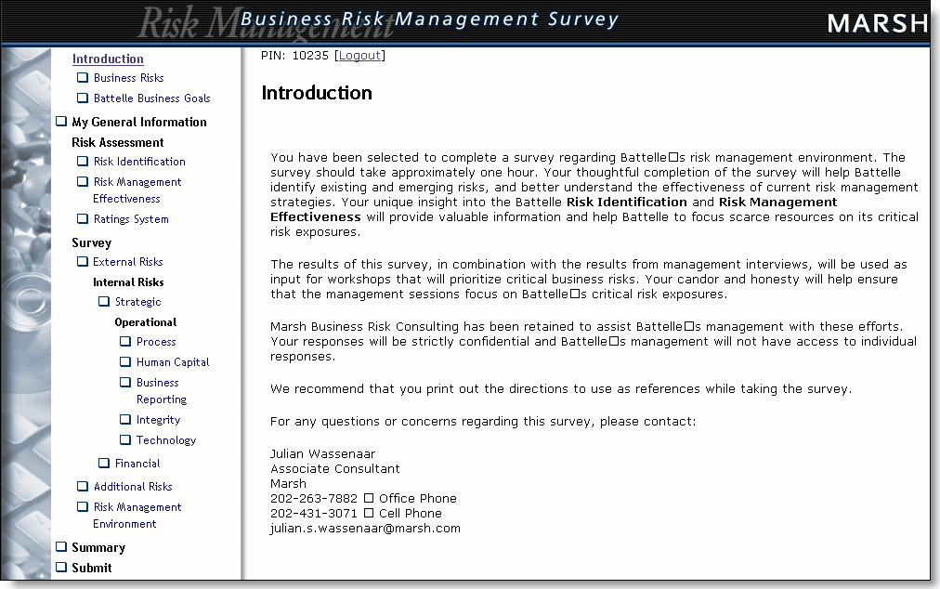
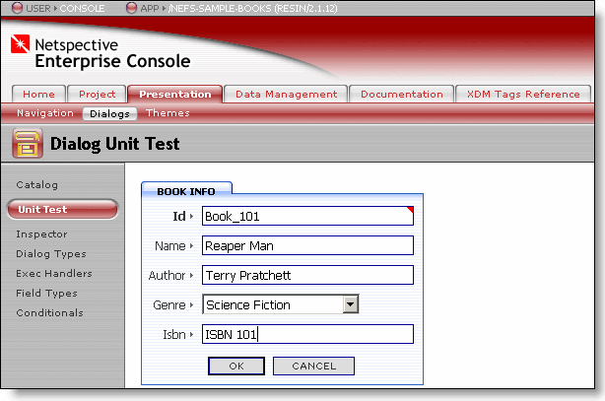
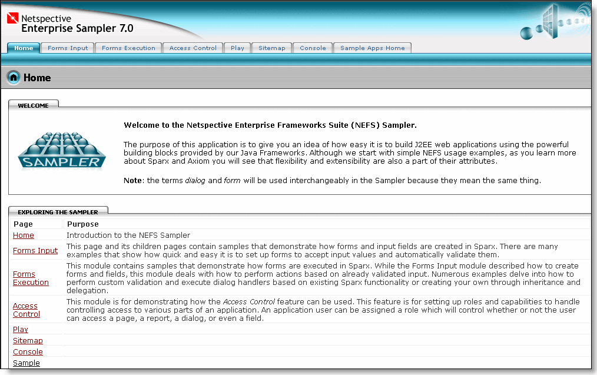
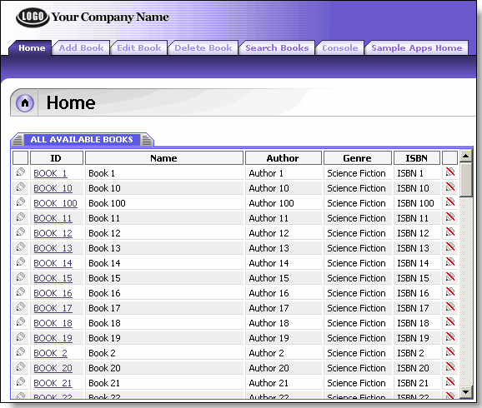
Application Presentation Themes
Your applications can look as great as they work.
You won’t need to sacrifice appearance for power or vice-versa.

Slide 10
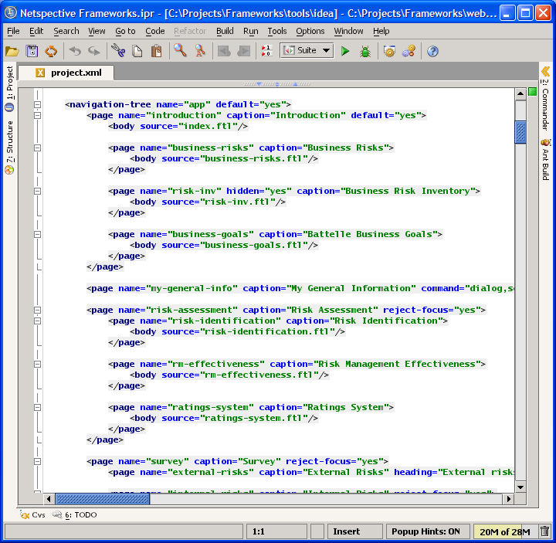
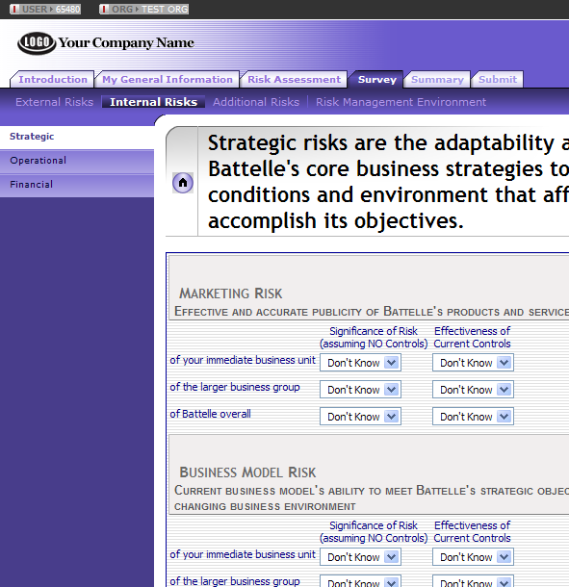
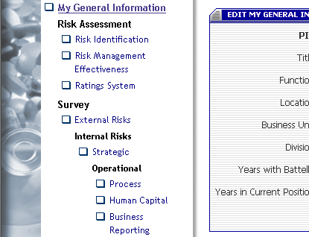
Hierarchical Application Navigation
Using your favorite IDE or editor, declare simple tags like <page> and <body> to create sophisticated hierarchical navigation…
NEFS automatically generates all HTML, CSS, images, etc and allows easy switching between different themes.

Slide 11
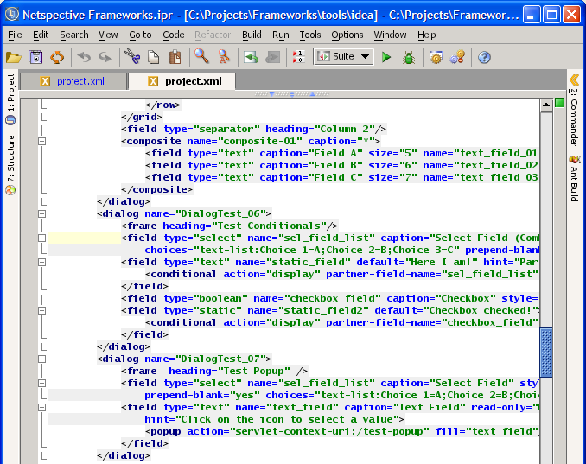
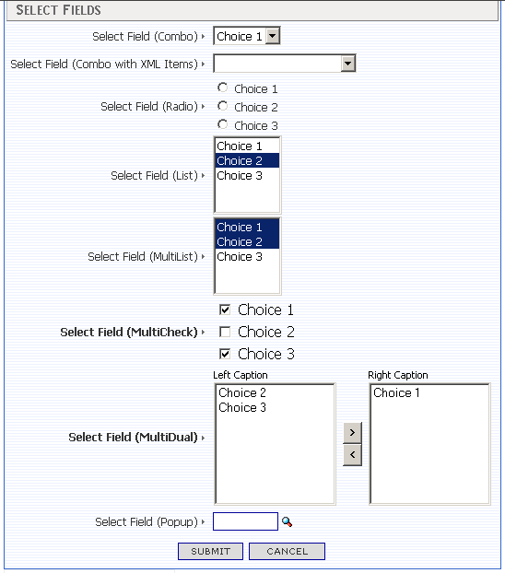
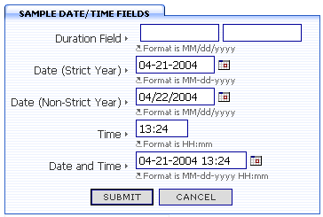
Auto Validated Forms
Use tags like <dialog>,<field>, and <validate> to create entire forms.
HTML generation, population of form data (including repopulation of data on error), and validation is completely automatic. A dozen lines of XML produces hundreds of lines of Java, JavaScript, and HTML.

Slide 12
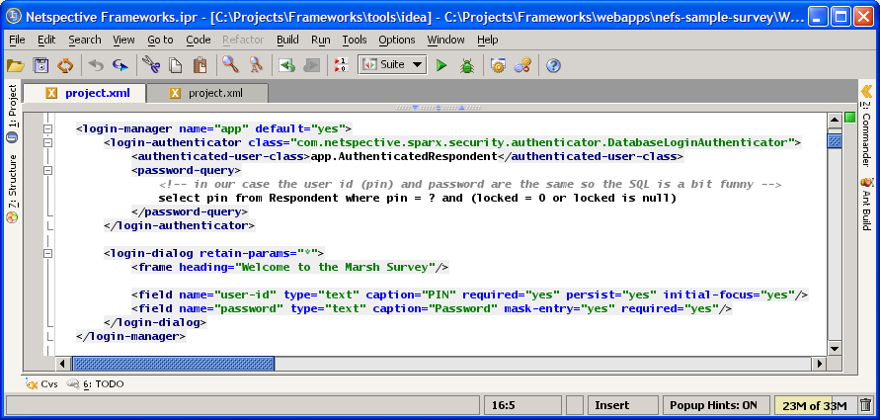
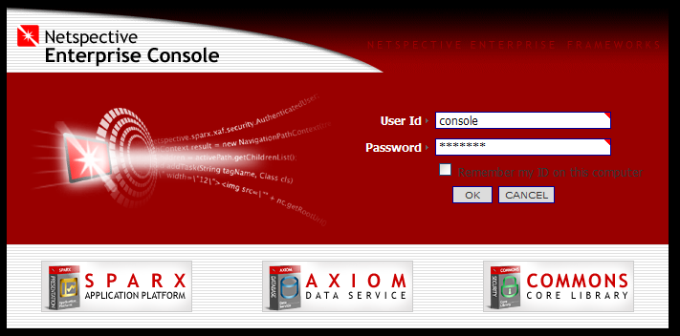
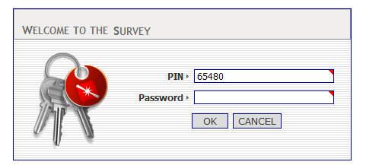
Declarative Security
You can easily secure your mission-critical app by using simple tags like <login-manager>,<login-authenticator>, <permission>, and <role>. Never worry about forgetting to secure a page again.
JAAS authentication, database authentication, and custom authenticators transparently protect your application code without requiring any extra work on your part.

Slide 13
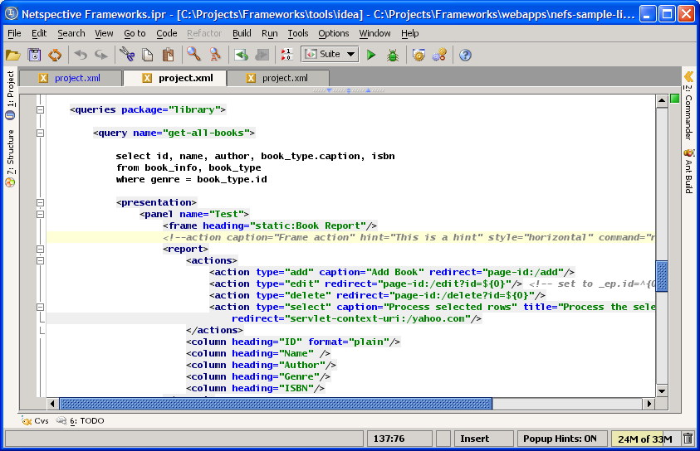
Declarative SQL Queries and Reports
Use the powerful <query> tag to extract data from ORACLE, SQL*Server, MySQL, or any other relational database. Using a single tag you can get data from a one db or multiple data sources simultaneously.
When you need to present your SQL data, just drop in the handy <report> tag which generates user interfaces that allow record adds, edits, and deletes with almost no code.

Slide 14
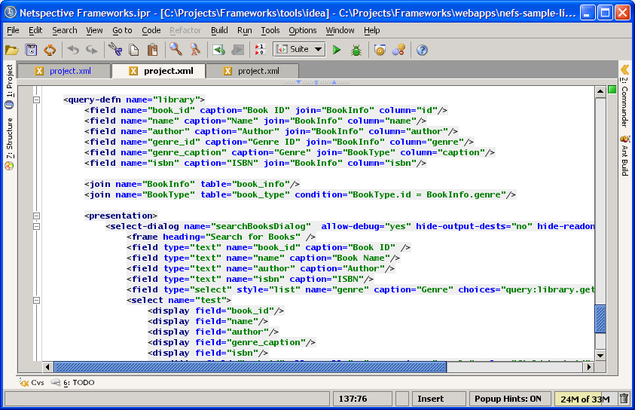
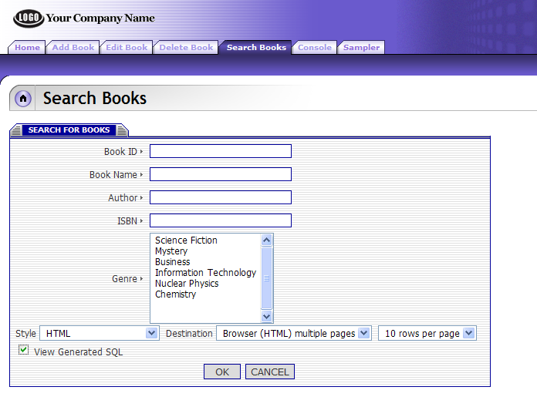
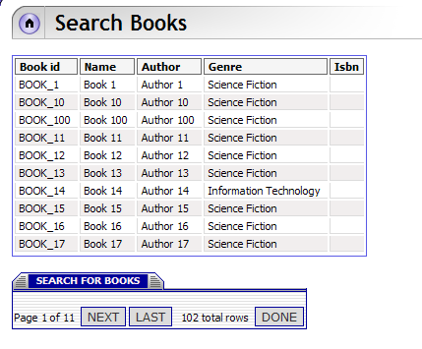
Dynamic SQL Queries and Reports
Tired of writing hundreds of lines of code for each search dialog? You’ll appreciate the <query-defn>, <field>, <join>, and <select-dialog> tags that define rules to map user interface fields to specific tables and columns in your database. Search dialogs can be written in hours instead of days.
Once the map is created, NEFS automatically constructs search forms. Then, using data obtained from a user at run-time, the system automatically generates SQL, executes the SQL, and produces pageable reports with no java coding.

Slide 15
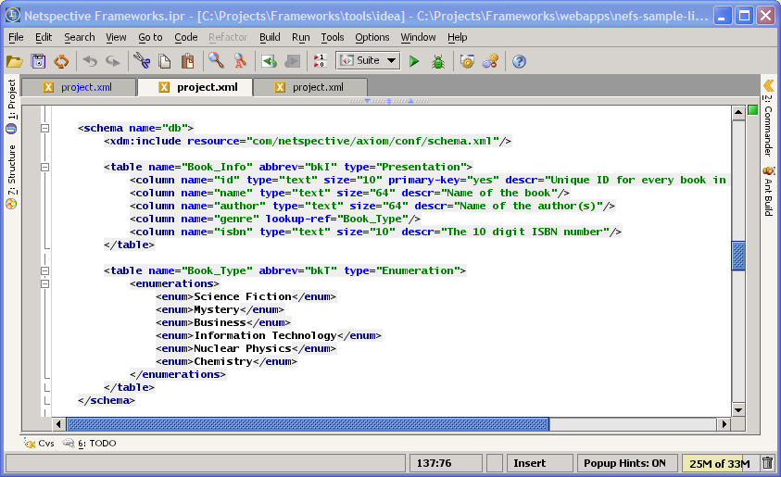
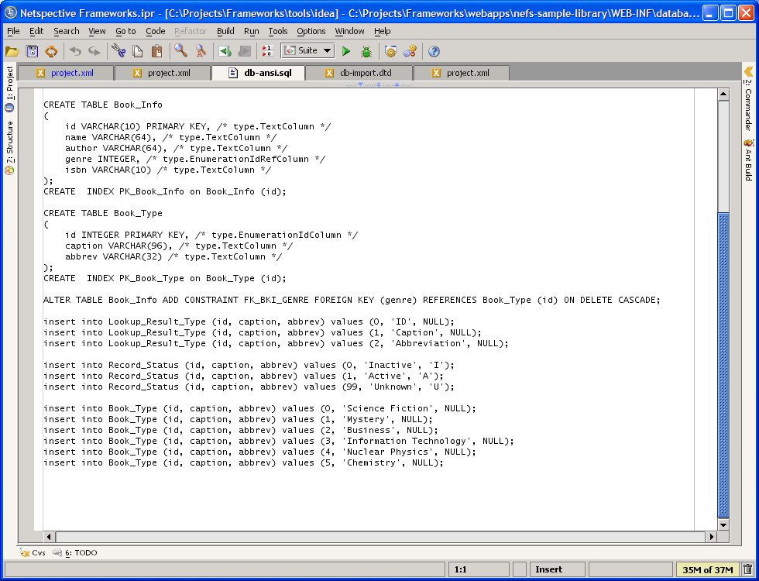
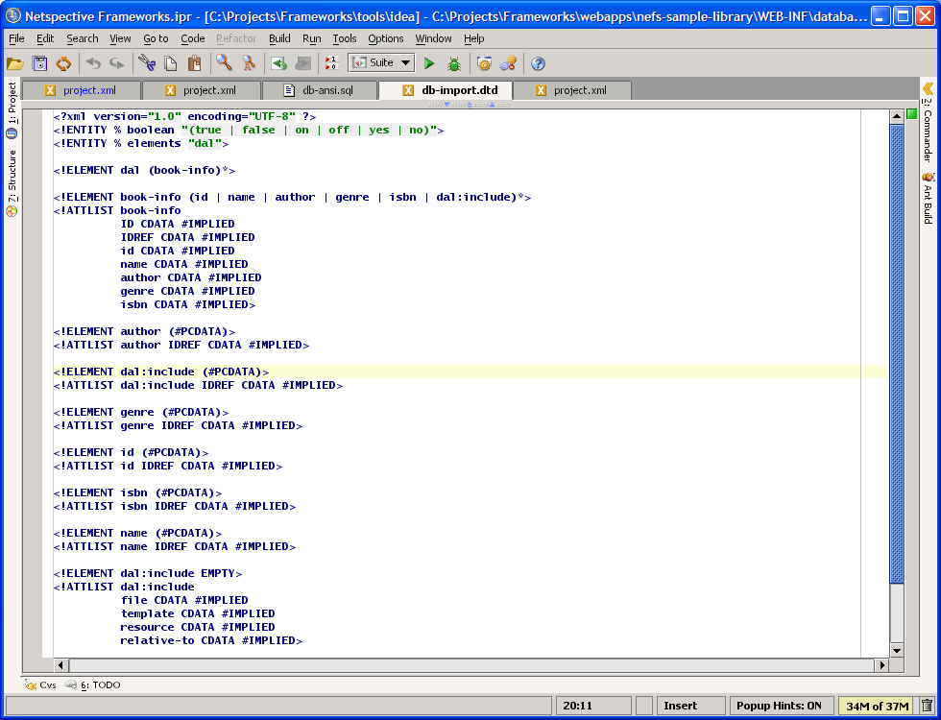
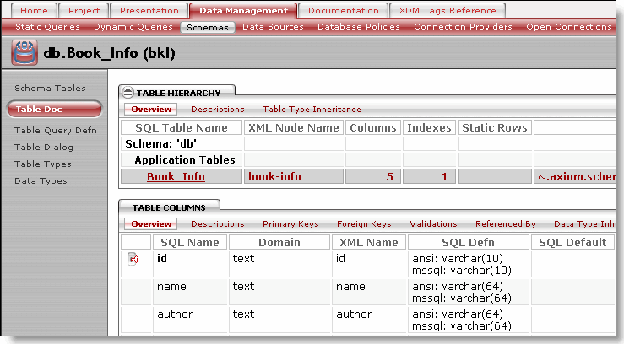
Database Schema Management
Tags like <schema>, <table>, <column>, and <accessor> are used to create a persistence mechanism by defining new database structures or mapping objects to existing relational databases.
Instead of spending weeks hand-coding the schema and O-R map, all SQL DDL and XML data import, DAO, and VO classes are automatically generated in minutes. And, it’s database-independent.

Slide 16
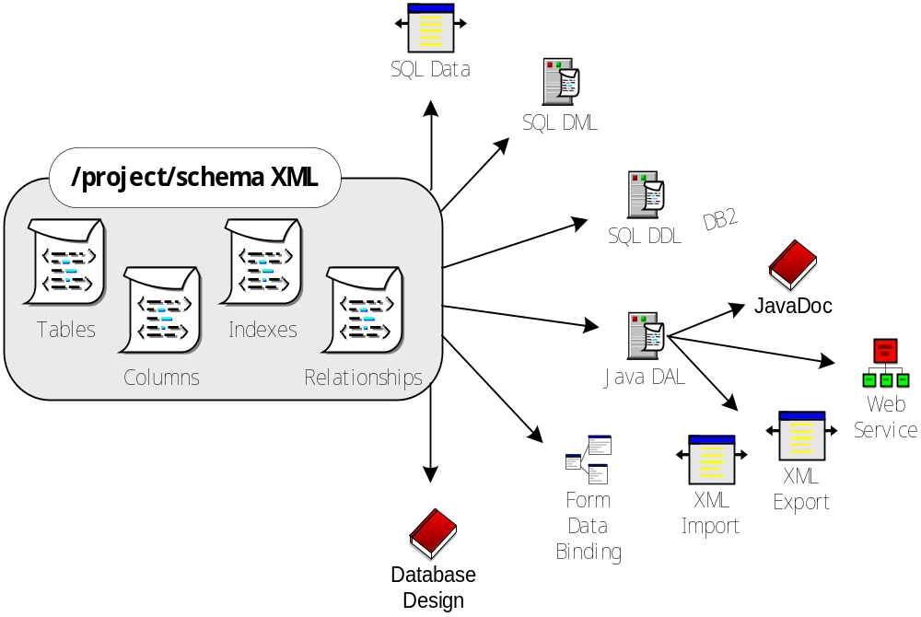
Database-independent Persistence

Slide 17
Leveraging Existing Investments
NEFS does not compete directly with most tools; therefore increasing ROI
Tool Category | Representative Tool Vendors | NEFS Fit | Sparx Scope
Application Framework | Avalon, Struts, Turbine, Barracuda, Expresso | Can Replace | ˜˜˜˜˜˜
O-R Mapping Framework | CocoBase | Can Replace | ˜˜˜˜˜˜
Security Framework | Netegrity | Can Replace | ˜˜˜˜˜˜
Database/ERD Design Tools | Embarcadero, ORACLE, Rational, TogetherSoft | Enhances | ˜˜˜˜˜
Analytics and Reporting Tools | Informatica, Crystal Reports, Actuate | Enhances | ˜˜˜
Template Language | Tag libraries, Cocoon, PHP, Velocity, ASP | Enhances | ˜˜˜
Portal and CMS Servers | JetSpeed, Brock, IBM, Microsoft SharePoint, BroadVision | Enhances | ˜˜˜
CASE Tools | Rational Rose, UML, TogetherJ, Elixir | Enhances | ˜˜
Unit Test Tools | JUnit, HttpUnit | Enhances | ˜˜
Functional and Load Test Tools | Mercury, Parasoft, Microsoft, Rational | Works with
IDE | JBuilder, NetBeans, Eclipse, Visual Studio, Visual Café | Works with
Transaction Server | MTS, DAO, TXSeries, Tuxedo | Works with
Debuggers, Profilers | Microsoft, IBM, Sun, Sitraka JProbe | Works with
Version-control Tools | ClearCase, CVS, Perforce | Works with
Database Server | IBM, ORACLE, Microsoft, mySQL (Free) | Includes
Application Server | Weblogic, Tomcat (Free), Websphere, Resin, JRun | Includes
XML, XSLT Tools | Xalan and Xerces (Free) | Includes
Build and Logging Tools | Ant and Log4J (Free) | Includes
Web Server | Apache or IIS (Free) | Includes

Slide 18
General Features
Complete three-tier application design support
Works with any IDE, editor, studio apps
Supports, but does not require, EJBs
Native J2EE API always available
Low learning curve, can utilize less experienced engineers
Works well with other frameworks
Source code available
Ability to version-control components and apps
Complete operating system and app-server independence
Thorough documentation
Many Sample applications
Future capability of migrating to .NET if required

Slide 19
Architecture Features
J2EE Design/Architecture Patterns
Application Integration Patterns
Application Functionality Patterns
Web-services
Externalization of Resources
Executable Specifications
Logging and Performance Stats
Business Rules Repository
Centralized Configuration Parameters
Allows production, testing, development modes
Code Generation

Slide 20
Presentation Layer Features
Forms and controls (advanced controls like e-mail, credit card, date/time with popup calendar, etc can automatically validate themselves)
Client-side validation
Server-side validation
No new template language (uses existing ones like FreeMarker, Velocity, and JSPs)
Automatic form reload on error
Dialog data state machine
Complete HTML generation
Data binding to presentation layer
Reports
Navigation and workflow (automatic creation of menus, submenus, etc)
Wireless, PDA, browser support
Multiple skins support (with no code changes)
Presentation object performance statistics

Slide 21
Data Management Layer Features
Schema management
Lightweight Data Access Objects (DAOs)
Object-relational mapping and persistence
Connection pooling
SQL DML generation
SQL DDL generation
Static SQL queries library
Dynamic SQL queries library
HTML design documentation
Dynamic data sources
SQL performance statistics
Transaction management and isolation

Slide 22

Conclusion – Why Use NEFS?
Improves developer productivity and reduces time to market by eliminating repetitive coding through an extensive library of pre-built and well-tested e-business functionality and database components.
Requires less-qualified engineers to complete a project by using XML to code in a declarative style instead of a programmatic style.
Reduces the number of engineers on a project by producing and automatically maintaining process artifacts like unit tests and documentation.
Increases reusability and consistency across projects by providing built-in metrics, an administration console, and performance statistics.

