Slide 1

Taking
J2EE & Web Services
Further Faster.

Slide 2

Challenges — Corporate
In every industry, companies are struggling to find new ways to capitalize on e-business opportunities.
They want to increase the value of their existing technical infrastructure in and data by extending functionality to their customers, vendors, and trading partners without disrupting their current plans and without replacing everything they’ve built over the years.

Slide 3
Challenges — IT Executives
Develop systems that meet business objectives and ROI goals faster and more effectively.
Develop a common, enterprise-wide architectural vision.
Lower total cost of ownership.
Maximize resource utilization.
Improve enterprise integration.
Formalize planning, implementation, and documentation processes.
Reduce technology debates to those that provide proven business value.
Increase reusability (stop discarding code and use existing systems/data yet still be able to extend the enterprise to new users and revenue sources).

Slide 4
Challenges — IT Staff
IT groups are overworked and understaffed and have few resources to redundant features.
The recent economic downturn and upcoming rebound will create significant staff turnover and increase the cost of maintaining existing systems that may be poorly documented and may be using diverse technologies and languages.
The availability of senior staff members with extensive architectural, design, and process experience using modern technologies is limited (and costly when available).
Many firms are forced to rely on less-experienced developers to perform architecture and design duties which implies more expensive implementation and maintenance phases due to improperly optimized designs.

Slide 5

Challenges —J2EE Development
Enabling technology- substantial application plumbing code has to be written.
  Administration Layer
  Presentation Layer
  Application Layer
  Data Layer
  Security Layer
Regeneration of code for all your applications.
No Unit Testing and Documentation Generation
Limited Senior Resources

Slide 6
Extending the Enterprise using Sparx
EXTENDING
J2EE and XML
IN THE ENTERPRISE.

Slide 7
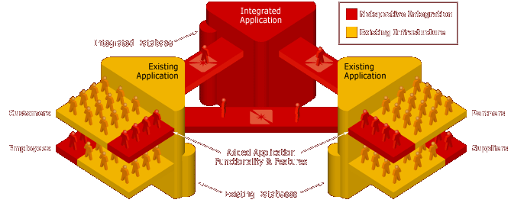
Extending the Enterprise
Sparx helps IT Executives meet business requirements that span multiple functional areas, requiring application integration.
Sparx helps IT staffs to extend their existing applications’ functionality to include an integrated set of users like customers, suppliers, and trading partners while continuing to serve their own company’s employees and staff.
The Sparx Application Platform serves your entire company’s needs.

Slide 8
Sparx Application Platform
The Sparx Application Platform simplifies the development of complex Java 2 Enterprise Edition (J2EE) applications by integrating dozens of J2EE APIs and making them accessible through XML. Sparx provides a common, reusable, multi-tier application functionality architecture and data models for data-intensive mission-critical requirements.
Sparx extends and complements but does not compete with existing application servers like BEA WebLogic and IBM WebSphere. Since app servers only provide general-purpose application infrastructure, Sparx is required to provide the feature-rich application functionality architecture and data models that would otherwise need to be developed by internal IT staff.
Sparx consists of hundreds of ready-to-deploy classes and is delivered as a pure Java library that can be included in any data-intensive web application or integration project at almost any stage of development.
Sparx contains ready-to-use and general-purpose e-business data models (data structures, database schemas, etc) as well as presentation objects.

Slide 9
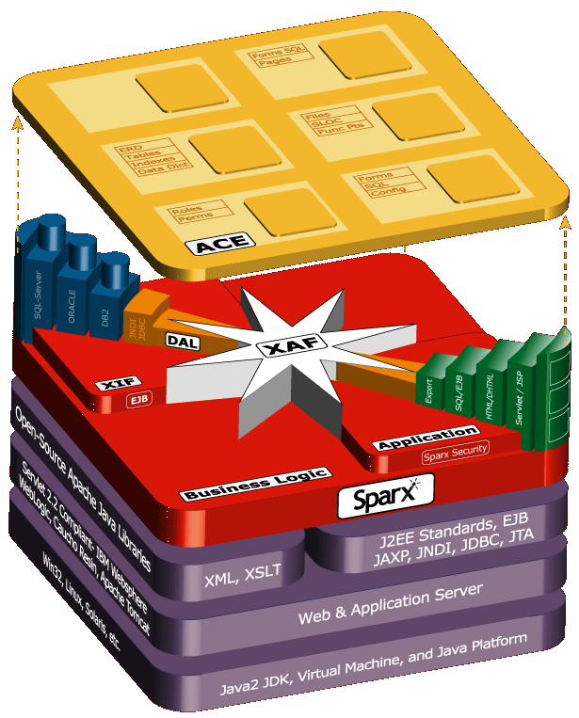
Sparx Multi-tier Overview
The Sparx Application Platform is a family of Java libraries that supports multi-tier applications; it relies on a JDK, Application Server (like Weblogic or Websphere); Web Standards like XML, XSLT, and SOAP; and J2EE standards like EJB, JAXP, JNDI, and JDBC. It builds on existing infrastructures and doesn’t throw anything away.
Sparx ACE (Application Components Explorer) assists with the development process: it manages programmer & end-user artifacts, metrics, logs, and unit-testing.
Sparx XAF (eXtensible Application Framework) assists with the Presentation and Business Tiers: the user interface, database access, security, report writing, business rules, and navigation.
Sparx XIF (eXtensible Information Framework) and DAL (Data Access Layer) assist with the Data Tier: they manage database schemas, tables, indexes, O-R maps, web services, and meta-data.

Slide 10
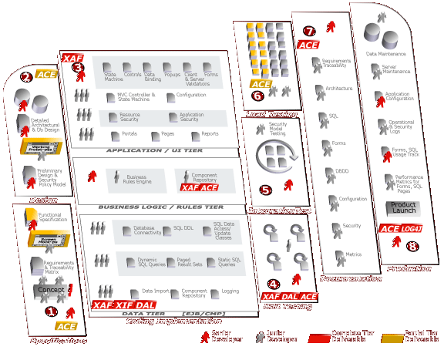
Sparx Development Process
The Sparx Platform includes libraries and applications that improve many aspects of the development process (some basic, some significantly).
Since it is a family of libraries, Sparx does not replace or compete with (but does augment) tools like:
WebLogic/Websphere or other App Servers (Sparx requires these tools)
Rational Rose and Suite
TogetherSoft
Borland JBuilder and other IDEs (Sparx does not require any specific IDE nor does it provide its own)
Version-control systems
ER and Database design tools
Sparx does not impose any specific development process like waterfall, XP, RUP, or any other process. The choice is yours.

Slide 11
Sparx Positioning
Sparx competes directly with very few tools but enhances many.
Tool Category | Representative Tool Vendors | Sparx Fit | Sparx Scope
Application Framework | Avalon, Struts, Turbine, Barracuda, Expresso | Can Replace | ˜˜˜˜˜˜
O-R Mapping Framework | CocoBase | Can Replace | ˜˜˜˜˜˜
Security Framework | Netegrity | Can Replace | ˜˜˜˜˜˜
Database/ERD Design Tools | Embarcadero, ORACLE, Rational, TogetherSoft | Enhances and Can Replace | ˜˜˜˜˜
Analytics and Reporting Tools | Informatica, Crystal Reports, Actuate | Enhances | ˜˜˜
Template Language | Tag libraries, Cocoon, PHP, Velocity, ASP | Enhances | ˜˜˜
Portal and CMS Servers | JetSpeed, Brock, IBM, Microsoft SharePoint, BroadVision | Enhances and Can Replace | ˜˜˜
Modeling and CASE Tools | Rational Rose, UML, TogetherJ, Elixir, System Arch. | Enhances | ˜˜
Unit Test Tools | JUnit, HttpUnit | Enhances | ˜˜
Functional and Load Test Tools | Mercury, Parasoft, Microsoft, Rational | Uses
IDE | JBuilder, NetBeans, Eclipse, Visual Studio, Visual Café | Uses
Transaction Server | MTS, DAO, TXSeries, Tuxedo | Uses
Debuggers, Profilers | Microsoft, IBM, Sun, Sitraka JProbe | Uses
Version-control Tools | ClearCase, CVS, Perforce | Uses
Database Server | IBM, ORACLE, Microsoft, mySQL (Free) | Requires
Application Server | Weblogic, Tomcat (Free), Websphere, Resin, JRun | Requires
XML, XSLT Tools | Xalan and Xerces (Free) | Requires
Build and Logging Tools | Ant and Log4J (Free) | Requires
Web Server | Apache or IIS (Free) | Requires

Slide 12
Sparx Development Benefits
Helps companies succeed with J2EE regardless of level of programmer experience (junior programmers can be as productive as senior ones and even non-Java programmers can be easily trained).
Helps less experienced developers become productive throughout the development lifecycle without requiring them to learn dozens of tools.
Helps with both the design and actual coding process by providing ready to run components, ready to integrate database schemas, and fully functional code modules.
Sparx is provided as standard Java libraries that can be integrated into any application at almost any stage of development.

Slide 13
Sparx Architecture Benefits
Implements most common design and architectural patterns.
  View Helper, Composite View, Intercepting Filter, Service to Worker, Dispatcher View, and Business Delegate.
  Value Object, Composite Entity, Value List Handler, Service Locator, Value Object Assembler, and Data Access Object
Provides a solid architecture for complex data-intensive applications where a high level of quality is critical.
Implementation documentation and process artifacts are automatically generated and maintained throughout the development lifecycle.
Unit tests and test harnesses are automatically generated and maintained throughout the development lifecycle.

Slide 14
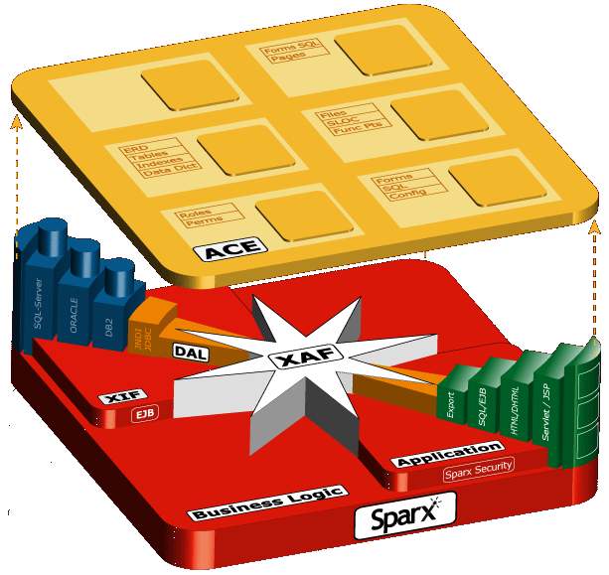
Sparx Components
ACE manages programmer and end-user artifacts, metrics, and unit testing
DBMS
Dynamic queries (SQL writer)
Data Tier
Static queries and SQL libraries
Complex forms and UI (HTML)
Interface to app server connection pooling
Controllers & State Machine
Presentation
Tier
XIF manages database schema, tables, indexes, O-R map, and meta-data
DAL is a multi-language (Java, C++, etc) data-access layer (O-R map) generator for isolating application and database code
Integrated application, business, and database security with complete authorization, roles, authentication support

Slide 15
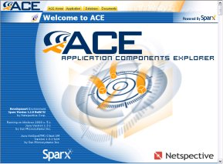
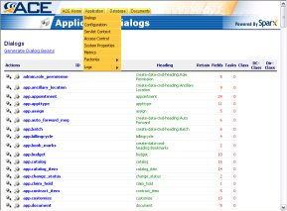
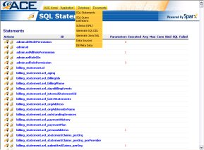
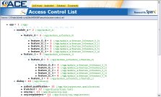
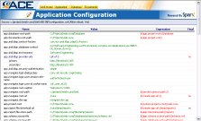
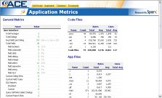
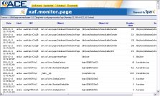
Sparx ACE Overview
ACE manages programmer and end-user artifacts, metrics, and unit testing
ACE is itself a Sparx application that helps to explore and document application components.
Creates automatic implementation documentation for all declarative components like forms, rules, SQL, and dynamic queries.
Allows interactive testing of forms, validation, SQL statements, database connectivity, and dynamic queries.
Serves as a centralized project documentation manager.

Slide 16
Sparx Presentation Tier Benefits
Application Programmers spend time on real features significant to end-users instead of infrastructure issues significant only to programmers.
Because a sophisticated presentation architecture is provided by Sparx, junior programmers create most of the presentation layer regardless of the sophistication required in the user interface.
Most of the user interface and database logic is coded in a declarative style using XML instead of programmatic style using Java. This significantly reduces the amount of code (as much as 50-75% of code can be eliminated).
Most of the presentation layer components created by any programmer are reusable across multiple Sparx applications.
Sparx Java classes are completely integrated with JavaScript to provide both server- and client-side objects on multiple browsers.
Sparx produces high-quality data-intensive thin-client applications that can be easily deployed in an ASP mode.

Slide 17
Sparx Business Tier Benefits
Application Programmers can create a business object repository using XML and Java that allows business rules to be encapsulated into reusable Java classes.
Once defined, the same business rules can be applied in the presentation and data tiers in both XML declarations and Java classes.
The Sparx business rules libraries can be integrated with existing business rules engines.
Since a sophisticated business rule architecture is provided by Sparx, even junior or mid-level programmers can create properly partitioned applications (presentation/business/data).
Most of the business layer components created by any programmer are reusable across multiple Sparx applications.

Slide 18
Sparx Data Tier Benefits
Expensive Database Administrators (DBAs) are no longer required for generation of SQL DDL, database documentation, or Object-relational mapping; with Sparx, DBAs can spend more time on information modeling, performance, and data management instead of repetitive work that can easily be done by junior programmers.
Database Programmers spend time on essential tables and schema elements significant to a specific application instead of rewriting common schema elements for each application.
Allows for re-use of Schemas across applications and produces and maintains Schema documentation. Starter e-business schemas are provided with Sparx.
Database-independent documentation and type-sensitive Data Access Layer is generated and automatically maintained throughout the development lifecycle.

Slide 19
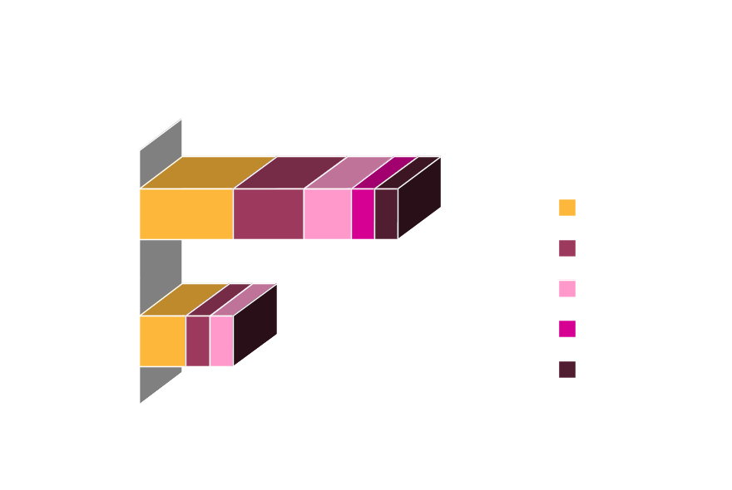
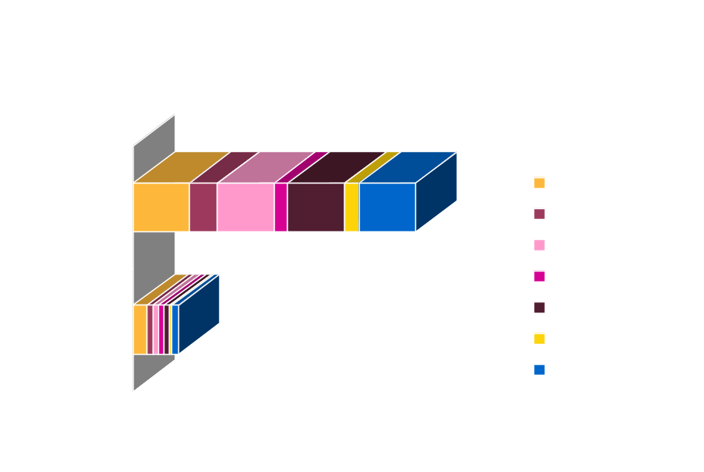
Sparx Benefits
Sparx reduces the time to complete any mission-critical thin-client application because fewer engineers are required to produce prototypes, code, unit tests, and documentation
Produce high-quality applications using fewer engineers (even less experienced ones).
Eliminate the requirement for dedicated development DBAs and technical documentation professionals.
Amount of pure lines of Java code can be reduced significantly.
Quality is much higher much earlier in the process.
Maintenance phase is less expensive.

Slide 20
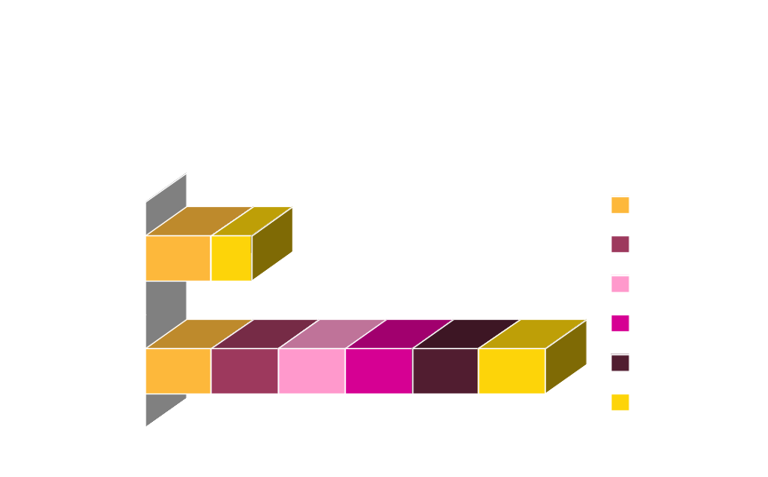
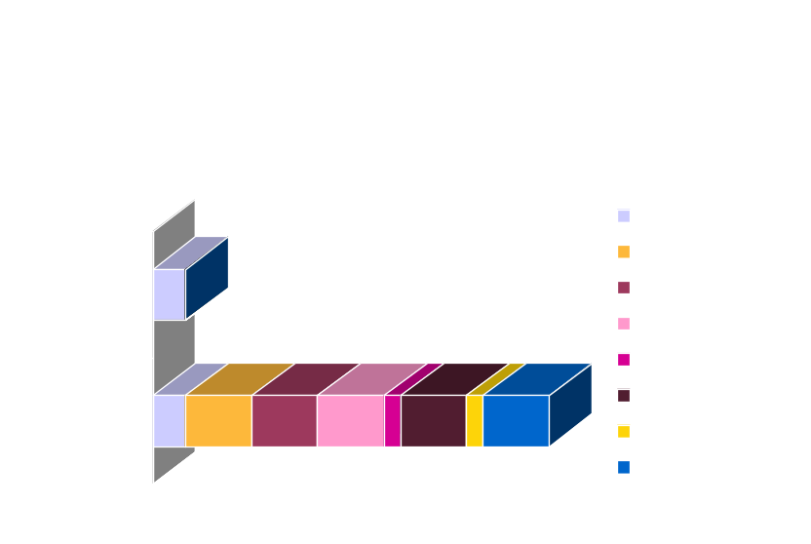
Sparx Benefits
Sparx reduces the overall cost for mission-critical thin-client applications by generating automatic unit tests, and documentation; therefore reducing implementation and maintenance costs.
Helps reduce time spent on documentation
Implementation time is reduced
Maintenance costs are reduced
Application stability is enhanced
Time to Market is reduced
Stability of the product is greatly increased

Slide 21
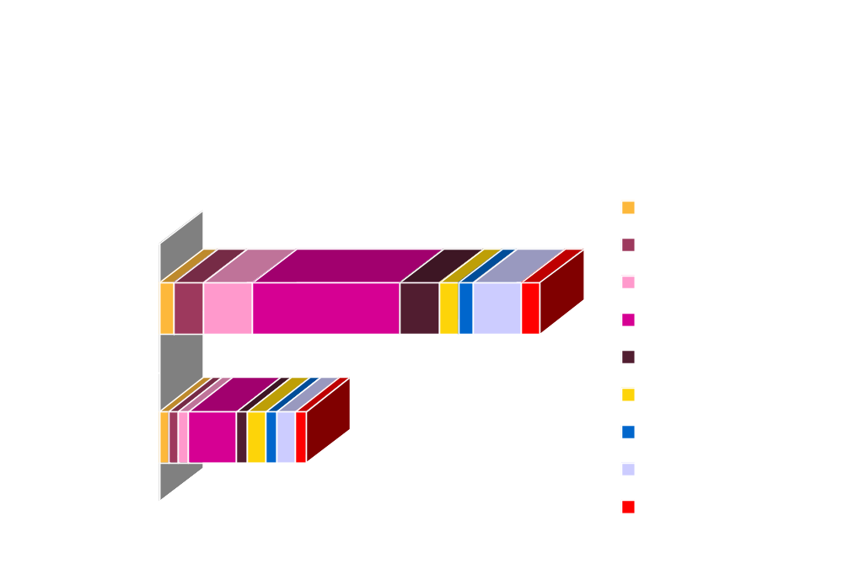
Sparx Benefits
Sparx reduces the total cost of Ownership for mission-critical thin-client applications by reducing the time required for all phases of the J2EE application lifecycle.

Slide 22
Summary of Key Benefits
IT Groups spend time on real issues/features significant to your business instead of infrastructure issues significant only to programmers.
Significantly reduces the amount of code (as much as 50-75% of code can be eliminated).
Significantly reduce application development time.
Improve time to market.
Minimize maintenance costs.
Applications are built on industry accepted best practices and standards.
Applications are ready for tomorrow's technologies like Web Services.
Lower total cost of ownership for your J2EE applications.
Minimize application integration costs.
Applications are automatically documented.

Slide 23
Value Proposition
Sparx makes J2EE app servers like WebLogic and WebSphere more accessible by allowing development organizations to rapidly deploy complex data-intensive, web-services-enabled, e-business applications using less experienced engineers than J2EE and app servers alone. TCO is reduced, time to market is shortened, quality is improved, and very little training is required to become highly productive.

Slide 24
Why Netspective?
We are a leader in the XML and J2EE Application Platform tools market.
  Our products and services, allow IT organizations to extend their existing technology infrastructure to additional customers, partners and vendors by creating new applications, integrating existing systems and databases, and improving the productivity of their development staff.
  Our platforms reduce time to market and improve the probability of successful project completion because our customers spend time extending our components and quasi-finished functionality to craft their solutions instead of building their own infrastructure; customers complete more projects faster, with higher quality using fewer technical resources because we significantly reduce the amount of work they need to do.
So, if you want to leverage your existing IT investment and get more out of what you’ve already built, we offer the tools and techniques to help you extend your enterprise further faster.

Slide 25
Customers
Internal IT Departments- TRW and The American Red Cross, Xerox, and Roche
System Integrators – COMSYS, Vantix, 5th Quadrant.
…are extending their enterprise today!

Slide 26
Extending the Enterprise Further Faster…

