Slide 1


Slide 2
Agenda
Introduction to Sparx
  Extending the Enterprise with Sparx
  Overview of Sparx
  How Sparx improves the development process
  How Sparx fits in with existing development tools
  How Sparx reduces development resource consumption
Sparx Application Component Explorer (ACE) Details
Sparx eXtensible Application Framework (XAF) Details
Sparx eXtensible Information Framework (XIF) Details

Slide 3
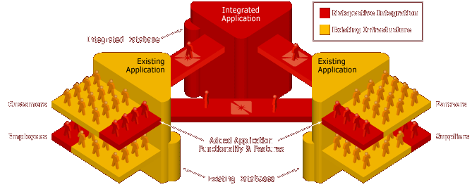
Extending the Enterprise
Most Enterprises have business requirements that span multiple functional areas, requiring application integration.
Almost all IT groups today are looking for ways to extend their existing applications’ functionality to include an integrated set of users like customers, suppliers, and trading partners while continuing to serve their own company’s employees and staff.
The Sparx Application Platform serves these needs.

Slide 4
Extending the Enterprise
Enterprise Application Integration (EAI)
  Web Services
  Web-enabling legacy and active systems
  Transforming data from one system into another
  Distributing application functionality
Application Development
  Business- and mission-critical data-intensive thin-client apps
  Retiring legacy applications but retaining legacy databases
  Replacing legacy applications and databases
  Enhancing application security and business continuity
Sample applications
e-Commerce
Customer relationship management (CRM)
Supply chain management (SCM)
Collaborative applications
Knowledge-management (KM)
Data-intensive portals (more than just read-only content)

Slide 5
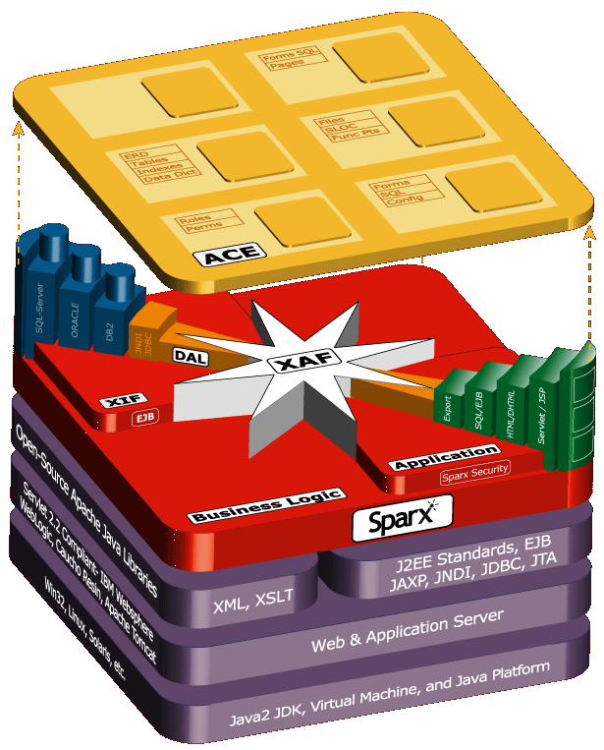
Sparx Multi-tier Overview
The Sparx Application Platform is a family of Java libraries that supports multi-tier applications; it relies on a JDK, Application Server (like Weblogic or Websphere); Web Standards like XML, XSLT, and SOAP; and J2EE standards like EJB, JAXP, JNDI, and JDBC. It builds on existing infrastructures and doesn’t throw anything away.
Sparx ACE (Application Components Explorer) assists with the development process: it manages programmer & end-user artifacts, metrics, logs, and unit-testing.
Sparx XAF (eXtensible Application Framework) assists with the Presentation and Business Tiers: the user interface, database access, security, report writing, business rules, and navigation.
Sparx XIF (eXtensible Information Framework) and DAL (Data Access Layer) assist with the Data Tier: they manage database schemas, tables, indexes, O-R maps, web services, and meta-data.

Slide 6
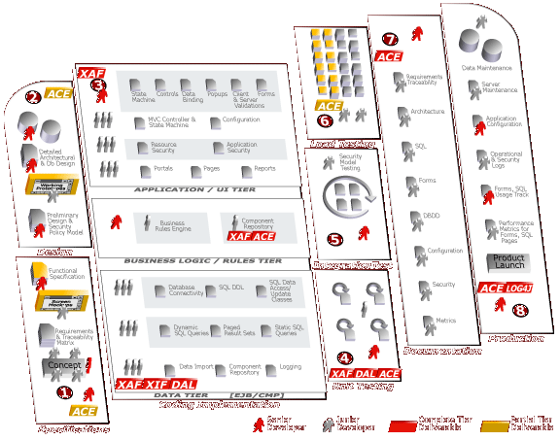

Sparx Development Process
The Sparx Platform includes libraries and applications that improve many aspects of the development process (some basic, some significantly).
Since it is a family of libraries, Sparx does not replace or compete with (but does augment) tools like:
WebLogic/Websphere or other App Servers (Sparx requires these tools)
Rational Rose and Suite
TogetherSoft
Borland JBuilder and other IDEs (Sparx does not require any specific IDE nor does it provide its own)
Version-control systems
ER and Database design tools
Sparx does not impose any specific development process like waterfall, XP, RUP, or any other process. The choice is yours.

Slide 7
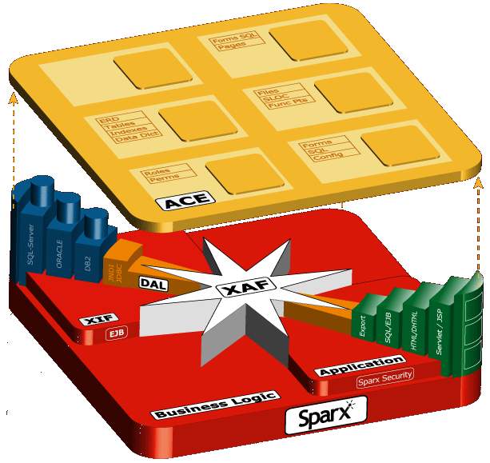
Sparx Components
ACE manages programmer and end-user artifacts, metrics, and unit testing
DBMS
Dynamic queries (SQL writer)
Data Tier
Static queries and SQL libraries
Complex forms and UI (HTML)
Interface to app server connection pooling
Controllers & State Machine
Presentation
Tier
XIF manages database schema, tables, indexes, O-R map, and meta-data
DAL is a multi-language (Java, C++, etc) data-access layer (O-R map) generator for isolating application and database code
Integrated application, business, and database security with complete authorization, roles, authentication support

Slide 8
Sparx Positioning
Sparx competes directly with very few tools but enhances many.
Tool Category | Representative Tool Vendors | Sparx Fit | Sparx Scope
Application Framework | Avalon, Struts, Turbine, Barracuda, Expresso | Can Replace | ˜˜˜˜˜˜
O-R Mapping Framework | CocoBase | Can Replace | ˜˜˜˜˜˜
Security Framework | Netegrity | Can Replace | ˜˜˜˜˜˜
Database/ERD Design Tools | Embarcadero, ORACLE, Rational, TogetherSoft | Enhances | ˜˜˜˜˜
Analytics and Reporting Tools | Informatica, Crystal Reports, Actuate | Enhances | ˜˜˜
Template Language | Tag libraries, Cocoon, PHP, Velocity, ASP | Enhances | ˜˜˜
Portal and CMS Servers | JetSpeed, Brock, IBM, Microsoft SharePoint, BroadVision | Enhances | ˜˜˜
CASE Tools | Rational Rose, UML, TogetherJ, Elixir | Enhances | ˜˜
Unit Test Tools | JUnit, HttpUnit | Enhances | ˜˜
Functional and Load Test Tools | Mercury, Parasoft, Microsoft, Rational | Uses
IDE | JBuilder, NetBeans, Eclipse, Visual Studio, Visual Café | Uses
Transaction Server | MTS, DAO, TXSeries, Tuxedo | Uses
Debuggers, Profilers | Microsoft, IBM, Sun, Sitraka JProbe | Uses
Version-control Tools | ClearCase, CVS, Perforce | Uses
Database Server | IBM, ORACLE, Microsoft, mySQL (Free) | Requires
Application Server | Weblogic, Tomcat (Free), Websphere, Resin, JRun | Requires
XML, XSLT Tools | Xalan and Xerces (Free) | Requires
Build and Logging Tools | Ant and Log4J (Free) | Requires
Web Server | Apache or IIS (Free) | Requires

Slide 9

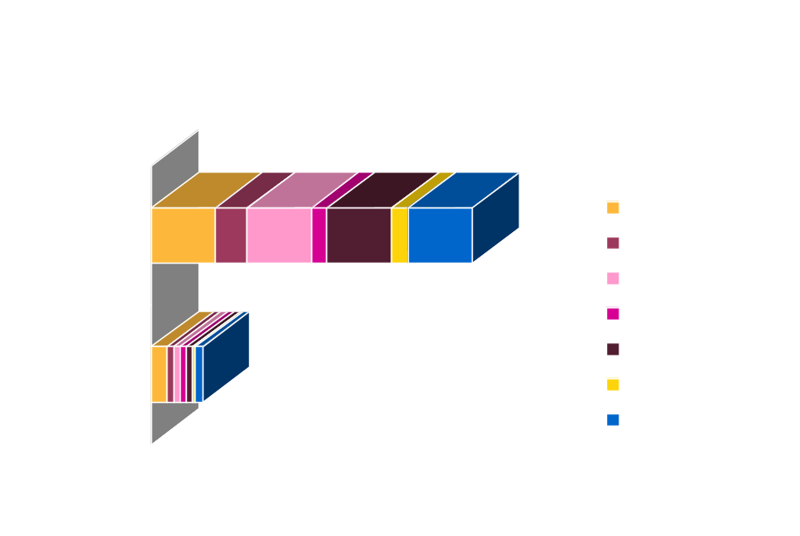
Sparx Benefits
Sparx reduces the time to complete any mission-critical thin-client application because fewer engineers are required to produce prototypes, code, unit tests, and documentation
Using Sparx, development teams can produce high-quality applications using fewer engineers (even less experienced ones) and eliminate the requirement for dedicated development DBAs and technical documentation professionals. Very little tech docs expertise is needed because much of the implementation documentation is automatically generated.
Using Sparx, the amount of pure lines of Java code that engineers produce manually can be reduced significantly. Because far fewer lines of code need to be written by hand, the quality is much higher much earlier in the process and the maintenance phase is less expensive.

Slide 10
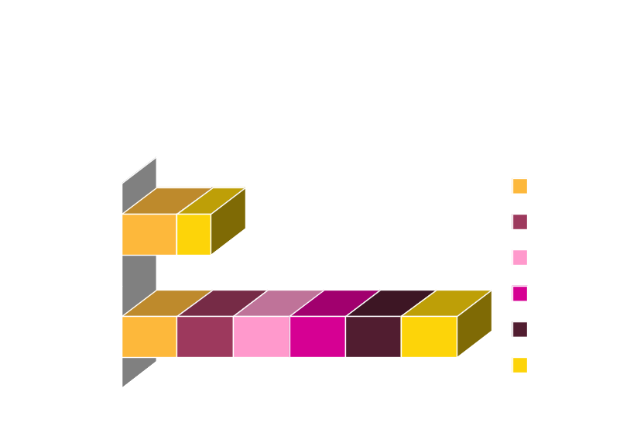
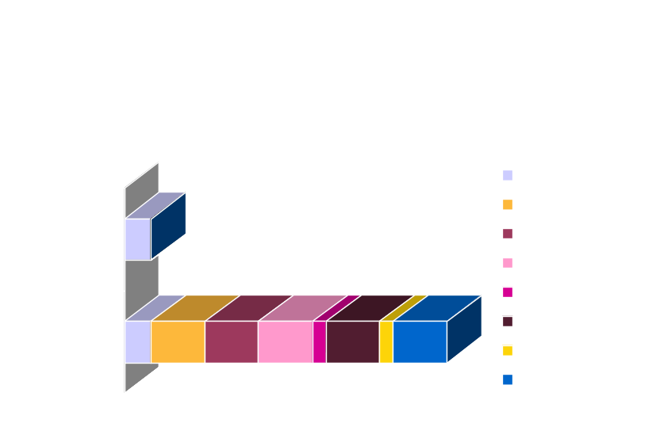
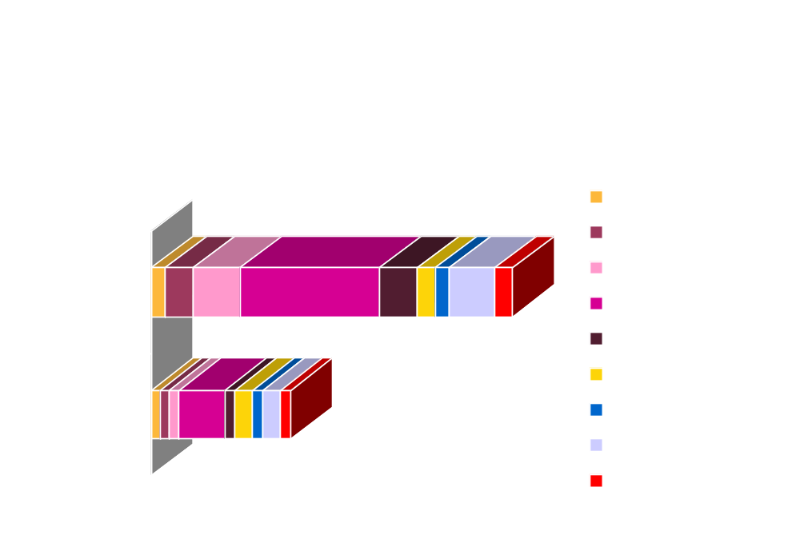
Sparx Benefits

Slide 11
Sparx Development Benefits
Helps companies succeed with J2EE regardless of level of programmer experience (junior programmers can be as productive as senior ones).
Helps less experienced developers become productive throughout the development lifecycle without requiring them to learn dozens of tools.
Helps with both the design and actual coding process by providing ready to run components, ready to integrate database schemas, and fully functional code modules.
Standard Java libraries can be integrated into any application at almost any stage of development.
Implements most common design and architectural patterns.
  View Helper, Composite View, Intercepting Filter, Service to Worker, Dispatcher View, and Business Delegate.
  Value Object, Composite Entity, Value List Handler, Service Locator, Value Object Assembler, and Data Access Object
Provides a solid architecture for complex data-intensive applications where a high level of quality is critical.
Implementation documentation and artifacts are automatically generated and maintained throughout the development lifecycle.
Unit tests and test harnesses are automatically generated and maintained throughout the development lifecycle.

Slide 12
Sparx Presentation Tier Benefits
Application Programmers spend time on real features significant to end-users instead of infrastructure issues significant only to programmers.
Most of the user interface and database logic is coded in a declarative style using XML instead of programmatic style using Java. This significantly reduces the amount of code (as much as 50-75% of code can be eliminated)
Applications are built by assembling declared UI (forms/dialogs) and database (SQL) components combined with application-specific business logic.
Sparx Java classes are completely integrated with JavaScript to provide both server- and client-side objects.
Sparx produces high-quality data-intensive thin-client applications that can be easily deployed in an ASP mode.

Slide 13

Sparx Business Tier Benefits
Application Programmers can create a business object repository using XML and Java that allows business rules to be encapsulated into reusable Java classes.
Once defined, the same business rules can be applied in the presentation and data tiers in both XML declarations and Java classes.
The Sparx business rules libraries can be integrated with existing business rules engines.

Slide 14
Sparx Data Tier Benefits
Database Programmers spend time on essential tables and schema elements significant to a specific application instead of rewriting common schema elements for each application.
Allows for re-use of Schemas across applications and produces and maintains Schema documentation.
Most schema objects like tables, columns, data types, etc. are managed in a database-independent XML SchemaDoc.
Database-independent documentation is generated and automatically maintained throughout the development lifecycle.
Database-specific SQL DDL is created by applying XSLT style sheets to a SchemaDoc.
Database-independent Java Object-relational classes are created by applying XSLT style sheets to a SchemaDoc. This is a called the Application DAL (Data Access Layer).

Slide 15
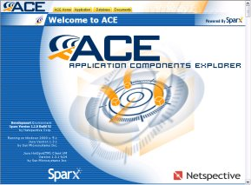
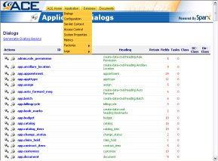
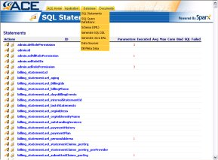
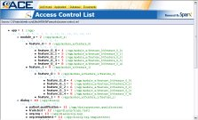
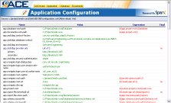
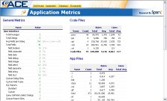
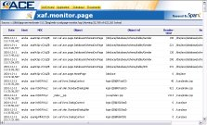
Sparx ACE Overview
ACE manages programmer and end-user artifacts, metrics, and unit testing
ACE is itself a Sparx application that helps to explore and document application components.
Creates automatic implementation documentation for all declarative components like forms, rules, SQL, and dynamic queries.
Allows interactive testing of forms, validation, SQL statements, database connectivity, and dynamic queries.
Serves as a centralized project documentation manager.

Slide 16
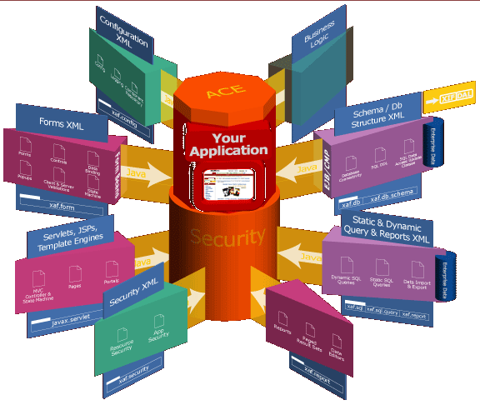
Sparx XAF Overview
XAF manages the user interface, database access, security, report writing, business rules, and navigation
Significant Features
Most declarations are externalized in XML
In the end, everything becomes Java
Value Sources for business rules
Centralized Configuration
Advanced Forms/Dialog Management
Log Management
MVC Page Control and automated navigation
HTML Management
Database Connectivity
Consistent user interfaces based on “skins”
SQL Statements Management, Pooling, and tracking
SQL Query Definitions for dynamic SQL
Integrated report writer
Fine-grained security and access control

Slide 17
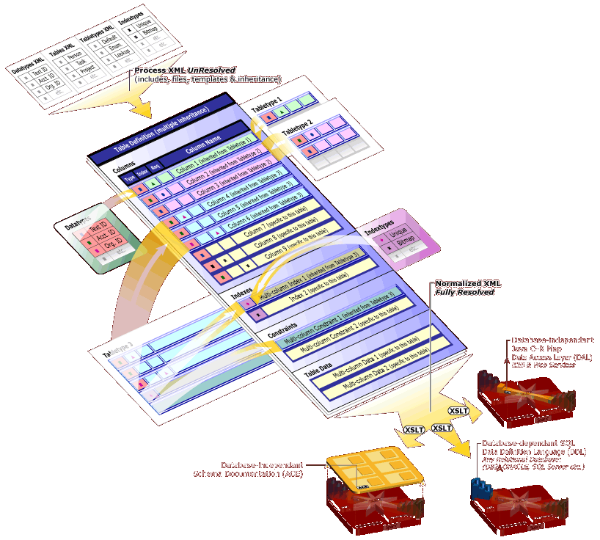
Sparx XIF Overview
XIF manages database schemas, tables, indexes, O-R map, and meta-data
Significant Features
XIF is comprised of Datatypes, Tabletypes, and Indextypes which form the basis of an XML-based data dictionary and Tables, Columns, Indexes, and Data which form the basis of the actual relational schema.
Tables are the actual data structures that will hold data in a relational database. Tables can inherit and extend content from tabletypes and contain columns.
XIF supports a variety of reference types (foreign key relationships).
XIF provides a powerful mechanism for storing and accessing static lookup data that reduces the overhead of making SQL calls and improves performance.
Using XSLT style sheets, the XIF can generate complete SQL DDL for almost any relational SQL database.

Slide 18
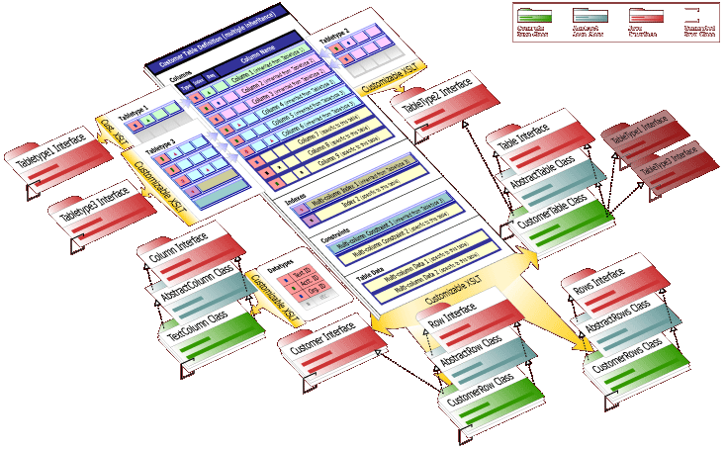
Sparx DAL Overview
DAL is a multi-language (Java, C++, etc) data-access layer (object-relational map) generator
Single-row insert, update, load, delete
Multi-row complex queries
Stored procedure calls
Bulk update and delete
One-to-one and one-to-many relationships

Slide 19
Netspective Sparx XAF
the eXtensible Application Framework (XAF) library

Slide 20
Key XAF Features
Supports low or no-html code preparation (move to XML-based declarative programming for most common needs)
Provides automated navigation (and automatically register new applications) for applications that don’t need advanced user interfaces or custom navigation
Automates forms/input management (using dialogs that can be pooled/reused, automatically validate complex data requirements, and are skinnable)
Automates reports/output preparation (using pooled SQL statements and skins)
Automates common query requirements by allowing moderately-complex SQL select statements to be generated automatically by end-users, executed in the database, and returned as paged XAF reports
Allows Schemas to be specified in XML and generate appropriate SQL DDL
Implements common design patterns like MVC and Factories

Slide 21
XAF Modules
Value Sources for dynamic access to variables from XML
Centralized configuration
Advanced forms/dialog management
Log management
MVC page control and automated navigation
HTML management
Database connectivity
Consistent user interfaces based on “skins”
SQL statements management, pooling, and tracking
SQL Query Definitions for dynamic SQL
Integrated report writer
Fine-grained security and access control

Slide 22
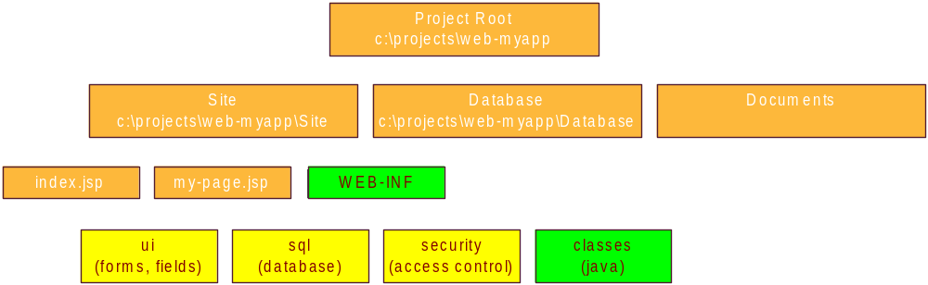
XML Sources
All declarative structures are created in XML files.
Sparx XML files have a root tag of <xaf>.
Every XML file is considered an XML Source and can contain <include> directives to include other, perhaps centralized XML files.

Slide 23
Value Sources
Value Sources are a simple and extensible way of maintaining business rules and logic and work throughout the presentation and data tiers.
A Value Source is the source of a single value, or a collection of values (a data object), for use in many places throughout Sparx. The format of a value source is similar to a URL (name:params).
  request:abc
  form:abc
  my-business-object:xyz/abc/def
A SingleValueSource is an object that returns a single value from a particular source (like a request parameter, text field, or session attribute).
A ListValueSource is an object that returns a list of values from a particular source (like a select field or SQL query).

Slide 24
Centralized Configuration
All Sparx applications use a single XML-based repository for all configuration items.
Sparx configuration files contain <property> and <properties> tags that can use dynamic value replacements to define properties that depend on the runtime values of other properties.
Unlike Java properties, Sparx configuration files allow programmers to define dynamic properties driven by value sources that change their values depending upon the execution environment (request-time parameters, session attributes, etc).

Slide 25
Advanced Data Entry (Dialogs)
Dialogs
Apply Skin
Specify Controls
Requirements
(XML tags)
String
Number
Date
Date Range
List
Checkbox
Radio Buttons
Multi-select list
Custom lookups
Query lookups
Generate Form HTML
Business Logic
Execution
(Servlets, JSPs,
XML tags)
Validate Form
Data Entry

Slide 26
Sample Dialog Code
<dialog name="listdrugs" heading="List Drugs By Name" loop="no">
<field.text name="trad" caption="Trade Name" required="yes" initial-focus="yes"/>
<execute-tasks>
<exec-statement>
select lblcode+'-'+ltrim(prodcode) as ndccode, tradename, strength, unit, dosage_form,
listing_seq_no, firm_name
from listings, firms
where tradename like ?+'%' and listings.firm_seq_no=firms.firm_seq_no
order by tradename,strength,unit
<params>
<param value="form:trad"/>
</params>
<report>
<column heading="NDC 2 Part" url="navigate/_Disp_drugs.jsp?seqno=${5}"/>
<column heading="Drug Name"/>
<column heading="Strength"/>
<column heading="Units"/>
<column heading="Type"/>
<column display="no"/>
<column heading="Manufacturer"/>
</report>
</exec-statement>
<exec-redirect url="config:something"/>
</execute-tasks>
</dialog>

Slide 27
Dialog Features
Dialogs specified as XML tags with zero HTML knowledge (including labels, validation, conditions, etc).
Data Persistence allows easy handling of stateless HTML pages by automatically filling in controls with appropriate values without programmer involvement.
Server-side data binding to HTML controls allows queries to be executed and automatically bound to controls such as list boxes.
Complicated client-side validation and processing is completely automated through a fully integrated JavaScript library.

Slide 28
More Dialog Features
Completely automatic advanced validation features.
Skins provide consistency look and feel and allows the same code to run on a variety of browsers and platforms (e.g. hand-helds).
Form Objects provide caching of dialog definitions for high performance.
Transaction integrity through unique per-request dialog identifiers.
Simple tasks can be created and executed without any Java coding (using pure XML tags) and complex ones can use complete Java and JDK functionality.

Slide 29
Navigation Styles
Page Controller – Servlet-based MVC style allows clean separation of presentation, data, and business logic.
Structured JSPs – Dialogs and SQL resides in XML, presentation and navigation resides in JSP files.
File System Navigator – Navigation is done by auto-scanning JSPs in a directory and auto-generating most navigation links.

Slide 30
Data Management
SQL Statement Pooling – create and store all static SQL statements (identified by a unique name) with bind parameters in an XML repository (away from Java code)
Data Aggregation – aggregate data from multiple data sources (even from different databases)
SQL DML Generation – automatically generate insert/update/delete statements
SQL Select Generation – allows end-users to automatically generate select statements from a set of programmer-defined rules and user interface

Slide 31
Sample Pooled SQL
<statement name="donorlisting">
SELECT To_Char(D.Donor_ID),
S.sponsor_id,
DM.Last_Name || ' ' || DM.Suffix || ', ' || DM.First_Name || ' ' || DM.MI as Name,
to_char(DM.birth_date, 'mm/dd/yyyy') as DOB,
DM.blood_type as bloodtype,
S.name as sponsor,
nvl(DM.Work_E_Mail, DM.Home_E_MAIL) as email,
DM.work_phone as workphone,
L.Name as orggroup,
DM.status as status
FROM donors D,sponsors S,donor_demographics DM,locations L
WHERE D.Donor_ID = DM.Donor_ID
and D.Location_ID = L.Location_ID(+)
and D.Sponsor_ID = S.sponsor_id
and D.icc =?
order by Name
<params>
<param values="session:icc"/>
</params>
<report heading="Donors">
<column index="0" display="no"/>
<column index="1" display="no"/>
<column url="/igl/navigate/Manage_Donors/__edit_donor.jsp?donor_id=${0}&amp;sponsor_id=${1}" />
</report>
</statement>

Slide 32
Data Aggregation
SQL from
DataSource
A
HTML from
WebSite
C
SQL from
DataSource
B
XML from
Vendor
D
DataSources
Descriptors (XML)
HTML or
XML

Slide 33
Query Definitions
Programmer specifies the fields (SQL columns and table) and sort conditions [like SQL “views”] that comprise a “virtual table”.
User selects fields from auto-generated dialogs.
Sparx automatically generates and executes SQL on the fly complete with paged results.
Much simpler and far less code than using J2EE EJBs and CMP for common database classes.

Slide 34
Sample Query Definition
<query-defn id="Donor Search">
<field id="donor_id" caption="Donor ID" join="donors" column="donor_id" >
<report display="no"/>
</field>
<field id="donor_lname" caption="Last Name" join="donordemo" column="last_name" where- expr="upper(donordemo.last_name)"/>
<field id="donor_fname" caption="First Name" join="donordemo" column="first_name" where- expr="upper(donordemo.first_name)">
<report type="default" urledit.jsp?donor_id=${0}&amp;sponsor_id=${11}" align="left" heading="First Name"/>
</field>
<field id="donor_date_of_birth" caption="Date of Birth" join="donordemo" column="birth_date"
where-expr="to_char(birth_date, 'MM/DD/YYYY')" column-expr="TO_CHAR(birth_date,'MM/DD/YYYY')" />
<join id="donors" table="donors" auto-include="yes"/>
<join id="donordemo" table="donor_demographics" condition="donors.donor_id = donordemo.donor_id "/>
<join id="sponsors" table="sponsors" condition="donors.sponsor_id = sponsors.sponsor_id "/>
<join id="locations" table="locations" condition="donors.location_id = locations.location_id(+) "/>
<select id="basic" caption="Basic Donor Information" distinct="yes">
<display field="donor_id"/>
<display field="donor_fname"/>
</select>
</query-defn>

Slide 35
Report Writing
XML-based report definitions that are tied to actual SQL statements.
Multiple source reports.
Skins for multiple output styles and destinations (user can select paged, single-page, CSV, etc).
Developers worry mainly about specifying what data to output instead of how to output the data.

Slide 36
Security
Built-in fine-grained security through the use of hierarchical access control lists (ACLs).
Personalization features allow specific components to be shown based on user names, locations, etc.

Slide 37
Netspective Sparx
XIF and DAL
the eXtensible Information Framework (XIF) and Data Access Layer (DAL) libraries

Slide 38
Key Concepts
The entire schema is managed in XML as an XML document (a SchemaDoc) and SQL is generated through XSLT style sheets (the templates). The same SchemaDoc can be used to generate database-specific SQL DDL.
XIF encourages the creation and re-use of a set of datatypes and tabletypes that define standard behaviors for columns and tables. Datatypes and tabletypes comprise the SchemaDoc database dictionary and can easily be inherited and extended.
Experienced DBAs are not required to create consistent, high-quality SQL DDL during the design and construction phases of an application.
XIF can automatically generate a Java Object-relational DAL (Data Access Layer) for an entire schema, automating the majority of SQL calls by providing strongly-typed Java wrappers for all tables and columns.

Slide 39
SchemaDoc Overview
Significant Features
XIF is comprised of Datatypes, Tabletypes, and Indextypes which form the basis of an XML-based data dictionary and Tables, Columns, Indexes, and Data which form the basis of the actual relational schema.
Tables are the actual data structures that will hold data in a relational database. Tables can inherit and extend content from tabletypes and contain columns.
XIF supports a variety of reference types (foreign key relationships).
XIF provides a powerful mechanism for storing and accessing static lookup data that reduces the overhead of making SQL calls and improves performance.
Using XSLT style sheets, the XIF can generate complete SQL DDL for almost any relational SQL database.

Slide 40
Datatypes
Datatypes easily generate and maintains a database-independent data dictionary.
Datatypes should be considered “column templates” that allow a programmer to specify a column type and are created using the <datatype> tag.
Datatypes are completely schema dependent but may be reused across applications. This means that the basic templating system (SchemaDoc to XSLT generator) does not have any “built-in” datatypes.
Datatypes may be inherited from other datatypes, allowing better reuse and object-orientation in relational databases.
Datatypes provide their SQL DDL using the <sqldefn> tag (multiple <sqldefn> tags may be used to provide DDL specifications for a variety of databases).
Datatypes provide Java object-relational mapping (DAL) using the
  <java-type> (for primitives) and
  <java-class> (for normal classes) elements. The <java-type> element is optional, but the <java-class> element is required if a Java DAL will be generated for a schema.
Datatypes are usually simple types like “text”, “integer”, or “float”.
More complex types like “duration” can be created by using the <composite> tag allowing a single datatype to automatically generate multiple columns in tables.

Slide 41
Tabletypes
Tabletypes should be considered “table templates” that allow a programmer to specify a table type.
Tabletypes are completely schema dependent but may be reused across applications. This means that the basic templating system (SchemaDoc to XSLT generator) does not have any “built-in” tabltypes.
Tabletypes may be inherited from other tabletypes, allowing better reuse and object-orientation in relational databases.
Create tabletypes using the <tabletype> tag.
In a Java OR map, each <tabletype> tag becomes a very simple Java interface that can be implemented by Table classes so that the Java OR map matches the SchemaDoc.

Slide 42
Sample Datatypes and Tabletype
<datatype name="text">
<java-class package="java.lang">String</java-class>
<sqldefn dbms="ansi">varchar(%size%)</sqldefn>
<size>32</size>
</datatype>
<datatype name="integer">
<java-type default="0">int</java-type>
<java-class package="java.lang">Integer</java-class>
<sqldefn dbms="ansi">integer</sqldefn>
<sqldefn dbms="oracle">number(8)</sqldefn>
</datatype>
<datatype name="duration">
<composite>
<column name="$name$_begin_date" type="date"/>
<column name="$name$_end_date" type="date"/>
</composite>
</datatype>
<tabletype name="Default">
<column name="cr_stamp" type="stamp" required="dbms" default="sysdate"/>
<column name="cr_person_id" lookupref="Person.person_id”/>
<column name="cr_org_id" lookupref="Org.org_id"/>
</tabletype>

Slide 43
Naming Conventions
The DDL and Java DAL system assumes certain table and column naming conventions:
  Because the SchemaDoc is pure XML, all of the column and table names are case sensitive
  Each table is named as a singular, not plural, noun with title case. For instance, you have a Person table not People table. Each tables’ name’s words are separated by an underscore and capitalized. For example, use Person_Login not personLogin.
  Each column is named as a singular noun in all lower case with each word inside a name separated by underscores. For instance, person_id is a good column name but personid is harder to read
Most of the schema will work no matter what you call your tables and columns; however, the online documentation, DDL, and Java generators assume the Title_Case format for tables and lower_case format when generating DDL objects and class names.

Slide 44
Table Columns
The <column> element in the <table> elements creates actual columns derived from a particular <datatype>.
The <column> elements will automatically maintain all type definitions and links to foreign keys automatically. If you are referencing another column, the type attribute should not be specified.
The columns are arguably the most important definitions in the entire SchemaDoc. They take abstract representations of datatypes and instantiate actual columns in tables.

Slide 45
Table <column> Attributes
Attribute | Description | Example
name (required) | Name of the column. If the column definition is within a composite datatype definition (a composite datatype is defined as two or more columns), the name will contain the special variable $name$, which will be replaced with the name of the column that use | name="invoice_id"
type (optional) | This datatype of the column. Must be a previously defined <datatype>. | type="text"
usetype (optional) | Note: If used, the type attribute is unnecessary. | usetype="SampleTable.SampleField"
size (required by some data types) | The size attribute of the specified data type. What the size means depends on the data type. For example, in text fields, it specifies the number of characters used. | size="32"
lookupref (optional) | Will be parsed one of two ways, either as <Table name> or as <Table name>.<Field name>. If just the table name is given, then the table's primary key will be used as the field. If used, the type attribute is unnecessary. | lookupref="Invoice_Type"
parentref (optional) | The primary key of the parent table. This creates a foreign-key constraint. The string is parsed as follow: <Table name>.<Name of primary key field>. | parentref="Person.person_id"
selfref (optional) | The value from one of the other columns in the table. In most cases this will pointing to the primary key. This creates a self-referencing foreign-key constraint. | selfref="org.org_id"
descr (optional) | Description | descr="Marital status"
required (optional) | Possible values: "yes", "no" or "dbms". | required="yes"
default (optional) | The value that is used if the user doesn't specify a value. | default="5"
unique (optional) | If column requires a unique value for each row, set to "yes." This creates a unique constraint. | unique="yes"

Slide 46
Foreign Key References
There are three types of references in a SchemaDoc that generate identical DDL but are treated differently by the DBDD (online documentation) and Java OR generators
  <column lookupref=“X.Y”> -- this creates a general foreign key relationship from the defining column which references the foreign column Y of table X (creates a 1:1 or 1:N relationship between defining column and the referenced column)
  <column parentref=“X.Y”> -- this creates a parent/child foreign key relationship which indicates that table X is a parent of the defining column using column Y’s value (creates a 1:N relationship between X and the defining column)
  <column selfpref=“X.Y”> -- this creates a self-referential foreign key relationship which indicates that table X column Y is used to maintain an internal hierarchy (creates a 1:N relationship between itself)
When using the SchemaDoc to create any reference type (lookup, parent, or self) the type definition from the referenced column is automatically maintained.
Another type of reference is the usetype reference which merely says to that one column is the same type as another column (datatype, size, etc) meaning that it contains similar data but should not really be a foreign-key reference.
  <column usetype=“X.Y”> -- this looks up the type definition of column Y in Table X and copies the type definition to defining column (this is a weak reference since no foreign key reference is implied)

Slide 47
Tables
Each <table> can be based on one or more table types so that it can autoinclude columns.
A table type is a set of one or more column definitions. So when you create a table based on a table type, that table will include all the columns of the table type as well as its own.
Using table types, you can quickly and consistently create similar tables that are automatically updated whenever the tabletypes change.
The following attributes are allowed for the <table> element:
  Name – the name of the table
  Abbrev – should be kept to 3 or 4 characters to allow constraint names and indexe names to be created properly
  Type – the tabletype of the table
  Parent – the parent table if a parent-child relationship is desired.

Slide 48
Sample SchemaDoc Table
<table name="Person" abbrev="Per" type="Default">
<description>Any person (client, staff member, etc.)</description>
<column name="person_id" primarykey="yes" type="autoinc"/>
<column name="name_prefix" type="text" size="16"/>
<column name="name_first" type="text" required="yes" size="32"/>
<column name="name_middle" type="text" size="32"/>
<column name="name_last" type="text" required="yes" size="32"/>
<column name="name_suffix" type="text" size="16"/>
<column name="short_name" type="text" required="dbms" size="42"/>
<column name="simple_name" type="text" required="dbms" size="96"/>
<column name="complete_name" type="text" required="dbms" size="128"/>
<column name="short_sortable_name" type="text" required="dbms" size="42"/>
<column name="complete_sortable_name" type="text" required="dbms" size="128"/>
<column name="ssn" indexed="yes" type="text" size="11"/>
<column name="gender" lookupref="Gender" default="0"/>
<column name="marital_status" lookupref="Marital_Status" default="0"/>
<column name="date_of_birth" type="date"/>
<column name="age" type="integer"/>
</table>

Slide 49
Generating SQL DDL
Using ACE, a database-independent SchemaDoc XML file becomes a database-dependent SQL DDL file.
Regenerating SQL DDL is the preferred method to modifying DDL during the design and construction phases (pre-production).
In post-production usage, the entire SQL is regenerated for changed tables and relationships but a experienced DBA should be involved for the alteration of live schemas.

Slide 50
Sample Generated DDL
create table Person (
cr_stamp date DEFAULT sysdate,
cr_person_id number(16),
cr_org_id number(16),
person_id number(16),
name_prefix varchar2(16),
name_first varchar2(32),
name_middle varchar2(32),
name_last varchar2(32),
short_name varchar2(42),
simple_name varchar2(96),
complete_name varchar2(128),
short_sortable_name varchar2(42),
complete_sortable_name varchar2(128),
ssn varchar2(11),
gender number(8) DEFAULT 0,
marital_status number(8) DEFAULT 0,
date_of_birth date,
age number(8));
create index Per_ssn on Person(ssn);
alter table Person modify (person_id constraint Per_person_id_REQ NOT NULL);
alter table Person modify (name_first constraint Per_name_first_REQ NOT NULL);
alter table Person modify (name_last constraint Per_name_last_REQ NOT NULL);
alter table Person add (constraint Person_PK PRIMARY KEY (person_id));
alter table Person add (constraint Per_cr_person_id_FK FOREIGN KEY (cr_person_id) REFERENCES Person(person_id));
alter table Person add (constraint Per_cr_org_id_FK FOREIGN KEY (cr_org_id) REFERENCES Org(org_id));
alter table Person add (constraint Per_gender_FK FOREIGN KEY (gender) REFERENCES Gender(id));

Slide 51
Enumerations
Sparx allows for generalizing all static lookup tables into what are called Enumeration tables.
  All Enumeration tables share a common structure
  All Enumeration tables have their data and structure closely bound in the SchemaDoc
  All Enumeration tables have their data present in the XML which means that the data is available to the application at runtime simply by reading the SchemaDoc. This allows the runtime application to read static values without making any database calls.
  Using the DAL, all Enumeration tables can generate real Enumerated Java classes with final and static modifiers to allow access to the enumerations without having access to the SchemaDoc (for instance, in EJBs).

Slide 52
Enumerations (XML)
<tabletype name="Enumeration" parent="Reference_Item">
<param name="capsize">64</param>
<param name="abbrevsize">32</param>
<column name="id" type="integer" primarykey="yes"/>
<column name="caption" type="text" size="$capsize$" required="yes"/>
<column name="abbrev" type="text" size="$abbrevsize$" unique="yes"/>
</tabletype>
<table name=“My_Lookup_Table" abbrev=“MyLkTb" type="Enumeration">
<enum>Item 1</enum>
<enum>Item 2</enum>
<enum id=“100”>Item 3</enum>
</table>

Slide 53
Enumerations (DDL)
create table My_Lookup_Table
(
id number(8),
caption varchar2(64),
abbrev varchar2(32)
);
create unique index MyLkTb_abbrev_unq on My_Lookup_Table(abbrev);
alter table My_Lookup_Table modify (id constraint MyLkTb_id_REQ NOT NULL);
alter table My_Lookup_Table modify (caption constraint MyLkTb_caption_REQ NOT NULL);
alter table My_Lookup_Table add (constraint My_Lookup_Table_PK PRIMARY KEY (id));
insert into My_Lookup_Table(id, caption) values (0, 'Item 1');
insert into My_Lookup_Table(id, caption) values (1, 'Item 2');
insert into My_Lookup_Table(id, caption) values (100, 'Item 3');

Slide 54
Generating the DAL
Allows strongly-typed Java classes to be generated for each datatype, tabletype, and table in the schema.
The entire schema becomes fully documented through the generation of JavaDoc documentation (the DAL generators generate JavaDoc comments automatically for all classes, members, and methods).
Each datatype becomes a Column Java Class (which an actual table’s column becomes an instance of).
Each tabletype becomes a Table Type Java interface that each appropriate Table class implements.
Each table generates specific classes. Assuming a table called Person,
  A Person Interface is created
  A PersonRow class that implements the PersonDomain is created
  A PersonRows class that can hold a list of PersonRow objects is created
  A PersonTable class that contains the column definitions (names, validation rules, foreign key constraints, etc) and SQL generation methods is created.
Each enumeration table generates an Enumeration class with Java constants for each enumerated value.

Slide 55
Java Mappings

Slide 56
Column Classes
Each datatype becomes a Java class that extends the com.xaf.db.schema.AbstractColumn class and implements the com.xaf.db.schema.Column interface. For example, the “text” datatype becomes a schema.column.TextColumn class; the “integer” datatype becomes the schema.column.IntegerColumn class; etc.
When a column is actually defined, it becomes an instance of a Column class. For example, when a text column called “first_name” is defined as part of a table, it is defined as “schema.column.TextColumn firstName;”
Each datatype’s Column class instance has information like
  Whether or not the column is a primary key
    Natural
    Sequenced
  Whether the column is required or not
  Java class used to represent the column
  The default column value (as an SQL expression or Java value)
  The SQL Definition used to generate the column’s DDL
  If the column is a sequenced value, the name of the sequence
  Foreign key information
  Whether or not the column’s value is unique

Slide 57
Domain, Row, and Rows Classes
Each table generates three different Java files which represent the data stored in the table. Assuming a Person table,
  The domain.Person interface specifies the get and set methods that will allow access to the data stored in a single row. The reason this is an interface is so that it can easily be extended by classes that may need to store data in something other than a database.
  The domain.row.PersonRow class is a concrete class that represents an actual row in the Person table. All of the columns become member variables and have
    Get/set methods for all column data
    For each child table, access to child rows that are represented by the <column parent=“X.Y”> specification. For example, if a Person_Address table exists and is a child of the Person table, then the PersonRow class will have a corresponding getPersonAddressRows() method that will retrieve all the addresses for a given PersonRow based on the primary key
  The domain.row.PersonRows class represents a list of PersonRow objects and allows
    Adding to the list
    Getting a specific row by number

Slide 58
Table Classes
Each table generates its own Table class. For example, assuming a Person table in the database, a table.PersonTable class is generated that allows the following:
  Methods like createPersonRow() and createPersonRows() to create row objects
  Methods like insert(conn, personRow), update(conn, personRow), and delete(conn, personRow) to perform SQL DML tasks (with transaction protection if needed)
  Method like getPersonByPersonId() that retrieves a row by primary key
  If the table is a child table, it allows its parent to retrieve all child tables based on the foreign-key reference.
  If the table is an enumeration table, the DAL generates Java constants for each enumerated value.

Slide 59
Conclusion

