Slide 1


Slide 2
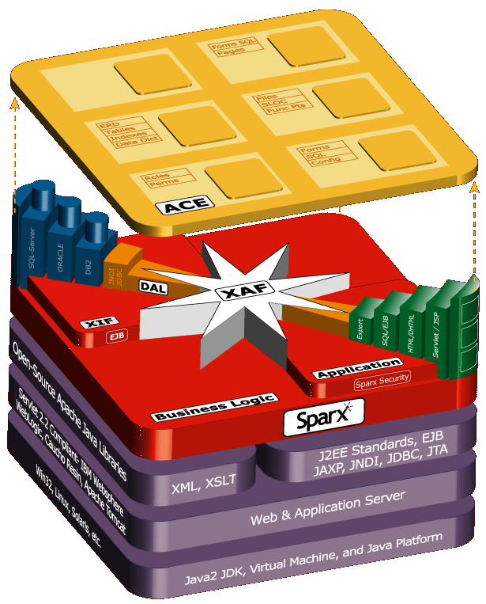
Sparx Multi-tier Overview
The Sparx Application Platform is a family of Java libraries that supports multi-tier applications; it relies on a JDK, Application Server (like Weblogic or Websphere); Web Standards like XML, XSLT, and SOAP; and J2EE standards like EJB, JAXP, JNDI, and JDBC. It builds on existing infrastructures and doesn’t throw anything away.
Sparx ACE (Application Components Explorer) assists with the development process: it generates programmer & end-user artifacts, metrics, logs, and unit-testing.
Sparx XAF (eXtensible Application Framework) assists with the Presentation and Business Tiers: the user interface, database access, security, report writing, business rules, and navigation.
Sparx XIF (eXtensible Information Framework) and DAL (Data Access Layer) assist with the Data Tier: they manage database schema, tables, indexes, O-R maps, and meta-data.

Slide 3
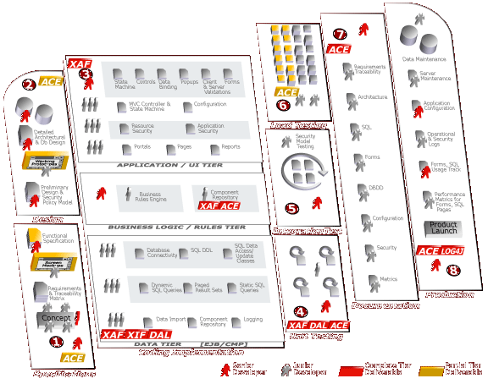

Sparx Positioning
The Sparx Platform includes libraries and applications that improve many aspects of the development process (some basic, some significantly).
Since it is a family of libraries, Sparx does not replace or compete with (but does augment) tools like:
WebLogic/Websphere or other App Servers (Sparx requires these tools)
Rational Rose and Suite
TogetherSoft
Borland JBuilder and other IDEs (Sparx does not require any specific IDE nor does it provide its own)
Version-control systems
ER and Database design tools
Sparx does not impose any specific development process like waterfall, XP, RUP, or any other process. The choice is yours.

Slide 4
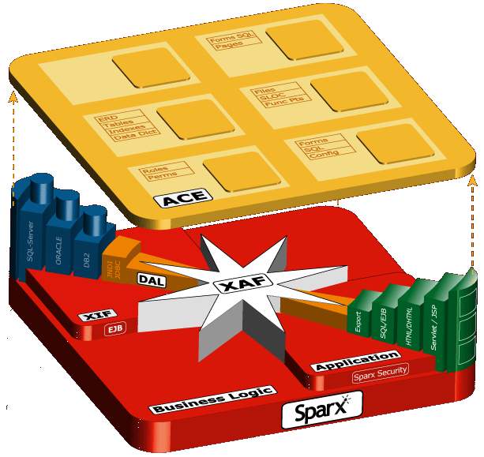
Sparx Components
ACE manages programmer and end-user artifacts, metrics, and unit testing
DBMS
Dynamic queries (SQL writer)
Data Tier
Static queries and SQL libraries
Complex forms and UI (HTML)
Interface to app server connection pooling
Controllers & State Machine
Presentation
Tier
XIF manages database schema, tables, indexes, O-R map, and meta-data
DAL is a multi-language (Java, C++, etc) data-access layer (O-R map) generator for isolating application and database code
Integrated application, business, and database security

Slide 5
Sparx Development Benefits
Helps companies succeed with J2EE regardless of level of programmer experience (junior programmers can be as productive as senior ones)
Standard Java libraries can be integrated into any application at almost any stage of development.
Implements most common design and architectural patterns.
  View Helper, Composite View, Intercepting Filter, Service to Worker, Dispatcher View, and Business Delegate.
  Value Object, Composite Entity, Value List Handler, Service Locator, Value Object Assembler, and Data Access Object
Provides a solid architecture for complex data-intensive applications.

Slide 6
Sparx Presentation Tier Benefits
Application Programmers spend time on real features significant to end-users instead of infrastructure issues significant only to programmers.
Most of the user interface and database logic is coded in a declarative style using XML instead of programmatic style using Java. This significantly reduces the amount of code (as much as 50-75% of code can be eliminated)
Applications are built by assembling declared UI (forms/dialogs) and database (SQL) components combined with application-specific business logic.
Sparx is not a templating system that simply generates HTML but a feature-rich framework that significantly reduces the time to produce high-quality data-intensive thin-client applications.
Sparx Java classes are completely integrated with JavaScript to provide both server- and client-side objects.

Slide 7

Sparx Business Tier Benefits
Application Programmers can create a business object repository using XML and Java that allows business rules to be encapsulated into reusable Java classes.
Once defined, the same business rules can be applied in the presentation and data tiers in both XML declarations and Java classes.
The Sparx business rules libraries can be integrated with existing business rules engines.

Slide 8
Sparx Data Tier Benefits
Database Programmers spend time on essential tables and schema elements significant to a specific application instead of rewriting common schema elements for each application.
Allows for re-use of Schemas across applications and produces and maintains Schema documentation.
Most schema objects like tables, columns, data types, etc. are managed in a database-independent XML SchemaDoc.
Database-specific SQL DDL is created by applying XSLT style sheets to a SchemaDoc.
Database-independent Java Object-relational classes are created by applying XSLT style sheets to a SchemaDoc. This is a called the Application DAL (Data Access Layer).

Slide 9
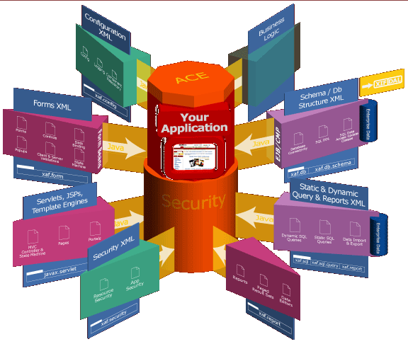
Sparx XAF Overview
Significant Features
Most declarations are externalized in XML
In the end, everything becomes Java
Value Sources for business rules
Centralized Configuration
Advanced Forms/Dialog Management
Log Management
MVC Page Control and automated navigation
HTML Management
Database Connectivity
Consistent user interfaces based on “skins”
SQL Statements Management, Pooling, and tracking
SQL Query Definitions for dynamic SQL
Integrated report writer
Fine-grained security and access control

Slide 10
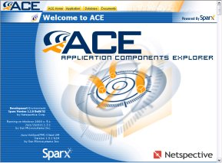
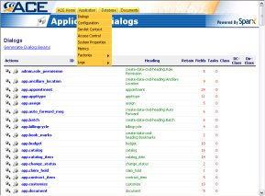
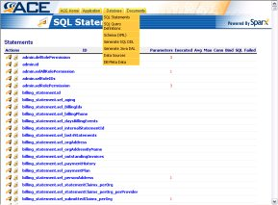
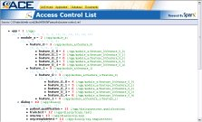
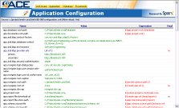
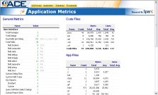
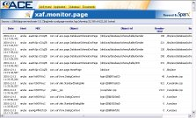
Sparx ACE Overview
ACE is itself a Sparx application that helps to explore and document application components.
Creates automatic implementation documentation for all declarative components like forms, rules, SQL, and dynamic queries.
Allows interactive testing of forms, validation, SQL statements, database connectivity, and dynamic queries.
Serves as a centralized project documentation manager.

Slide 11
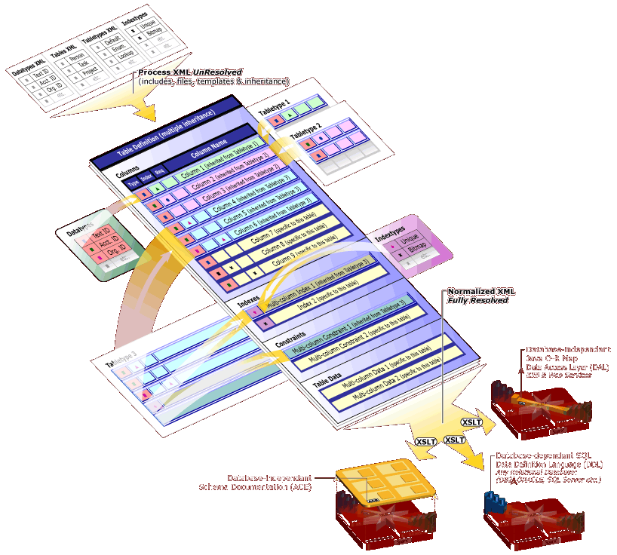
Sparx XIF Overview
Significant Features
XIF is comprised of Datatypes, Tabletypes, and Indextypes which form the basis of an XML-based data dictionary and Tables, Columns, Indexes, and Data which form the basis of the actual relational schema.
Tables are the actual data structures that will hold data in a relational database. Tables can inherit and extend content from tabletypes and contain columns.
XIF supports a variety of reference types (foreign key relationships).
XIF provides a powerful mechanism for storing and accessing static lookup data that reduces the overhead of making SQL calls and improves performance.
Using XSLT stylesheets, the XIF can generate complete SQL DDL for almost any relational SQL database.

Slide 12
Key XAF Features
Supports low or no-html code preparation (move to XML-based declarative programming for most common needs)
Provides automated navigation (and automatically register new applications) for applications that don’t need advanced user interfaces or custom navigation
Automates forms/input management (using dialogs that can be pooled/reused, automatically validate complex data requirements, and are skinnable)
Automates reports/output preparation (using pooled SQL statements and skins)
Automates common query requirements by allowing moderately-complex SQL select statements to be generated automatically by end-users, executed in the database, and returned as paged XAF reports
Allows Schemas to be specified in XML and generate appropriate SQL DDL
Implements common design patterns like MVC and Factories

Slide 13
Prerequisites
Basic knowledge of web-based applications and how they differ from traditional apps
Basic knowledge of Java2, JVMs, the Servlet API, and Java Server Pages (JSPs)
Java2 JDK (1.3.x)
Application Server (Tomcat, Resin, etc) supporting Servlet 2.2 and JDBC 2.0 APIs
Jakarta Ant 1.3
Jakarta Log4J 1.1
Jakarta ORO 2.0
Apache Xerces 1.4
Apache Xalan 2.1

Slide 14
XAF Modules
Value Sources for dynamic access to variables from XML
Centralized Configuration
Advanced Forms/Dialog Management
Log Management
MVC Page Control and automated navigation
HTML Management
Database Connectivity
Consistent user interfaces based on “skins”
SQL Statements Management, Pooling, and tracking
SQL Query Definitions for dynamic SQL
Integrated report writer
Fine-grained security and access control

Slide 15
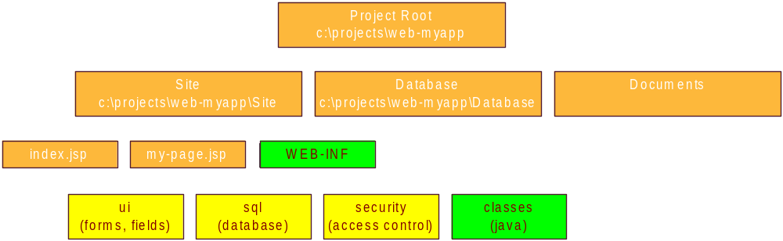
XML Sources
All declarative structures are created in XML files.
Sparx XML files have a root tag of <xaf>.
Every XML file is considered an XML Source and can contain <include> directives to include other, perhaps centralized XML files.

Slide 16
Value Sources
Value Sources are a simple and extensible way of maintaining business rules and logic and work throughout the presentation and data tiers.
A Value Source is the source of a single value, or a collection of values (a data object), for use in many places throughout Sparx. The format of a value source is similar to a URL (name:params).
  request:abc
  form:abc
  my-business-object:xyz/abc/def
A SingleValueSource is an object that returns a single value from a particular source (like a request parameter, text field, or session attribute).
A ListValueSource is an object that returns a list of values from a particular source (like a select field or SQL query).

Slide 17
Centralized Configuration
All Sparx applications use a single XML-based repository for all configuration items.
Sparx configuration files contain <property> and <properties> tags that can use dynamic value replacements to define properties that depend on the runtime values of other properties.
Unlike Java properties, Sparx configuration files allow programmers to define dynamic properties driven by value sources that change their values depending upon the execution environment (request-time parameters, session attributes, etc).

Slide 18
Advanced Data Entry (Dialogs)
XAF
Forms
Apply Skin
Specify Controls
Requirements
(XML tags)
String
Number
Date
Date Range
List
Checkbox
Radio Buttons
Multi-select list
Custom lookups
Query lookups
Generate Form HTML
Business Logic
Execution
(Servlets, JSPs,
XML tags)
Validate Form
Data Entry

Slide 19
Sample Dialog Code
<dialog name="listdrugs" heading="List Drugs By Name" loop="no">
<field.text name="trad" caption="Trade Name" required="yes" initial-focus="yes"/>
<execute-tasks>
<exec-statement>
select lblcode+'-'+ltrim(prodcode) as ndccode, tradename, strength, unit, dosage_form,
listing_seq_no, firm_name
from listings, firms
where tradename like ?+'%' and listings.firm_seq_no=firms.firm_seq_no
order by tradename,strength,unit
<params>
<param value="form:trad"/>
</params>
<report>
<column heading="NDC 2 Part" url="navigate/_Disp_drugs.jsp?seqno=${5}"/>
<column heading="Drug Name"/>
<column heading="Strength"/>
<column heading="Units"/>
<column heading="Type"/>
<column display="no"/>
<column heading="Manufacturer"/>
</report>
</exec-statement>
<exec-redirect url="config:something"/>
</execute-tasks>
</dialog>

Slide 20
Dialog Features
Dialogs specified as XML tags with zero HTML knowledge (including labels, validation, conditions, etc).
Data Persistence allows easy handling of stateless HTML pages by automatically filling in controls with appropriate values without programmer involvement.
Server-side data binding to HTML controls allows queries to be executed and automatically bound to controls such as list boxes.

Slide 21
More Dialog Features
Completely automatic advanced validation features.
Skins provide consistency look and feel and allows the same code to run on a variety of browsers and platforms (e.g. hand-helds).
Form Objects provide caching of dialog definitions for high performance.
Transaction integrity through unique per-request dialog identifiers.
Can execute tasks without any Java coding.

Slide 22
Navigation Styles
Page Controller – Serlvet-based MVC style (all code in XML and Java, little or no Java code). Allows clean separation of presentation, data, and business logic.
Structured JSPs – Dialogs and SQL resides in XML, presentation and navigation resides in JSP files.
File System Navigator – Navigation is done by auto-scanning JSPs in a directory and auto-generating most navigation links.

Slide 23
Data Management
SQL Statement Pooling – create and store all static SQL statements (identified by a unique name) with bind parameters in a single repository
Data Aggregation – aggregate data from multiple sources
SQL DML Generation – automatically generate insert/update/delete statements
SQL Select Generation – allows end-users to automatically generate select statements from a set of programmer-defined rules and user interface

Slide 24
Sample Pooled SQL
<statement name="donorlisting">
SELECT To_Char(D.Donor_ID),
S.sponsor_id,
DM.Last_Name || ' ' || DM.Suffix || ', ' || DM.First_Name || ' ' || DM.MI as Name,
to_char(DM.birth_date, 'mm/dd/yyyy') as DOB,
DM.blood_type as bloodtype,
S.name as sponsor,
nvl(DM.Work_E_Mail, DM.Home_E_MAIL) as email,
DM.work_phone as workphone,
L.Name as orggroup,
DM.status as status
FROM donors D,sponsors S,donor_demographics DM,locations L
WHERE D.Donor_ID = DM.Donor_ID
and D.Location_ID = L.Location_ID(+)
and D.Sponsor_ID = S.sponsor_id
and D.icc =?
order by Name
<params>
<param values="session:icc"/>
</params>
<report heading="Donors">
<column index="0" display="no"/>
<column index="1" display="no"/>
<column url="/igl/navigate/Manage_Donors/__edit_donor.jsp?donor_id=${0}&amp;sponsor_id=${1}" />
</report>
</statement>

Slide 25
Data Aggregation
SQL from
DataSource
A
HTML from
WebSite
C
SQL from
DataSource
B
XML from
Vendor
D
DataSources
Descriptors (XML)
HTML or
XML

Slide 26
Query Definitions (Automated SQL Generator)
Programmer specifies the fields (SQL columns and table) and sort conditions [like SQL “views”] that comprise a “virtual table”.
User selects fields from auto-generated dialogs.
Sparx automatically generates and executes SQL on the fly complete with paged results.
Much simpler and far less code than using J2EE EJBs and CMP for common database classes.

Slide 27
Sample Query Definition
<query-defn id="Donor Search">
<field id="donor_id" caption="Donor ID" join="donors" column="donor_id" >
<report display="no"/>
</field>
<field id="donor_lname" caption="Last Name" join="donordemo" column="last_name" where- expr="upper(donordemo.last_name)"/>
<field id="donor_fname" caption="First Name" join="donordemo" column="first_name" where- expr="upper(donordemo.first_name)">
<report type="default" urledit.jsp?donor_id=${0}&amp;sponsor_id=${11}" align="left" heading="First Name"/>
</field>
<field id="donor_date_of_birth" caption="Date of Birth" join="donordemo" column="birth_date"
where-expr="to_char(birth_date, 'MM/DD/YYYY')" column-expr="TO_CHAR(birth_date,'MM/DD/YYYY')" />
<join id="donors" table="donors" auto-include="yes"/>
<join id="donordemo" table="donor_demographics" condition="donors.donor_id = donordemo.donor_id "/>
<join id="sponsors" table="sponsors" condition="donors.sponsor_id = sponsors.sponsor_id "/>
<join id="locations" table="locations" condition="donors.location_id = locations.location_id(+) "/>
<select id="basic" caption="Basic Donor Information" distinct="yes">
<display field="donor_id"/>
<display field="donor_fname"/>
</select>
</query-defn>

Slide 28
Schema Objects
XML-based schema creation and database-independent repository
Object-based relational tables
DDL generation
Schema and meta data available within applications and closely tied to ui

Slide 29
Report Writing
XML-based report definitions that are tied to actual SQL statements.
Multiple source reports.
Skins for multiple output styles and destinations (user can select paged, single-page, CSV, etc).
Developers worry mainly about specifying what data to output instead of how to output the data.

Slide 30
Security
Built-in fine-grained security through the use of hierarchical access control lists (ACLs).
Personalization features allow specific components to be shown based on user names, locations, etc.

Slide 31
Conclusion

