Slide 1
Massively Parallel Graphs
Lauro Beltrão Costa
Abdullah Gharaibeh
Elizeu Santos-Neto

Slide 2
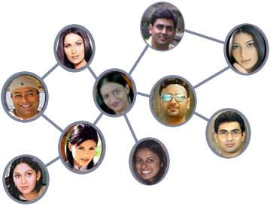
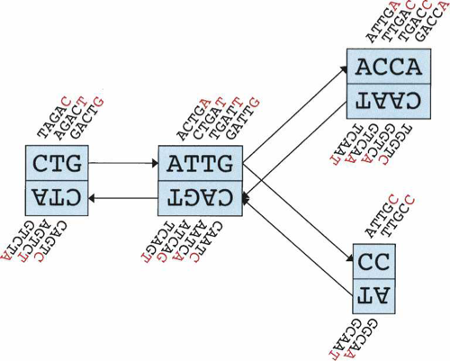
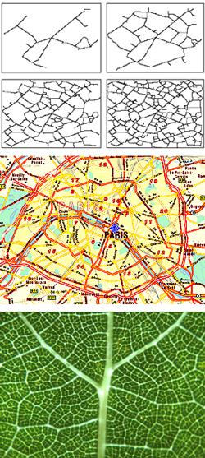

Graphs, Graphs, Graphs Everywhere
Notes:
Discussing applications that process large-scale graphs
Single out DNA sequence assembly and make the connection with the next slide

Slide 3
Graphs
  Data-parallel
  Memory intensive
  Benefit many applications
GPU
Massively parallel
High memory bandwidth
Opportunity
  Data Intensive
  Amorphous parallelism
Limited memory
Strict computational model
Challenges
Notes:
Opportunity:
The application is data intensive and has parallel access patterns
GPU is massively parallel
Challenges:
The GPU’s strict computational model
Graph applications exhibit amorphous parallelism

Slide 4
Goals
Gain insights on processing graphs on GPUs
Design a framework for graph processing on GPUs
Implement and evaluate use-case applications
  community detection
  evolution of centrality
Notes:
REview

Slide 5
Related Work
Parallel graph algorithms
Graph algorithms on GPUs
Graph processing frameworks

Slide 6
Methodology
Review bibliography
Port simple and well known graph algorithms
Define framework building blocks:
  Processing model
  Abstractions
  Communication substrate

Slide 7
Progress to date
Bibliography review
Development infrastructure
Implementation
  Breadth-First Search (BFS)
  Single Source Shortest Path
  PageRank
Preliminary Evaluation

Slide 8
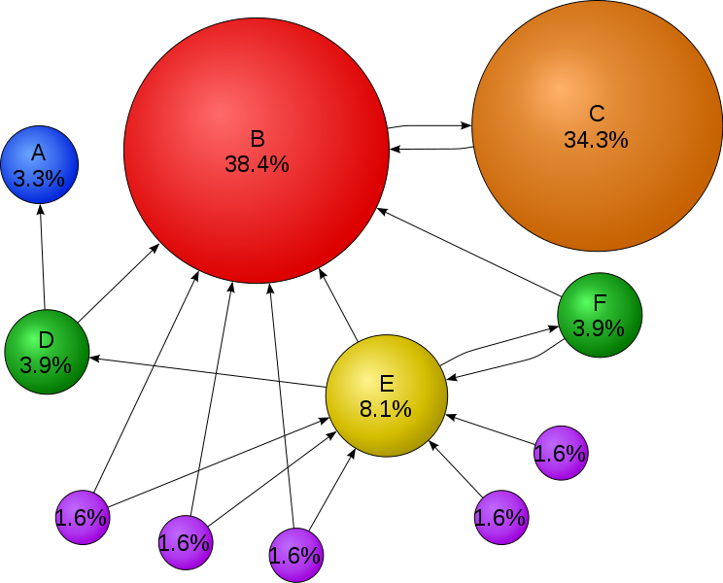
PageRank
Notes:
One more slides before.

Slide 9
Evaluation
Testbed
  CPU: Dual-socket Xeon Quad-core @ 2.27GHz
  GPU: GeForce GTX 480 – 480 cores @ 1.4Ghz and 1536 MB memory
Metric
  Speed up of GPU and multi-threaded CPU over sequential CPU

Slide 10
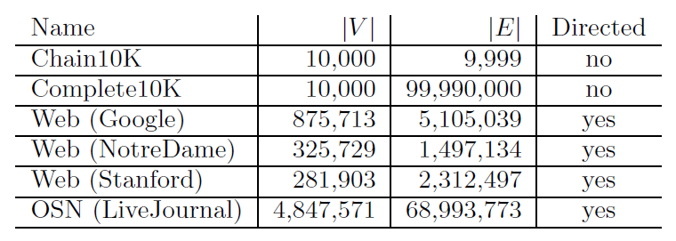
Workload

Slide 11
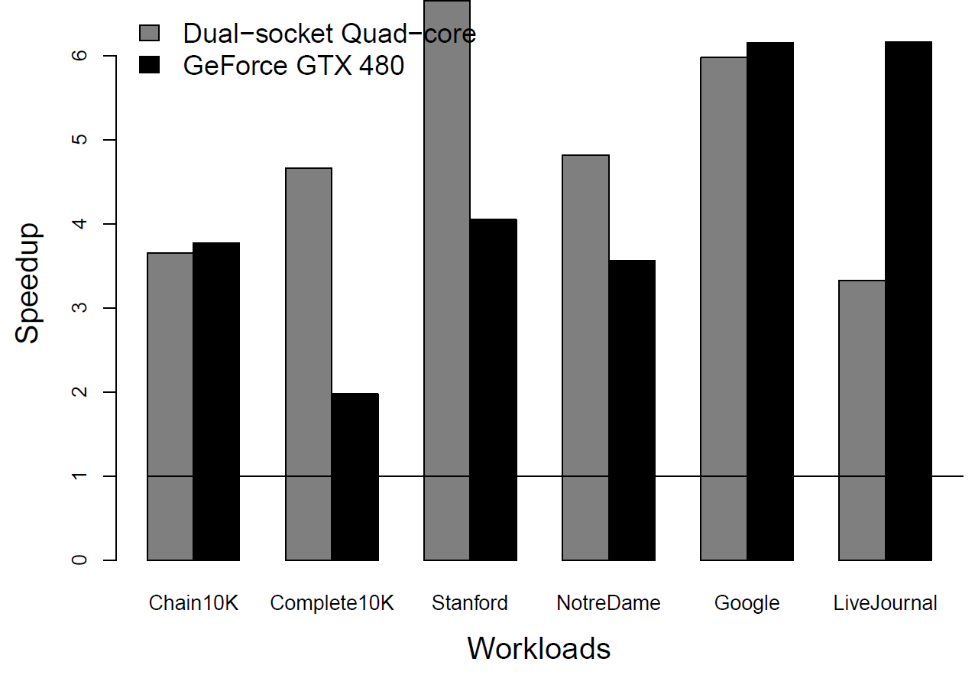
Page Rank

Slide 12
Lessons
Potential speed up for large-scale real-world graphs
Impact of graph structure
Common kernels, graph construction, memory allocation and data transfers
Vertex-centric programming, need for message passing abstraction

Slide 13
What now?
Analyze the impact of graph structure
Identify common building blocks
Study applications
Define the programming model and scope
Scale up to multi-GPU

Slide 15
Breadth-First Search (BFS)
Given a graph, traverses the graph in levels
Each GPU thread processes a vertex
In each iteration, each thread checks if its vertex belongs to the current level
If true, it updates the costs of its not yet visited neighbors

Slide 16
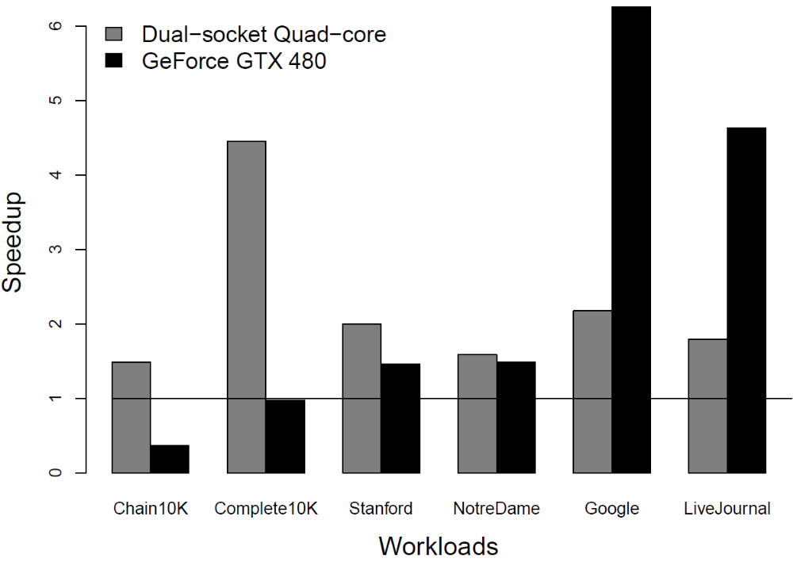
BFS Speedup

