Slide 1
Massively Parallel Graphs
A DNA Assembly Use Case
Lauro Beltrão Costa
Abdullah Gharaibeh
Elizeu Santos-Neto

Slide 2
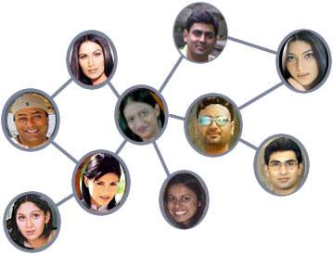
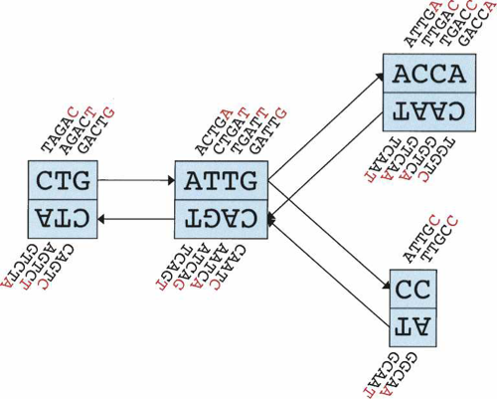
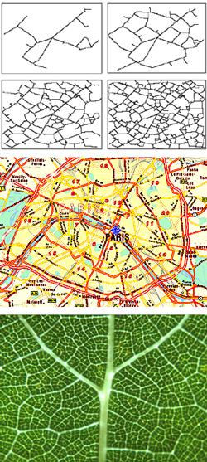

Graphs, Graphs, Graphs Everywhere
Notes:
Discussing applications that process large-scale graphs
Single out DNA sequence assembly and make the connection with the next slide

Slide 3
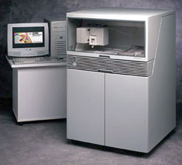
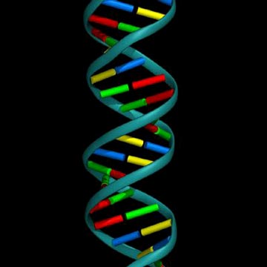
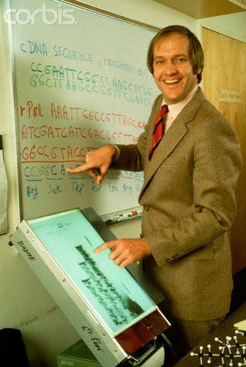
Obtaining a DNA Sequence
    …CCAT GGCT... CGCCCTA GCAATTT ...GCGG TAGGC TGCGC... ...CGGCA ... GGCTA ATGCG… .…TCGG... TTTGCG ...TAGG ...ATAT… .…CCTA... CAAT..
Phase1:
Sequencing
Phase2:
Assembly
    …CCAT GGCT... CGCCCTA GCAATTT ...GCGG TAGGC TGCGC... ...CGGCA ... GGCTA ATGCG… .…TCGG... TTTGCG ...TAGG ...ATAT… .…CCTA...
CCATAGGCTATATGCGCCCTATCGGCAATTTGCGGCG…
Phase3:
Verification
Notes:
Phases:
DNA sequencing: a biochemical process, outcome is short unordered sequences
Sequence assembly: putting the pieces together
Manual verification by a specialist

Slide 4
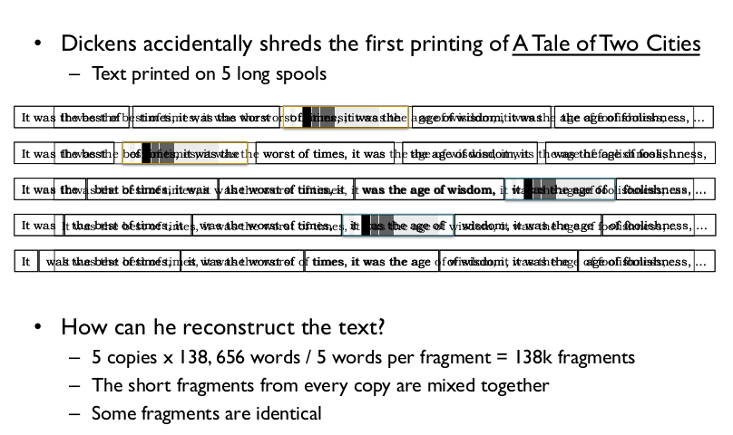
Sequence Assembly: Shredded Book Analogy
Slide courtesy of Michael C. Schatz
Notes:
The analogy with putting a puzzle or a shredded book together using a figure
The problem is NP-Complete. So, one should use heuristics.

Slide 5
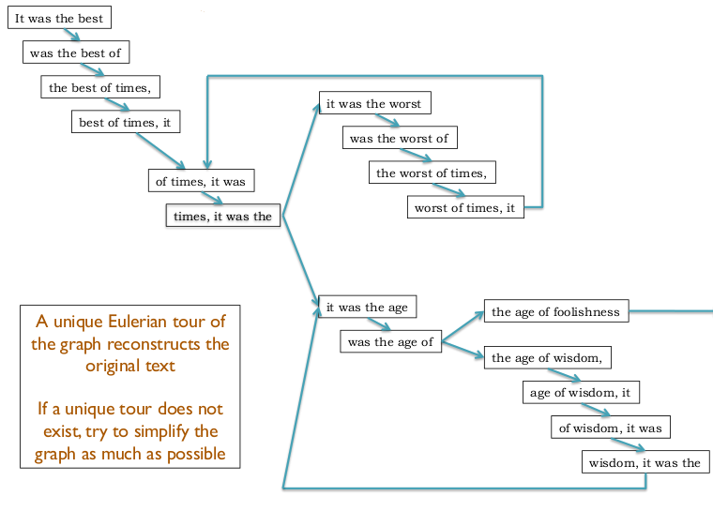
De Bruijn Graph to the Rescue!
Figure courtesy of Michael C. Schatz
Notes:
a directed graph representing overlaps between sequences of symbols
The problem can be modeled with a graph (e.g., figure from the Velvet paper):
Building the graph
Finding the Eulerian path
The two phases are computationally expensive

Slide 6
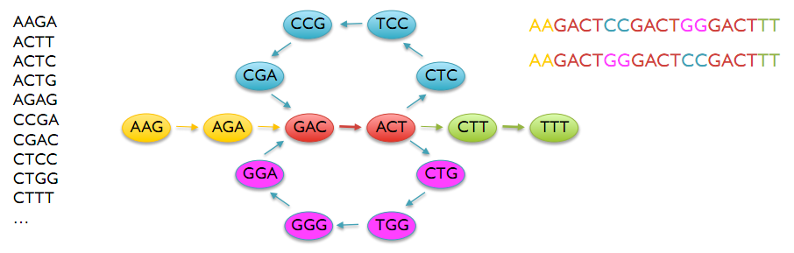
Sequence Assembly
Build a De Bruijn graph
Find an Eulerian tour
Notes:
a directed graph representing overlaps between sequences of symbols
The problem can be modeled with a graph (e.g., figure from the Velvet paper):
Building the graph
Finding the Eulerian path
The two phases are computationally expensive

Slide 7
Graphs
  Data-parallel
  Memory intensive
  Benefit many applications
GPU
Massively parallel
High memory bandwidth
Opportunity
  Data Intensive
  Amorphous parallelism
Limited memory
Strict computational model
Challenges
Notes:
Opportunity:
The application is data intensive and has parallel access patterns
GPU is massively parallel
Challenges:
The GPU’s strict computational model
Graph applications exhibit amorphous parallelism

Slide 8
Expected Results
Insights on mapping graph problems to GPUs
Design of a framework for large-scale graph processing on GPUs
Speedup the use-case application: DNA sequence assembly

