Slide 1
Promotion provider progress 1
Tananawat Sitthitan
Nattakit Chaiwongsri
Advisor
Phudinan Singkhumfu

Slide 2
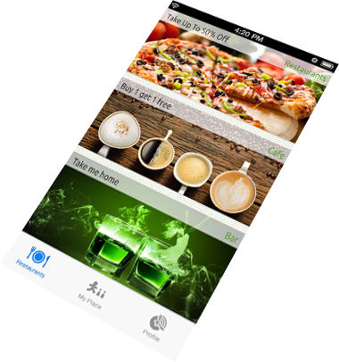
What is promotion provider?
iPhone application
Update real time promotion
Notification when get in 20 meters.
Collecting points

Slide 3
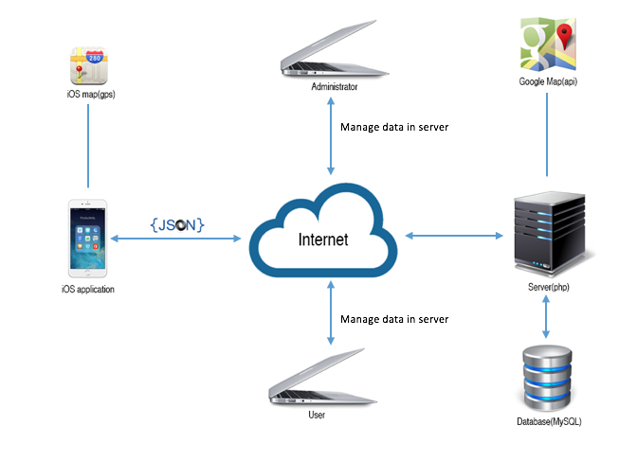
System architecture

Slide 4
Project status
Milestone Deliverables | Due Date | % Complete | Deliverable Status
Project progress 1 milestone
Project Management Plan | 29 July 2015 | 100% | On schedule
Software Requirement Specification | 29 July 2015 | 100% | On schedule
Software Design Document | 29 July 2015 | 100% | On schedule
Source Code | 29 July 2015 | 100% | On schedule
Test Plan | 29 July 2015 | 100% | On schedule
Test Record | 29 July 2015 | 100% | On schedule
Traceability Record | 29 July 2015 | 100% | On schedule

Slide 5
Project plan

Slide 6
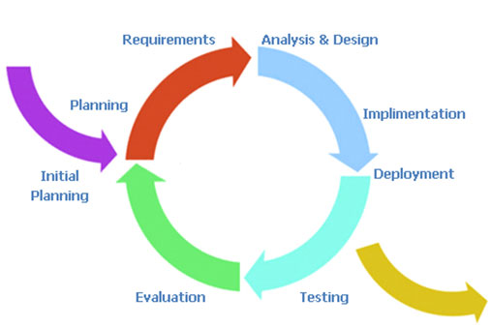
Iterative model

Slide 7
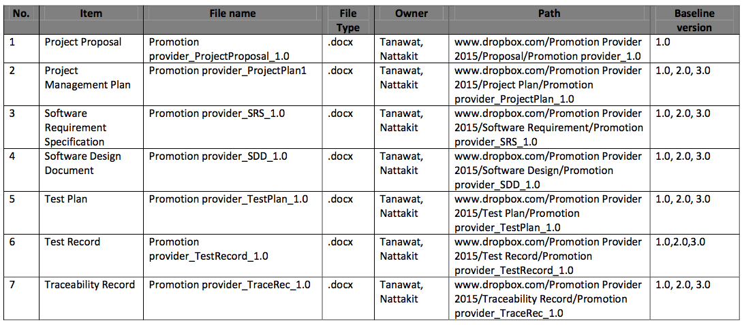
Configuration management

Slide 8
Software requirements
Notes:
From project features, we analyzed it into 40 User requirement specification and from 40 URS we analyzed into 65 software requirement specification. You can go to Chapter 3 on page 10 in Software requirement specification document

Slide 9
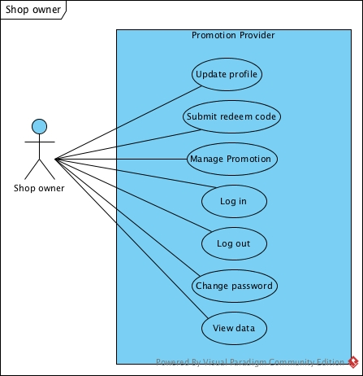
Use case diagram
Notes:
Page 24
View data page 29

Slide 10
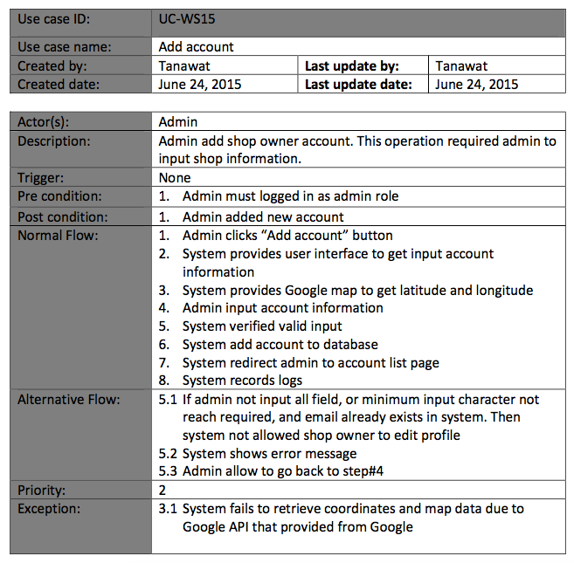
USE case description

Slide 11
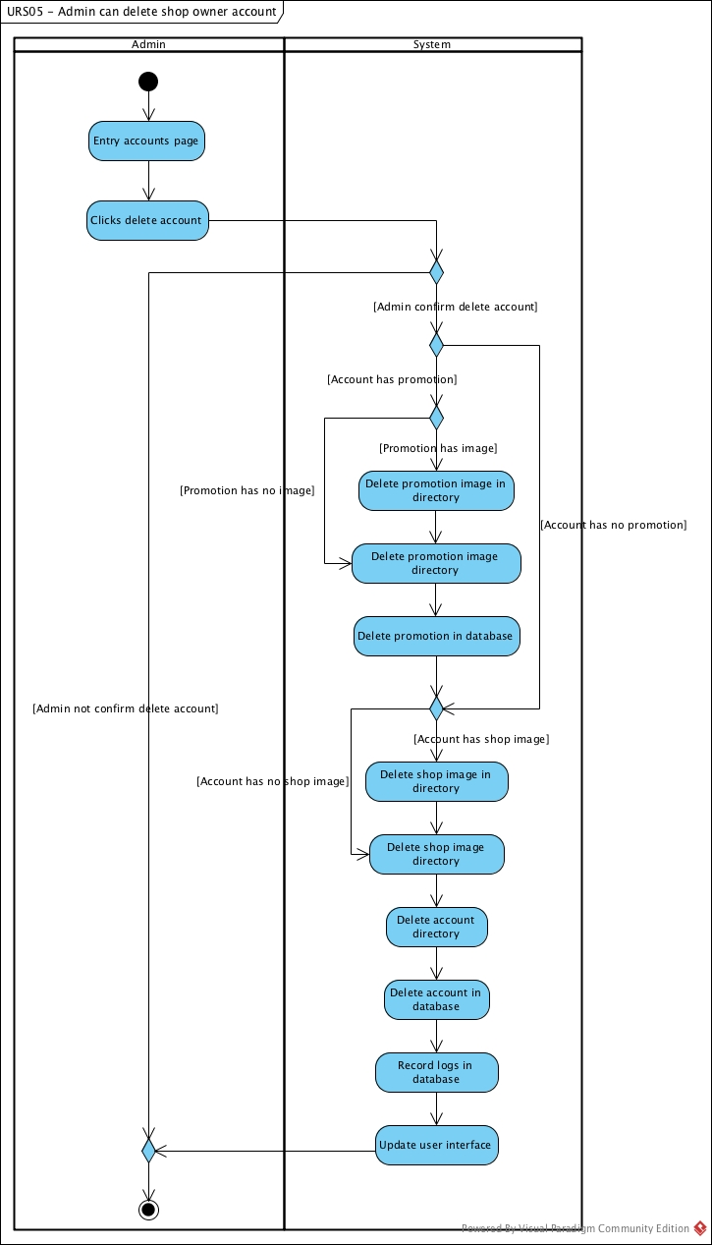
Activity diagram
Notes:
Page 63

Slide 12
Software design

Slide 13
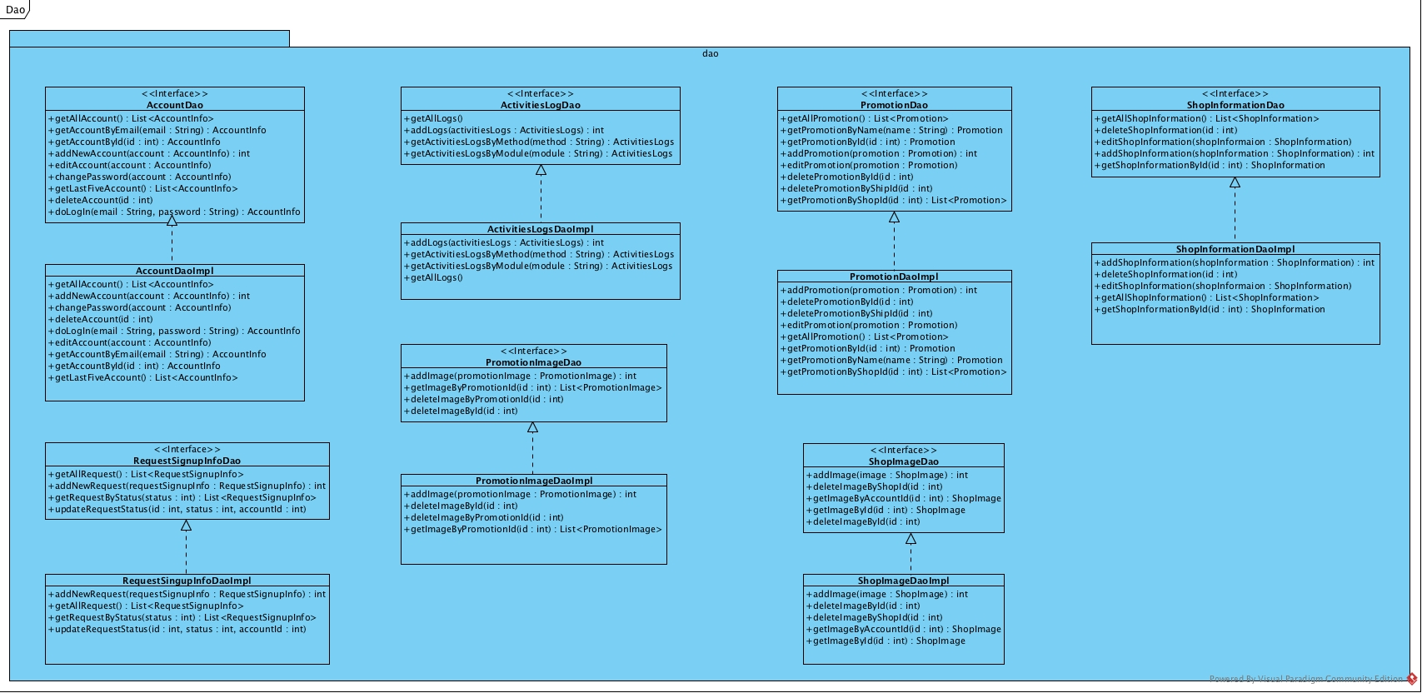
Class diagram

Slide 14
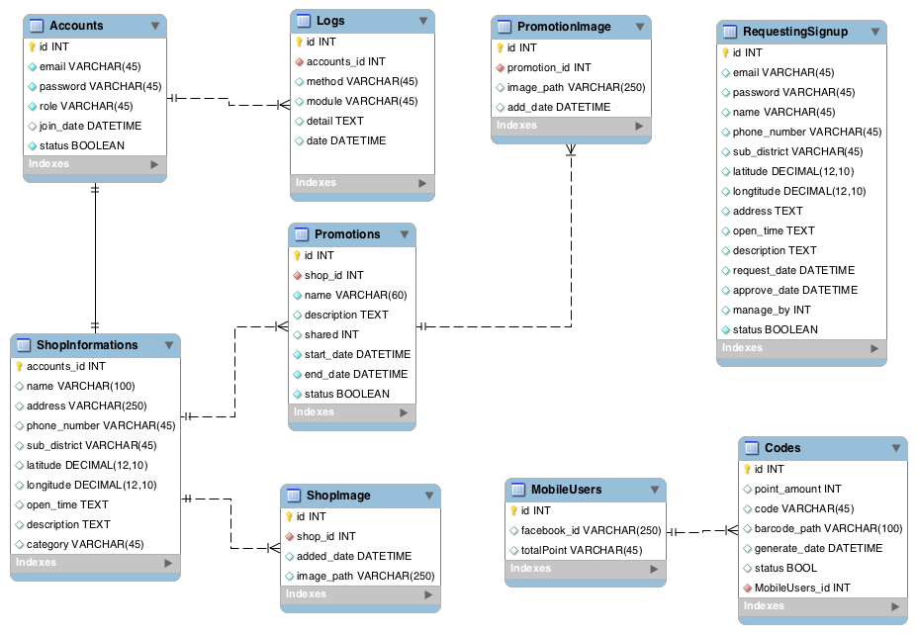
ER diagram

Slide 15
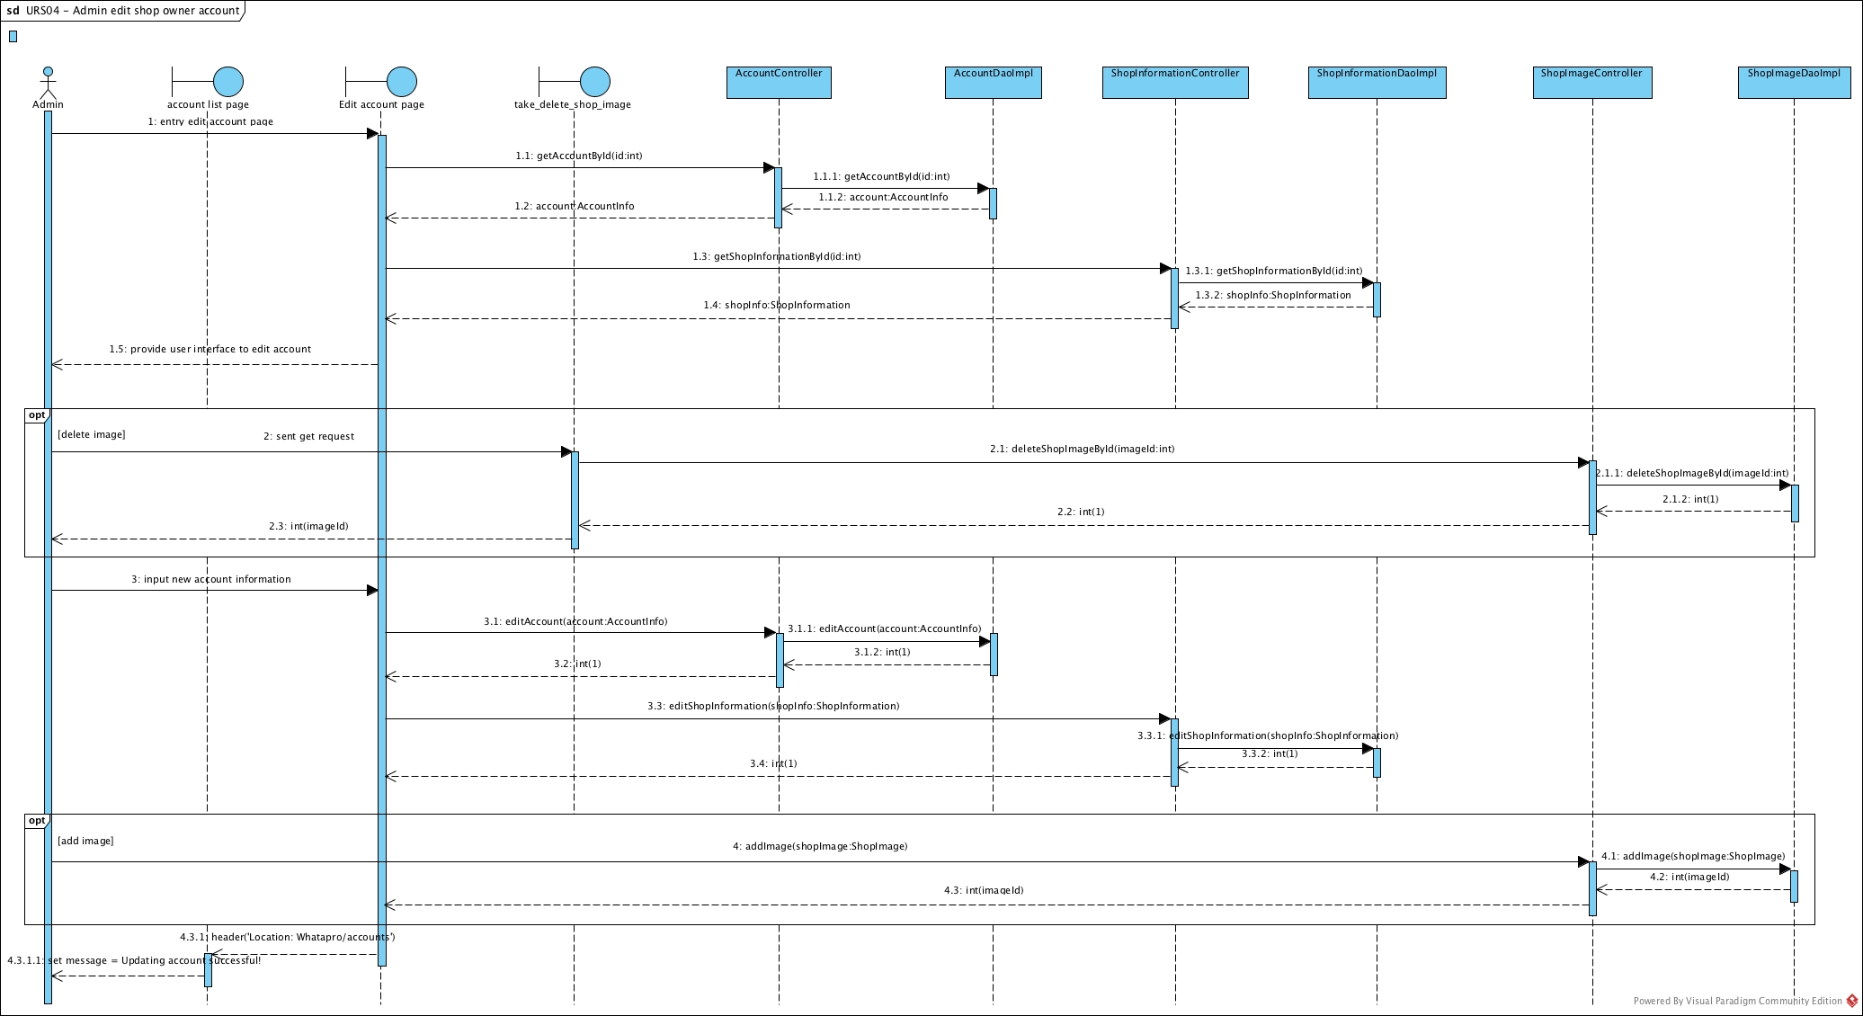
Sequence diagram

Slide 16
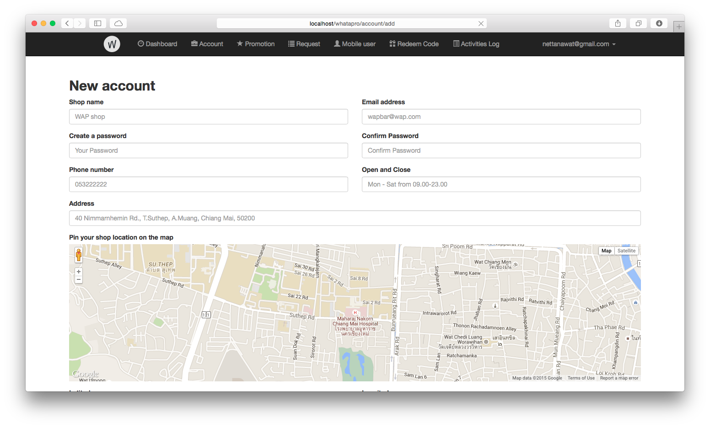
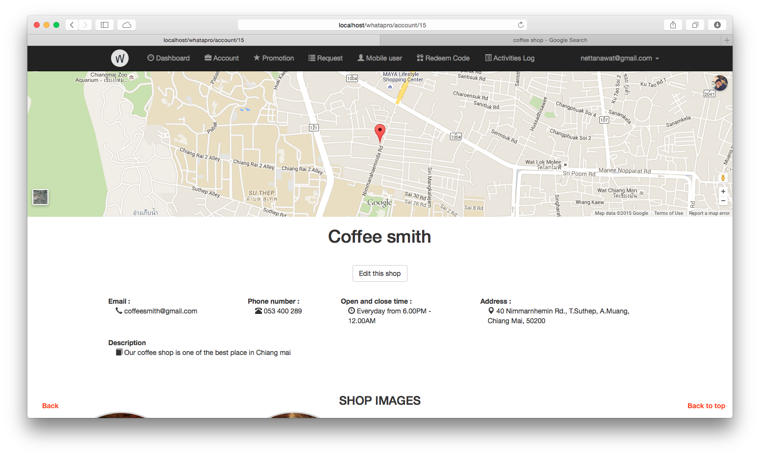
User interface

Slide 17
Test plan

Slide 18
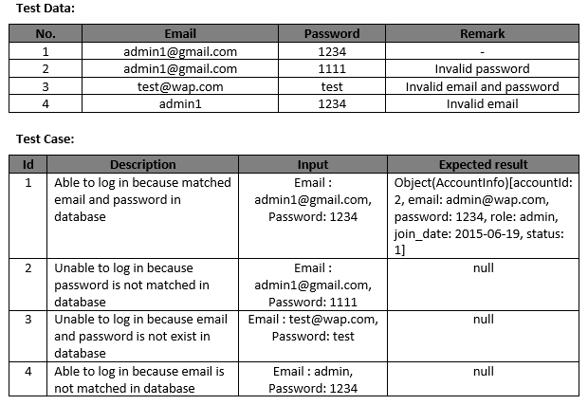
Sequence diagram

Slide 19
Test record

Slide 20
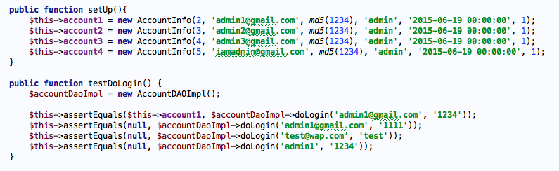
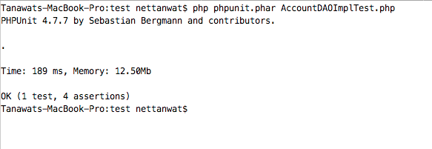
Unit testing

Slide 21
Program demo

Slide 22
Question & Answer

